Slide 1
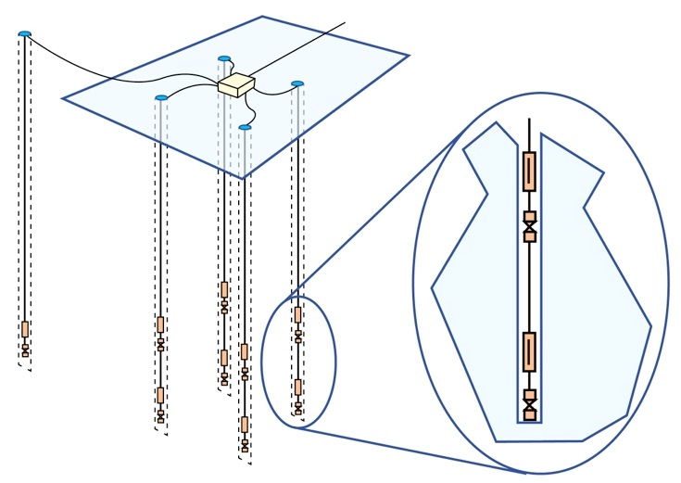
40 m
30 m
Top HPol
200 m
2 m
Top VPol
15 m
2 m
Bottom HPol
Bottom VPol
Calibration Pulsers

