Slide 1
DAPT 612: Text Mining
Group 3
Aaron Clark, Brie Dubinsky, Kate Loomis, Aastha Malhotra, and Bindhya Neupane
Notes:
You can choose any data that has text values for processing and getting insights from. Tools can be used as appropriate. Not required to only use the tools we discussed in class. Report/Presentation needs to discuss the dataset, techniques used for processing, insights obtained, failures, and final outputs from this project. No maximum length.
Deliverables to Canvas
Team Project Presentation Deck
Team Project Scripts
Link to Data or Data Used

Slide 2
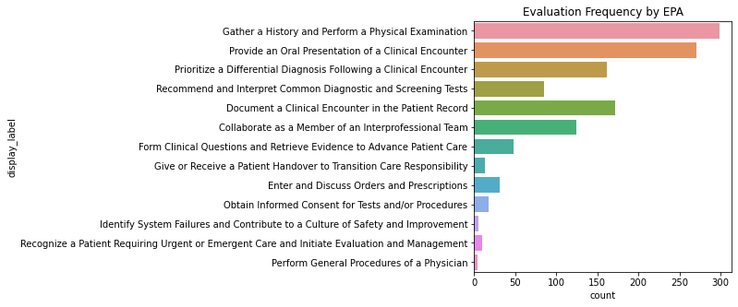
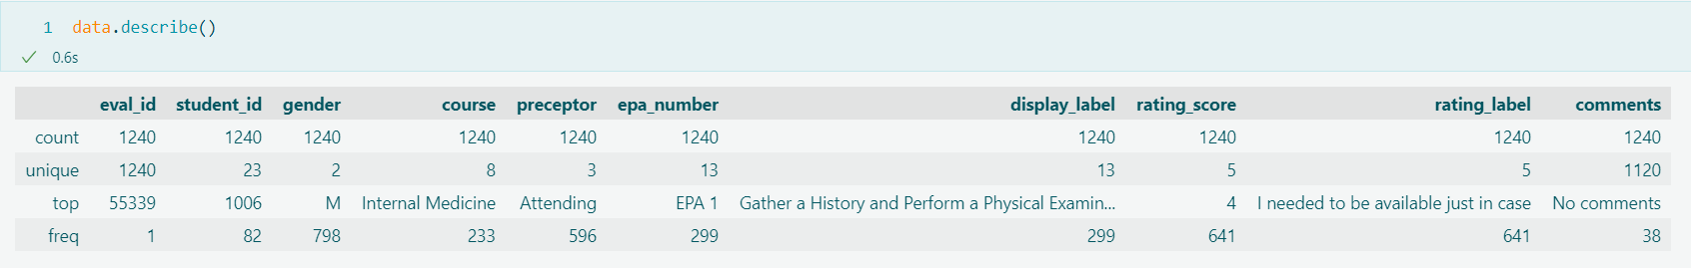
Overview of the Dataset
Notes:
Brie: In this project, we’re looking at the feedback which a sample of 23 students received on their core entrustable professional activities, or EPAs. These skills outline the core tasks that students should be able to perform on the first day of their residency training. Students request feedback on these skills from the attendings, or senior doctors, residents (doctors in training), and occasionally from other members of the team, such as nurses. As you can see here, some EPAs are evaluated more often, which makes sense because students have more opportunities to perform these skills and they are able to practice early in their training. Higher-order skills, such as obtaining informed consent, may not be appropriate until students are closer to graduating.

Slide 3
The Evaluation Form
EPA 1: Gather a History and Perform a Physical Exam
Original Ottawa Scale (Rekman et al 2016)
I had to do (i.e. requires complete hands-on guidance, did not do, or was not given the opportunity to do)
I had to talk them through (i.e. able to perform tasks but requires constant direction)
I had to prompt them from time to time (i.e. demonstrates some independence but requires intermittent direction)
I needed to be there in the room just in case (i.e. independence but unaware of risks and still requires supervision for safe practice)
I did not need to be there (i.e. complete independence, understands risk and performs safely, practice ready)
Developing
Independent
Notes:
Brie add notes: The evaluation is designed to tell the student whether they need to focus on improving in this skill or if they have achieved sufficient mastery to complete the task independently. The evaluation form features a modified Ottawa Clinic Assessment Scale (OCAT) with values ranging from 1 (I had to do it for them) to 5 (I did not need to be there). The evaluation also includes an open-ended comments field designed to capture notes on what the student can do to become more proficient. My team at work designed the application which captures this feedback. However, the feedback that students receive on clinical evaluations can be inconsistent, as you’ll see in the next slide.

Slide 4
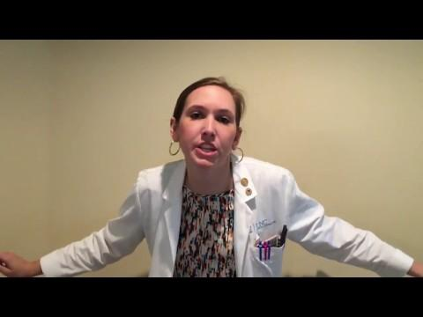
Why Does This Matter?
“Mean Evals” parody skit by M3 students at the University of North Carolina.

Slide 5
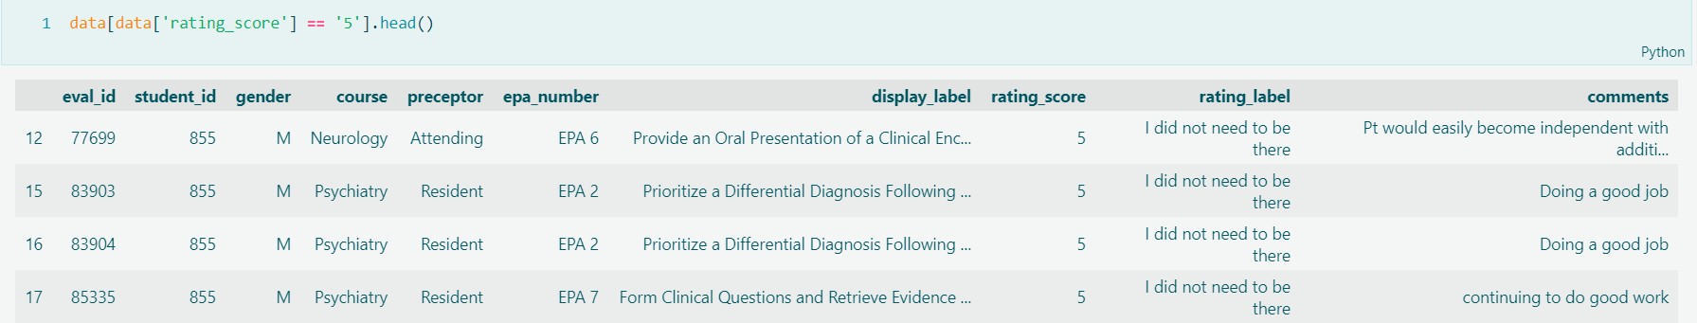
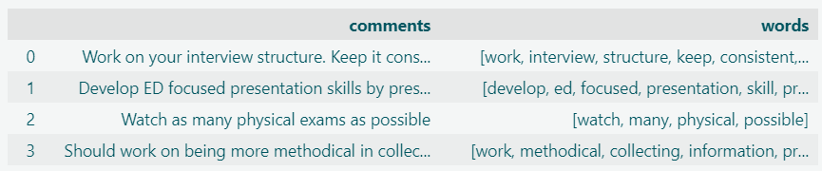
Processing Techniques
Notes:
Before the group received access, I removed identifiers, such as first/middle/last name, from the comments. I also reviewed the comments for sensitive details and excluded those observations.
Data Cleaning:
Remove duplicates (i.e., identical rating/comments submitted for a student/course/preceptor/EPA).
Replaced the course name “Obstetrics & Gynecology” with “Obstetrics.”
Visualized top words by highest/lowest eval rating
Visualized words with word clouds
Ran comments through a cleaning pipeline that removed common stopwords, punctuation, made words lower-case. Then we created a custom set of stop-words to filter out redundancy/noise (e.g., “student”) and used this to create a column of “clean words” and a column of sanitized sentence strings. This preserved the original comments but we also have a column of words and a column of sanitized comments for analysis.

Slide 6
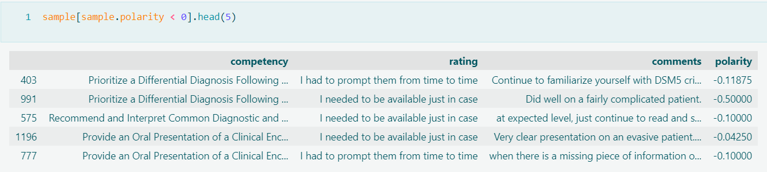
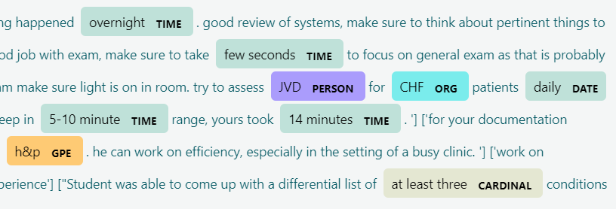
Challenges
Notes:
Brie/Aaron/team add notes:
Our main challenges come from the highly contextual nature of the data. When cleaning and interpreting the comments, we consistently noticed quirks specific to medical terminology and jargon. For example, in this screenshot, we see that the entity-recognition model has flagged CHF (congestive heart failure) as an organization and JVD (Jugular vein distention) as a person. Additionally, the evaluation itself is formative in nature; techniques like sentiment analysis may need fine-tuning in order to fully reflect the complex nature of this feedback.

Slide 7
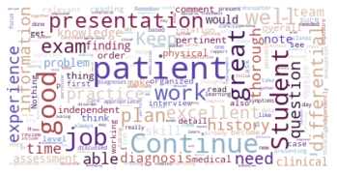
Insights & Outcomes
Notes:
Aaron/team add notes:
So now that you understand why the importance of the evaluations and how the data set was tuned we’ll show you a few important findings.

Slide 8
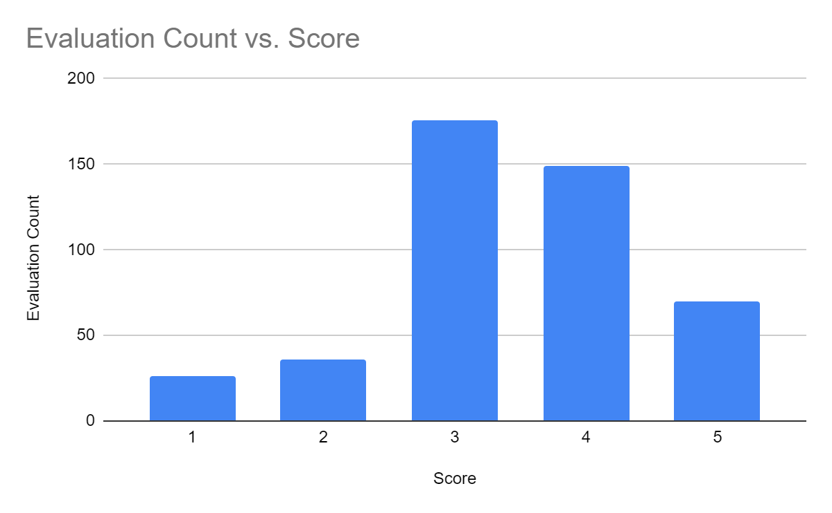
Notes:
It was a relief to see that many of the students were doing moderately well to well. There were more 5s than ones which means something is working...

Slide 9
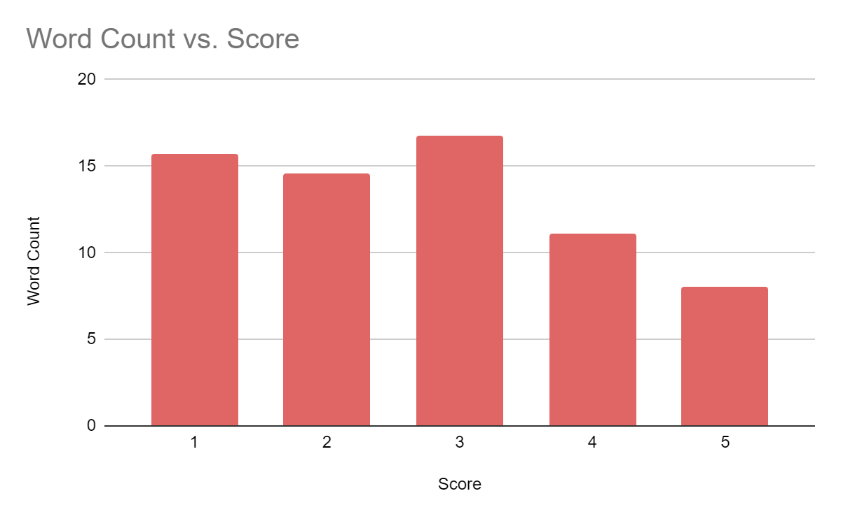
Notes:
Aaron/team add notes:
Because of the problems with short, incomplete or evals with “no-effort” on the behalf of the evaluator --we thought it was important to at least get a sense of the word count by rating…
We can at least get a sense that scores where the student needs to improve had more comments made. Evaluations of 1, 2, 3’s received more feedback than 4’s and especially 5’s, which received the least.
But this opens up a conversation for “if the comments are enough.” Especially in the case of lower scores? Additional insights may need to be collected, especially with lower-scoring evaluations.

Slide 10
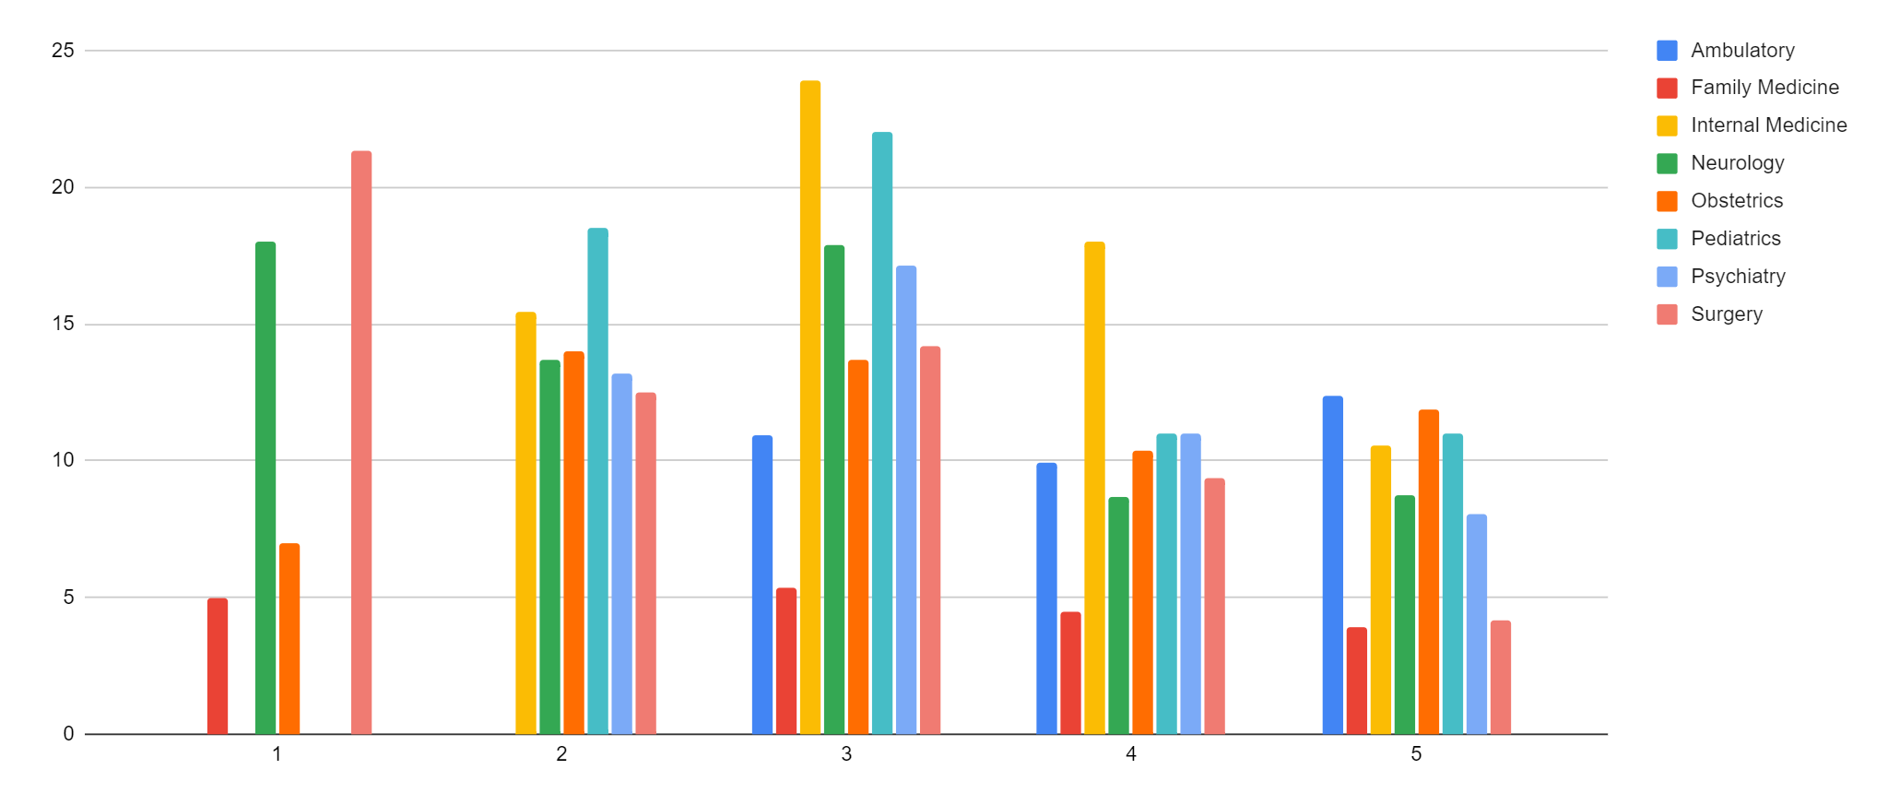
Average word count by Course & Rating
course | 1 | 2 | 3 | 4 | 5 | Grand Total
Ambulatory |  |  | 11 | 10 | 12 | 11
Family Medicine | 5 |  | 5 | 4 | 4 | 5
Internal Medicine |  | 15 | 24 | 18 | 11 | 17
Neurology | 18 | 14 | 18 | 9 | 9 | 13
Obstetrics | 7 | 14 | 14 | 10 | 12 | 11
Pediatrics |  | 19 | 22 | 11 | 11 | 16
Psychiatry |  | 13 | 17 | 11 | 8 | 12
Surgery | 21 | 13 | 14 | 9 | 4 | 12
Notes:
Aaron/team add notes:
It’s probably also important to gain insight into into how the scores are being evaluated across different areas of practice.
For instance, I personally am glad that students with scores of 1 in surgery are receiving a good bit of feedback...
You might also notice that, comparitively, Internal medicine (in green) tend to provide more feedback across the evaluations than the others, followed by what appears to be pediatrics.

Slide 11
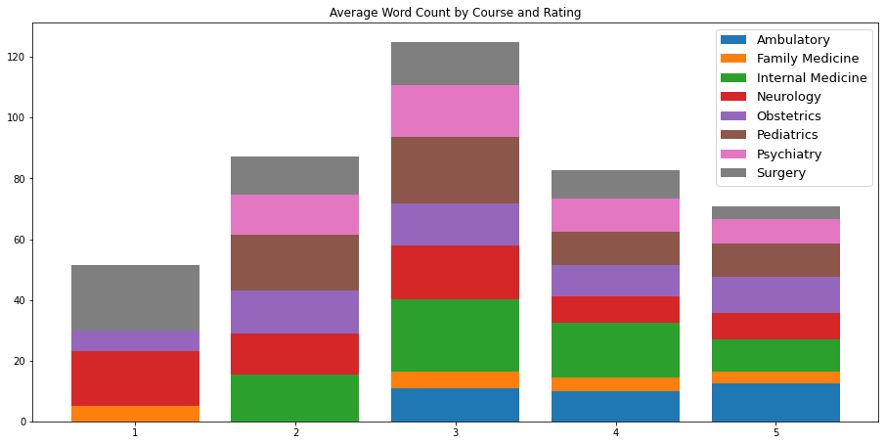

Slide 12
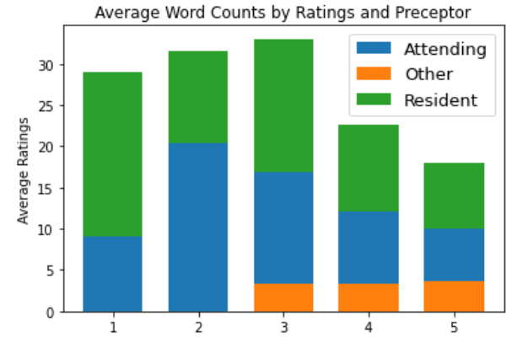
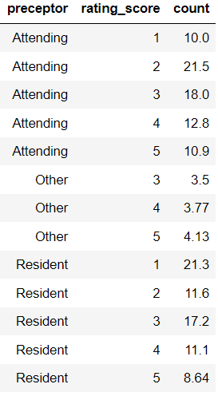
Notes:
Aaron/team add notes:
The next measurement was Average word counts by rating and preceptor (or the team member evaluating the student)--in this case the other category includes nurses.
The word counts were daily mixed between the attendings (or senior doctors), residents (doctors in training).
Again, it is good to see that the word counts were higher among evaluations scoring low.
One might ask, if the nurses are only giving higher scores?

Slide 13
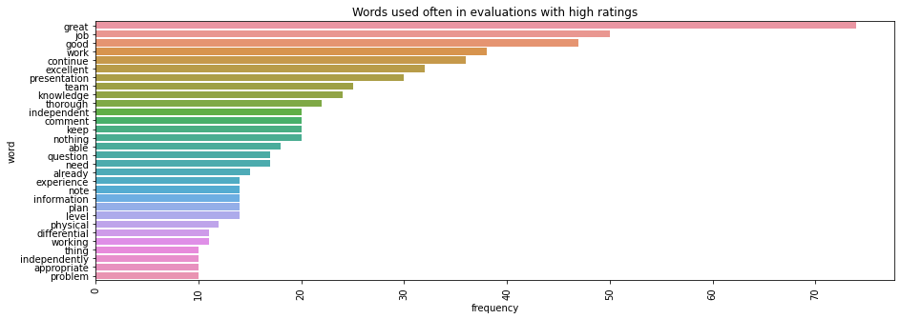
Notes:
Aaron/team add notes:
moving on to analyzing the content, specifically the words used in the evaluations….
HEre is a look at the top words for evaluations with a score of 5
This is a nice gut check because many of these are words that would be expected to be seen.
Great, Good, excellent, presentation are all nice to see.
There is also probably room to remove some additional stop words (like job)

Slide 14
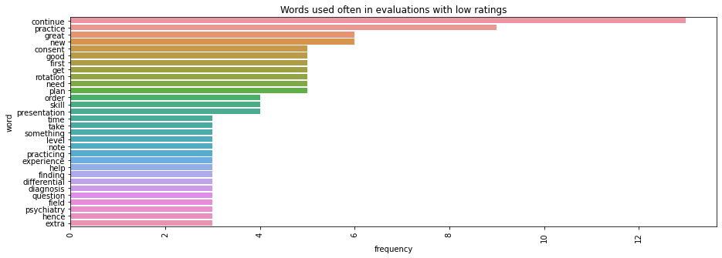
Notes:
Aaron/team add notes:
Likewise, low scoring evaluations saw words like “continue, practice, need” things you would expect
Where this sort of breaks down, again like in the high-scoring evaluations is where you see words like “great”
This could mean there were multiple sentences containing a mix of sentiment.
The size of the data may contribute to this also...it would be interesting to get a larger data set.

Slide 15
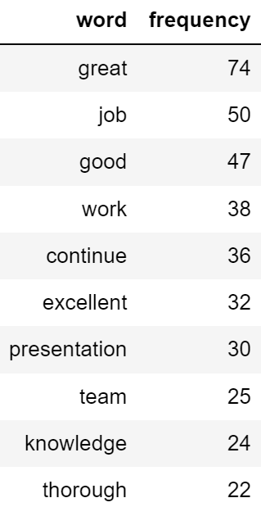
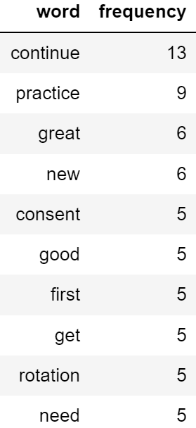
Notes:
Aaron/team add notes:
Again, the higher scoring words and their frequency vs lower scores and their frequency.

Slide 16
Wordcloud All Evaluations
Notes:
Aaron/team add notes:

Slide 17
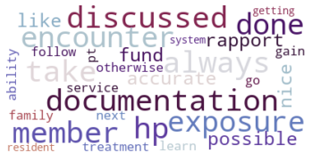
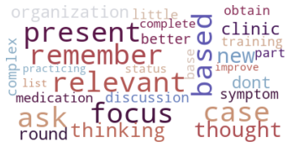
Words unique to Gender
Females Males
Notes:
Aaron/team add notes:
Words in top 100 most common words from ALL evaluations that are unique to FEMALES & MALES

Slide 18
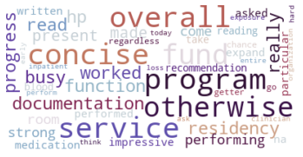
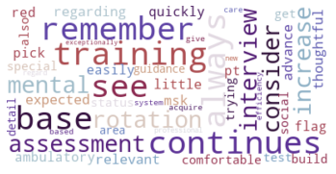
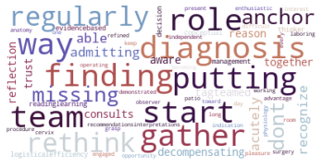
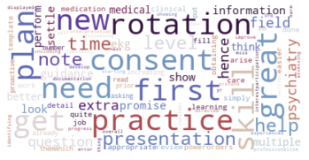
Words unique to Gender X Rating
Females Males
High Score
Low Score
Notes:
Aaron/team add notes:
Words in top 100 most common words from HIGH SCORING evaluations that are unique to FEMALES/ MALES
Words in top 100 most common words from LOW SCORING evaluations that are unique to FEMALES

Slide 19
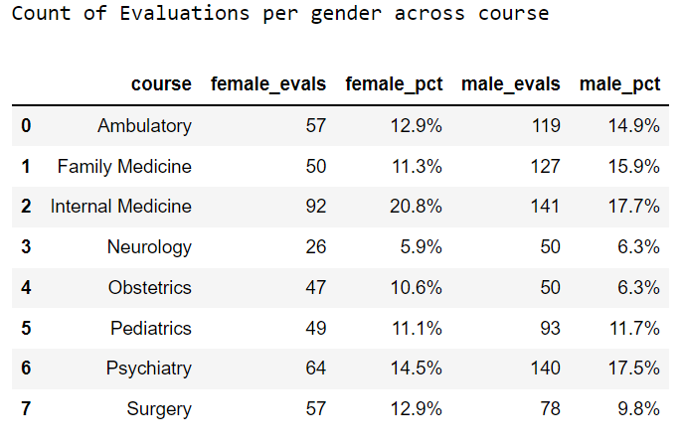
Notes:
One may think there may be some difference just based on the courses males & females are taking, but there doesn’t seem to be enough difference to make that, which is why in the future it would be smart to give more context to this.

Slide 20
Retrospective
Specialized Field
Prescriptive Analysis
Sentiment Analysis
Sensitive Data
Notes:
Aaron/team add notes:
Overall, the more concrete findings were within the word counts (length of evaluation) across disciplines.
The wordclouds were interesting, but less predictive. It is harder to make sense of than the more concrete findings...
It is nice to gut-check the analysis of the common words for what we would expect to see (Great, Excellent vs. needs missing, etc.) because with some validation it may allow us to uncover additional patterns in the data, across demographics, and across disciplines/ course. For instance, surgery may have more thorough evaluations vs internal medicine

