Slide 1

Automating Forestry Field Data Geoprocesses
Ben Clark

Slide 2
Problem
Repetitive task that can be automated through a python script to increase efficiency, improve accuracy and save time which in turn decreases cost.

Slide 3
Pseudocode/Outline
Scan a designated folder for files
If new files, run certain geoprocessing tools on each file
Geoprocessing tools: KML to shapefile conversion, Export to individual shapefiles, clean and organize attributes, Buffer specific shapefiles, merge buffers, and clip to harvest unit boundary
Output will be multiple shapefiles saved in specific job folder
Methods: check for file, create new folder, convert to shapefile, export individual, add/delete attributes

Slide 4
Code
https://github.com/clarkbennett/Python_Final/blob/master/Final%20Project.ipynb

Slide 5
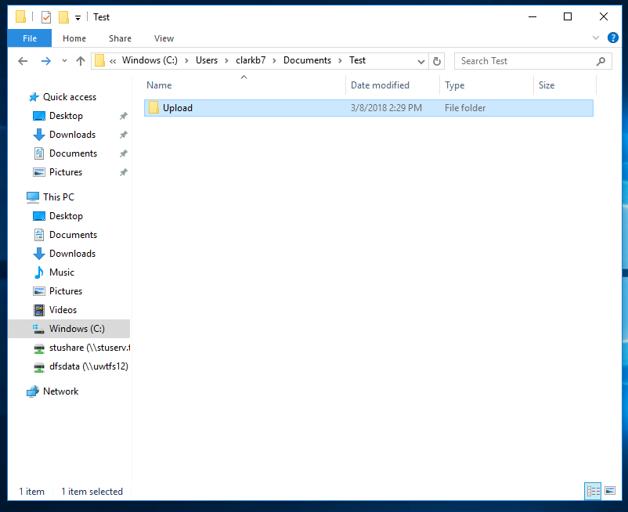
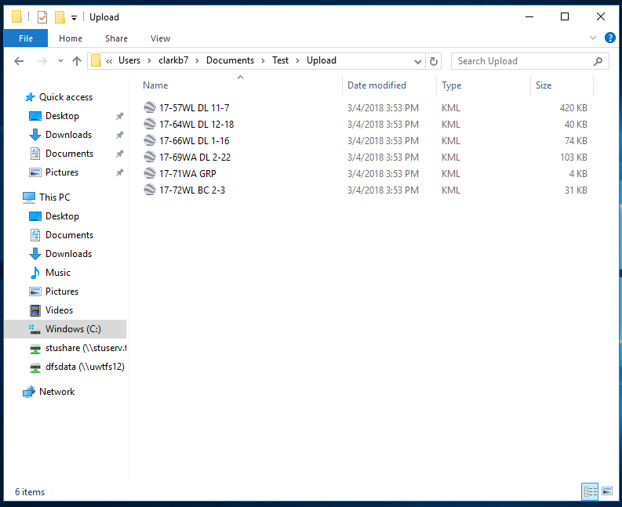
Input

Slide 6
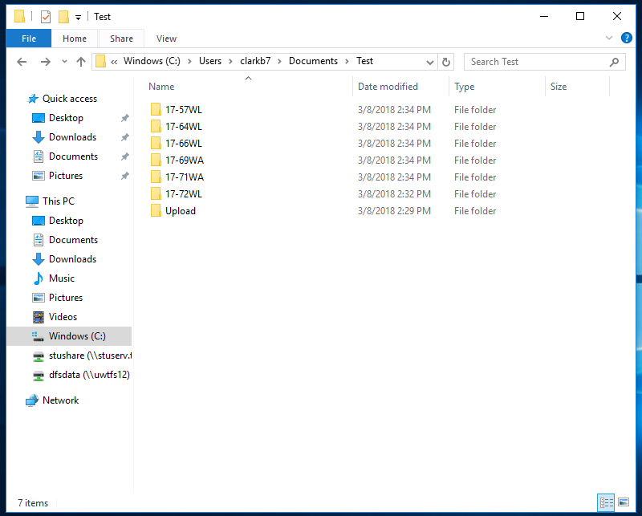
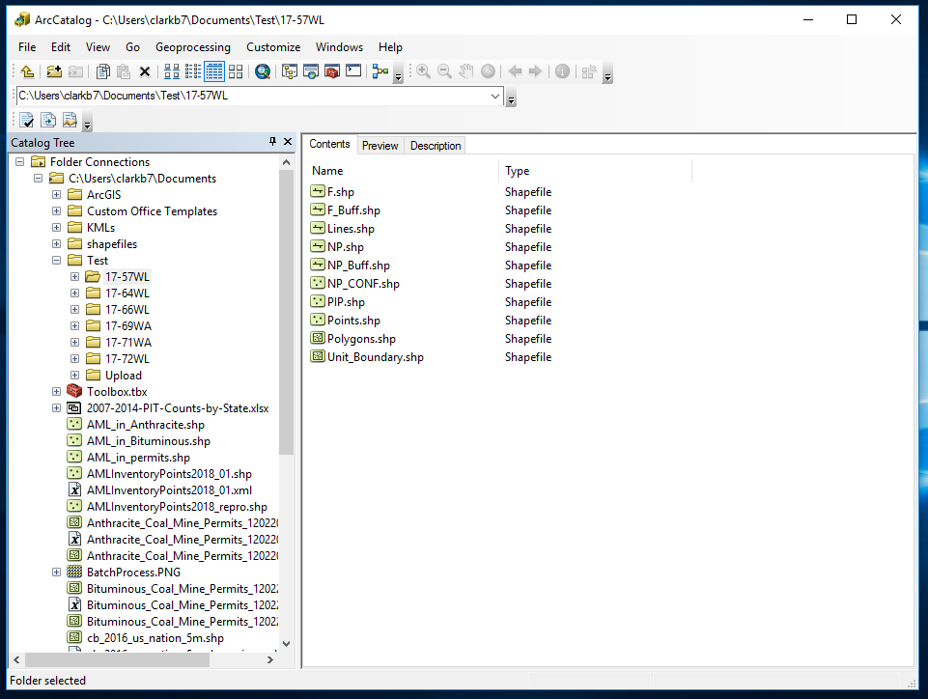
Resulting Output

Slide 7
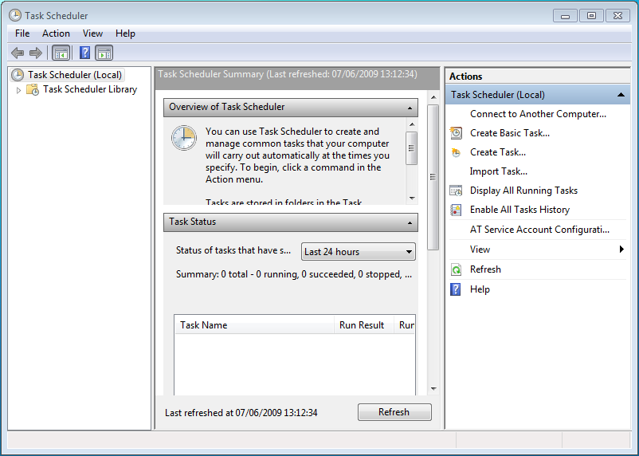

Future Progress
Buffers and Clip
Clean up code
Make completely automated
Windows Task Scheduler

