Slide 1

Cytoscape for the Social Sciences and Humanities

Slide 2
Networks
Networks consist of:
  Nodes – usually things (people, places, books, etc.)
  Edges – usually relationships (friends, authorship, transferring money)
Networks can be made up of nodes of different types
Networks of two different things (e.g. books and authors) are ‘bipartite’ networks
  Bipartite networks can be transformed into single type networks by creating a co-occurrence network (e.g. co-authors)

Slide 3
Networks

Slide 4
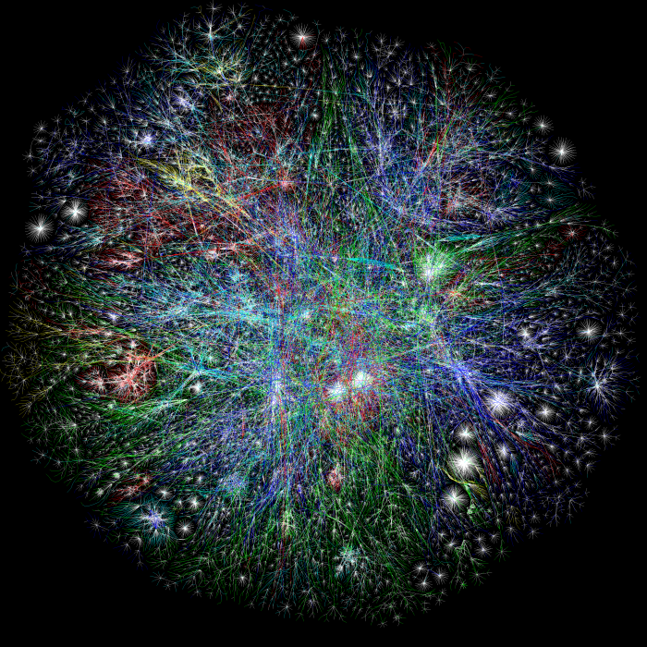
Networks – Map of the Internet
Source: Opte Project, 2003

Slide 5
Cytoscape
Cytoscape = open source network visualization and analysis software
Software “core” provides basic functionality
Plugins/apps
  Add extra functionality beyond the core
Network (graph) with countries represented as nodes, and number of immigrants represented as links (edges) between nodes
http://www.cytoscape.org/

Slide 6
Cytoscape
Initially made public in 2002
Latest version = 3.2.1
  Today’s training on 3.2.1
Cytoscape App Store: http://apps.cytoscape.org/

Slide 7
Cytoscape Consortium
  Agilent Technologies
  Gladstone Institutes
  Institut Pasteur
  Institute for Systems Biology
  Memorial Sloan-Kettering Cancer Center
  National Center for Integrative Biomedical Informatics (NCIBI)
  National Institute of General Medical Sciences
  National Resource for Network Biology (NRNB)
  University of Toronto
  UCSD
  UCSF

Slide 8
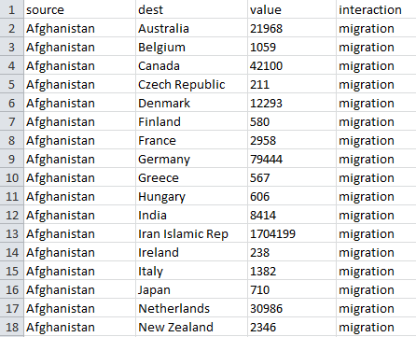
Source
Target
Edge Attribute
Interaction Type

Slide 9
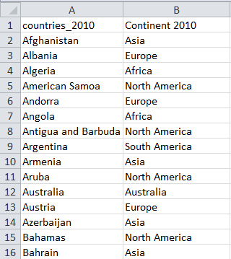
Node
Attribute

Slide 10
Metrics
Notes:
Degree
Shortest Path
Diameter
Betweeness Centrality

Slide 11
Metrics - Directed

Slide 12
Plugins/Apps
“Although the Cytoscape core application is distributed under a Library GNU Public License (LGPL), plugins are separate works which use Cytoscape as a Java code library. Plugins are therefore governed by independent software licenses distributed with and specific to each plugin.”

Slide 13
Plugin/Apps Examples
CytoNCA (3.X)
  For network centrality analysis
SocialNetwork (3.X)
  Creates visual summary of how individuals are connected (Ex. Nodes = authors, edges = publications)
Interference
  Evaluates topological effects of single or multiple nodes removal from network
  Virtual node knock-out experiments

Slide 14
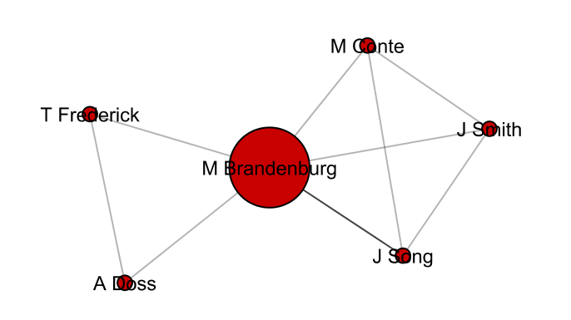
SocialNetwork App
Notes:
Marci Brandenburg publication authors network using SocialNetwork App and doing a search in PubMed.

Slide 15
Literature
Shannon P, et al. 2003. Cytoscape: a software environment for integrated models of biomolecular interaction networks. Genome Research 13(11): 2498-2504.
Bader GD and Hogue CWV. 2003. An automated method for finding molecular complexes in large protein interaction networks. BMC Bioinformatics.
Smoot, et al. 2011. Cytoscape 2.8: new features for data integration and network visualization. Bioinformatics 27(3): 431-432.

Slide 16

Get Help
About Cytoscape
  http://www.cytoscape.org/what_is_cytoscape.html
Cytoscape Help
  Cytoscape User Manual and Online Tutorials
  http://www.cytoscape.org/documentation_users.html

