Slide 1



Using spline interpolation to extract the pure SU(3) deconfinement temperature
Coleman Rohde, University of Utah
In collaboration with
Kai Ebira
David Clarke
Daeton McClure
Notes:
Abstract: At sufficiently high temperatures and/or baryon chemical potential, nuclear matter is known to transition from a gas of hadrons to a plasma of quarks and gluons. In the limit of infinitely massive quarks, which is formally equivalent to a theory of only gluons, pure $SU(3)$, this transition is known to be of first order. In this study we use lattice field theory to extract the pure SU(3) deconfinement temperature $T_d$. Historically $T_d$ has been extracted using histogram reweighting. Here, we try an alternative approach based on spline interpolation.

Slide 2
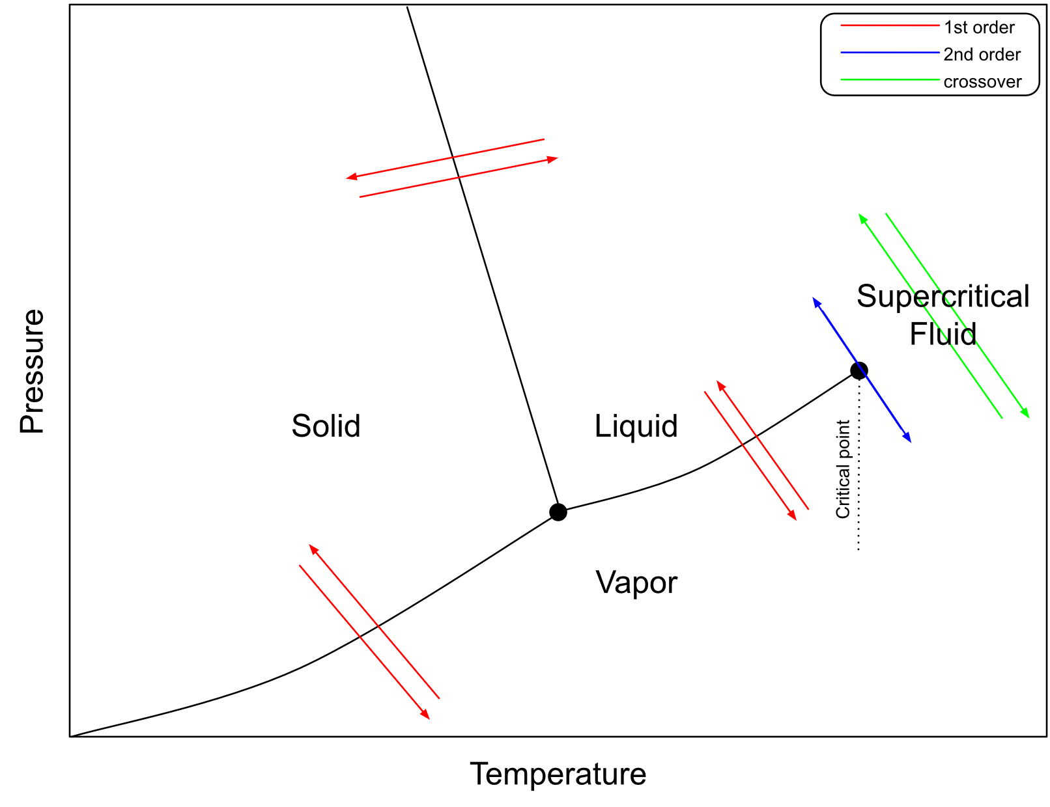
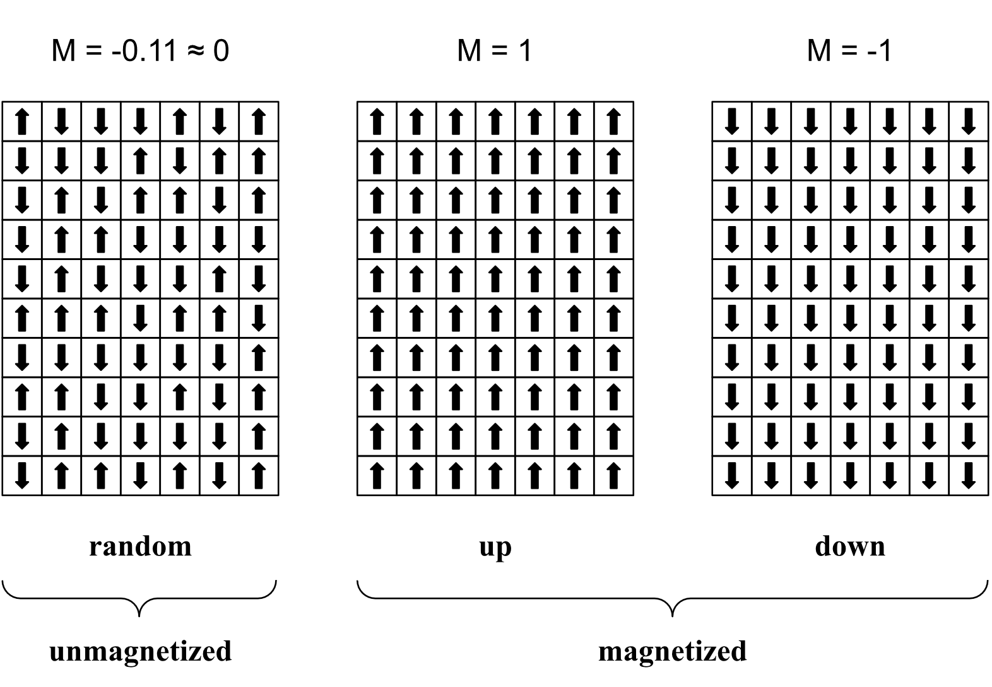
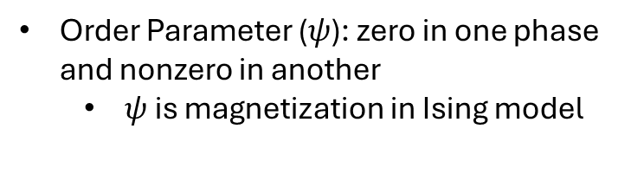
Phase Transitions
First order transitions are discontinuous and associated with a latent heat
Second order transitions are discontinuous in the second derivative of free energy
Crossovers are smooth
Order Parameter ($ψ$): zero in one phase and nonzero in another
$ψ$ is magnetization in Ising model
Notes:
Research lee young edges and lee young singularity
Phase transitions occur in the thermodynamic limit (i.e. infinite volume)

Slide 3
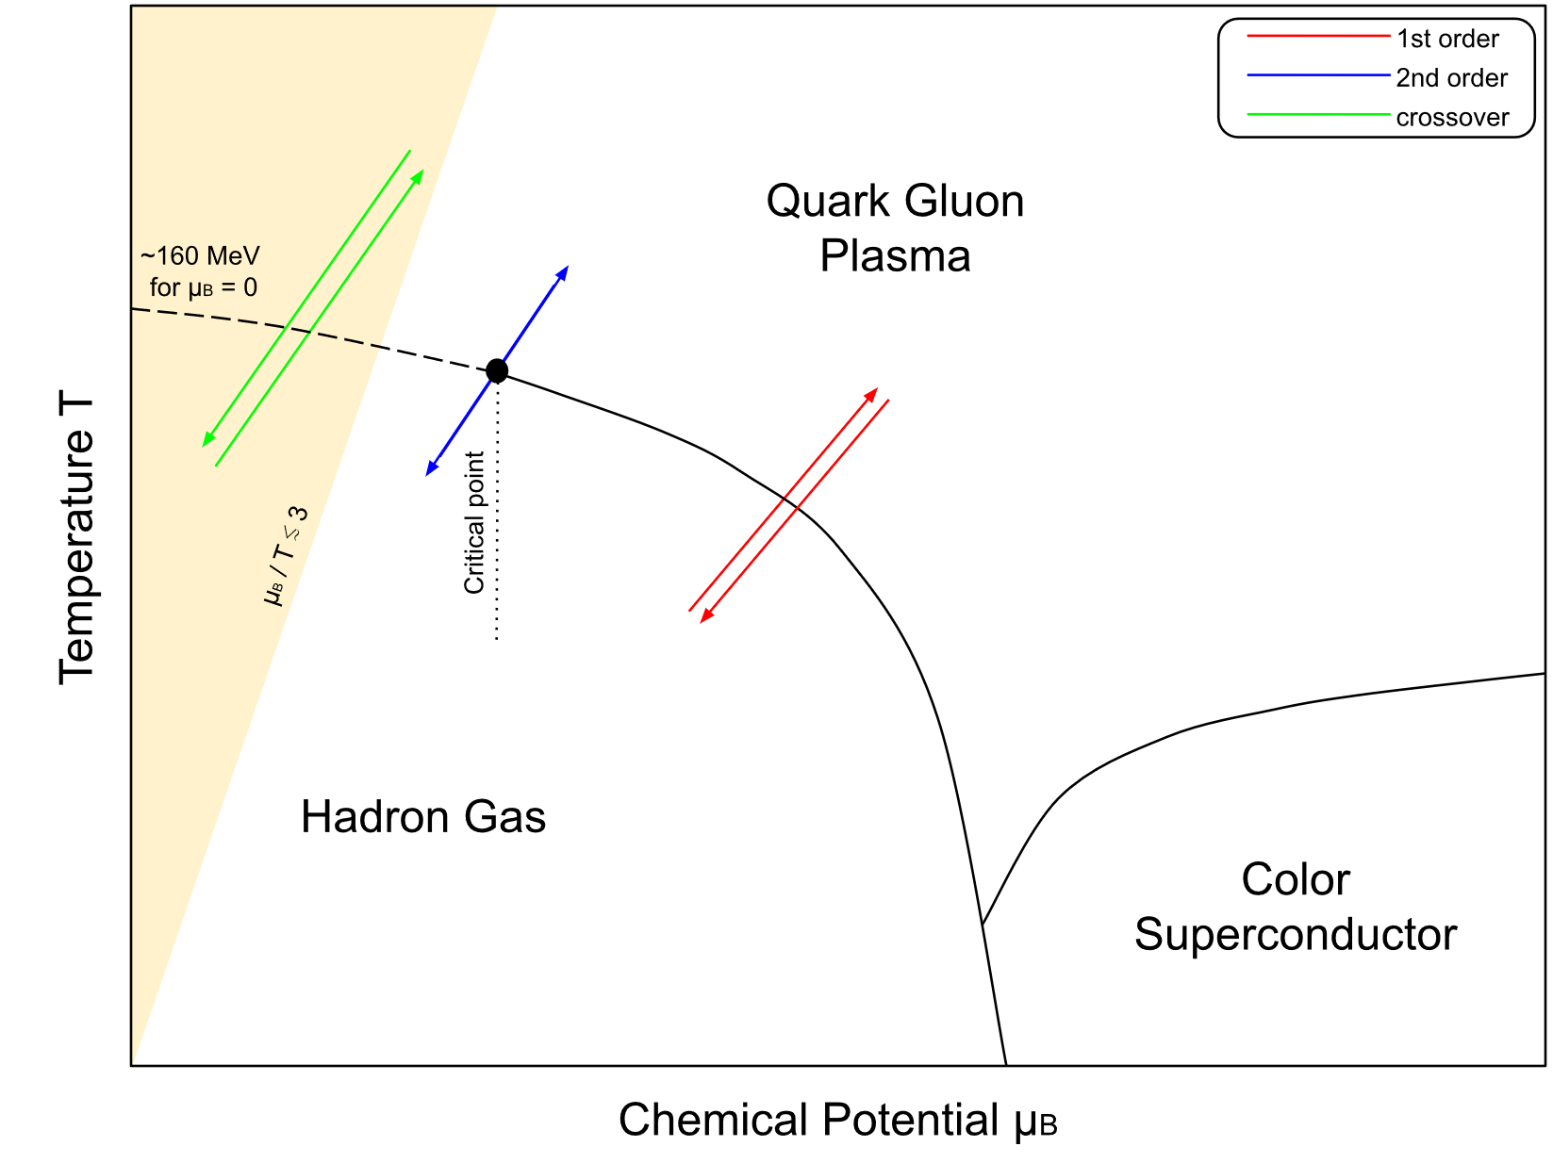
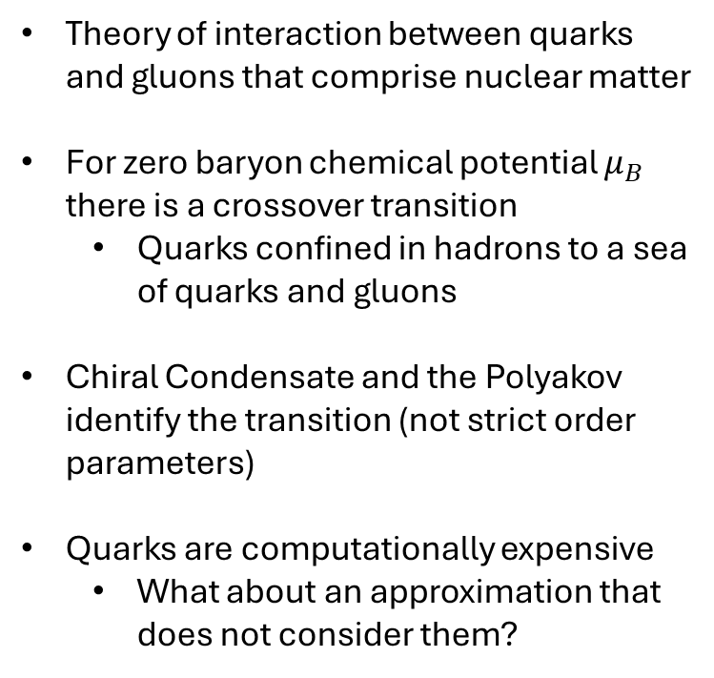
Quantum Chromodynamics phase diagram
Theory of interaction between quarks and gluons that comprise nuclear matter
For zero baryon chemical potential $μ_{B}$ there is a crossover transition
Quarks confined in hadrons to a sea of quarks and gluons
Chiral Condensate and the Polyakov identify the transition (not strict order parameters)
Quarks are computationally expensive
What about an approximation that does not consider them?
[1]
[1] Bollweg et al. Phys. Rev. D. 105, (2022).
Notes:
What is a color superconductor? Be prepared to discuss
Color superconductors are a theoretical form of matter that could possibly form in the cores of neutron stars. Low temperature analogy of ordinary (electric) superconductors.
Only the crossover transition is accessible to lattice QCD
Sign problem in finite $μ_{B}$

Slide 4
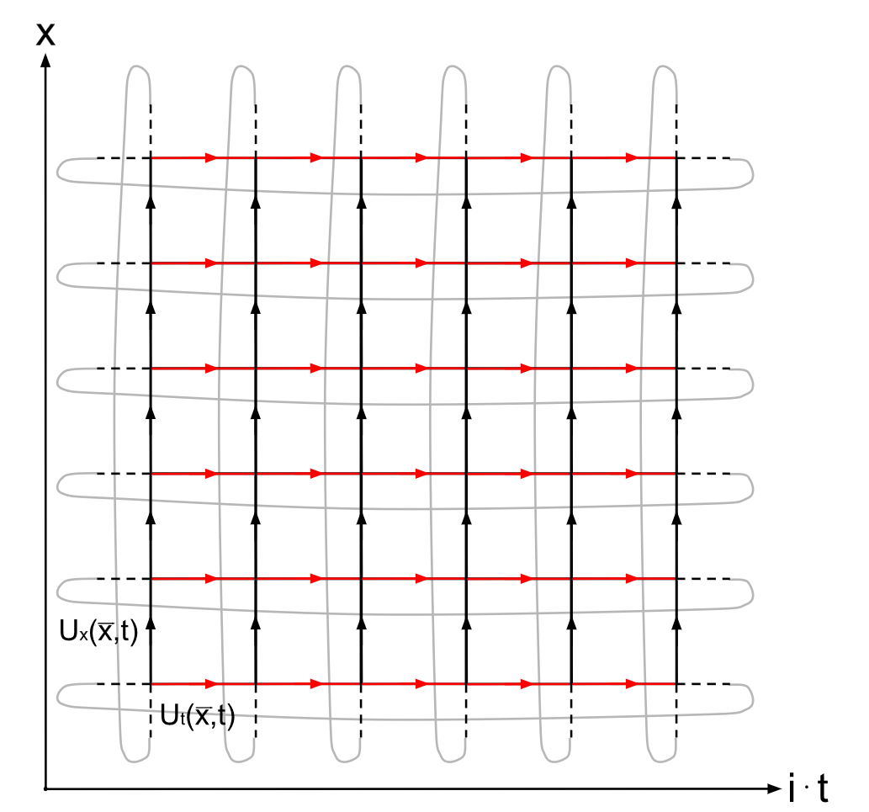

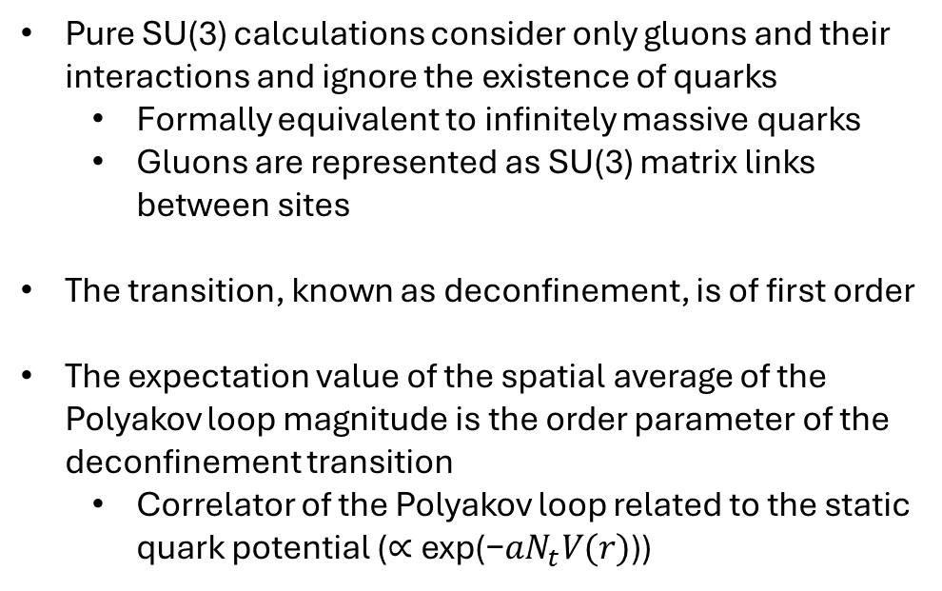


Pure SU(3) vs QCD
$$P(\vec{x})=tr(\prod_{j=1}^{N_{τ}−1}{U_{t}(\vec{x},j)})$$
Pure SU(3) calculations consider only gluons and their interactions and ignore the existence of quarks
Formally equivalent to infinitely massive quarks
Gluons are represented as SU(3) matrix links between sites
The transition, known as deconfinement, is of first order
The expectation value of the spatial average of the Polyakov loop magnitude is the order parameter of the deconfinement transition
Correlator of the Polyakov loop related to the static quark potential ($\text{∝} \text{exp}\text{(−}{aN}_{t}V(r)\text{))}$
$$N_{s}=6$$
$$N_{τ}=6$$

Slide 5
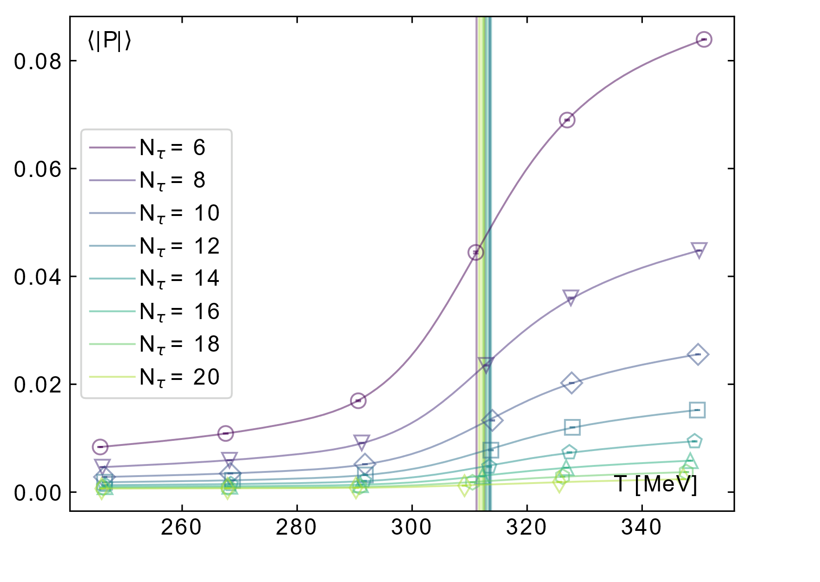
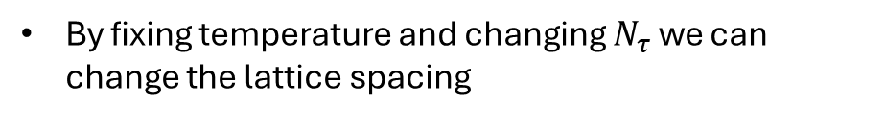

Spline Interpolation
By fixing temperature and changing $N_{τ}$ we can change the lattice spacing
$$T=\frac{1}{a(β)N_{τ}}$$
Finite size changes a discontinuity in the order parameter to an inflection point
Pseudo critical temperature
Functional form of the Polyakov loop unknown
Each point is computationally expensive
Splines allow us to interpolate from a limited number of points
The inflection point of the spline locates the critical temperature
Notes:
Recreate figure with most recent data

Slide 6
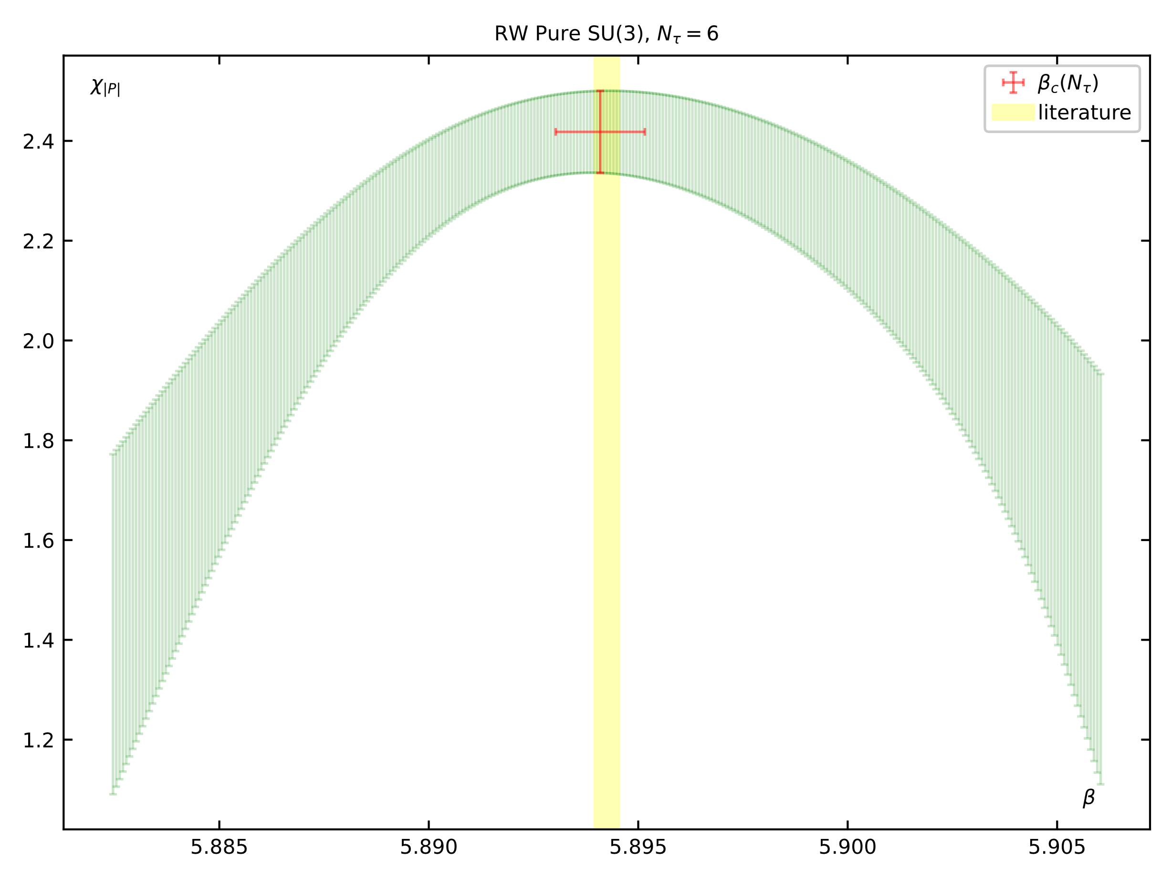
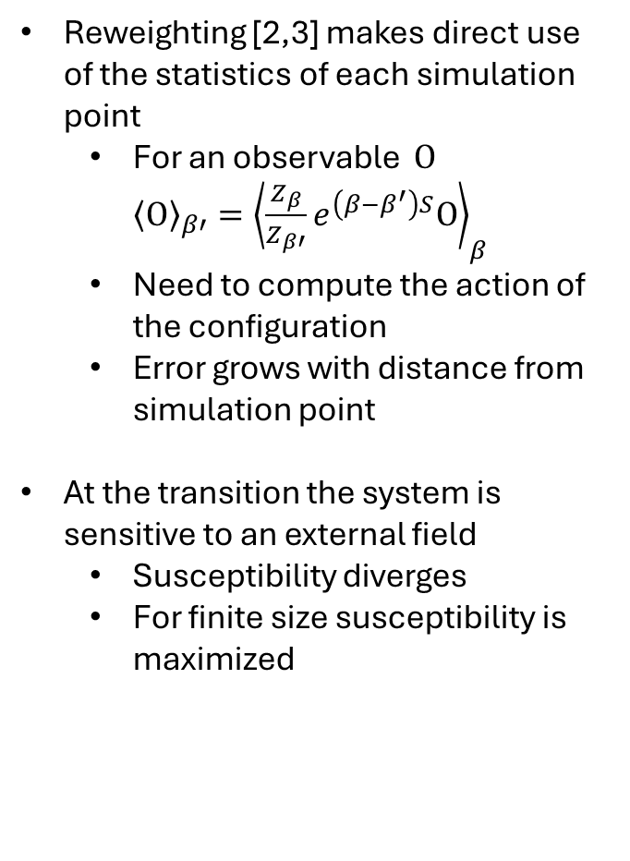
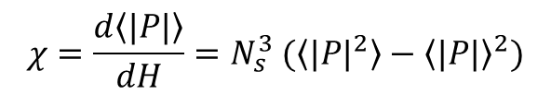
Reweighting
$$χ=\frac{d\left\langle |P|\right\rangle }{dH}=N_{s}^{3} (\left\langle {|P|}^{2}\right\rangle −{\left\langle |P|\right\rangle }^{2})$$
Reweighting [2,3] makes direct use of the statistics of each simulation point
For an observable $Ο$ ${\left\langle Ο\right\rangle }_{β′}={\left\langle \frac{Z_{β}}{Z_{β′}}e^{\left(β−β^{′}\right)S}Ο\right\rangle }_{β}$
Need to compute the action of the configuration
Error grows with distance from simulation point
At the transition the system is sensitive to an external field
Susceptibility diverges
For finite size susceptibility is maximized
[4]
[2] Ferrenberg & Swendsen Phys. Rev. Lett. 63(12), 1195. (1989b).
[3] Ferrenberg & Swendsen Phys. Rev. Lett. 61, 2365. (1989a).
[4] Francis et al. Phys. Rev. D. 91, (2015).
Notes:
Susceptibility diverges at critical point since as you approach that point the system becomes more sensitive to perturbation by an eternal field.

Slide 7
Results
Notes:
Abstract: At sufficiently high temperatures and/or baryon chemical potential, nuclear matter is known to transition from a gas of hadrons to a plasma of quarks and gluons. In the limit of infinitely massive quarks, which is formally equivalent to a theory of only gluons, pure $SU(3)$, this transition is known to be of first order. In this study we use lattice field theory to extract the pure SU(3) deconfinement temperature $T_d$. Historically $T_d$ has been extracted using histogram reweighting. Here, we try an alternative approach based on spline interpolation.

Slide 8
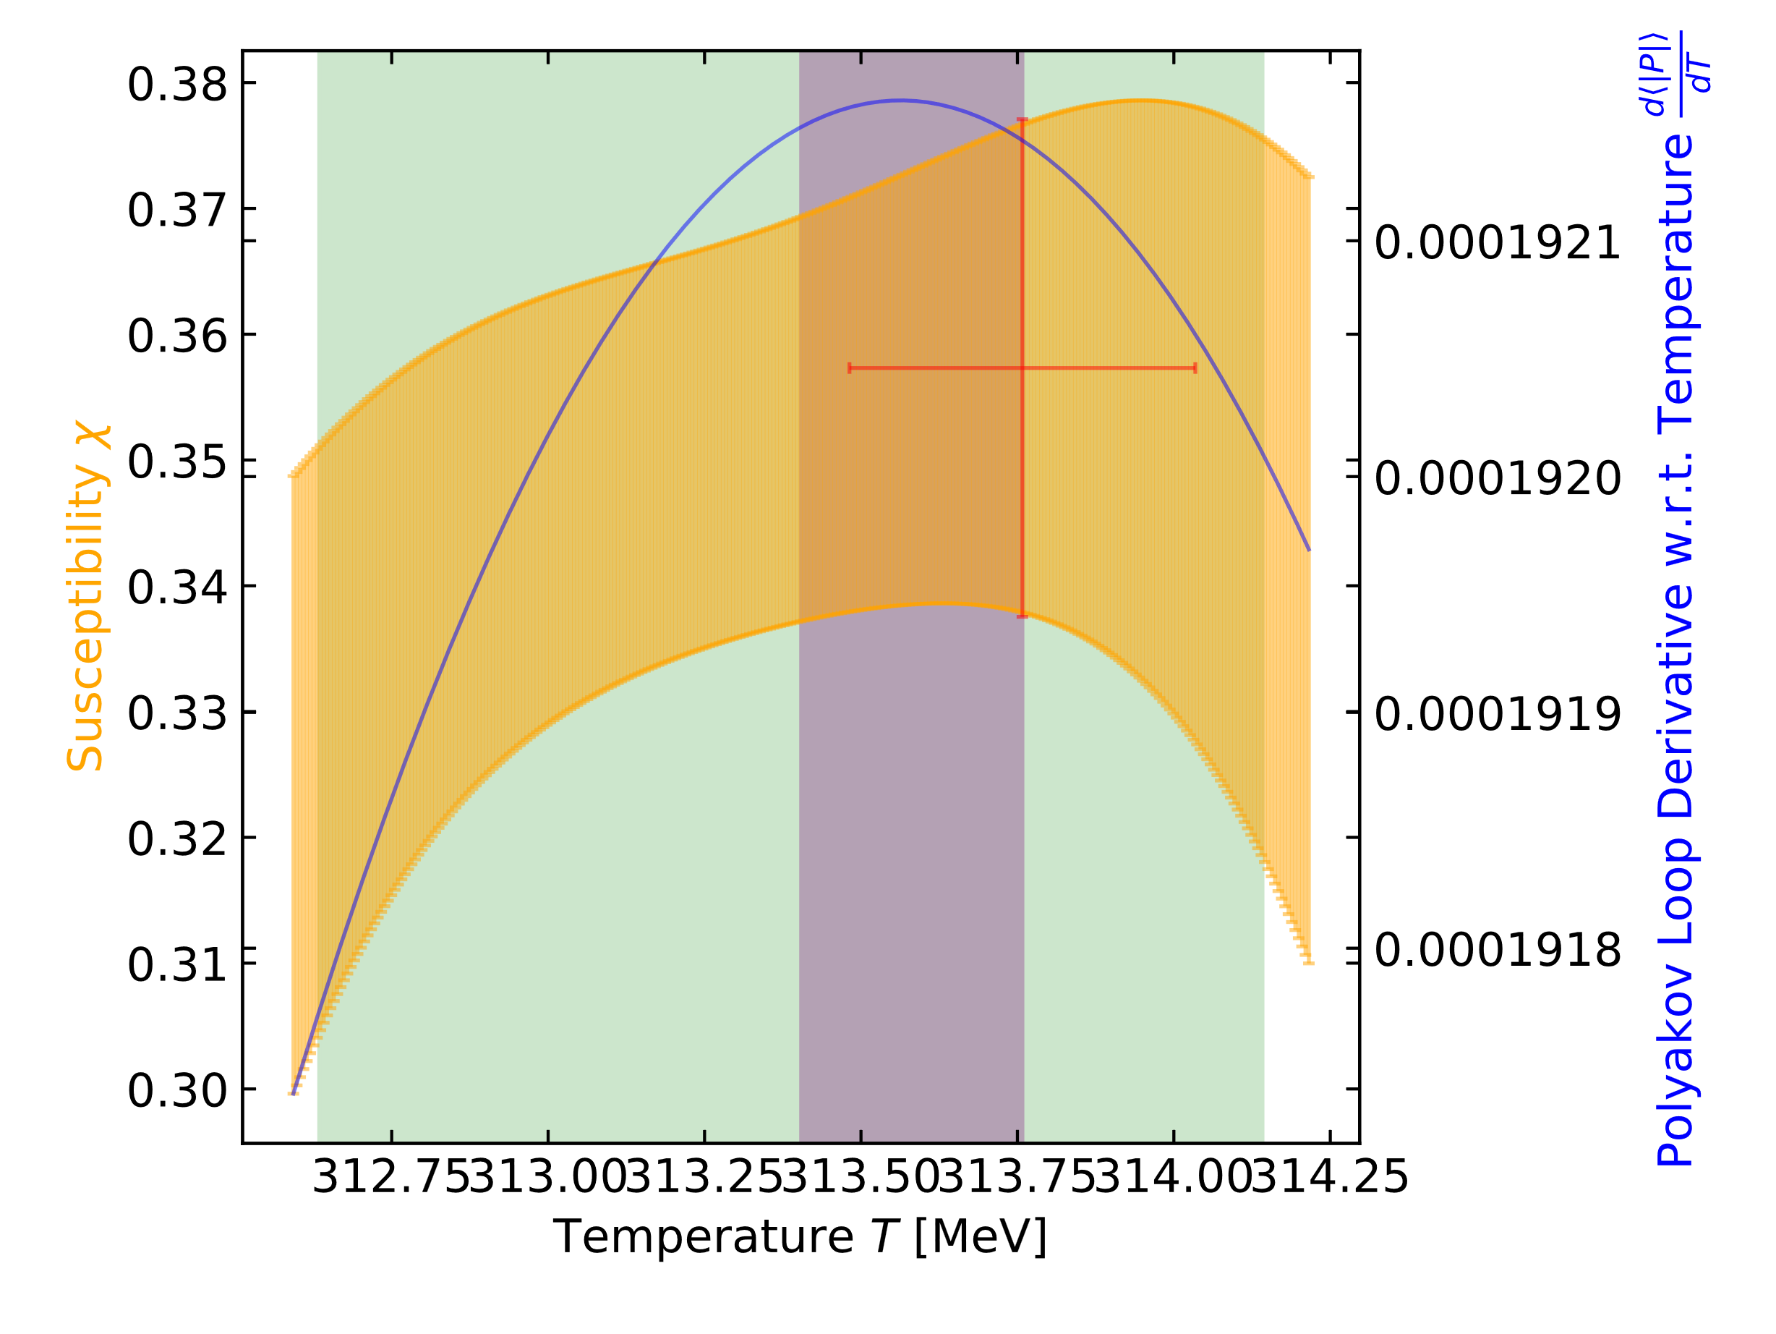
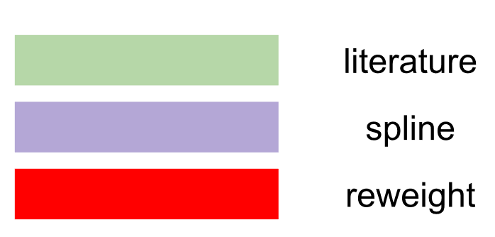

Shape of reweight curve is a concern
Lower statistics than Francis et al.
Spline error likely underestimated
$$N_{τ}=14$$
lit v spl p = 0.84
lit vs rw p = 0.63
rw vs spl p = 0.54
[4]
[4] Francis et al. Phys. Rev. D. 91, (2015).
Notes:
At larger times extensions, closer to the continuum limit, the spline results are considerably larger than the literature or reweighting results.
Rw error bar is computed by resampling set of 1000 configurations by throwing out a couple hundred configurations so kind of a jackknife so it is likely underestimated. The mean in rw is also likely unreliable due to lack of statistics.
We would like to have a cleaner result like the literature value using more statistics than we have. However, given the statistics we have our results are not bad.

Slide 9
Splines vs Reweighting: advantages and disadvantages
Splines allow global extrapolation using a small amount of data
Locating the general area of a phase transition
Introduces systematic error that is difficult to account for
Free to choose many spline parameters
Reweighting errors are simple to propagate and reliably reproduced literature results
Reweighting range becomes smaller close to the continuum
Higher number of statistics required
Must be near transition
Thanks for listening
Notes:
Where is this systematic error from the spline interpolation coming from and how can we account for it?
We would like to have a cleaner result like the literature value using more statistics than we have. However, given the statistics we have our results are not bad.

Slide 10
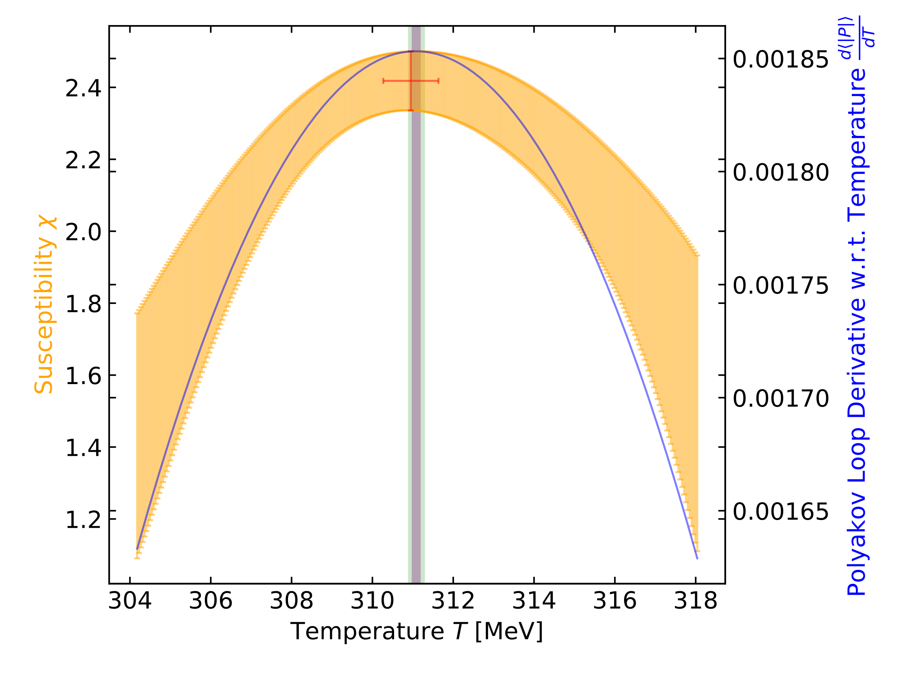

$$N_{τ}=6$$
lit v spl p = 0.97
lit vs rw p = 0.91
rw vs spl p = 0.0.91
[4]
[4] Francis et al. Phys. Rev. D. 91, (2015).
Notes:
At smaller time extensions spline results agree with literature and reweighting values.
Replace these figures with one that includes the error in the rw result.
Present Ntau = 18

Slide 11
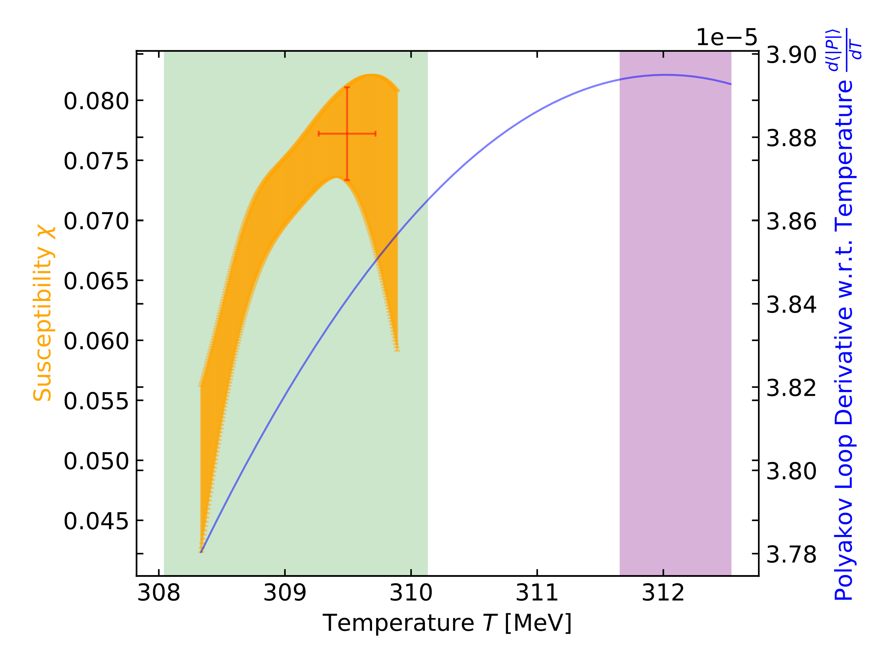

$$N_{τ}=20$$
lit v spl p = 4.7e-3
lit vs rw p = 0.71
rw vs spl p = 1.3e-6
[4]
[4] Francis et al. Phys. Rev. D. 91, (2015).

Slide 12
Bibliography
[1] D. Bollweg, J. Goswami, O. Kaczmarek, F. Karsch, S. Mukherjee, P. Petreczky, C. Schmidt, and P. Scior, Taylor Expansions and Padé Approximants for Cumulants of Conserved Charge Fluctuations at Nonvanishing Chemical Potentials, Physical Review D 105, (2022).
[2] Ferrenberg, A. M., & Swendsen, R. H. (1989b). Optimized Monte Carlo data analysis. Phys. Rev. Lett., 63(12), 1195.
[3] Ferrenberg, A. M., & Swendsen, R. H. (1989a). New Monte Carlo Technique for Studying Phase Transitions. Phys. Rev. Lett., 61, 2365.
[4] A. Francis, O. Kaczmarek, M. Laine, T. Neuhaus, and H. Ohno, Critical Point and Scale Setting in SU(3) Plasma: An Update, Physical Review D 91, (2015).
Further Reading
C. Gattringer and C. Lang, Quantum Chromodynamics on the Lattice: An Introductory Presentation (Springer Science & Business Media, 2009).

