Slide 1



Continuum-Limit Extrapolation of the Pure SU(3) Deconfinement Temperature Using Bayesian Model Averaging
Kai Ebira, University of Utah
with Coleman Rohde, David Clarke, Daeton McClure
Notes:
First: go over LFT and its key concepts
Introduce challenges of representing continuous spacetime on the lattice using computer
How we attempted to address those challenges
What we found

Slide 2
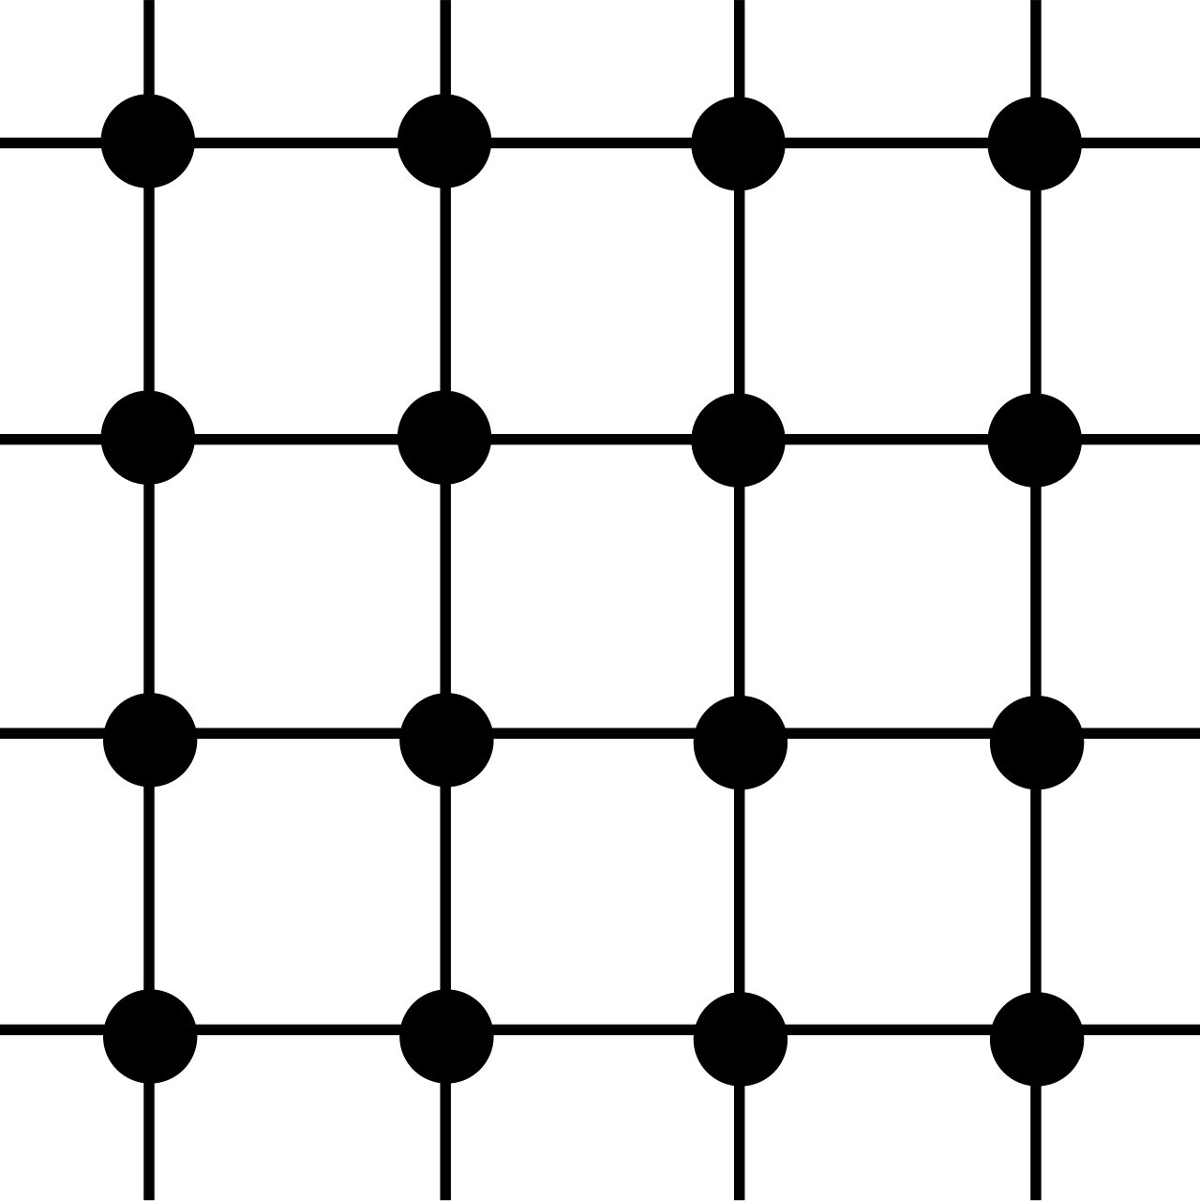




Lattice Field Theory: The Basics
Definition: LFT is a non-perturbative approach to quantum field theory on a discretized spacetime lattice
Replaces continuous spacetime with a grid of points
Can be simulated on a computer
Enables numerical calculations of quantum field theories, especially useful for strong interactions
Quark fields → defined on lattice sites
Gluon fields → defined on links between sites
Image credit: Wikipedia
Notes:
Key Concepts of Lattice
And what this means is that we're still thinking about particles and their respective fields but to make calculations possible we're only defining the fields at discrete points.
Quark fields are defined on lattice sites
Gluon fields are defined on links, intuitively this makes sense because gluon fields are directional fields
Note this is a visualization in 2D but our models are in 4D

Slide 3



Lattice Parameters and Their Implications
Lattice spacing : Distance between adjacent points on the lattice
Smaller → closer approximation to continuum
Finite lattice size : Total extent of the lattice
Larger → better representation of infinite volume
Notes:
We have two parameters that affect the form of the lattice: Lattice spacing a and the lattice extent L

Slide 4
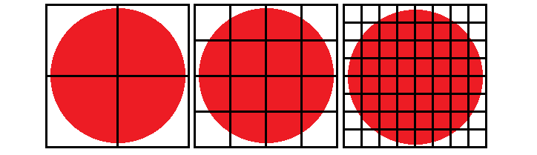
Lattice Parameters and Their Implications
Notes:
A fixed volume and increasing resolution as the spacing between each point decreases that inherently leads to a higher amount of points we need to iterate over which is more computational expensive. We can think of this as taking the limit as a goes to 0.
Likewise, if we expanded the volume that increased the number of points to compute.

Slide 5
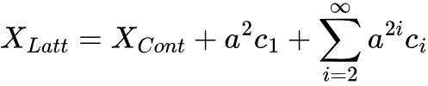
Reaching the Continuum Limit
Definition: Process of taking lattice spacing a → 0
Importance:
Removes discretization artifacts
This talk: Focus on continuum-limit extrapolation of SU(3) deconfinement temperature
Notes:
As I mentioned earlier we're taking the limit to zero which is the definition of the continuum limit.
Having a non-zero lattice space leads us to this relationship where our simulation result is equal to our "continuous" result plus some discretization artifacts.
Analogous to a Riemann Sum in an integral where as the base of the rectangle increases the less accurate our measurements are, so to mitigate error we take the limit to zer
Used to extrapolate 0 spacing

Slide 6

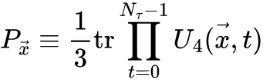

Gauge Observables
Plaquettes: Elementary closed loops on the lattice
Used to construct the gauge action
Polyakov loops: Measurement of loops wrapping around the temporal direction
Order parameter for deconfinement transition
Used for:
Notes:
The plaquette is the "interpolator" for the energy
The Polyokov Loop is the "interpolator" for infinitely heavy quarks

Slide 7

Sampling Gauge Configurations
Use Markov chains to sample SU(3) configurations
Because , there is inherent correlation
Want: Effectively independent configurations, separate measurements with many intermediate configurations (500)
Near the phase transition→even more intermediate configurations
Notes:
We have the distribution of all possible gauge configurations of the gluon field, and we draw a configuration based off of what configurations are likely
Updates to the chain are drawn accepted based on a boltzmann factor
Su(3) -> only gluons are chgangin

Slide 8

Computational Challenges
 | Pure SU(3) (infinite quark mass) | Nf 2+1 HISQ (physical quark mass)
Hardware | A100 | A100
Dimensions | 72^3 * 12 | 32^3 * 10
Time | 19 Hrs | 72 Hrs
Configurations | 1000 | 48
Computational complexity:
Scales with volume
Scales with decreasing quark mass
Requires repeating measurements at different spacings
Notes:
Moving onto the computational challenges

Slide 9
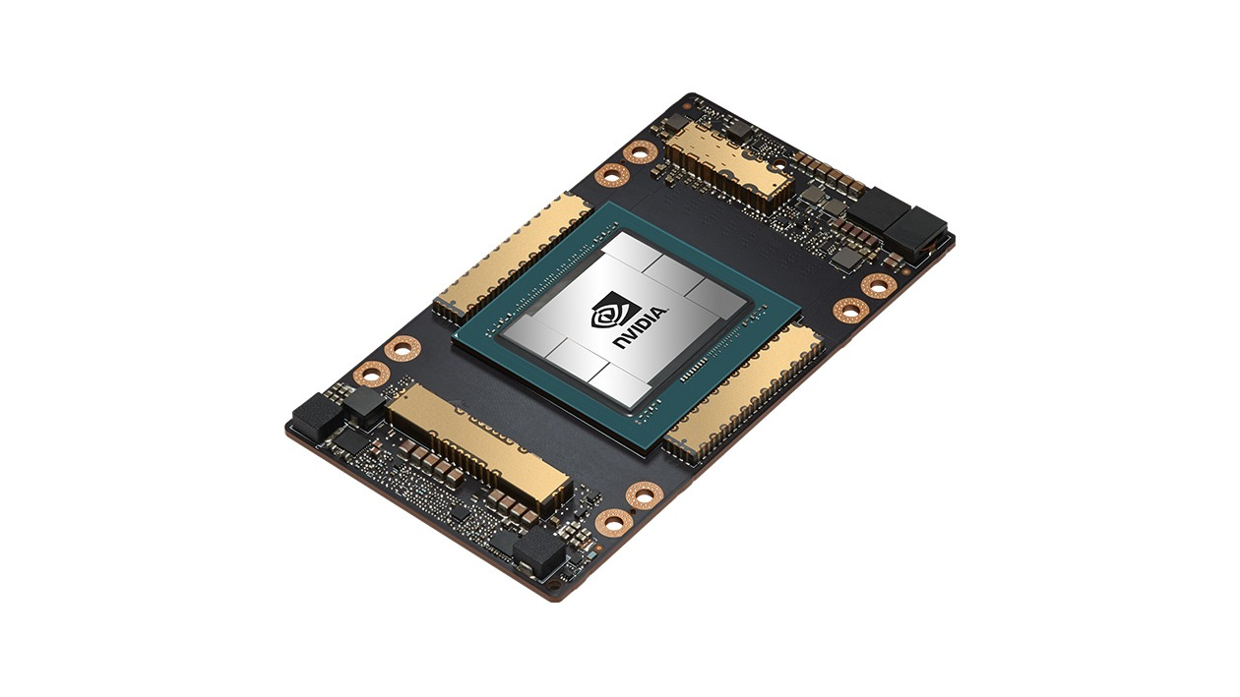
Parallel Computing and Optimizations
Parallel Computing Strategies:
Use of MPI (Message Passing Interface)
Use of GPUs (massively parallel processors)
C++ Optimizations:
Low-level control for performance optimization
Custom memory allocators for lattice objects
Cache-friendly data structures
Vectorization of critical code sections
Pure SU(3) | A100 | RTX 3090
Configurations | 1000 | 1000
Dimensions | 72^3 * 12 | 72^3 * 12
Time | 19 Hrs | 72 Hrs
Image credit: NVIDIA

Slide 10


Finite-Size Effects
Lattice spacing and extent introduce systematics:
Minimum distance (lattice spacing)
Maximum distance (lattice extent)
Aim to check if these systematics are more than our statistical error
Check our measurements over increasing with fixed to determine this
We find that finite-size effects shifts our central value by about 0.1%
Notes:
Minimum distance -> continuum extrap

Slide 11

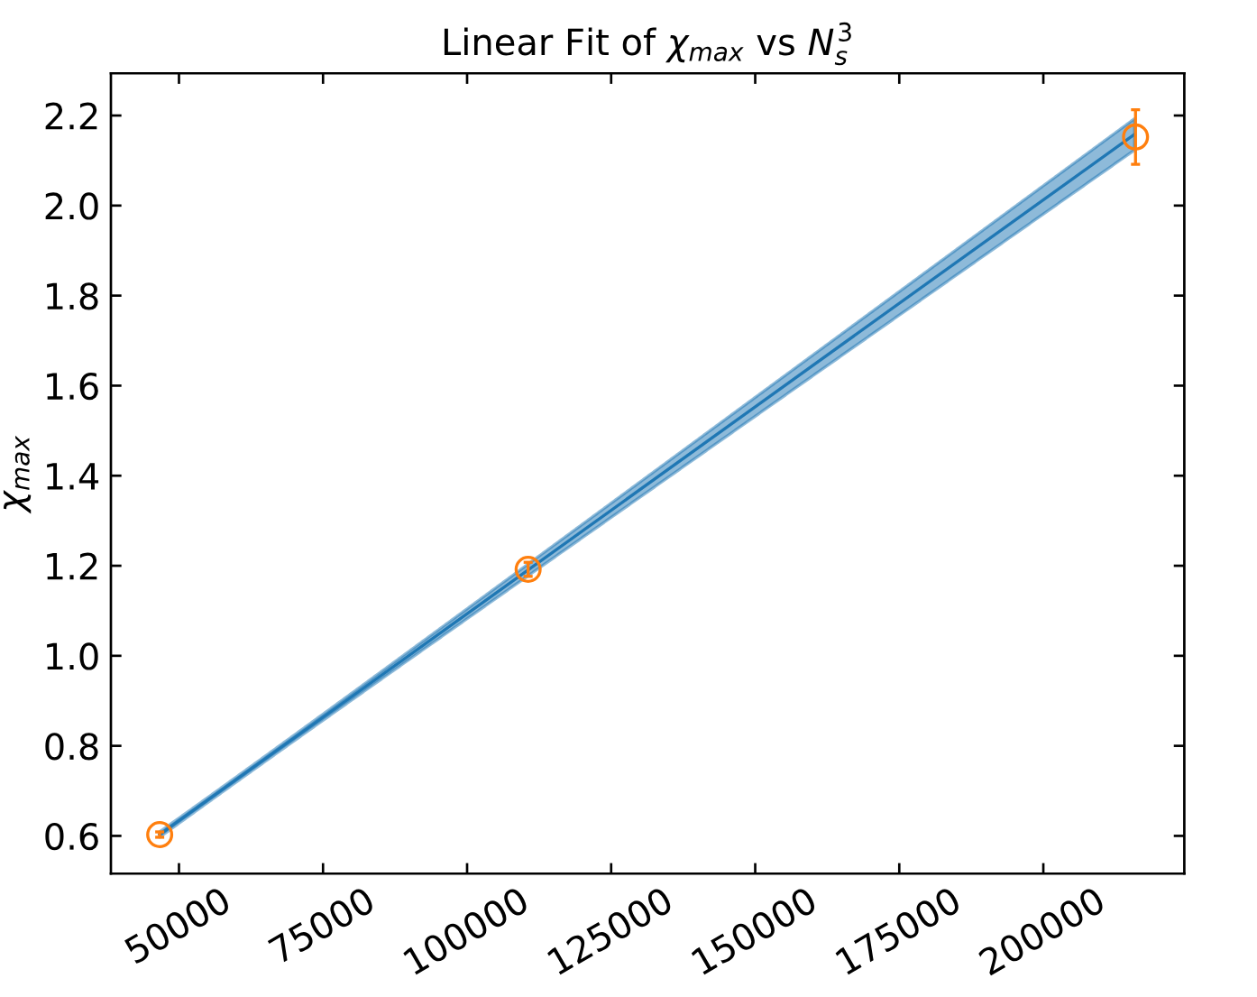
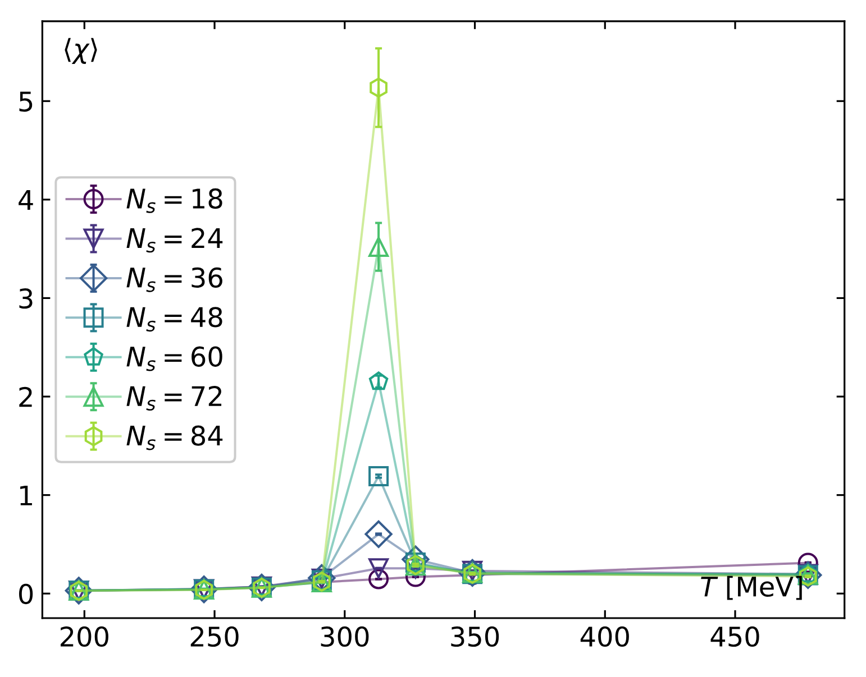
Finite-Size Scaling in SU(3)
Fukugita, M., Okawa, M., & Ukawa, A. (1989). Order of the deconfining phase transition in SU(3) lattice gauge theory. Phys. Rev. Lett., 63(17), 1768–1771. doi:10.1103/PhysRevLett.63.1768
Notes:
In a first order transition, the max susceptibility scales linearly with Ns cubed, and there should be a peak in the susceptibility at the critical temp. We can see this behavior here
Peak height scales -> first order

Slide 12
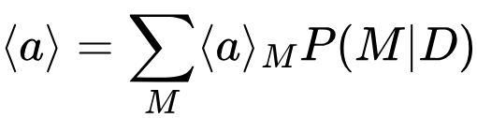

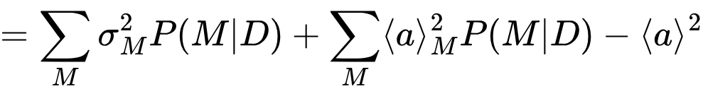
Bayesian Model Averaging (BMA)
BMA is a statistical technique that aims to account for model uncertainty by combining predictions from multiple models, weighted by their estimated likelihoods
Jay, W. I., & Neil, E. T. (2021). Bayesian model averaging for analysis of lattice field theory results. Physical Review D, 103(11), 114502. doi:10.1103/PhysRevD.103.114502
Notes:
Statistics and Results
Model = fit
Considers different points

Slide 13
Summary of Statistics
N_tau | 6 | 8 | 10 | 12 | 14 | 16 | 18 | 20
N_conf | 1.0e4 | 1.0e4 | 1000 | 1.0e4 | ~860 | 8000 | 4000 | 1300
(One to two orders of magnitude fewer than literature)
Francis, A., Kaczmarek, O., Laine, M., Neuhaus, T., & Ohno, H. (2015). Critical point and scale setting in SU(3) plasma: An update. Phys. Rev. D, 91(9), 096002. doi:10.1103/PhysRevD.91.096002

Slide 14
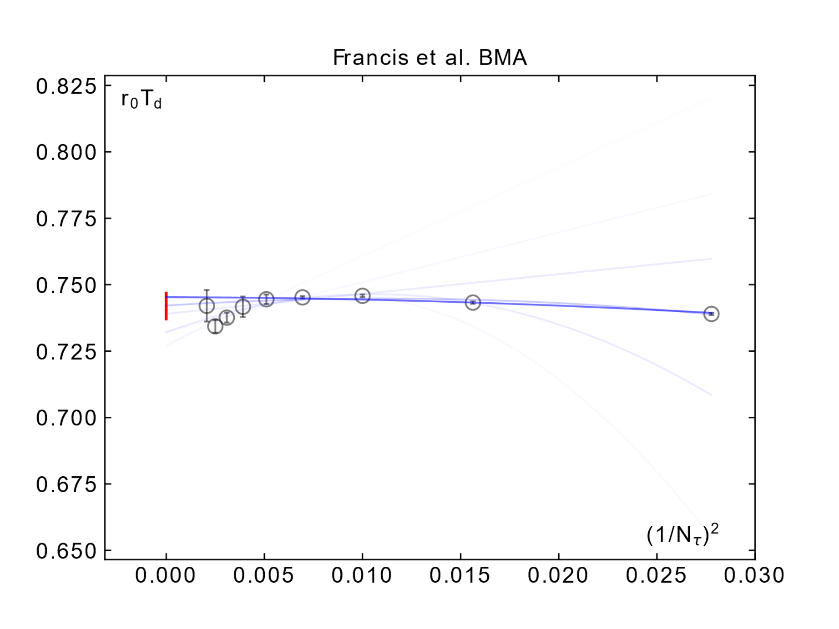
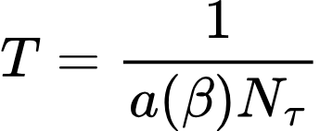
Continuum-Limit Extrapolation
Literature w/ BMA | 0.7420(54)
Literature | 0.7457(45)
Francis, A., Kaczmarek, O., Laine, M., Neuhaus, T., & Ohno, H. (2015). Critical point and scale setting in SU(3) plasma: An update. Phys. Rev. D, 91(9), 096002. doi:10.1103/PhysRevD.91.096002
Notes:
r0, reference scale, comes from an experimental result unitless -> unitfull
Td – deconfinement temp
Data points are different lattice spacings, models are different orders and cut out smallest (rightmost) lattice spacings as they mess with our approximations more
Error bars might be larger due to testing more models

Slide 15
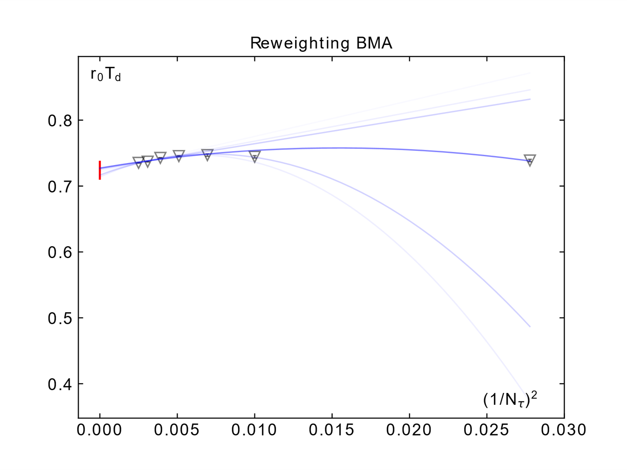
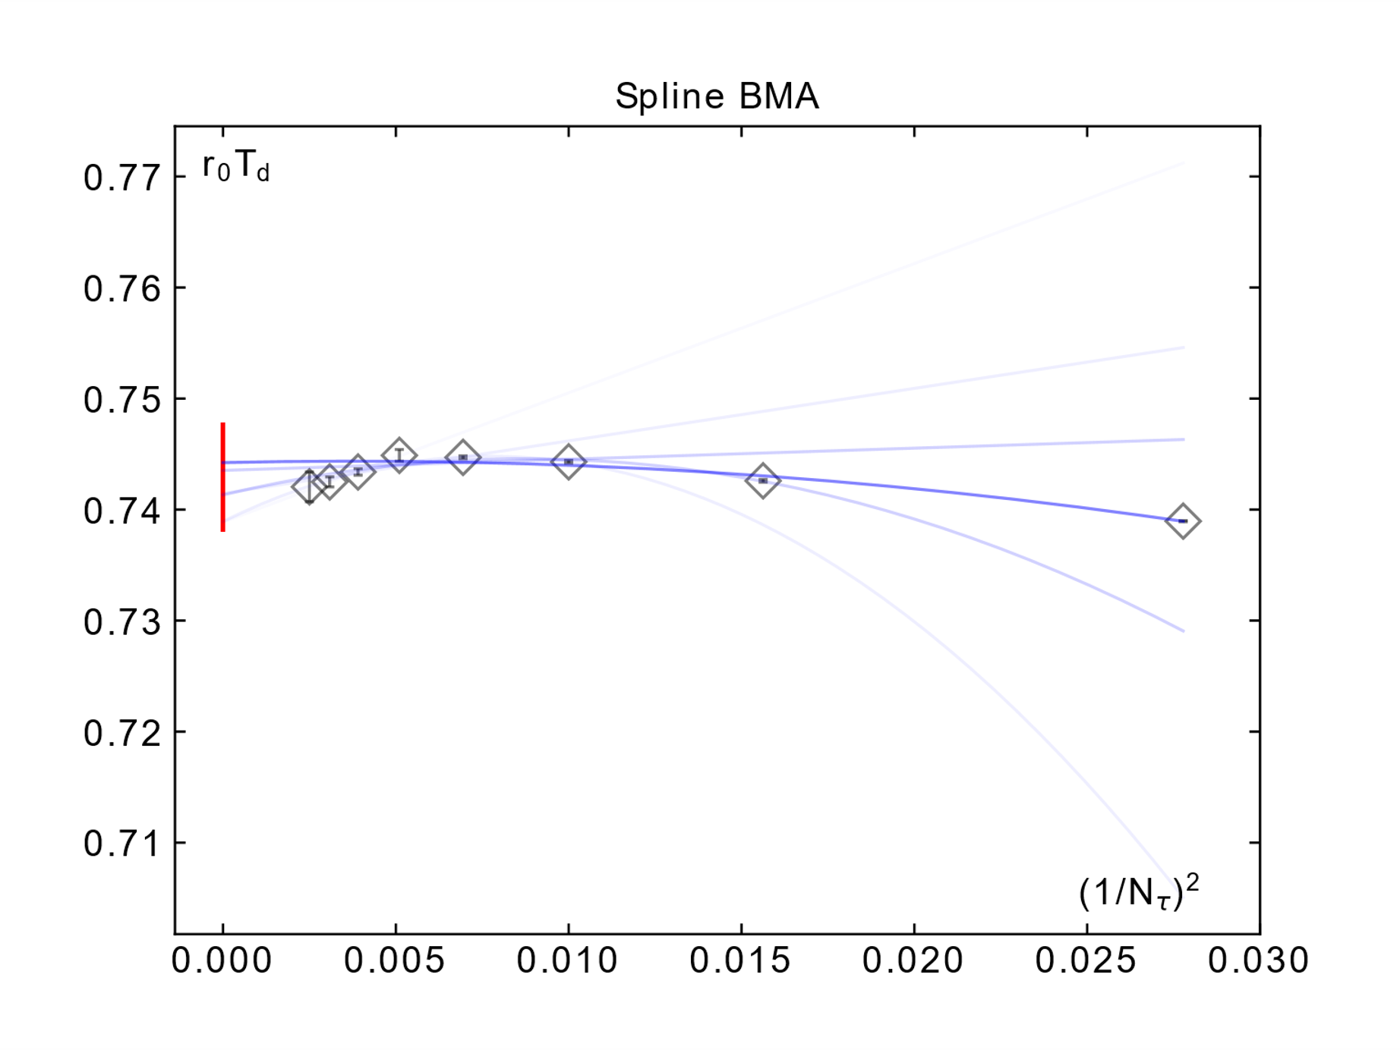
Literature | SRI w/ RW | SRI w/ Splines
0.7457(45) | 0.724(15) | 0.7429(50)
Notes:
All three of these are within each other

Slide 16
Summary
Both RW and spline results agree with literature value of Td
Found some modest finite-size effects
Literature error is arguably slightly underestimated according to BMA
Thank you!

