Slide 1
Lecture 1: Introduction to data structures and algorithms
Lê Sỹ Vinh
Computer science department
Email: vinhls@vnu.edu.vn

Slide 2
Outline
Data structure and algorithm concepts
Industrial problems
Data types
Abstract data structures
Problem description

Slide 3
Data structure?
What is a data structure?
A data structure is a particular way of storing and organizing data
so that they can be used efficiently.
Efficiency?
Correctness
Memory usage
Search and retrieval
modification, insertion/deletion
Simple and understandable/implementable
Standard data structures
Struct
Array
List
Tree
Hash table
Set
Dictionary

Slide 4
Algorithms?
What is an algorithm?
An algorithm is a step by step procedure to solve a problem. An algorithm can be described by nature languages (English, Vietnamese...) or programming languages (C++, Java, Python…)
Example: How to cook rice?
Step 1: Get rice
Step 2: Combine rice and water
Step 3: Boil the rice
Step 4: Check the rice
A good algorithm?
Correctness
Fast
Memory
Simple, understandable/implementable

Slide 5
Example 1: Sort a list
Problem: K55 CA has N students. Sort these students decreasingly by their average scores.
Example:
# Name Average score 1 Tuấn 22 2 Thăng 29 3 Vinh 26 4 Ánh 27 | # Name Average score 1 Thăng 29 2 Ánh 27 3 Vinh 26 4 Tuấn 22

Slide 6
Bubble sort by nature language
Algorithm: Iterate through the list, if there are two consecutive students with the wrong orders, swap them. Repeat this process until we get the correct list.
Step 0 Step 1 Step 2
(Tuấn, 22) 1. (Thăng, 29) 1. (Thăng, 29)
(Thăng , 29) 2. (Tuấn, 22) 2. (Vinh, 26)
(Vinh, 26) 3. (Vinh, 26) 3. (Tuấn, 22)
(Ánh , 27) 4. (Ánh, 27) 4. (Ánh, 27)
Step 3 Step 4
(Thăng, 29) 1. (Thăng, 29)
(Vinh, 26) 2. (Ánh, 27)
(Ánh, 27) 3. (Vinh, 26)
(Tuấn, 22) 4. (Tuấn, 22)

Slide 7
Bubble sort by programming language
Function bubbleSort (studentList) {
swapped := false;
do
swapped := false;
for each i = 0 to N-2 do
if studentList[i].averageScore < StutentList[i + 1]. averageScore {
swap (studentList[i], studentList[i+1]);
swapped := true;
}
while (swapped = true)
}

Slide 8
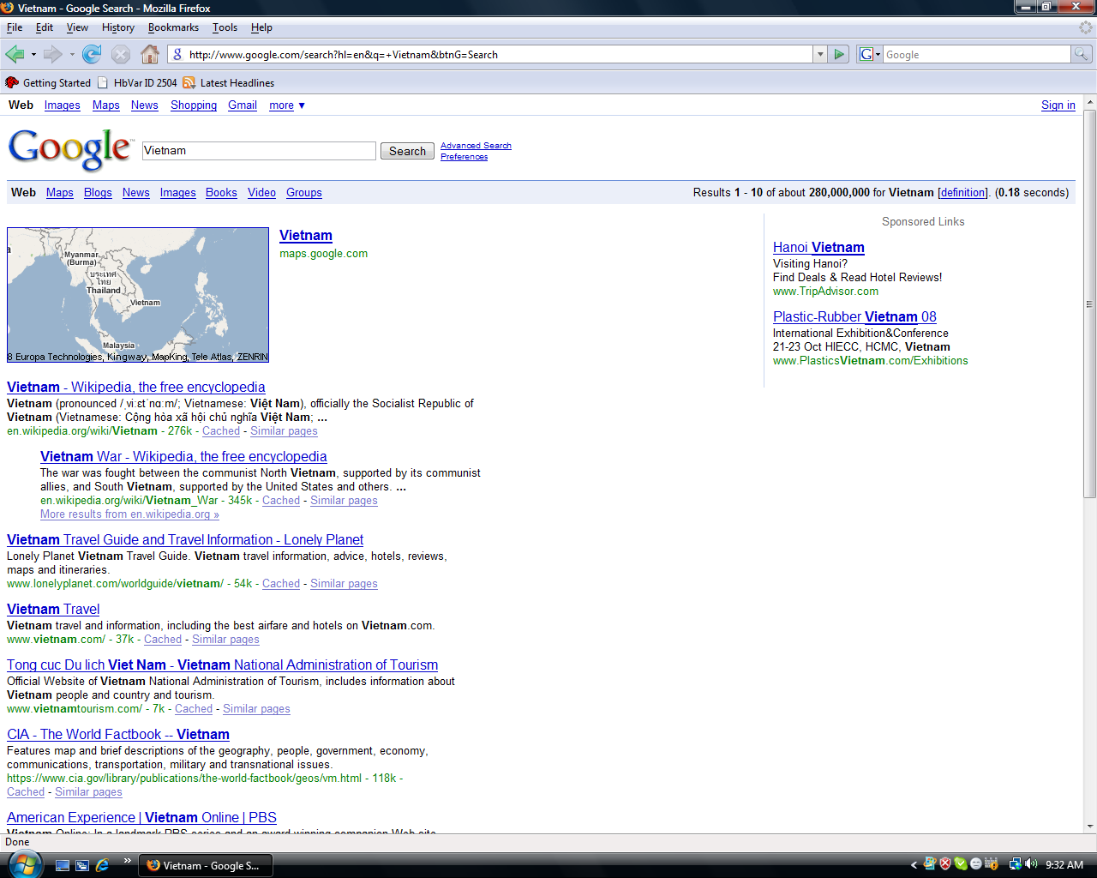

Slide 9
Example 2: Sort a list of websites (Google search)
Google has a list N websites. Website x has the priority value f(x). Sort the websites decreasingly by their f(x).
Question: Can we use bubble sort?
Answer: Yes, but not efficient

Slide 10
Example 3: Phone dictionary
Design a program to manage a phone dictionary with main operations:
Check if a phone number is in the phone dictionary?
Insert a new phone number
Delete a phone number
Edit a phone number

Slide 11
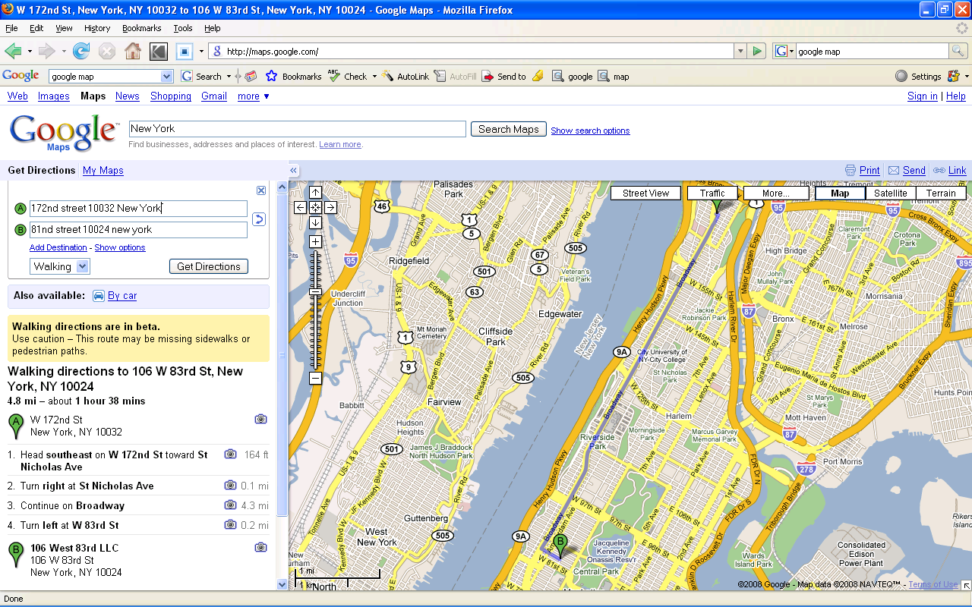
Example 4: Find the best road (Google map)

Slide 12
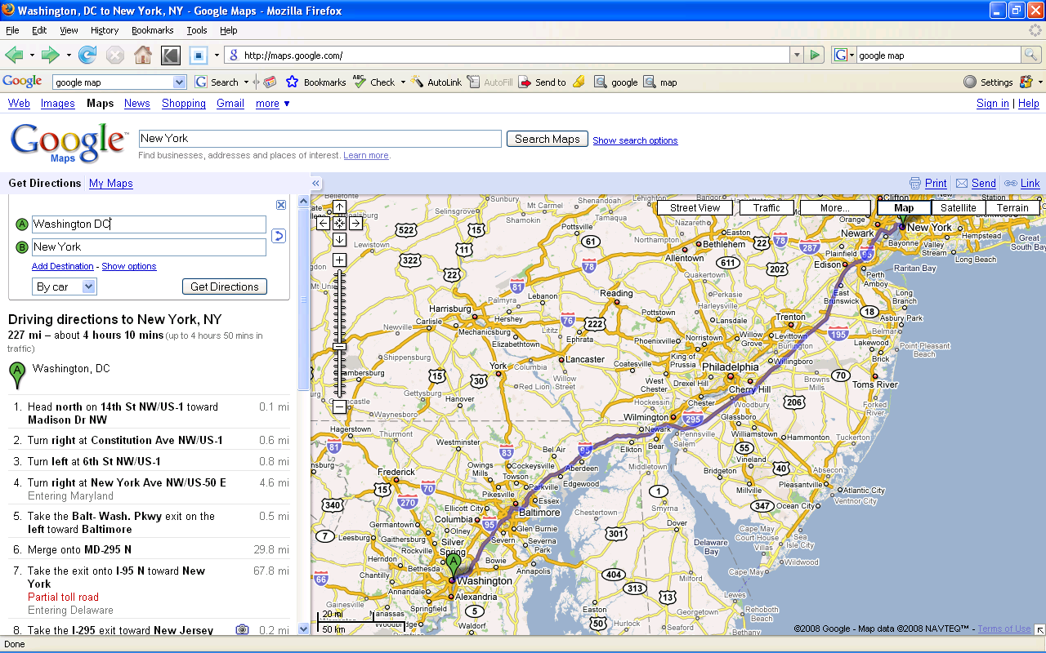
Example 4: Find the best path (Google map)

Slide 13
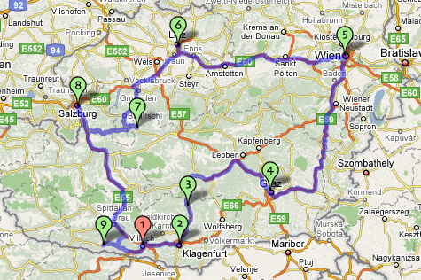
Example 5: Traveling salesman problem (TSP)
A salesman needs to visit N customers at N cities. Find a path for the salesman satisfied:
Visit each city exactly one time, then return the start city
The total distance is shortest.

Slide 14
Traveling salesman problem (TSP)
Nearest neighbor algorithm: From the current city, visit the nearest un-visited city. Repeat the process until all cities have been visited, then return to the start city.

Slide 15
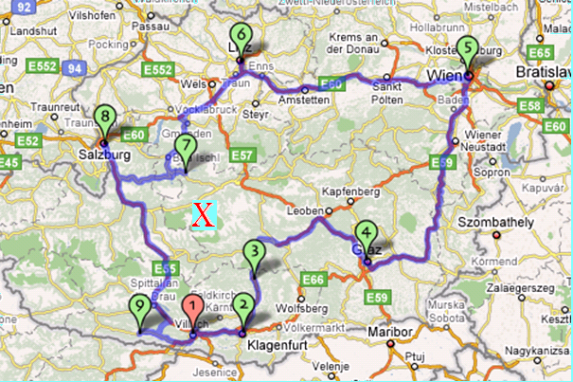
Traveling salesman problem (TSP)
Nearest neighbor path: 1 → 2 → 3 → X → 7 → 8 → 6 → 5 → 4 → 9 → 1
Optimal path: 1 → 2 → 3 → 4 → 5 → 6 → 8 → 7 → X → 9 → 1

Slide 16
What is a good program?
Correctness
Effective
Simple/Understandable
Easy to find bugs
Easy to change and upgrade/maintain
“Algorithm + Data structure = Program”
N. Wirth

Slide 17
Data
Data are information which computer can process such as integer numbers, real numbers, string, and other complex data
In computer memories, data are presented in binary format (0 or 1)
In programming languages (C++, Java…), data are abstractly presented so that they are easy to understand. For example:
int age
double weight
String name

Slide 18
Standard data types
A data type is specified by:
The range of values or the values it can hold.
Operations on values
Example in C++
type range operations
bool true / false and, or, not,
char -127 -> 127 ‘<‘, ‘>’, ‘=’
int -32,767 -> 32,767 ‘<‘, ‘>’, ‘=’, ‘+’, ‘-’, ‘*’, ‘/’
float ~1E-37 -> ~1E+37 ‘<‘, ‘>’, ‘=’, ‘+’, ‘-’, ‘*’, ‘/’
double ~1.7E-308 -> ~1.7E+308 ‘<‘, ‘>’, ‘=’, ‘+’, ‘-’, ‘*’, ‘/’

Slide 19
Structured data types
Question: How to present a point on the plane?
Answer: Programming languages provide us rules to define a new data type T from defined data types t₁, t₂,…,t_{n}.
Example in C++:
struct T {
t₁ x₁
t₂ x₂
……..
t_{n} x_{n}
}

Slide 20
Structured data types
How to present a point on the plane?
struct pointType {
double x;
double y;
}
How to present a line on the plane?
struct lineType {
point Type start;
pointType end;
}

Slide 21
Structured data types
Define a data structure to present student information
struct studentType {
char name[100];
int age;
bool sex;
}
Define a data structure to present our class information
struct studentClassType{
char className[100];
int numberStudent;
studentType studentArr[100];
}

Slide 22
Range and operations on structured data types
Consider a data type T defined from data types t₁, t₂,…,t_{n,}
Example:
struct complexType {
double real;
double image;
}
Range: Define by the ranges of component types
real: the range of ‘double’ type
image: the range of ‘double’ type

Slide 23
Range and operations on structured data types
Operations: Defined by program
Example:
struct complexType {
double real;
double image;
}
complexType createComplex (double real, double image) {
complexType c;
c.real = real;
c.image = image;
return c;
}

Slide 24
Range and operations on structured data types
complexType add (complexType c1, complextType c2) {
complexType c12;
c12.real = c1.real + c2.real;
c12.image = c1.image + c2.image;
return c12;
}
complexType multiply (complexType c1, complextType c2) {
complexType c12;
c12.real = (c1.real * c2.real) – (c1.image * c2.image);
c12.image = (c1.real * c2.image) + (c1.image * c2.real);
return c12;
}

Slide 25
Range and operations on structured data types
complexType getReal (complexType c) {
c.real
}
complexType getImage (complexType c) {
c.image
}
void printComplex (complexType c) {
cout << c.real << “ +i ” << c.image << “ \ n” ;
}

Slide 26
Abstract data types
Abstract components of structured data type
Example: complex number type
Real
image
Abstract operations
Example: complex number type
createComplex (real, image)
getReal (complexNumber)
getImage (complexNumber)
add (complexNumber1, complexNumber2)
multiply (complexNumber2, complexNumber2)
print (complexNumber)

Slide 27
Abstract data types
Abstract student data type
Abstract data type components
name, age, sex, address
Abstract operations
createStudent (name, age, sex, address)
compare (student1, student2)
getName (student)
getAge (student)
getSex (student)
getAdd (student)

Slide 28
Problem description
Example: Given a list of complex numbers
Calculate the sum
Find the number which has the biggest real component
Find the number which has the biggest image component
Problem description:
Input: Give a list of complex numbers, each number is presented by two real numbers one for real component, the other for image one.
Output:
c1 (the complex number presented the total of the list)
c2 (the number which has the biggest real component
c2 (the number which has the biggest image component

