Slide 1
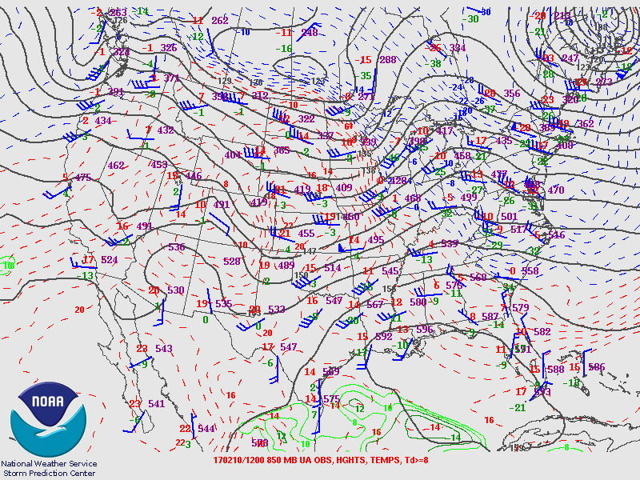
850 hPa Chart
Image from http://www.spc.noaa.gov/obswx/maps/

Slide 2
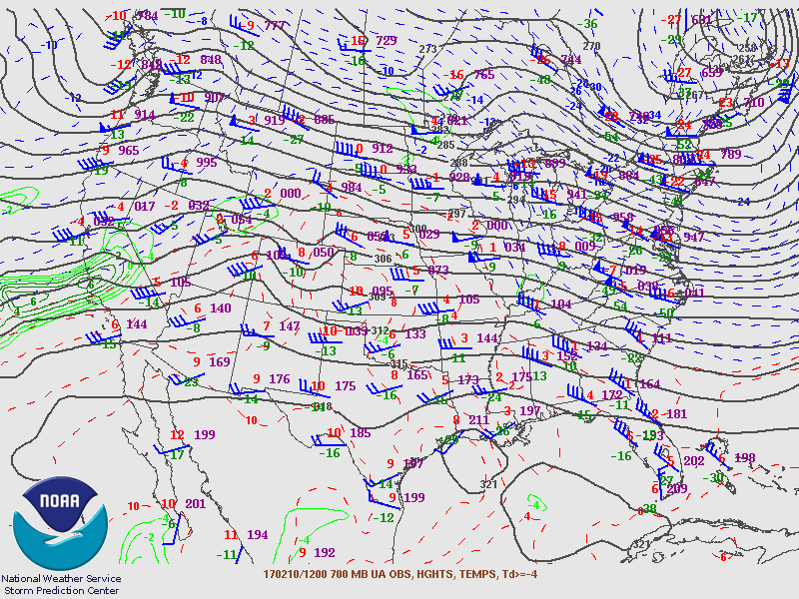
700 hPa Chart
Image from http://www.spc.noaa.gov/obswx/maps/

Slide 3
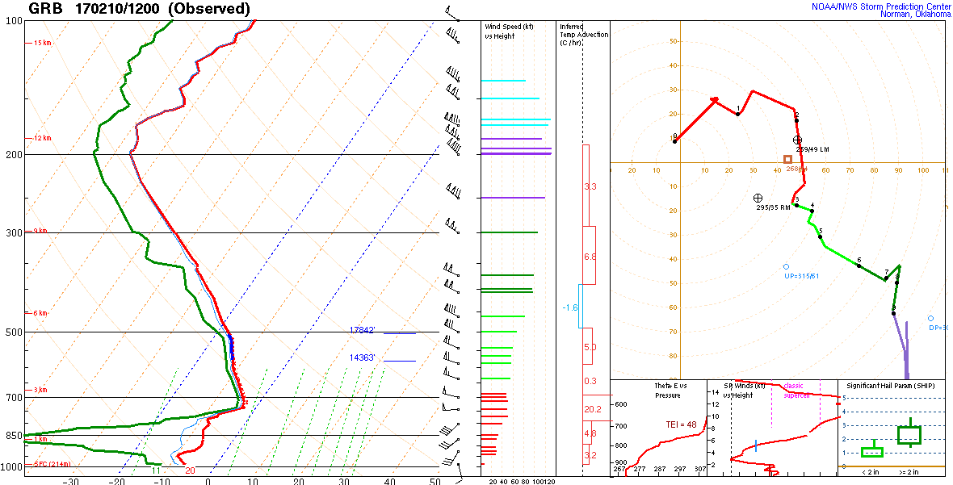
Green Bay, WI Sounding
Image from http://www.spc.noaa.gov/exper/soundings/

Slide 4
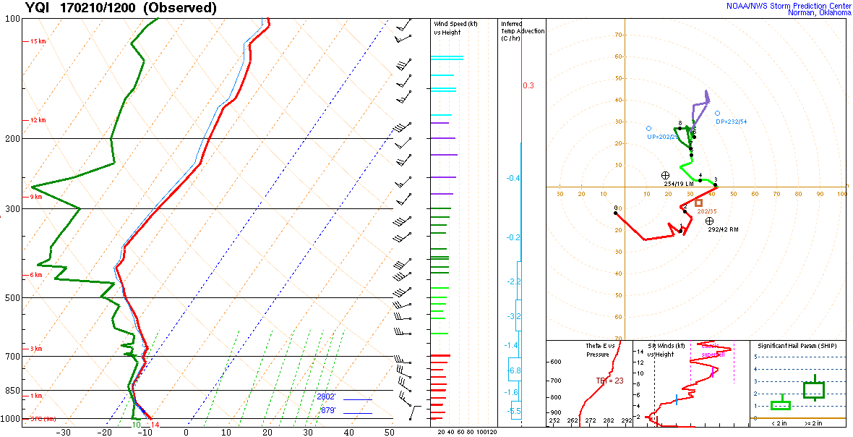
Yarmouth, Nova Scotia Sounding
Image from http://www.spc.noaa.gov/exper/soundings/

Slide 5
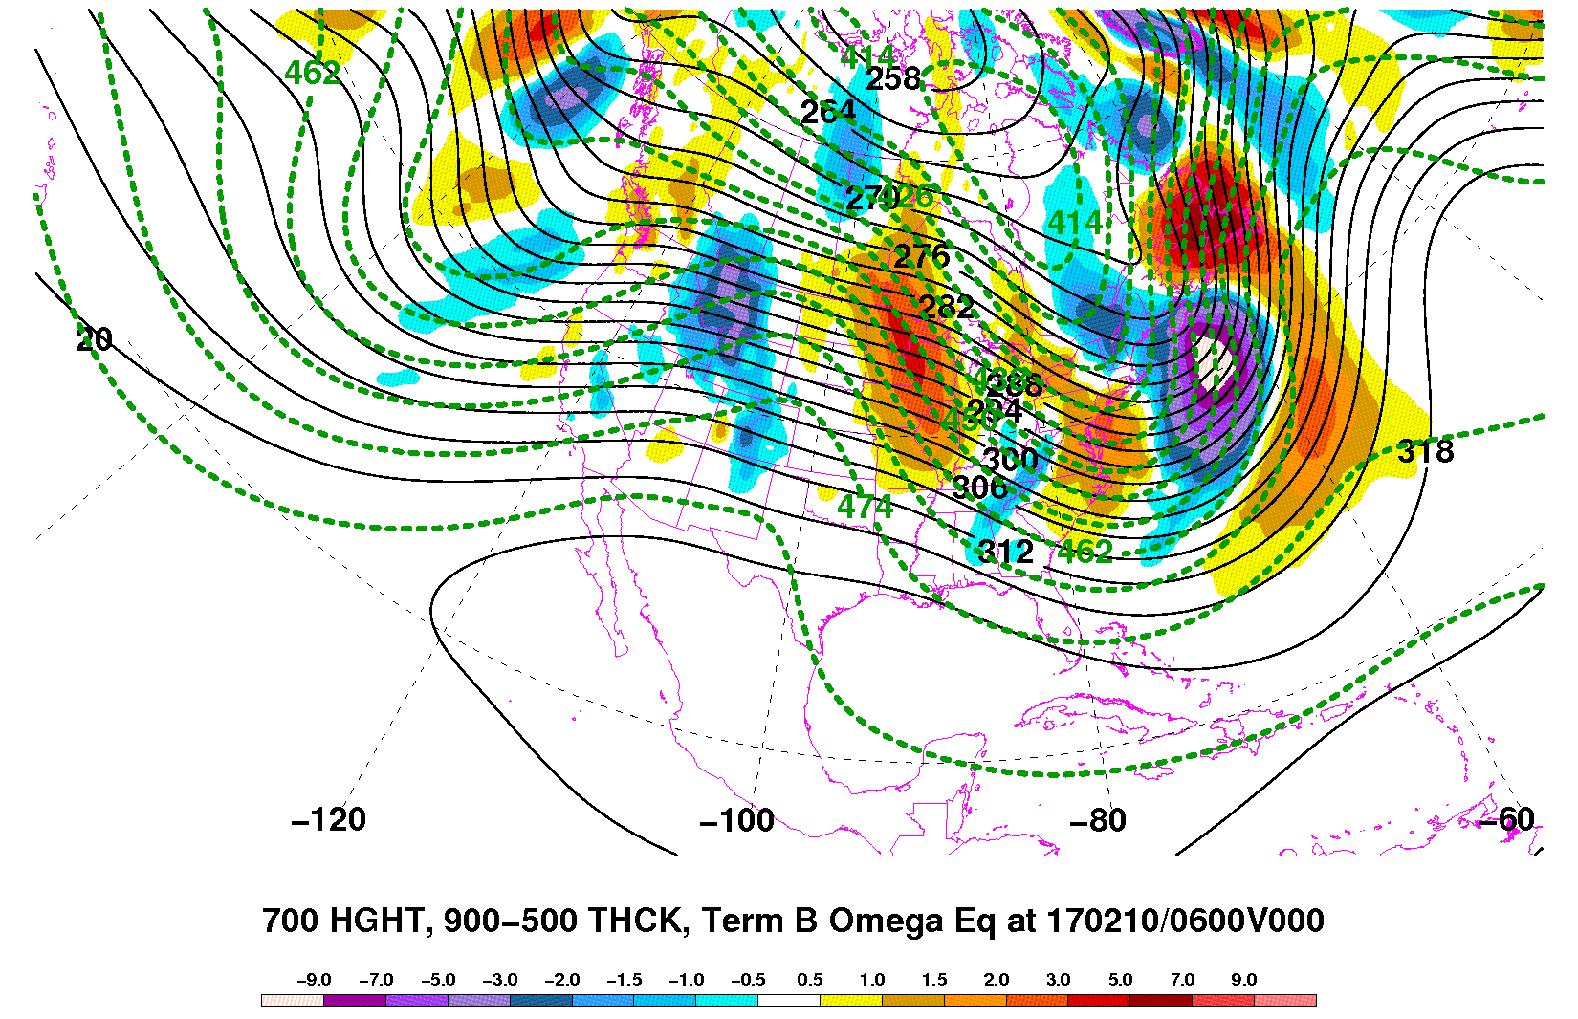
Q-G Omega Temperature Advection Term
(Note 6 h early offset from the soundings on the previous slides.)
forcing for descent
forcing for ascent
Image from http://www.atmo.arizona.edu/~tgalarneau/realtime/diagnostics.html

Slide 6
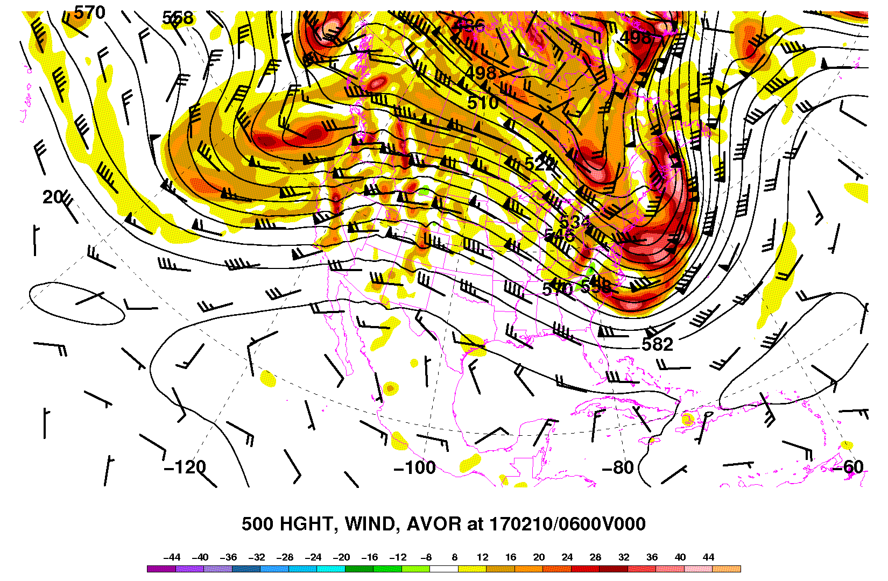
Q-G Height Tendency Example
0600 UTC 10 Feb 2017
Weak to possibly negative (anticyclonic) absolute vorticity advection.
Implies: forcing for height rises at 500 hPa.
500 hPa height (contours, dam), wind (barbs; kt), absolute vorticity (shaded, x10⁻⁵ s⁻¹)
Image from http://www.atmo.arizona.edu/~tgalarneau/realtime/diagnostics.html

Slide 7
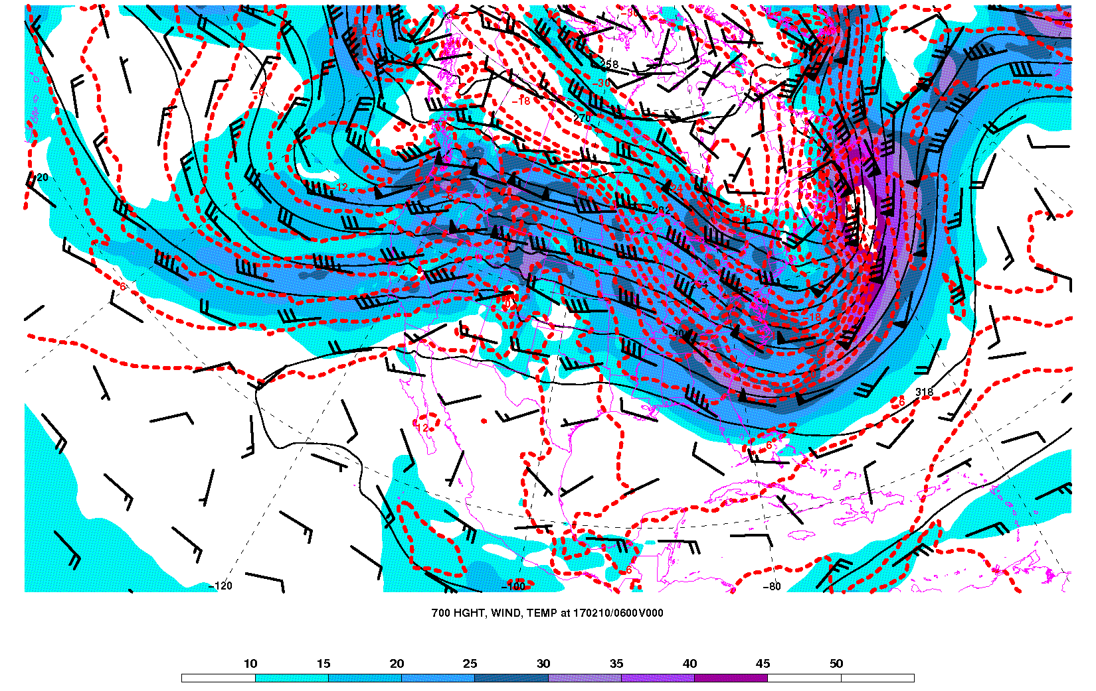
Q-G Height Tendency Example
0600 UTC 10 Feb 2017
Moderately strong warm air advection at 700 hPa.
700 hPa height (contours, dam), wind (barbs and shaded; kt), temperature (red contours, °C)
Image from http://www.atmo.arizona.edu/~tgalarneau/realtime/diagnostics.html

Slide 8
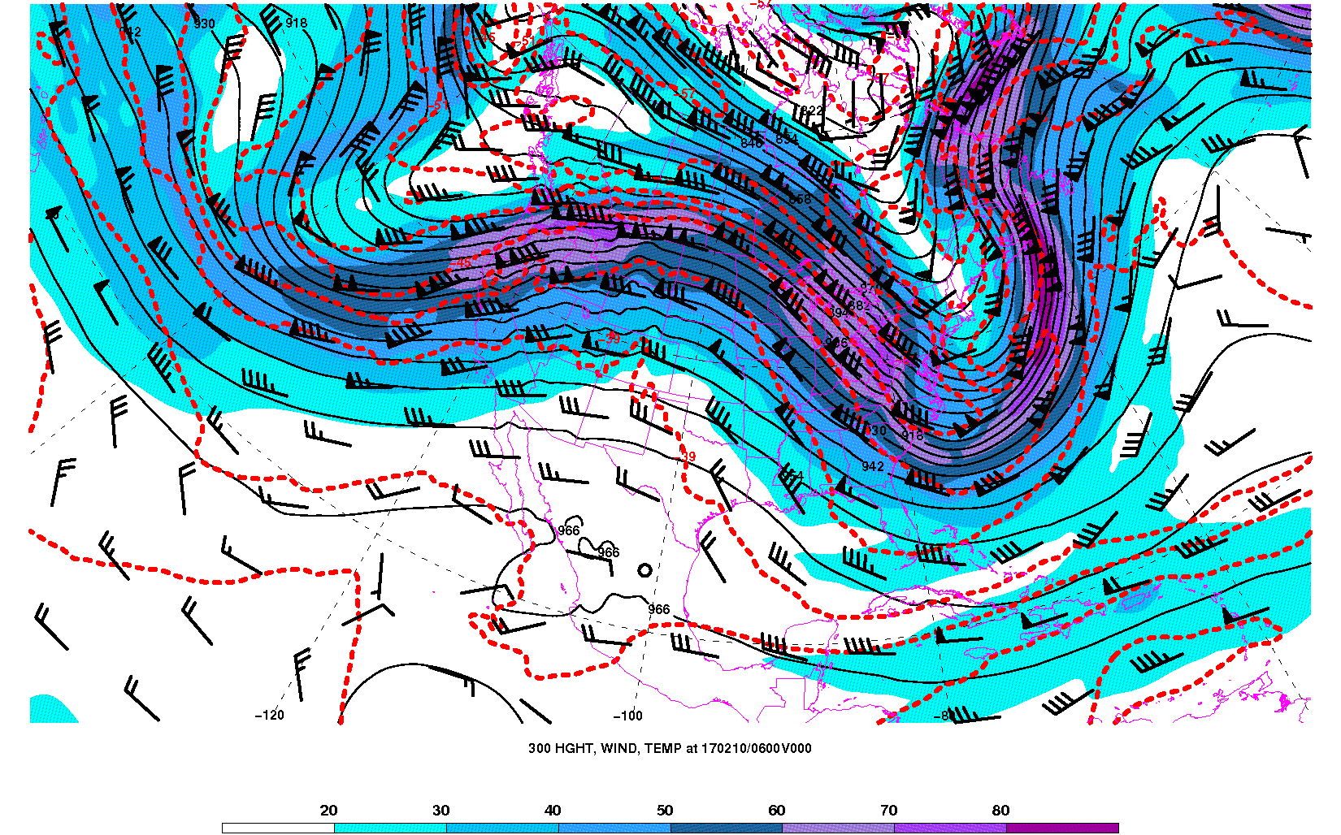
Q-G Height Tendency Example
0600 UTC 10 Feb 2017
Neutral temperature advection at 300 hPa.
Implies: warm air advection decreasing with height…
…or forcing for height rises at 500 hPa.
700 hPa height (contours, dam), wind (barbs and shaded; kt), temperature (red contours, °C)
Image from http://www.atmo.arizona.edu/~tgalarneau/realtime/diagnostics.html

Slide 9
Q-G Omega Example
0600 UTC 10 Feb 2017
Moderately strong warm air advection at 700 hPa.
Implies: forcing for ascent at 700 hPa.
700 hPa height (contours, dam), wind (barbs and shaded; kt), temperature (red contours, °C)
Image from http://www.atmo.arizona.edu/~tgalarneau/realtime/diagnostics.html

Slide 10
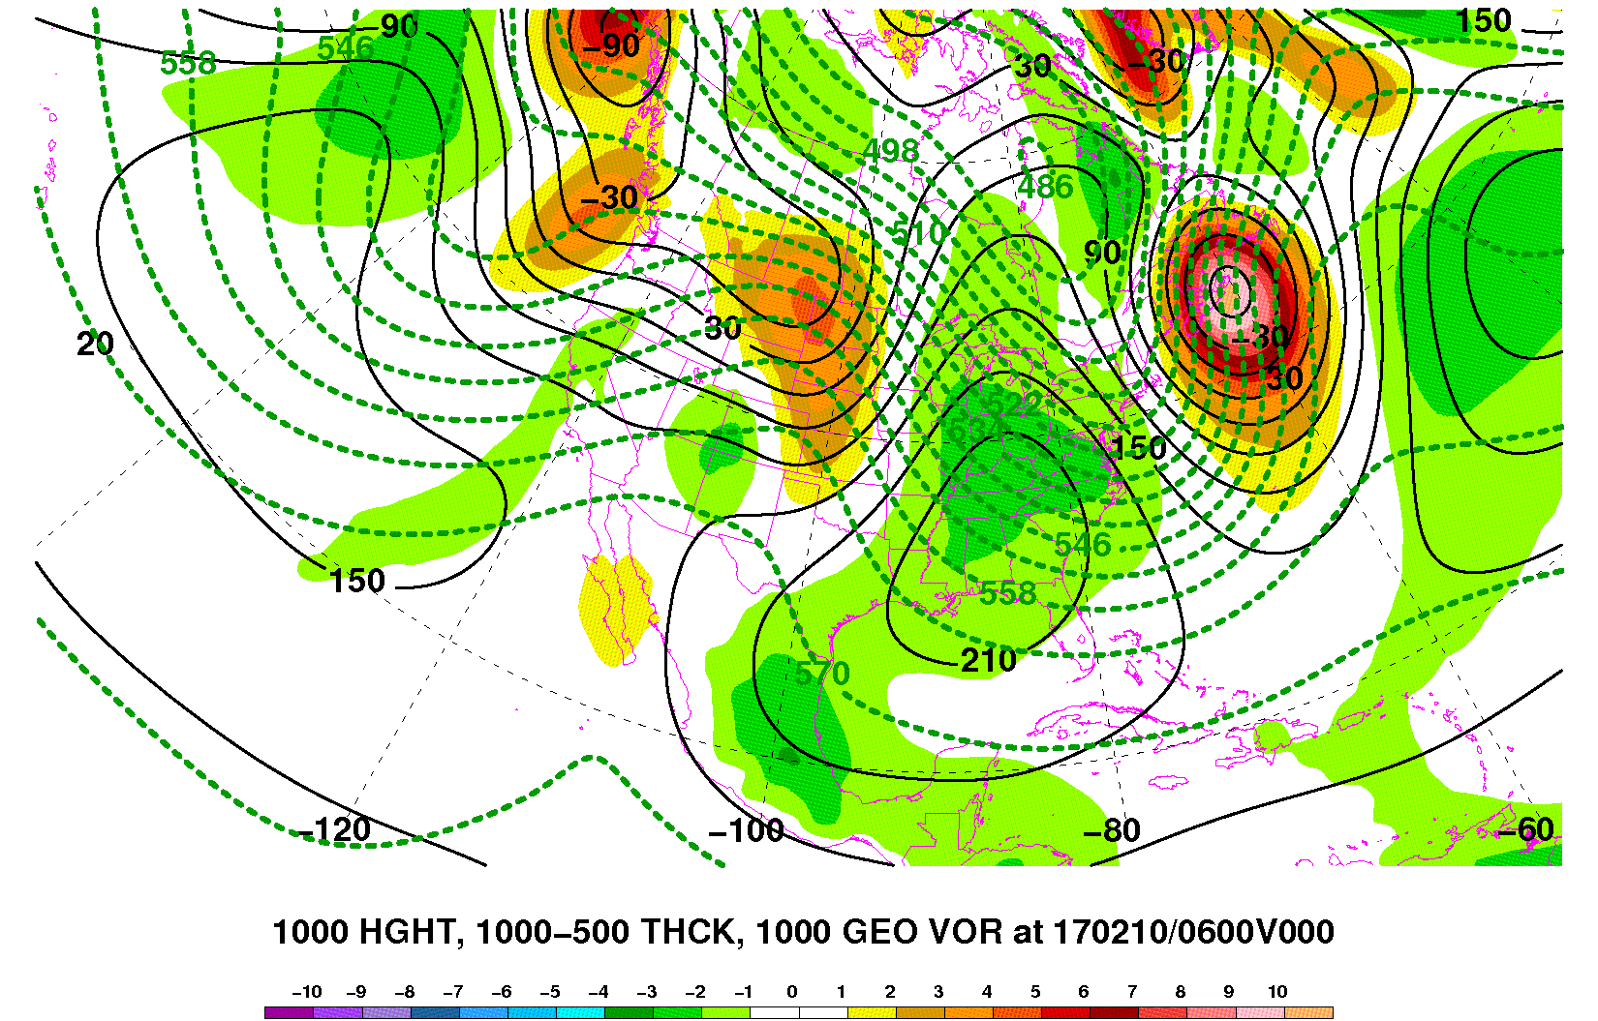
Q-G Omega Example
0600 UTC 10 Feb 2017
Weak positive (cyclonic) absolute vorticity advection.
1000 hPa height (contours, m), 1000-500 hPa thickness (dashed green contours, dam), absolute vorticity (shaded, x10⁻⁵ s⁻¹)
Image from http://www.atmo.arizona.edu/~tgalarneau/realtime/diagnostics.html

Slide 11
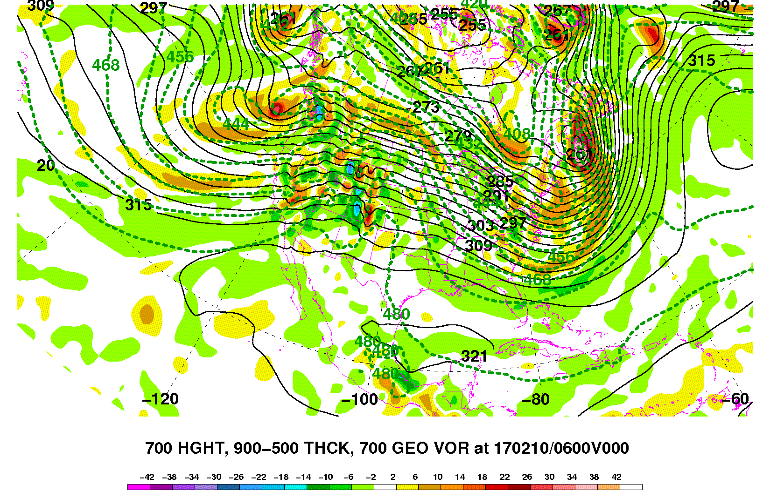
Q-G Omega Example
0600 UTC 10 Feb 2017
Near-zero absolute vorticity advection.
Implies: cyclonic absolute vorticity advection that decreases with height…
…or forcing for descent at ~700 hPa.
700 hPa height (contours, dam), 900-500 hPa thickness (dashed green contours, dam), relative vorticity (shaded, x10⁻⁵ s⁻¹)
Image from http://www.atmo.arizona.edu/~tgalarneau/realtime/diagnostics.html

Slide 12
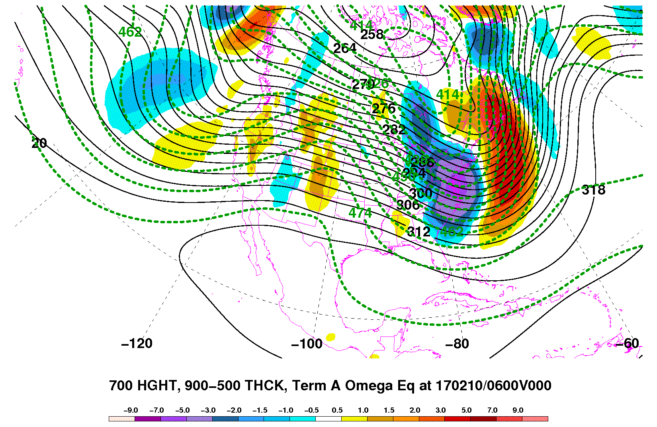
Q-G Omega Example
0600 UTC 10 Feb 2017
Differential vorticity advection forcing term is near-zero in this example.
700 hPa height (contours, dam), 900-500 hPa thickness (dashed green contours, dam), vorticity advection term (shaded)
forcing for descent
forcing for ascent
Image from http://www.atmo.arizona.edu/~tgalarneau/realtime/diagnostics.html

Slide 13
Q-G Omega Example
0600 UTC 10 Feb 2017
Temperature advection forcing term is strongly positive.
Implies: forcing for ascent.
700 hPa height (contours, dam), 900-500 hPa thickness (dashed green contours, dam), temperature advection term (shaded)
forcing for descent
forcing for ascent
Image from http://www.atmo.arizona.edu/~tgalarneau/realtime/diagnostics.html

Slide 14
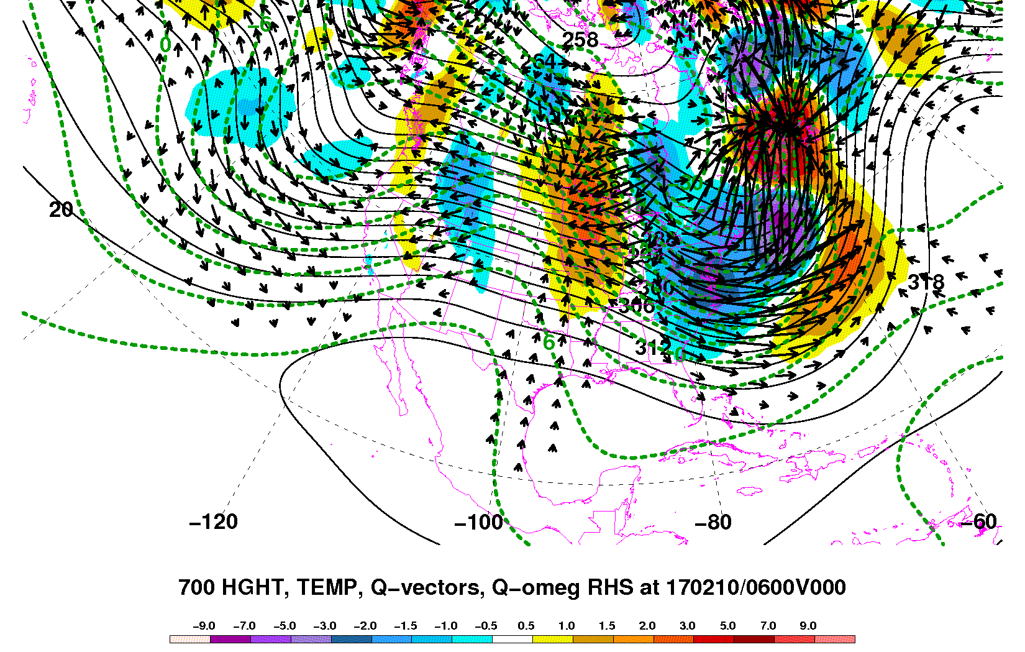
Q-Vector Example
0600 UTC 10 Feb 2017
Q-vector convergence implies forcing for ascent.
Added bonus: Q-vectors point along and in the same direction as temperature gradient, implying (warm) frontogenesis.
700 hPa height (contours, dam), temperature (dashed green contours, °C), Q-vector convergence (shaded)
forcing for descent
forcing for ascent
Image from http://www.atmo.arizona.edu/~tgalarneau/realtime/diagnostics.html

Slide 15
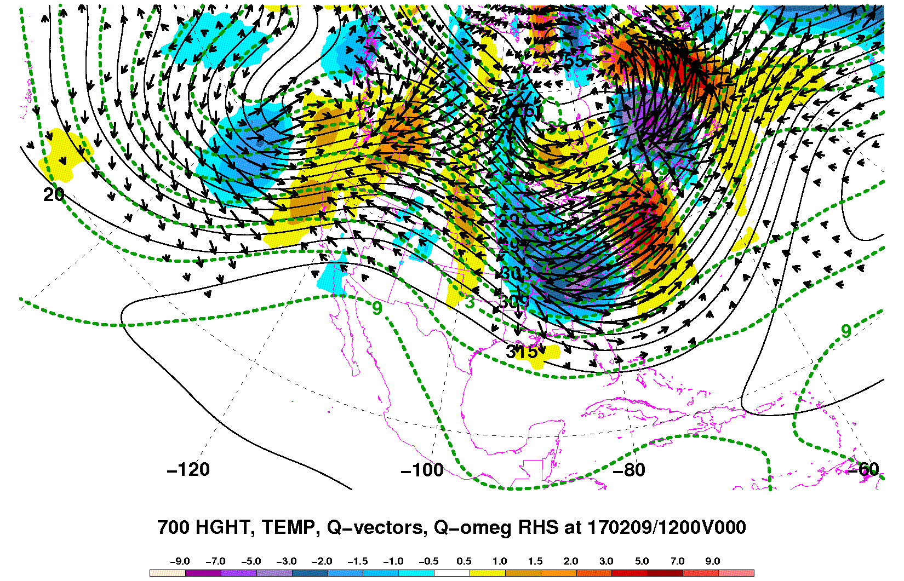
Q-Vector Example
1200 UTC 9 Feb 2017
Strong Q-vector convergence
-plus-
frontogenesis
This event was responsible 3-4”/hr snowfall rates with a mesoscale band of snow rooted ~850-700 hPa.
700 hPa height (contours, dam), temperature (dashed green contours, °C), Q-vector convergence (shaded)
forcing for descent
forcing for ascent
Image from http://www.atmo.arizona.edu/~tgalarneau/realtime/diagnostics.html

Slide 16
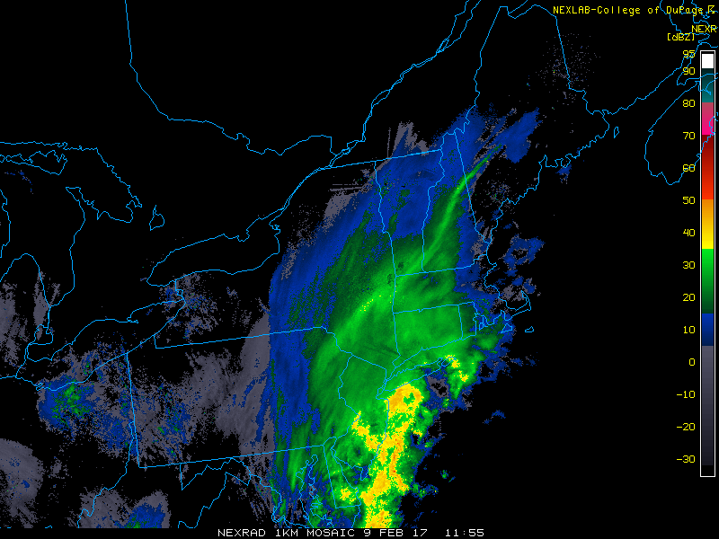
Q-Vector Example: Corresponding Radar
Image from College of DuPage via http://www2.mmm.ucar.edu/imagearchive/

