Slide 1
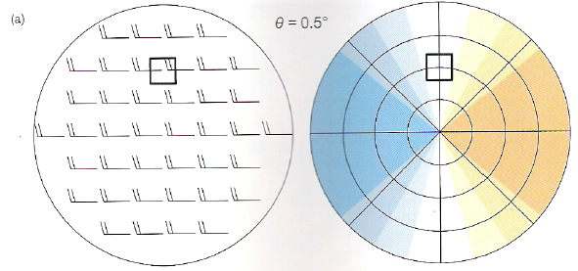
Vertically-Uniform Westerly Winds
Wind entirely perpendicular to beam
Wind entirely along-beam

Slide 2
Analytic Evaluation
If the horizontal wind components u and v are known, and vertical velocity is negligible, then the radial velocity v_{R} is given by:
projects the horizontal wind onto a sloping elevation angle (since v_{R} is along the slope, not a 2-D surface like u and v)
ϕ

Slide 3
Analytic Evaluation
If the horizontal wind components u and v are known, and vertical velocity is negligible, then the radial velocity v_{R} is given by:
project u and v onto the radial given by the chosen azimuthal angle θ
horizontal wind direction = azimuth angle: v_{R} ~ wind speed (slightly smaller due to tilt angle)
horizontal wind direction azimuth angle: v_{R} = 0

Slide 4
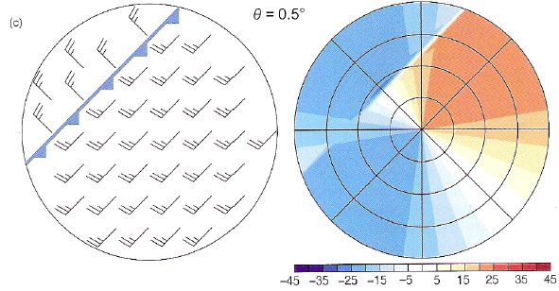
Cold Front – Wind Discontinuity
Similar to previous slide, except rotated with wind and with discontinuity

Slide 5
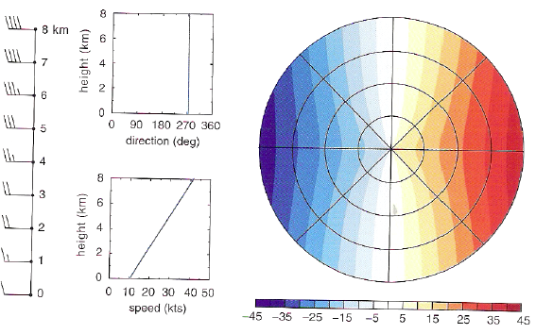
Westerly Shear
As radar beam becomes elevated with height, inferred velocity increases

Slide 6
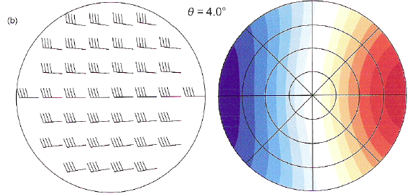
Westerly Shear with Confluence
Inferred inbound velocities skew to right of N-S radial

Slide 7
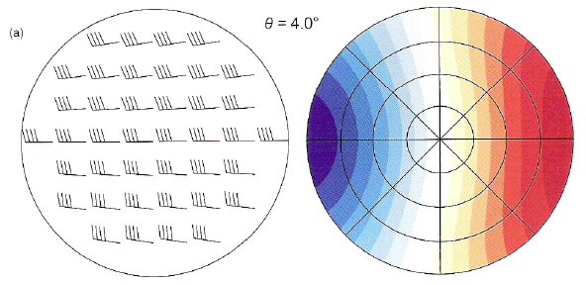
Westerly Shear with Diffluence
Inferred outbound velocities skew to left of N-S radial

Slide 8
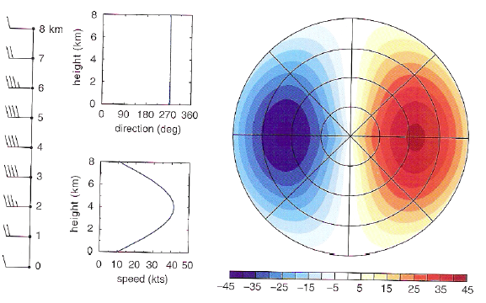
Westerly Elevated Jet
As radar beam becomes elevated with height, inferred velocity increases to jet level, then decreases

Slide 9
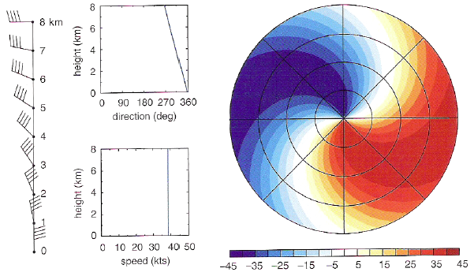
Backing Winds with Height
Note backing of winds through progressively distant range ring locations

Slide 10
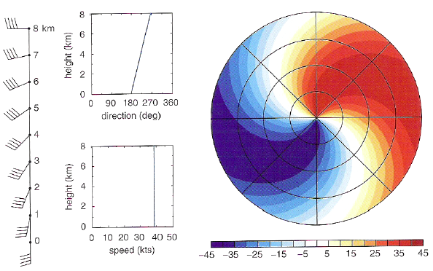
Veering Winds with Height
Note veering of winds through progressively distant range ring locations

Slide 11
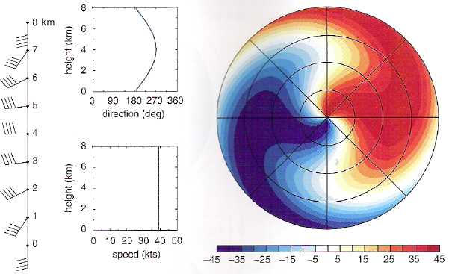
Veering and Backing Winds with Height
Any volunteers wish to take this one on?

Slide 12
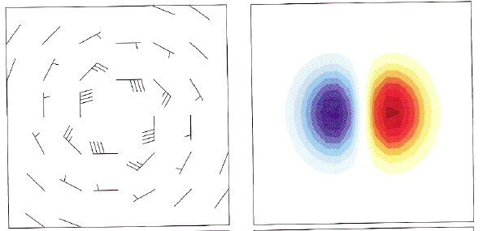
Pure Rotation
The radar location is indicated for each panel by the black star.

Slide 13
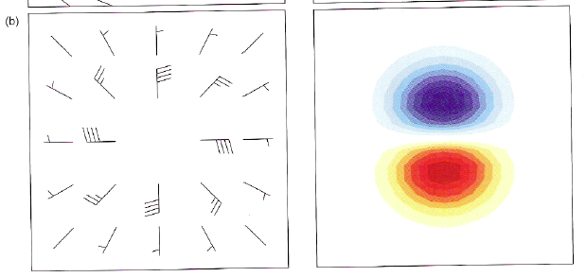
Pure Convergence
The radar location is indicated for each panel by the black star.

Slide 14
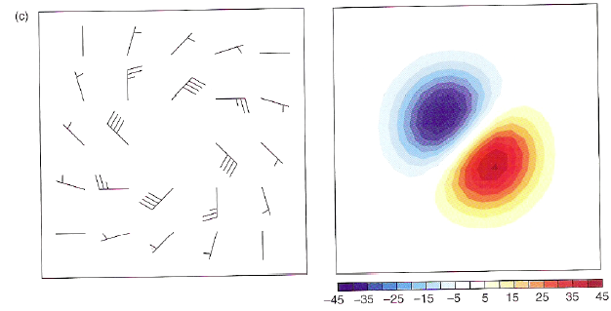
Rotation + Convergence
The radar location is indicated for each panel by the black star.

