Slide 1
El Niño Southern Oscillation

Slide 2
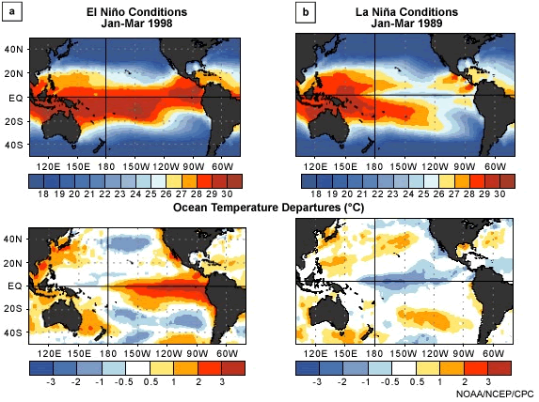
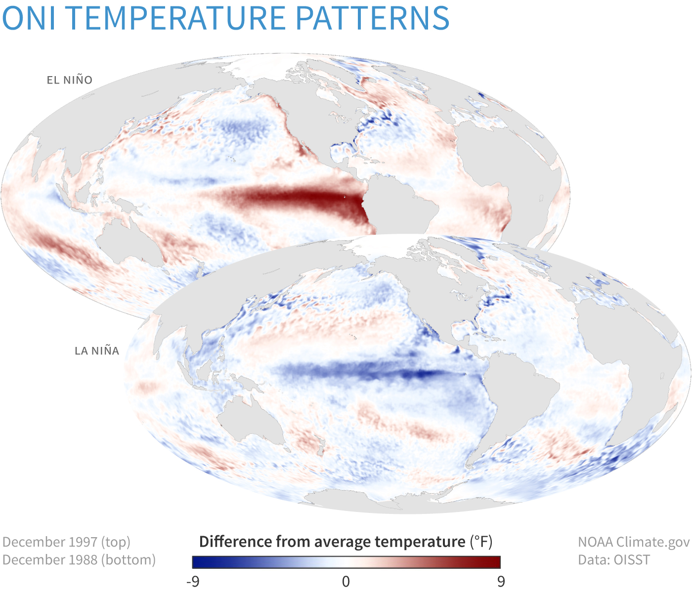
El Niño vs. La Niña Sea-Surface Temperatures
(Left: Figure obtained from Ch. 4 of An Introduction to Tropical Meteorology, 2nd Edition. © 2016, COMET.)
(Right: Figure obtained from https://www.climate.gov/news-features/understanding-climate/climate-variability-oceanic-ni%C3%B1o-index.)

Slide 3
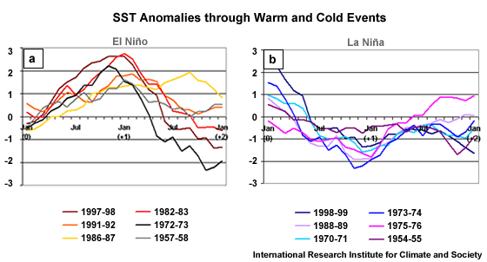
El Niño vs. La Niña SST Evolution
(Figure obtained from Ch. 4 of An Introduction to Tropical Meteorology, 2nd Edition. © 2016, COMET.)

Slide 4
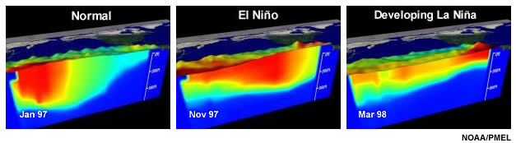
El Niño vs. La Niña Subsurface Temperatures
Warm west, cold east
Warm everywhere, but particularly in the central Pacific Ocean
Warming erodes everywhere in response to upwelling
(Figure obtained from Ch. 4 of An Introduction to Tropical Meteorology, 2nd Edition. © 2016, COMET.)

Slide 5
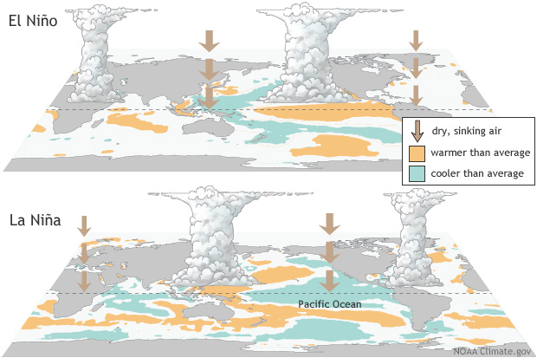
Walker Circulation: El Niño vs. La Niña
(Figure obtained from https://www.climate.gov/news-features/understanding-climate/el-ni%C3%B1o-and-la-ni%C3%B1a-frequently-asked-questions.)

Slide 6
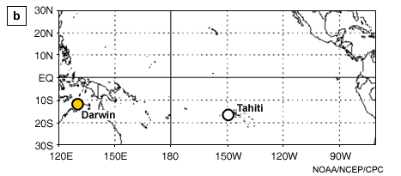
Southern Oscillation Index
p_{diff} = p(Tahiti) – p(Darwin)
(Figure obtained from Ch. 4 of An Introduction to Tropical Meteorology, 2nd Edition. © 2016, COMET.)

Slide 7
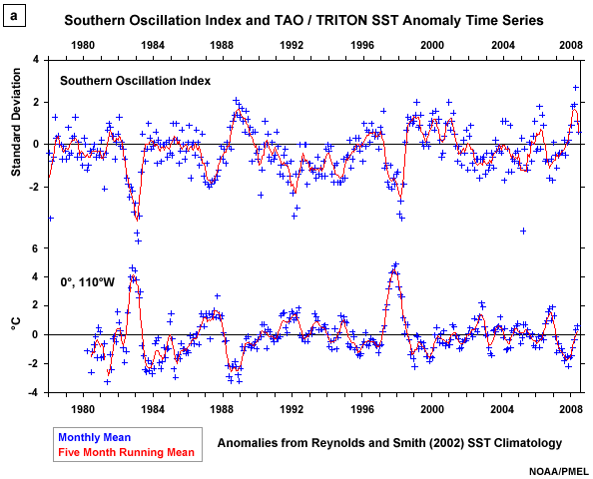
Southern Oscillation Index
El Niño: Warmer at Tahiti -> Lower SLP -> Negative SOI
La Niña: Cooler at Tahiti -> Higher SLP -> Positive SOI
(Figure obtained from Ch. 4 of An Introduction to Tropical Meteorology, 2nd Edition. © 2016, COMET.)

Slide 8
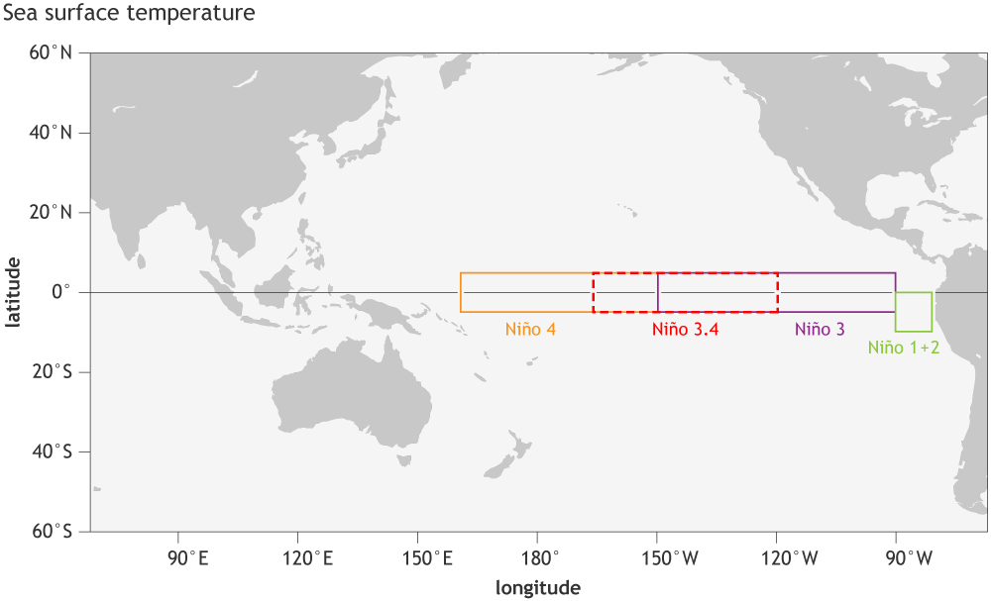
ENSO Monitoring Regions
(Figure obtained from https://www.climate.gov/news-features/understanding-climate/climate-variability-oceanic-ni%C3%B1o-index.)

Slide 9
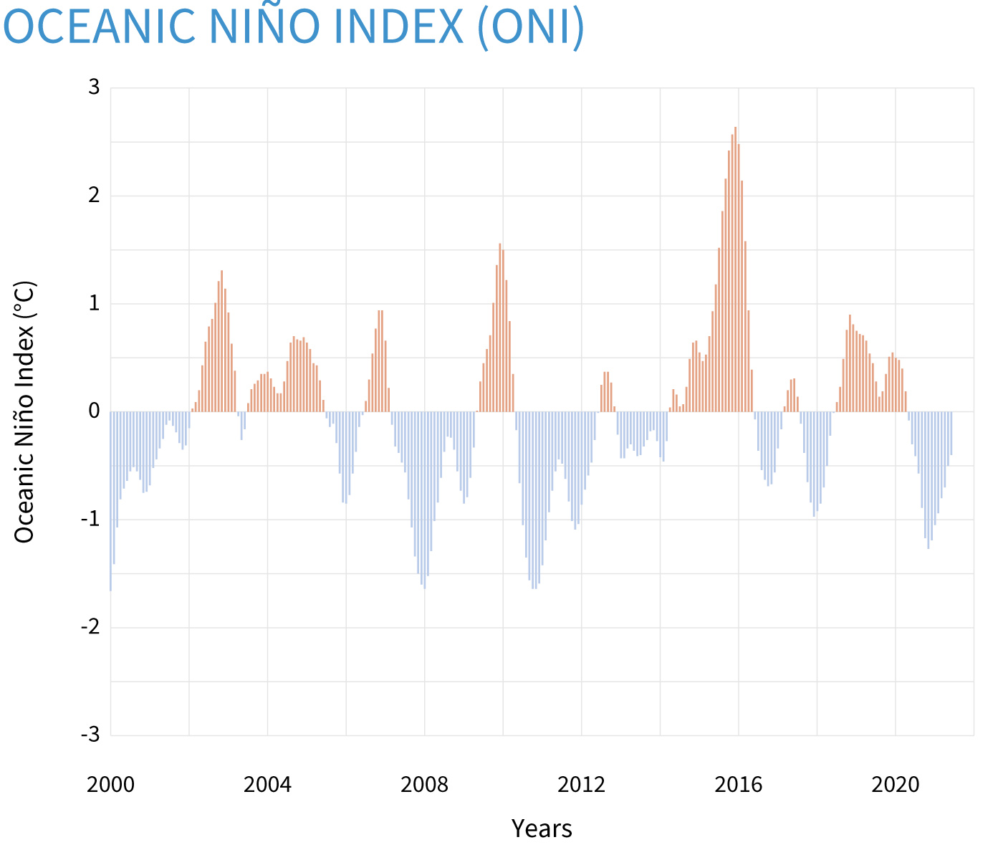
Oceanic Niño Index
(Figure obtained from https://www.climate.gov/news-features/understanding-climate/climate-variability-oceanic-ni%C3%B1o-index.)

Slide 10
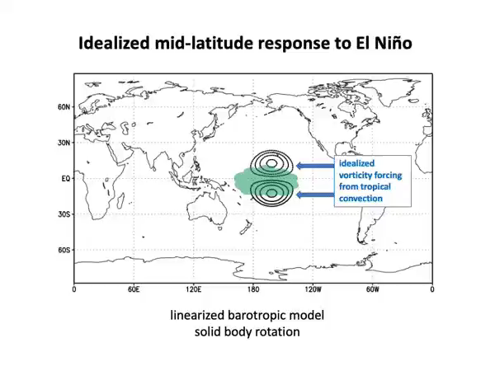
Atmospheric Response to El Niño
(Video obtained from Prof. Mathew Barlow, Univ. of Massachusetts-Lowell.)

Slide 11
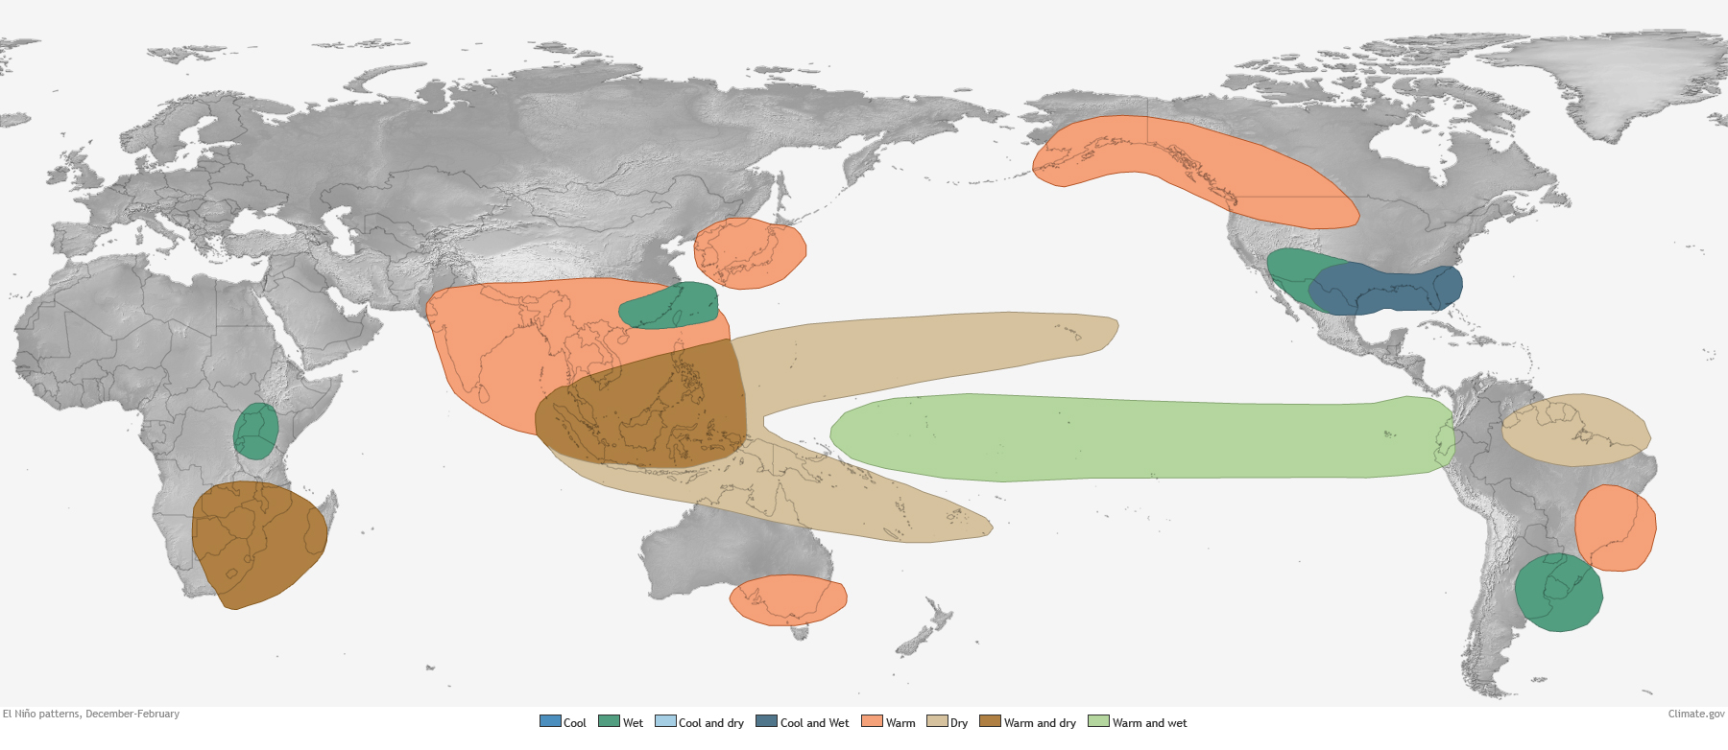
NH Winter Impacts of El Niño
(Figure obtained from https://www.climate.gov/news-features/featured-images/global-impacts-el-ni%C3%B1o-and-la-ni%C3%B1a.)

Slide 12
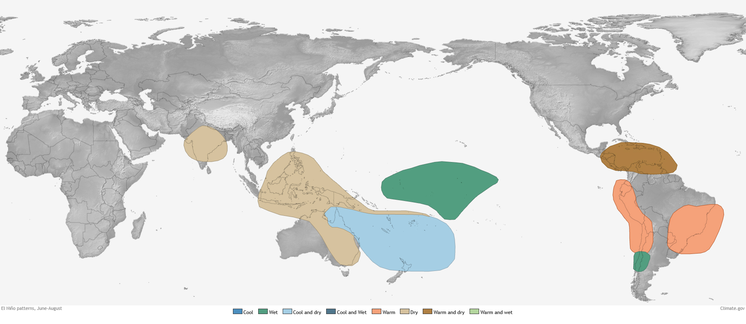
NH Summer Impacts of El Niño
(Figure obtained from https://www.climate.gov/news-features/featured-images/global-impacts-el-ni%C3%B1o-and-la-ni%C3%B1a.)

Slide 13
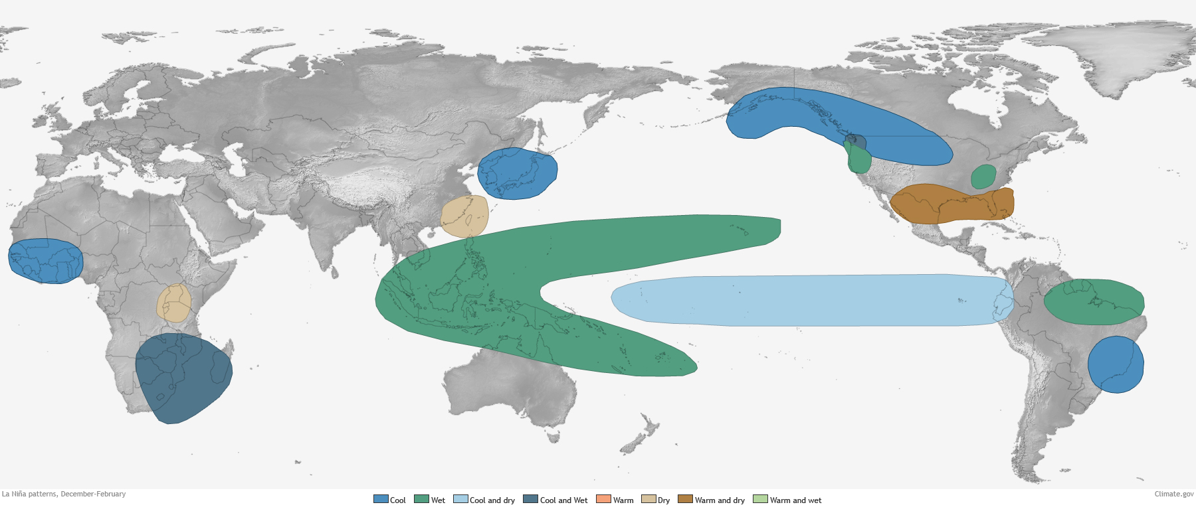
NH Winter Impacts of La Niña
(Figure obtained from https://www.climate.gov/news-features/featured-images/global-impacts-el-ni%C3%B1o-and-la-ni%C3%B1a.)

Slide 14
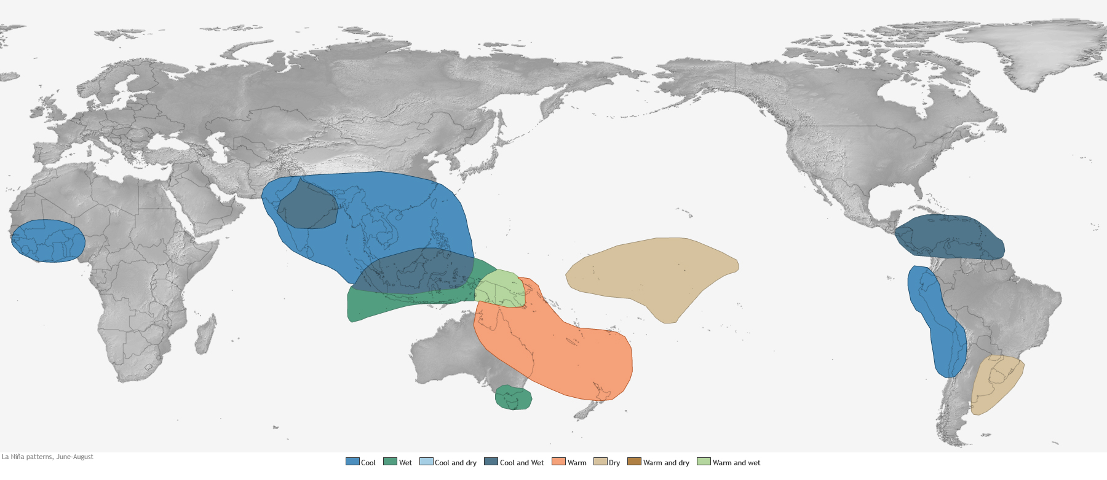
NH Summer Impacts of La Niña
(Figure obtained from https://www.climate.gov/news-features/featured-images/global-impacts-el-ni%C3%B1o-and-la-ni%C3%B1a.)

Slide 15
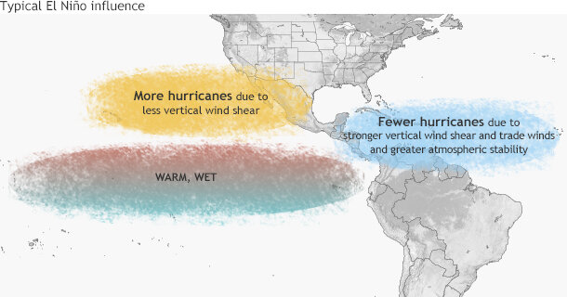
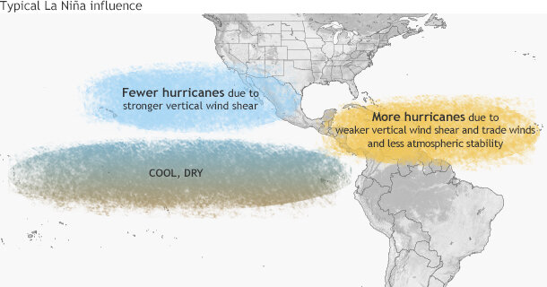
ENSO and W. Hemisphere Tropical Cyclones
(Figure obtained from https://www.climate.gov/news-features/blogs/enso/impacts-el-ni%C3%B1o-and-la-ni%C3%B1a-hurricane-season.)

Slide 16
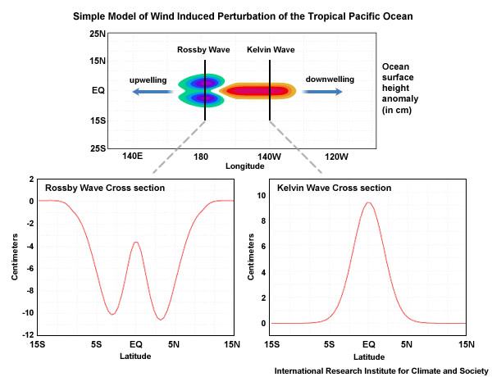
Delayed Oscillator Theory
(Figure obtained from Ch. 4 of An Introduction to Tropical Meteorology, 2nd Edition. © 2016, COMET.)

Slide 17
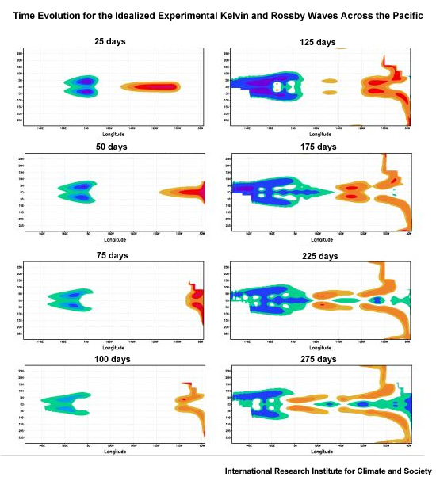
Delayed Oscillator Theory
Upwelling (cyclonic) oceanic ERW propagates west, downwelling (anticyclonic) oceanic KW propagates east.
Together, these result in an El Niño ocean state.
The oceanic waves reflect off of the western/eastern coastlines:
Upwelling oceanic ERW as an upwelling oceanic KW.
Downwelling oceanic KW as a downwelling oceanic ERW.
Together, these reverse the El Niño ocean state.
(Figure obtained from Ch. 4 of An Introduction to Tropical Meteorology, 2nd Edition. © 2016, COMET.)

Slide 18
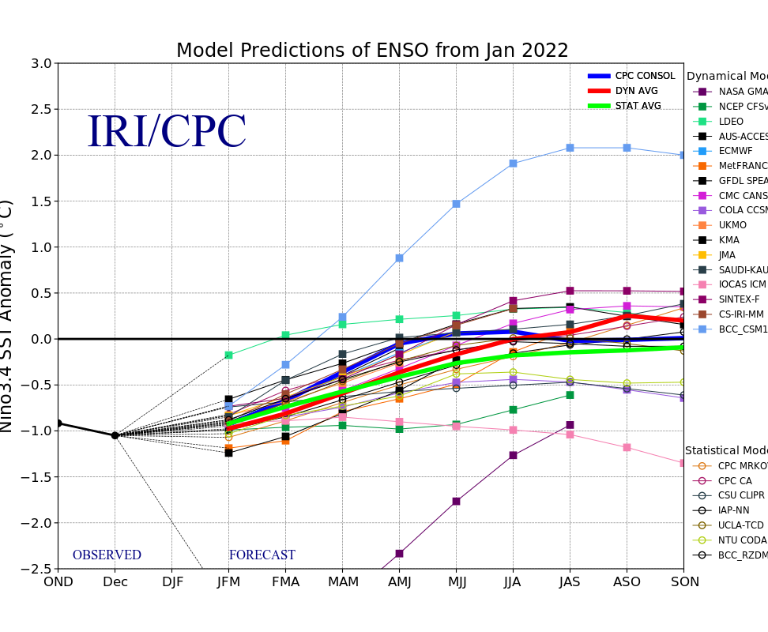
ENSO Forecasts
(Figure obtained from https://iri.columbia.edu/our-expertise/climate/forecasts/enso/current/.)

