Slide 1
Equatorial Waves

Slide 2
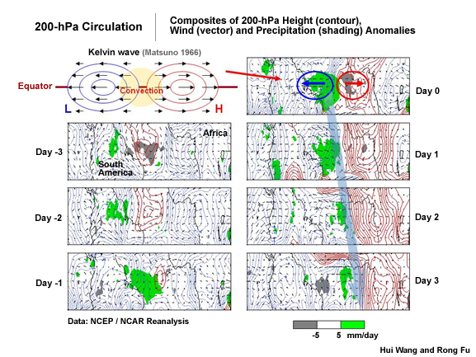
Kelvin Waves
(Figure obtained from Introduction to Tropical Meteorology, 2nd Edition, © 2016 COMET.)

Slide 3
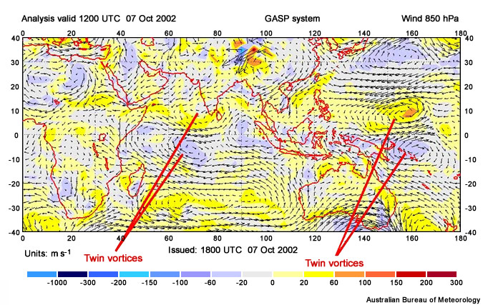
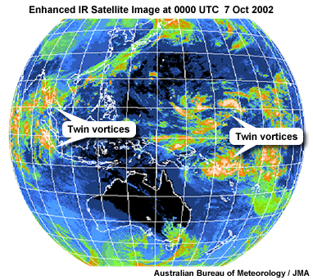
Equatorial Rossby Waves
(Figures obtained from Introduction to Tropical Meteorology, 2nd Edition, © 2016 COMET.)

Slide 4
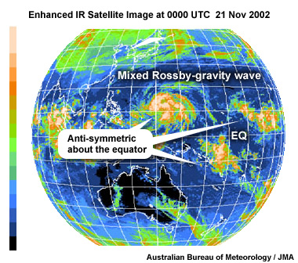
Mixed Rossby-Gravity Waves
(Figure obtained from Introduction to Tropical Meteorology, 2nd Edition, © 2016 COMET.)

Slide 5
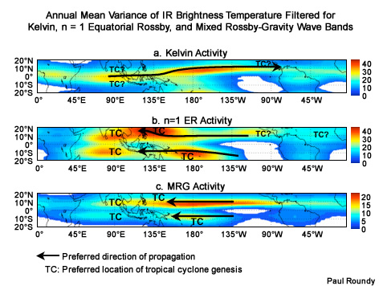
Preferred Equatorial Wave Paths
(Figure obtained from Introduction to Tropical Meteorology, 2nd Edition, © 2016 COMET.)

Slide 6
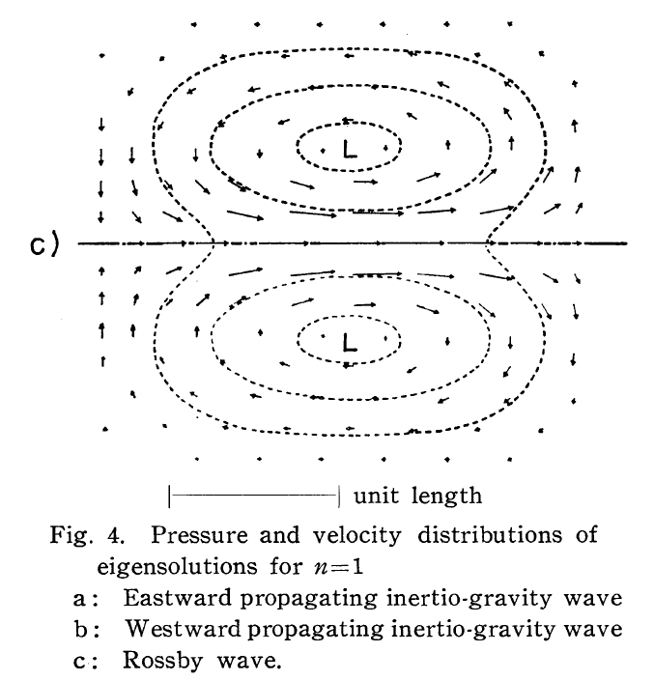
Equatorial Rossby Wave Solution
Winds maximized near equator and decay rapidly N/S from there
Location of maximized convergence
(Figure obtained from Matsuno (1966), their Figure 4c. © 1966, J. Meteor. Soc. Japan.)

Slide 7
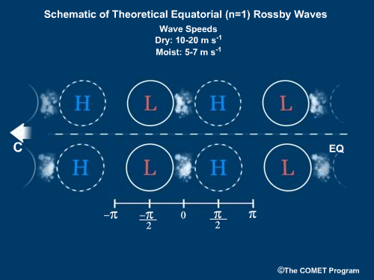
Equatorial Rossby Wave Solution
Diabatic generation of cyclonic PV rearward of lower pressures acts as a brake on wave propagation
(Figure obtained from Introduction to Tropical Meteorology, 2nd Edition, © 2016 COMET.)

Slide 8
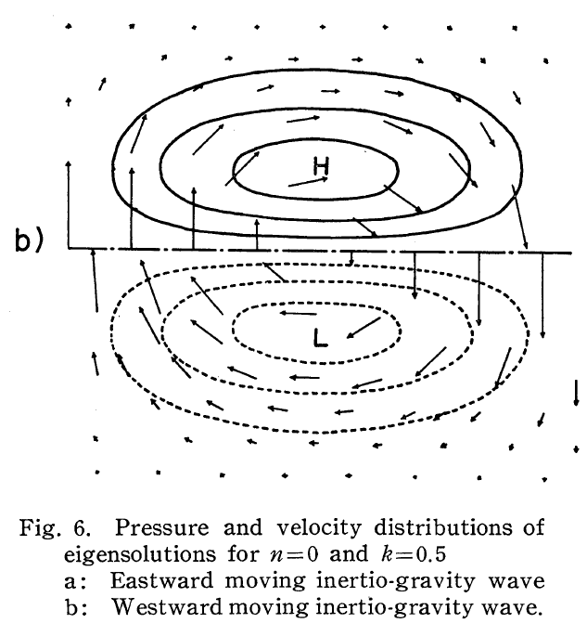
Mixed Rossby-Gravity Wave Solution
Winds maximized near equator and decay rapidly N/S from there
Locations of maximized speed convergence
(Figure obtained from Matsuno (1966), their Figure 6b. © 1966, J. Meteor. Soc. Japan.)

Slide 9
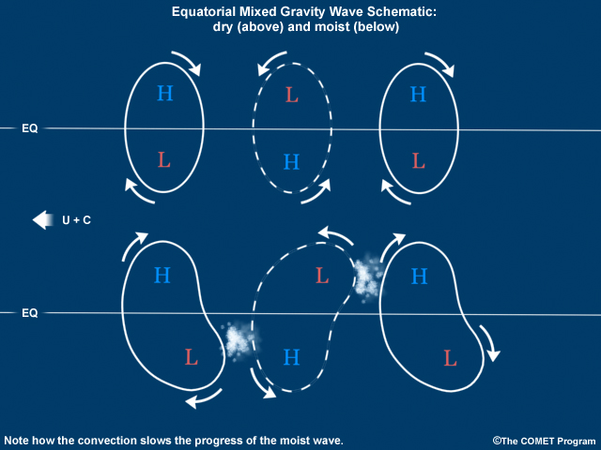
Mixed Rossby-Gravity Wave Solution
Diabatic generation of cyclonic PV rearward of lower pressures acts as a brake on wave propagation
(Figure obtained from Introduction to Tropical Meteorology, 2nd Edition, © 2016 COMET.)

Slide 10
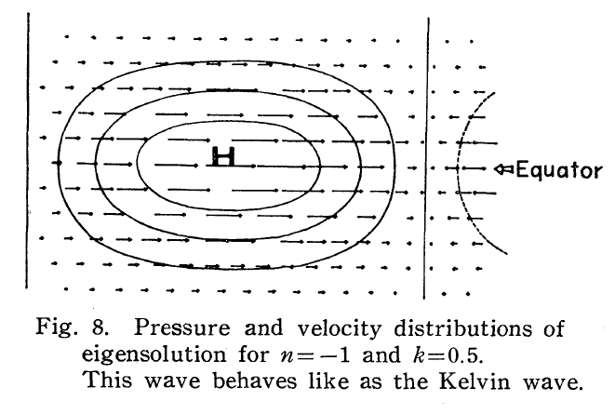
Kelvin Wave Solution
Cyclonic shear vorticity located to the N/S of equator; along equator: opposite signed pressure field response
Winds maximized near equator and decay rapidly N/S from there.
Winds also maximized at heart of mass (pressure) field anomalies and decay E/W from there.
Location of maximized convergence
(Figure obtained from Matsuno (1966), their Figure 8. © 1966, J. Meteor. Soc. Japan.)

Slide 11
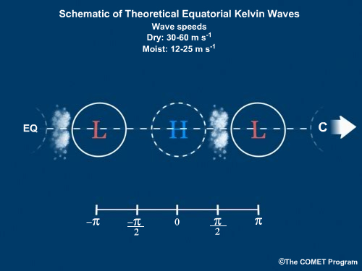
Kelvin Wave Solution
Diabatic generation of cyclonic PV rearward of lower pressures acts as a brake on wave propagation
(Figure obtained from Introduction to Tropical Meteorology, 2nd Edition, © 2016 COMET.)

Slide 12
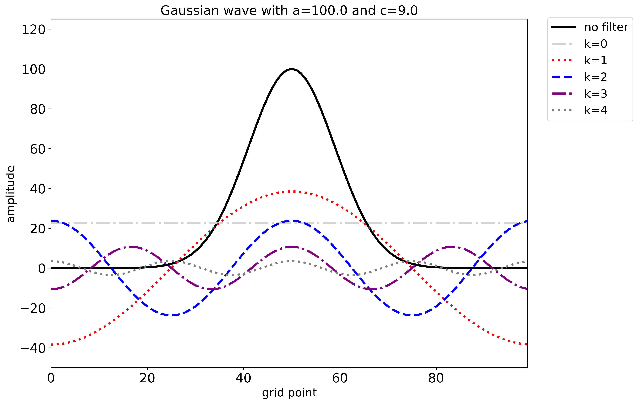
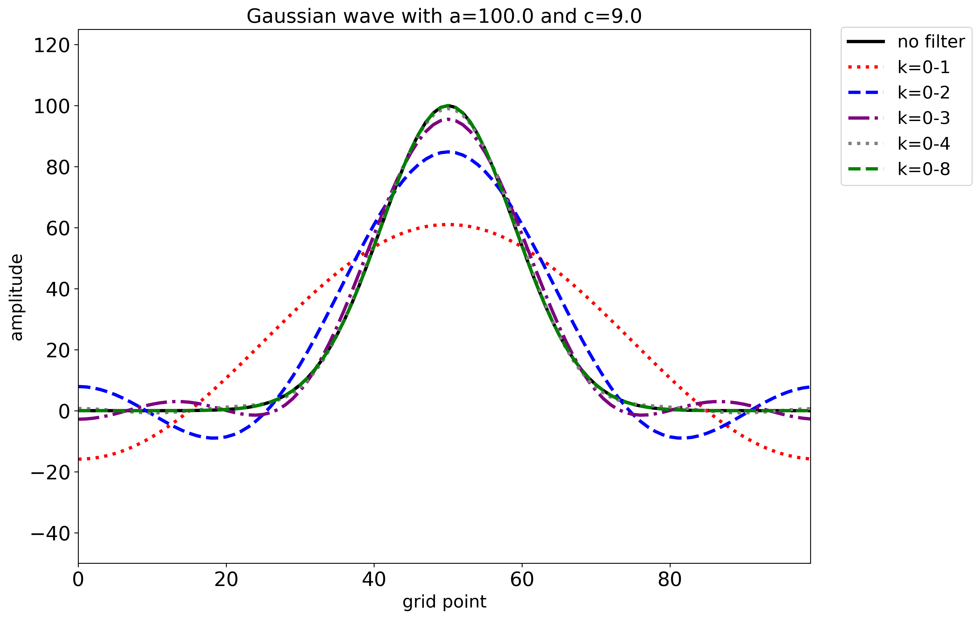
Fourier Transform Examples
The bell curve has an amplitude of 100 and is centered at x=50. Its wavenumber 0-4 components each have different wavelengths (zero to four waves across the domain) and amplitudes (in this case, becoming smaller as wavenumber increases).
Retaining the partial sums of wavenumbers 0-1, 0-2, 0-3, 0-4, and 0-8 shows that the partial sum more closely resembles the bell curve when more wavenumbers are retained. In this example, retaining wavenumbers 0-8 nearly matches the bell curve.

Slide 13
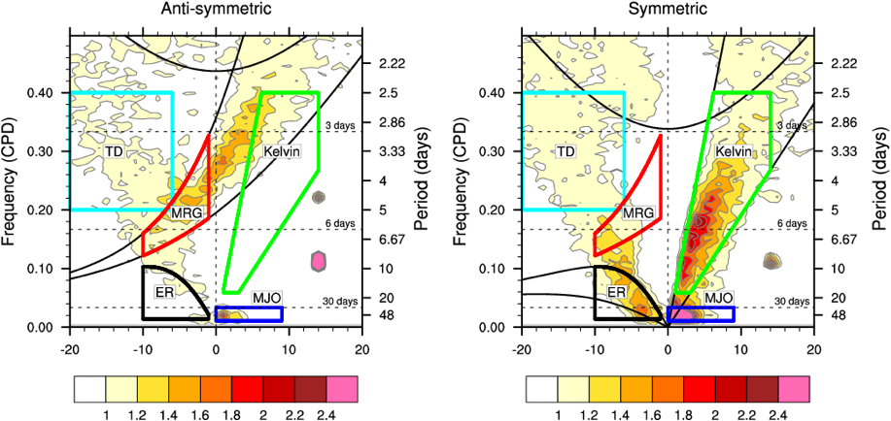
Equatorial Wave Monitoring
Longevity (lower frequency = higher period)
direction of motion
(Figure obtained from https://ncics.org/portfolio/monitor/mjo/.)

Slide 14
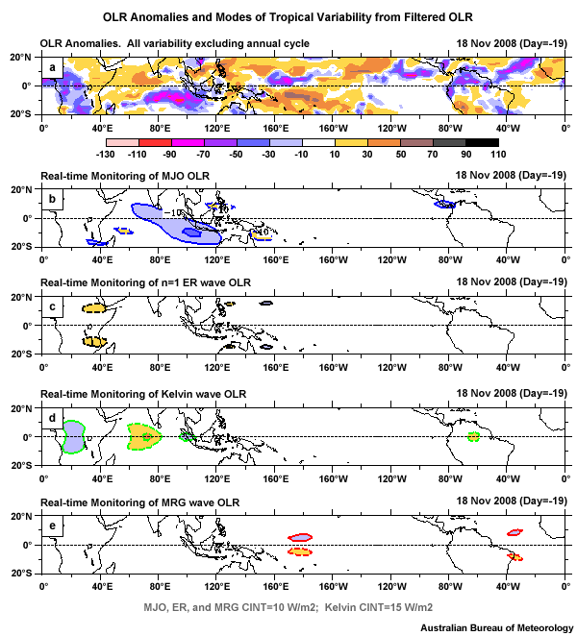
Equatorial Wave Monitoring
Yellow: suppressed
convection
Blue: enhanced
convection
Strong, widespread, long-lasting OLR anomalies
Equatorially symmetric OLR anomalies
Local, near-equator OLR anomalies
Equatorially asymmetric OLR anomalies
(Figure obtained from Introduction to Tropical Meteorology, 2nd Edition, © 2016 COMET.)

Slide 15
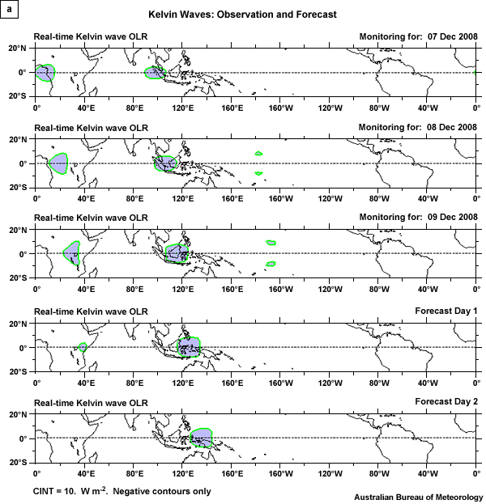
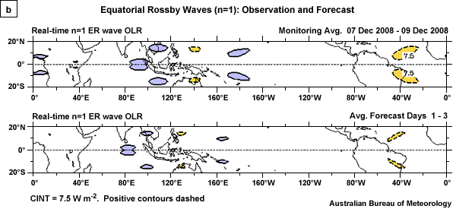
Equatorial Wave Monitoring
(Figure obtained from Introduction to Tropical Meteorology, 2nd Edition, © 2016 COMET.)

Slide 16
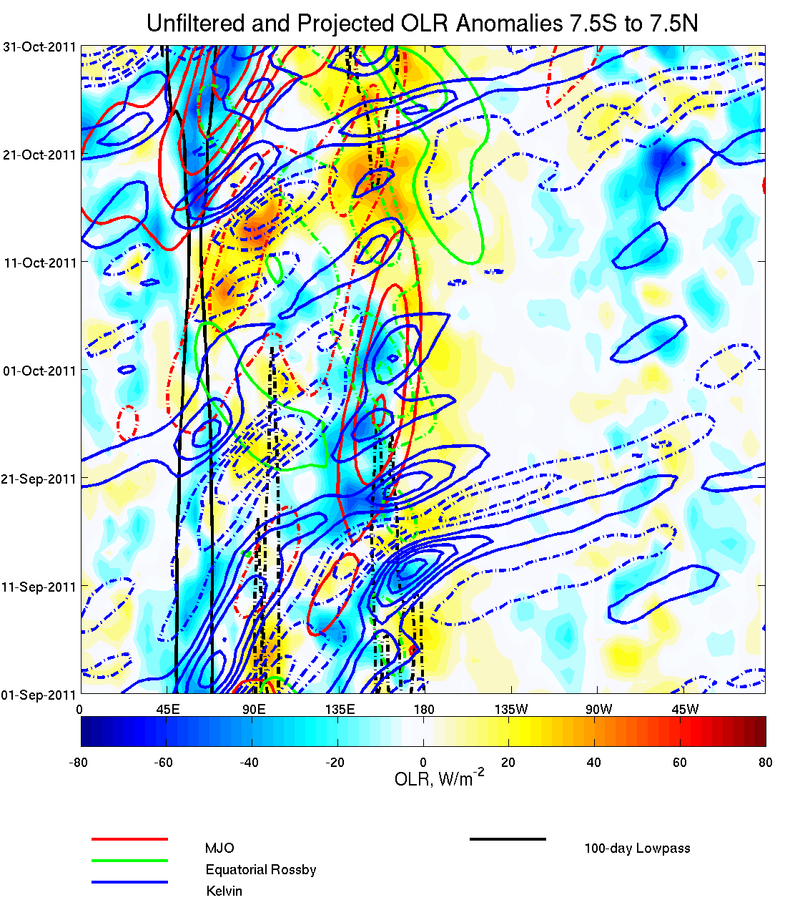
Equatorial Wave Monitoring
(All fields are meridionally averaged)
time
(Figure obtained from http://www.atmos.albany.edu/facstaff/roundy/waves/hovsdet/)

