Slide 1
Hadley Cell

Slide 2
Temperature-Pressure-Thickness
z
H
L
P_{trop}
P_{near-sfc}
L
H
N
WARM
COLD
H
(in the lower troposphere, when coupled with friction)
L
(PGF: high to low, Coriolis: right of motion)

Slide 3
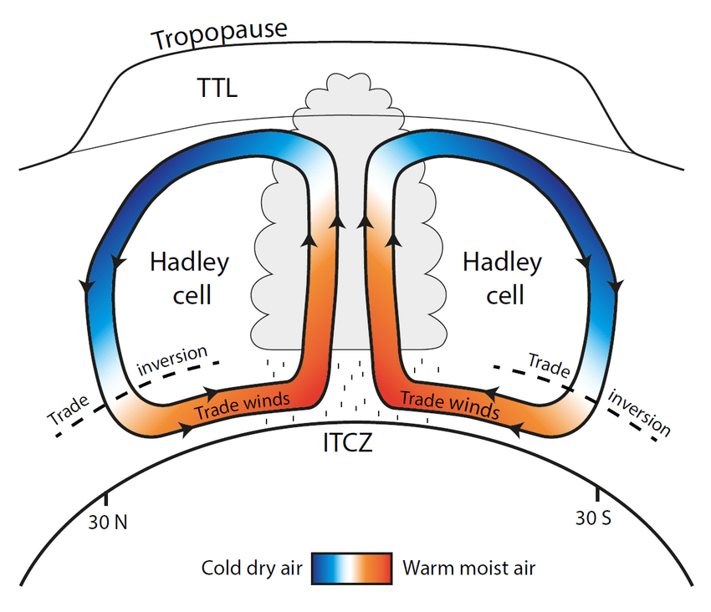
Hadley Cell Circulation
(Figure obtained from Fiehn (2017), Ph.D. Dissertation at Kiel University in Germany.)

Slide 4
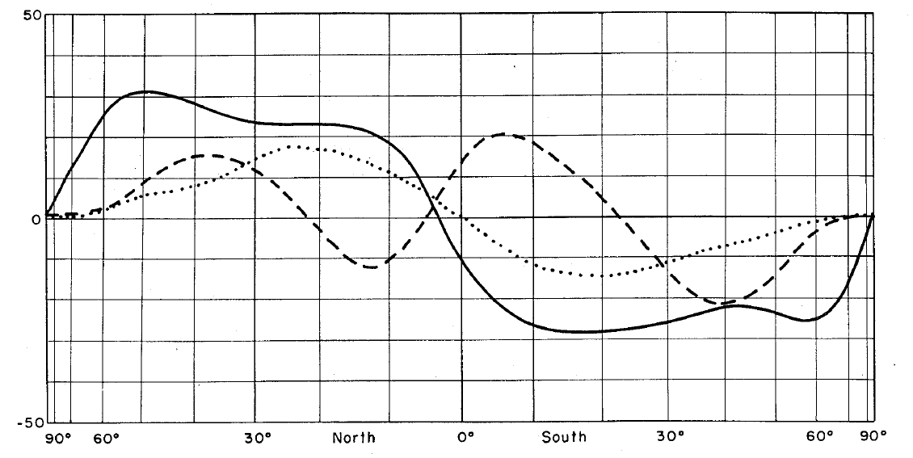
Meridional Heat Transport
total energy transport
sensible heat transport
by the oceans
transport (north = positive, south = negative)
latent heat transport
by the atmosphere
sensible + potential + kinetic energy transport by the atmosphere
Figure obtained from Lorenz (1967). © 1967, World Meteorological Organization.

Slide 5
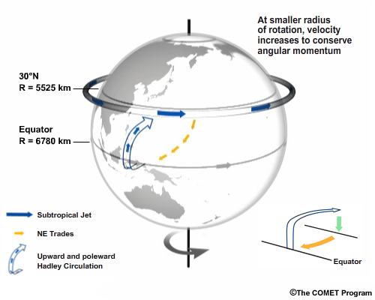
Axis of Rotation
axis of rotation
(Figure obtained from Introduction to Tropical Meteorology, 2nd Edition, © 2016 COMET.)

Slide 6
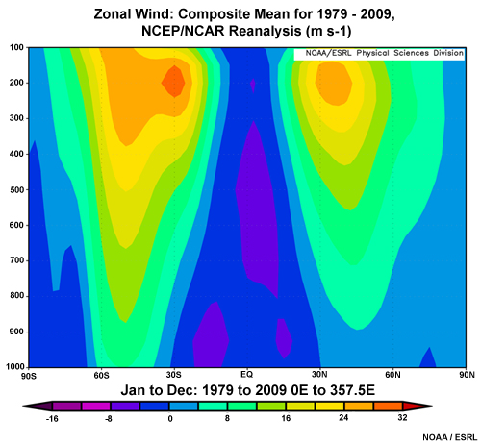
Profile of Mean Zonal Wind
(Figure obtained from Introduction to Tropical Meteorology, 2nd Edition, © 2016 COMET.)

Slide 7
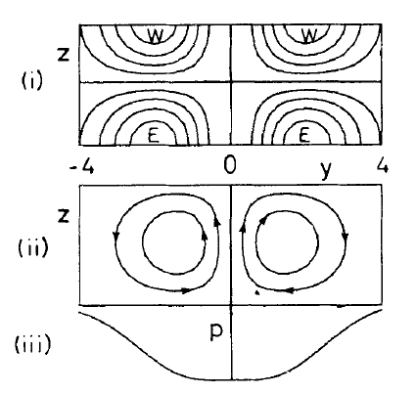
Diabatic Heating & the Hadley Cell
zonal velocity
streamfunction
pressure perturbation
(Figure obtained from Gill (1980), © 1980 Royal Meteorological Society/Wiley Interscience.)

