Slide 1
Tropical Jets and Disturbances

Slide 2
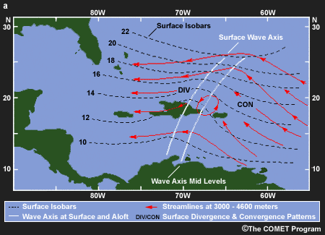
African Easterly Waves
(Figure obtained from Introduction to Tropical Meteorology, 2nd Edition, © 2016 COMET.)

Slide 3
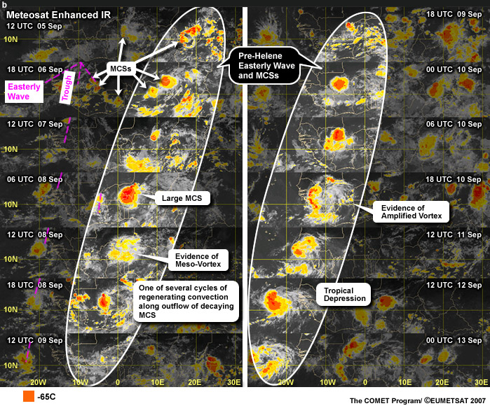
African Easterly Waves
(Figure obtained from Introduction to Tropical Meteorology, 2nd Edition, © 2016 COMET.)

Slide 4
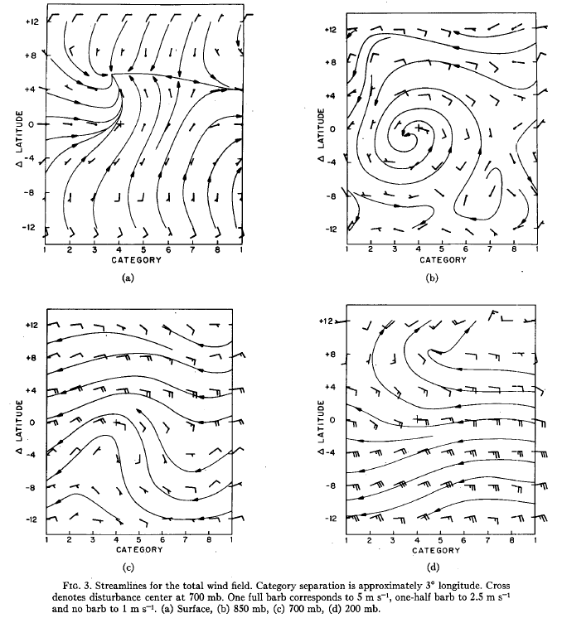
African Easterly Waves: Total Wind
surface
850 hPa
700 hPa
200 hPa
(Figure obtained from Reed et al. (1977), © 1977 American Meteorological Society.)

Slide 5
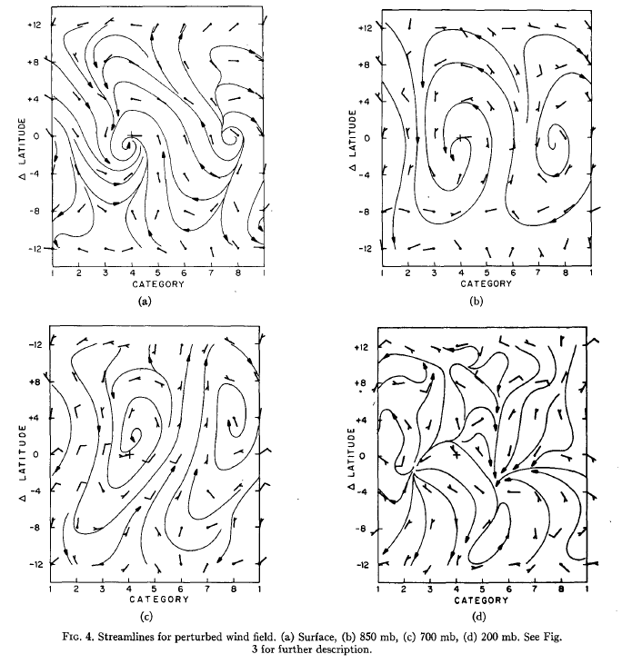
African Easterly Waves: Wave Only
surface
850 hPa
700 hPa
200 hPa
(Figure obtained from Reed et al. (1977), © 1977 American Meteorological Society.)

Slide 6
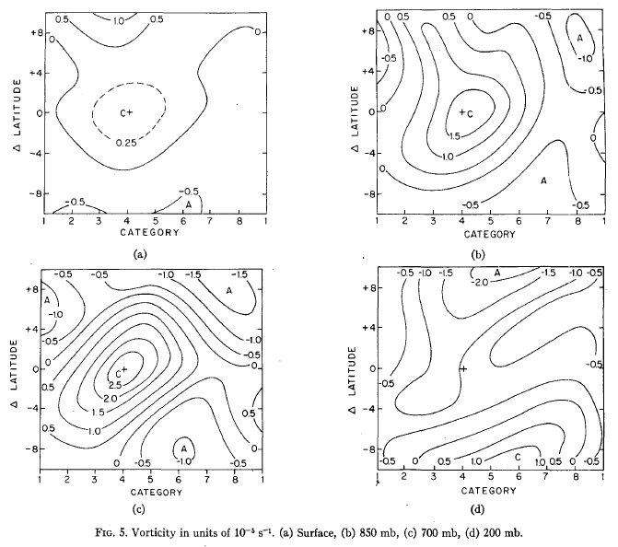
African Easterly Waves: Vorticity
surface
850 hPa
700 hPa
200 hPa
(Figure obtained from Reed et al. (1977), © 1977 American Meteorological Society.)

Slide 7
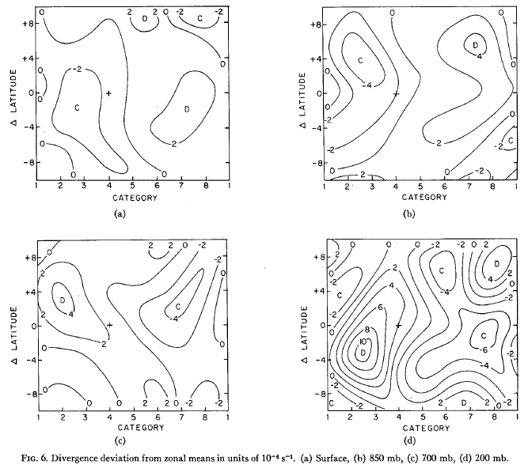
African Easterly Waves: Divergence
surface
850 hPa
700 hPa
200 hPa
(Figure obtained from Reed et al. (1977), © 1977 American Meteorological Society.)

Slide 8
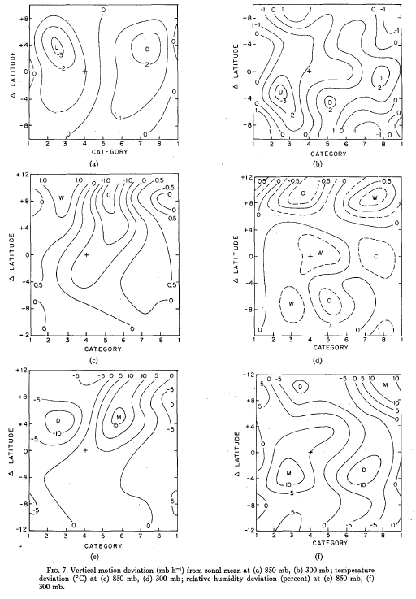
African Easterly Waves: ω’
850 hPa
300 hPa
(Figure obtained from Reed et al. (1977), © 1977 American Meteorological Society.)

Slide 9
African Easterly Waves: T’, RH’
850 hPa
300 hPa
T'
RH'
(Figure obtained from Reed et al. (1977), © 1977 American Meteorological Society.)

Slide 10
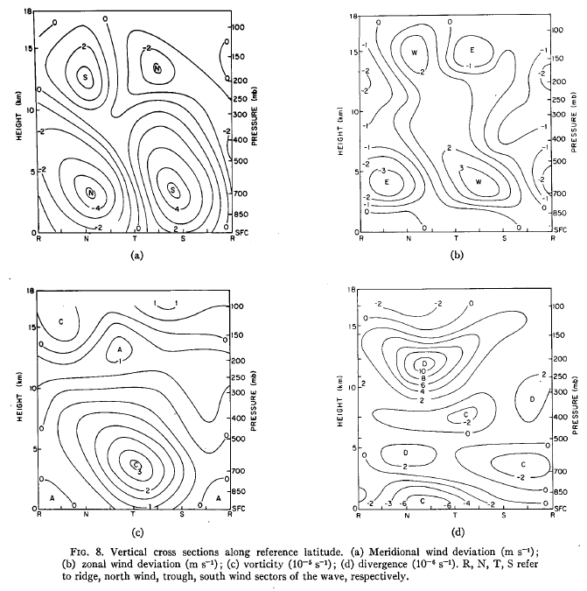
AEW Vertical Structure: v’, u’, ζ’, D’
v'
u'
ζ'
D'
all cross-sections are along central latitude of wave
(Figure obtained from Reed et al. (1977), © 1977 American Meteorological Society.)

Slide 11
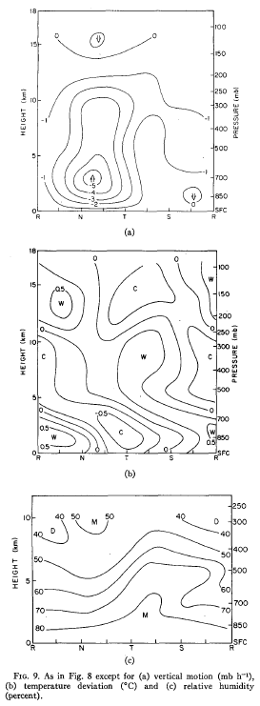
AEW Vertical Structure: ω’, T’, RH’
ω'
T'
RH'
all cross-sections are along central latitude of wave
(Figure obtained from Reed et al. (1977), © 1977 American Meteorological Society.)

Slide 12
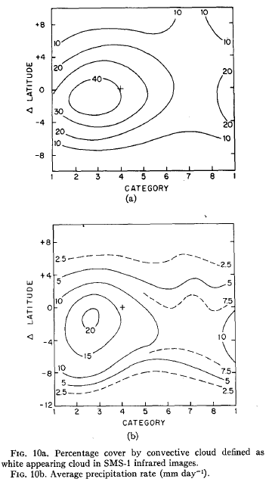
African Easterly Waves: Clouds and Rain
cloud
rain rate
(Figure obtained from Reed et al. (1977), © 1977 American Meteorological Society.)

Slide 13
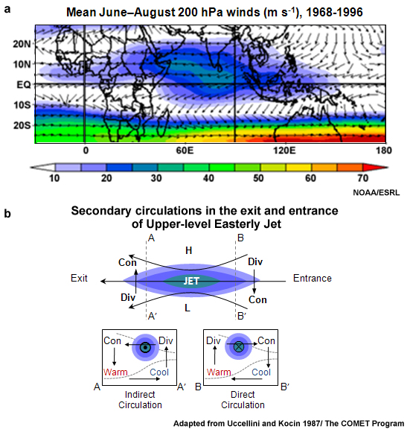
Tropical Easterly Jet
(Figure obtained from Introduction to Tropical Meteorology, 2nd Edition, © 2016 COMET.)

Slide 14
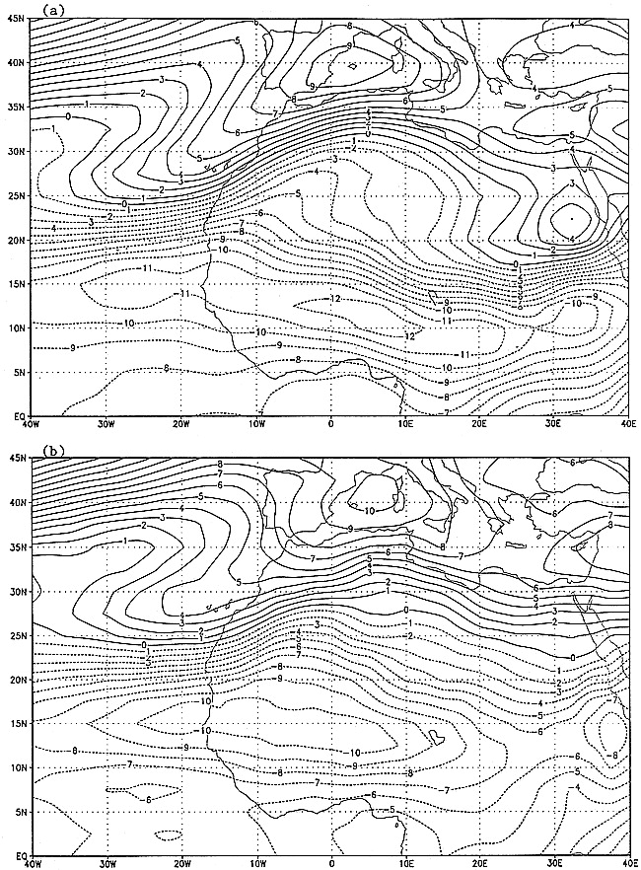
African Easterly Jet: Climatology
600 hPa U
NCEP Reanalysis
500 hPa U
ECMWF Climatology
(Figure obtained from Cook (1999), © 1999 American Meteorological Society.)

Slide 15
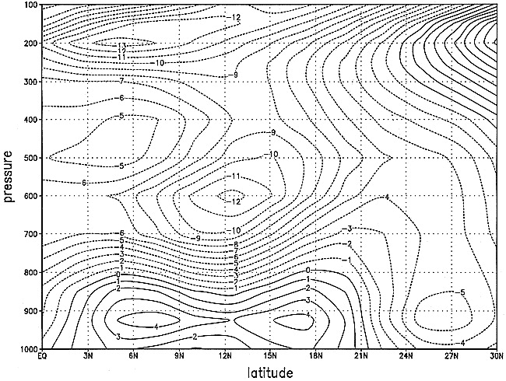
African Easterly Jet: Climatology
Vertical cross-section at 0° longitude, NCEP Reanalysis
(Figure obtained from Cook (1999), © 1999 American Meteorological Society.)

Slide 16
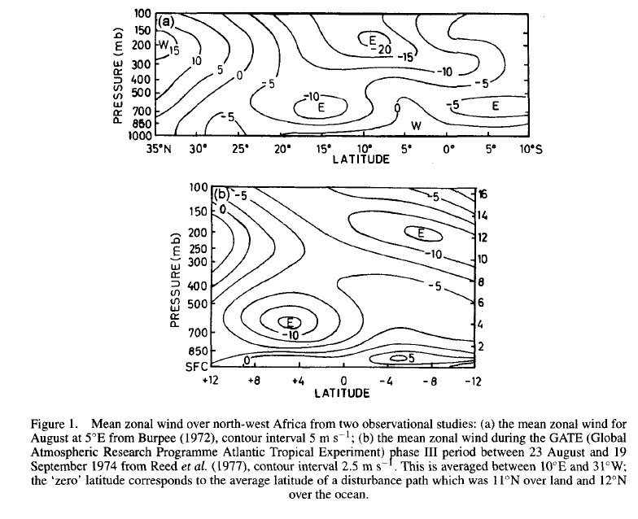
African Easterly Jet: Climatology
Vertical cross-section at 5°E
Vertical cross-section averaged between 10°E-31°W
(Figure obtained from Thorncroft and Blackburn (1999), © 1999 Wiley Interscience.)

Slide 17
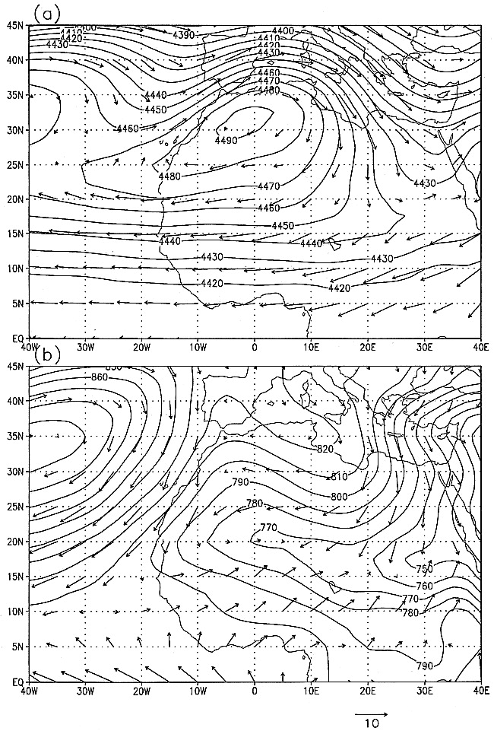
African Easterly Jet: Climatology
600 hPa height and (u,v),
NCEP Reanalysis
925 hPa height and (u,v),
NCEP Reanalysis
(Figure obtained from Cook (1999), © 1999 American Meteorological Society.)

Slide 18
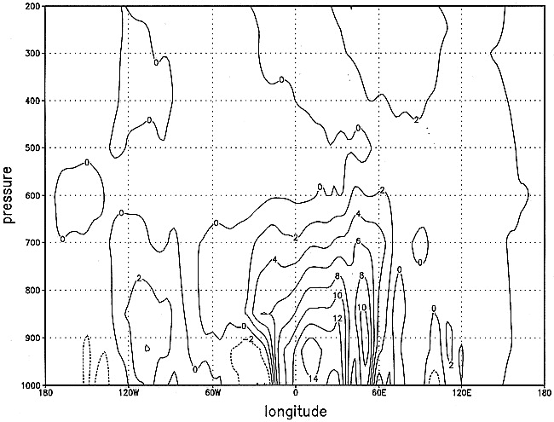
African Easterly Jet: Climatology
Meridional temperature gradient at 12.5°N (*2x10⁻⁶ K m⁻¹)
(Figure obtained from Cook (1999), © 1999 American Meteorological Society.)

Slide 19
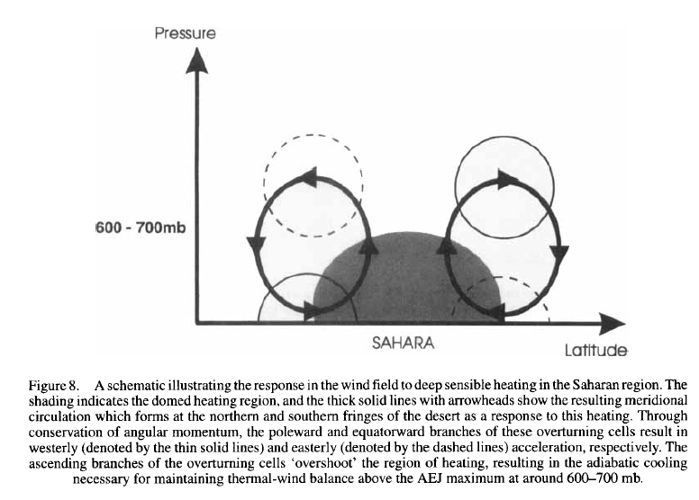
African Easterly Jet: Schematic
N
(Figure obtained from Thorncroft and Blackburn (1999), © 1999 Wiley Interscience.)

Slide 20
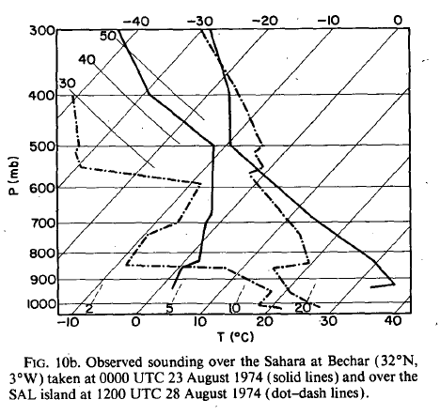
Saharan Air Layer
Over Africa (solid)
Along Coast (dash)
(Figure obtained from Karyampudi and Carlson (1988), © 1988 American Meteorological Society.)

Slide 21
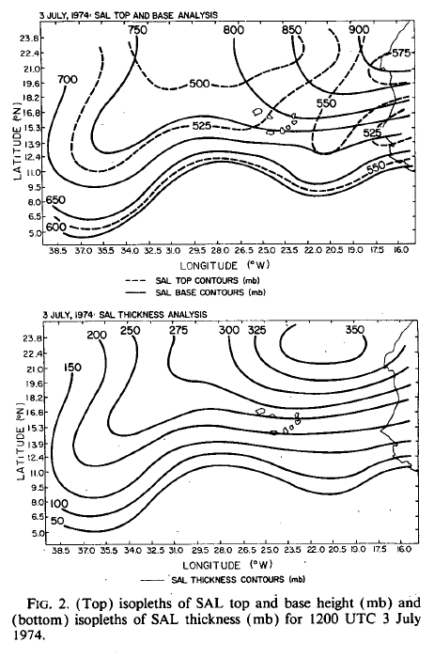
Saharan Air Layer
SAL Height (hPa): Top (dash)
Base (solid)
SAL Thickness (hPa)
(Figure obtained from Karyampudi and Carlson (1988), © 1988 American Meteorological Society.)

Slide 22
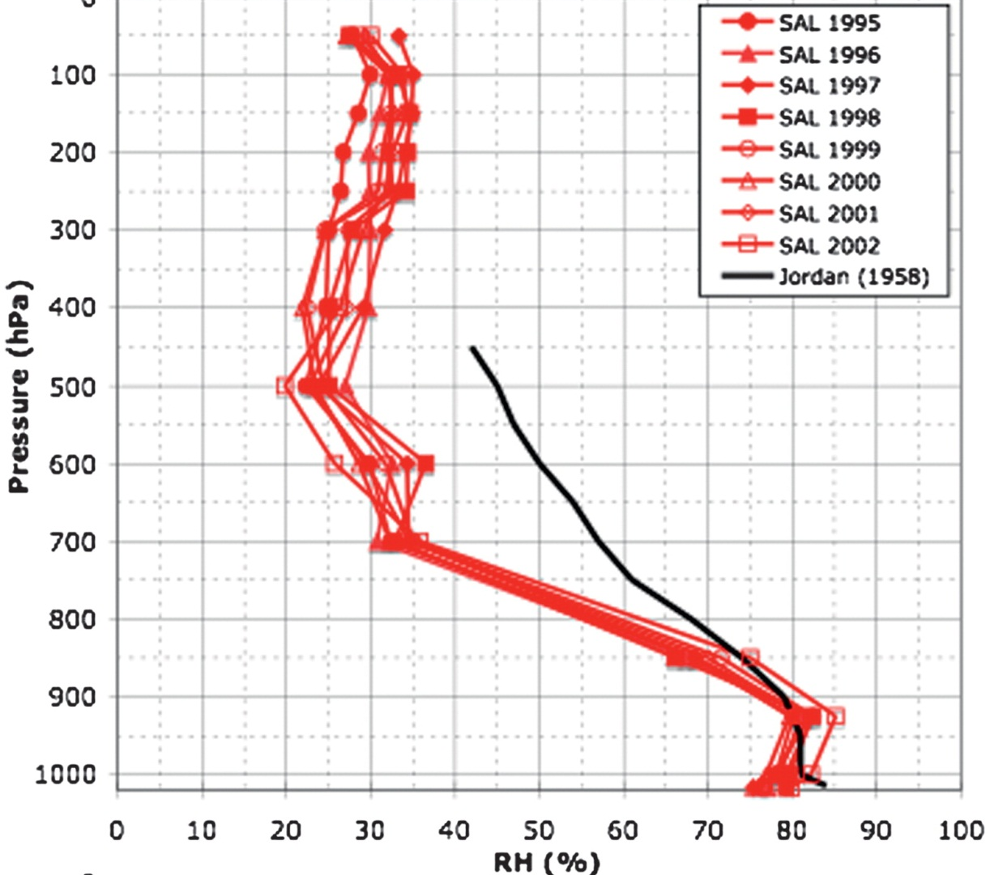
Saharan Air Layer
(Figure obtained from Dunion (2011), © 2011 American Meteorological Society.)

