Slide 1
Monsoons

Slide 2
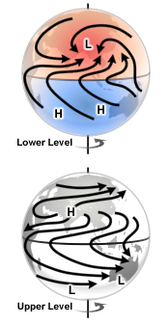
Monsoon Flow Patterns
(Figure obtained from Introduction to Tropical Meteorology, 2nd Edition, © 2016 COMET.)

Slide 3
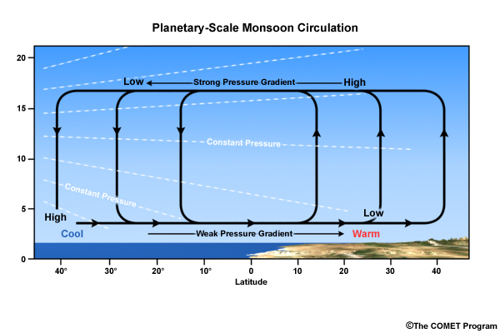
Thickness View of the Monsoon
(Figure obtained from Introduction to Tropical Meteorology, 2nd Edition, © 2016 COMET.)

Slide 4
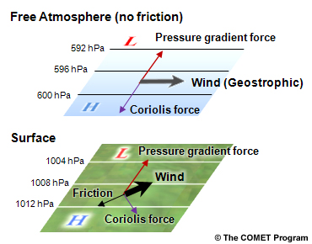
Force Balances: Impact of Friction
(Figure obtained from Introduction to Tropical Meteorology, 2nd Edition, © 2016 COMET.)

Slide 5
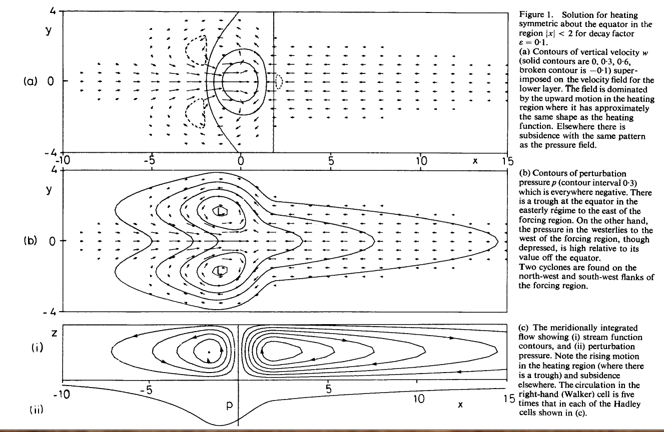
Symmetric Heating: Walker Circulation
heat forcing
(u,v) - vectors
w - contours
(u,v) - vectors
p - contours
Meridionally-integrated flow
(Figure obtained from Gill (1980), © 1980 Royal Meteorological Society/Wiley Interscience.)

Slide 6
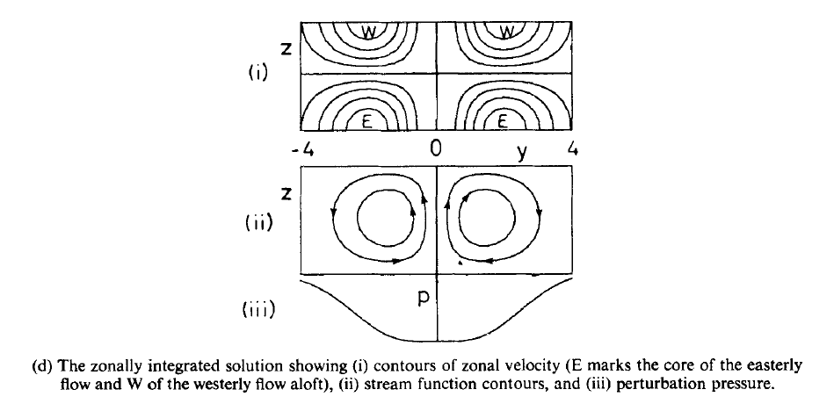
Symmetric Heating: Hadley Circulation
zonal velocity
streamfunction
pressure perturbation
(Figure obtained from Gill (1980), © 1980 Royal Meteorological Society/Wiley Interscience.)

Slide 7
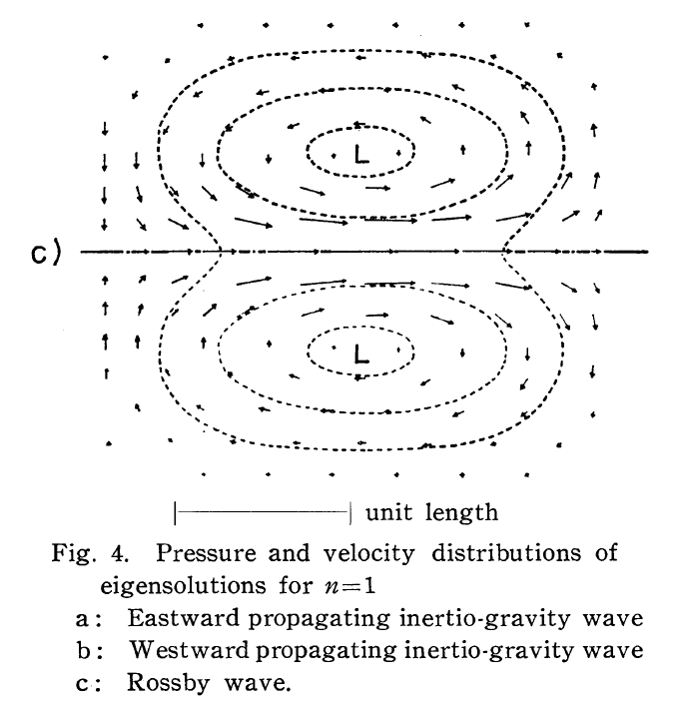
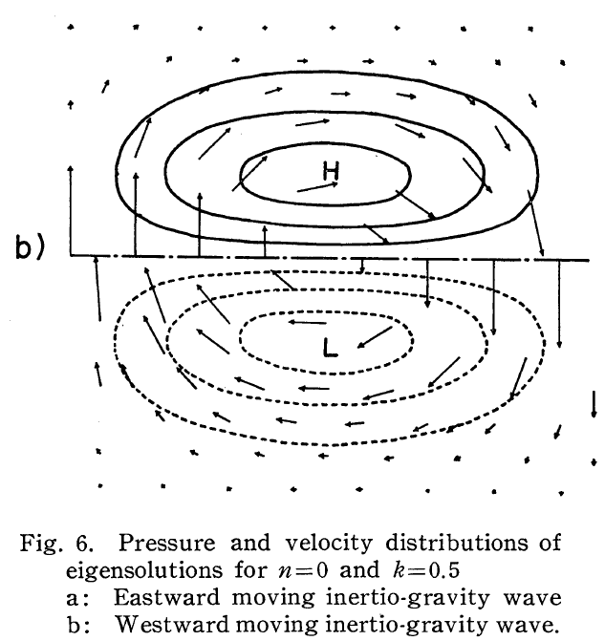
Recall: n = 1 ER and n = 0 MRG Waves
n = 1 ER Wave
n = 0 MRG Wave
(Figure obtained from Matsuno (1966), their Figures 4c and 6b. © 1966, J. Meteor. Soc. Japan.)

Slide 8
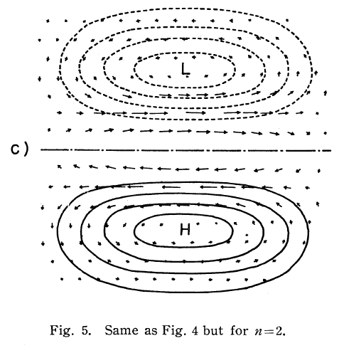
n = 2 Equatorial Rossby Waves
Location of maximized speed convergence
Winds maximized near equator and decay rapidly N/S from there
Negligible cross-equatorial flow
Location of maximized divergence
(Figure obtained from Matsuno (1966), their Figure 5c. © 1966, J. Meteor. Soc. Japan.)

Slide 9
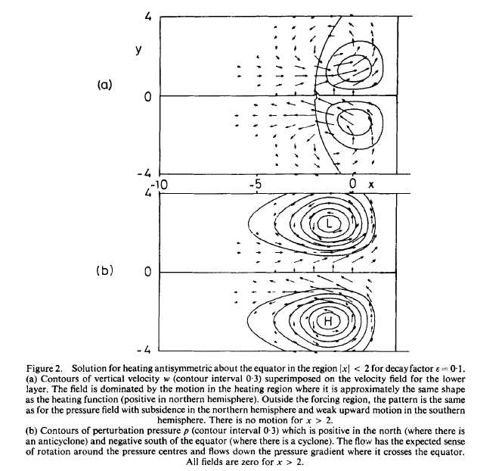
Asymmetric Heating: Monsoon
heat forcing
(u,v) - vectors
w - contours
(u,v) - vectors
p - contours
(Figure obtained from Gill (1980), © 1980 Royal Meteorological Society/Wiley Interscience.)

Slide 10
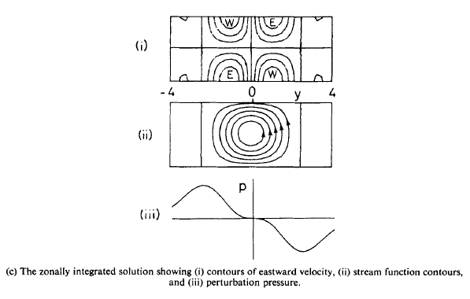
Asymmetric Heating: Monsoon
zonal velocity
streamfunction
pressure perturbation
(Figure obtained from Gill (1980), © 1980 Royal Meteorological Society/Wiley Interscience.)

Slide 11
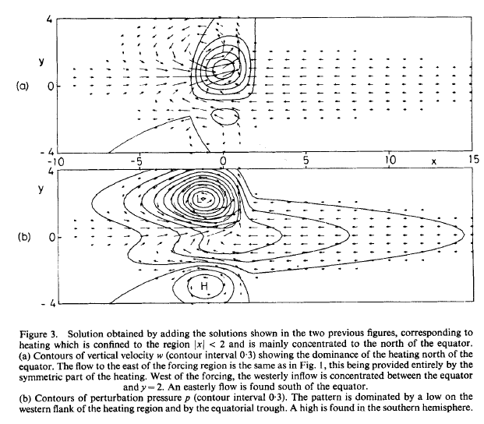
Symmetric + Asymmetric Solution
(u,v) - vectors
w - contours
(u,v) - vectors
p - contours
(Figure obtained from Gill (1980), © 1980 Royal Meteorological Society/Wiley Interscience.)

Slide 12
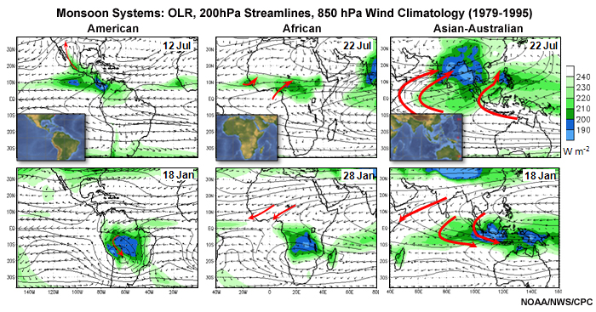
Asian Monsoon: Structure
Shaded: OLR (lower: more convective)
Vector: 850 hPa Winds (m s⁻¹)
Streamlines: 200 hPa Winds
(Figure obtained from Introduction to Tropical Meteorology, 2nd Edition, © 2016 COMET.)

Slide 13
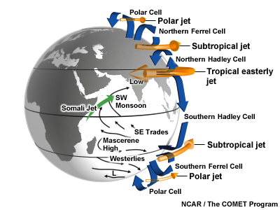
Asian Monsoon: Key Features
(Figure obtained from Introduction to Tropical Meteorology, 2nd Edition, © 2016 COMET.)

Slide 14
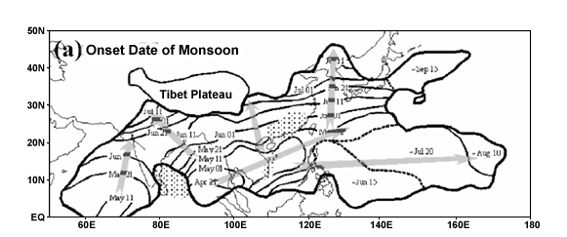
Asian Monsoon: Normal Onset Date
(Figure obtained from Introduction to Tropical Meteorology, 2nd Edition, © 2016 COMET.)

Slide 15
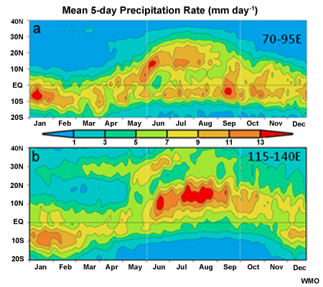
Asian Monsoon: Precipitation
Near India
W. Pacific Ocean
(Figure obtained from Introduction to Tropical Meteorology, 2nd Edition, © 2016 COMET.)

Slide 16
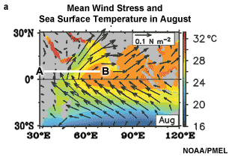
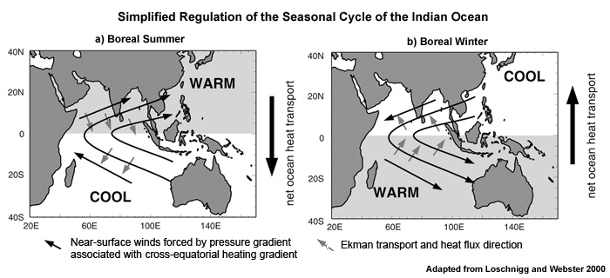
Oceanic Transport: Asian Monsoon
Grey arrows: oceanic transport through the depth of the oceanic mixed layer (~90° in layer-average)
(Figure obtained from Introduction to Tropical Meteorology, 2nd Edition, © 2016 COMET.)

Slide 17
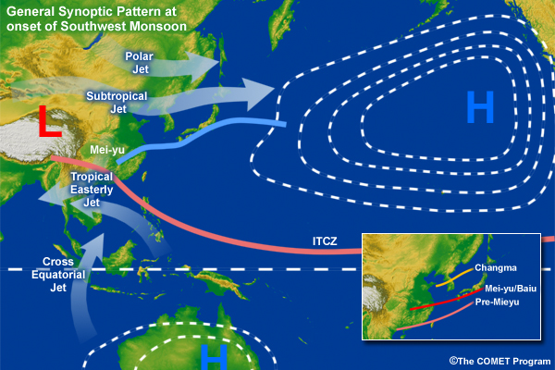
Mei-yu/Baiu Front
(Figure obtained from Introduction to Tropical Meteorology, 2nd Edition, © 2016 COMET.)

Slide 18
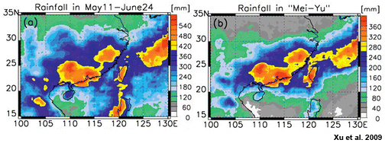
Mei-yu/Baiu Front: Precipitation
Total Rainfall
Mei-yu/Baiu-related Rainfall
(Figure obtained from Introduction to Tropical Meteorology, 2nd Edition, © 2016 COMET.)

Slide 19
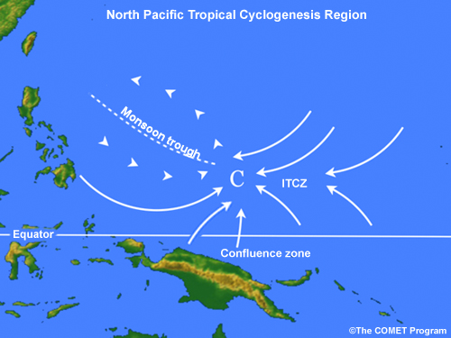
Monsoon Trough
(Figure obtained from Introduction to Tropical Meteorology, 2nd Edition, © 2016 COMET.)

Slide 20
Structure of the Australian Monsoon
Shaded: OLR (blues: reduced OLR)
Vector: 850 hPa Winds (m s⁻¹)
Streamlines: 200 hPa Winds
(Figure obtained from Introduction to Tropical Meteorology, 2nd Edition, © 2016 COMET.)

Slide 21
Oceanic Transport: Australian Monsoon
Grey arrows: oceanic transport through the depth of the oceanic mixed layer (~90° in layer-average)
(Figure obtained from Introduction to Tropical Meteorology, 2nd Edition, © 2016 COMET.)

Slide 22
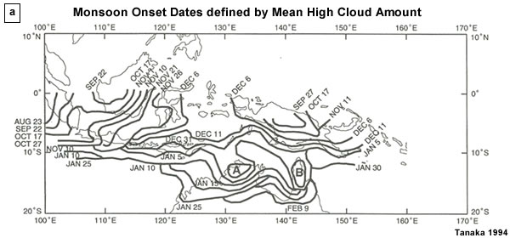
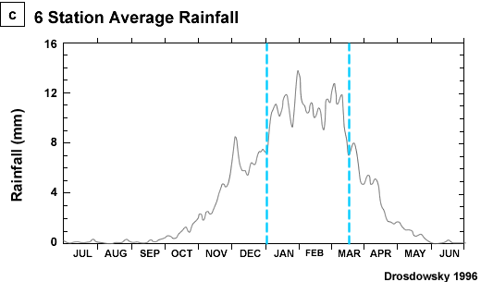
Australian/Maritime Continent Monsoon
(Figure obtained from Introduction to Tropical Meteorology, 2nd Edition, © 2016 COMET.)

Slide 23
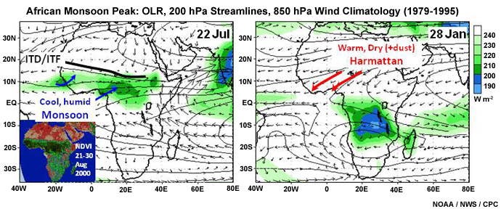
West African Monsoon
NH Summer
SH Summer
Shaded: OLR (lower: more convective)
Vector: 850 hPa Winds (m s⁻¹)
Streamlines: 200 hPa Winds
(Figure obtained from Introduction to Tropical Meteorology, 2nd Edition, © 2016 COMET.)

Slide 24
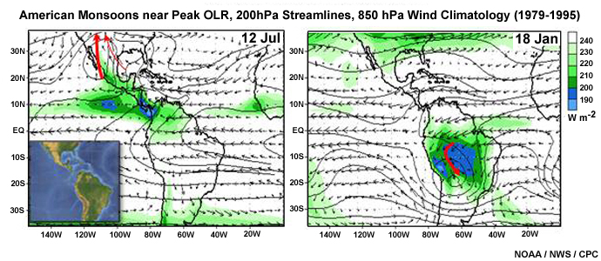
Monsoons of the Americas
North American Monsoon
South American Monsoon
(Figure obtained from Introduction to Tropical Meteorology, 2nd Edition, © 2016 COMET.)

Slide 25
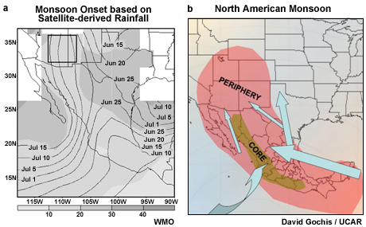
North American Monsoon
(Figure obtained from Introduction to Tropical Meteorology, 2nd Edition, © 2016 COMET.)

Slide 26
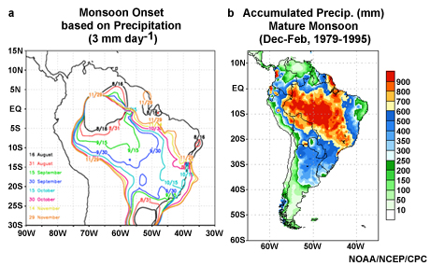
South American Monsoon
(Figure obtained from Introduction to Tropical Meteorology, 2nd Edition, © 2016 COMET.)

Slide 27
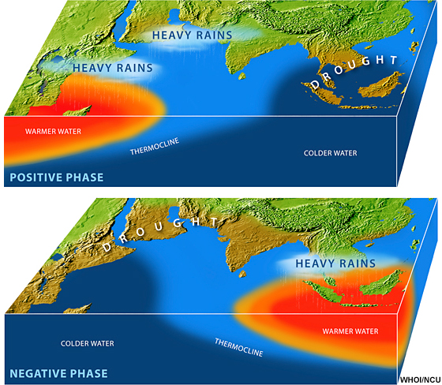
Indian Ocean Dipole
(Figure obtained from Introduction to Tropical Meteorology, 2nd Edition, © 2016 COMET.)

Slide 28
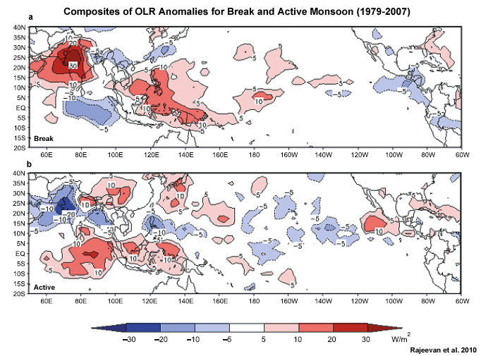
Active and Break Periods
break
Convection Modulation
Red: suppressed
Blue: enhanced
active
(Figure obtained from Introduction to Tropical Meteorology, 2nd Edition, © 2016 COMET.)

