Slide 1
Tropical Cyclone Climatology

Slide 2
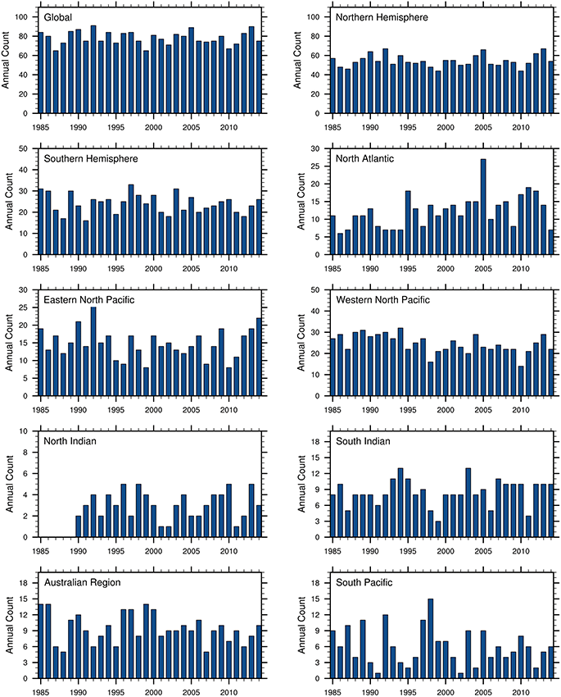
Annual Tropical Cyclone Counts
(Figure obtained from Ramsay (2017, Nat. Haz. Science). © 2017, Oxford.)

Slide 3
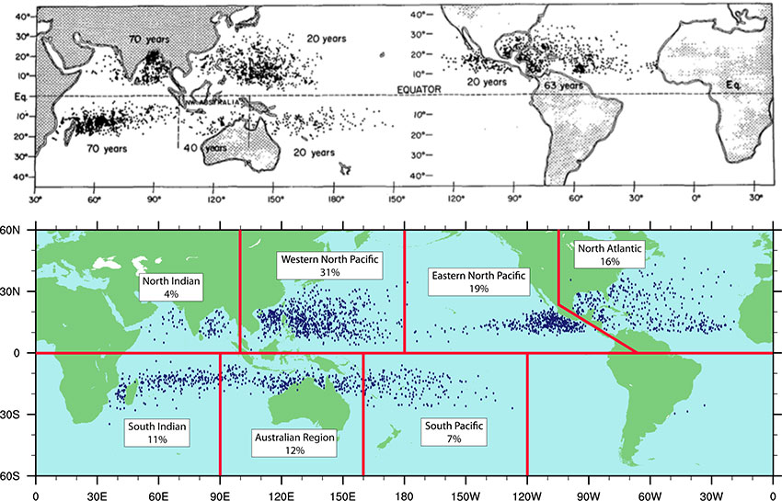
Tropical Cyclone Formation Locations
(Figure obtained from Ramsay (2017, Nat. Haz. Science). © 2017, Oxford.)

Slide 4
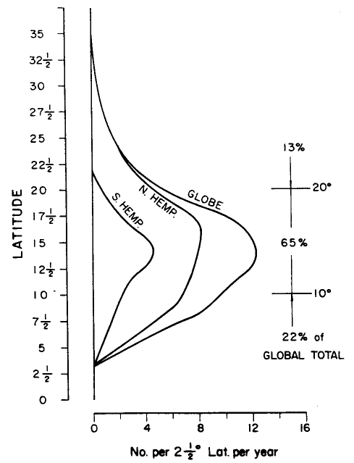
Tropical Cyclone Formation Locations
(Figure obtained from Global Perspectives on Tropical Cyclones, Ch. 3, © 1995 WMO.)

Slide 5
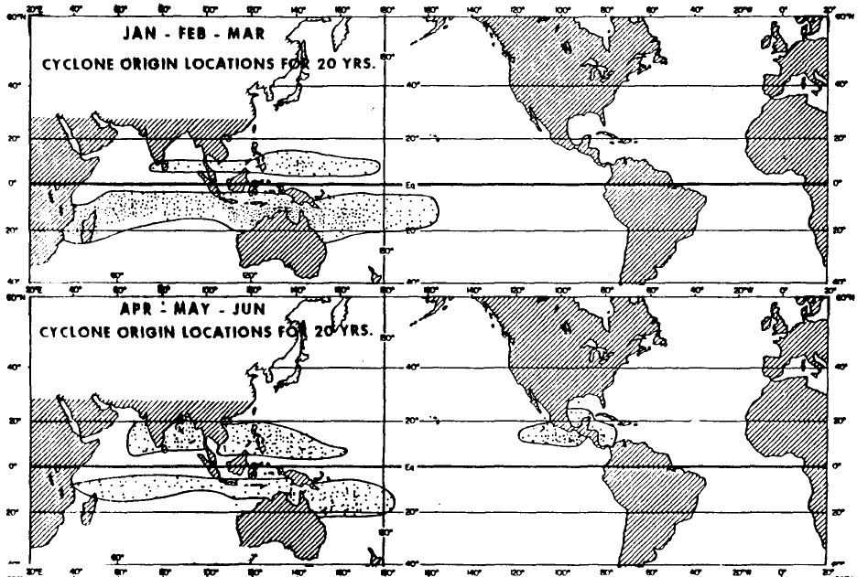
Tropical Cyclone Formation Locations
(Figure obtained from Global Perspectives on Tropical Cyclones, Ch. 3, © 1995 WMO.)

Slide 6
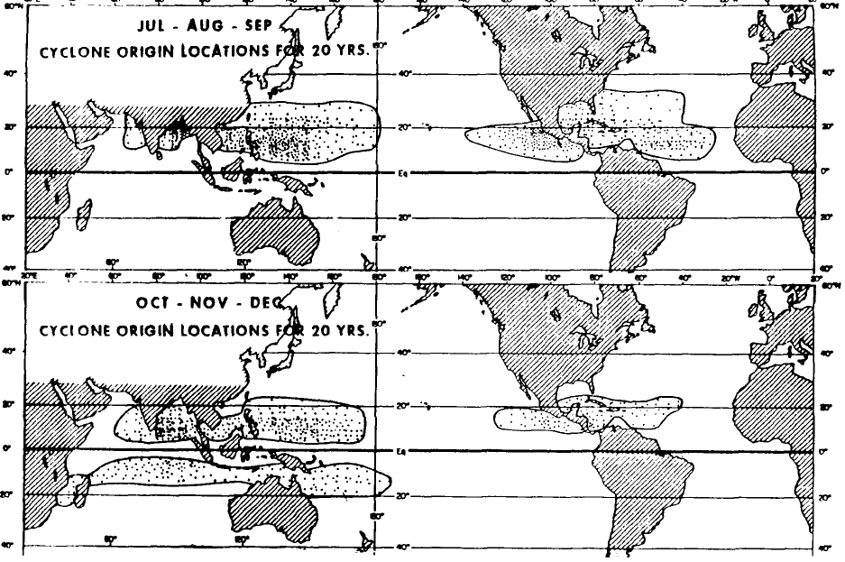
Tropical Cyclone Formation Locations
(Figure obtained from Global Perspectives on Tropical Cyclones, Ch. 3, © 1995 WMO.)

Slide 7
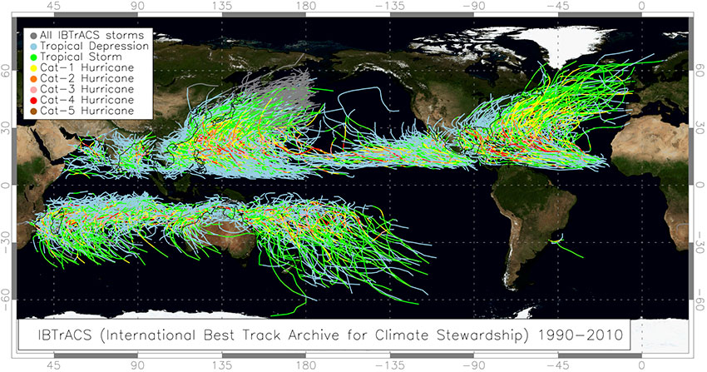
Climatology of Tropical Cyclone Tracks
(Figure obtained from Ramsay (2017, Nat. Haz. Science). © 2017, Oxford.)

Slide 8
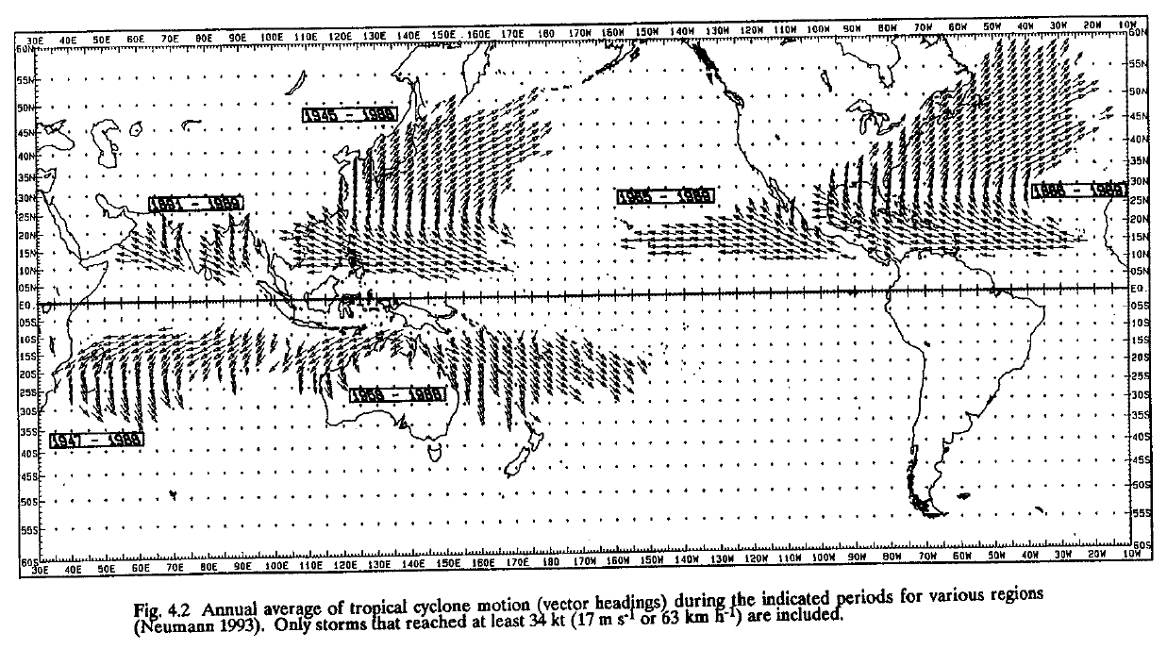
Climatology of Tropical Cyclone Motion
(Figure obtained from Global Perspectives on Tropical Cyclones, Ch. 4, © 1995 WMO.)

Slide 9
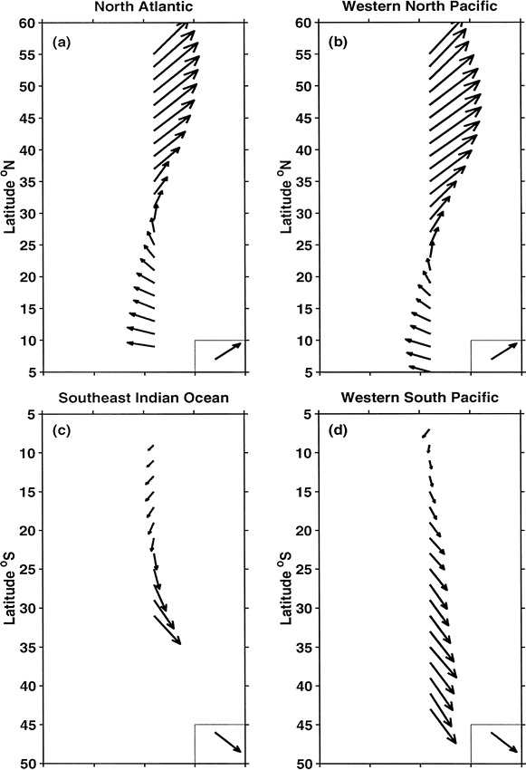
Climatology of Tropical Cyclone Motion
(Figure obtained from Jones et al. (2003, Wea. Forecasting), © 2003, American Meteorological Society.)

Slide 10
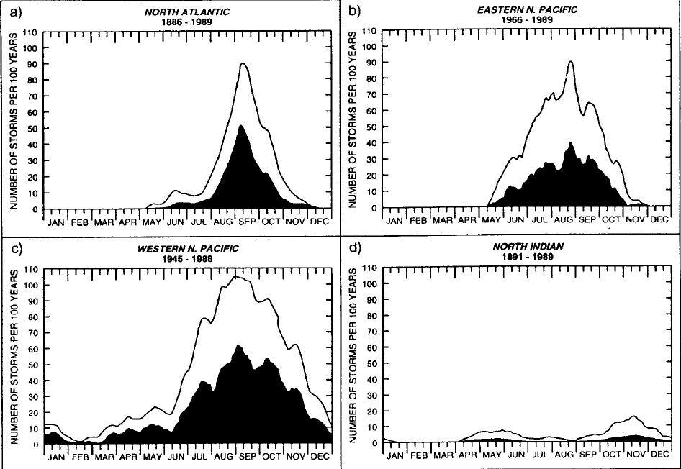
Seasonal Distribution of TC Activity
(Figure obtained from Global Perspectives on Tropical Cyclones, Ch. 3, © 1995 WMO.)

Slide 11
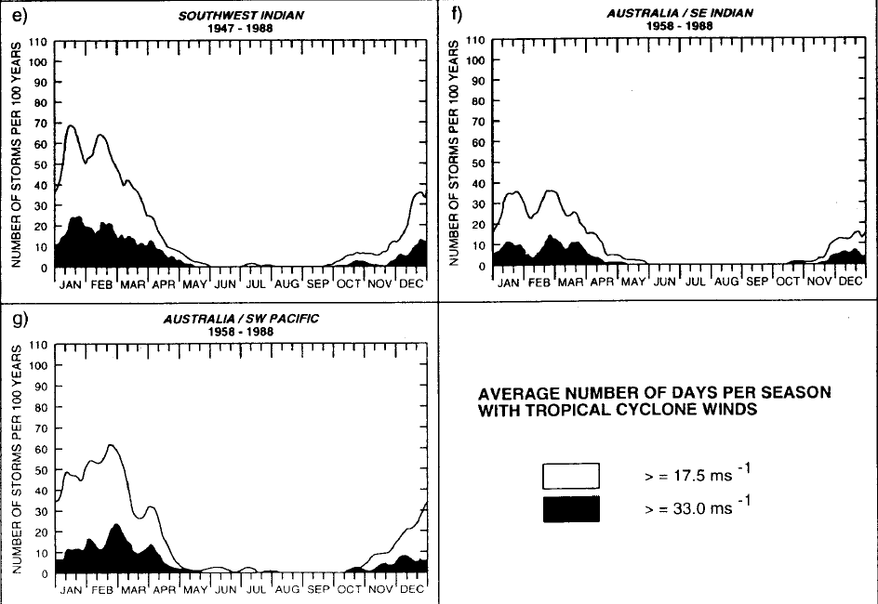
Seasonal Distribution of TC Activity
(Figure obtained from Global Perspectives on Tropical Cyclones, Ch. 3, © 1995 WMO.)

Slide 12
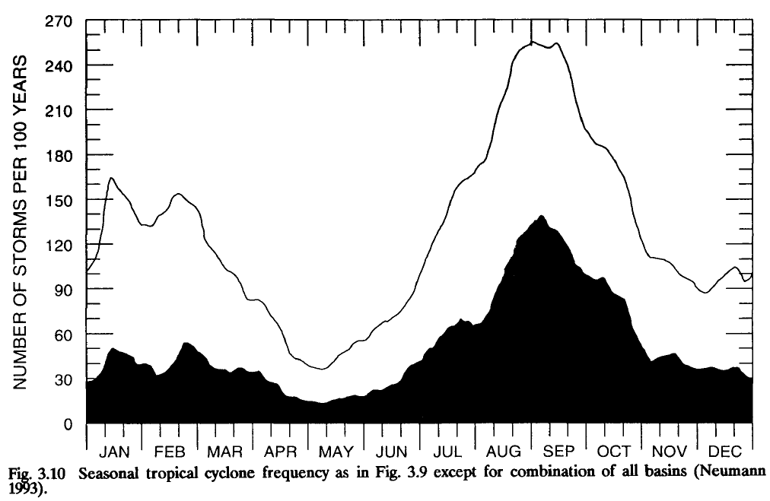
Seasonal Distribution of TC Activity
(Figure obtained from Global Perspectives on Tropical Cyclones, Ch. 3, © 1995 WMO.)

Slide 13
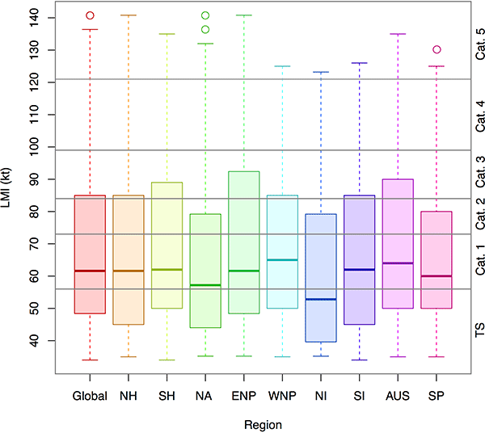
TC Lifetime Max Intensity Climatology
(Figure obtained from Ramsay (2017, Nat. Haz. Science). © 2017, Oxford.)

Slide 14
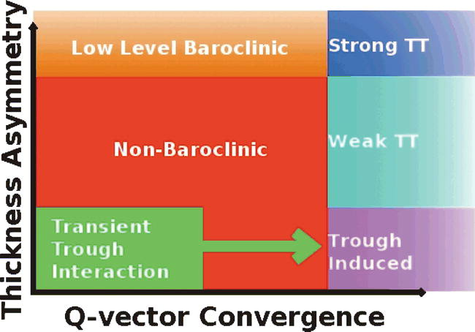
Tropical Cyclone Genesis Pathways
Revisited in 2013; TTI category removed.
(Figure obtained from McTaggart-Cowan et al. (2008), © 2008 American Meteorological Society.)

Slide 15
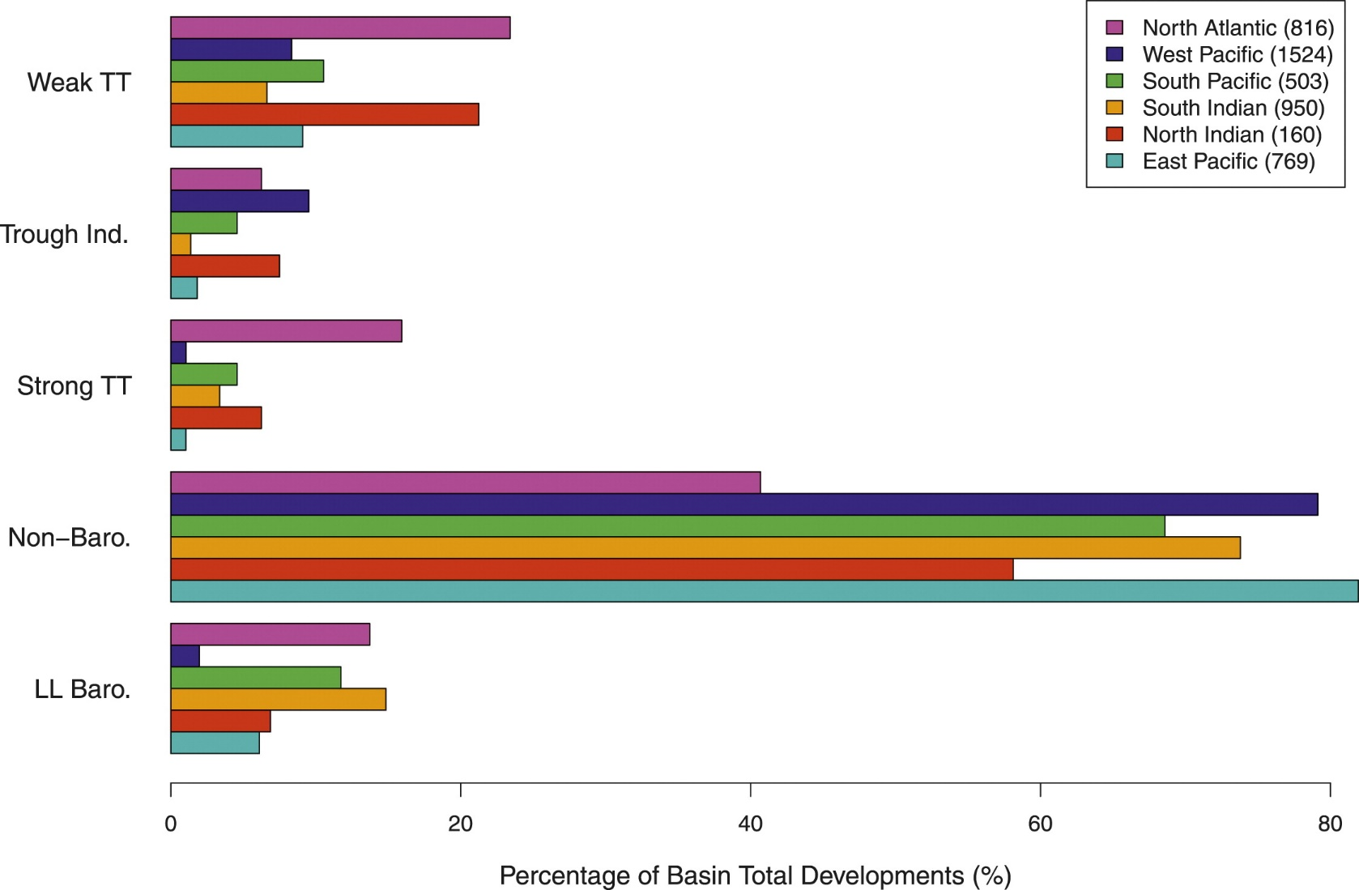
Global Genesis by Pathway
(Figure obtained from McTaggart-Cowan et al. (2013), © 2013 American Meteorological Society.)

Slide 16
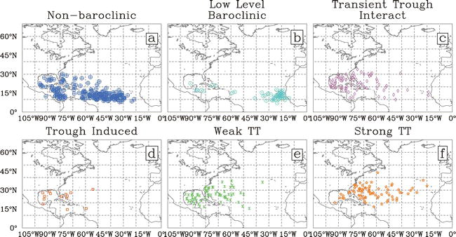
Atlantic Formation Location by Pathway
(Figure obtained from McTaggart-Cowan et al. (2008), © 2008 American Meteorological Society.)

Slide 17
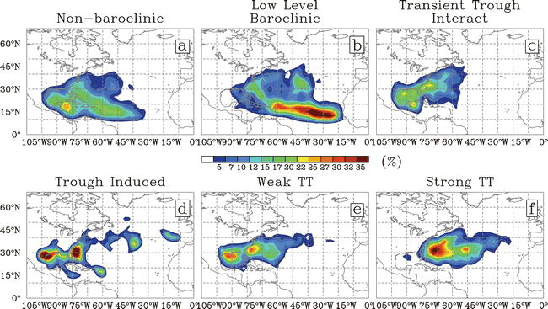
Atlantic Formation Location by Pathway
(Figure obtained from McTaggart-Cowan et al. (2008), © 2008 American Meteorological Society.)

Slide 18
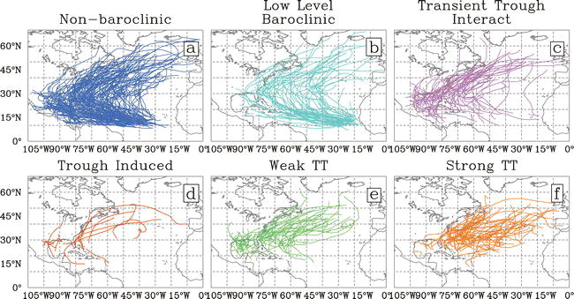
Atlantic Tracks by Formation Pathway
(Figure obtained from McTaggart-Cowan et al. (2008), © 2008 American Meteorological Society.)

Slide 19
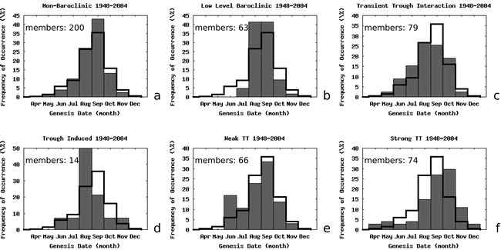
Seasonality of Formation by Pathway
(Figure obtained from McTaggart-Cowan et al. (2008), © 2008 American Meteorological Society.)

Slide 20
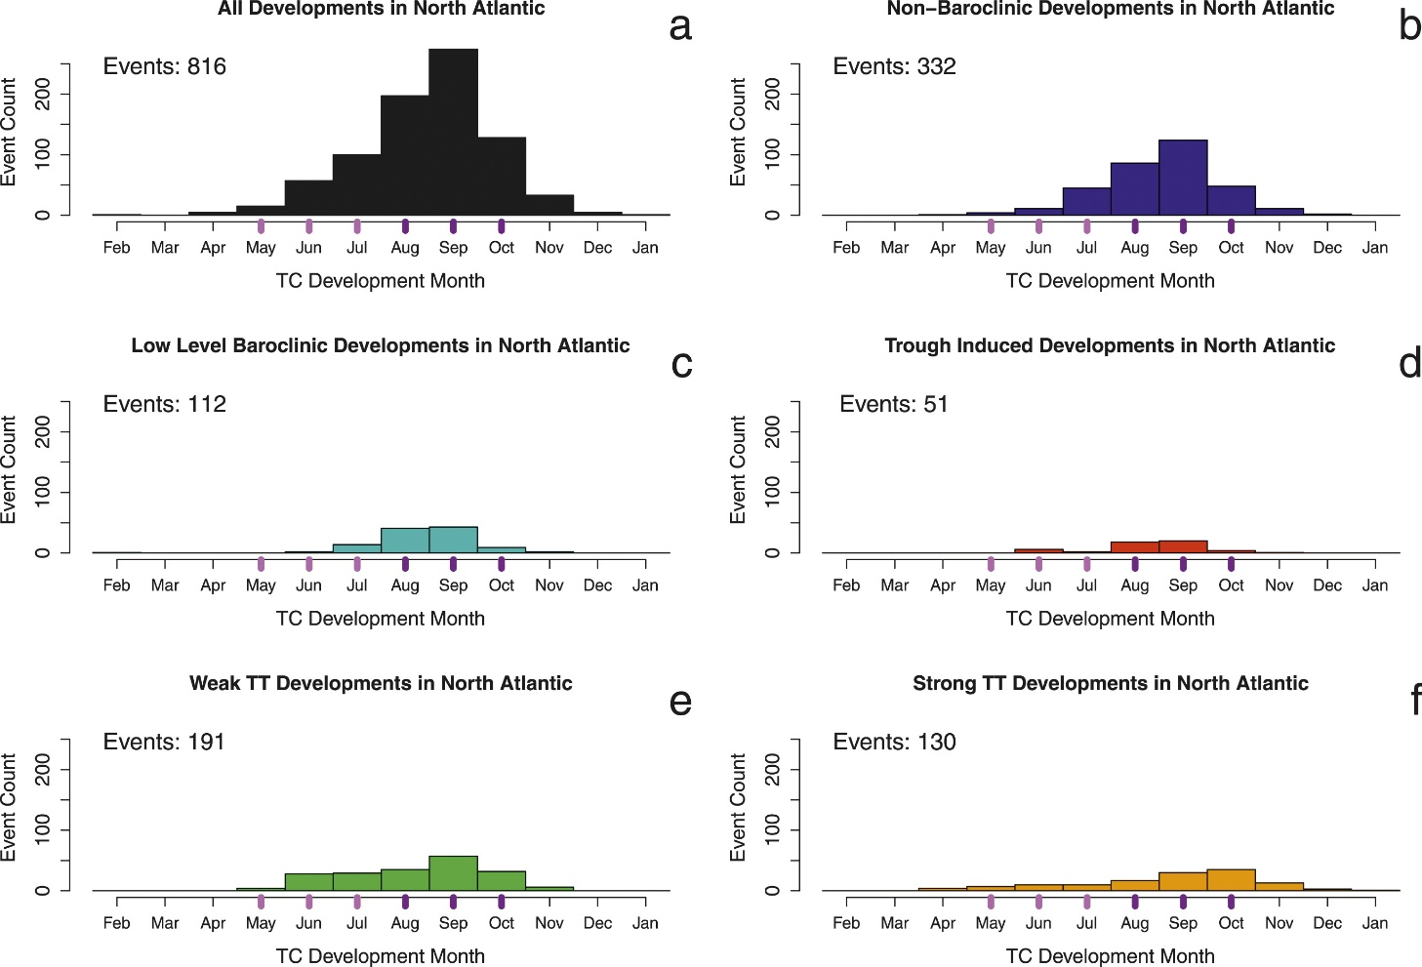
Seasonality of Formation by Pathway
(Figure obtained from McTaggart-Cowan et al. (2013), © 2013 American Meteorological Society.)

Slide 21
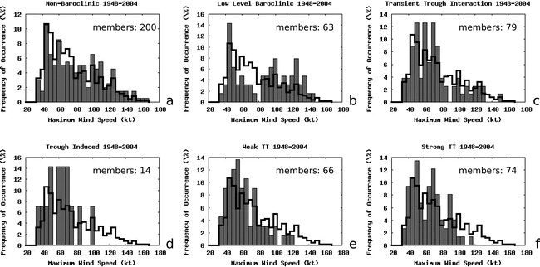
Peak Intensity as a Function of Pathway
(Figure obtained from McTaggart-Cowan et al. (2008), © 2008 American Meteorological Society.)

