Slide 1
Tropical Cyclone Formation and Subsequent Development

Slide 2
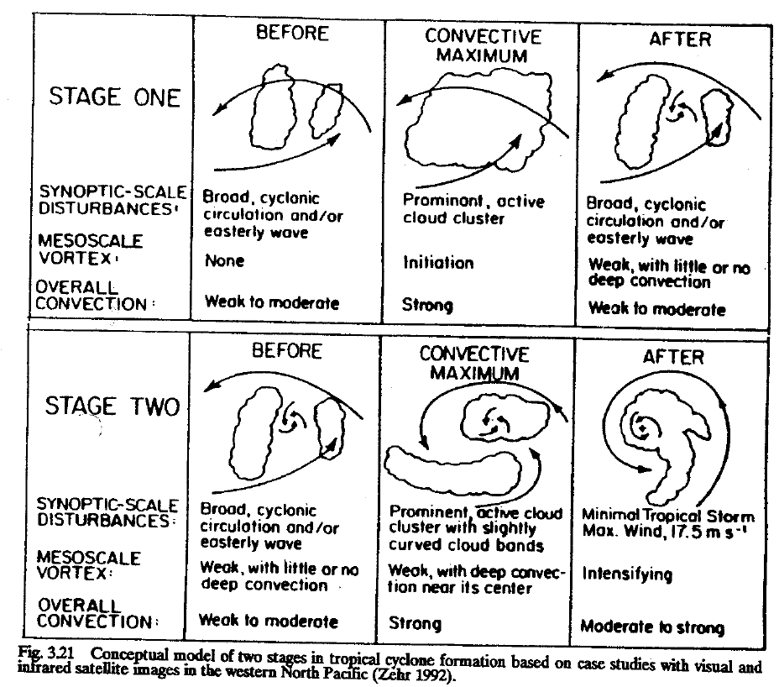
Zehr (1992) Model of Formation
(Figure obtained from Global Perspectives on Tropical Cyclones, Ch. 3, © 1995 WMO.)

Slide 3
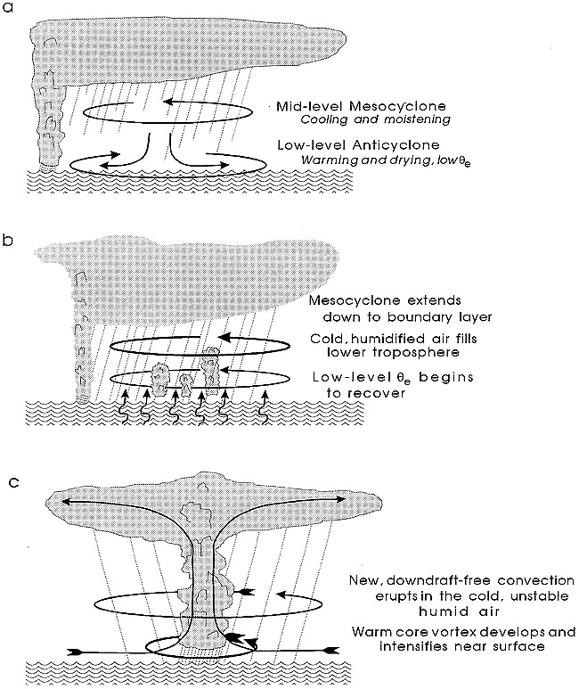
Bister and Emanuel (1997) Schematic
(Figure obtained from Bister and Emanuel (1997, MWR), their Fig. 13. © 1997 American Meteorological Society.)

Slide 4
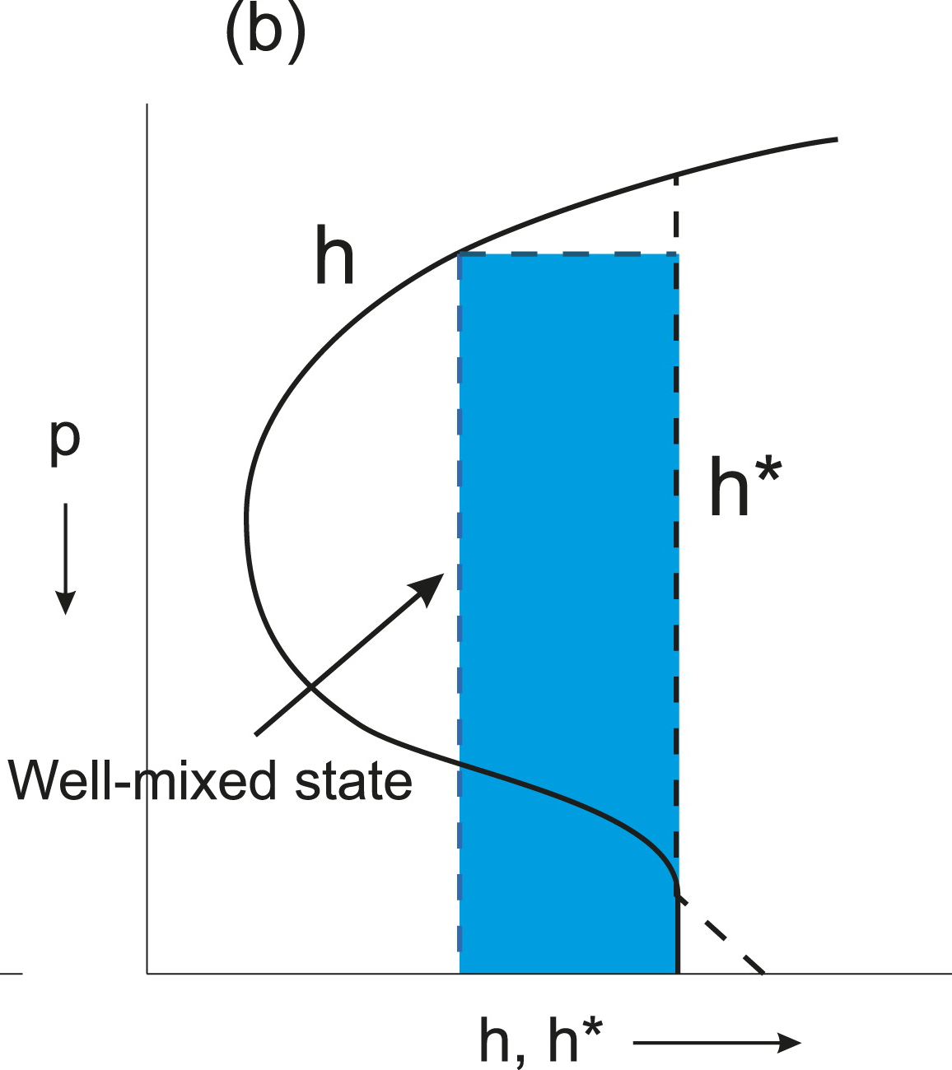
Tropical-Cyclone Warm-Core Development
post-convective conditions
environment
= saturated moist static energy
post-convection
governed by ocean conditions
moist static energy
(Figure obtained from Emanuel (2019, Meteor. Monographs), their Fig. 16b. © 2019, American Meteorological Society.)

Slide 5
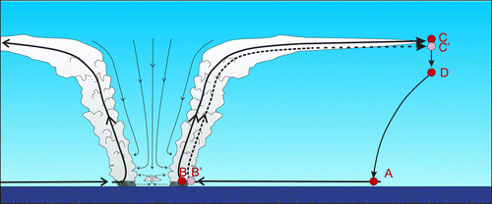
WISHE and the Carnot Cycle Approximation
(Figure obtained from Emanuel (2019, Meteor. Monographs), their Fig. 6. © 2019, American Meteorological Society.)

Slide 6
The WISHE Feedback Loop
weak surface enthalpy fluxes
heating mixed/lofted upward by t’storms
strengthens/creates warm anomaly aloft
reduces surface pressure in cyclone
increases air-sea disequilibrium
increases surface enthalpy fluxes
increases surface wind speeds
increases horizontal pressure gradient

