Slide 1
Tropical Cyclone Motion

Slide 2
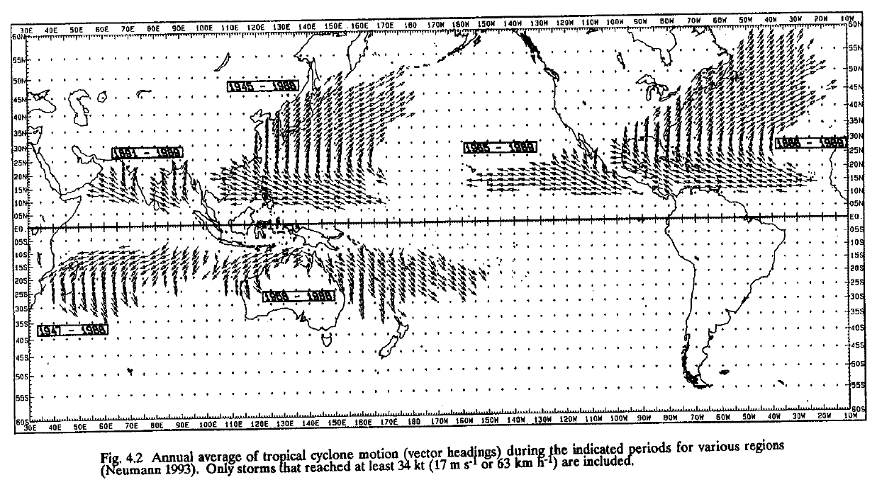
Tropical Cyclone Motion Climatology
(Figure obtained from Global Perspectives on Tropical Cyclones, Ch. 4, © 1995 WMO.)

Slide 3
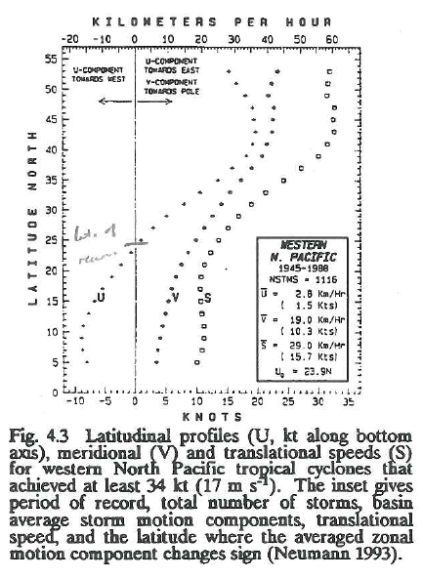
Tropical Cyclone Motion Climatology
(Figure obtained from Global Perspectives on Tropical Cyclones, Ch. 4, © 1995 WMO.)

Slide 4
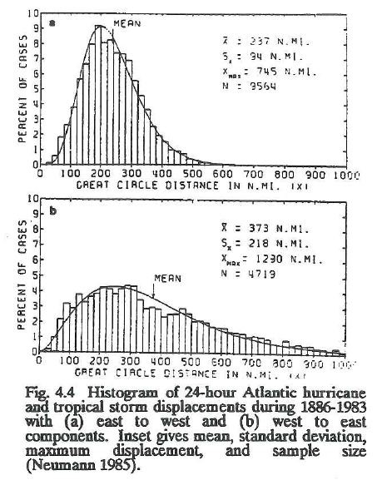
Tropical Cyclone Motion Climatology
(Figure obtained from Global Perspectives on Tropical Cyclones, Ch. 4, © 1995 WMO.)

Slide 5
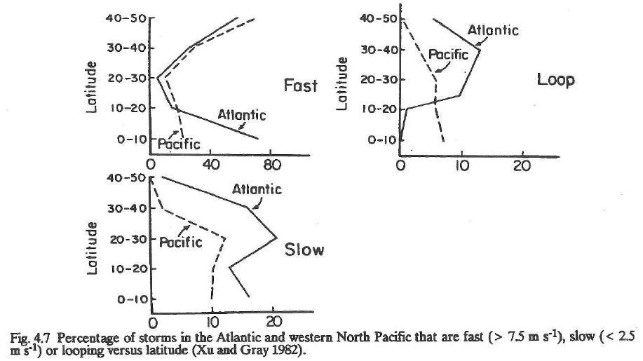
Tropical Cyclone Motion Climatology
(Figure obtained from Global Perspectives on Tropical Cyclones, Ch. 4, © 1995 WMO.)

Slide 6
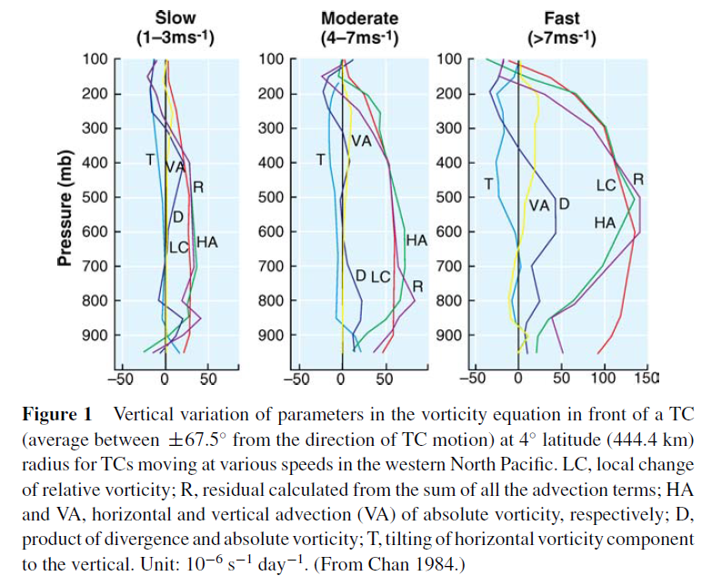
Motion by Steering Flow
(Figure obtained from Chan (2005). © 2005, Annual Reviews.)

Slide 7
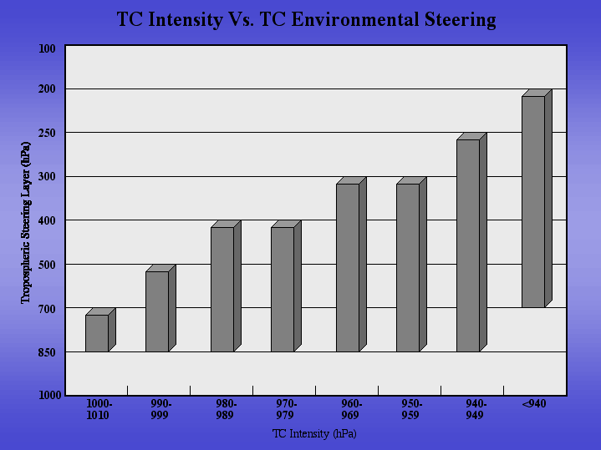
Steering Flow: Layer Determination
(Figure obtained from http://tropic.ssec.wisc.edu/misc/dlm/dlm3.gif.)

Slide 8
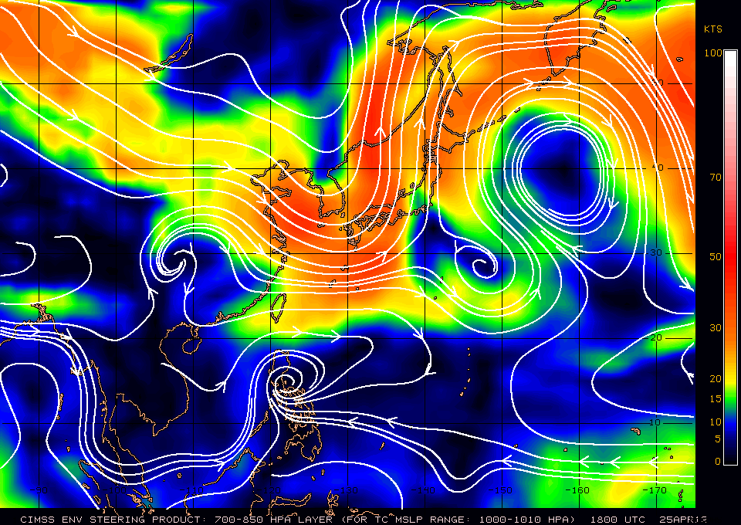
Steering Flow: 850-700 hPa Example
(Figure obtained from http://tropic.ssec.wisc.edu/.)

Slide 9
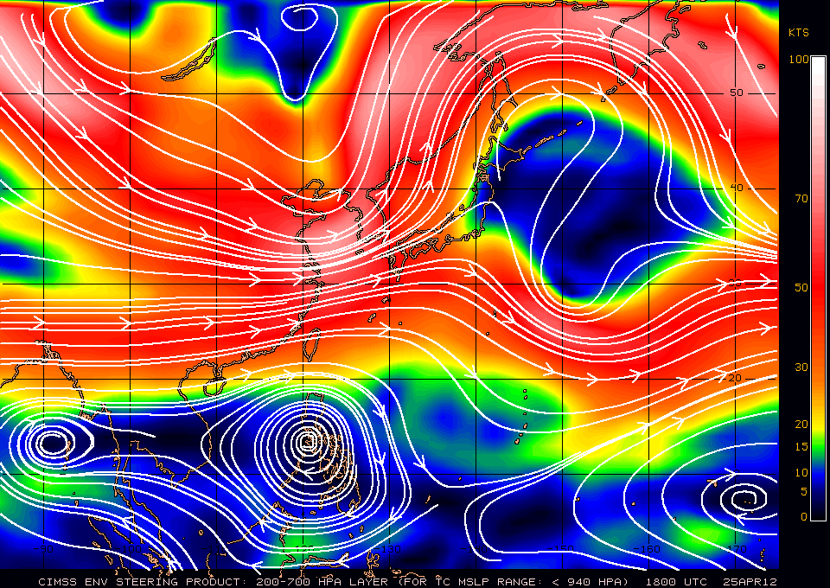
Steering Flow: 700-200 hPa Example
(Figure obtained from http://tropic.ssec.wisc.edu/.)

Slide 10
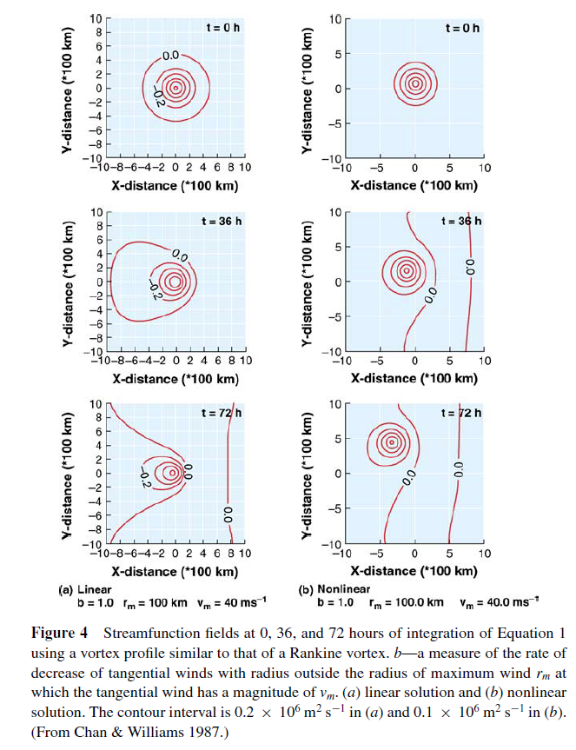
Beta Effect
t = 0 h
t = 36 h
t = 72 h
LINEAR
NON-LINEAR
(Figure obtained from Chan (2005). © 2005, Annual Reviews.)

Slide 11
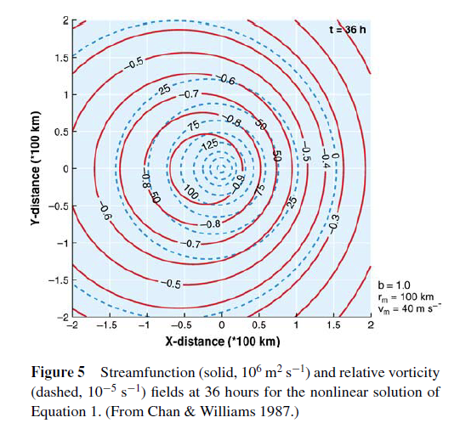
Beta Effect
(Figure obtained from Chan (2005). © 2005, Annual Reviews.)

Slide 12




Non-Uniform Horizontal Flow
N
zonal wind
Case 1: Linear Horizontal Shear, No Flow Over TC Center

Slide 13




Non-Uniform Horizontal Flow
N
zonal wind
Case 2: Linear Horizontal Shear, Flow Over TC Center

Slide 14
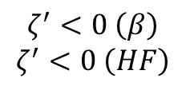
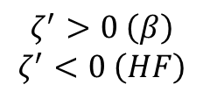
Non-Uniform Horizontal Flow
Horizontal tilt of vortex strengthens anticyclonic beta gyre to NE but weakens cyclonic beta gyre to SW
N
zonal wind
Case 1, Except With Beta Gyres

Slide 15
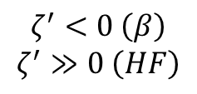
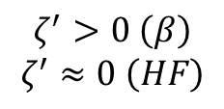
Non-Uniform Horizontal Flow
Horizontal tilt of vortex weakens anticyclonic beta gyre
N
zonal wind
Case 2, Except With Beta Gyres

Slide 16
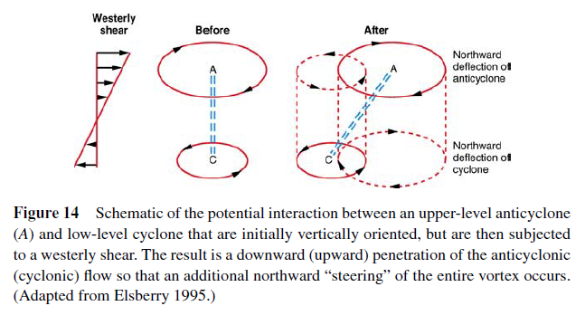
Vertical Wind Shear Effect on Motion
(Figure obtained from Chan (2005). © 2005, Annual Reviews.)

Slide 17
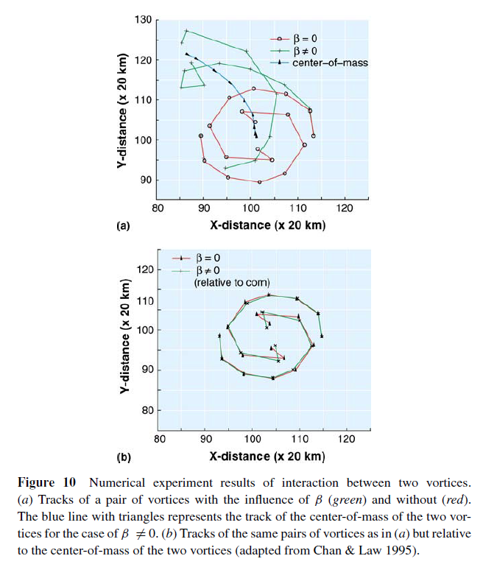
Fujiwhara Rotation
earth-relative
center of mass-relative
(Figure obtained from Chan (2005). © 2005, Annual Reviews.)

