Slide 1
Other Modes of Tropical Variability

Slide 2
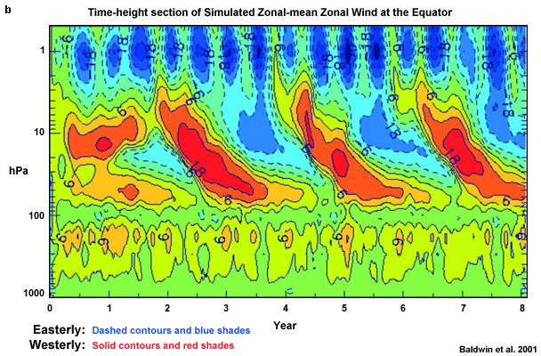
Quasi-Biennial Oscillation
(Figure obtained from Ch. 4 of An Introduction to Tropical Meteorology, 2nd Edition. © 2016 COMET.)

Slide 3
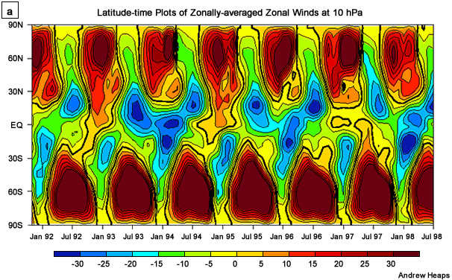
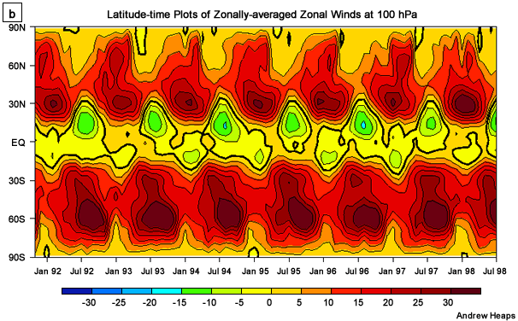
Quasi-Biennial Oscillation
(Figure obtained from Ch. 4 of An Introduction to Tropical Meteorology, 2nd Edition. © 2016 COMET.)

Slide 4
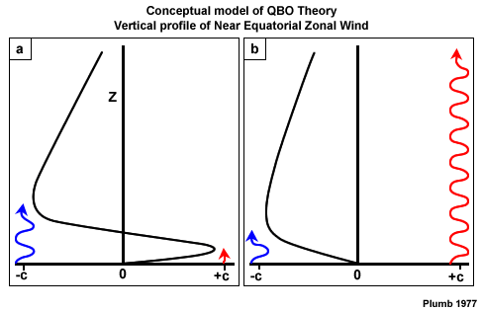
QBO Dynamics
Mixed Rossby-Gravity Wave Forcing
Equatorially Trapped Kelvin Wave Forcing
stratopause
tropopause
U < 0
U > 0
U < 0
U > 0
(Figure obtained from Ch. 4 of An Introduction to Tropical Meteorology, 2nd Edition. © 2016 COMET.)

Slide 5
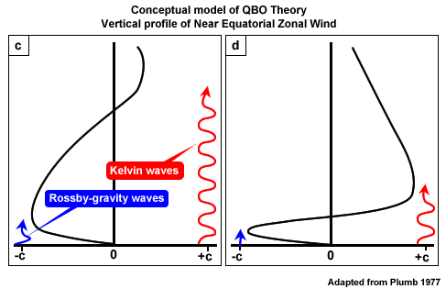
QBO Dynamics
stratopause
tropopause
U < 0
U > 0
U < 0
U > 0
(Figure obtained from Ch. 4 of An Introduction to Tropical Meteorology, 2nd Edition. © 2016 COMET.)

Slide 6
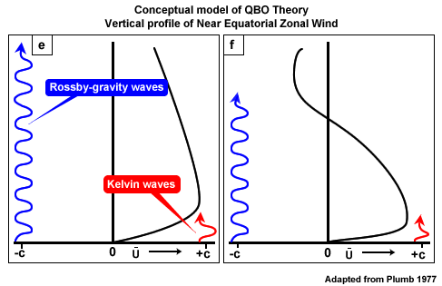
QBO Dynamics
stratopause
tropopause
U < 0
U > 0
(Figure obtained from Ch. 4 of An Introduction to Tropical Meteorology, 2nd Edition. © 2016 COMET.)

Slide 7
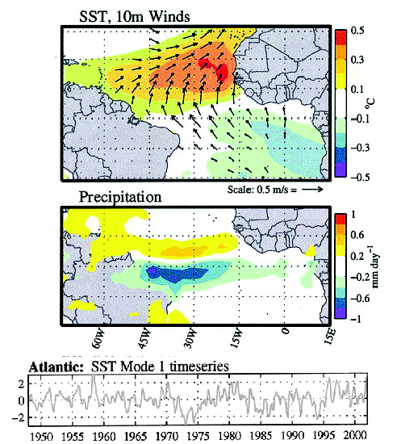
Atlantic Meridional Mode
(Figure obtained from http://www.aoml.noaa.gov/phod/research/tav/tcv/amm/index.php. © 2012, NOAA/AOML.)

Slide 8
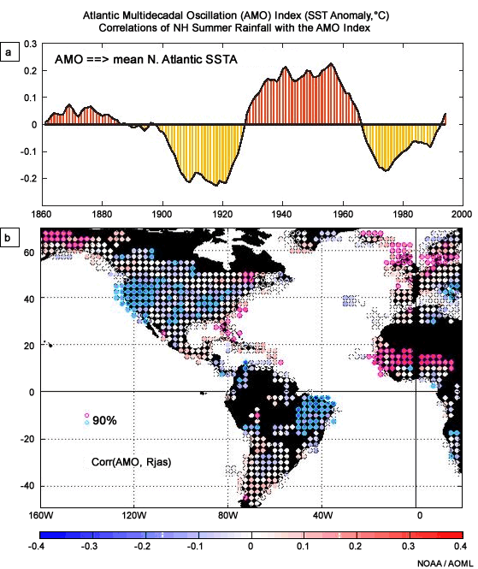
Atlantic Multidecadal Oscillation
(Figure obtained from Ch. 4 of An Introduction to Tropical Meteorology, 2nd Edition. © 2016 COMET.)

Slide 9
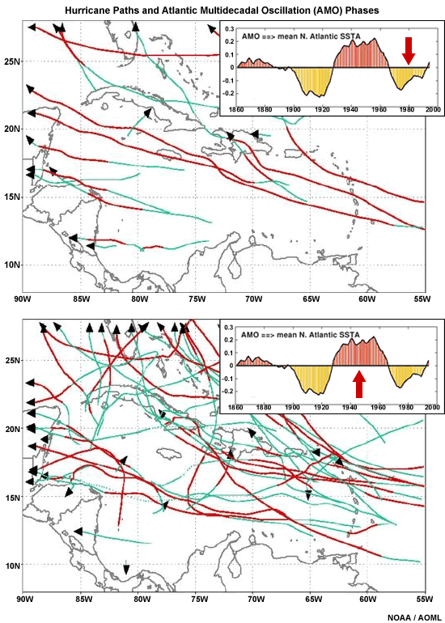
Atlantic Multidecadal Oscillation
(Figure obtained from Ch. 4 of An Introduction to Tropical Meteorology, 2nd Edition. © 2016 COMET.)

