Slide 1
Walker Circulation

Slide 2
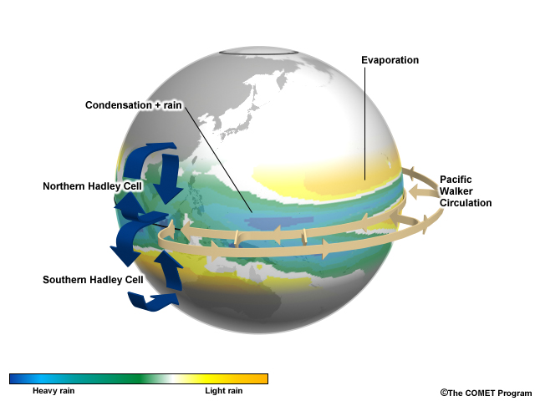
Mean Tropical Overturning Circulations
(Figure obtained from Introduction to Tropical Meteorology, 2nd Edition, © 2016 COMET.)

Slide 3
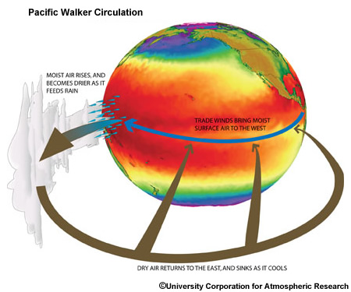
Base State Pacific Zonal Circulation
(Figure obtained from Introduction to Tropical Meteorology, 2nd Edition, © 2016 COMET.)

Slide 4
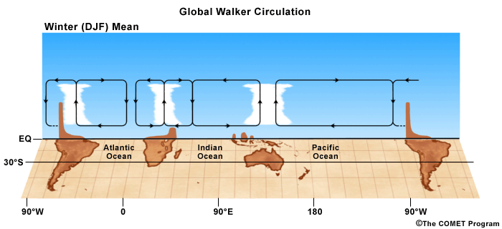
Base State Global Walker Circulation
(Figure obtained from Introduction to Tropical Meteorology, 2nd Edition, © 2016 COMET.)

Slide 5
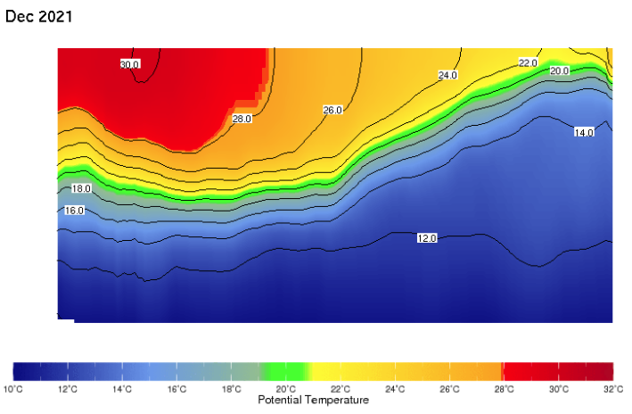
The Oceanic Thermocline
top of ocean
350 m depth
121°E
180°
79°W
(Figure obtained from the Columbia Univ. International Research Institute ENSO Monitoring Diagnostics.)

Slide 6
Oceanic Transport
v
z
warming
20°C isotherm
cooling
W
Each of the equatorial oceans (Indian, Pacific, Atlantic) are bounded by landmasses on their west and east ends. Easterly surface winds are constantly trying to push the water (known as a stress) to the west. The surface water on the ocean’s east boundary is replaced by the colder water from below resulting in relatively cold equatorial sea-surface temperatures in the eastern oceans.

Slide 7
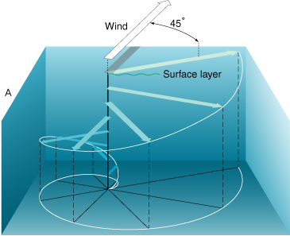
Oceanic Transport
(Figure: oceanmotion.org)
Equatorial ocean temperatures are also influenced by Ekman transport. The surface wind tugs the water along, but this induces a Coriolis force (90° right/left in the Northern/Southern Hemisphere) that leads to the surface current being 45° right/left of the wind. This then tugs the water beneath, which is deflected by Coriolis, and so on. Friction steadily weakens this tugging force, leading to near-zero wind-driven current ~200 m below the surface. The net transport is 90° right/left of the surface wind, causing upwelling along the Equator from water being carried away in both hemispheres.

Slide 8
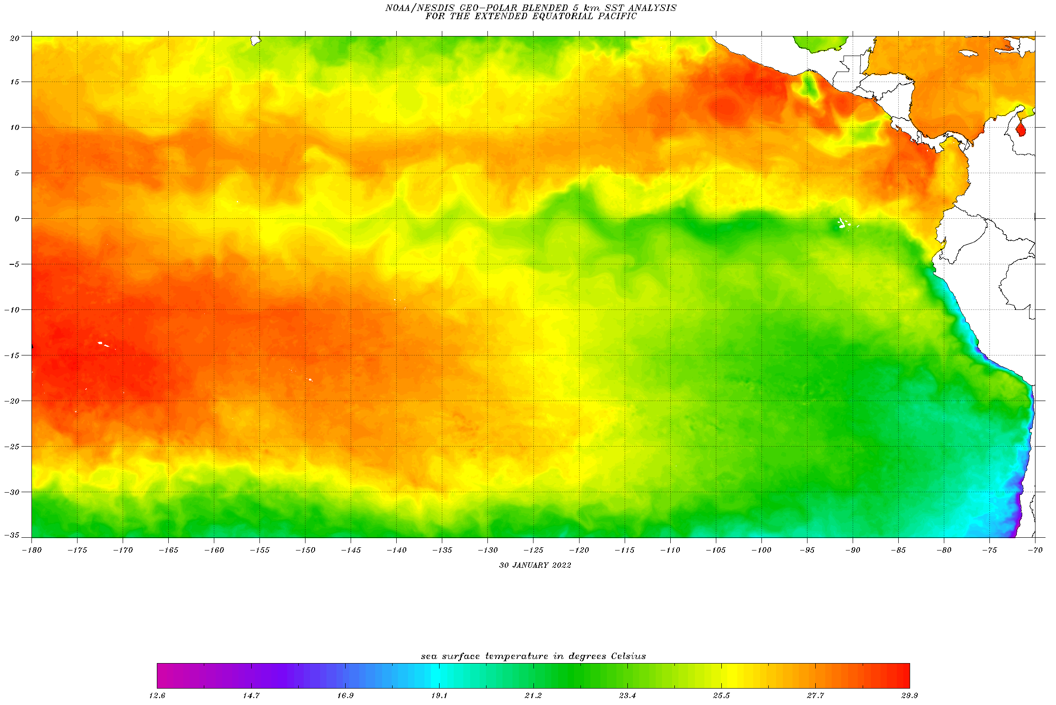
Equatorial Sea-Surface Temperatures
(Figure obtained from https://www.ospo.noaa.gov/Products/ocean/sst/contour/.)

Slide 9
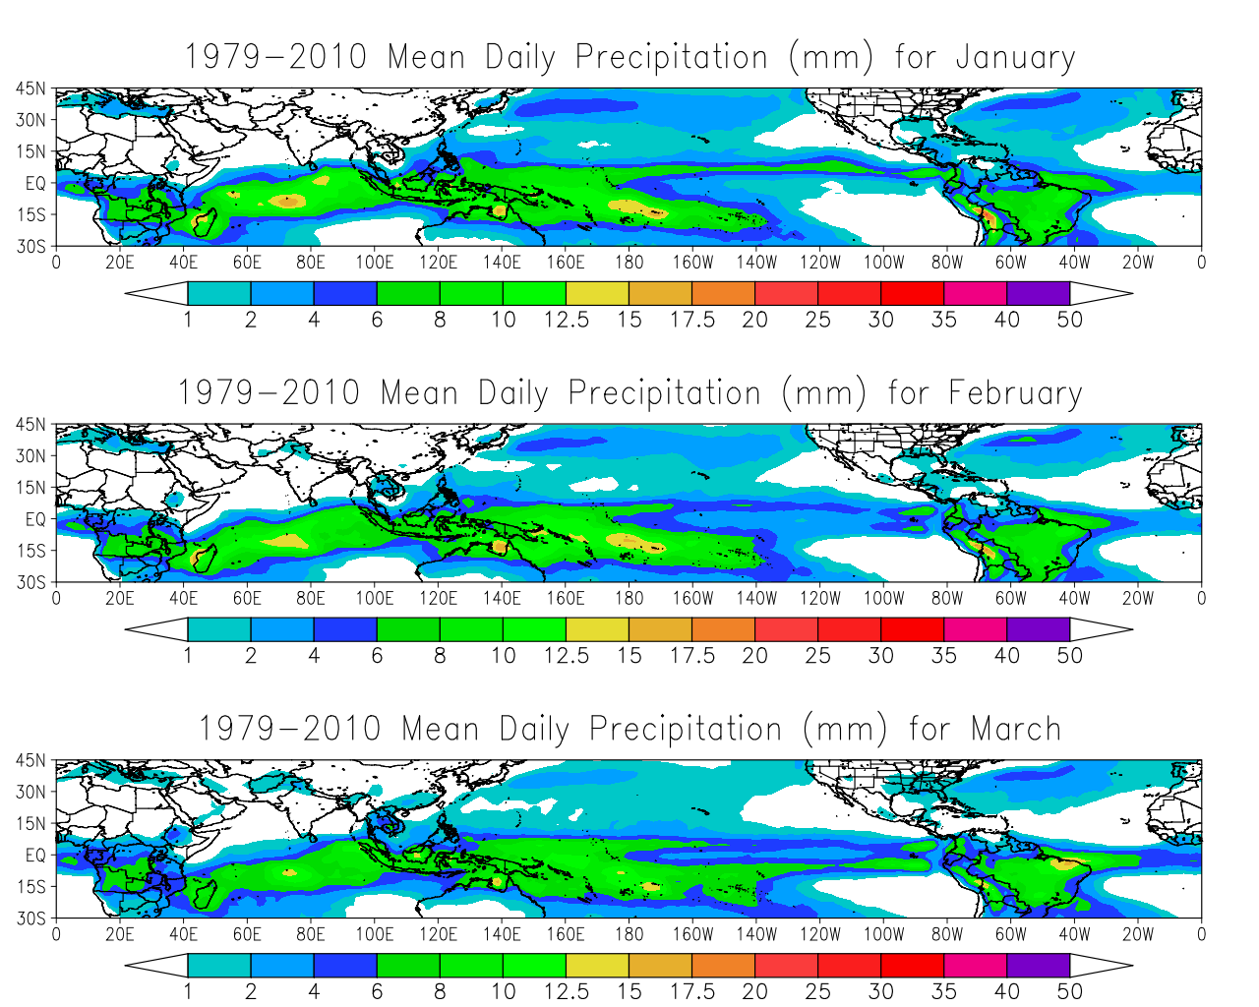
Mean Daily Precipitation: Jan-Mar
Enhanced precipitation found to the west, especially with Pacific circulation and over South America.
Figures obtained using the freely-available NCEP-DOE Reanalysis II dataset.

Slide 10
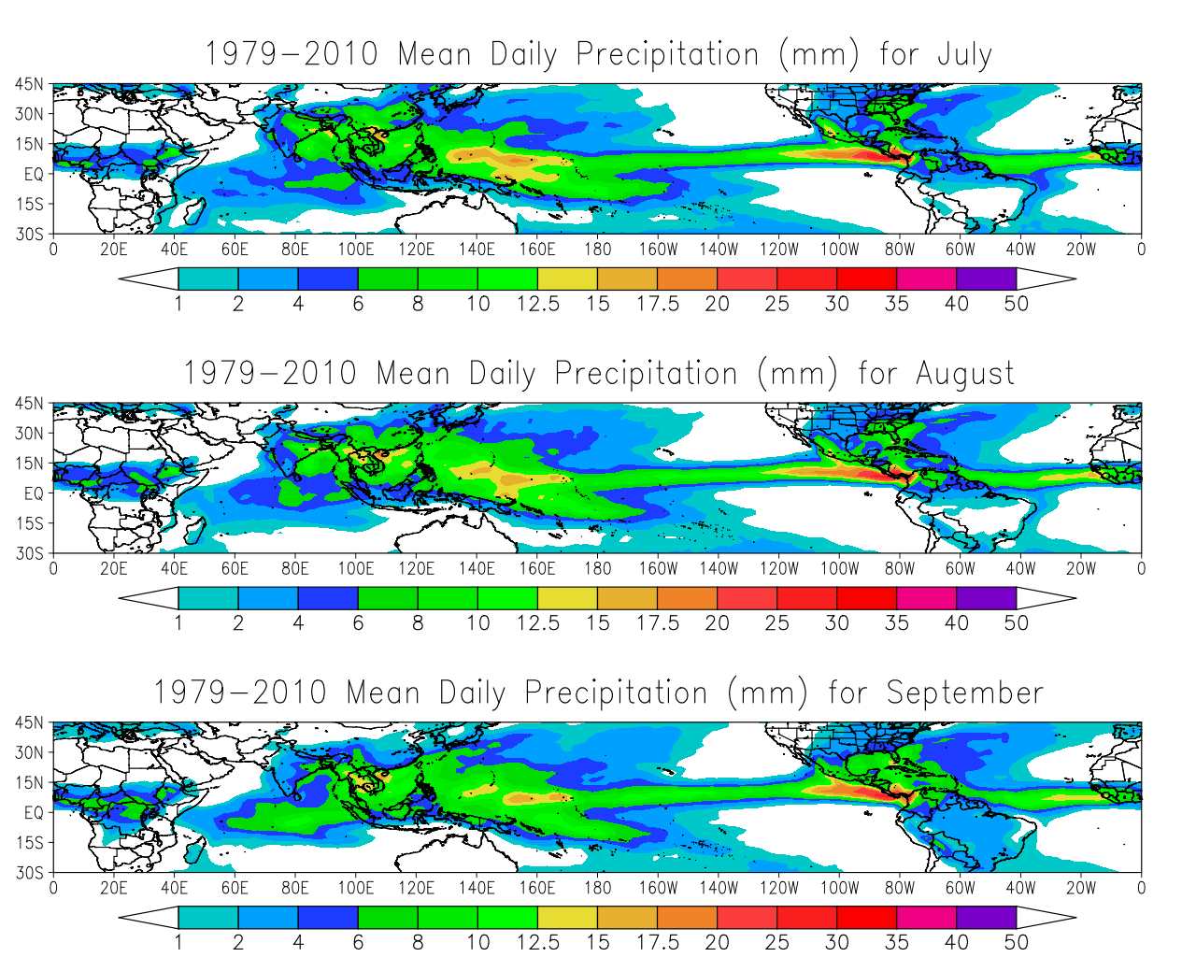
Mean Daily Precipitation: Jul-Sep
Northward shift of enhanced precipitation occurs but still favors the western branches of the three major zonal circulations.
Other heating-induced features also contribute to precipitation patterns, as we will discuss later.
Figures obtained using the freely-available NCEP-DOE Reanalysis II dataset.

Slide 11
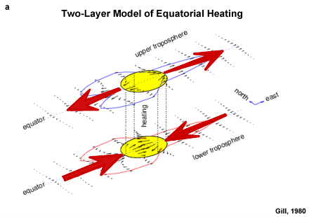
Linear Approximation: Walker Circulation
(Figure obtained from Introduction to Tropical Meteorology, 2nd Edition, © 2016 COMET.)

Slide 12
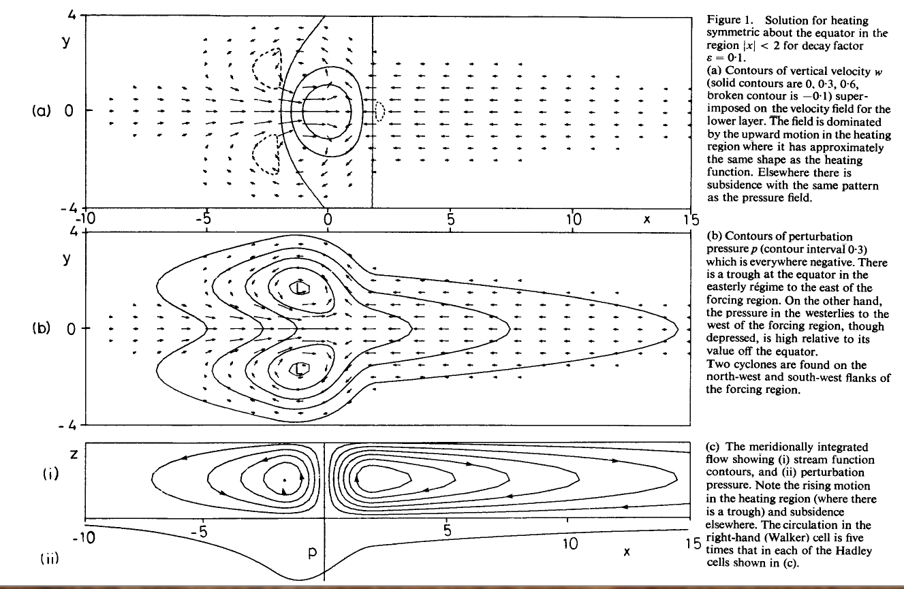
Linear Approximation: Walker Circulation
(u,v) - vectors
w - contours
(u,v) - vectors
p - contours
Meridionally-integrated flow
(Figure obtained from Gill (1980), © 1980 Royal Meteorological Society/Wiley Interscience.)

