Slide 1
Tweets on Google and Apple Products NLP Classifier
By: Konnor Clark

Slide 2
Overview and Business Understanding
Google wishes to classify Twitter sentiment about both their own products as well as Apple products.
Gauging the negative or positive feedback on Twitter opinion about Google and Apple products can assist Google with future product development by informing what aspects of a product were well or ill-received.

Slide 3
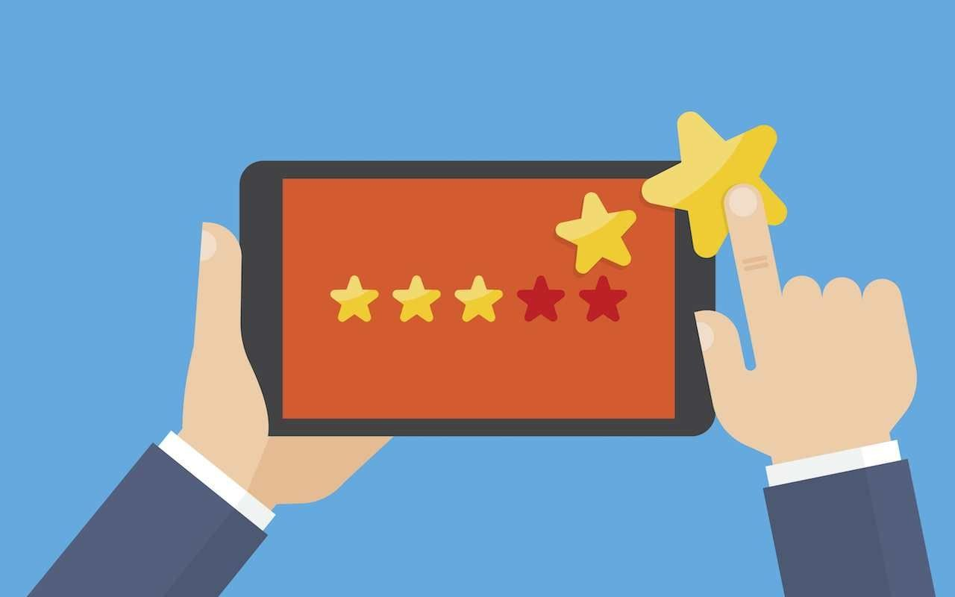

Business Questions
How can we categorize tweets as positive or negative?
What kind of terms and hashtags are more likely to surround or embody positive or negative sentiment?

Slide 4
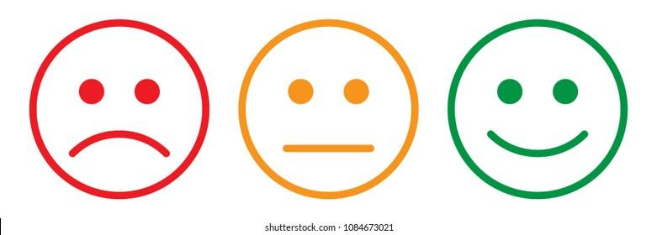

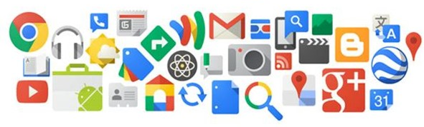
Data Understanding and Analysis: 3 Features
is_there_an_emotion_directed_at_a_brand_or_product
tweet_text
emotion_in_tweet_is_directed_at
Notes:
Emotion features includes positive, negative, no emotion.
Emotion directed at includes labels like Apple and Google, but also iPad, iPad or iPhone app, and iPhone. This could help the model, but perhaps should be relabeled for future iterations to be clearer and more distinguishable.

Slide 5
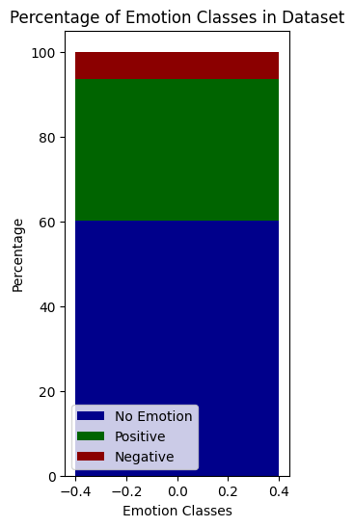
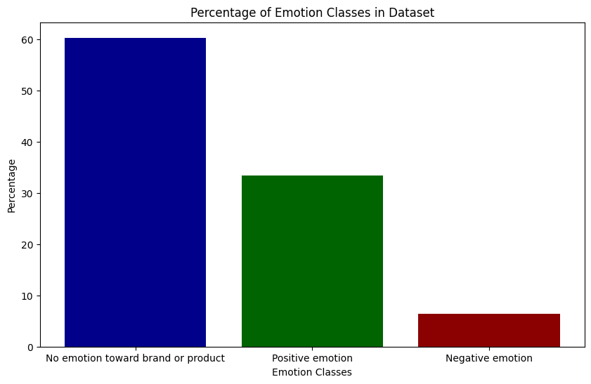
Data Understanding and Analysis: Class Imbalance
Notes:
We can see that this data is much more skewed toward no emotion tweets. Only 570 of the 8920 tweets are negative emotion, so the current model struggles to label the negative emotion accurately.

Slide 6
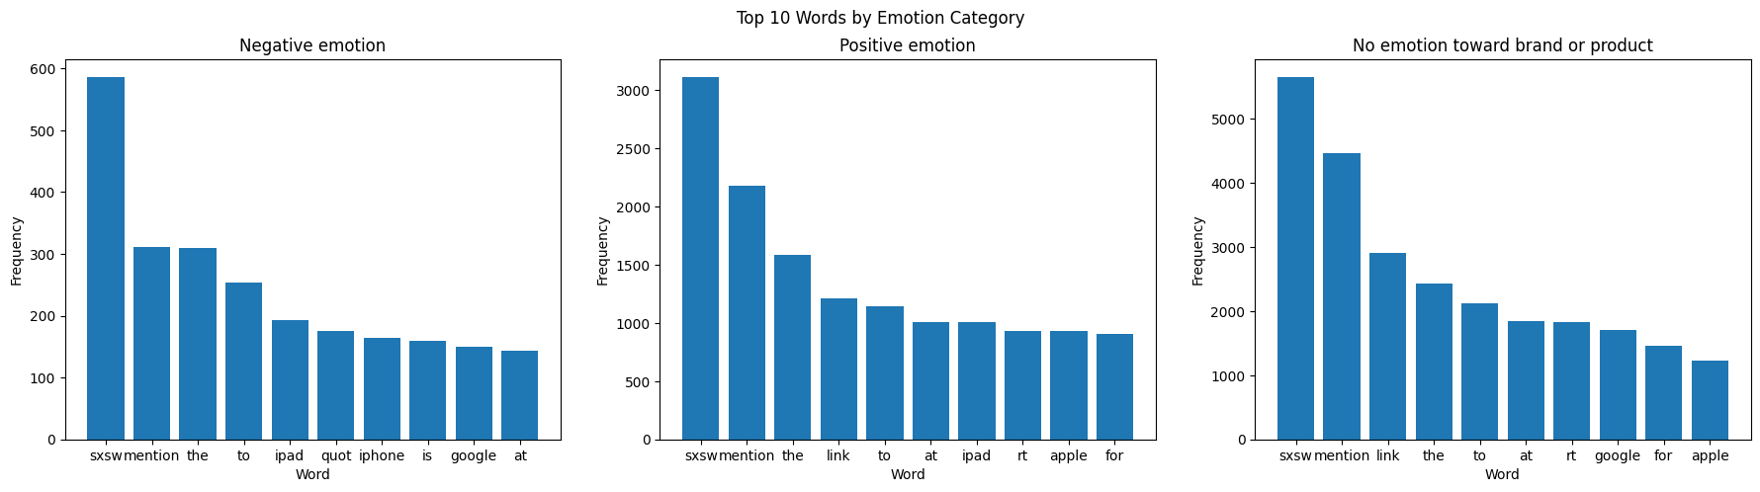
Data Understanding and Analysis
Notes:
Initial top words

Slide 7
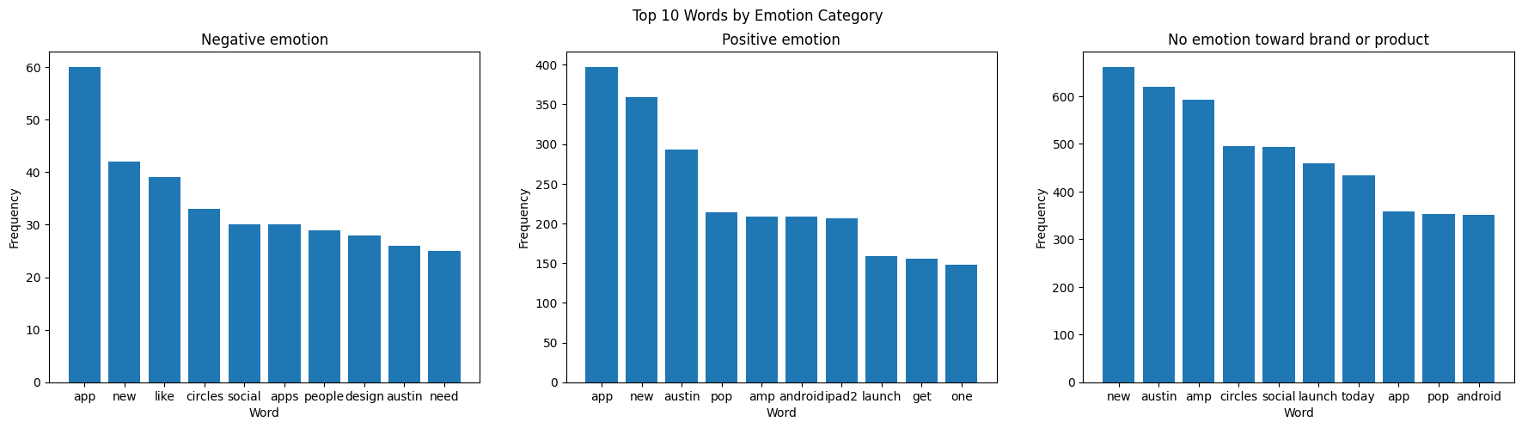
Data Understanding and Analysis
Notes:
After removing stop words and overlapping top 10.

Slide 8
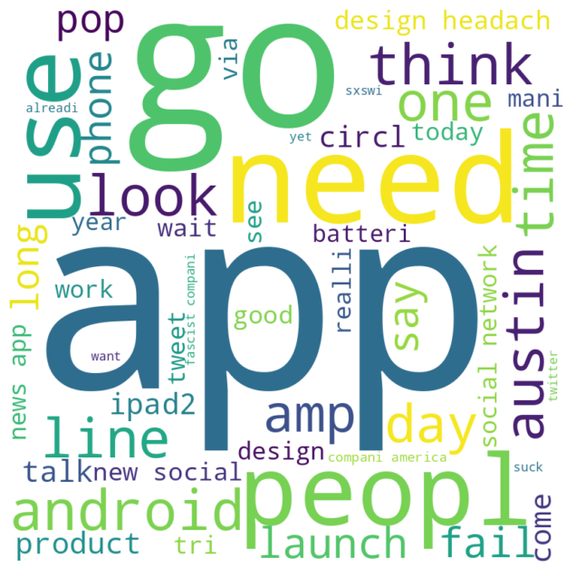
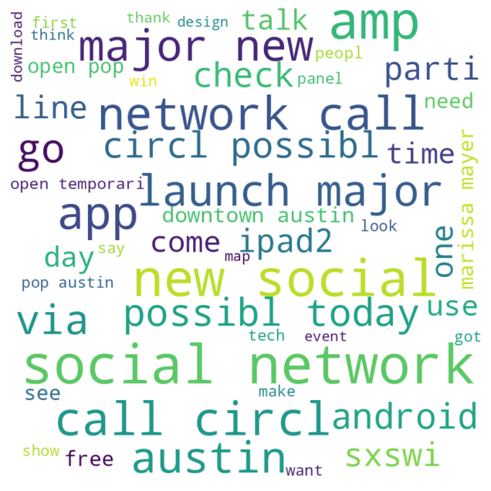
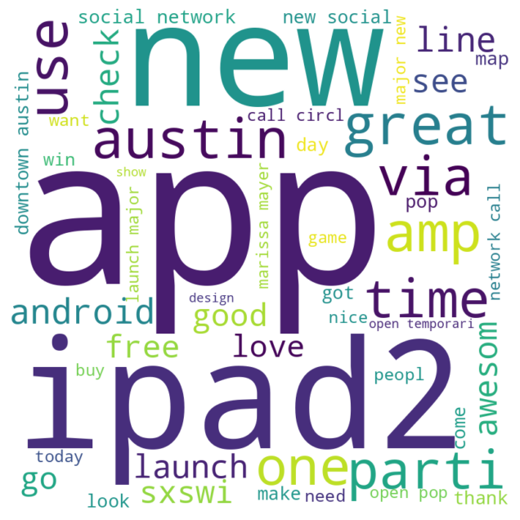
Word Clouds for each Emotion Class
Negative Emotion
No Emotion
Positive Emotion
Notes:
I was interested in the iPad2 in the Positive Emotion word cloud, so I removed all entries in the dataset except the ones labeled as positive emotion and ones containing the stem ipad2 in the stemmed tweets.

Slide 9
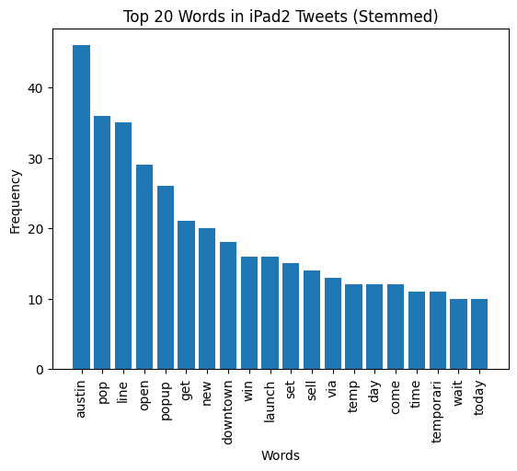
Notes:
Recall that the words new and austin are high frequency terms in all three emotion classes, while launch and pop are high frequency in two. Outside of these terms, the term "line" is the highest frequency, so let's take a look at the kinds of tweets that contain it (along with stem ipad2, of course)

Slide 10
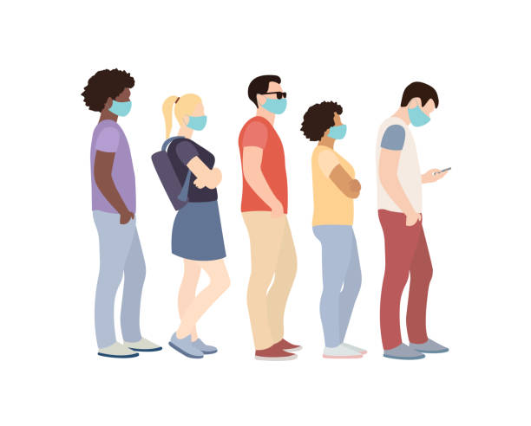
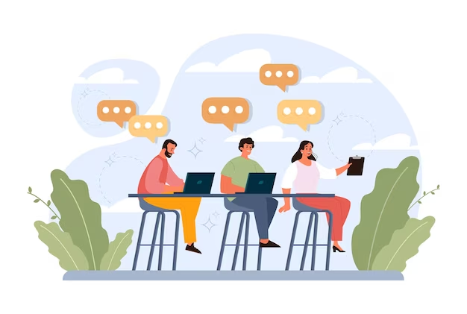
Tweets with “Line” and “iPad2”
Lines
Interest and Discussion
Notes:
Most of these tweets are about waiting in line and/or the size of the line to acquire the ipad2. Customers are talking about the lines for the ipad2 in a positive way, and so not only does queuing up for a new release seem to generate positive publicity concerning the product itself, but also tracking tweets with the term "line" may help Google track the positive zeitgeist surrounding the release of a product. The lines generate interest and discussion, which in turn likely generate lines, so these tweets are visual indicators of this phenomenon happening live.

Slide 11
Data Inaccuracies: Tweets Labeled as Positive
ipad2 takes over #sxsw. the line was already halfway down the block around noon. craziness
days later there's still a line out the door at the #sxsw apple store for the ipad2.
the line for the apple popup store at #sxsw stretches around the block...guess i won't be getting the ipad2
Notes:
I did discover, however, some potential problems with the dataset.

Slide 12
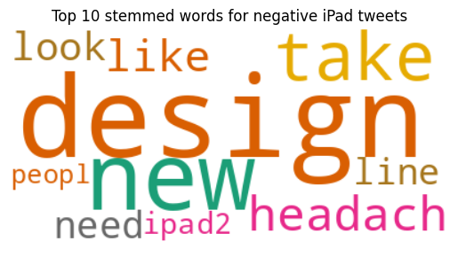
Word Cloud for Negative Emotion, iPad Product Tweets
“Design” most common stem in negative iPad tweets
Notes:
I then looked at the top 3 products for each emotion class and then created word clouds for each of these three products. Rather than show you all 9 word clouds, let’s focus on one. For the negative iPad tweets, the most common word was design, so let’s follow that thread.

Slide 13
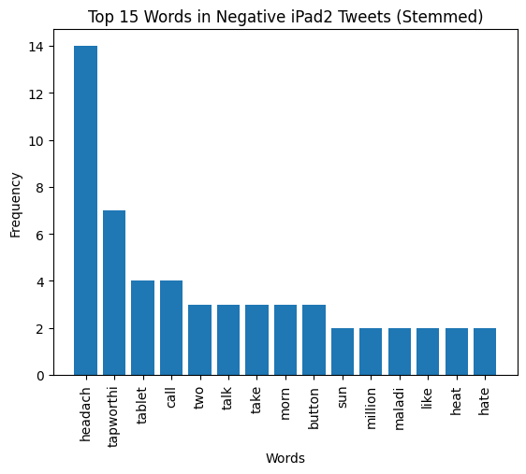
Notes:
I then looked at the top

Slide 14
Mislabeled iPad Tweets with Stems “Design” and “Headach”
attending @mention ipad design headaches #sxsw {link}
in ipad design headaches: take two tablets, call me in the am panel - excited to hear @mention live! #sxsw
headed for ipad design headaches (2 tablets, call in the morning) #sxsw {link}
Notes:
Perhaps surprisingly, this looks like the name of a talk given at South by Southwest, and perhaps has been mislabeled negatively, as most of these tweets are simply posting about their attendance at the talk itself. Some even express their interest in the talk, as in the second example.
This calls into question the data itself, as these tweets shouldn't be labeled as expressing negative emotions.

Slide 15
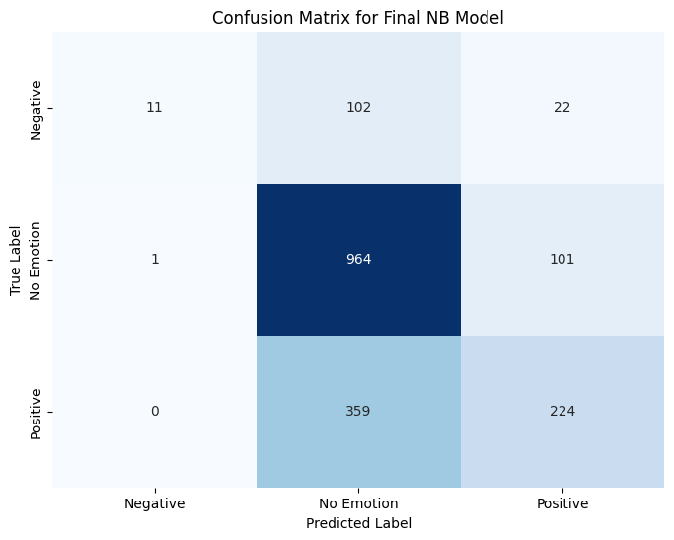
Precision: 75%
Recall: 46%
CV: 66%
Notes:
Green boxes where we want the high numbers. Accurate predictions.
The red boxes have higher numbers than ideal. Inaccurate predictions.
Precision: 0.75
Accuracy: 0.67
Recall: 0.46
F1 score: 0.47
Final CV score: [0.66386555 0.66783462 0.67203924 0.66012614 0.64891381]
If Google wants to prioritize precision, the final MultinomialNB model with precision of 0.75 is better, which means it correctly identifies more true positives and has fewer false positives.

Slide 16
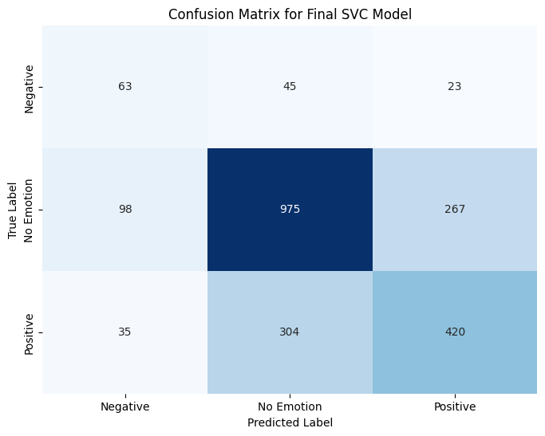
Precision: 55%
Recall: 59%
CV: 65%
Notes:
Green boxes where we want the high numbers. Accurate predictions.
The red boxes have higher numbers than ideal. Inaccurate predictions. This model has better true positives than the other model, so we will stick with this one as our final model.
Precision: 0.55
Accuracy: 0.65
Recall: 0.59
F1 score: 0.56
Final CV score: [0.64872945 0.66068759 0.66442451 0.64723468 0.6554559 ]
If Google wants to prioritize recall, the LinearSVC model with recall of 0.59 is better, which means it correctly identifies more true positives and has fewer false negatives.

Slide 17
Recommendations from Data
Follow High Frequency Stems
Interest and Discussion
Positive Emotion Words
Lines

Slide 18
Recommendations for Model
Further removal of overlapping tokens

Slide 19
Recommendations for Model
Additional Data

Slide 20
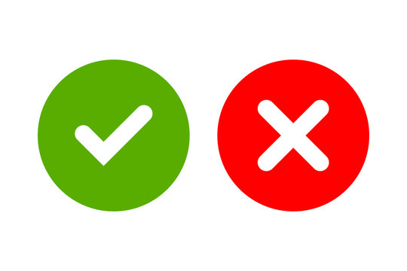
Recommendations for Model
Correct Mislabeled Data

Slide 21
Next Steps
Implementing the model on new data can begin after recommendations.
An analysis of the new data's tokens may prove useful, as demonstrated- what words are more likely to be contained in a negative or positive tweet?
Corresponding information in each of the three classes of tweets will provide Google keen insights for future product development based on these informal product reviews on twitter.
Notes:
Once token overlap is reduced, the additional data is included, and the cross-validation score is improved for the three classes,

Slide 22
Thank you
I would be happy to answer any questions
You may find my contact information below:
https://www.linkedin.com/in/konnorclark/

