Slide 1
DiFX at the US Naval Observatory
John Spitzak (USNO)
2016 DiFX Users Meeting, Shanghai

Slide 2
Correlator Work at USNO
All for Geodesy
Daily VLBI Observations
Determination of EOP and UT1 (LOD)
VLBA Observations (under investigation)
Pavlis, E.C. (2004)

Slide 3
Correlator Work at USNO
What is This For?
EOP and UT1 Published Daily
Vital for Timekeeping, Geodesists, etc.
Space Navigation/GPS

Slide 4
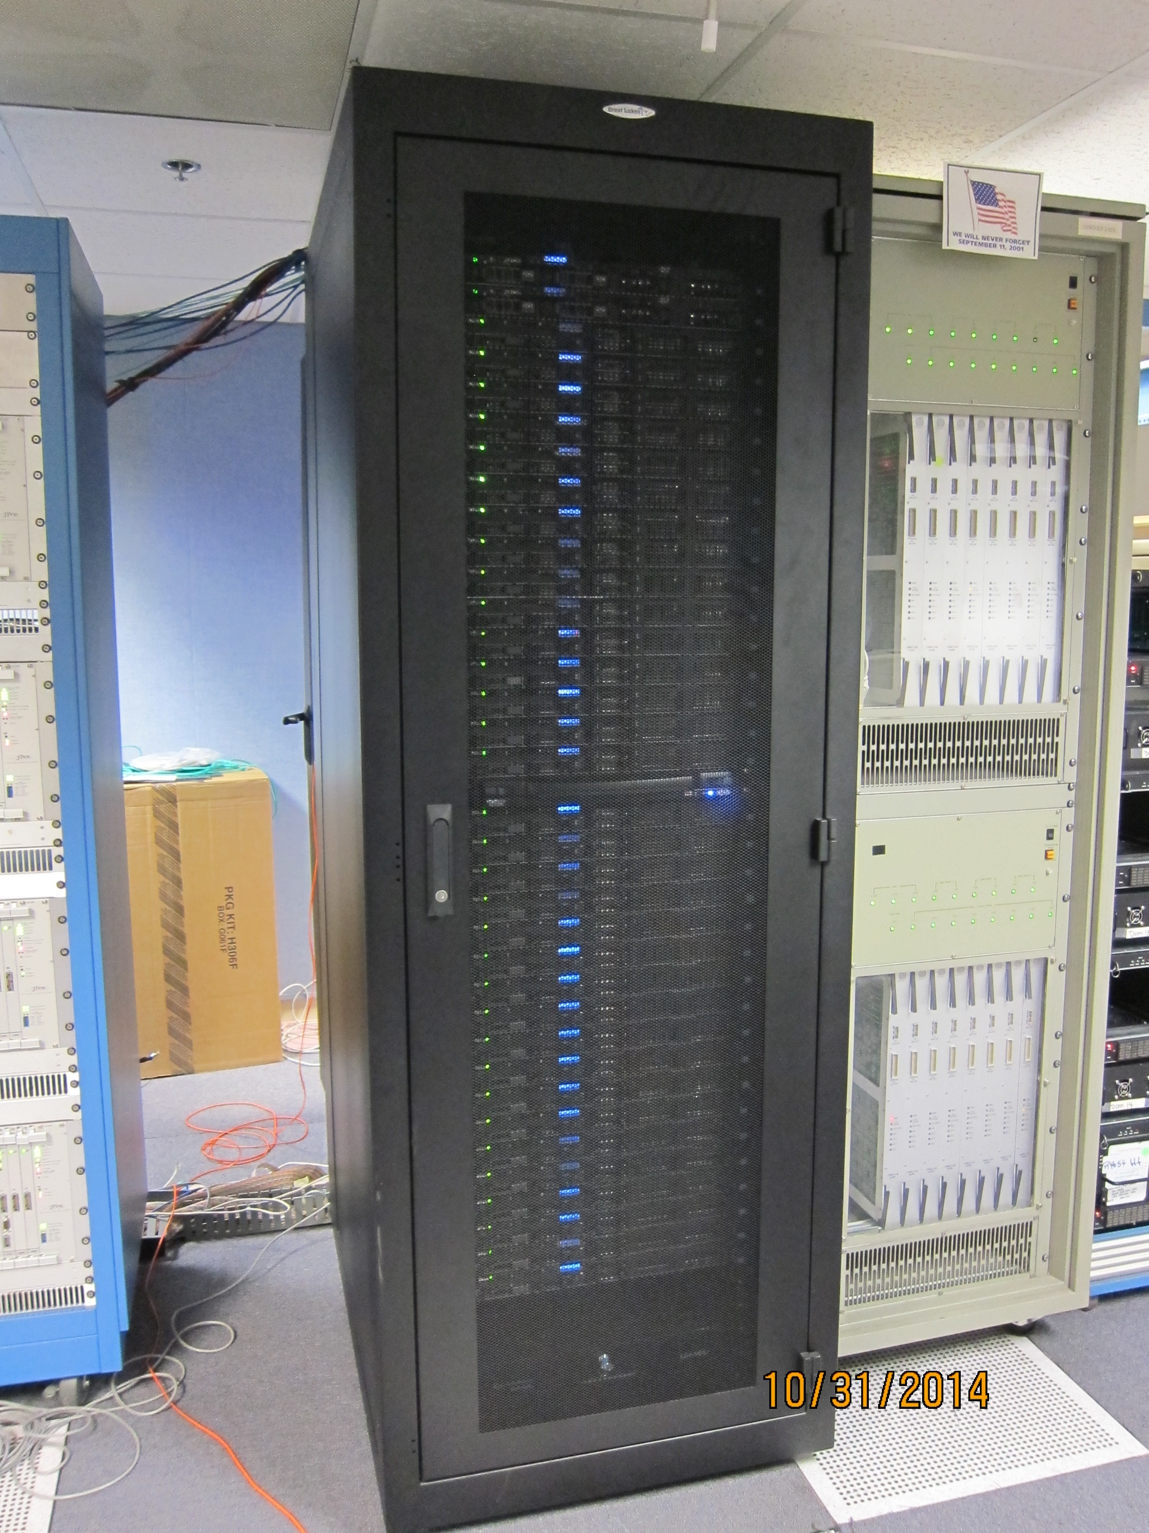
Dr. Gart Westerhout
WACO Software Correlator
^
Correlator Hardware
528 Processing Cores (33 Nodes)
64TB SAN
170 TB Lustre System
3 Mark5 Units (many spares)
Running Since 2014
Correlator Software
DiFX Version 2.2_r5454
Newer Versions Evaluated

Slide 5
DiFX Version 2.2??
Tried and Tested for Geodesy
Unchanging Processing Needs
Large Data Volumes
Daily Requirements

Slide 6
DiFX Version 2.2??
Tried and Tested for Geodesy
Unchanging Processing Needs
Large Data Volumes
Daily Requirements
Conservative Customer Base
Operationally Oriented
Mistakes are Unpleasant
“If it ain’t broke, don’t fix it” - unknown

Slide 7
Developments
Koke’e Park
Fully VGOS-compatible 12m
Support Systems Upgrade
Correlator Expansion
Double Processing Power
Mark6 Installation
DiFX to Support VGOS
KPGO 20m (left) and 12m VGOS-compatible
VLBI Group Expansion
Four New Staff Members
Moving to 24/7 Monitoring/Operations
Automation
Cloud Correlation?

Slide 8
USNO DiFX Wish List
Reliable Geodetic Processing
VGOS Support
Cloud Correlation

