Slide 1
Pandas –
Python And Data Analysis

Slide 2
特性
程式版的Excel套件
完整包含(import)下列套件: NumPy, Scipy, Matplotlab
兩種資料架構:
Series Object:兩個一維陣列: XX[索引]=[資料]
DataFrame Object:類似database的table, 如excel的cell,為二維矩陣標示一個格子資料, 每一個cell可以是不同的資料型態;
可直接載入和輸出:CSV, JSON, HTML
方便的日期格式與運算
群組整合功能: aggregating dataset transforming

Slide 3
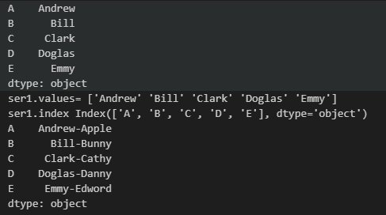
Series Object 操作 pandas.Series([],index=[])
import pandas as pd
#create series obj
indexlist = ['A','B', 'C', 'D', 'E']
ser1 = pd.Series(["Andrew","Bill","Clark","Doglas","Emmy"], index=indexlist)#如果沒有設index, Pandas會自行建立
print(ser1)
print("ser1.values=",ser1.values) #列印value list
print( "ser1.index", ser1.index) #列印 index list
ser2 = pd.Series(["Apple","Bunny","Cathy","Danny","Edword"], index=indexlist )
print(ser1+"-"+ser2) #有相同的index的 series object 相加
list

Slide 4
Series Object 操作 物件相加
import pandas as pd
#value為數字, 又有相同index的series obj 相加
indexlist = ['A','B', 'C', 'D', 'E']
ser1 = pd.Series([100,200,300,400,500], index=indexlist)
ser2 = pd.Series([10,20,30,40,50], index=indexlist)
print("ser1:") ;print(ser1)
print( "ser2:");print(ser2)
print("ser1 – ser2"); print(ser1 - ser2)
print("sum(ser1+ser2)=", sum(ser1+ser2))
ser1:
A 100
B 200
C 300
D 400
E 500
dtype: int64
ser2:
A 10
B 20
C 30
D 40
E 50
dtype: int64
ser1 – ser2
A 90
B 180
C 270
D 360
E 450
dtype: int64
sum(ser1+ser2)= 1650

Slide 5
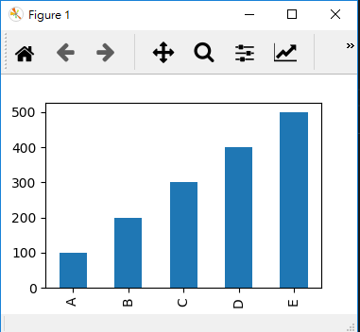
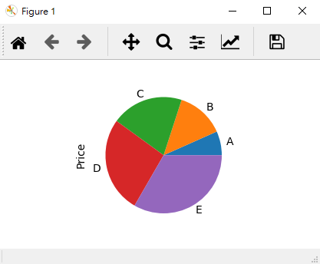
Series Object 操作 使用 Series Obj 繪圖
import pandas as pd
import matplotlib.pyplot as plt
indexlist = ['A','B', 'C', 'D', 'E']
ser1 = pd.Series([100,200,300,400,500], index=indexlist, name="Price")
ser1.plot(kind="bar")
plt.show()
ser1.plot(kind="bar")
ser1.plot(kind="pie")

Slide 6
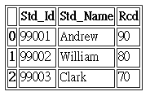
DataFrame Object 操作 pandas.Series([],index=[]), .to_json(), read_json()
DataFrame 就像表格 或 Excel試算表; 或想像成 有索引的SeriesObj所組成的Dictionary
有 列 與 欄
單一個 cell只有一種資料型態
list
import pandas as pd
myDict = { "Std_Id": ["99001", "99002", "99003"],
"Std_Name": ["Andrew","William", "Clark"],
"Rcd": [90,80,70]
}
myData = pd.DataFrame(myDict)
print(myData)
myHtml = myData.to_html() #也可直接輸出 .to_html("c:\\test\\myHTML.html")
print("myHtml:");print(myHtml)
myJson = myData.to_json () #也可直接輸出 .to_json("c:\\test\\myJSON.json")
print("myJson:");print(myJson)
欄位
值

Slide 7
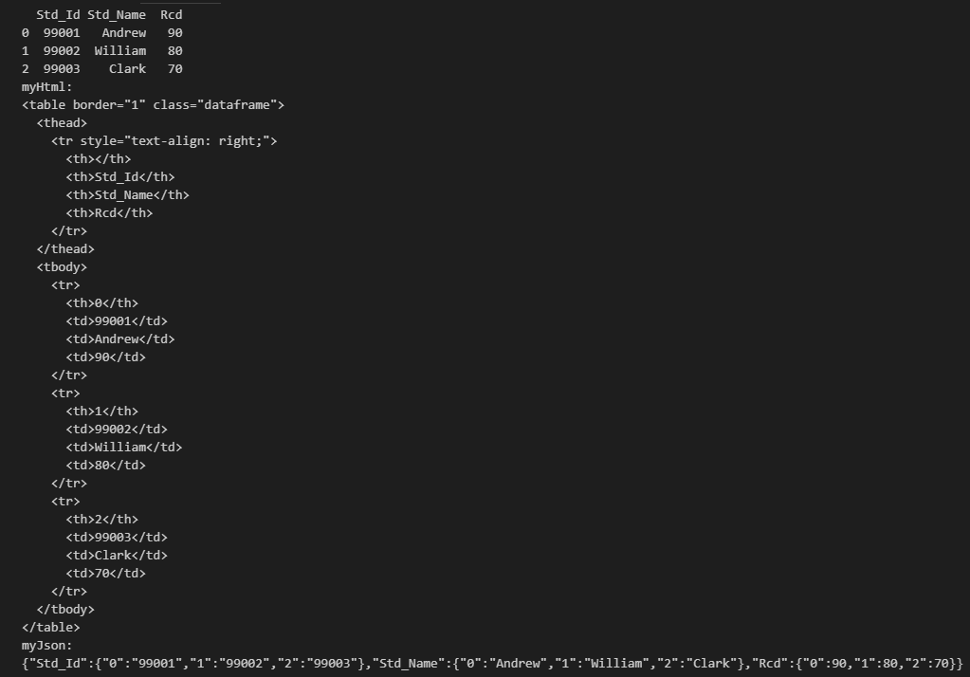
html
json

Slide 8
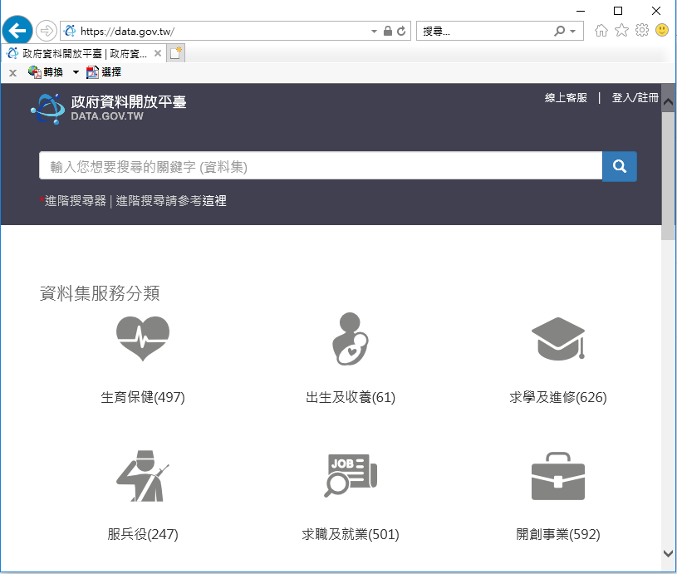
練習: https://data.gov.tw/ 為政府資料開放平台, 下載一個 json, 讀入程式, 並寫成一個.csv檔, 用 Excel開啟閱讀
備註:有亂碼時試試
encoding='utf_8_sig', 'uft-8", 'utf-8'

Slide 9
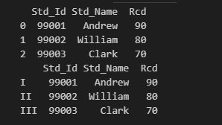
DataFrame Object 操作 利用list建立index
myDict = { "Std_Id": ["99001", "99002", "99003"],
"Std_Name": ["Andrew","William", "Clark"],
"Rcd": [90,80,70]
}
myData = pd.DataFrame(myDict)
print(myData)
#補建索引 idxList = ["I", "II","III"]
myData.index = idxList
print(myData)
#上面也可以建立DataFrame時就附帶index:
# myData=pd.DataFrame(myDict, index=idxList)

Slide 10


DataFrame Object 操作 調整欄位的順序columns
myDict = { "Std_Id": ["99001", "99002", "99003"],
"Std_Name": ["Andrew","William", "Clark"],
"Rcd": [90,80,70]
}
idxList = ["I", "II","III"]
myData = pd.DataFrame(myDict, columns=("Rcd","Std_Id", "Std_Name"), index=idxList)
print(myData)
#在DataFrame建立後才指定columns, 指示更改title, data不會跟著搬
myData.columns=("Std_Name","Std_Id", "Rcd")
print(myData)
不可寫為rcd,大小寫不同

Slide 11


DataFrame Object 操作 利用現有欄位做為建立index
myDict = { "Std_Id": ["99001", "99002", "99003"],
"Std_Name": ["Andrew","William", "Clark"],
"Rcd": [90,80,70]
}
idxList = ["I", "II","III"]
myData = pd.DataFrame(myDict, columns=("Rcd","Std_Id", "Std_Name"), index=myDict["Rcd"])
print(myData)
利用現有欄位做為建立index, 通常會將該欄位從columns移除,也就是 columns=("std_id", "Std_Name")
#欄列互換
print(myData.T)

Slide 12
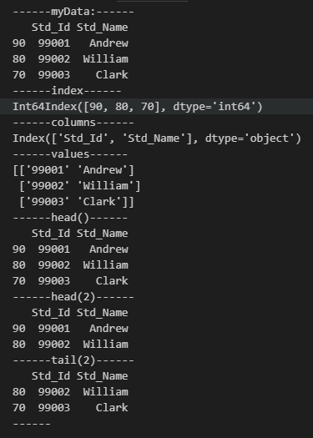
DataFrame Object 操作 .index, .columns, .values, .head(), .tail()
myDict = { "Std_Id": ["99001", "99002", "99003"],
"Std_Name": ["Andrew","William", "Clark"],
"Rcd": [90,80,70]
}
idxList = ["I", "II","III"]
myData = pd.DataFrame(myDict, columns=("Std_Id", "Std_Name"), index=myDict["Rcd"])
print("------myData:------")
print(myData);
print("------index------");print(myData.index); #index list
print("------columns------");print(myData.columns); #columns list
print("------values------");print(myData.values); #values list
print("------head()------");print(myData.head()); #前5筆
print("------head(2)------");print(myData.head(2)); #前2筆
print("------tail(2)------");print(myData.tail(2)); #最後2筆
print("------")

Slide 13
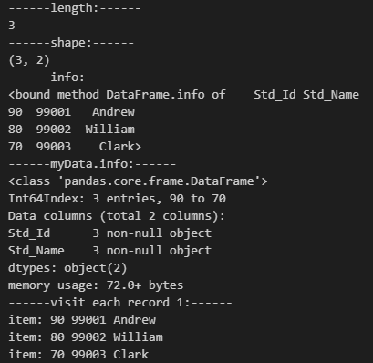
DataFrame Object 操作 .index, .columns, .values, .head(), .tail()
print("------length:------"); print(len(myData))
print("------shape:------"); print(myData.shape)
print("------info:------"); print(myData.info)
print("------myData.info:------"); myData.info()
print("------visit each record 1:------")
for idx, row in myData.iterrows():
print("item:", idx, row["Std_Id"], row["Std_Name"])

Slide 14
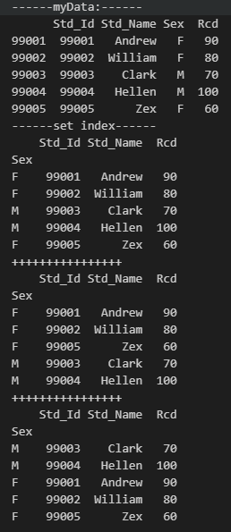
DataFrame Object 操作 .sort_index,
myDict = { "Std_Id": ["99001", "99002", "99003", "99004", "99005"],
"Std_Name": ["Andrew","William", "Clark", "Hellen", "Zex"],
"Rcd": [90,80,70, 100, 60],
"Sex": ["F", "F", "M", "M", "F"]
}
myData = pd.DataFrame(myDict, columns=("Std_Id", "Std_Name", "Sex", "Rcd"), index=myDict["Std_Id"])
print("------myData:------");print(myData)
print("------set index------");myData1 = myData.set_index("Sex")
#myData2 = myData1.reset_index()
print(myData1.head())
print("++++++++++++++++")
myData1 = myData.set_index("Sex")
myData1.sort_index(ascending=True, inplace=True) #先排Sex(由小到大, ascending=True)
print(myData1.head())
print("++++++++++++++++")
myData1 = myData.set_index("Sex","Std_Id")
myData1.sort_index(ascending=False, inplace=True) #先排Sex, 再排Std_Id(Sex由大到小)
print(myData1.head())
#inplace表示將結果取代現有的myData2

Slide 15
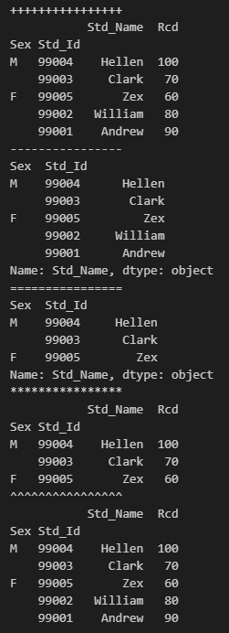
import pandas as pd
myDict = { "Std_Id": ["99001", "99002", "99003", "99004", "99005"],
"Std_Name": ["Andrew","William", "Clark", "Hellen", "Zex"],
"Rcd": [90,80,70, 100, 60],
"Sex": ["F", "F", "M", "M", "F"]
}
myData = pd.DataFrame(myDict, columns=("Std_Id", "Std_Name", "Sex", "Rcd"), index=myDict["Std_Id"])
print("++++++++++++++++")
myData1 = myData.set_index(["Sex","Std_Id"])
myData1.sort_index(ascending=False, inplace=True)
print(myData1.head())
print("----------------")
print(myData1["Std_Name"].head()) #不可看 "Sex" 或 "Std_Id"
print("================")
print(myData1.Std_Name.head(3)) #前三筆 ,不可看 "Sex" 或 "Std_Id"
print("****************")
print(myData1[:3])
print("^^^^^^^^^^^^^^^^")
print(myData1[["Std_Name", "Rcd"]].head()) # 不可以有"Sex", 它在list Index 的1st欄位
欄位名稱清單不能有["Sex", "Std_Id"]任一欄位, 因為已經會出現在index 欄

Slide 16
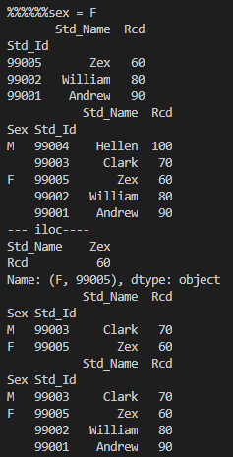
DataFrame Object 操作 .loc(標籤索引)
print("%%%%%%sex = F")
print(myData1.loc["F"]) #印出 Sex = "F"
print(myData1.loc[:, ["Std_Name", "Rcd"]]) #印出 Std_Name Rcd
print("--- iloc----")
print(myData1.iloc[2])
print(myData1.iloc[1:3, 1:2]) # 1:3 表 第2筆到第4筆資料, 1:2 2-Rcd
print(myData1.iloc[[1,2,3,4], [0,1]]) #第1,2,3,4筆, 第0,1欄位
第 2到第4筆
第 2到第3欄位, 用 : 表示全部欄位

Slide 17
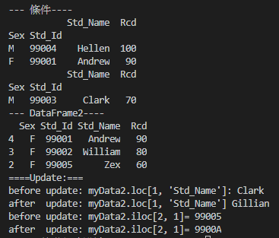
#條件查詢
print("--- 條件----")
print(myData1[myData1.Rcd >= 90])
print(myData1[myData1.Std_Name == "Clark"]) #放在 index list的欄位不可當條件
#重新crete 一個 DataFrame
print("--- DataFrame2----")
myData2 = myData1.reset_index()
myData2.sort_index(ascending=False, inplace=True) #inplace表示將結果取代現有的myData2
print(myData2[myData2.Sex == "F"]) #現有欄位都沒放在index list,所有欄位可用
#Update
print("====Update:===")
print("before update: myData2.loc[1, 'Std_Name']:", myData2.loc[1, "Std_Name"])
myData2.loc[1, "Std_Name"] = "Gillian" #Update
print("after update: myData2.loc[1, 'Std_Name']", myData2.loc[1, "Std_Name"])
print("before update: myData2.iloc[2, 1]=",myData2.iloc[2, 1]) #Std_Id
myData2.iloc[2,1] = "9900A" #Update
print("after update: myData2.iloc[2, 1]=",myData2.iloc[2, 1]) #Std_Id

Slide 18
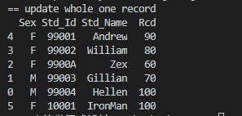
#insert new record
print("== update whole one record")
sm = [ "F","10001", "IronMan", 100]
myData2.loc[5] = sm
print(myData2)
#delete record

Slide 19
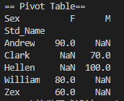
DataFrame Object 操作 pivot table 樞紐分析表
#print("== Pivot Table==")
myData_Pivot = myData.pivot_table(index="Std_Name", columns="Sex", values="Rcd" )
print(myData_Pivot)

Slide 20
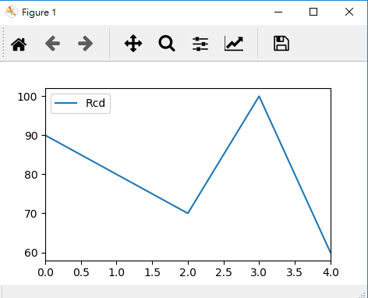
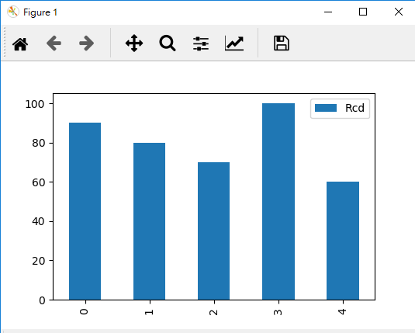
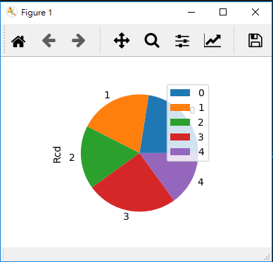
DataFrame Object 操作 統計圖
import pandas as pd
import matplotlib.pyplot as plt
myDict = { "Std_Id": ["99001", "99002", "99003", "99004", "99005"],
"Rcd": [90,80,70, 100, 60]
}
myData = pd.DataFrame(myDict)
myData.plot(kind="bar")
#myData.plot()
#myData.plot(kind="pie", y="Rcd")
plt.show()

Slide 21
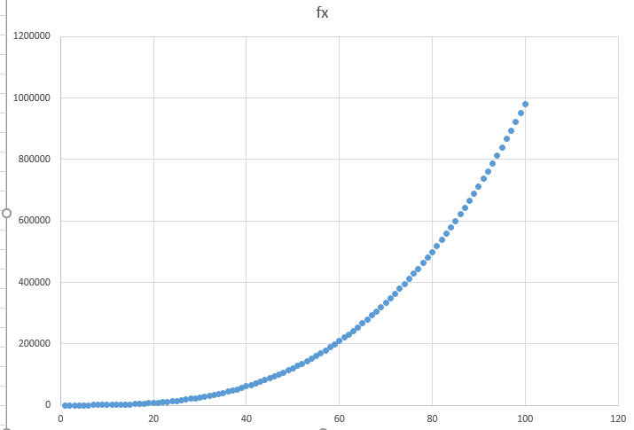
練習: 利用DataFrame Object , 劃出 : f(x) = x³ - 2x² + 2x 的曲線圖

Slide 22
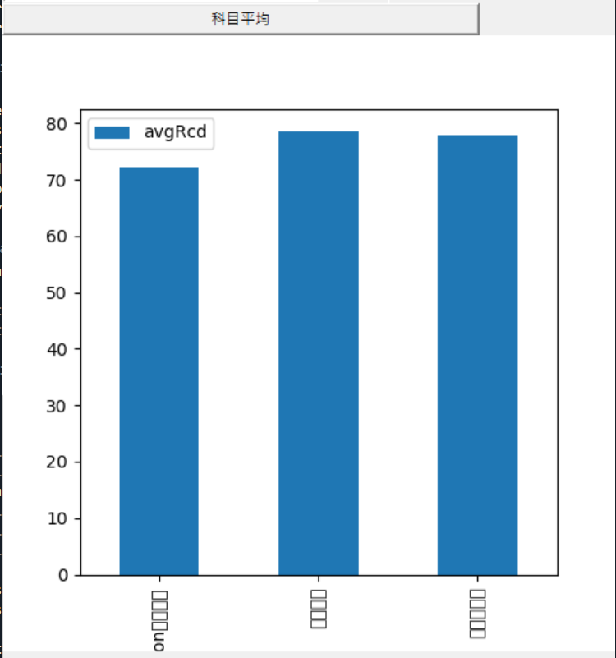
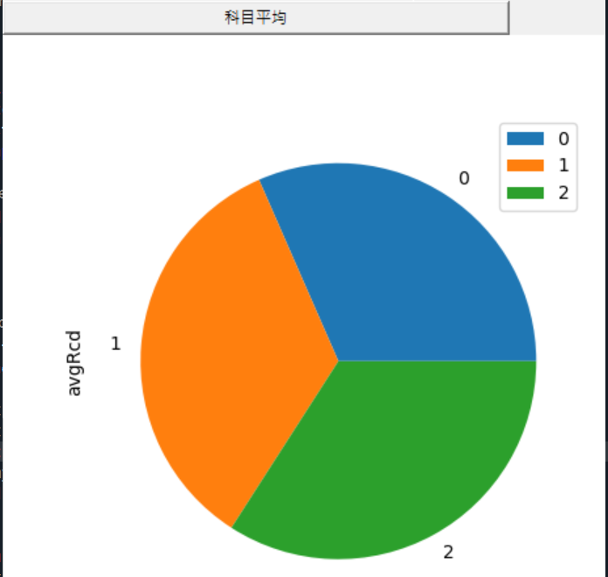
將圖畫在tkinter需使用Dataframe
使用Dataframe需使用Dictionary
Kind='bar'
下頁顯示程式getStat()

Slide 23
# -*- coding: utf-8 -*-
"""
Created on Wed Dec 16 18:41:21 2020
@author: Administrator
"""
from tkinter import *
from matplotlib.figure import Figure
from matplotlib.backends.backend_tkagg import (FigureCanvasTkAgg, NavigationToolbar2Tk)
import sqlite3
import matplotlib.pyplot as plt
import pandas as pd
def execSQLcommand(sqlstr):
global myConn
global myCursor
try:
myCursor = myConn.execute(sqlstr)
myConn.commit()
print("指令已成功執行:" + sqlstr)
return myCursor
except:
print("指令有誤:", sqlstr)
myConn = sqlite3.connect("student.db")
myCursor = myConn.cursor()
win = Tk()
win.geometry('500x500')
def getAvg():
sqlstr = "select c.course_name as course_name, avg(r.rcd) as avgRcd"
sqlstr += " from course c, record r "
sqlstr += " where r.course_id = c.course_id "
sqlstr += " group by c.course_name "
listx = execSQLcommand(sqlstr).fetchall()
#--------------------
courseList = []
avgList=[]
for item in listx:
courseList.append(item[0])
avgList.append(item[1])
#產生Dataframe-------
myDframe = pd.DataFrame({'course_name':courseList, 'avgRcd':avgList})
#產生Figuration-----
fig = Figure(figsize = (5, 5), dpi = 100)
plot1 = fig.add_subplot(111)
#
#plot1.plot(x, y1)
#plot1.plot(x, y2, linestyle='-', color='r')
myDframe.plot(x='course_name', y='avgRcd', ax=plot1, kind='bar')
#plot1.plot(myDframe)
#plot1.legend()
#plot1.grid()
#
canvas = FigureCanvasTkAgg(fig, master = win)
canvas.get_tk_widget().grid(row=3, column=0, columnspan=3)
btnGetStat = Button(win, text='科目平均', command=getAvg)
btnGetStat.grid(row=2, column=0, columnspan=2 ,sticky=S+W+E)
win.mainloop()
產生Dictionary
由dictionary產生DataFrame

Slide 24
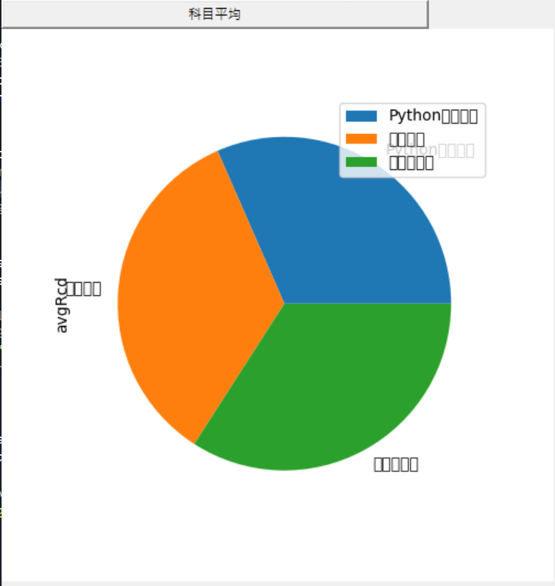
將上頁的程式
myDframe.plot(x='course_name', y='avgRcd', ax=plot1, kind='bar')
改為
myDframe.plot(x='course_name', y='avgRcd', ax=plot1, kind='pie', labels=courseList)

Slide 25
DataFrame.plot(x=None, y=None, kind='line', ax=None, subplots=False, sharex=None, sharey=False, layout=None,figsize=None, use_index=True, title=None, grid=None, legend=True, style=None, logx=False, logy=False, loglog=False, xticks=None, yticks=None, xlim=None, ylim=None, rot=None, xerr=None,secondary_y=False, sort_columns=False, **kwds)
x : label or position, default None#指數據框列的標籤或位置參數
y : label or position, default None
kind : str ‘line’ : line plot (default)#折線圖 ‘bar’ : vertical bar plot#橫條圖 ‘barh’ : horizontal bar plot#橫向橫條圖 ‘hist’ : histogram#柱狀圖 ‘box’ : boxplot#箱線圖 ‘kde’ : Kernel Density Estimation plot#Kernel 的密度估計圖，主要對柱狀圖添加Kernel 概率密度線 ‘density’ : same as ‘kde’ ‘area’ : area plot#不瞭解此圖 ‘pie’ : pie plot#圓形圖 ‘scatter’ : scatter plot#散點圖 需要傳入columns方向的索引 ‘hexbin’ : hexbin plot#不瞭解此圖
ax : matplotlib axes object, default None#**子圖(axes, 也可以理解成坐標軸) 要在其上進行繪製的matplotlib subplot對象。如果沒有設置，則使用當前matplotlib subplot**其中，變數和函數通過改變figure和axes中的元素（例如：title,label,點和線等等）一起描述figure和axes，也就是在畫布上繪圖。
subplots : boolean, default False#判斷圖片中是否有子圖 Make separate subplots for each column
sharex : boolean, default True if ax is None else False#如果有子圖，子圖共x軸刻度，標籤 In case subplots=True, share x axis and set some x axis labels to invisible; defaults to True if ax is None otherwise False if an ax is passed in; Be aware, that passing in both an ax and sharex=True will alter all x axis labels for all axis in a figure!
sharey : boolean, default False#如果有子圖，子圖共y軸刻度，標籤 In case subplots=True, share y axis and set some y axis labels to invisible
layout : tuple (optional)#子圖的行列佈局 (rows, columns) for the layout of subplots
figsize : a tuple (width, height) in inches#圖片尺寸大小
use_index : boolean, default True#預設用索引做x軸 Use index as ticks for x axis

Slide 26
title : string#圖片的標題用字串 Title to use for the plot
grid : boolean, default None (matlab style default)#圖片是否有網格 Axis grid lines
legend : False/True/’reverse’#子圖的圖例，添加一個subplot圖例(默認為True) Place legend on axis subplots
style : list or dict#對每列折線圖設置線的類型 matplotlib line style per column
logx : boolean, default False#設置x軸刻度是否取對數 Use log scaling on x axis logy : boolean, default False Use log scaling on y axis
loglog : boolean, default False#同時設置x，y軸刻度是否取對數 Use log scaling on both x and y axes
xticks : sequence#設置x軸刻度值，序列形式（比如列表） Values to use for the xticks
yticks : sequence#設置y軸刻度，序列形式（比如列表） Values to use for the yticks
xlim : 2-tuple/list#設置坐標軸的範圍，列表或元組形式
ylim : 2-tuple/list rot : int, default None#設置軸標籤（軸刻度）的顯示旋轉度數 Rotation for ticks (xticks for vertical, yticks for horizontal plots)
fontsize : int, default None#設置軸刻度的字體大小 Font size for xticks and yticks
colormap : str or matplotlib colormap object, default None#設置圖的區域顏色 Colormap to select colors from. If string, load colormap with that name from matplotlib.
colorbar : boolean, optional #圖片柱子 If True, plot colorbar (only relevant for ‘scatter’ and ‘hexbin’ plots)
position : float Specify relative alignments for bar plot layout. From 0 (left/bottom-end) to 1 (right/top-end). Default is 0.5 (center)
table : boolean, Series or DataFrame, default False #如果為正，則選擇DataFrame類型的資料並且轉換匹配matplotlib的佈局。 If True, draw a table using the data in the DataFrame and the data will be transposed to meet matplotlib’s default layout. If a Series or DataFrame is passed, use passed data to draw a table. yerr : DataFrame, Series, array-like, dict and str See Plotting with Error Bars for detail.
xerr : same types as yerr.
stacked : boolean, default False in line and bar plots, and True in area plot. If True, create stacked plot.
sort_columns : boolean, default False # 以字母表順序繪製各列，預設使用前列順序
secondary_y : boolean or sequence, default False ##設置第二個y軸（右y軸） Whether to plot on the secondary y-axis If a list/tuple, which columns to plot on secondary y-axis
mark_right : boolean, default True When using a secondary_y axis, automatically mark the column labels with “(right)” in the legend
kwds : keywords Options to pass to matplotlib plotting method
Returns:axes : matplotlib.AxesSubplot or np.array of them

Slide 27
Datframe.plot(kind='圖形類型')
‘line’ : line plot (default) 折線圖
‘bar’ : vertical bar plot 垂直方塊
‘barh’ : horizontal bar plot
‘hist’ : histogram 水平條狀圖
‘box’ : boxplot 箱線圖, 五個統計量, 觀察對稱姓
‘kde’ : Kernel Density Estimation plot
‘density’ : same as ‘kde’ 機率分配圖
‘area’ : area plot 面積消長
‘pie’ : pie plot 圓餅圖
‘scatter’ : scatter plot 點狀圖
‘hexbin’ : hexbin plot. x必須數值資料

Slide 28
解決中文問題

Slide 29
在 Python 上通常最常見的繪圖套件包就是Matplotlib。其他繪圖套件包的基礎也是以Matplotlib 為基礎, 只要完成Matplotlib 設定基本上其他套件包的中文顯示設定也會解決！
解法：
方法一、 "設定字體絕對路徑",放在程式, 所以每次都執行一次:
使用Matplotlib.font_manager ,指定字體檔案的絕對路徑, 產生Matplotlib 字體物件;只要是有顯示中文就加上只要是有顯示中文的地方就都要加上fontproperties 這項參數, 但並非所有指令都接受fontproperties
方法二、修改matplotlibrc 設定檔 & 設定rcParams 參數:
rcParams 預設的字體從讀取matplotlibrc 檔而來，沒有進行設定，就會使用預設字型。
import matplotlib.font_manager as fm
Step1: 先在Console找到目前使用字體路徑:
from matplotlib.font_manager import findfont, FontProperties
findfont(FontProperties(family=FontProperties().get_family()))
In [1]: from matplotlib.font_manager import findfont, FontProperties
findfont(FontProperties(family=FontProperties().get_family()))
Out[6]: 'C:\\Users\\clark\\anaconda3\\lib\\site-packages\\matplotlib\\mpl-data\\fonts\\ttf\\DejaVuSans.ttf'
Step1: 也可在Console直接找字體預設檔的路徑:
In[1]:import matplotlib
In[2]:matplotlib.matplotlib_fname()
Out[10]: 'C:\\Users\\clark\\anaconda3\\lib\\site-packages\\matplotlib\\mpl-data\\matplotlibrc'

Slide 30
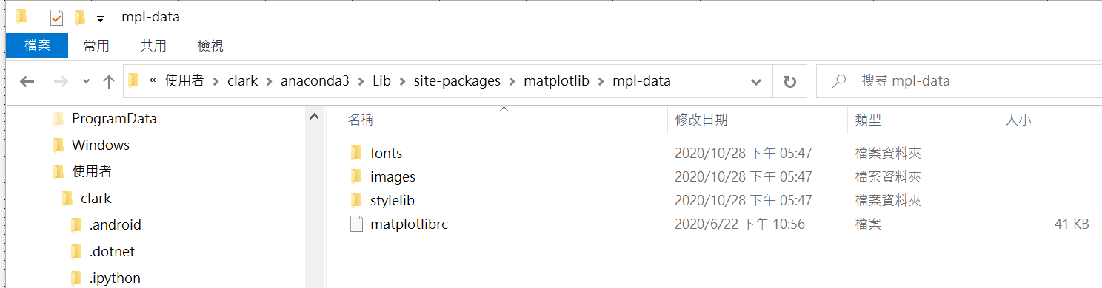
Step2: 進入查詢到的預設路徑, 準備編輯預設檔matplotlibrc:
'C:\\Users\\clark\\anaconda3\\lib\\site-packages\\matplotlib\\mpl-data'
用記事本Note開檔

Slide 31
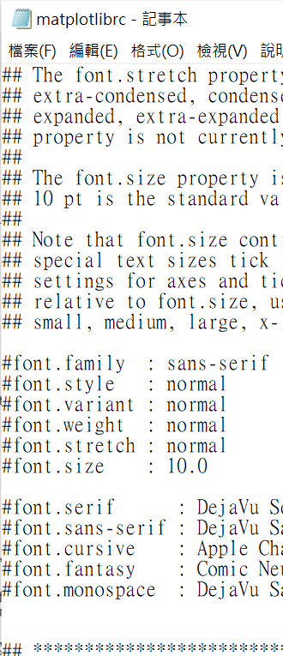
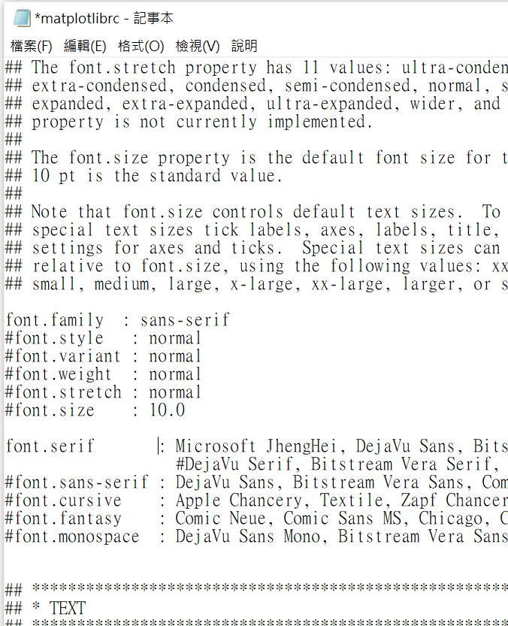
Step 3: 更改內容後 存檔
約在250行
Unmark #font family : sans-serif
Unmark #font.serif:
font.serif : Microsoft JhengHei, DejaVu Sans, Bitstream Vera Sans, Computer Modern Sans Serif, Lucida Grande, Verdana, Geneva, Lucid, Arial, Helvetica, Avant Garde, sans-serif

Slide 32
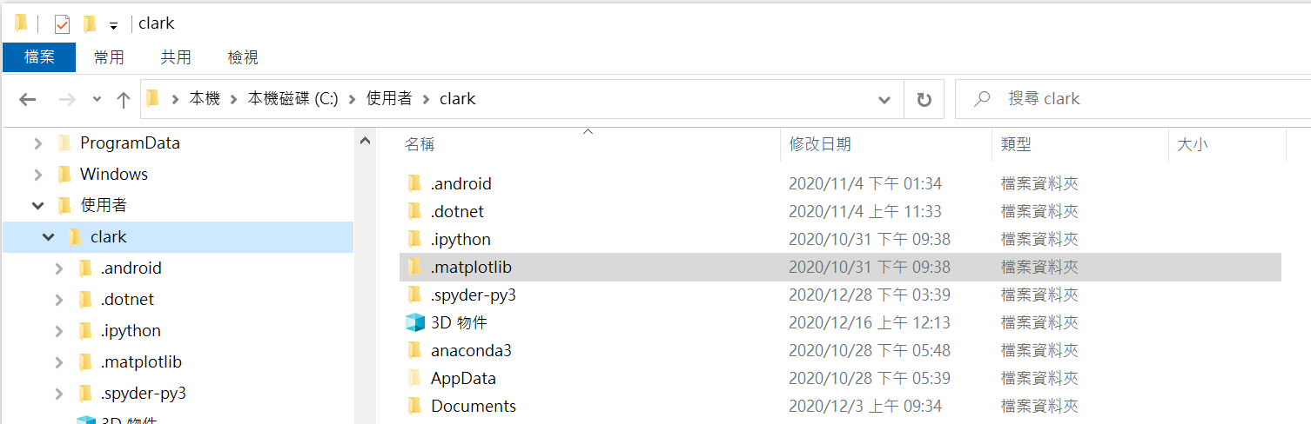
Step 4: 刪除.matplotlib快取資料夾:避免更新後的字體在讀取到舊的快取

Slide 33
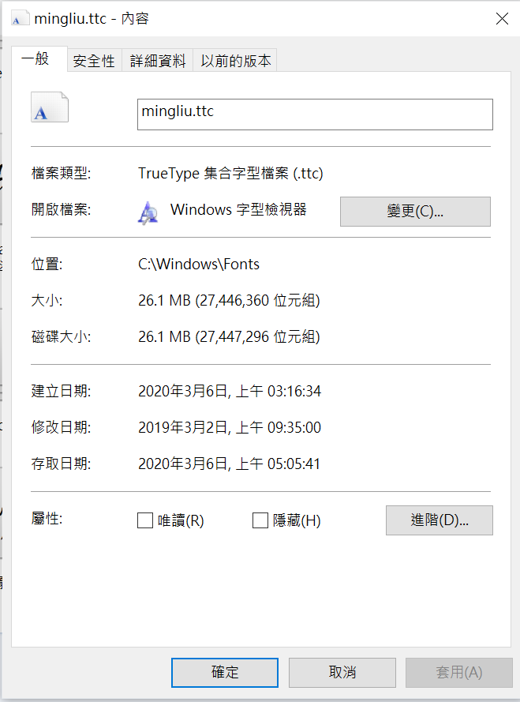
Step 5, 將msj文字檔放入字體至matplotlib指定字體路徑 C:\Users\您的使用者名稱\Anaconda3\Lib\site-packages\matplotlib\mpl-data\fonts\ttf
Ex:
C:\\Users\\clark\\anaconda3\\lib\\site-packages\\matplotlib\\mpl-data\\fonts\\ttf
可以將c:\\windows\\fonts的字體複製過來用

Slide 34
Step 6: 程式宣告引用
import matplotlib.pyplot as plt
from matplotlib.font_manager import FontProperties
# . . . . . … . . . . . . .
plt.rcParams['font.sans-serif'] = ['Microsoft JhengHei']
plt.rcParams['axes.unicode_minus'] = False
#之後用plt畫的圖就可使用引用的字形

Slide 35
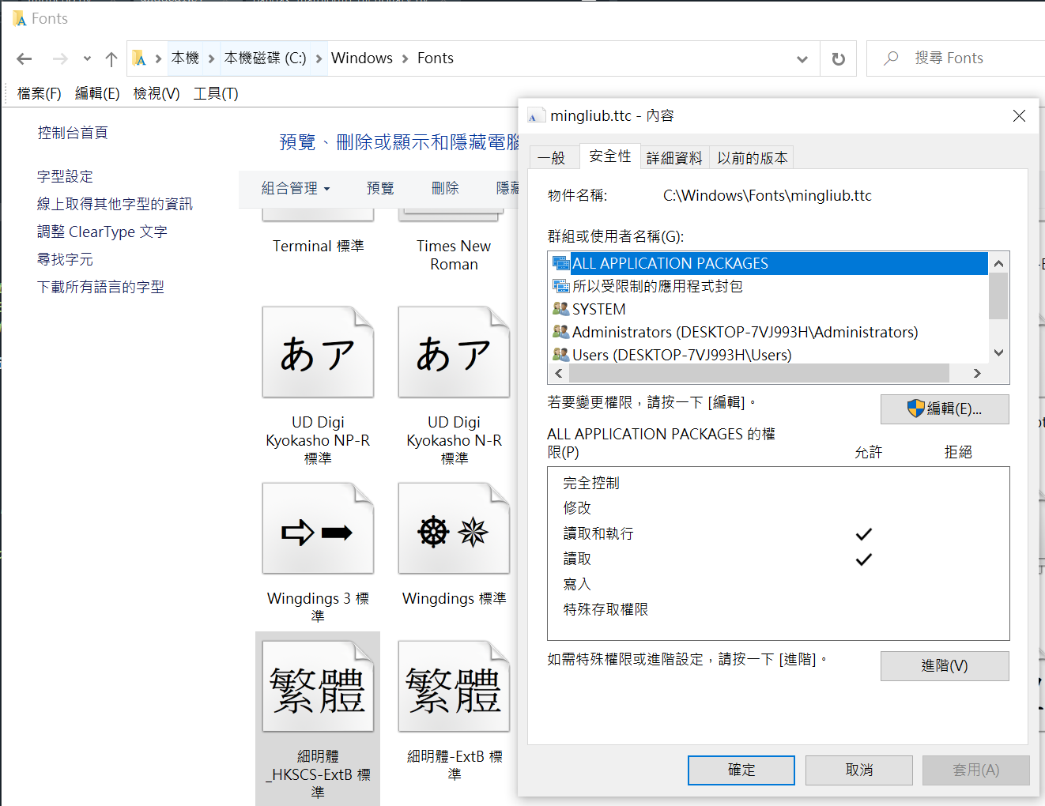
Example:使用方法 一, 引用字形的絕對路徑
右鍵選[內容]

Slide 36
From tkinter import *
From matplotlib.figure import Figure
From matplotlib.backends.backend_tkagg import (FigureCanvasTkAgg, NavigationToolbar2Tk)
import sqlite3
import numpy
#from pandas import DataFrame
import matplotlib.pyplot as plt
import sys
import os
import matplotlib.font_manager as fm

Slide 37
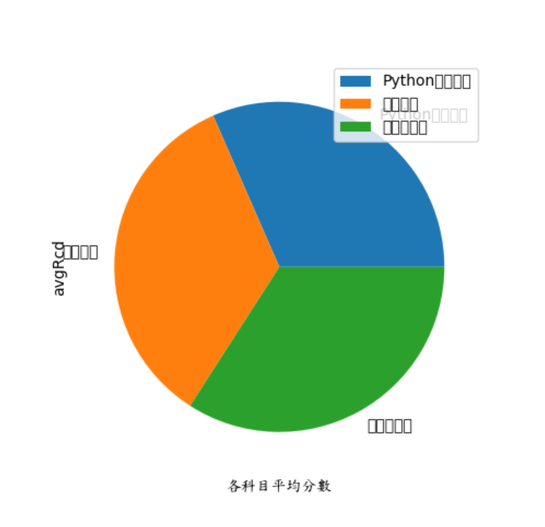
def getAvg():
#處理字形
if sys.platform == 'win32':
fpath = 'C:\\Windows\\Fonts\\kaiu.ttf'
elif sys.platform.startswith('linux'):
basedir = '/usr/share/fonts/truetype'
fonts = ['freefont/FreeSansBoldOblique.ttf', 'ttf-liberation/LiberationSans-BoldItalic.ttf', 'msttcorefonts/Comic_Sans_MS.ttf']
for fpath in fonts:
if os.path.exists(os.path.join(basedir, fpath)):
break
else:
fpath = '/Library/Fonts/Tahoma.ttf'
if os.path.exists(fpath):
prop = fm.FontProperties(fname=fpath)
fname = os.path.split(fpath)[1] #取得 kaiu.ttf
else:
print('Demo fails--cannot find a demo font')
. . . . . .
#產生Dataframe-------
. . . . . .
#產生Figuration-----
fig = Figure(figsize = (5, 5), dpi = 100 )
plot1 = fig.add_subplot(111)
plot1.set_xlabel('各科目平均分數', fontproperties=prop) #.set_xlabel 有fontproperties, 所以可以指定字形
. . . . .
指令沒用fontproperties無法顯示中文
myDframe.plot(x='course_name', y='avgRcd', ax=plot1, kind='bar', labels=courseList) #不接受fontproperties

Slide 38
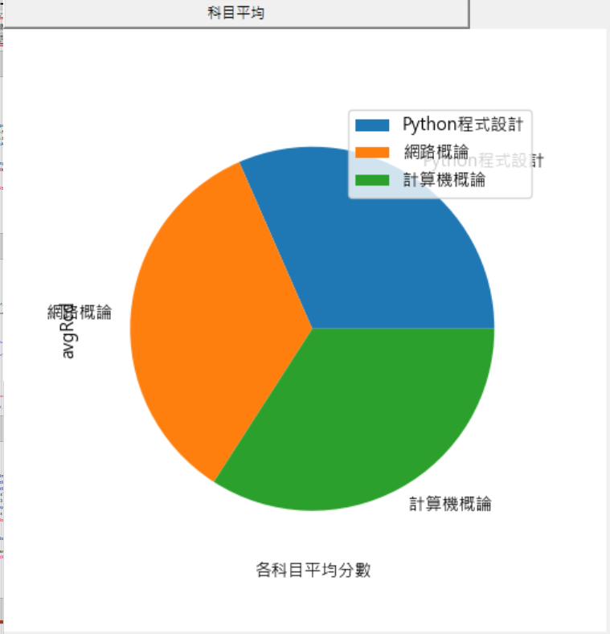
Example:使用方法 二, 變更設定檔
. . . . .
import matplotlib.pyplot as plt
. . . . .
import pandas as pd
from matplotlib.font_manager import FontProperties
def getAvg():
#處理字形
plt.rcParams['font.sans-serif'] = ['Microsoft JhengHei']
plt.rcParams['axes.unicode_minus'] = False
. . . . . . . . . .
#產生Dictionary-------
courseList = []
avgList=[]
for item in listx:
courseList.append(item[0])
avgList.append(item[1])
#產生Dataframe-------
myDframe = pd.DataFrame({'course_name':courseList, 'avgRcd':avgList})
#產生Figuration-----
fig = Figure(figsize = (5, 5), dpi = 100 )
plot1 = fig.add_subplot(111)
plot1.set_xlabel('各科目平均分數') #plot1.set_xlabel('各科目平均分數', fontproperties=prop)
myDframe.plot(x='course_name', y='avgRcd', ax=plot1, kind='pie', labels=courseList)
canvas = FigureCanvasTkAgg(fig, master = win)
canvas.get_tk_widget().grid(row=3, column=0, columnspan=3)
已可顯示中文

