Slide 1
overlay_cases in test/algorithms/overlay/overlay_cases.hpp
Used in the unit tests:
get_turns
traverse
some of them are used in union/intersection
Note: the majority is drawn as powerpoint arrows. The newer system is to draw
polygons and is used at the last cases. The first cases should be updated to that system.
Boost.Geometry (aka GGL, Generic Geometry Library) test file
Copyright Barend Gehrels 2009-2010, Geodan, Amsterdam, the Netherlands
Use, modification and distribution is subject to the Boost Software License,
Version 1.0. (See accompanying file LICENSE_1_0.txt or copy at
http://www.boost.org/LICENSE_1_0.txt)

Slide 2
# 1, simplex
# 2, simple-4
# 3, touch
A
A
A
B
B
B
# 4, holes
# 5, multi-ip
# 6, common
A
B
A
B
A
B

Slide 3
# 7, no overlap
# 8, no overlap
# 9, no overlap
B
B
B
1
0
2
A
A
A
# 10, no overlap
# 11, touch inside 1
# 12, new hole
B
B
B
A
A
A

Slide 4
# 13, no overlap
# 14, no overlap
# 15, no overlap
B
B
B
A
A
A
# 16, encapsulated
# 17, common
# 18, common
A
B
B
B
A
A

Slide 5
# 19, no overlap
# 20, equal
# 21, filled hole
B
B
B
A
A
A
# 22, touch L
# 23, cross in
# 24, touch inside
B
B
B
A
A
A

Slide 6
# 25, touch R
# 26, touch LR
# 27, cross out
B
A
B
A
B
A
# 28, cross out
# 29, cross in
# 30, concave*2
B
B
B
A
A
A

Slide 7
# 31, touch coll^2
# 32, touch coll
# 33, touch coll.
B
B
B
A
A
A
# 34, cross out coll
# 35, inside conc
# 36, int+touch
B
B
B
A
A
A

Slide 8
# 37 int. point
# 38 int.point
# 39, bends
B
B
A
B
A
A
# 40 union points
# 41 equal with collinear
# 42 equal with collinear,degenerate
B
B
B
A
A
A

Slide 9
# 43, keyhole (invalid)
# 44, self-tangent
# 45, self-inters.
A
B
B
B
A
A
# 46, self-tangent
# 47, self-inters.
# 48,
B
B
A
A

Slide 10
# 49
# 50, col. oppos.
# 51, fit
#52, partially eq fake hole
# 53 semi-interior
# 54 node
Two reps, one with tangent hole; one with (not SF valid) self-touch

Slide 11
# 55, 2xsemi-interior
# 56 semi-interior+semi-multi
# 57 semi-multi+simplex
#58 fourfold
# 59
# 60

Slide 12
# 61 self-tangent boxes
# 62 equal+touch
# 63 equal+touch
#64
# 65
# 66 multi overlap/touch

Slide 13
# 67
# 68
# 69
#70
# 71
#72

Slide 14
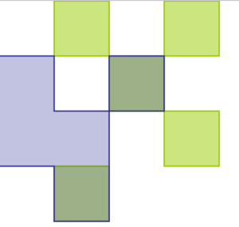
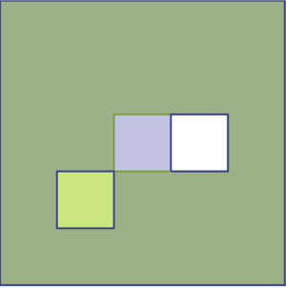
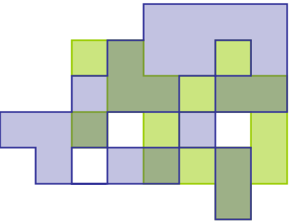
# 73
# 74
# 75
# 76
# 77
# 78

Slide 15
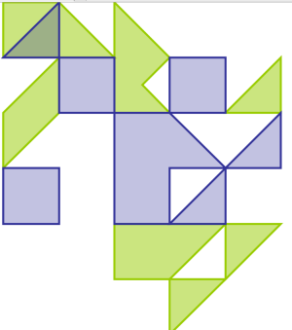
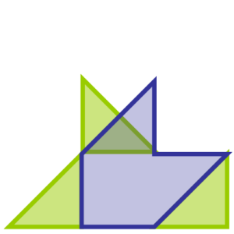
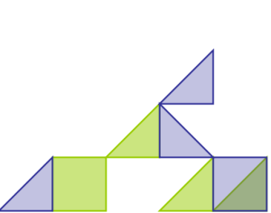
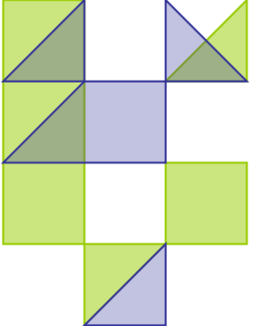
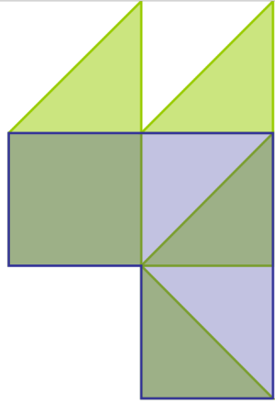
# 79
# 80
# 81 (cat)
#82
# 83
#84

Slide 16
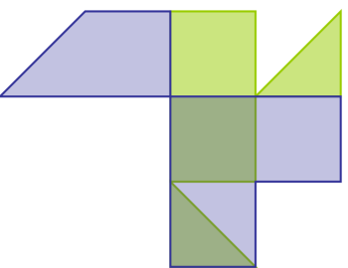
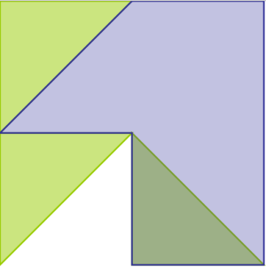
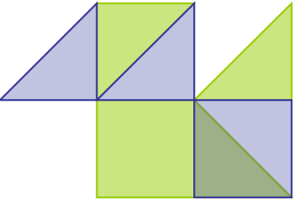
# 85
# 86
# 87
#88
# 89
#90

Slide 17
# 67
# 68
# 69
#70
# 71
#72

Slide 18
0
5
10
15
20
20
# many situations
15
10
A
B
5
0

Slide 19
0
5
10
15
20
20
#new polygon within hole
15
10
5
0

Slide 20
0
5
10
15
20
20
#collinear overlap cases
15
10
5
0

Slide 21
# 101, line-line
A
B

