Slide 1


ABET Accreditation for Engineering and Technology
Presented by: Dr. Vincent F. Bralts
November 15, 2016

Slide 2
What is ;
Total Quality Management
Outcomes Based Assessment
ABET Accreditation
Who Sets the Standards
Professional Licensure

Slide 3
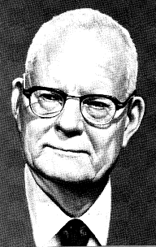
What is ;
Total Quality Management
  W. Edwards Deming
  Continuous Quality Improvement
Outcomes Based Assessment
ABET Accreditation
Who Sets the Standards
Professional Licensure

Slide 4
What is ;
Total Quality Management
Outcomes Based Assessment
ABET Accreditation
Who Sets the Standards
Professional Licensure

Slide 5
What is ;
Total Quality Management
Outcomes Based Assessment
ABET Accreditation
Who Sets the Standards
Professional Licensure

Slide 6
What is ;
Total Quality Management
Outcomes Based Assessment
ABET Accreditation
Who Sets the Standards
  Professional Organizations (ASABE, ASME..
Professional Licensure

Slide 7
What is ;
Total Quality Management
Outcomes Based Assessment
ABET Accreditation
Who Sets the Standards
  Professional Organizations (ASABE, ASME..
Professional Licensure

Slide 8
Role of ABET Accreditation
The role of ABET accreditation is to provide periodic external assessment and evaluation in support of the continuous quality improvement program of the institution.

Slide 9
Criteria for Accrediting Programs in Engineering in the United States
ABET is recognized in the United States as the sole agency responsible for accreditation of educational programs leading to degrees in engineering.
Objectives of Accreditation
The ABET accreditation process is a voluntary system of accreditation that
  assures that graduates of an accredited program are prepared adequately to enter and continue the practice of engineering
  stimulates the improvement of engineering education
  encourages new and innovative approaches to engineering education
  identifies these programs to the public.

Slide 10
Accreditation for
AE and BE programs
https://engineering.purdue.edu/ABE/InfoFor/CurrentStudents/majors.html/

Slide 11
II. Basic Level Accreditation Criteria
It is the responsibility of the institution seeking accreditation of an engineering program to demonstrate clearly that the program meets the following criteria.
Criterion 1. Students
The quality and performance of the students and graduates is an important consideration in the evaluation of an engineering program. The institution must evaluate, advise, and monitor students to determine its success in meeting program objectives.
Criterion 2. Program Educational Objectives
Each engineering program for which an institution seeks accreditation or reaccreditation must have in place;
detailed published educational objectives that are consistent with the mission of the institution and these criteria
a progress based on the needs of the program’s various constituencies in which the objectives are determined and periodically evaluated
a curriculum and process that ensures the achievement of these objectives
a system of ongoing evaluation that demonstrates achievement of these objectives and uses the results to improve the effectiveness of the program.

Slide 12
II. Basic Level Accreditation Criteria, continued
Criterion 3. Program Outcomes and Assessment
Engineering programs must demonstrate that their graduates have
Graduates of this program will demonstrate:
An ability to apply knowledge of mathematics, science, and engineering
An ability to design and conduct experiments, as well as to analyze and interpret data
An ability to design a system, component, or process to meet desired needs within realistic constraints such as economic, environmental, social, political, ethical, health and safety, manufacturability, and sustainability
An ability to function on multidisciplinary teams
An ability to identify, formulate, and solve engineering problems
An understanding of professional and ethical responsibility
An ability to communicate effectively
The broad education necessary to understand the impact of engineering solutions in a global, economic, environmental, and societal context
A recognition of the need for, and an ability to engage in life-long learning
A knowledge of contemporary issues
An ability to use the techniques, skills, and modern engineering tools necessary for engineering practice
Each program must have an assessment process with documented results. Evidence must be given that the results are applied to the further development and improvement of the program. The assessment process must demonstrate that the outcomes important to the mission of the institution and the objectives of the program, including those listed above, are being measured. Evidence that may be used includes, but is not limited to the following: student portfolios, including design projects; nationally-normed subject content examinations; alumni surveys that document professional accomplishments and career development activities; employer surveys; and placement data of graduates.

Slide 13
II. Basic Level Accreditation Criteria, continued
The institution must have and enforce policies for the acceptance of transfer
students and for the validation of credit courses taken elsewhere. The institution
must also have and enforce procedures to assure that all students meet all
program requirements.
Criterion 4. Professional Component
The Professional Component requirements specify subject areas appropriate to engineering but do not prescribe specific courses. The engineering faculty must assure that the program curriculum devotes adequate attention and time to each component, consistent with the objectives of the program and institution. Students must be prepared for engineering practice through the curriculum culminating in a major design experience based on the knowledge and skills acquired in earlier coursework and incorporating engineering standards and realistic constraints that include most of the following considerations: economic; environmental; sustainability; manufacturability; ethical; health and safety; social; and political. The professional component must include
one year of a combination of college-level mathematics and basic sciences (some with experimental experience) appropriate to the discipline
one and one-half years of engineering topics, to include engineering sciences and engineering design appropriate to the student’s field of study
a general education component that complements the technical content of the curriculum and is consistent with the program and institution objectives.

Slide 14
II. Basic Level Accreditation Criteria, continued
Criterion 5. Faculty
The faculty is the heart of any educational program. The faculty must be of sufficient number, and must have the competencies to cover all of the curricular areas of the program. There must be sufficient faculty to accommodate adequate levels of student-faculty interaction, student advising and counseling, university service activities, professional development, and interactions with industrial and professional practitioners, as well as employers of students.
The faculty must have sufficient qualifications and must ensure the proper guidance of the program and its evaluation and development. The overall competence of the faculty may be judged by such factors as education, diversity of backgrounds, engineering experience, teaching experience, ability to communicate, enthusiasm for developing more effective programs, level of scholarship, participation in professional societies, and registration as Professional Engineers.
Criterion 6. Facilities
Classrooms, laboratories, and associated equipment must be adequate to accomplish the program objectives and provide an atmosphere conducive to learning. Appropriate facilities must be available to foster faculty-student interaction and to create a climate that encourages professional development and professional activities. Programs must provide opportunities for students to learn the use of modern engineering tools. Computing and information infrastructures must be in place to support the scholarly activities of the students and faculty and the educational objectives of the institution.

Slide 15
II. Basic Level Accreditation Criteria, continued
Criterion 7. Institutional Support and Financial Resources
Institutional support, financial resources, and constructive leadership must be adequate to assure the quality and continuity of the engineering program. Resources must be sufficient to attract, retain, and provide for the continued professional development of a well-qualified faculty. Resources also must be sufficient to acquire, maintain, and operate facilities and equipment appropriate for the engineering program. In addition, support personnel and institutional services must be adequate to meet program needs.
Criterion 8. Program Criteria
Each program must satisfy applicable Program Criteria. Program Criteria provide the specificity needed for interpretation of the basic level criteria as applicable to a given discipline. Requirements stipulated in the Program Criteria are limited to the areas of curricular topics and faculty qualifications. If a program, by virtue of its title, becomes subject to two or more sets of Program Criteria, then that program must satisfy each set of Program Criteria; however, overlapping requirements need to be satisfied only once.

Slide 16
Program Criteria for Agricultural
and Similarly Named Engineering Programs
Lead Society: American Society of Agricultural and Biological Engineers
These program criteria apply to engineering programs including “agricultural,” “forest,”
and similar modifiers in their titles.
Curriculum
Programs must demonstrate that graduates have proficiency in mathematics through differential equations and in biological and engineering sciences consistent with the program educational objectives. Competence must be demonstrated in the application of engineering to agriculture, aquaculture, forestry, human, or natural resources.
2. Faculty
The program shall demonstrate that those faculty members teaching courses that are primarily design in content are qualified to teach the subject matter by virtue of education and experience or professional licensure.

Slide 17
Program Criteria for Biological
and Similarly Named Engineering Programs
Lead Society: American Society of Agricultural and Biological Engineers
Cooperating Societies: American Academy of Environmental Engineers,
American Institute of Chemical Engineers, American Society of Civil Engineers,
American Society of Mechanical Engineers, Biomedical Engineering Society,
CSAB, Institute of Electrical and Electronics Engineers,
Institute of Industrial Engineers, Minerals, Metals, and Materials Society,
National Institute of Ceramic Engineers
These program criteria apply to engineering programs including “biological,” “biological systems,” and similar modifiers in their titles with the exception of bioengineering and biomedical engineering programs.
1. Curriculum
Programs must demonstrate that graduates have proficiency in mathematics through differential equations, a thorough grounding in chemistry and biology and a working knowledge of advanced biological sciences consistent with the program educational objectives. Competence must be demonstrated in the application of engineering to biological systems.
2. Faculty
The program shall demonstrate that those faculty members teaching courses that are primarily design in content are qualified to teach the subject matter by virtue of education and experience or professional licensure.

Slide 18
Objective of the Student Focus Group Meetings
The objective of the meeting is to solicit feedback on program objectives and outcomes for both AE and BE curricula from the current students. The key questions are:
  How familiar are you with the program objectives and outcomes?
  How well do you think you are trained to fulfill these program outcomes?
  What can we do to better train you?

Slide 19
Program Educational Objectives
The educational objectives of the Agricultural Engineering program is to produce graduates who:
effectively practice agricultural engineering in the areas of machine systems, environmental and natural resources;
have demonstrated proficiency in fundamental engineering skills and technical knowledge as well as professional and personal skills appropriate for their profession;
are prepared for future challenges in agricultural engineering through the application and discovery of knowledge; and
learn and grow as individuals, contribute to society, and attain maximum potential through life-long learning.
The educational objectives of the Biological Engineering program is to produce graduates who:
effectively practice Biological Engineering for the design and operation of systems for processing of biological materials to develop products for the food, pharmaceutical, and biochemical industries.
have demonstrated proficiency in fundamental engineering skills and technical knowledge as well as professional and personal skills appropriate for their profession.
are prepared for future challenges and opportunities in the areas of food, pharmaceutical and biochemical engineering through the discovery and application of knowledge.
learn and develop as individuals, contribute to the profession and society, and attain maximum potential through life-long learning.

Slide 20
AE Student Outcomes 1-6
AE Student Outcomes
The Student Outcomes for the Agricultural Engineering (AE) program are listed below. Graduates of this program will demonstrate:
Basic Engineering Skills
An understanding of the agricultural and biological engineering profession and practice;
The ability to understand and apply knowledge of mathematics, science, and engineering;
An understanding of, and the ability to identify, formulate, and model and solve problems for engineering systems;
The ability to design a system, component, or process to meet desired goal subject to constraints;
An ability to design and/or conduct experiments and analyze and interpret data;
Effective use of appropriate techniques, skills, and state-of-the-art engineering tools necessary for engineering practice.

Slide 21
AE Student Outcomes 7-12
Professional and Personal Skills
An understanding of the global and societal impact of engineering practice, research, and discovery;
A knowledge of contemporary issues;
Appropriate and effective writing, speaking, and listening skills;
The ability to function on, and contribute effectively to, a multi-disciplinary team;
The ability to understand and practice ethical responsibility in personal and professional life; and
An appreciation for the value of life-long learning to maintain “life-balance” and achieve maximum potential.

Slide 22
BE Student Outcomes 1-6
BE Student Outcomes
The Student Outcomes for the Biological Engineering (BE) program are listed below. Graduates of this program will demonstrate:
Basic Engineering Skills
An understanding of the fundamental principles of mathematics and science;
An understanding of biological engineering principles;
The ability to design and/or conduct experiments to analyze biological and food systems and processes;
An understanding of, and the ability to, identify, formulate, model and solve problems for biological and food process engineering systems;
An ability to design a system or a process to meet desired needs in the area of biological and food process engineering;
Effective use of appropriate techniques, skills, and state-of-the-art engineering tools necessary for engineering practice.

Slide 23
Student Outcomes 7-12 BE
Professional and Personal Skills
An understanding of the global and societal impact of engineering practice, research , discovery, entrepreneurship and business;
A knowledge of contemporary issues;
Appropriate and effective writing, speaking, and listening skills;
The ability to function on, and contribute effectively to, a multi-disciplinary team;
The ability to understand and practice ethical responsibility in personal and professional life; and
An appreciation for the value of life-long learning to maintain “life-balance” and achieve maximum potential.

Slide 24
How were the Outcomes Established ?
Student Feedback
Alumni Surveys
Industry Surveys
Senior Project Professional Evaluations
Senior Feedback Sessions with ABE Head

Slide 25
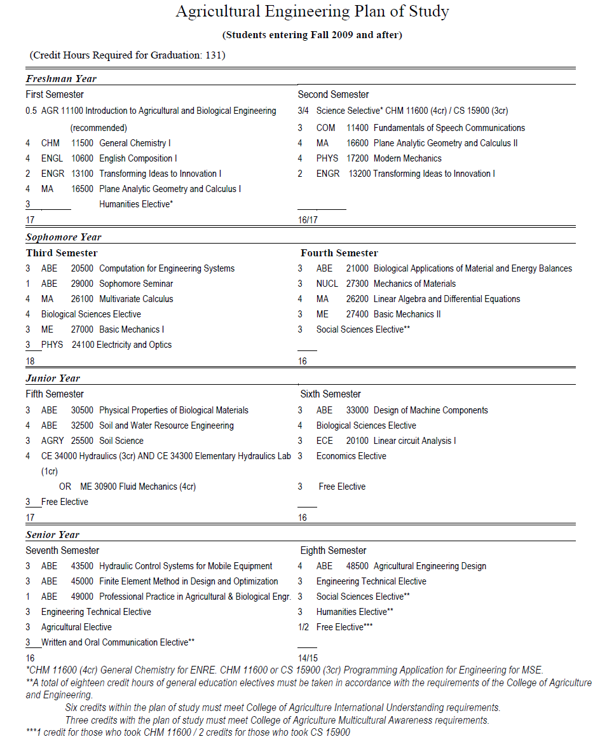

Slide 26
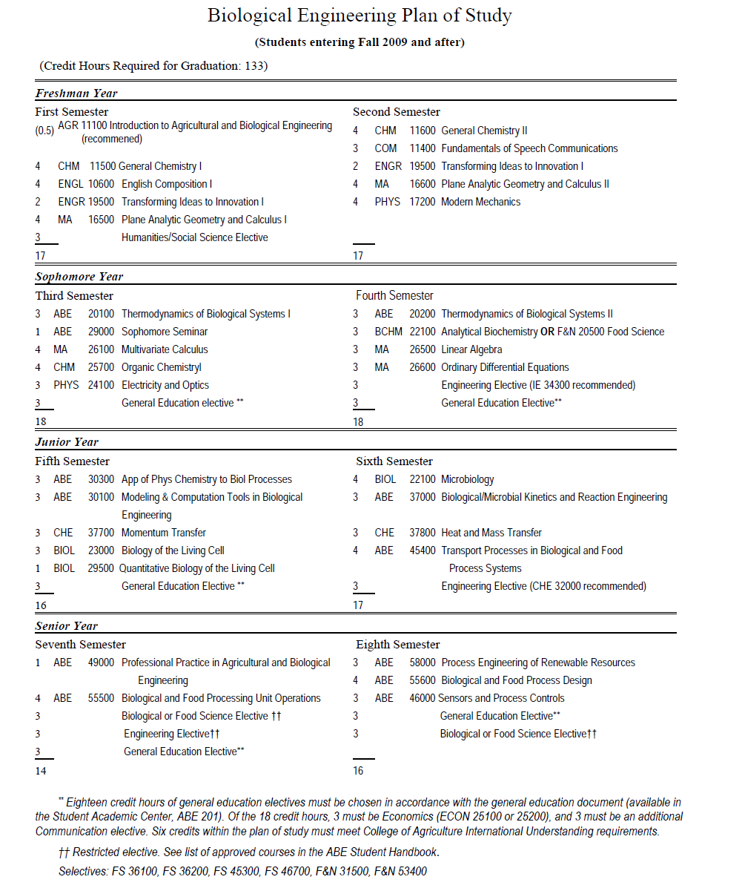

Slide 27
Sample Interview Questions
Do you know what the program objectives are?
Do you know what skills you are expected to acquire (i.e. outcomes) to graduate?
How did you discover what outcomes are expected of you?
Are you acquiring the required skills?
Are the technical faculty members competent in the subjects they teach?
Are they available and helpful to you at times convenient to you?
Why did you choose this school? This program?
Are the laboratories well-equipped?
Is the laboratory equipment well-maintained?
How good is the hands-on experience?
Do you plan to continue your education after graduation? Where? When?
Do you plan to accept a job after graduation? Where? When?
What type of job can you get as a graduate of this program? At what salary?
What is your overall view of the program?
Would you recommend it to a friend?
Either you or your folks are paying for this education. Are you getting your “money’s worth?”

Slide 28
ABET Accreditation Discussion
Do you have any questions?
Thank you for your attention,
Have a great day !
https://engineering.purdue.edu/ABE/InfoFor/CurrentStudents/majors.html/

