Slide 1
ABE 301: Understanding what this course is about and how to do well in this course

Slide 2
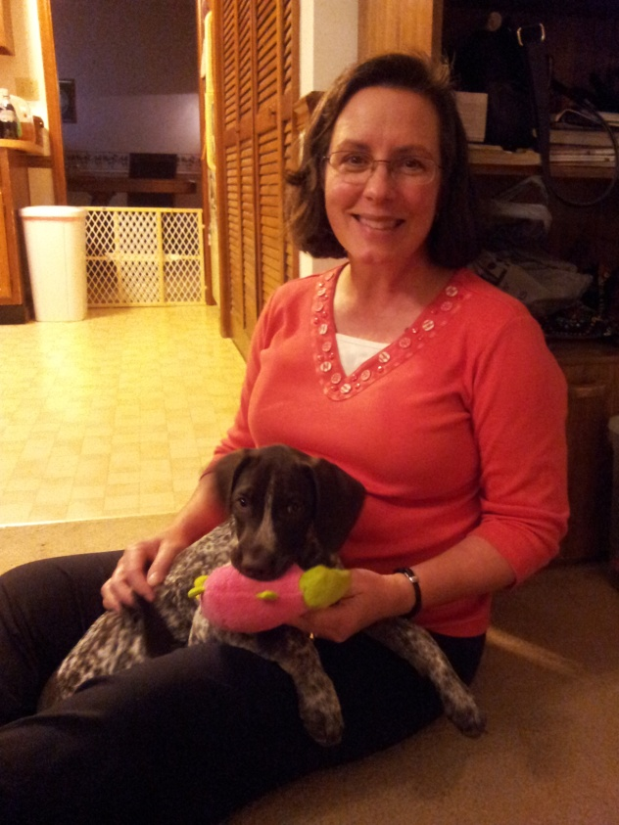
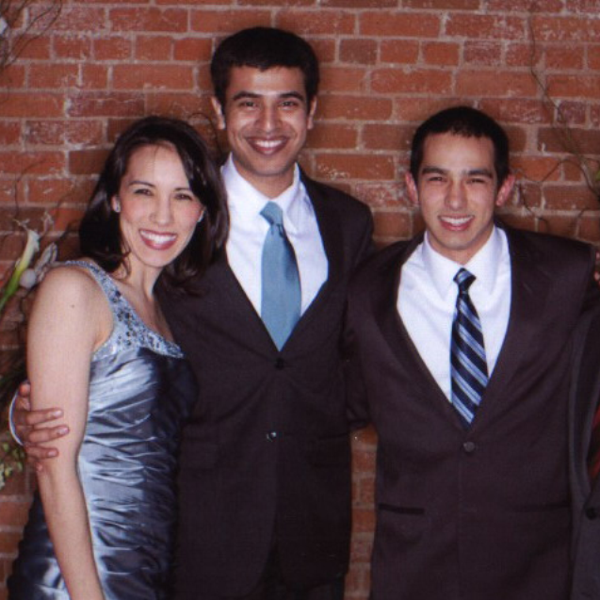
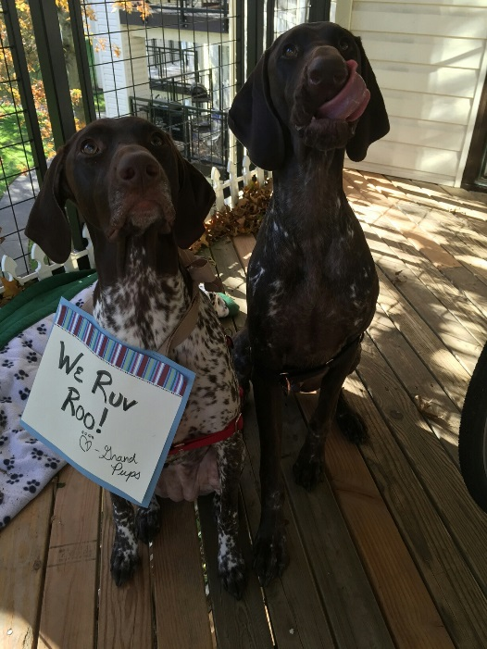
Bernie Tao
Christian, husband, father, nice guy, ABE Prof.
Done short term missions work in Mexico, Russia, Germany, Romania, Papua New Guinea
Grew up in Nebraska, graduated Chem. Eng/Biochem. MIT/Iowa State
Worked for P&G, Gen. Electric, Monsanto, Atlantic Richfield, Oakridge Natl. Labs before coming to Purdue
Spouse (Ann), children (Erin, spouse Akshay, both Purdue grads), Greg, MIT ME), grand pups (Arthur & Bailey)

Slide 3
How to succeed in ABE 301
I want you all to do well in this course, but it is probably different than many of your other courses historically. It requires a somewhat different learning/performance strategy.
Recognize that we are partners in your education; you have to do your part if we are to be successful.
Read the syllabus (‘rules of the game’) for evaluation and what is expected. See the schedule, understand it may change/adapt over the semester.
One of your responsibilities is to be courageous and ask questions to succeed; participate in your education.
Be proactive if you need something, do not wait until the last moment to come in to chat.
Comment on grades vs. learning

Slide 4
Mindset Mentality
Cognitive plasticity – learning to be smart is just like learning to be strong
Changing mindset from ‘I want to be smart’ to ‘I want to learn’
Making mistakes is just an opportunity to experiment to improve
Eduardo Briceno - Power of belief
https://www.youtube.com/watch?v=pN34FNbOKXc
Derek Sivers- Why You Need to Fail
https://www.youtube.com/watch?v=AWwDzHFSyLs

Slide 5
Vision & Preparation
With great privilege comes great responsibility
Knowing facts and having good grades do not make you valuable
Vision + Preparation = Opportunity
Society is changing to provide you with immense opportunity; Are you going to be ready?
Notes:
Le hasard ne favorise que les esprits préparés

Slide 6
With great privilege comes great responsibility
How well do you know the world?

Slide 7
How well do you know the world?
1. What % of the people in the world can read (in any language)?
2. What % of the people in the world have adequate food/nutrition?
3. On average, how much wealthier are you than people in other countries?
4. What % of the people in the world have a college education?

Slide 8
The world expects a lot from you
Getting a college education is a great privilege
that carries great responsibilities
  If the world were a village of 100 people…
    57 Asians, 21 Europeans, 14 Americas, 8 Africans
    70 people in the village would be unable to read
    50 people would suffer from malnutrition
    80 people would live in sub-standard housing
    half of the whole village’s wealth would be owned by 6 people, all from the U.S. (16 times rest of world)
    Only 1 person would have a college education
  Who will feed the village, teach them to read, create the houses, roads, hospitals, and technologies needed to create a better world?

Slide 9
Vision + Preparation = Opportunity
Part 1: Vision

Slide 10
WHAT IS THE MAIN PURPOSE OF AN ENGINEER?
Solve problems
Develop/improve products/processes
Optimize/improve quality/economics of products/services
Entrepreneurship, create new things
Make money for companies/self
To serve others by fulfilling their needs using your skills and abilities

Slide 11
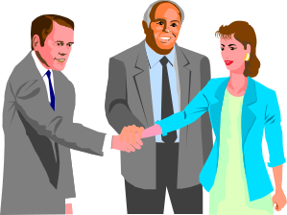

What is Engineering?
Adaptation of technology/science to people and their needs
Transformation of raw material resources and energy to useful products/services
Development of economically profitable services and products

Slide 12
Mechanical Eng.
Electrical Eng.
Aeronautical Eng.
Physics
1700’s
Chemical Eng.
Materials Eng.
Petroleum Eng.
Chemistry
1900’s
Biological Eng.
Agricultural Eng.
Pharmaceutical Eng.
Biology
2000’s

Slide 13
Fundamental Changes in Technology = Human Happiness
Nikolai Dimitriyevitch Kontratyev
Long-Wave Cycle Theory
50-Year Cycles “Inherent In
The Capitalistic Economy”
Driven by new Technologies
Water Power
Era
Steam Engine
Era
Railroad
Era
Petrochemical
Era
Information
Age
Biological
Age
1780
1830
1880
1930
1980
2030
2080
Technology changes driving industrial growth have a phase lag ~50 years
Peaks/valleys correspond to boom economies/depressions

Slide 14
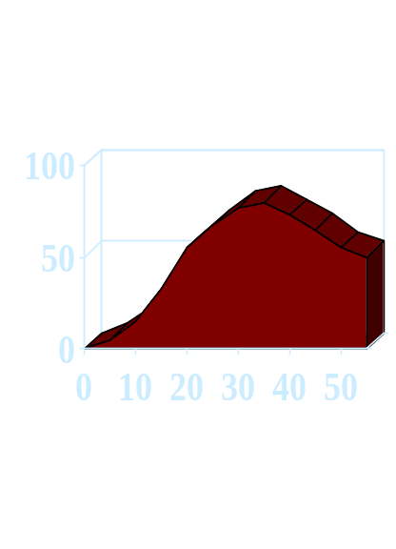
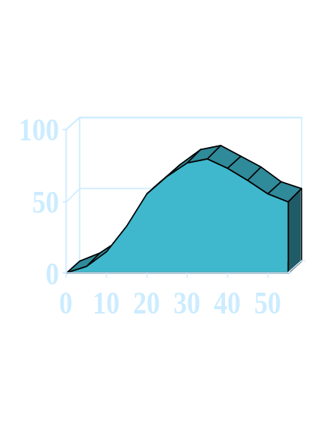
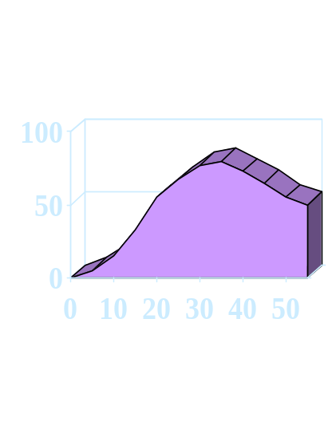
Current Status
Years
Years
Years
Oil In Declining Phase
Internet / E-commerce
peaking phase
Biotechnology growth Phase
Chemical Engineering
Biological Engineering
EE/Computer Engineering
Implications:
Science has ~20 year lead time in shaping technology
Investments in industries will change in anticipation of new technologies
Industries employing graduates will change
Educational processes will change to produce new graduates

Slide 15
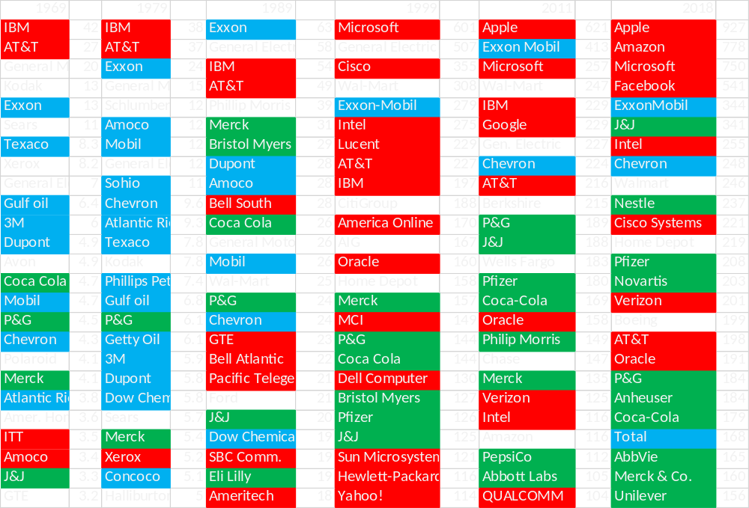
Top 25 U.S. Companies by Market Capitalization

Slide 16
Vision + Preparation = Opportunity
Part 1: Preparation

Slide 17
Thoughts/suggestions
(Useful things I hope you will gain from this class)
How to do well in life/future classes/work
“Be prepared and be honest. “
“If you don't have time to do it right, when will you have time to do it over? “ – John Wooden, former Purdue player/most successful college basketball coach in history (10 NCAA championships in 11 years)
“Preparation is the key to victory in any game that you play. The will to prepare to win is far more important than the will to win.” – Bob Knight, former IU basketball coach
“Insanity: doing the same thing over and over again and expecting different results.” – Albert Einstein

Slide 18
"Bury me on my face," said Diogenes; and when he was asked why, he replied, "Because in a little while everything will be turned upside down." - Socrates
Technology makes your lifestyle very different than previous generations
  You have access to knowledge/content 24/7 on any topic
  Youtube, MIT open courseware, Khan academy, etc. have all the same information as your engineering classes online and free for anyone, anywhere, anytime in any language, any culture
  Artificial intelligence (AI) threatens to replace educated people in society
So, what good is a college level education if all the content/information is free online?

Slide 19
What makes you valuable to others (employers, society)?
  After you graduate, what do you think the likelihood is of:
  You directly using the equations from thermodynamics, fugacity, the Navier-Stokes eqns, shear stress, reaction kinetics, Fourier’s heat transfer equation, Dittus-Bolter nucleate boiling, etc. ?
  Your college grades having anything to do with your 1st job promotion (or raising a family, community involvement, how you live your life in general)?
  So, why are you in college and what are you supposed to have learn here?

Slide 20
In a world where knowledge is cheap, knowing facts does not make you valuable
How does a college/engineering education help make you valuable?
  Move from dependence to independence
  Gain skills and understanding of relationships/purpose
  Changes understanding/perception of education/learning
  Changes learning strategy from memorization/regurgitation for grades
  Increases perception of education as opportunities/challenges/utility by participation
  Gain abilities to learn how to learn independently
Critical analysis/thinking (why vs. what, analysis & planning)
Using skills/knowledge to create/fulfill needs

Slide 21
In a survey of 800 executives, 78% stated that a person’s background is actually a poor indicator of future success. 87% believe that personal traits explain the difference in performance between good and great.
On top of the list comes personal drive and ambition. Climbing to the top means hard work and long hours; e.g., from age 5-13, Bill Gates spent 10,000 hours programming (avg. of 3.5 hrs/day, 365 days/year)
Communication skills are high up on the list of requirements. Convincing others to follow your goals/ideas is difficult. Not all future CEOs possess natural talent. So for some of them it comes back to the hard work of analyzing situations, synthesizing action models and convincing others.

Slide 22
Break

Slide 23
Modeling
The purpose of modeling is to provide you with tools to be a more effective engineer/human being. This includes both computations and communication.
Numerical model – a form of reasoning used to analyze/create a mathematical approximation of the behavior/performance of a physical system
Critical argument – a form of reasoning used to analyze/create communications to persuade changes in actions/behavior
Note: explain sequencing of course lectures/structure

Slide 24
Intro to modeling (get started on your models!)
Critical arguments
Mathematics/numerical methods

Slide 25
Arguments vs. Models:
Parallel structure
Knowledge
  Inductive/deductive
Premises
  Accuracy/truth
  HOS
Conclusion
  Logical construction
Behavioral change/decision
Knowledge
  Theory/observation
Assumptions
  Accuracy/quantification
  parameters/relationships
Model
  Logical construction (mathematical)
Application/Utility decision
Same analysis/thinking skills needed for both

Slide 26
Why is modeling so important to Biological Engineering?
The foundation of major engineering disciplines is based on models (Newtonian motion, thermodynamics, fluid/heat/mass flow, reaction chemistry, Ohm/electricity, etc.)
Models provide the means to efficiently evaluate process efficiency/product quality, economics, environmental impacts, legal/governmental regulations
What are the fundamental models of biological engineering?

Slide 27
Understanding importance of reasoning/justification in model development/human interaction
  Recognizing benefits/limitations of language/science/mathematics
Understanding of how to use/incorporate your knowledge (prior studies) to develop models in food/molecular biological/pharmaceutical engineering.
Understanding modeling process (assumptions/iterations to improve)
Comprehension of impact of modeling in development of biological engineering discipline.

Slide 28
Modeling Process
1. Identify model output parameter(s), eg. Amounts, rate, time, expense, etc.
2. Draw a picture of the situation to help you understand it.
3. Define a system and its boundaries.
4. Define with is crossing the boundaries.
5. Identify input parameters and give each one a symbolic name, e.g. Time – t, mass – m, force – f, volume – v, density – r, etc.
6. Identify fundamental relationships between parameters, e.g. V = m/r, f = ma (Note: these are essentially definitions)
7. Identify principles, assumptions, basic theories, etc. that apply to problem, e.g. 1st law, conservation of mass, rate of reaction, etc. (note: these are often natural phenomena, theories, and constraints)

Slide 29
Modeling Process
8. Assemble parameters and principles into relationships with regards to what is being asked. 3. Define a system and its boundaries.
9. Write the algebraic/differential equations that describe the model.
10. Quantitatively solve these equations to obtain a numerical solution.
11. If possible, test the model or parts of the model with know data/circumstances, i.e. do dimensional analysis, plug in values and calculate, etc.
12. Inspect/evaluate the solutions for reasonability/adequacy.
13. Iterate to improve model until satisfactory.

