Slide 1
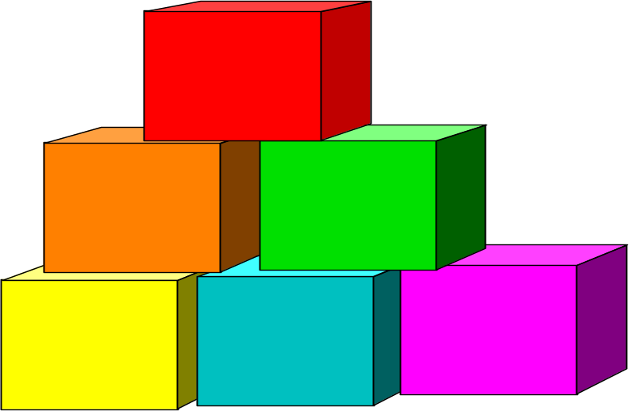
Cubic Splines by Bernie Tao

Slide 2
Concept
Modeling data using a regression polynomial provides a smooth, continuous curve. However, regression polynomials tend to oscillate wildly and require massive numerical computations for polynomials of order greater than 10. The concept of splines was introduced to avoid these problems.

Slide 3
Concept
(cont’d)
A spline is a set of curves generated between data points such that they go through each data point and their derivatives are equal at each point to insure smoothness. Imagine putting a bunch of nails into a board and weaving a stiff, but flexible plastic rod around the nails. The path taken by the rod is called a spline.

Slide 4
Mathematically
A spline is a set of functions fitted together at data points. The derivatives of the functions on either side of a data point are matched to provide smoothness to the overall spline.
NOTE: A spline is not a single function across the entire range. It is a set of functions each valid over a sub-range.

Slide 5
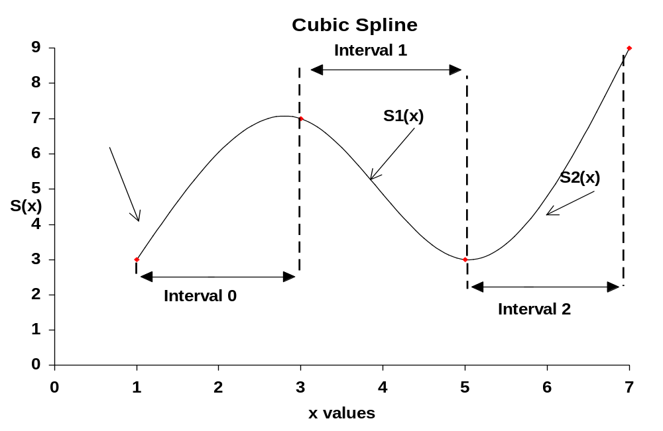

Slide 6
Polynomial Splines
Splines use polynomials as convenient functions for modeling. Since many physical situations require 1st and 2nd derivatives, the third order polynomial is the most frequent form used.
Cubic polynomials have the general form,
f(x) = a + bx + cx² + dx³

Slide 7
Polynomial Splines
(cont’d)
To simplify calculations on each interval, replace x with [x - x_{i}]. ( This allows us to calculate the a_{i} coefficients, when x = x_{i}, a_{i} = y_{i}.)
NOTE: S_{i}(x) covers the interval x_{i}<x<x_{i+1}.
The polynomial will now has the form,
S_{i}(x) = a_{i} + b_{i} (x-x_{i}) + c_{i}(x-x_{i})² + d_{i}(x-x_{i})³

Slide 8
Polynomial Splines
(cont’d)
The first and second derivatives of S_{i}(x) are:
S_{i}’(x) = b_{i} + 2c_{i}(x - x_{i}) + 3d_{i}(x - x_{i})²
S_{i}”(x) = 2c_{i} + 6d_{i}(x - x_{i})
The set of equations, [S_{i}(x), S_{i}’(x), S_{i}’’(x)], plus boundary conditions can then be used to determine values for the coefficients of each interval polynomial.

Slide 9

Spline Equations
To find the equation of each polynomial, it is necessary to calculate the coefficients a_{i}, b_{i}, c_{i}, d_{i}.
a_{i} is determined to be y_{i}
c_{i} can then be calculated by H * C = K. The H matrix can be inverted and multiplied by K to get C, e.g. C = H-1*K

Slide 10
H matrix
h₀ = (x_{i+1} - x_{i}), h₁ = (x_{i+2} - x_{i+1}), ...
1 0 ... 0
h₀ 2(h₀+h₁) h₁ 0 ... 0
0 h₁ 2(h₁+h₂) h₂ 0 0
.
.
0... h_{n-2} 2(h_{n-2}+h_{n-1}) h_{n-1}
0... 0 0 1
H =

Slide 11
K and C matrices
0
3(a₂ - a₁)/h₁ - 3(a₁ - a₀)/h₀
3(a₃ - a₂)/h₂ - 3(a₂ - a₁)/h₁
.
.
.
3(a_{n} - a_{n-1})/h_{n-1} - 3(a_{n-1} - a_{n-2})/h_{n-2}
0
c₀
c₁
c₂
.
.
.
c_{n}
K =
C =

Slide 12
Natural Cubic Spline
The boundary conditions used most often assume that the second derivatives at the range ends are zero, i.e. c₀=c_{n}=0. This is called a natural cubic spline.
The last two equations :
b_{i} = (a_{i+1} - a_{i})/h_{i} - (c_{i+1} + 2c_{i})h_{i}/3
d_{i} = (c_{i+1} - c_{i})/3h_{i}

Slide 13

How to do Calculations
Cubic Splines
Determine h values
Determine H and K matrices
Determine C matrix by inverting the H matrix and multiplying by K
Determine b and d coefficients and write spline equations
Graph spline

Slide 14
Example #1
Using the data below, calculate a natural cubic spline model to fit the data.
x
0
2
6
11
y
8
3
6
2

Slide 15
Example #1
(cont’d)
Determine the h values
index
0
1
2
3
x
0
2
6
11
y
8
3
6
2
h
2
4
5

Slide 16
H matrix
1 0 0 0
2 2(2+4) 4 0
0 4 2(4+5) 5
0 0 0 1
1 0 0 0
2 12 4 0
0 4 18 5
0 0 0 1
H =
=
1 0 0 0
-0.18 0.09 -0.02 0.1
0.04 -0.02 0.06 -0.03
0 0 0 1
Inverted H matrix
H⁻¹ =

Slide 17
K Matrix
0
3(6 - 3)/4 - 3(3 - 8)/2
3(2 - 6)/5 - 3(6 - 3)/4
0
0
9.75
-4.65
0
K =
=

Slide 18
Example #1
(cont’d)
Determine the H and K matrix. Invert H and multiply by K matrix to find C matrix.
0
0.9705
-0.474
0
C = H⁻¹ * K =

Slide 19
b_{i} = (a_{i+1} - a_{i})/h_{i} - (c_{i+1} + 2c_{i})h_{i}/3
b₀ = (3-8)/2 – (0.9705+2*0)*2/3 = -3.147
b₁ = -1.206
b₂=0.78
d_{i} = (c_{i+1} - c_{i})/3h_{i}
d₀ = (0.9705 – 0)/(3*2) = 0.16175
d₁ = -0.120375
d₂ = 0.0316

Slide 20
Example #1
(cont’d)
Find values of b’s and d’s and determine spline equations.
0-2 S₀(x) = 8 - 3.147(x-x₀) – 0(x-x₀)² + 0.16175(x-x₀)³
2-6 S₁(x) = 3 –1.206(x-x₁) +0.9705(x-x₁)² -0.120375(x-x₁)³
6-11 S₂(x) = 6 + 0.78(x-x₂) + 0(x-x₂)² + 0.0316(x-x₂)³

Slide 21
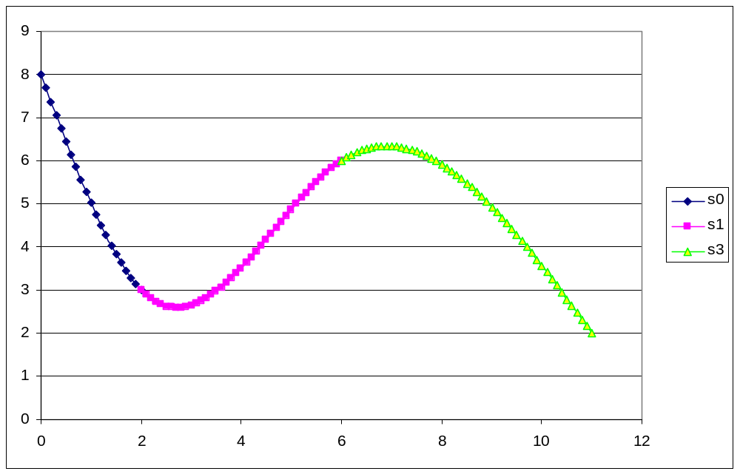
Example #1 (cont’d)
Graph the equations

Slide 22
Concepts and Skills to Know
Explain what a spline model is, both conceptually and mathematically.
Explain the advantages and disadvantages of a cubic spline for modeling.
Define natural cubic spline.
Use an electronic spreadsheet to calculate and graph a cubic spline model.

