Slide 1

Modeling Binary Vapor-Liquid Non-ideal Systems
Bernie Tao

Slide 2
Learning objectives
Understand the concept of excess Gibbs energy and its relationship to phase equilibrium and composition
Understand the relationships between activity coefficients and composition at equilibrium
Be able to apply models to various multiphase binary compositions to generate phase diagrams and bubble/dew properties of mixtures

Slide 3
Modeling non-ideal behavior
Ideal behavior of materials and solutions does not take into account the complexity of intermolecular interactions that cause phenomena such as condensed phases.
Developing a simple, quantitative theoretical model for this behavior is difficult since there is no simple, comprehensive theory that adequately measures all types of intermolecular interactions.
Fortunately, we can approach this problem using Gibbs energy to develop relationships between composition and thermodynamic variables.

Slide 4
Excess properties
An excess property is the general concept used to quantify the difference between the actual and ideal behavior of a solution.
ME = M - M^{is}
We used excess properties earlier to describe mixing of pure components. Recall the volume of mixing,
V_{mix} = V - V^{is} = V - Σ x_{i} V_{i}
Nomenclature
M - actual property value
Mis - ideal solution property value
ME - excess property value

Slide 5
Excess Gibb’s Energy
When considering non-ideal solution equilibrium behavior, the Gibbs energy is particularly useful. First recall some definitions:
G = Σ x_{i}μ_{i} (the definition of molar Gibbs energy of solution and chemical potential)
μ_{i} - G_{i} = RT ln f_{i}/f_{i}º (relationship of chemical potential and fugacity)
Nomenclature
μ_{i} - chemical potential of component i
x_{i} - mole fraction of component I
G - actual molar Gibbs energy
G_{i} - specific molar Gibbs energy of pure component i
f_{i} - partial molar fugacity of component i
f_{i}º - partial molar fugacity of pure component i at reference conditions

Slide 6
More definitions
G_{mix} = G - Σ x_{i} G_{i} (definition of Gibbs energy of mixing)
G^{is}_{mix} = G^{is} - Σ x_{i} G_{i} (definition of ideal solution Gibbs energy of mixing)
G^{is}_{mix} = G^{is} - Σ x_{i} G_{i} = RT Σ x_{i} ln x_{i} (definition of ideal solution)
Nomenclature
x_{i} - mole fraction of component I
G - actual molar Gibbs energy
G_{i} - specific molar Gibbs energy of pure component i
G^{is} - molar Gibbs energy of an ideal solution
G^{is}_{mix} - molar Gibbs energy of mixing of an ideal solution

Slide 7
Gibbs Excess Energy
Starting with the definition of Gibbs excess energy
G^{E} = G - G^{is}
subtracting and adding Σ x_{i}G_{i}
G^{E} = (G - Σ x_{i}G_{i}) + (G^{is} - Σ x_{i}G_{i})
using the definition of mixing
G^{E} = (G - Σ x_{i}G_{i}) + (G^{is} - Σ x_{i}G_{i}) = ΔG_{mix}- ΔG^{is}_{mix}
using the definition of ideal solution mixing
G^{E} = ΔG_{mix}- ΔG^{is}_{mix} = ΔG_{mix}- RT Σ x_{i} ln x_{i}

Slide 8
G^{E} = ΔG_{mix}- RT Σ x_{i} ln x_{i}
Now we need to analyze ΔG_{mix}
Recall that by definition,
ΔG_{mix} = G - Σ x_{i}G_{i}
Since G = Σ x_{i}μ_{i} ,
ΔG_{mix} = Σ x_{i}μ_{i} - Σ x_{i}G_{i} = Σ x_{i}(μ_{i} - G_{i})
Recalling that μ_{i} - G_{i} = RT ln f_{i}/f_{i}º, this becomes
ΔG_{mix} = Σ x_{i}(μ_{i} - G_{i}) = RT Σ x_{i} ln f_{i}/f_{i}º

Slide 9
G^{E} = RT Σ x_{i} ln γ_{i}
ΔG_{mix} = RT Σ x_{i} ln f_{i}/f_{i}º
Recalling the definition of the activity coefficient, γ_{i} = f_{i}/x_{i}f_{i}º
ΔG_{mix} = RT Σ x_{i} ln f_{i}/f_{i}º = RT Σ x_{i} ln x_{i} γ_{i}
Now substituting this back into our earlier equation for ΔG_{mix},
G^{E}=ΔG_{mix}- RT Σ x_{i} ln x_{i} = RT Σ x_{i} ln x_{i} γ_{i} - RT Σ x_{i} ln x_{i}
re-arranging,
G^{E} = RT Σ [x_{i} ln x_{i} γ_{i} - x_{i} ln x_{i}] = RT Σ x_{i} ln γ_{i}
This result very compactly expresses the value of the excess Gibbs energy function in describing the complex nature of equilibrium phase behavior. The next step is to extend this theoretical result to develop models for quantitative relationships between thermodynamic variables and composition.

Slide 10
Models for γ_{i}
This simple relationship, G^{E} = RT Σ x_{i} ln γ_{i}, reduces the quantitation problem to modeling γ_{i}.
For example, recall the modified Raoult’s law, y_{i} P = γ_{i} x_{i} P_{i}*
Re-arranging this, γ_{i} = y_{i} P/x_{i} P_{i}*
Since all the quantities on the right side are experimentally measurable, the value of γ_{i} can be obtained. Therefore, for a binary solution at constant T, the Gibbs excess energy can be obtained,
G^{E}/RT = x₁ ln γ₁ + x₂ ln γ₂
Quantifying the excess Gibbs energy by this method requires measurements at each composition, making this somewhat tedious experimentally. It would be more useful to have some kind of general model describing how γ_{i} changes with composition.

Slide 11
Margules model
The simplest model for the Gibbs excess energy is the one parameter Margules equation.
G^{E}/RT = A x₁ x₂
This simple model uses a constant, A, which can be obtained from a single experimental measurement at constant T.
Inserting this model into the previous equation for a binary system
G^{E}/RT = x₁ ln γ₁ + x₂ ln γ₂ = A x₁ x₂
Solving for γ ‘s
ln γ₁ = A x₂²
ln γ₂ = A x₁²
These equations are a model of how activity coefficients are related to composition. This model can be used to calculate phase equilibrium thermodynamic properties at various compositions.

Slide 12
Example: 1-parameter Margules model
For the chloroform-methanol binary system, at 54.7 ºC and 760 mm Hg, the liquid mole fraction of chloroform is 0.383 and the vapor mole fraction of chloroform is 0.540.
i) Calculate the bubble pressure when the liquid chloroform composition is 30 mol % at 54.7 ºC. What is the composition of the vapor at this state?
ii) Create a pressure-composition phase envelope for chloroform-methanol at 54.7 ºC.

Slide 13
Solution 1-parameter Margules model
Step 1. At the given data value, calculate the vapor pressures of chloroform and methanol 54.7 ºC. Using the Antoine equation, Pc* = 611.65 mm Hg and Pm* =509.19 mm Hg
Step 2. Using the modified Raoult’s law to calculate values of the activity coefficients
γ_{c} = y_{c}P/x_{c}P_{c}* = 0.54*760/0.383*611.65 = 1.7519
γ_{m} = y_{m}P/x_{m}P_{m}* = 0.46*760/0.617*509.19 = 1.11277
Step 3. Use these values to calculate the excess Gibbs energy.
G^{E}/RT = x_{c} ln γ_{c} + x_{m} ln γ_{m} = 0.383*ln(1.7519)+0.617*ln(1.11277)=0.2807
Step 4. Use this value in the 1-parameter Margules equation to calculate the model constant.
A = G^{E}/RT/x₁ x₂ = 0.2807/(.383)(.617) = 1.1877

Slide 14
Solution 1-parameter Margules model (con’t)
Now that we have the model constant calculated (A= 1.1877 ), we can use this to solve for the requested information.
At x_{c} = 0.3, calculate the activity coefficients.
ln γ_{c} = A x_{m}² so γ_{c} = exp(1.1877*0.7²)=1.7896
ln γ_{m} = A x_{c}² so γ_{m} = exp(1.1877*0.3²)=1.1128
Now using the modified Raoult’s law, calculate the vapor composition
y_{c} P = γ_{c} x_{c} P_{c}* = 1.7896*0.3* 611.65 = 328.38
y_{m} P = γ_{m} x_{m} P_{m}* = 1.1128*0.7* 509.19 = 396.64
Since P = y_{c} P + y_{m} P = 328.38 + 396.64 = 725.02 mm Hg
and y_{c} = γ_{c} x_{c} P_{c}*/P = 328.38/725.02 = 0.4529
y_{m} = 1 - y_{c} = 0.5471

Slide 15
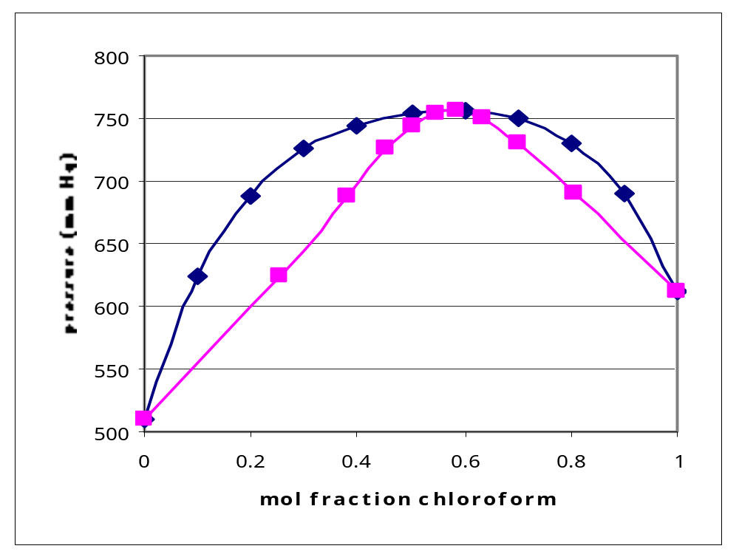
Solution 1-parameter Margules model(con’t)
Using this method, we can generate the pressure of any composition and hence the pressure-composition diagram for this binary system.
Note that this
model predicts
an azeotrope at
approx. 60%
chloroform.
Actual data show
an azeotrope at
65 % chloroform
at 53.5 ºC.

Slide 16
2-parameter Margules model
The 2 parameter Margules model is
G^{E}/RT = x₁ x₂ (A₂₁ x₁ + A₁₂ x₂)
Solving for the constants A₂₁ and A₁₂
ln γ₁ = x₂² [A₁₂ + 2(A₂₁ - A₁₂ ) x₁]
ln γ₂ =x₁² [A₂₁ + 2(A₁₂ - A₂₁ ) x₂]
As with the one parameter model, the constants can be fitted with a single experimental measurement,
A₁₂ = (2-1/x₂)ln γ₁/x₂ + 2 ln γ₂/x₁
A₂₁ = (2-1/x₁)ln γ₂/x₁ + 2 ln γ₁/x₂

Slide 17
Example: 2-parameter Margules model
Repeat the same problem using the 2-parameter Margules model.
Pc* = 611.65 mm Hg Pm* =509.19 mm Hg
γ_{c} = 1.7519 γ_{m} = 1.11277
x_{c} = 0.3 x_{m} = 0.7
Calculate the Margules constants
A_{cm} = (2-1/x_{m})ln γ_{c}/x_{m} + 2 ln γ_{m}/x_{c} = 0.902597
A_{mc} = (2-1/x_{c})ln γ_{m}/x_{c} + 2 ln γ_{c}/x_{m} = 1.647037
Use these constants and Margules model to calculate activity coefficients at any composition,
ln γ_{c} = x_{m}² [A_{cm} + 2(A₂₁ - A_{cm} ) x_{c}]
ln γ_{m} =x_{c}² [A_{mc} + 2(A_{cm} - A_{mc} ) x_{m}]

Slide 18
2-parameter Margules model (con’t)
Repeat the same problem using the 2-parameter Margules model.
At x_{c} = 0.3, calculate the activity coefficients.
γ_{c} = exp(x_{m}² [A_{cm} + 2(A_{mc}- A_{cm} ) x_{c}])
=exp(0.7²[0.902597+2(1.647037 - 0.902597)0.3]) =
= 1.937
γ_{m} =x_{c}² [A_{mc} + 2(A_{cm} - A_{mc} ) x_{m}]=
0.3 ² [1.647037 + 2(0.902597 - 1.647037 ) 0.7]
= 1.056
Now calculate the system pressure
P = γ_{c} x_{c} P_{c}* + γ_{m} x_{m} P_{m}* = 1.937*0.3* 611.65 + 1.056*0.7* 509.19
= 731.804 mm Hg
y_{c} = γ_{c} x_{c} P_{c}*/P = 1.937*0.3* 611.65/731.804 = 0.4857
y_{m} = 1- y_{c} = 0.5143

Slide 19
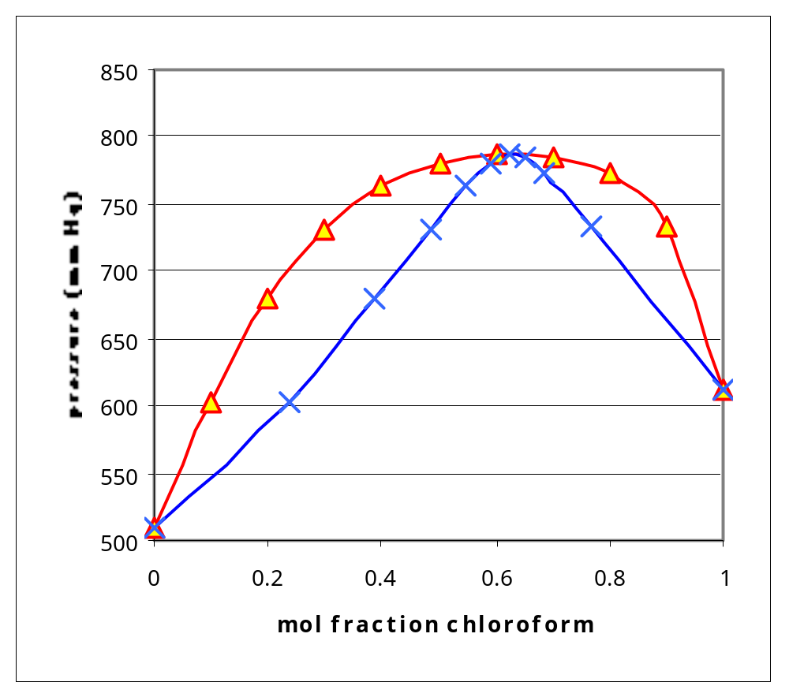
2-parameter Margules model (con’t)
Repeating this calculation to obtain the P-x diagram
Note that this
model is somewhat
more accurate in
predicting the azeotrope
at 65 % chloroform
at 53.5 ºC.

Slide 20
van Laar Model
The van Laar model has a bit more theoretical foundation than the Margules equation. It is presented here without going into the derivation of the model,
G^{E} = A₁₂A₂₁x₁x₂/[x₁A₁₂ + x₂A₂₁]
Recognize that the constants are NOT the same as the Margules constants.
Solving for the activity coefficients,
ln γ₁ = A₁₂ / [1 + A₁₂ x₁ - A₂₁ x₂]²
ln γ₂ =A₂₁ / [1 + A₂₁ x₂ - A₁₂ x₁]²
or for the constants,
A₁₂ = ln γ₁[1+x₂ ln γ₂/x₁ ln γ₁]
A₂₁ = ln γ₂[1+x₁ ln γ₁/x₂ ln γ₂]

Slide 21
Van Laar model example
Repeat the same problem using the van Laar model.
The initial calculations are the same.
Pc* = 611.65 mm Hg Pm* =509.19 mm Hg
γ_{c} = 1.7519 γ_{m} = 1.11277
x_{c} = 0.3 x_{m} = 0.7
Calculate the van Laar constants
A_{cm} = ln γ_{c}[1+x_{m} ln γ_{m}/x_{c} ln γ_{c}]
= ln(1.7519)[1+0.7*ln(1.11277)/0.3*ln(1.7519)]²
= 0.957792
A_{mc} = ln γ_{m}[1+x_{c} ln γ_{c}/x_{m} ln γ_{m}]
= ln(1.11277)[1+0.3*ln(1.7519)/0.7*ln(1.11277)]²
= 1.93668

Slide 22
Van Laar model example (con’t)
A_{cm} = 0.957792 A_{mc} = 1.93668
Use these constants and van Laar model to calculate activity coefficients at x_{c} = 0.3,
ln γ_{c} = A_{cm} / [1 + A_{cm} x_{c} - A_{mc} x_{m}]²
ln γ_{m} =A_{mc} / [1 + A_{mc} x_{m} - A_{cm} x_{c}]²
Plugging in values gives
γ_{c} = 1.919529 γ_{m} =1.061022
Now calculate the system pressure
P = γ_{c} x_{c} P_{c}* + γ_{m} x_{m} P_{m}*
= 1.919529 *0.3* 611.65 + 1.061022 *0.7* 509.19
= 730.41 mm Hg
Calculating the vapor composition,
y_{c} = γ_{c} x_{c} P_{c}*/P = 1.919529 *0.3* 611.65/ 730.41 = 0.4822
y_{m} = 1- y_{c} = 0.5178

Slide 23
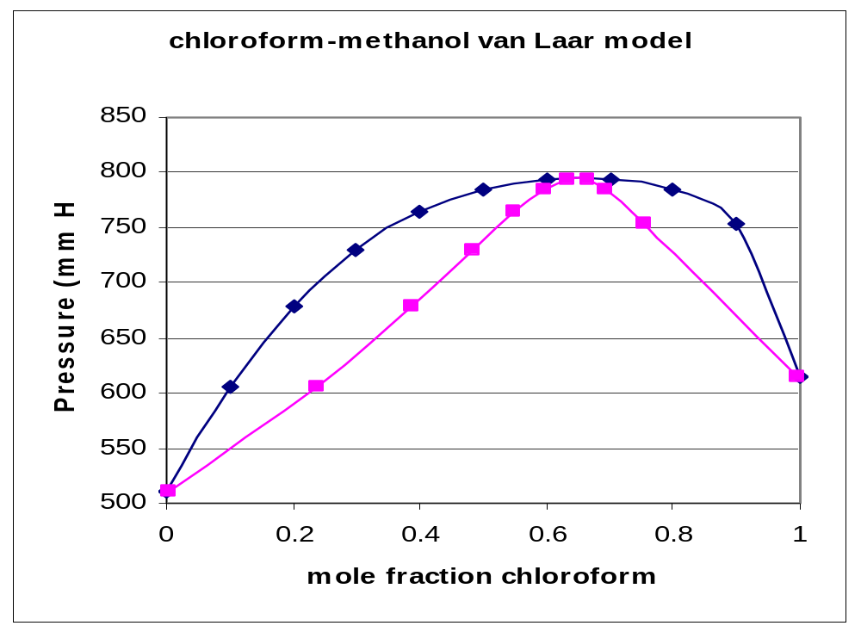
Van Laar model example (con’t)
Repeating this calculation to obtain the P-x diagram

Slide 24
General method of applying binary activity models
Step 1. Using the experimental data conditions, calculate values for the vapor pressures of the pure components (eg. Antoine’s eqn.)
Step 2. Use the V-L equilibrium relationship (e.g. modified Raoult’s law) to calculate activity coefficients at the experimental data conditions.
Step 3. Use the activity coefficients to calculate the model constants at the experimental data conditions.
Step 4. Given a composition, use the model constants to calculate the activity coefficients at that composition.
Step 5. Use the activity coefficients and the model to calculate the vapor composition, bubble pressure, etc.

