Slide 1
Review of Thermodynamic Basics
Bernie Tao
ABE 301

Slide 2
Tao’s Laws of Thermodynamics
1st law – You can not win. (conservation)
2nd law – You cannot break even. (entropy)
3rd law – Zero is zero. (Absolute zero)
4th law – A football does not move unless you kick it. (equilibrium)

Slide 3
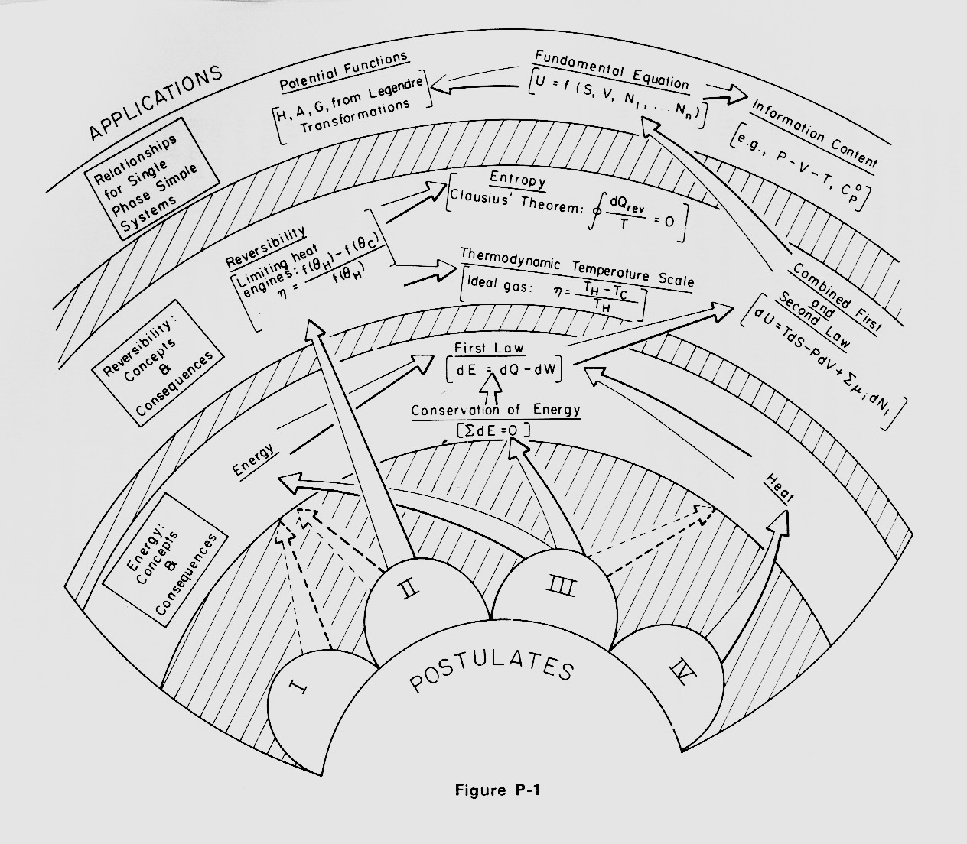
Map of Thermodynamic Utility
From Thermodynamics and Its Applications
M. Modell and R. Reid,
Prentice-Hall, Inc. 1974
Note that this is simply a pictorial model.

Slide 4
Energy Concepts/Models
Energy is the capacity to do work
Mechanical forms of energy (E_{K}, E_{P}) involve forces acting on the system body, such as gravity or movement
Internal energy (U) involve energies contained within the system mass, due to intermolecular interactions, such as pressure, temperature, chemical bonds, and composition
Energy is always quantified relative to a reference state, ΔE = E₁ - E_{ref}
  ΔE_{P} = m*g*(Z₁ – Z_{ref}) Note: these are models
  ΔE_{K} = ½*m*(V₁ – V_{ref}) based on definitions of types
  ΔU = U₁ – U_{ref} energy

Slide 5
Internal Energy Concepts
The fundamental form of thermodynamic energy is a concept called internal energy (energy contained within mass)
Internal energy is composed of all the forms of energy due to molecular movement and intermolecular interactions (vibration/translation/rotation, chemical bonds, hydrogen bonding, etc.)
Humans cannot easily sense internal energy (unlike mechanical forms of energy) so quantifying it requires using parameters that we can sense, e.g. temperature, pressure, etc.

Slide 6
Systems, boundaries, and the universe (It’s all about us)
The concept of energy becomes useful when considering what it can do for us. To do this, we must define a boundary between ‘us’ (the system) and everything else that is not ‘us’ (the universe). In some cases, we also need to characterize what ‘us’ looks like, e.g. constant temperature, adiabatic, volume, etc.
The movement of energy/mass between the system and universe (a process) is used to characterize any benefits or limitations obtained by the system.

Slide 7
Definitions of systems (different kinds of ‘us’)
System (mass/volume under study, subset of universe)
Boundary (separation of system and rest of universe, can be physical or conceptual)
Open vs. Closed system (mass transfer)
Insulated (no heat transfer)
Rigid (cons’t volume)
Isolated (no interactions with universe)
Intensive (not dependent upon system mass, e.g. T, P, x) vs. extensive properties
Steady state, transient/dynamic
Equilibrium (no spontaneous changes occur in the system)

Slide 8
System definitions (picture model)
2
3
Rest of universe
System boundary
system
4
1
interactions between system and universe (red arrows)
Notes:
Interactions must cross system boundary
Interactions can be w or w/o mass (energy or mass or both)
System properties and interactions can change (dynamic)

Slide 9
Thermodynamic ‘Laws’
The fundamental relationships between different forms of energy form the basis for thermodynamic concepts and models
These are collectively known as the 3 ‘Laws’ of thermodynamics
Note that these ‘Laws’ are only postulates, since there is no logical reason they should be this way. The reason we presume they are ‘Laws’ is simply that we have never observed any violation of them.

Slide 10
1st Law
The concept of the conservation of mass and energy is the 1st law of thermodynamics
This law simply states that for any process, the total net change of energy (or mass) in the universe must be zero.
ΣΔE_{final} - ΣΔE_{initial} = 0
(note this is a model)

Slide 11
1st Law: Conservation of mass/energy
Material balance (Δm_{sys}= Σm_{i} or dm_{sys}= Σdm_{i})
Energy balance (ΔE_{sys}= ΣE_{i} or dE_{sys}= ΣdE_{i})
  dE_{sys}= dQ – dW (closed system)
Note: i refers to ith system interaction, m_{i} for mass flow, E_{i} for energy flow
(Note the creation of a model to help us quantify the 1st law.)

Slide 12
2nd Law Concepts
The 2nd law deals with the spontaneity or preferential direction of physical processes
It states that real, isolated systems spontaneously proceed towards an equilibrium state that minimizes the ability to extract useful work from the system
The variable used to measure the extent of this degradation is called entropy (S), which increases as spontaneous processes occur
dS>0

Slide 13
Entropy Concepts
Entropy is a real physical quantity (difficult to measure) that
can cross the boundaries of a system, just like energy and mass
Can be contained in mass or exist without mass (just like energy)
Must use other parameters to quantify
Useful to quantify:
Structural order
Energetic efficiency of a process
Gradients of concentration, energy

Slide 14
Entropy
The 2nd law can be quantified in alternative forms based on it utility, such as Clausius’s statement with regard to work, heat flow and others.
With regards to heat flow particularly,
dQ = T dS (model!)
(for homogeneous, reversible processes)
Entropy balance
  ΔS=Σm_{i}S_{i} + Q/T + S_{gen} (model!)
Note: entropy is not conserved and increases for spontaneous processes (S_{gen}> 0)
Note nomenclature, S_{i} is the specific entropy (entropy per unit mass)

Slide 15
3rd Law Concepts
The 3rd Law invokes the concept that there is a reference state of matter that has no measurable entropy (S=0)
This state is at absolute zero temperature in a perfectly crystalline solid
This provides a reference condition for measuring the absolute value of entropy

Slide 16
4th ‘Law’ Concepts
There is an addendum to the 3 laws, which exists to cover Maxwell’s statistical analysis of random molecular motion (Maxwell’s demon)
This postulate basically states that if 2 systems (A, B) with temperatures T_{A}>T_{B} are placed in contact, heat will only flow from A to B
Note: While this is obvious from experience, the first 3 laws do not explain this.

Slide 17
Tao’s Laws of Thermodynamics
1st law – You can not win. (conservation)
2nd law – You cannot break even. (entropy)
3rd law – Zero is zero. (Absolute zero)
4th law – A football does not move unless you kick it. (equilibrium)

Slide 18
How are Energy/Entropy Quantified?
Unfortunately, we do not have energy or entropy meters, so we can not directly measure the quantity of energy/entropy in mass or without mass.
Therefore, we must use parameters we can measure to calculate energy/entropy.
The traditional measurable thermodynamic parameters used are temperature, pressure, and specific volume (density).

Slide 19
Internal Energy
Since humans cannot easily directly sense internal energy, we rely on other physical properties that we can measure and try to relate these to internal energy
For example, pressure (P), temperature (T), volume (V), color, taste, etc.
dU = dQ - dW = TdS -PdV (model!)
(closed, homogenous, reversible process)

Slide 20
Physical properties
Equations of State (ideal gas, compressibility, etc.) (models!)
Data tables/charts (steam tables, Antoine, etc.) [interpolation] (models!)
Phase charts (P-T, P-V, T-V) (models!)
  quality (mass % vapor)

Slide 21
Convenience Forms of Energy
(USHAG)
To make quantification of internal energy/entropy more convenient, made-up forms of energy have been developed:
  Enthalpy : H = U + PV
  Gibb’s energy : G = H-TS
  Helmholtz energy : A = U – TS
Note: Internal energy (U) is the only real form of energy. The others (HAG) are only for convenience of calculations/analysis

Slide 22
Internal Energy
Internal energy can be expressed in differential form as a function of two variables,
dU = Q - W = T dS - P dV = (δU/δS)_{V} dS + (δU/δV)_{S} dV (model!)
This expression states that U is a ‘natural function’ of S and V and allows us to use exact differential rules of calculus.
For example, (δU/δV)_{S} = -P. This means that if entropy were held constant, the internal energy could be calculated by integrating the changes in pressure with volume.
nomenclature
S - entropy P - pressure
T - temperature V - volume

Slide 23
Convenience Energy Functions - Enthalpy
Internal energy is not easily measured under practical circumstances. For example, in open systems, where masses entering and leaving the system do work related to their volume and external pressure. In these systems, a new energy function is defined, enthalpy (H).
H = U + PV
The benefit of calculating H is that the PV work performed by masses entering and leaving an open system is automatically included without having to do additional calculations.
To determine the variables of which H is a natural function, first write the differential form.
dH = dU + d(PV) = dU + P dV + V dP (model!)
Now substitute for dU=T dS - P dV
dH = T dS - P dV + P dV + V dP = T dS + V dP (model!)
So H is a natural function of S and P, i.e. H(S,P).

Slide 24
Gibb’s Energy
Gibb’s energy is particularly useful in phase and chemical/biochemical equilibria, as it is a natural function of the easily measured variables temperature and pressure. Interestingly, G is also most convenient for lab work and for biological systems (why?).
dG = dH-d(TS) = TdS + VdP - SdT - TdS
= VdP – SdT (model!)
therefore G(T,P)

Slide 25
Gibbs energy
Gibbs energy (G=H-TS) is most useful because it is a natural function of T and P, which can be experimentally controlled.
Writing it in differential form and subsituting for dH
dG= dH - d(TS) = dH - TdS - S dT
= T dS + V dP - TdS - S dT
= -S dT + V dP
So G(T,P) = -S dT + V dP (model!)
Since most biological systems are at constant T and P, Gibbs energy is particularly useful in exploring energy and its relationship to living systems.

Slide 26
Helmholtz energy
Helmholtz energy is defined as A = U - TS. It is most useful because it is a natural function of T and V, which can easily be controlled experimentally.
This can be shown in a similar fashion by writing it in differential form and substituting for dU.
dA = dU - d(TS) = dU - T dS -S dT
= T dS - P dV - T dS -S dT
= - S dT - P dV
Therefore, A(T,V)= -S dT - P dV (model!)
Helmholtz energy is useful with 2 dimensional surface systems (why?).

Slide 27
Maxwell relationships
Relating measurable parameters (P, T, V) to obtain unmeasurable thermodynamic quantities (entropy, energy, etc.) can be accomplished using mathematical relationships, such as exact differentials
For example, the cross-differentials of an exact differential are equal
Given F(x,y), dF = (δF/δx)_{y} dx + (δF/δy)_{x}dy
= M dx + N dy
therefore, (δM/δy)_{x} = (δN/δx)_{y}
For example, dG =VdP – SdT = (δG/δP)_{T} dP + (δG/δT)_{P} dT
So, (δG/δP)_{T} = V and (δG/δT)_{P}= -S
and (δV/δT)_{P} = (-δS/δP)_{T}

Slide 28
Maxwell relationships
Since energy is a state function (not path dependent), it is an exact differential. Applying this concept to U, H, A, G,
dU = TdS - PdV (δT/δV)_{S} = -(δP/δS)_{V}
dH = TdS + VdP (δT/δP)_{S} = (δV/δS)_{P}
dA = - PdV - SdT (δP/δT)_{V} = (δS/δV)_{T}
dG = VdP - SdT (δV/δT)_{P} = -(δS/δP)_{T}

Slide 29
Maxwell relationships [(δM/δy)_{x} = (δN/δx)_{y}]
A property of exact differentials is that their cross derivatives must be equal These types of relationships are useful in quantifying properties that cannot be directly measured, such as entropy.
A set of 12 relationships can be obtained in this fashion from the 4 energy functions. These are called the Maxwell relationships.
T = (δU/δS)_{v}=(δH/δS)_{P}
-P=(δU/δV)_{S}=(δA/δV)_{T}
V=(δH/δP)_{S}=(δG/δP)_{T}
-S=(δA/δT)_{v}= (δG/δT)_{P}
(-δP/δS)_{v} = (δT/δV)_{S}
(δV/δS)_{P} = (δT/δP)_{S}
(δP/δT)_{v} = (δS/δV)_{T}
(-δS/δP)_{T} = (δV/δT)_{P}

Slide 30
Utility of Maxwell Relationships quantifying USHAG
The utility of these equations is to quantify difficult to measure thermodynamic properties, like entropy, using easily measured properties, like temperature and pressure.
For example, using (δV/δT)_{P} = -(δS/δP)_{T}, the change in entropy could be obtained by measuring the change in volume with respect to temperature at constant pressure.

Slide 31
So if we had a mathematical function (a model!) of measurable parameters (T, V, P), called an equation of state, we could quantify the unmeasurable parameters such as U, S, H, A, and G

Slide 32

Calculus and Thermodynamic Energy Functions
For example,
dG(T,P) = -S dT + V dP = (δG/δT)_{P} dT + (δG/δP)_{T} dP
So (δG/δT)_{P} = -S and (δG/δP)_{T} = V
Since we can experimentally control changes in V, T and P, values of Gibbs energy can be directly calculated by measuring changes in volume with pressure at constant temperature.
For example, ΔG = V dP at constant T (why?).
So if we have some kind of functional relationship between V and P that can be integrated, we can directly calculate Gibbs energy.
An example of such a relationship is the ideal gas equation, V=RT/P (model!)
So for an ideal gas, ΔG = G₂ - G₁ = RT ln (P₂/P₁)

