Slide 1

Phase Equilibria -
Clausius-Clapeyron Equation
Bernie Tao

Slide 2
Phase equilibria
Many biological and chemical processes rely on separation of materials using 2 phases. For example, distillation of fuels, crystallization of proteins, precipitation of gums, etc.
Understanding the thermodynamic properties of multi-phase systems is therefore an important part of engineering separations applications.

Slide 3
Learning Objectives
Understand the thermodynamic concept of liquid-vapor equilibrium
Recognize the relationships between saturation temperature/pressure and enthalpy of vaporization
Be able to use the Clapeyron or Clausius-Clapeyron equations to calculate saturation temperature/pressure and enthalpy of vaporization

Slide 4
Liquid-vapor equilibria
Imagine a single component in the liquid phase. At any given temperature, there will be some vapor co-existing with the liquid at a pressure called the vapor pressure. You are probably most familiar with the temperature at which the vapor pressure equals 1 atm, which is called the boiling point. The term saturation is used to describe a liquid at equilibrium with its vapor, e.g. saturated liquid or saturated vapor. The amount of energy needed to change from the liquid phase to the vapor phase is called the enthalpy of vaporization.

Slide 5
The vapor pressure of a material is a physical property unique to that substance, just like melting point or density. However, it is a function of temperature, so it is not a single value.
The enthalpy of vaporization also changes with temperature, so it is important to be able to develop quantitative relationships for these properties.

Slide 6
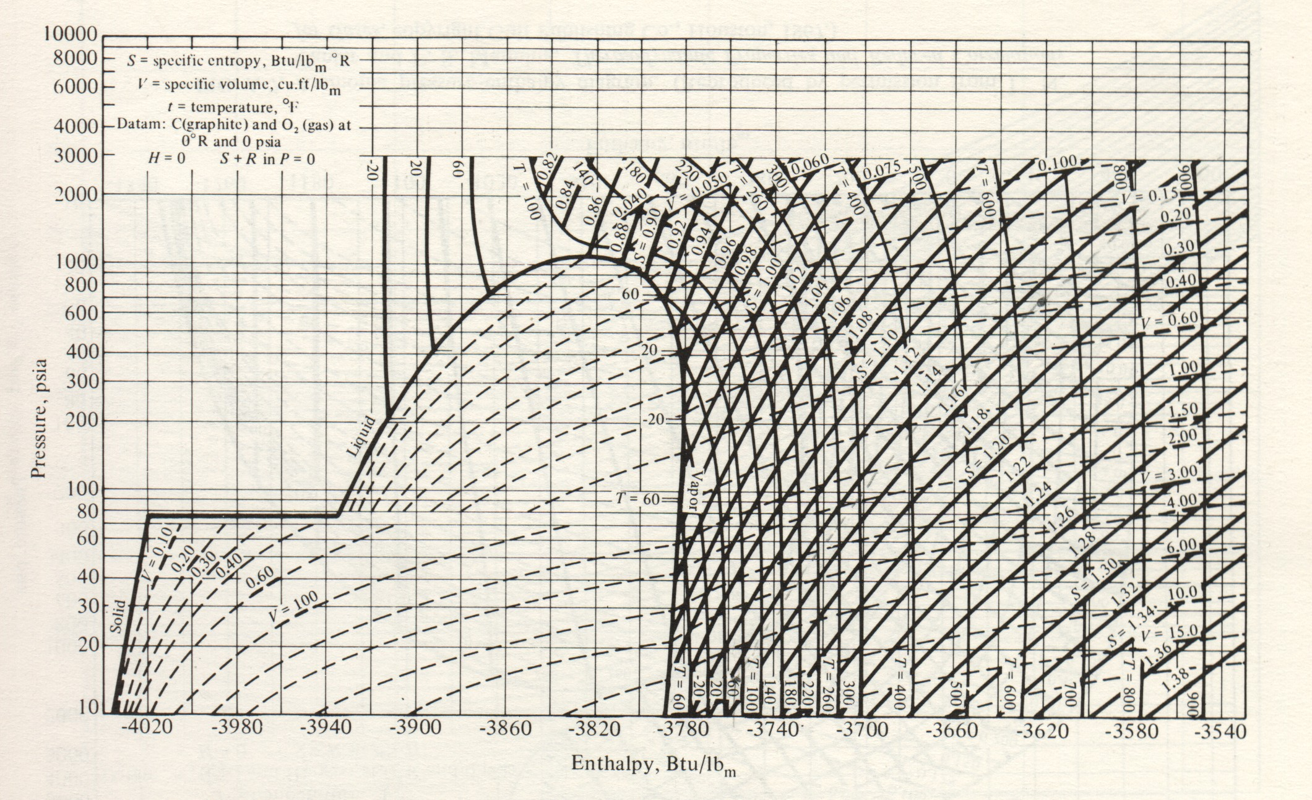
This is the pressure-enthalpy phase diagram of carbon dioxide. Notice how the enthalpy of vaporization changes with pressure (changing width of red arrows).

Slide 7
Clapeyron eqn
For a 2 phase L-V mixture at saturated conditions, the relationship between the vaporization pressure and temperature can be obtained by considering the thermodynamic energetic state of each phase.
Equilibrium requires that the specific Gibb’s energy in each phase be the same, i.e.
dG_{L} = dG_{V}
We also recognize that during a phase change the temperature and pressure are also constant.

Slide 8
Clapeyron eqn
Since dG=VdP - SdT,
dG_{L} = V_{L}dP - S_{L}dT =V_{V}dP -S_{V}dT = dG_{V}
Since T and P are fixed at saturated conditions
Re-arranging,
dP_{sat}/dT_{sat} = (S_{L} - S_{V})/(V_{L} - V_{V}) =ΔS_{vap}/ΔV_{vap}

Slide 9
Clapeyron eqn
dP_{sat}/dT_{sat} = ΔS_{vap}/ΔV_{vap}
Enthalpy is defined as dH = TdS + VdP
Since during a phase change, dP=0,
dH_{vap} =T_{sat}dS_{vap}
integrating and re-arranging,
ΔS_{vap} = ΔH_{vap}/T_{sat}

Slide 10
Clapeyron eqn
ΔS_{vap} = ΔH_{vap}/T_{sat}
substituting this into the previous eq’n,
dP_{sat}/dT_{sat} = ΔH_{vap}/T_{sat} Δv_{vap}
re-arranging,
ΔH_{vap} = (dP_{sat}/dT_{sat}) T_{sat} Δv_{vap}
So if we could quantify the relationship between P_{sat}and T_{sat} and the volume of vaporization, the enthalpy of vaporization can be calculated.

Slide 11
Clausius-Clapeyron equation
Clausius further simplified the Clapeyron eqn. by assuming ideal gas behavior (PV=RT) and that V_{V} >> V_{L} (ΔV=V_{V}-V_{L} = V_{V})
dP_{sat}/dT_{sat} = ΔH_{vap}/T_{sat} Δv_{vap}
₌ ΔH_{vap}/T_{sat} v_{v}
= ΔH_{vap}/T_{sat} (RT/P_{sat})

Slide 12
Clausius-Clapeyron equation
dP_{sat}/dT_{sat} = ΔH_{vap}/T_{sat} (RT_{sat}/P_{sat})
re-arranging,
(dP_{sat}/P_{sat})/dT_{sat} = ΔH_{vap}/R T_{sat}²
or
ΔH_{vap}= -R T_{sat}² d(ln P_{sat})/dT_{sat}
So the enthalpy of vaporization can also be estimated from saturated P, T data

Slide 13
Clausius-Clapeyron equation
An alternative form of the C-C is to re-arrange
 d(ln P_{sat}) = -ΔH_{vap} /R d(1/T_{sat})
Integrating this assuming constant ΔH_{vap},
ln (P_{sat2}/P_{sat1}) = -ΔH_{vap}/R (1/T_{sat2} -1/T_{sat1})
So knowing ΔH_{vap}, P_{sat} and T_{sat} at one state allow you to estimate P_{sat} or T_{sat} at another state

Slide 14
Example calculation
Estimating ΔH_{vap} using C-C equation
Calculate the enthalpy of vaporization of water at 50 ºC using steam tables.
Taking the 2 bracketing values of P and T around 50 ºC, to estimate dP/dT:
at 45 ºC, P=0.009595 mPa
at 55 ºC, P = 0.01580 mPa
From C-C eqn, ΔH_{vap} = RT_{sat}² *(d P_{sat}/dT_{sat})/P_{sat}
= (8.3143 J/mol-K)(323.15²K²){(0.01580-0.009595 mPa)/(55-45 K}/0.01240 mPa
= 43446.43 J/mol * 1/18 mol/gm = 2413.69 J/gm = 2413.69 kJ/kg
from steam tables, at 50 ºC ΔH =2381.85 kJ/kg (approx. 1.3% error)

Slide 15
Example calculation
Estimating T_{sat} using C-C equation
At 165 ºC the vapor pressure of water is 0.7009 MPa and the enthalpy of vaporization is 2065.57 kJ/kg. Using the C-C equation, estimate the saturation temperature at a pressure of 0.8 MPa.
ln(P₂/P₁) = -ΔH/R (1/T₂ -1/T₁)
Re-arranging this equation,
T₂ = 1/{R ln(P₂/P₁)/ΔH + 1/ T₁}
Plugging in values,
T₂ = 443.90 K = 170.75 ºC
from steam tables, at P=0.80 MPa, T = 170.41 ºC

Slide 16
Modeling the vapor pressure
A function called Antoine’s equation has been used to model the temperature dependency of vapor pressure for a variety of materials.

Slide 17
The Antoine equation
The Antoine equation has the form:
ln P* = A - B/(C+T)
where
P* - vapor pressure
T - absolute temperature
A, B, C - constants dependent on the material
Constants for Antoine’s equation can be found in a variety of references including the appendix of the course text.

Slide 18
Example calculation
Estimating P_{sat} using Antoine equation
Calculate the enthalpy of vaporization of water at 50 ºC.
Antoine constants: A = 9.6655
P [=] Mpa B = 3985.64
T [=] K C = -39.72
ln P_{sat} = A - B/(C+T) = 9.6655 - 3985.64/(323.15-39.72)
= -4.397
P_{sat} = exp(-4.397) = 0.01232 mPa
From steam tables, P_{sat} = 0.01240 (approx. 0.6% error)

Slide 19
Example calculation
Estimating ΔH_{vap} using Antoine and C-C equation
Calculate the enthalpy of vaporization of water at 50 ºC.
Antoine constants: A = 9.6655
P [=] Mpa B = 3985.64
T [=] K C = -39.72
From the C-C equation, d(lnP)/dT=ΔH/RT²
From Antoine’s eqn, d(lnP)/dT=B/(C+T)²
note: T in K, B/(C+T)² has units of 1/T
ΔH=RT^{2*}B/(C+T)² = (8.3143 kJ/mol-K)(323.15²K²)(3985.65/(323.15-39.72)²(1/K)
= 43076.61 kJ/mol * 1/18 mol/gm = 2393.15 kJ/kg
from steam tables, at 50 ºC ΔH =2381.85 kJ/kg (approx. 0.5% error)

