Slide 1
Lab Safety
Jan 12 2018
ABE 304

Slide 2
General Safety Notes
PPE Required
Closed toe shoes, long pants, gloves, lab coat (for some labs), safety goggles/glasses
No eating or drinking in the lab (includes water)
No chewing gum
No horseplay; please be attentive of experiments and those around you

Slide 3
Accidents happen
Please let the TA know right away
Even if it seems small!
Broken glass
Chemicals spilled on bare skin
Chemical spills
Any cuts, lacerations
Please follow instructions

Slide 4
Safety Quiz
Due Jan 19th at 11:59 pm
Lab Safety Fundamentals Quiz
Must be valid through to the end of the semester
Submit the certificate of completion
Visit REM website (link on Blackboard)

Slide 5
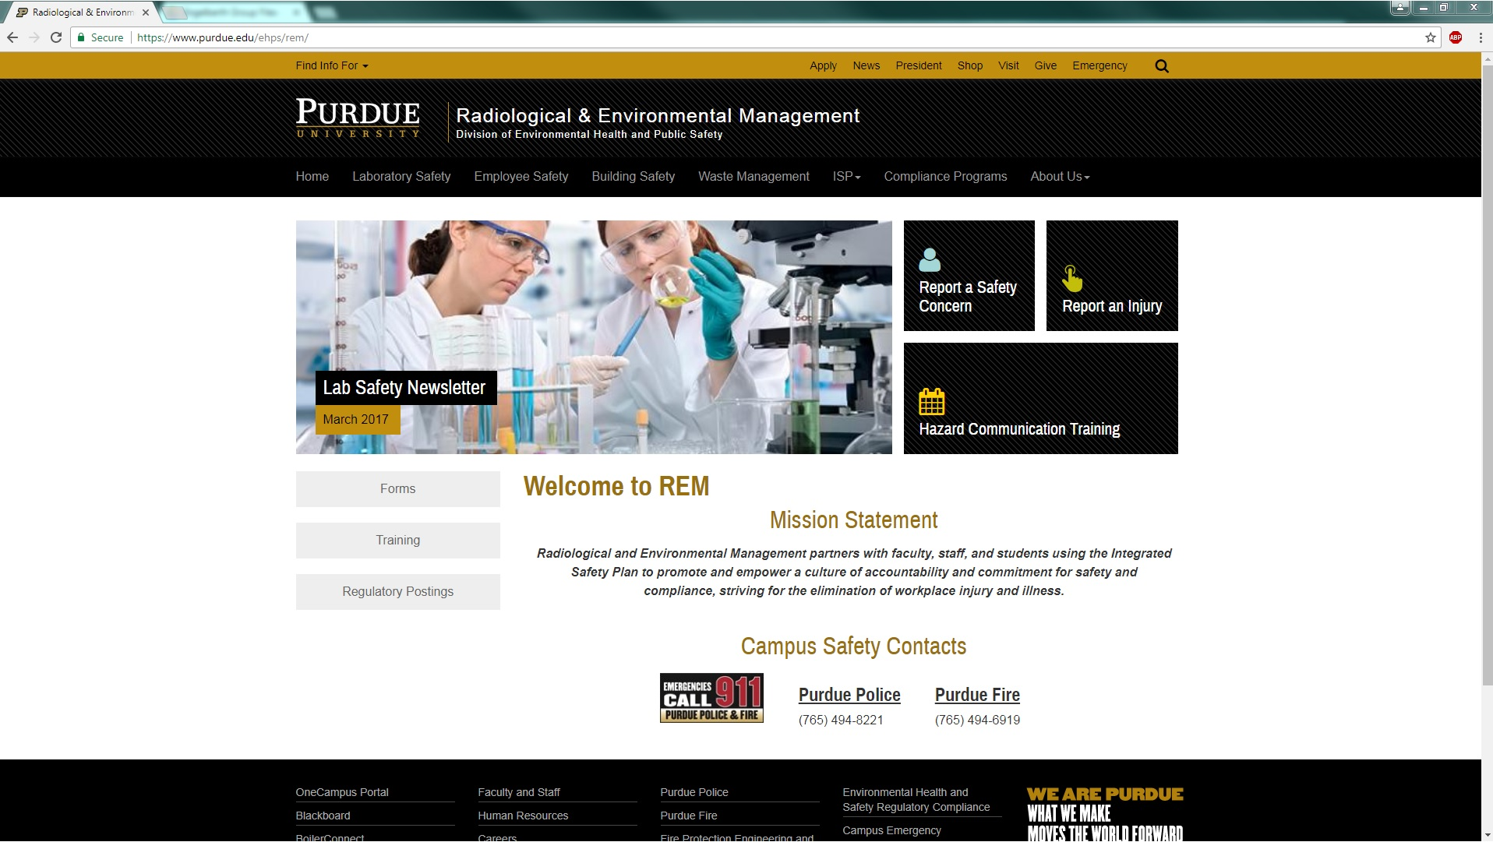

Slide 6
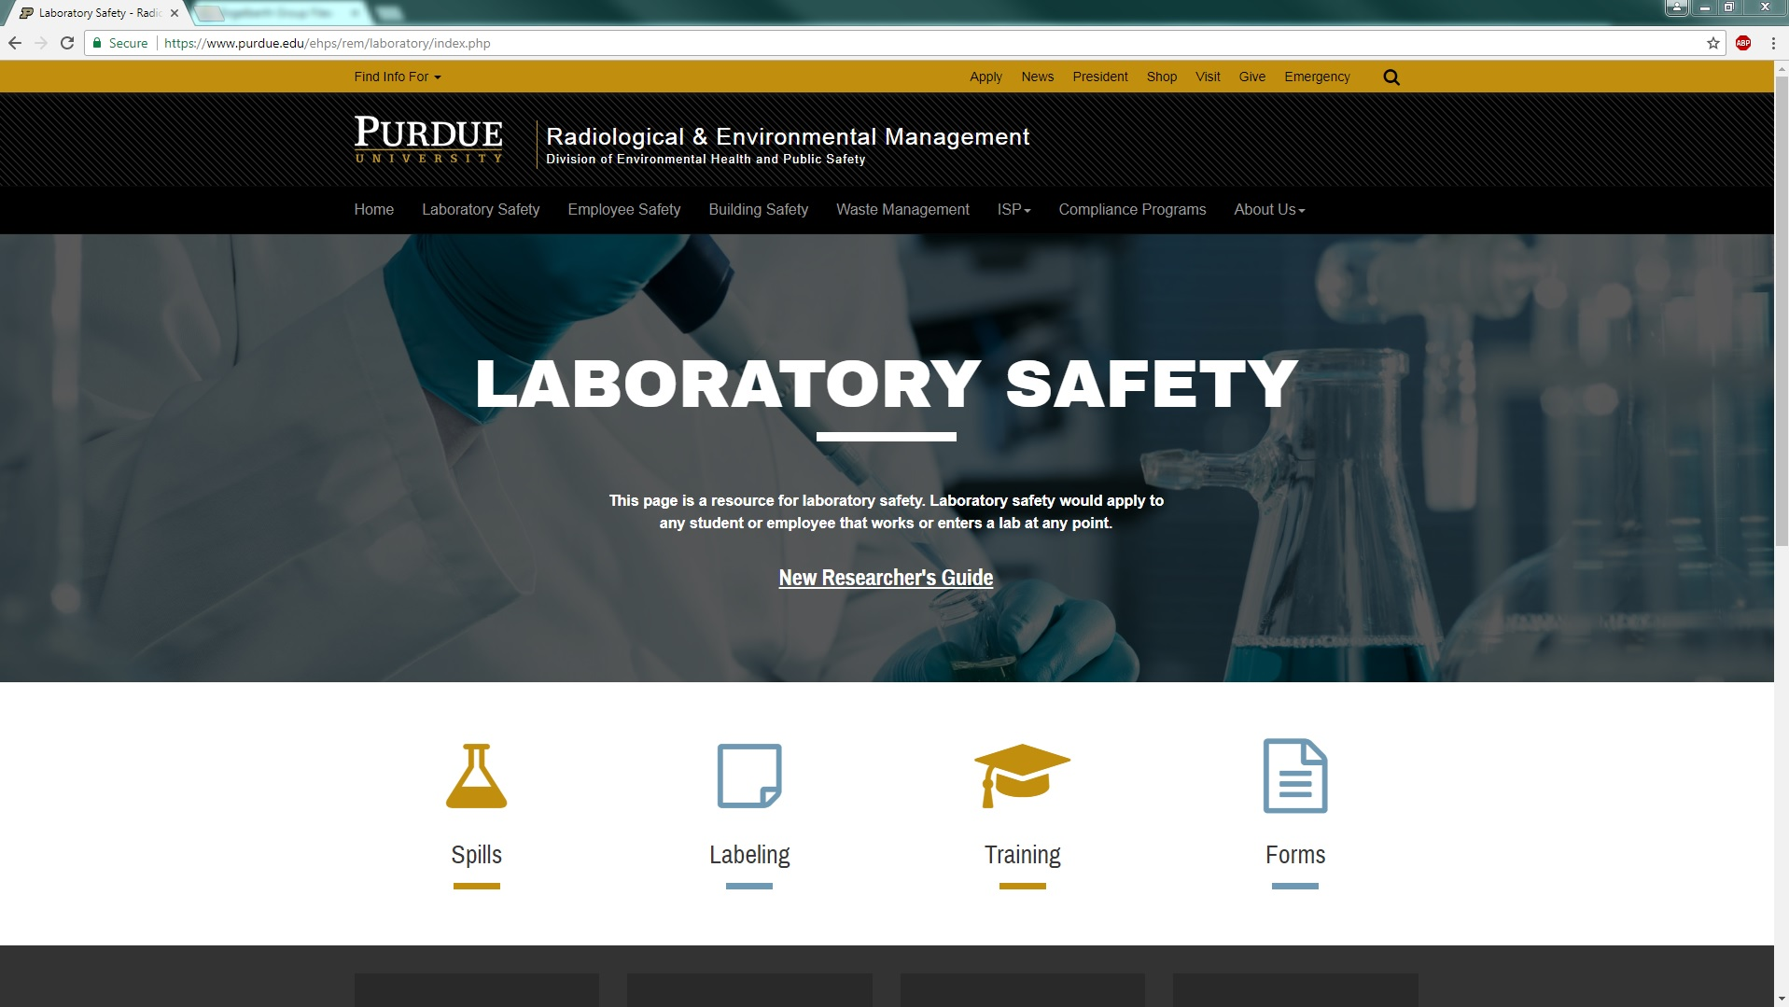

Slide 7
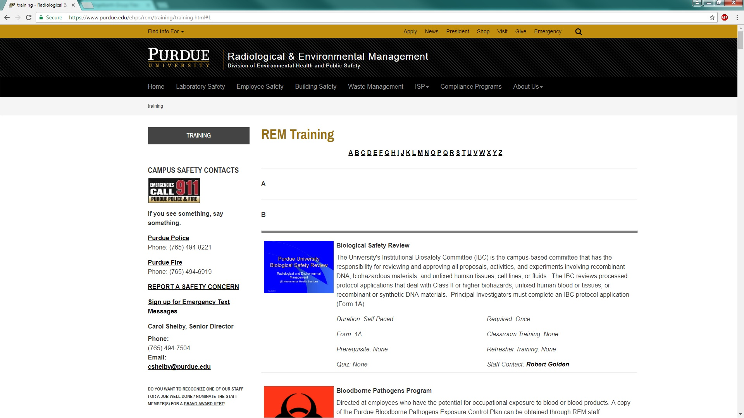
Click on L

Slide 8
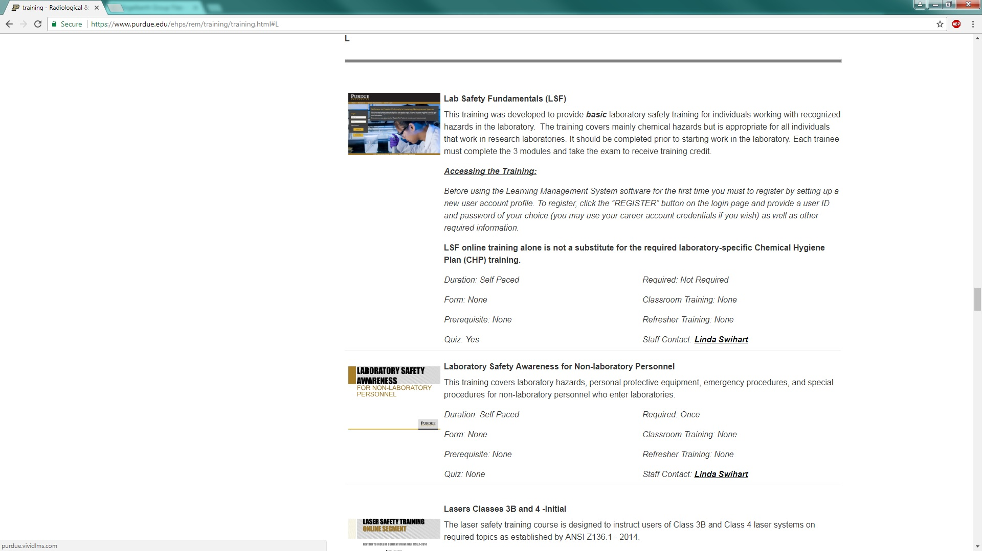
Click on image

Slide 9
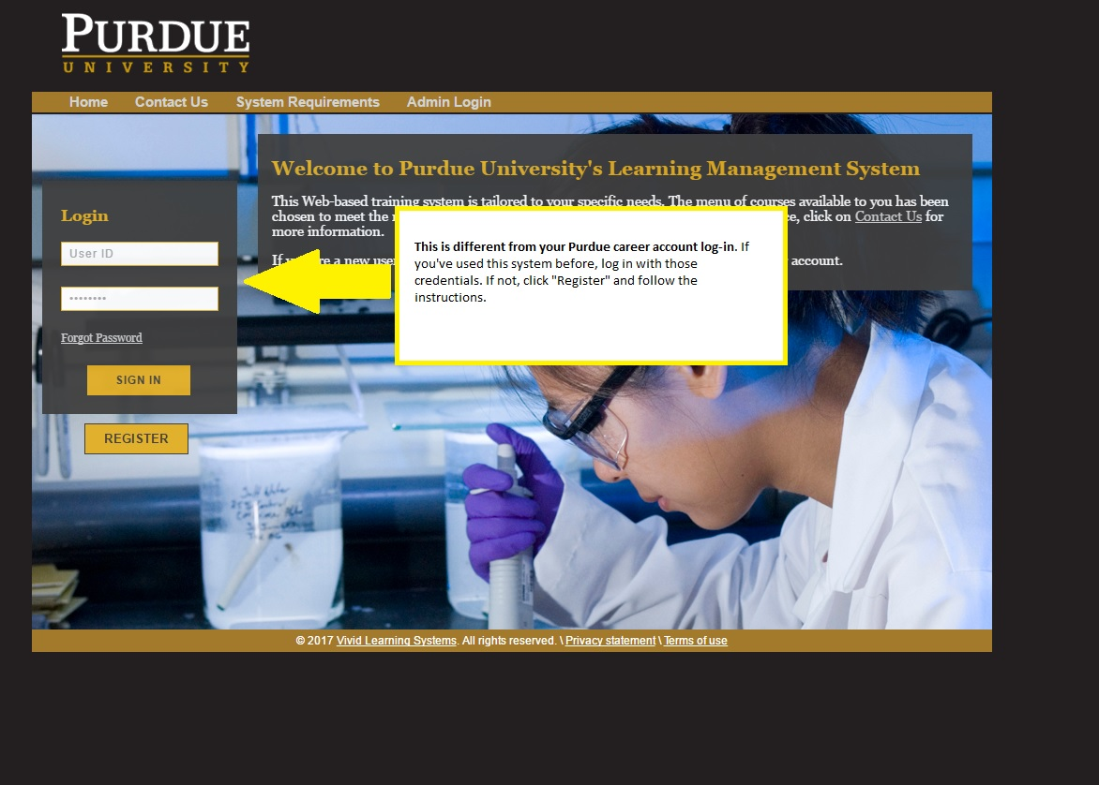

Slide 10
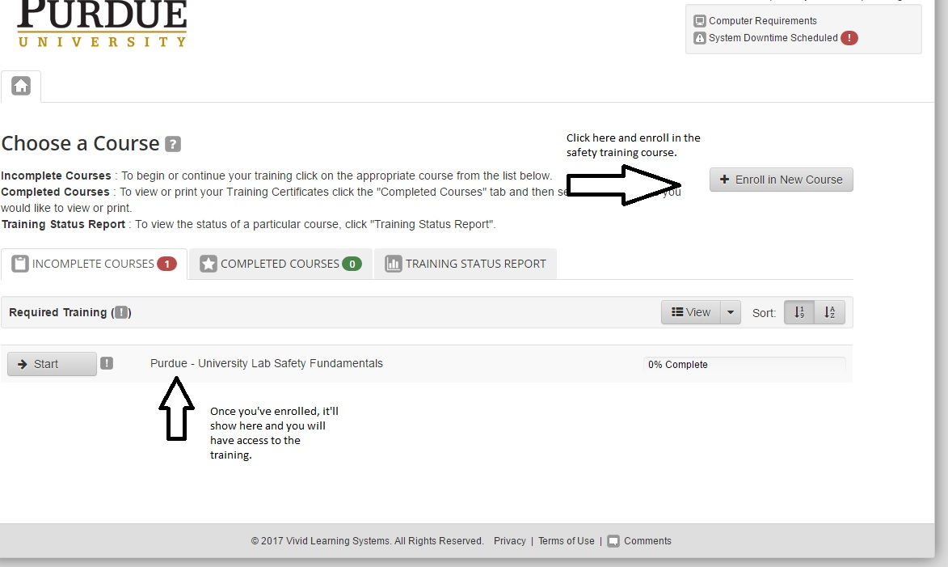

Slide 11
Very cool and super awesome safety video

