Slide 1
Lecture 8 (Part of Chapter 10)
Objectives
Understand molecular diffusion and how is related to molecular mobility
Define the Fick’s law
Define diffusivity and how it is affected by variables such as pressure, temperature composition, etc.

Slide 2
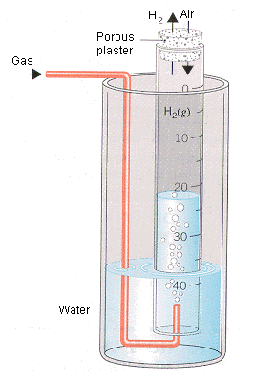
Mass Transfer
Assume that molecular species (components) move with the flow of fluid and in addition they are diffusing.
Fluid Velocity
Mass transfer of the components occurs due to the bulk movement of
the fluid (which is somewhat described by fluidmechanics) and due to
diffusion mechanisms.
Thomas Graham (1805-1869) during the
period 1828-1833 was investigating diffusion
of gases in other gases.
Molecular Diffusion
Diffusing gases such as
H₂ in air

Slide 3
Measured as the change
of volume in the liquid
Gas | equivalent volume | specific density | Molecular Weight (g/mol)
Hydrogen H₂ | 3.83 | 0.0694 | 2
Methane CH₄ | 1.344 | 0.455 | 16
Ethylene C₂H₄ | 1.0191 | 0.972 | 28
Carbon Monoxide CO | 1.0149 | 0.972 | 28
Nitrogen N₂ | 1.0143 | 0.972 | 28
Oxygen O₂ | 0.9487 | 1.111 | 32
Carbon Dioxide CO₂ | 0.812 | 1.527 | 44
Sulfurous Acid SO₃H₂ | 0.68 | 2.222 | 82

Slide 6
The diffusion time is inversely proportional to the
square root of molecular weigh of the diffusing specie

Slide 7
Graham’s Liquid Diffusion Experiments (Diluted Solutions)
Salt solution
water
Plate
Salt solution
Water
Experiment Results
Diffusion in liquids was several thousands times slower
than in gases
The diffusion process got still slower as the experiment
progressed
Quantities “diffused” are in closed proportion to the quantity of salt in the diffusion solution
Weight percent of sodium chloride | Relative Flux
1 | 1
2 | 1.99
3 | 3.01
4 | 4.00

Slide 8
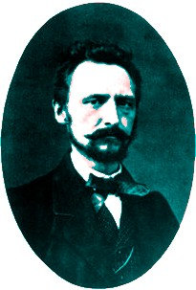
Adolph Fick (1829-1901)
Next to Graham’s experiments came Fick’s experiments and models. Fick, born
in 1829, liked very much mathematics but due influences of his brother he became
a Doctor in medicine. In 1847 he was tutored by Carl Ludwig, who strongly believed
that medicine, and indeed life itself, must have a basis in mathematics, physics
and chemistry. In addition to his development to the Diffusion equation, Adolf
Fick’s main discoveries were in physiology, e.g. the area of mechanics
(mechanics applied to the functioning of muscles), hydrodynamics and
hemorheology (viscosity of blood), and in the visual and thermal functioning
of the human body. In 1855 he proposed his famous diffusion equation
mainly based on Graham and his own experimental data

Slide 9
Fick’s Diffusion Experiments: In a cylindrical tube with a salt reservoir at the
bottom and flowing fresh water at the top
Liquid stream of water (component 2) and
salt (component 1) diffusing along the tube
z=L
z
Mass of salt diffusing at
z
Mass of salt diffusing at z
z=0
Water in the tube (stationary)
Saturated salt solution
and solid salt

Slide 10
Fick’s Law: From the original paper in 1855
“The diffusion of the dissolved material is
left completely to the influence of the
molecular forces basic to the same law for
the spreading of warmth in a conductor and
which has already been applied with such
great success to the spreading of electricity”
In other words diffusion can be described on the same
mathematical basis as Fourier’s law for heat conduction
or Ohm’s law for electrical conduction

Slide 11
Electrical Conduction
R
V₂
V₁
I
Heat Conduction
R
T₂
T₁
q
1-D Fourier’s Law
Diffusion
R
c₂
c₁

Slide 12

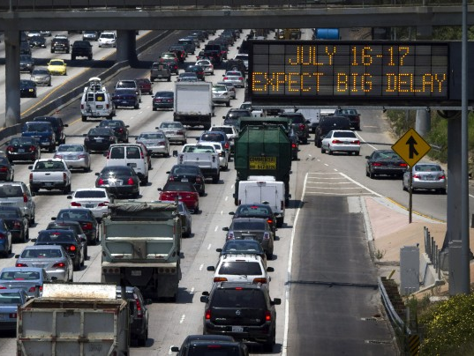

Slide 13
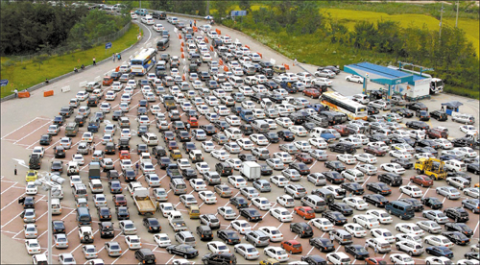
Concept on Mass Fluxes (a little more crazy!!!)

Slide 14
Concept on Mass Fluxes
Area A
z
Flux
x
is the vector velocity
and may have three
different directions
u_{i}, v_{i} and w_{i}
y
In a diffusing mixture the various chemical species (1,2,…..i) are moving
at different velocities ( ). denotes the velocity of the i species
respect to a stationary coordinate system

Slide 15
Frames of References to study mass transfer
Area A
z
Flux
x
y
Fixed Coordinate System
From a theoretical standpoint the approach is fine, but
practically it may result complicated. We are more
interested in describing how each component of the
mixture (1, 2, …..,i,…n) is moving respect to the bulk

Slide 16
How could we determine the bulk
velocity of the mixture?
z
Area A
x
Flux
y
Bulk velocity based
on the mass rate
Bulk velocity based
on the moles rate

Slide 17
Mass Average Velocity
is the local velocity
that one would measure
by means of a flowmeter
Molar Average Velocity

Slide 18
Mass and Molar Average Velocities
Area A
Flux
Local Rate at which mass passes through a unit
cross section placed perpendicular to the velocity
Local Rate at which moles pass through a unit
cross section placed perpendicular to the velocity

Slide 19
Diffusion Velocities
Fick’s Law for Diffusion (1D – x direction)
Diffusivity
concentration
gradient

Slide 20
Fick’s Law for Diffusion
Physical Interpretation of Diffusivity
t = 0
Dt = 0.05
Concentration
Dt = 0.1
Dt = 0.2
Demonstration
-2
-1
0
1
2
Distance from origin

Slide 21
Physical Interpretation of Diffusivity
Brownian Movement
Demonstration 2
For N₂
0.56 cm in 1 second
zigzag path 475 meters in 1 second

Slide 22
Typical Range of Diffusivities
capillary diffusivity of water
in unsaturated soil
In Solids
In Liquids
In Gases
10⁻¹²
10⁻¹¹
10⁻¹⁰
10⁻⁹
10⁻⁸
10⁻⁷
10⁻⁶
10⁻⁵
Diffusivity for Gases

Slide 23
Diffusivity for liquids (non-electrolytes)
Viscosity of
the liquid
Friction
f
r
Stokes-Einstein Relation
v

Slide 24
Diffusion of gases in porous solids (effective diffusivity)
Transport in cell membrane
Passive transport (lipid bilayers)
Active transport
Dispersive Mass Transfer
Dispersion
coefficient
concentration
gradient

Slide 25
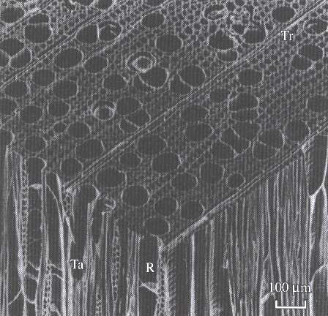
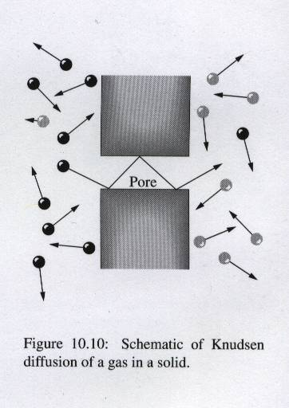
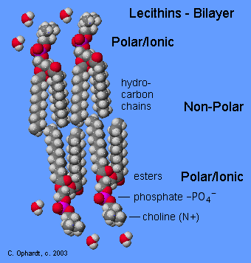
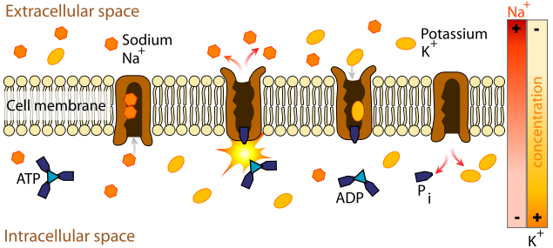
Diffusion in a porous media
Structure of Wood
Membrane Bilayer
Transport through cell membrane
Active transport is the mediated transport
of biochemicals, and other atomic/molecular
substances, across membranes. Unlike passive
transport, this process requires the expenditure of chemical energy to move molecules "uphill" against a gradient.
Active diffusion

Slide 26
Convective Mass Transfer
Fluid at c₂
c₁

