Slide 1
AGITATION
The purposes of agitation:
Suspending solid particles
Blending miscible liquids
Dispersing a second liquid, immiscible with the first to form an emulsion
Dispersing a gas through the liquid in the form of fine bubbles
Promoting heat transfer between the liquid and a coil or a jacket

Slide 2
AGITATION
Agitation equipment consists of:
Vessel
Impeller
Baffles

Slide 3
IMPELLERS
Types of impellers:
Propeller: Axial flow high speed impeller
  used for low viscosity fluids
  predominantly axial flow
Turbine impellers:
  effective over much wider viscosity of fluids
  predominantly radial flow
Paddles:

Slide 4
IMPELLERS
Propellers used for viscosities upto 3 Pa.s
Turbines used below 100 Pa.s
Anchor agitators used above 50 Pa.s to 500 Pa.s
Helical or Ribbon agitators in the range of 1000 Pa.s to 25000 Pa.s

Slide 5
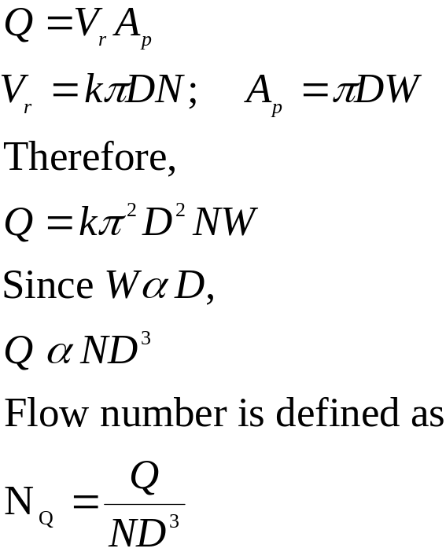
FLOW NUMBER
V
The flow rate of liquid from the impeller Q
is given by,
V_{r}
V_{t}

Slide 6
FLOW NUMBER
N_{Q} = 0.5 for marine propeller (pitch = diameter)
N_{Q} = 0.75 for 6 blade turbine with disk (W/D = 1/5)
N_{Q} = 0.5 for 6 blade turbine with disk (W/D = 1/8)
N_{Q} = 0.75 for pitched blade turbine ( W/D = 1/5)
N_{Q} = 1.3 for 6 blade flat turbine
N_{Q} = 0.87 for 4 blade 45⁰ turbine

Slide 7
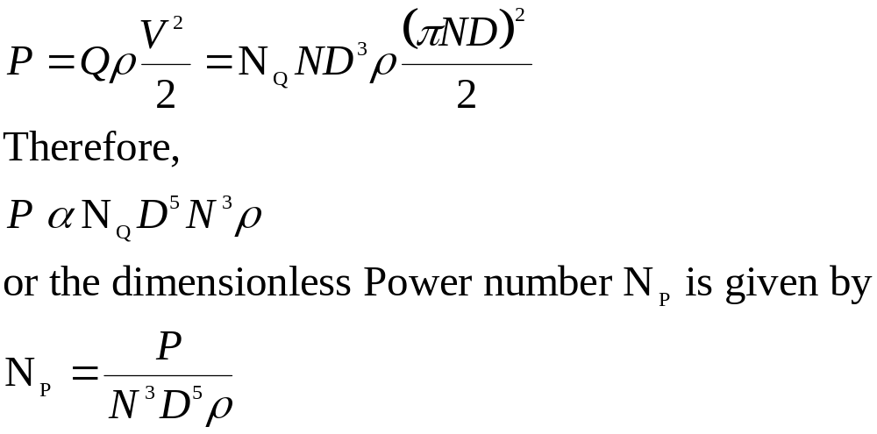
POWER CONSUMPTION
Power consumption P is proportional to the kinetic energy
of the liquid leaving the impeller. Therfore,

Slide 8
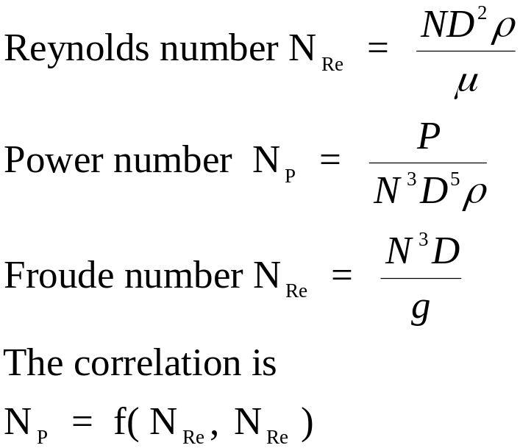
POWER CORRELATION
The dimensionless groups for the correlation are:

Slide 9
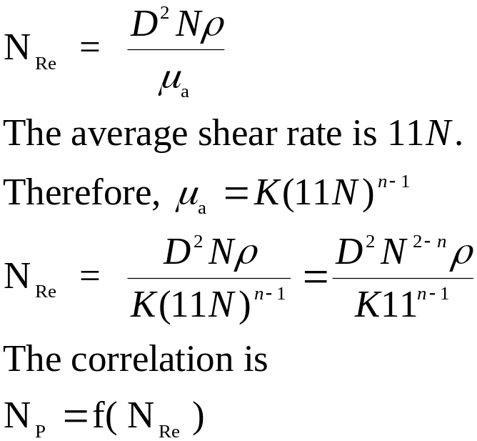
NON-NEWTONIAN FLUIDS
For non-Newtonian fluids,

Slide 10
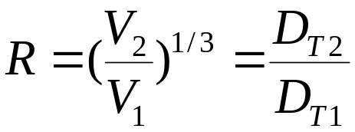
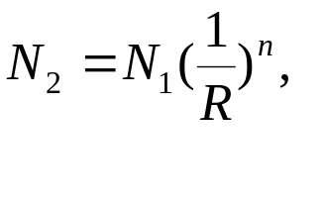
SCALEUP
Calculate the scale-up ratio R as given by,
Scaleup all the dimensions by scaleup ratio.
Scaleup the rpm using
n=1 for equal liquid motion
n=3/4 for equal suspension of solids
n=2/3 for equal mass transfer rates

