Slide 1
State Table to ladder logic
ABE 460

Slide 2
Example State Table
Create a state table for a program that:
  When the Start button is pressed the robot arm raises up (+Z)
  When the robot reaches the top it clamps for 3 seconds
  It then lowers, while clamped, and releases when it hits the bottom
State | Trigger | Pos_Z_Move | Clasp | Other
1 | Start | X
2 | +Z Limit | X | X | T1 (3s)
3 | T1 |  | X
4 | -Z Limit |  |  | Program Terminate (State 0)

Slide 3
Ladder logic
Step 1:
For each state create one latching ladder rung as follows:
1st element: Trigger
2nd element: Termination (usually the previous output)
3rd element: Timer (if necessary)
4th element: Output (internal relay )

Slide 4
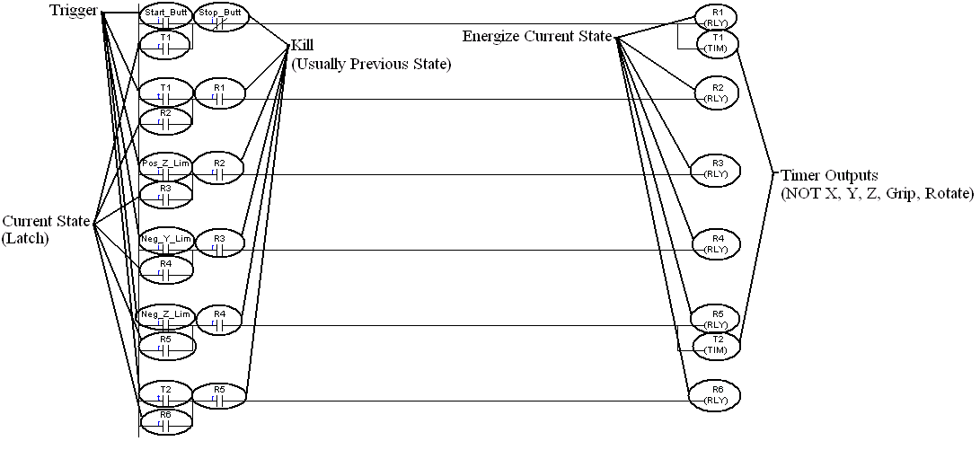
Basics to ladder logic
Notes:
The energized state using relays
Relays are just internal place holders (true or false)

Slide 5
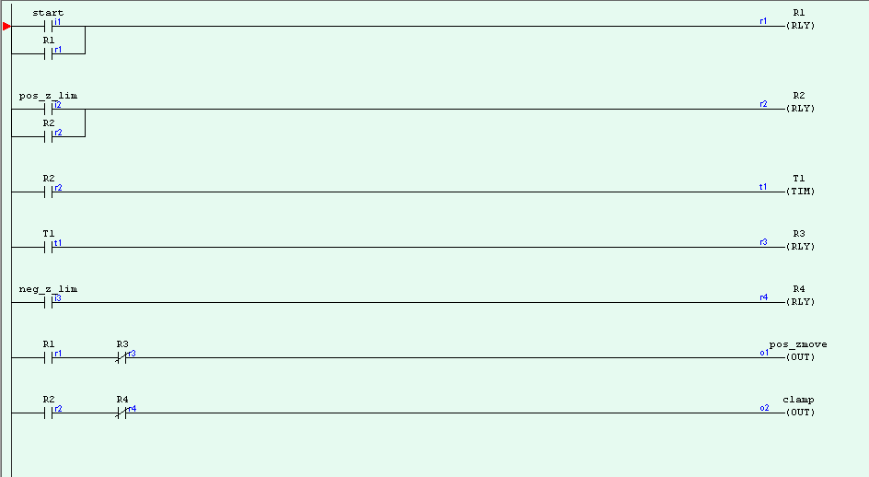
Notes:
Start makes the pos z move
When it hits pos z it holds that position and clamps and starts a 3 second timer
When timer ends it drops pos z but holds clamp
When it gets to neg z program ends

Slide 6
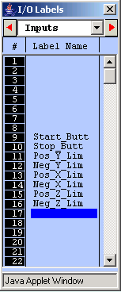
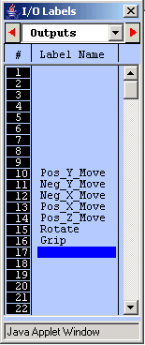
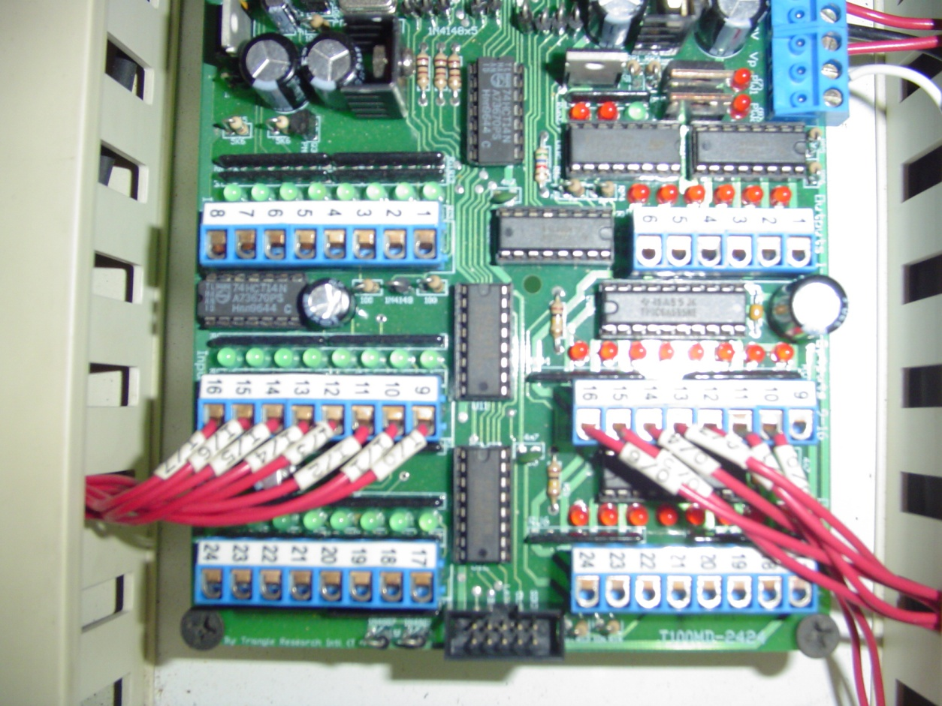
Fill in I/O Table
Inputs and outputs are physically connected to buttons, sensors, and actuators
Notes:
Make sure that the input and outputs match the ones that we have given you
They are physical connections in the PLC

Slide 7
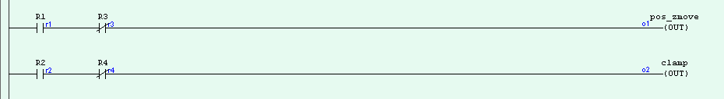
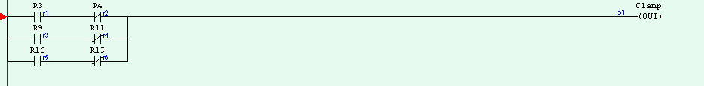
Outputs
Can only have one per output (+Z, clamp)

Slide 8
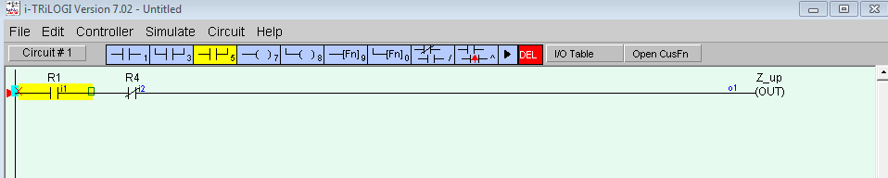
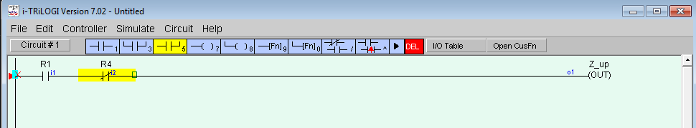
Output
How to make multiple rungs for an output
  Click on the first contact then the partial rung
  Then click on the other contact and again on the partial rung

Slide 9

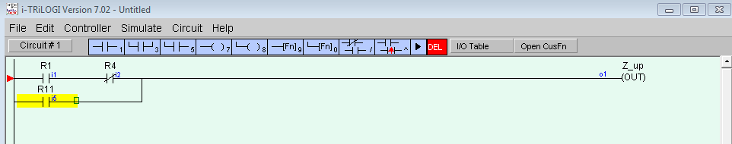
Outputs

