Slide 1
Ladder Logic Custom Functions
ABE460
Week 15

Slide 2
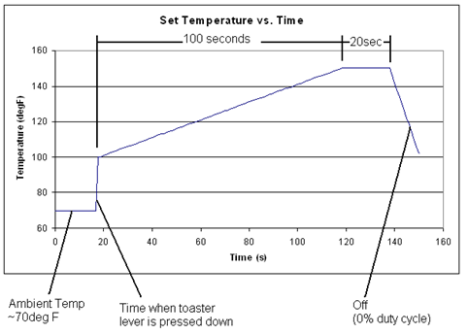
Goal
Toast the bread according to this temperature profile

Slide 3
How will we do that?
Determine the temperature set-point
Time based function
Measure actual temperature
Sensor is connected to channel 8
Convert integer readout to °F
Compare the set-point and actual temperatures
Bang-bang control based on comparison
Turn the heating elements fully on (100% PWM) if the error is positive
Turn the heating elements completely off (0% PWM) if the error is negative

Slide 4
1. Determine the temperature set-point
During last 20 seconds, set-point should be equal to 150F
During first 100 seconds, set-point should be calculated by the equation for this line
Toasting starts here (beginning of timer)
Make sure coils are set to 0% at the end of the 120 seconds

Slide 5
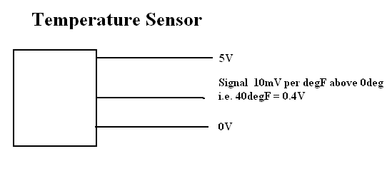
2. Measure actual temperature
The temperature sensor is connected to analog-to-digital port 8
To assign a variable to the measured temperature use
C = ADC(8) where C is any variable
ADC(8) returns an integer corresponding to measured voltage
0.00V is read as 0 or 0000 0000 0000
1.25V is read as 1024 or 0100 0000 0000
2.50V is read as 2048 or 1000 0000 0000
3.75V is read as 3072 or 1100 0000 0000
5.00V is read as 4095 or 1111 1111 1111
Temperature sensor: 10mV/°F ; 0mv = 0°F
Example: 40°F = 0.4V → 0.4V/5.0V*4096 = 328 (integer)

Slide 6
3. Compare the set-point and actual temperatures
Have a variable with the actual temperature
E.g. A = ______________________
Have a variable with the set-point temperature
E.g. B = _____________________
Might want an if-statement so that B is calculated differently for the first 100s vs the last 20s
If A < B
Then….
Else ….

Slide 7
4. Bang-bang control based on comparison
Bang-bang control
The heating elements are either fully on or completely off
The heating elements are connected to a relay. The relay is connected to channel 1, a PWM output on the controller
Command is:
SETPWM channel , %PWM on, frequency
Channel should be: 1
%PWM on:
0 for 0% on
10000 for 100% on
Frequency should be: 32

Slide 8
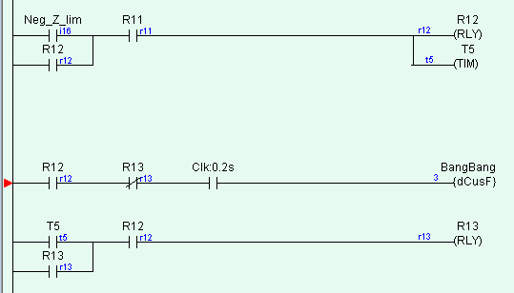
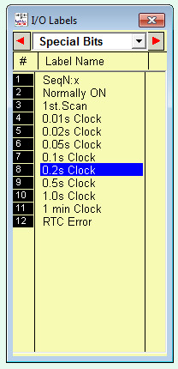
Ladder Logic
In this case, State 12 (R12) is the state in which toasting is done.
A new output rung is added that turns on at the beginning of State 12 and turns off at the beginning of State 13 (end of State 12)
Relay “Clk:0.2s” is a Clock that becomes true every 0.2s.
That forces the custom function to be run every 0.2s, instead of just once when R12 first becomes true.
Found under “Special Bits”

Slide 9
Custom Function
Only one custom function required
Calculates temperature error and turns heater elements on and off with bang-bang control
Variables should single, capital letters
E.g “A” or “B”
Can retrieve the value of timer with timerpv[]
E.g. for Timer 7: timerpv[7]
Remember that timers count down, not up
Remember timer is in 0.1 second

Slide 10
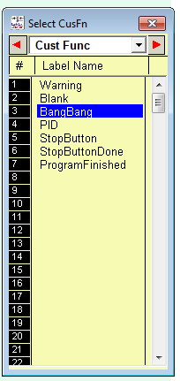
Creating a Custom Function
Only need one custom function

Slide 11
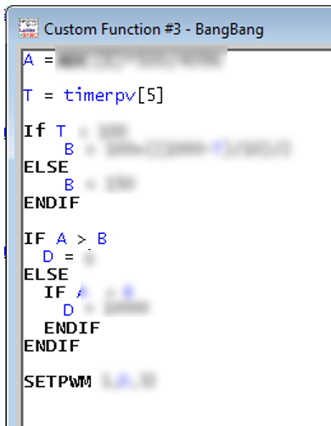
Creating a Custom Function

Slide 12

Adding a Custom Function

Slide 13
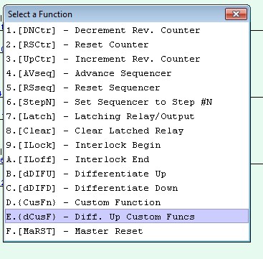
Adding a Custom Function

Slide 14
Lab Plan and Assignment
Gabe will help you test your code on the toaster robot
He will call one group at a time
Be ready and go quickly
David will be available to answer questions
Work on
Adding the custom function to your code
Correcting any problems you found when testing
Assignment
Next week: demonstrate a fully functional code
Get help Friday 11a to 5p

