Slide 1
Journal Club Paper #5:
Design of a Dynamic Sensor-Regulator System for Production of Chemicals and Fuels Derived from Fatty Acids
Fuzhong Zhang1–3, James M Carothers4 & Jay D Keasling1–6
Presented By:
Ryan Wollensak
&
Chitra Ram

Slide 2

In This Presentation:
What was the motive of the study?
What were the objectives, approach and conclusions of the study?
Paper specific:
  Why are the pathway intermediates toxic?
  What network motif was implemented? How does it compare to class?
  What is the logic gate implemented by authors?
  How can these results be applied to other systems?
What are overarching lessons that can be extrapolated?

Slide 3
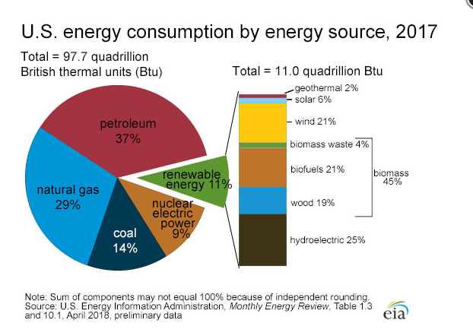
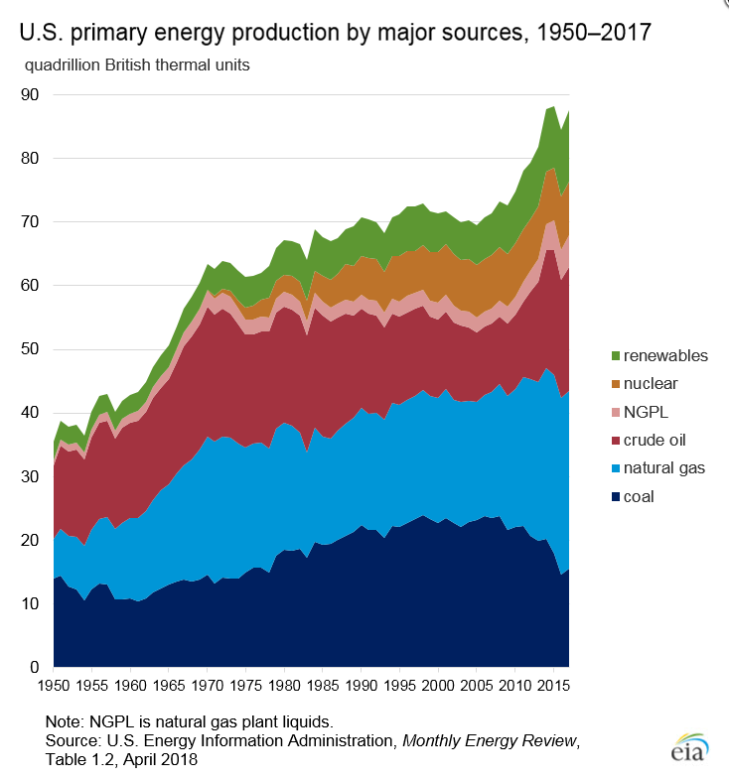
Motives
Currently the United States energy market is valued at $276 billion dollars in 2016
Renewable energy sources, including biofuels, have increased in market share over the past 50 years.
Microbial production of chemicals has emerged as an attractive solution to sustainable energy.
Many current techniques focus on part modification rather than balancing metabolism.
Figure 1 Pie chart of US energy market share. (top left)
Figure 2 Graphical representation of energy market share across past 67 years

Slide 4
Objectives
Develop a dynamic sensor-regulator system (DSRS)
  Identify biosynthetic pathway capable of generating chemicals used in biofuels
  Identify its key intermediates
  Develop biosensors for the key intermediate
  Create regulatory circuit
  Use measurement of biosensor to regulate an output
  Check functionality of the regulatory circuit
Objective function: Maximize product yield by minimizing leaky expression from promoters to obtain tightly regulated pathway.
Notes:
The key intermediate in this case for the FAEE biosynthetic pathway is fatty acyl-CoA and to a lesser extent, free fatty acids.
Here, the regulatory circuit was designed and created to increase the dynamic range of the native promoters by implementing a cascade.

Slide 5
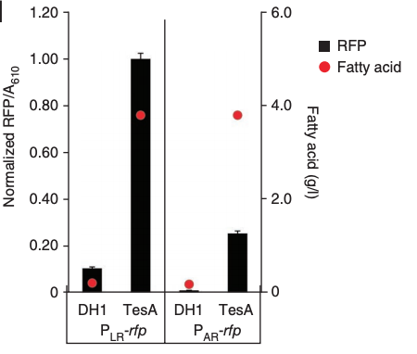
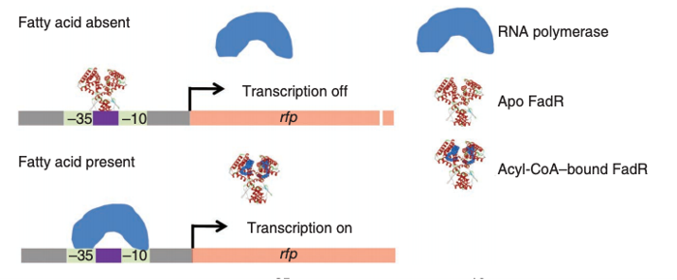
Approach: Identifying a Regulator
Key intermediate in FAEE pathway is acyl-CoA
Synthetic FA/Acyl-CoA-regulators were developed
(P_{L} & P_{A1}) based on lambda and T7 promoters.
Promoters were placed in rfp plasmids.
Tested biosensor response to exogenous fatty acids using DH1 cells.
Tested biosensor response to internally produced fatty acids using TesA cells.

Slide 6
Why are the pathway intermediates toxic?
The key to this question lies in the characteristics of FadR:
  Ligand responsive transcription factor
  Binds to specific DNA sequences & controls expression of several genes involved in
    Fatty acid biosythesis
    Degradation
    Transport through the membrane
  DNA binding activity specifically antagonized by Acyl-CoAs (present in nanomolar quantities)
  DNA binding activity lesser antagonized by free fatty acids (present in micromolar quantities)
  Or more simply, the pathway intermediate Acyl-CoA upon accumulation is toxic, diverts cellular resources toward rfp transcription and is detrimental to the objective of successful fatty acid biosynthesis into biofuel within the E. coli cells.
Notes:
As was mentioned in the previous lecture, any diversion of resources from the desired pathway can lead to a dilution of flux in the desired direction of our favored cellular product which creates imbalance in the desired dynamic pathway. Hence, the need for regulation of the pathway to enhance the desired product yield by creating a system/network motif that brings the desired metabolic pathway to as close a condition to steady state as possible.

Slide 7
What network motif was implemented?
Negative autoregulation!
Let's do a quick recap on what we already know about this network motif:
For any real system, negative feedback has a faster response time.
Negative feedback also makes a system more robust
  β, Kd, and μ vary from cell to cell which leads to variability in steady state
  If x < k, transciption increases, returns to steady state
  If x > k, transcription decreases, returns to steady state
Here, the negatively autoregulated control system chosen served to make this process easier by dynamically balancing the enzymes required for producing the product.
Notes:
The authors' goal for this research was to maximize productivity and conversion yield.
An additional challenge for the authors was that the strain of E. coli being used (A2A) was unstable owing to the burden of producing FAEE and the toxicity of intermediates.
Enhancing yield requires a nearly perfect balance (steady state) in host metabolism which relies on a well-designed regulatory system.

Slide 8
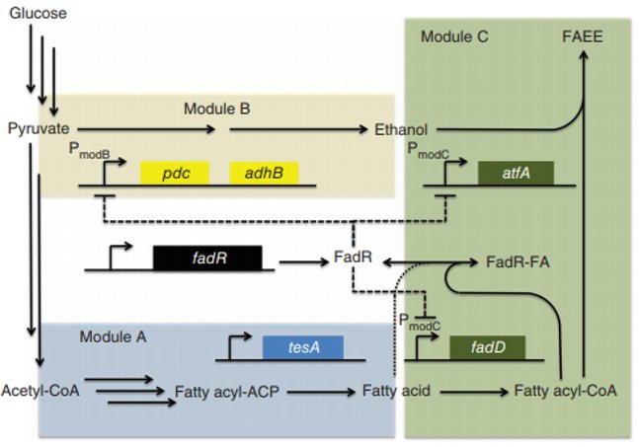
Approach: Integrating Regulator
To prevent leaky expression, author combined two sensors (FadR and LacI) to create three hybrid promoters
All promoters were fully activated only in presence of both IPTG and fatty-acids
FAEE pathway contains three modules:
  Module A: native biosynthetic pathway and heterologous thioesterase to produce fatty acids.
  Module B: ethanol biosynthetic pathway. Converts pyruvate to ethanol.
  Module C: acyl_CoA synthase and wax-ester synthase to condense products from other two modules.

Slide 9
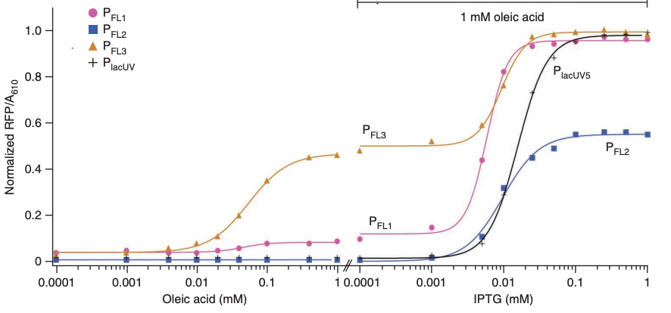
Approach: Visualization of Gene Circuit + Logic Gates
Fatty Acid
FFAE
AND Gate
+
AND Logic Table
Design of FA/Acyl-CoA biosensors
by authors
AND
IPTG
Inputs |  | Output
Fatty Acid | IPTG | FAEE
1 | 1 | 1
0 | 1 | 0
1 | 0 | 0
0 | 0 | 0
Notes:
In the absence of fatty acid, FadR is expected to bind to the 17-bp DNA sequences, which interferes with RNA polymerase binding to the phage promoter and inhibits rfp transcription.
When fatty acid is present, the fatty acid is activated to acyl-CoA by acyl-CoA synthase (encoded by fadD). Acyl-CoA in turn binds to FadR and releases FadR from the synthetic promoter, initiating rfp transcription

Slide 10
Approach: Motivations for Pathway Regulation
High concentrations of ethanol (an intermediate from Module B) is toxic to cell and takes carbon away from FAEE biosynthesis
High concentrations of intermediate Acyl-CoA robs cell of fatty acids required in cell-wall synthesis and CoA needed for vital metabolic processes
Conversion of fatty acid to Acyl-CoA is reversible due to cells ability to hydrolyze fatty acyl-acyl carrier proteins
Acyl-CoA is readily degraded via β-oxidation

Slide 11
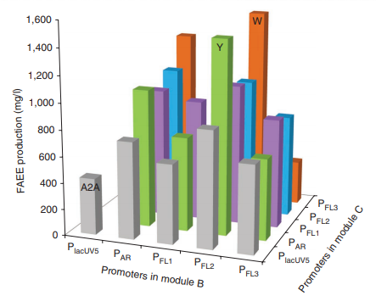
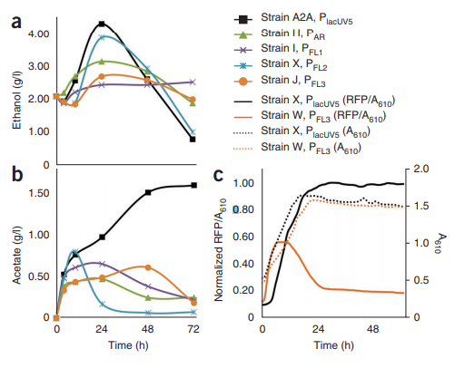
Conclusion: Wrapping Things Up
To regulate the toxic intermediates (ethanol and acyl-CoA) biosensor derived promoters were integrated upstream to control fadD, ethanol biosynthesis and atfA.
Gas chromatography was used to analyze yields.
DSRS cells produced 3-fold increase of product over 3d incubation. Achieving 28% max theoretical yield.
Metabolites of cells were used to ensure functionality of DSRS.
Global sensitivity analysis was performed using 19 molecular species and 26 effective rate constants.

Slide 12
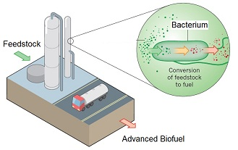
Beyond: Applicability of the Work
DSRS can be expanded to larger pool of natural ligand-response transcription factors.
  Bioinformatics identifies 36 ligand responsive transcription factors in E. Coli
  Heterologous ligand-responsive transcription factors from other organisms can be graft into host
Metabolic engineering can be used to produce a range of chemicals beyond biofuels
  Research group showed effectiveness of DSRS in generation of salicylic acid
  Other products of metabolic engineering include: plastics, pharmaceuticals and homecare products.

Slide 13
Works Cited:
Zhang, Fuzhong, James M. Carothers, and Jay D. Keasling. "Design of a dynamic sensor-regulator system for production of chemicals and fuels derived from fatty acids." Nature biotechnology 30.4 (2012): 354.
https://www.eia.gov/energyexplained/?page=us_energy_home
https://www.selectusa.gov/energy-industry-united-states

