Slide 1
Distributing a metabolic pathway among a microbial consortium enhances production of natural products
Kang Zhou, Kangjian Qiao, Steven Edgar & Gregory Stephanopoulos
Presented by Daniel A. Cabada Gomez

Slide 2
Overview of Project
Conceptually, the author’s demonstrated the construction of a microbe consortium that uses a heterologous metabolic pathway capable of synthesizing a complex molecule that could not be produced in either microbe alone.
More specifically, the author’s demonstrated the biosynthesis of Paclitaxel precursor (taxadien-5α-acetate-10β-ol) using both a prokaryotic organism (E. coli) and a eukaryotic organism (S. cerevisiae/Brewer’s yeast)
Demonstrated the production of other oxygenated isoprenoids (a large class of organic chemicals/natural products) in this microbe consortium system to show its flexibility.
Or, more specifically, the authors effectively produced the molecules Ferruginol and Nootkatone using a derivative of this system they created

Slide 3
Why use this method of biosynthesis?
Key advantages
Using a consortia of microbes allows for the convenient synthesis of complex molecules that are not capable of being produced in individual microbes or would otherwise be limited to less efficient systems (such as isolation of metabolites in plant tissue to produce paclitaxel)
E.g. Prokayrotes like E. coli are not well suited to produce more complex Eukaryotic enzymes for processing metabolites, and Eukaryotes like S. cerevisiae are not well suited for producing simple building block molecules in high yield.
Expression systems and pathway modules in microbe consortia can be optimized in tandem with each other to synthesize complex molecules quicker than alternative methods
Different Microbes have unique properties that allow them to perform different tasks (such as their individual cellular anatomy, gene expression, protein translation and modification systems, as well as genomes, transcriptomes, proteomes, metabolomes, etc.)
Consortium microbes can have beneficial interactions that enhances the productivity of other members (and vice-versa).
Allows for better spatial segregation by dividing the pathways between different organisms (and preventing undesired effects, such a negative feedback of a desired product/metabolite) [1]

Slide 4
General Design for Biosynthesis system (Pt. 1)
E. coli engineered to produce the building block molecule taxadiene, the scaffold molecule for producing paclitaxel
S. cerevisiae engineered to produces taxadiene processing molecules/pathways (such as cytochrome P450, CYP) to produce metabolites in the Paclitaxel synthesis pathway. This separation is also useful, since reactive oxygen species produce by CYPs and their reductases interfere with the biosynthesis of taxadiene.
S. cerevisiae
E. coli
Carbon source substrate for cell function and metabolism (required for both microbes)
Oxygenated Taxane and eventually complete processing of Paclitaxel Precursor
Taxadiene

Slide 5
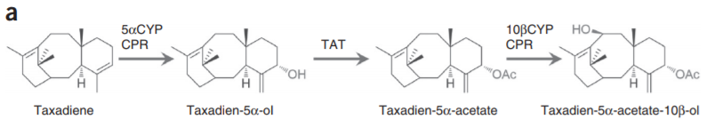
General Design for Biosynthesis system cont.
Complete synthesis and processing of Paclitaxel precursor
(Zhou et al., 2015)
Done In E. coli
Done in S. cerevisiae

Slide 6
Design 1: producing Oxygenated Taxanase
Used an engineered E. coli (TaxE1) to synthesis taxadiene.
Engineered the S. cerevisiae strain BY4700 to express a cytochrome P450, taxadiene 5α-hydroxylase (5αCYP) and its reductase (CPR) (dubbed TaxS1) in order to oxygenate the taxadiene from E.
Cultured both microbes together in a fed-batch bioreactor with glucose as the carbon-source for both microbes

Slide 7
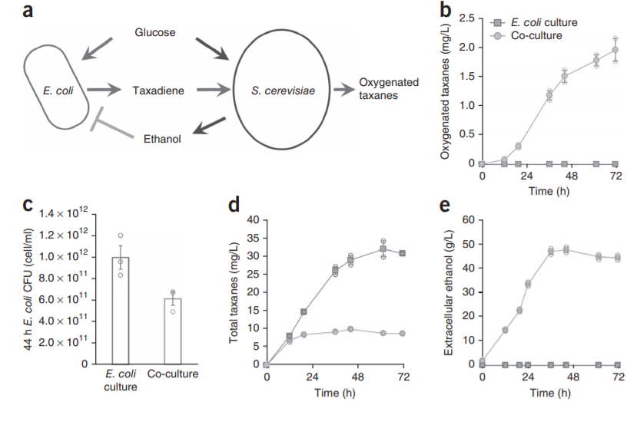
Issue 1: The Challenge of Microbial Competition
It worked! But the Ethanol byproduct produced by S. cerevisiae (along with other conditions) had undesired side effects and inefficient synthesis/processing.
(Zhou et al., 2015)

Slide 8
Resolution: Design 2
The authors used Xylose as a carbon source.
Xylose is unable to be metabolized by S. cerevisiae but is metabolized by E. coli to produce the side product acetate. Acetate is inhibitory to E. coli growth, but is capable of being processed by S. cerevisiae as a carbon source (and does not produce a substantial amount of Ethanol).
The metabolism of Acetate by S. cerevisiae reduces carbon accumulation (as well as the accumulation of acetate itself), which allowed for the increased growth of E. coli not only in the co-culture, but also allowed E. coli to reproduce at higher rates when compared to an E. coli only medium.
Xylose medium requires that S. cerevisiae be grown with E. coli to metabolize it (since it cannot) which allowed for mutualistic cooperation between the microbes, as well as the control of various other factors for optimization (more on that later).

Slide 9
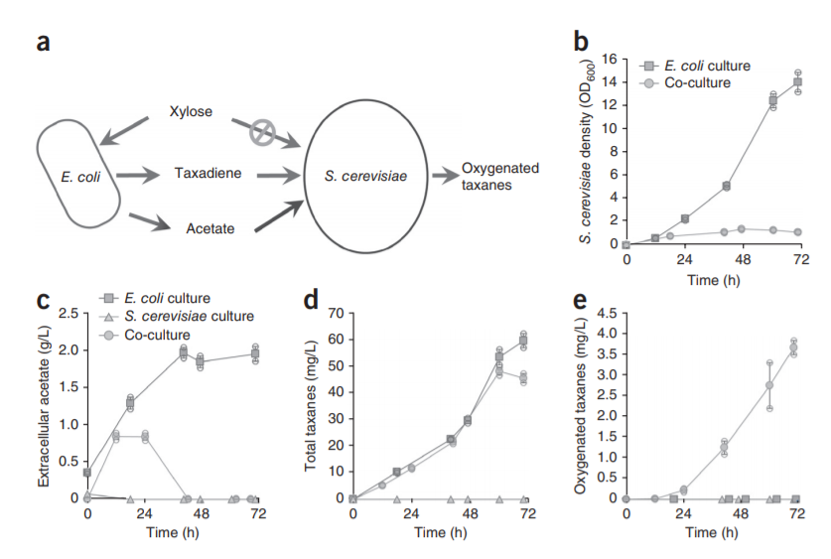
Issue 2
Better, but not quite efficient enough. The oxygenated taxanes production efficiency was only about 8%
(Zhou et al., 2015)

Slide 10
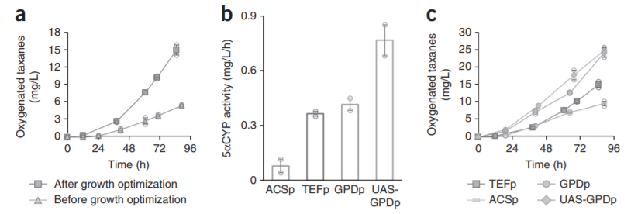
Resolution: Design 3
Nitrogen (ammonium) & Phosphorous (phosphate) also added.
(Zhou et al., 2015)

Slide 11
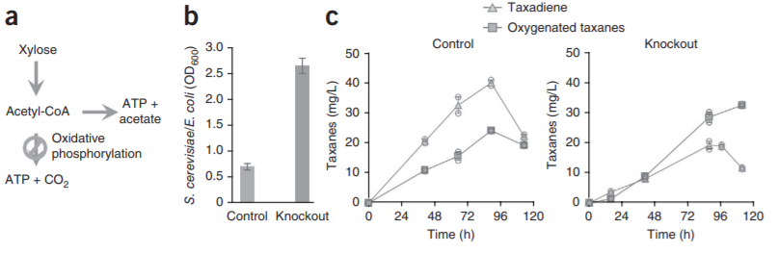
Resolution: Design 3 cont.
(Zhou et al., 2015)

Slide 12
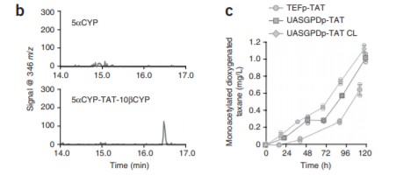
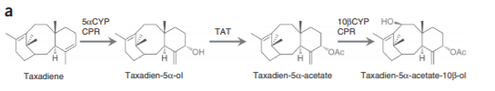
Completing the biosynthesis Pathway
The remainder of the processing pathway was added to yeast to finish the biosynthesis of the paclitaxel precursor.
Subsequent analysis of precursor, (through ion chromatography through mass spec).
(Zhou et al., 2015)

Slide 13
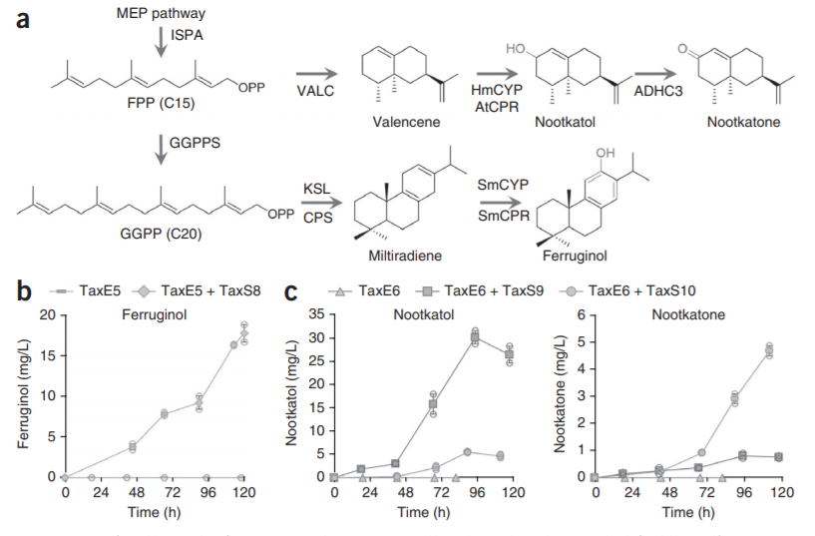
Biosynthesis System Pt. 2: Using the system to create other isoprenoids.
(Zhou et al., 2015)

Slide 14
Conclusions
The authors created a stable co-culture/consortium of microbes to biosynthesize a variety of isoprenoids/complex molecules (such as efficiently producing taxadiene-5α-acetate-10β-ol, Ferrunginol, and Nootkatone)
Similarly, the authors were able to produce the complex taxane (paclitaxel precursor/ taxadiene-5α-acetate-10β-ol), a feat that had not been done previously in microorganisms using just a simple carbon source substrate(such as xylose or glucose)
The co-culture created was mutualistic by introducing Xylose and removing Glucose addition, allowing for the production of acetate by E. coli, a carbon source used by S. cerevisiae to perform biological functions, which prevented ethanol (from yeast as a byproduct of Glycolysis) and acetate accumulation (prevented self-inhibitory effects on E. coli, due to it’s removal) and also allowed E. coli to grow more effective. This effect was further amplified through genetic and growth constraint optimization
In altering the consortium composition, the authors where able to minimize the accumulation of different undesired metabolites (e.g. taxadiene by increasing relative yeast population) and increase their desired products [1]

Slide 15
Limitations
Pathway intermediates that require processing in another organism, need to be able to cross their cell-membranes
Microbes need to be able to cooperate and not compete or antagonize the function of the other microbes in order to be effective in producing biomolecules.
In order to ensure stable and controllable microbial composition, the microbes making up the consortium should rely on each other for necessary nutrients or detoxifying agents to fight inhibitory substances required for cellular function. [1]
Possible ethical concerns?
Dual use for biosynthesis of harmful or dangerous substances with the right equipment. (the author’s did not take great measures to explicitly limit this use of their biosynthesis system)

Slide 16
Thank For listening
Questions?

Slide 17
References
Zhou, K., Qiao, K., Edgar, S., & Stephanopoulos, G. (2015). Distributing a metabolic pathway among a microbial consortium enhances production of natural products. Nature Biotechnology, 33(4), 377-383. doi:10.1038/nbt.3095

