Slide 1
Synthetic protein scaffolds provide modular control over metabolic flux
Dueber et al., 2009
Chrishan Fernando & Barbara McAnulty

Slide 2
Big Ideas
Inspiration: existing natural systems that produce small molecules by channeling intermediates iteratively through assembly lines of catalytic activities
Method: to make a metabolic pathway (e.g. mevalonate in E. coli) more efficient by constructing a spatial channel through which it occurs
Result: higher titers are achieved with lower enzyme expression since less material is lost via diffusion

Slide 3
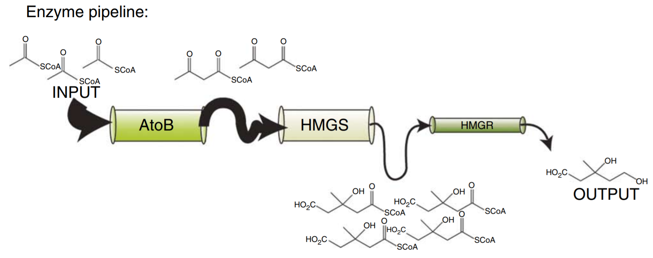
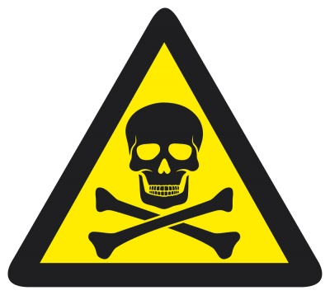
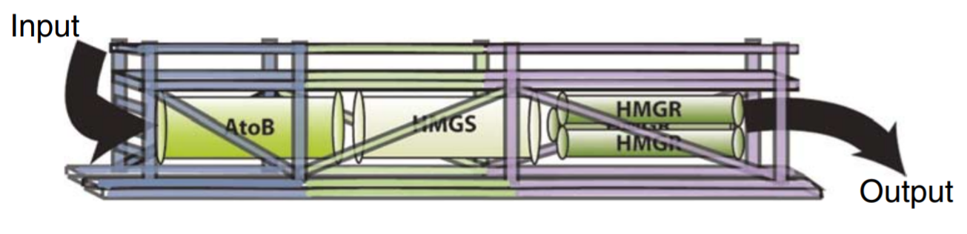
Enzymes with Different Levels of Activity
Natural System
Reduce Presence of Intermediates
Engineered System

Slide 4
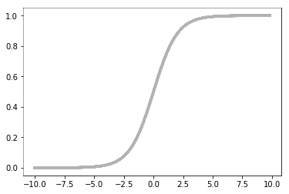
Enzymes with Different Levels of Activity
Natural System
Reduce Presence of Intermediates
Note:
Maximum of intermediate is toxic level
Minimum of intermediate is K_{m} to ensure pathway is on

Slide 5
Advantages of Substrate Channeling
Preventing loss of intermediates to diffusion or competing pathways
Protecting unstable intermediates from solvent
Decreasing transit time of intermediates
Generalizable to many pathways

Slide 6
Limitations
Ideally, one enzyme does all the work, but this system relies on many parts
Hard to find steady state with so many moving parts
Impedance matching is key

Slide 7
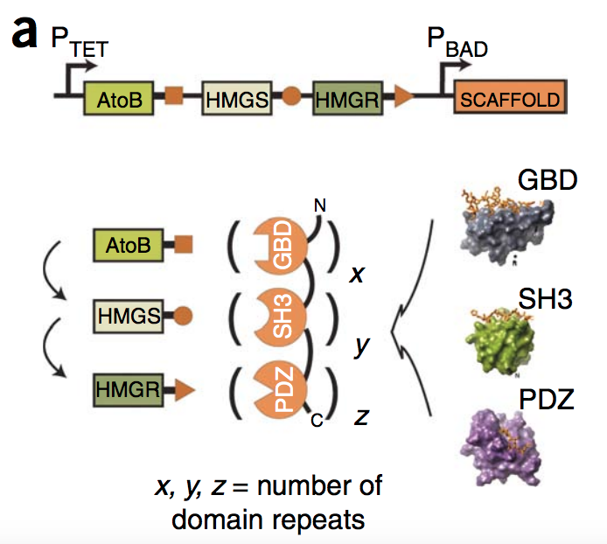
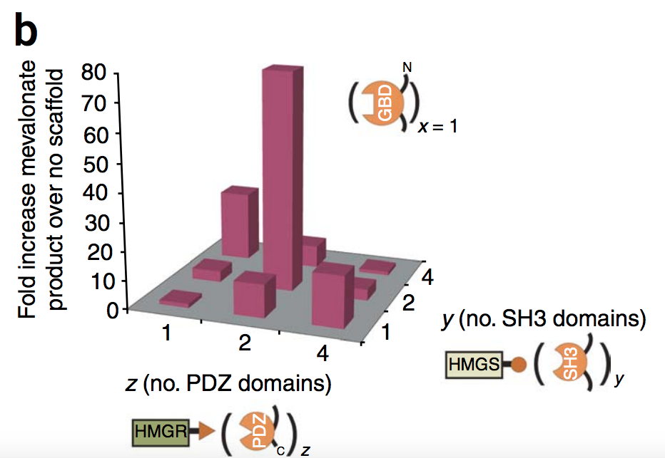
The optimal increase in mevalonate production comes with two repeats each of the PDZ and SH3 domains

Slide 8
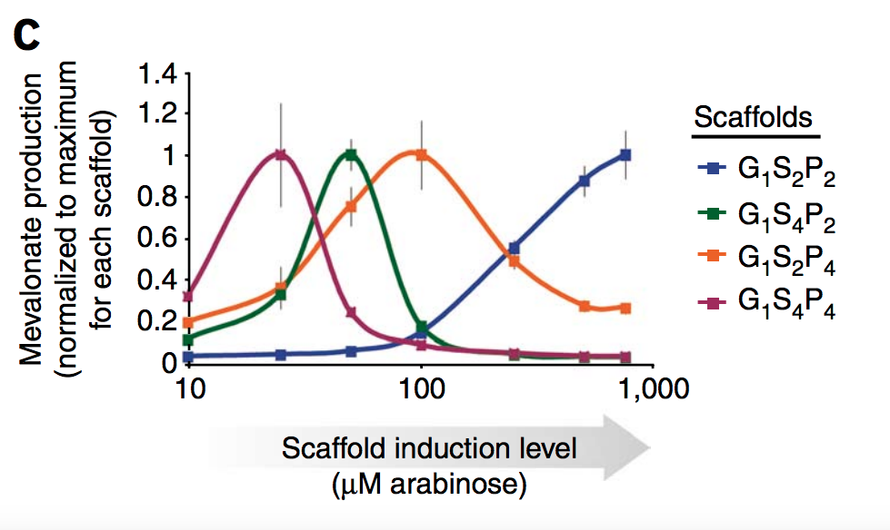
The different scaffolds achieved maximum mevalonate production at different expression levels

Slide 9
Alternative & Complementary Strategies
Controlling expression levels of enzymes in pathway
Identifying enzymes with more appropriate activity levels
Improving enzymes through directed evolution
Push/pull from intermediates or inputs
Introducing negative feedback

Slide 10
Conclusion
Ethics
Created a scaffold for the mevalonate pathway that increases mevalonate production 77 fold
Successfully implemented a scaffold strategy that is
Programmable
Generalizable
Modular
A scaffold method can be used in combination with other methods
Could be used to create a high titer of a toxic material
Because impedance matching is so difficult with many moving parts, a lab could tailor a pathway to operate only when fed certain materials

Slide 11
Questions?

