Slide 1
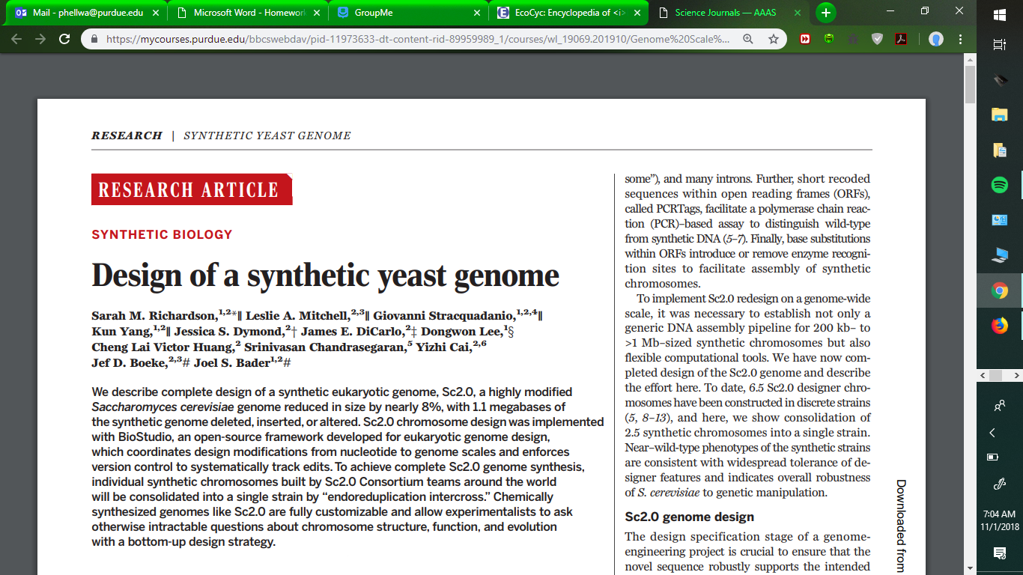
A Journal Club Review
By Anthony Park and Peter Hellwarth

Slide 2
Who is it by?
Collaborators from several colleges:
John Hopkins University: Biomedical, High Throughput Biology
New York University: Genetics, Biochemistry, Molecular Pharmacology
University of Essex: Computer Science, Electronic Engineering
University of Edinburgh: Biological Sciences

Slide 3
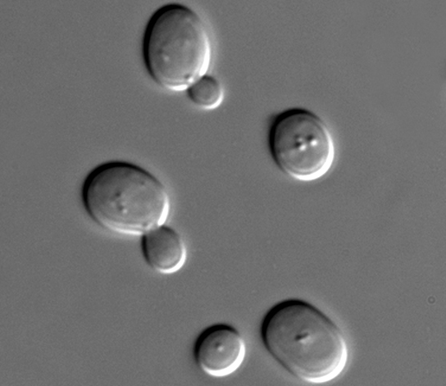
Meet Sc2.0
Yeast Cell
Formerly known as Saccharomyces Cerevisae-wild type
1.1 megabases of synthetic alterations
Genome reduced by nearly 8%

Slide 4
Main Ideas in the Article
Modularity for chromosome and genome assembly
SwAP-In
Recoding of RE sites for SwAP-In
PCRTags
loxPsym sites enabling SCRaMbLE
Stop codon recoding/stop swaps
Deletion of repeats, tRNAs, and introns

Slide 5
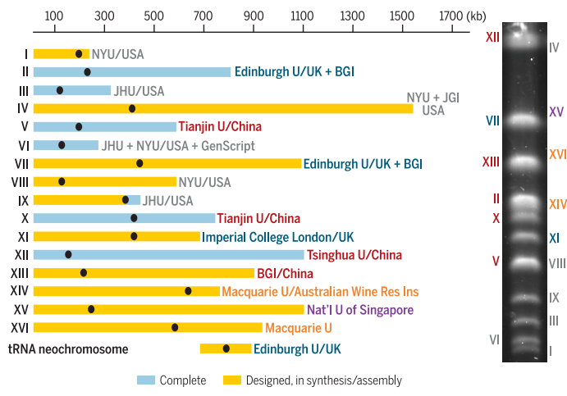
Modularity for chromosome and genome assembly
Design-build-assemble-test-learn cycle
Constraints are:
Creating unique PCRTags
Segmenting chromosomes for SwAP-In
Chromosomes were designed all over the world.

Slide 6
SwAP-In Switching Auxotrophies Progressively for Integration
Assemble chromosomes in segments
divided into 30-60kb "megachunks", which are comprised of 10kb chunks
Each chunk is surrounded by restriction enzymes
Assembled into megachunks through RE cutting and ligation
The megachunk is integrated into host genome, replacing the wild type version
Series of megachunks incorporated by alternating selectable markers, LEU2 and URA3 Megachunks (30 to 60 kb)
Chunks ( <10 kb)

Slide 7
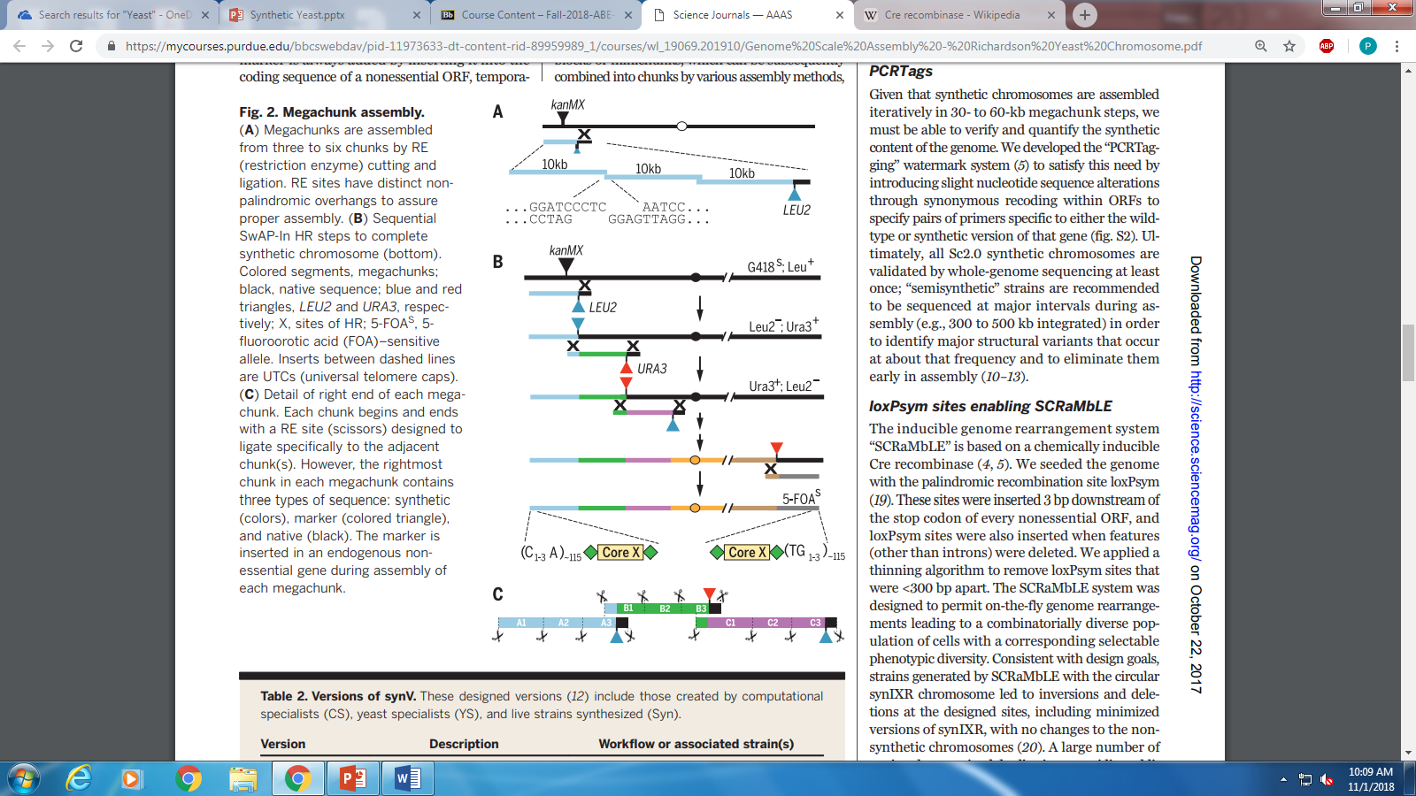
Megachunk Assembly
Megachunks assembled with 3 to 6 chunks with restriction enzyme cutting and ligation.
Synthetic chromosomes are assembled with SwAP-In method. Restriction Enzymes cut and ligate the DNA with the megachunks. Sequential selection markers are used (LEU2 and URA3) in order to build the chromosome.
Shows the right end of the megachunk assembly.

Slide 8
Recoding of RE sites for SwAP-In
Requires rare-cutting RE sites every 10kb or so
RE sites must leave nonpalindromic overhangs to enforce directional assembly of the chunks
Two distinct RE sites must flank the selectable marker. RE site on the right of the selectable marker is used to produce the right end. RE site on the left is used to produce left end of the next megachunk
Can naturally occur or the ORF must be recoded. Constrains site placement if the latter is done

Slide 9
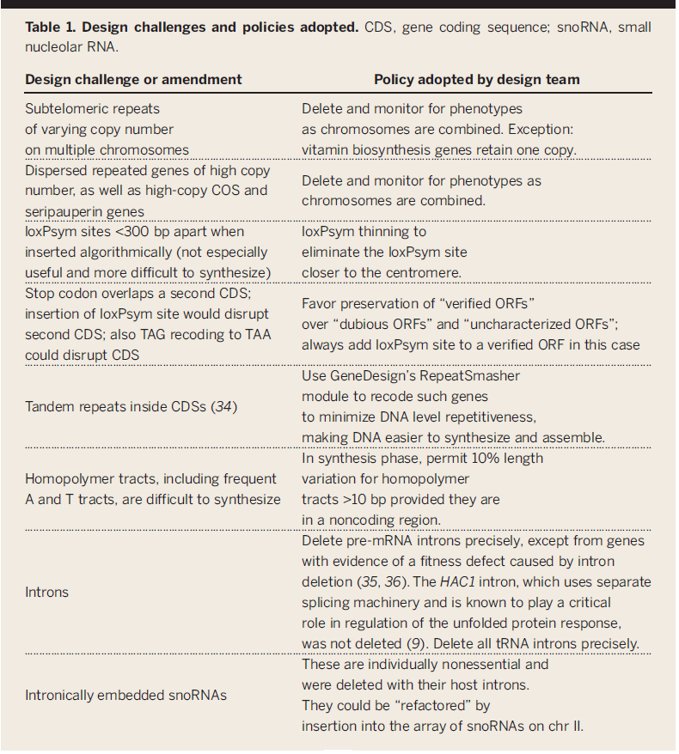
Challenges and Solutions

Slide 10
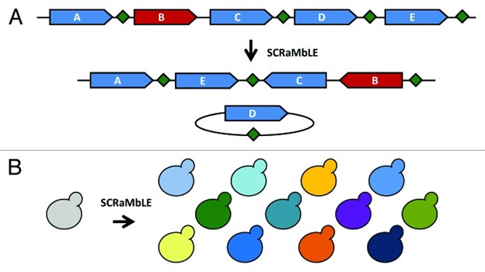
SCRaMbLE
Synthetic Chromosome Recombination and Modification by LoxP-mediated Evolution
Relies on chemically inducible Cre recombinase
LoxPsym sites were 3bp downstream of stop codons of every non-essential ORF
Sites were placed when features other than introns were removed
Permits inversions and deletion
Benefit: Random variation can create a wide variety of genome variants. Also useful for genome minimization
Sort of models evolution
Loxinserted
3 bp downstream of the stop codon of nonessential open reading frames
Where non-intron features were deleted
Sites must be >300 bp apart
Dymond et. Al Bioeng Bugs, 2012 May 1

Slide 11
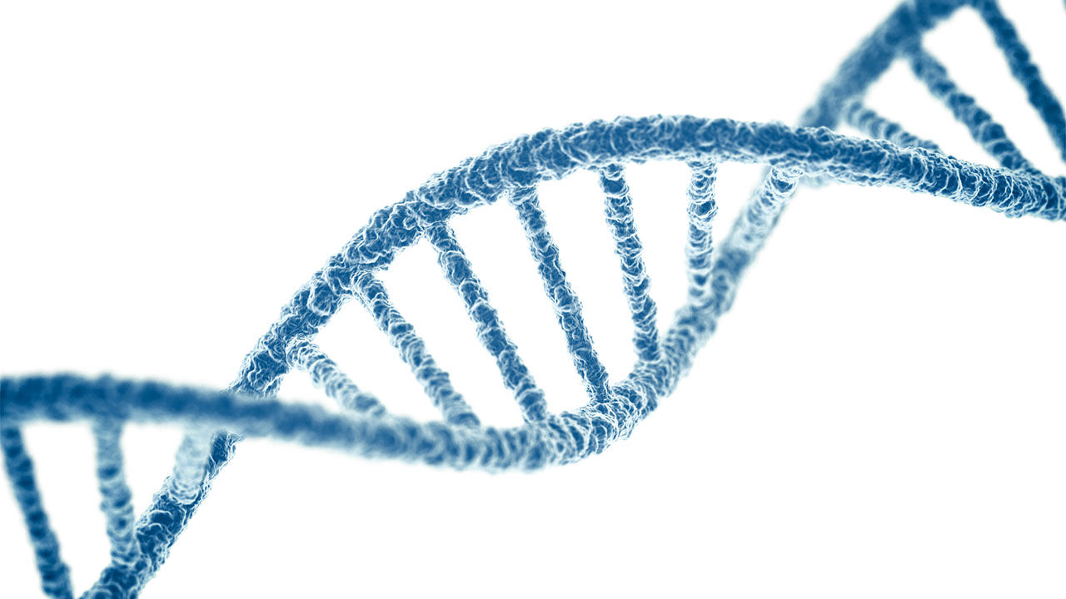
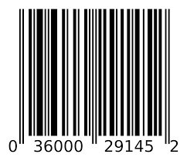
PCRTags
Essentially a barcode for DNA
Used to verify and quantify the synthetic content of the genome
Slight changes in the base pairs within ORFs to specify primers specific to wild type or the synthetic
Must keep unique to the rest of the genome

Slide 12
Stop Codon Swaps
All UAG stop codons replaced with a single UAA.
Removes unnecessary DNA size.
Why use multiple stop codons when one will suffice?
U A A
U A A

Slide 13
Deletion of Repeats, tRNA, and Introns
Removes repeats of retrotransposons
These retrotransposons have been found to be dispensable and are not vital to the cells.
Created a neochromosome specifically for tRNA
More stable construct
Removed pre-mRNA introns, except ones that appeared to show a defect to fitness.
Many of these sequences have been found to have no effect on the vitality of the cells and are removed based on trial and error.

Slide 14
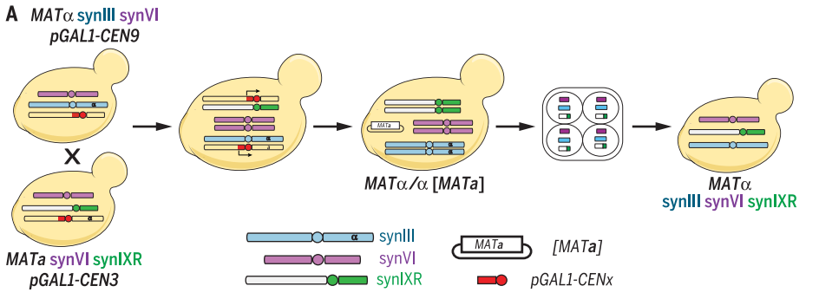
Combining Sc2.0 Chromosomes
Endoreduplication Intercross
Chromosomes from two different strains with synthetic chromosomes were crossed.
Chromosomes mate together.
Results in cells displaying both sets of synthetic chromosomes

Slide 15
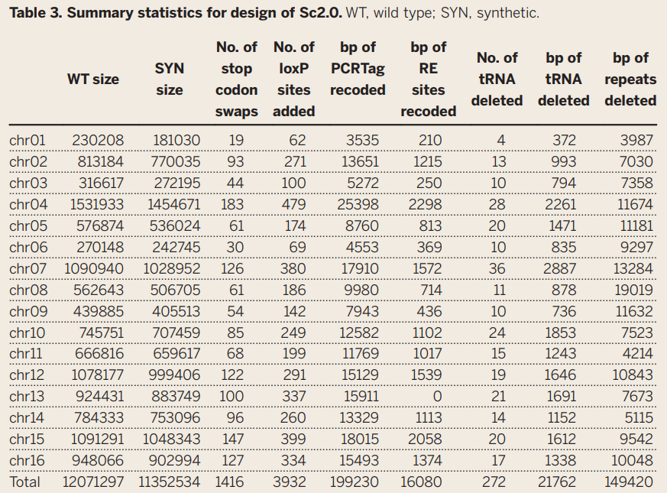
Summary Statistics

