Slide 1
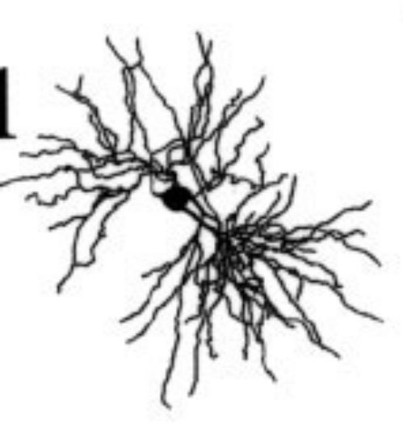
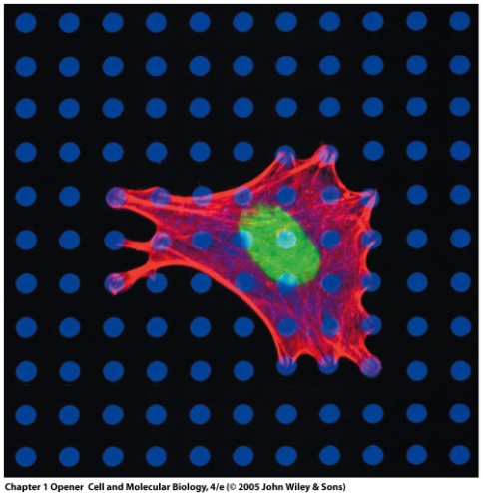
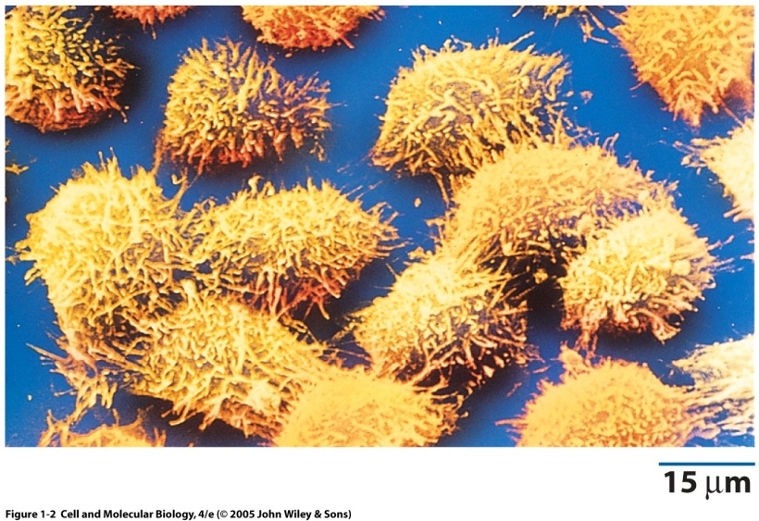
Biology of the Living Cell – Bio 230
Prof. Ed Bartlett

Slide 2
EMERGENCY PREPAREDNESS – A MESSAGE FROM PURDUE
To report an emergency, call 911. To obtain updates regarding an ongoing emergency, sign up for Purdue Alert text messages, view www.purdue.edu/ea.
There are nearly 300 Emergency Telephones outdoors across campus and in parking garages that connect directly to the PUPD. If you feel threatened or need help, push the button and you will be connected immediately.
If we hear a fire alarm during class we will immediately suspend class, evacuate the building, and proceed outdoors. Do not use the elevator. If the weather is bad, go to REC (out the doors to the left).
If we are notified during class of a Shelter in Place requirement for a tornado warning, hazardous materials release, or a civil disturbance we will suspend class and shelter in CL50 room, shutting the door and turning off lights for the latter two situations.
Notes:
One final piece of Purdue business before we begin: as we start this semester I want to take a few minutes to discuss emergency preparedness. Purdue University is a very safe campus and there is a low probability that a serious incident will occur here. However, just as we receive a safety briefing each time we get on an aircraft, we want to emphasize our emergency procedures for evacuation and shelter in place incidents. Our preparedness will be critical if an unexpected event occurs.
Purdue prepares for natural disasters or human‑caused incidents with the ultimate goal of maintaining a safe and secure campus, but nin the end, emergency preparedness is your personal responsibility. Let’s quickly review the following procedures:

Slide 3
Contact information
Teaching Assistants:
Jonathan Tang
Email: jatang@purdue.edu
Jing (Andy) Chen
Email: chen1163@purdue.edu
David Axe
Email: draxe@purdue.edu
Nicole Vike
Email: nvike@purdue.edu
Sanniv Ganguly
Email: gangulys@purdue.edu
Course email: bio230@purdue.edu
Edward L. Bartlett, Ph.D.
Office: MJIS 2023
office phone (765)496-1425
lab phone (765)496-1443
Email: ebartle@purdue.edu
Notes:
Introductions – instructors and TAs

Slide 4
Office Hours
Starting week of August 29th (next week)
Prof. Bartlett: T 10:30-11:30 am, Th 12:30-1:30 pm or by appointment
TA Office hours
David Axe - office hour: Wednesdays 10:30-11:30 am, MJIS 1080 or 1082
Jing (Andy) Chen - office hour: Thursdays 5-6 pm, MJIS 1080 or 1082
Sanniv Ganguly - office hour: Tuesdays 4:30-5:30 pm, MJIS 1080 or 1082
Jonathan Tang – office hour: Mondays 4-5 pm, MJIS 1080 or 1082
Nicole Vike - office hour: Thursdays 11 am-noon pm, MSEE
Class audio will be recorded and will be available via Boilercast. Class slides will be placed on Blackboard.
You are responsible for everything presented in class.
Notes:
The TAs and I will each hold weekly office hours, which are listed here and on Blackboard Learn.

Slide 5

Textbook and reference choices
Cell and Molecular Biology, 8th edition, by Gerald Karp (2013).
7th, 6th and 5th editions are also acceptable
Books are intended as support for the classes, not replacements
If there is a conflict between a textbook and the class, please let us know
There are multiple other college level cell biology textbooks, such as:
Molecular Biology of the Cell, Bruce Alberts et al.
Molecular Cell Biology, Lodish et al.
Becker’s World of the Cell, Hardin et al.
Molecular Biology, Robert Weaver.
In addition, free older versions of these books are searchable via http://www.ncbi.nlm.nih.gov/pubmed. In the menu to the left of the search, select ‘Books’ and then enter your topic of interest to search.
Notes:
The TAs and I will each hold weekly office hours, which are listed here and on Blackboard Learn.

Slide 6
Course Learning Objectives
Describe cellular components, their functions, and spatial relationships in prokaryotic and eukaryotic cells.
Understand major cellular processes along with the control and regulation of cellular operations.
Predict biochemical interactions based on energetics and/or 3-dimensional structure.
Given scenarios of biological regulation, predict outcomes of modifications to the scenarios.
Design cell biology experiments, including selection of appropriate experimental techniques, data analysis, and formulation of a specific, testable scientific hypothesis.
Evaluate (gather, analyze and interpret) biological data from data sources and curated databases (NCBI, GenBank, Protein Data Base, Allen Brain Institute, etc.) in order to answer a biological question.
Evaluate, critique, and communicate scientific information based on synthesis of scientific literature (e.g. journal articles on PubMed).
Notes:
Secondary: Use the concepts of homology, modularity and phylogenetics in order to determine relationships and predict functions of different genes or proteins or relationships between organisms.

Slide 7
Online quiz starting this week
Will occur approximately weekly and will be through Blackboard
All quiz grades averaged together will be equivalent to ~18% of your grade
  More than any individual exam
Quizzes will be available for ~4-5 days after they become available
The first quiz is available, listed as a survey.
Will take approximately 20-30 minutes. No studying needed.
1st quiz needs to be completed by 11:59 pm this Friday 8/26/15.
  This is a basic background assessment for biology and experimental and statistical thinking.

Slide 8
Exams
September 14, 2016, 8-9 pm Lilly 1105, Lilly G126
October 13, 2016, 8-9 pm, WTHR 200, WTHR 172
November 15, 2016, 6:30-7:30 pm, Lilly 1105, Lilly G126
Final date and time - TBD
Do not make travel plan for December before we confirm the date and time of the final exam.
Together, exams will constitute 52% of your grade.

Slide 9
Written Assignments
Research Paper
  4 to 7 pages for a non-science audience
  Due October 6th
Modern Techniques in Cell Biology
- Due November 21st
3. Other written assignments, designing experiments, and working with data - TBD

Slide 10
Groups
For a few of the assignments during the semester, you will be able to work in groups. The group work will either be collaborative, all working on the same assignment together, or as peer reviewers for each other's work on an assignment. For collaborative work, each group will submit the assignment, and for intra-group peer review, each individual will submit the assignment.
Groups may be up to 4 members in size, and you may select your partners.
If you have not enrolled by September 1, I will manually enroll you in a group.

Slide 11
i>Clickers
Purchase or rent from the book store or elsewhere
Test run on Thursday (8/25)
Officially begin on Tuesday (8/30)
  Answer questions during lecture
  Encourage interaction
  Improve discussions

Slide 12
Draw a human cell! (to turn in)
Please include:
Name
PUID
Major
Year you last took a biology course
Notes:
Draw cells – hand it in to the TAs.

Slide 13
Building your Dream House – Student responses
House/Person/Part | Function

Slide 14
Building your Dream House – Student responses
House/Person/Part | Function
Walls, door, windows | Separate in/out, control entry
Foundation | Prevents building from falling
Air conditioning | Temperature regulation
Jello swimming pool | Pleasure
Helicopter pad | transportation
Moat | Keep people out
Roof | Prevent weather coming in
Kitchen | eat
Solar cells | Generating and saving electricity
Par 3 golf course | fitness
Staff | General work around the house

Slide 15
House – cell analogy
House/Person/Part | Function | Cell Part
Walls, door, windows | Separate in/out, control entry | Membranes
Gas and electric | Power | Mitochondria, chloroplast
Blueprints, foreman | Building instructions and control | DNA, RNA
Factory, lumberyard | Fabricate building materials | Endoplasmic reticulum, ribosomes
Transport of food, building materials | Transport | Cytoskeleton and motors
Support beams | Provide strength and form | Cytoskeletal matrix
Yard, garden | Controlled environment near house | Extracellular matrix
Packaging food, drink, building materials | Packaging, preparing for transport | Endoplasmic reticulum, Golgi apparatus
Toilet, Trash | Waste removal | Vacuole, lysozyme, peroxisome
Garage, closets | Storage | Vacuoles, vesicles
Contractor | Building similar houses | Mitosis
Assistant foremen | Report progress/problems | Signaling pathways
The house can also build another copy of itself, repair itself, keep itself running, and defend itself.
Notes:
.

Slide 16
How would you monitor your house?
House | Cell | Experimenter
Power meter, water meter | Mechanosensors for volume, [ATP] | Microscopy, growth rates, etc.
Locks on doors, swipe cards | Ion channels, vesicles, vacuoles | Recordings of ion channels, etc.
What’s that smell? | Cell signaling paths | Biochemistry, fluorescence, etc.
Notes:
Given the housing market over the last couple of years and your upwardly mobile careers, you want to be able to be able to keep track of the costs of your house and maintain its value and function. Also, you are going to live there.
This requires you to maintain adequate supplies of food and beverages in the house, as regulating your utilities so that you can afford them, and identifying problems in the house that need repair.
Again, break into groups for a short time and consider how you would monitor your house for needs and repairs. Does one person do it? What items inside or outside of the house are needed.
Again, the cell has ways to sense the cell’s ongoing status. Equally importantly, researchers now also have ways to monitor cell states or take snapshots of those states during normal and abnormal conditions.
Before you acquire this fabulous dream house, most of you are now probably sharing an apartment with your friends.
Sign for a package = Receptor mediated endocytosis, Also Na/K exchanger for salt
Communication with other houses direct versus wireless
Apartment complex – gap junctions

Slide 17
Summary of the analogies
Cells are amazing, physical, machines composed of a large number of simpler, interacting components
We can measure many of the components and their interactions
We can describe the workings of the cell with mathematical models.
Machines, Measurements, Models
Notes:
Machines, measurements, models, kind’ve like a cyborg Elle McPherson

Slide 18
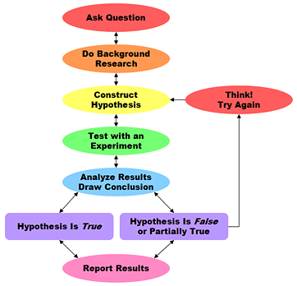
Scientific Inquiry Process
And/or observe
Refine hypothesis or construct new one
-Sciencebuddies.org

Slide 19
Atman’s Engineering Design Process
Problem Definition
(Derived from analysis of 7 engineering texts)
Problem Scoping
Gathering Information
Generating Ideas
Modelling
Developing Alternative Solutions
Feasibility Analysis
Evaluation
Decision
Project Realization
Communication
Moore, P.L., Atman, C.J., Bursic, K.M., Shuman, L.J. & Gottfried, B.S. (2005)

Slide 20
Construct a hypothesis related to the cell that you have drawn (on the same sheet of paper)
Examples:
Hypothesis about removal or alteration of a cellular component
Hypothesis about function of a given component
Your own hypothesis
Notes:
http://www.experiment-resources.com/how-to-write-a-hypothesis.html
http://www.sciencebuddies.org/blog/2010/02/a-strong-hypothesis.php

Slide 21
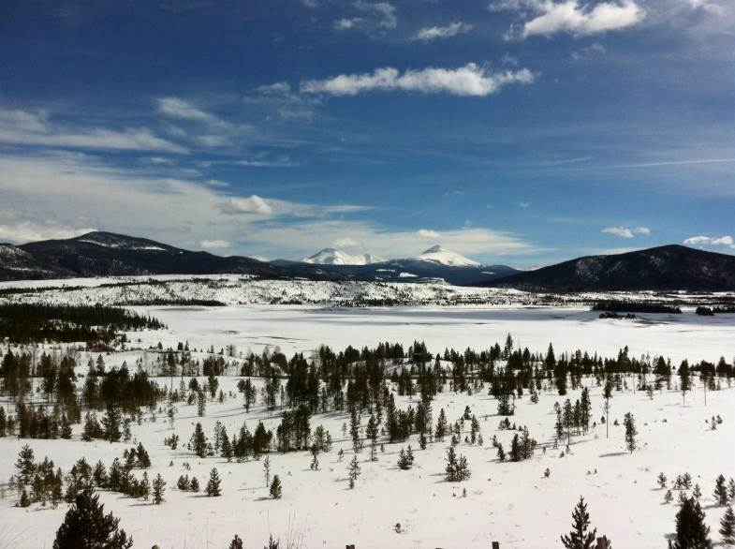
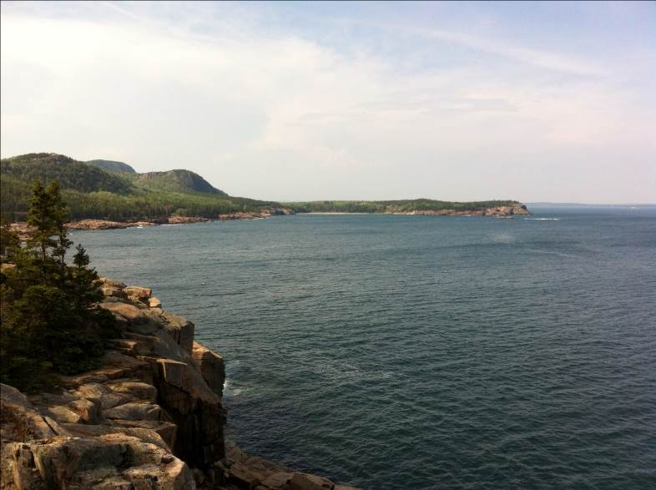
A sense of scale:
A bacterium traversing the length of our bodies is equivalent to us going from here to Denver, CO or to Portland, ME
Excellent link for perspective on relative sizes of cellular components
http://learn.genetics.utah.edu/content/begin/cells/scale/

Slide 22
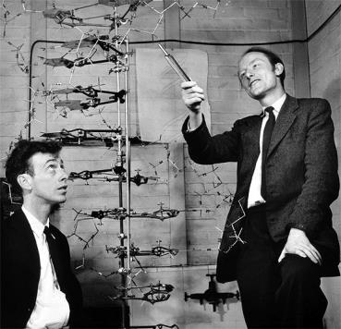
What defines a cell? A living organism?
“All life is an experiment” Ralph Waldo Emerson
“To live is so startling it leaves little time for anything else.”
Emily Dickinson
“He who has a why to live can bear almost any how.”
Friedrich Nietzsche
James Watson (left) and Francis Crick describing their model of DNA

Slide 23

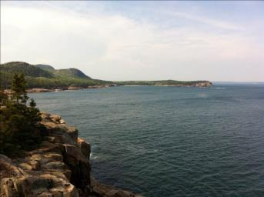
A sense of scale:
A bacterium traversing the length of our bodies is equivalent to us going from here to Denver, CO or to Portland, ME
Excellent link for perspective on relative sizes of cellular components
http://learn.genetics.utah.edu/content/begin/cells/scale/

Slide 24
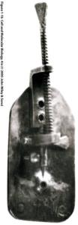
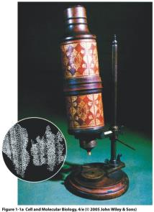
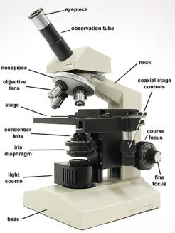
Cells were described only when appropriate magnification (microscopes) became refined
Cork “cells”
Left, simple microscope, Antony van Leeuwenhoek (~1660-70 AD)
Middle, compound microscope, Robert Hooke (~1660-70 AD)
Modern compound microscope, 20th century
Seventeenth century microscopes could magnify up to 200-250x (2 μm)
Modern light microscopes magnify up to 2000x (~0.2 μm resolution)

