Slide 1
Sir Bedevere: There are ways of telling whether she is a witch. Peasant 1: Are there? Oh well, tell us. Sir Bedevere: Tell me. What do you do with witches? Peasant 1: Burn them. Sir Bedevere: And what do you burn, apart from witches? Peasant 1: More witches. Peasant 2: Wood. Sir Bedevere: Good. Now, why do witches burn? Peasant 3: ...because they're made of... wood? Sir Bedevere: Good. So how do you tell whether she is made of wood? Peasant 1: Build a bridge out of her. Sir Bedevere: But can you not also build bridges out of stone? Peasant 1: Oh yeah. Sir Bedevere: Does wood sink in water? Peasant 1: No, no, it floats!... It floats! Throw her into the pond! Sir Bedevere: No, no. What else floats in water? Peasant 1: Bread. Peasant 2: Apples. Peasant 3: Very small rocks. Peasant 1: Cider. Peasant 2: Gravy. Peasant 3: Cherries. Peasant 1: Mud. Peasant 2: Churches. Peasant 3: Lead! Lead! King Arthur: A Duck. Sir Bedevere: ...Exactly. So, logically... Peasant 1: If she weighed the same as a duck... she's made of wood. Sir Bedevere: And therefore... Peasant 2: ...A witch!
Experimental Design courtesy of Monty Python and the Holy Grail

Slide 2
Announcements

Slide 3
The reaction quotient Q, gives the current state of the products and reactants
For the reaction A+B ↔ C+D, Q=[C][D]/[A][B] is the reaction quotient.
The instantaneous Gibbs energy for a reaction is given by ΔG = ΔG° + RT ln Q or 1.4 log Q
If Q < Keq : The reaction will shift to the right (i.e. ΔG<0, reaction goes in the forward direction, and thus more products will form)
If Q > Keq: The reaction will shift to the left (i.e. ΔG>0, reaction goes in the reverse direction, and thus more reactants will form)
If Q = Keq : The reaction is at equilibrium (ΔG=0)
Zumdahl, Steven; Zumdahl, Susan (2003). Chemistry 6th Edition. Houghton Mifflin Company. ISBN 0-618-22158-1.
Notes:
3

Slide 4
Clicker question: For the reaction A+B ↔ C+D, if ΔG is positive, how would the products or reactants have to change Q to make ΔG negative?
The concentrations of all components would have to increase in equal proportions
[A][B] would have to increase enough to make ΔG negative.
[C][D] would have to increase enough to make ΔG negative.
There is not enough information to answer this question.
Notes:
Answer is B.

Slide 5
Energetically unfavorable reactions are enabled by coupling them with favorable reactions
Example: Glutamic acid + NH3 ↔ glutamine, ΔG°’ = +3.4 kcal/mol
Recall that ΔG°’ for ATP hydrolysis = -7.3 kcal/mol
First, a reaction intermediate is formed in the reaction Glutamic acid + ATP ↔ glutamyl phosphate + ADP
Second, it is energetically favorable for the reaction intermediate to proceed to replace its phosphate with an amine group (NH3) in the reaction Glutamyl phosphate ↔ glutamine + Pi
Total reaction is glutamic acid + ATP + NH3 ↔ glutamine + ADP + Pi
Notes:
5

Slide 6
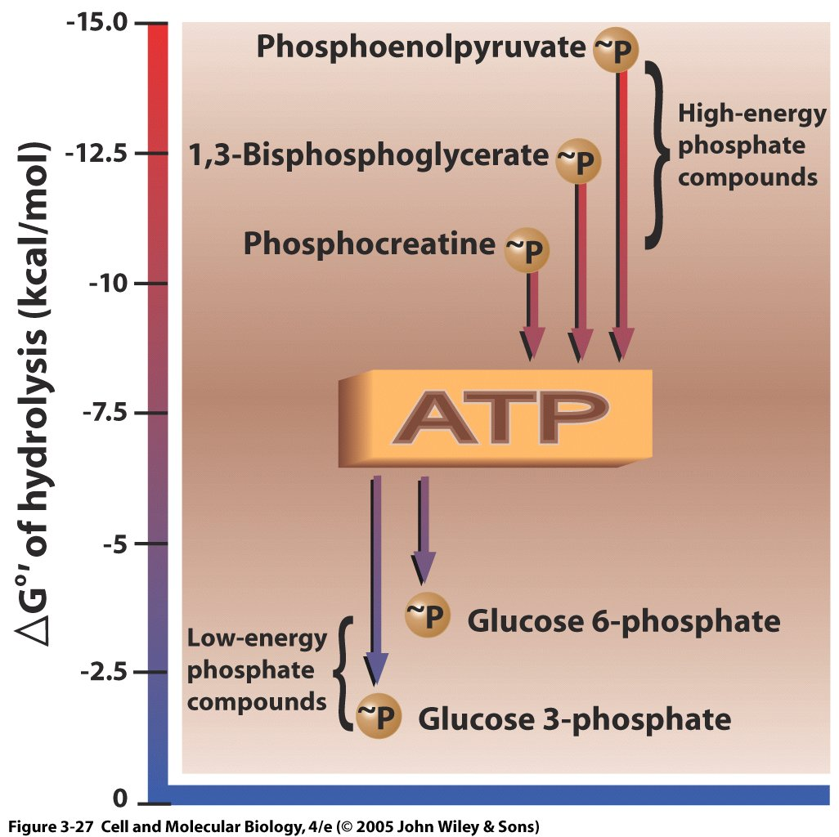
The difference in ΔG°, not the absolute value of ΔG°, will determine the ΔG of a coupled reaction
Anything higher on the chart, (larger ΔG°), can drive the reverse reaction of anything lower on the chart
For example, hydrolysis of phosphoenolpyruvate can drive ATP synthesis, and ATP hydrolysis can drive phosphorylation of glucose
Notes:
6
Glyceraldehyde-3-phosphate to 3-phosphoglycerate conversion includes direct ATP formation route
1. In 2nd step of overall reaction, phosphate group is moved from 1,3-bisphosphoglycerate to ADP to form ATP molecule; catalyzed by phosphoglycerate kinase by substrate-level phosphorylation
2. Formation of ATP is not that endergonic, not so energetic that it cannot be readily formed by metabolic reactions
3. There are many phosphorylated molecules whose hydrolysis has more negative DG0' than ATP
4. Any donor molecule with higher negative DG0' on scale can phosphorylate any molecule lower on scale, including phosphorylation of ADP to ATP
5. Molecules higher on scale (with higher free energy or larger –DG0') have higher transfer potential
6. DG0' of such a reaction will be equal to the difference between the two values
7. Such donor molecules have lower affinity for the phosphate group than the molecule accepting it; the lower the affinity, the better the donor; the greater the affinity, the better the acceptor
E. Neither phosphate group donation to ADP by 1.3-bisphosphoglycerate or by phosphoenolpyruvate requires molecular oxygen; thus, glycolytic production of ATP is anaerobic

Slide 7
Clicker question. Based on the chart, what is the approximate ΔG°’ for the reaction Glucose --> Glucose-6-phosphate, and what coupled reaction can drive that?
ΔG°’ = -3.5 kcal/mol, and therefore no coupled reaction is needed.
ΔG°’ = +3.5 kcal/mol, and therefore no coupled reaction is needed.
ΔG°’ = +3.5 kcal/mol, and Phosphenolpyruvate → pyruvate + Pi is a possible coupled reaction needed to drive this.
ΔG°’ = -3.5 kcal/mol, and ATP → ADP + Pi is a possible coupled reaction needed to drive this.
Notes:
Note that this is delta Go, not delta G. Answer is C.

Slide 8
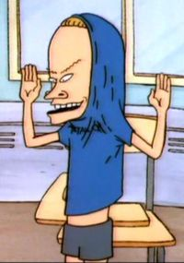
Feel the rush…oxidation of glucose provides lots of energy to cells
C₆H₁₂O₆ + 6 O₂ ↔ 6 CO₂ + 6 H₂O (aerobic)
ΔG°’ for this reaction is -686 kcal/mol !
Sugar is disassembled in many small steps to take advantage of the huge free energy difference
Energetically favorable steps in the reaction can be coupled with unfavorable reactions in this and other metabolic pathways
The more H atoms that can be stripped from a "fuel" molecule, the more ATP can be made
Fats > carbohydrates > proteins for chemical energy storage
Notes:
8

Slide 9
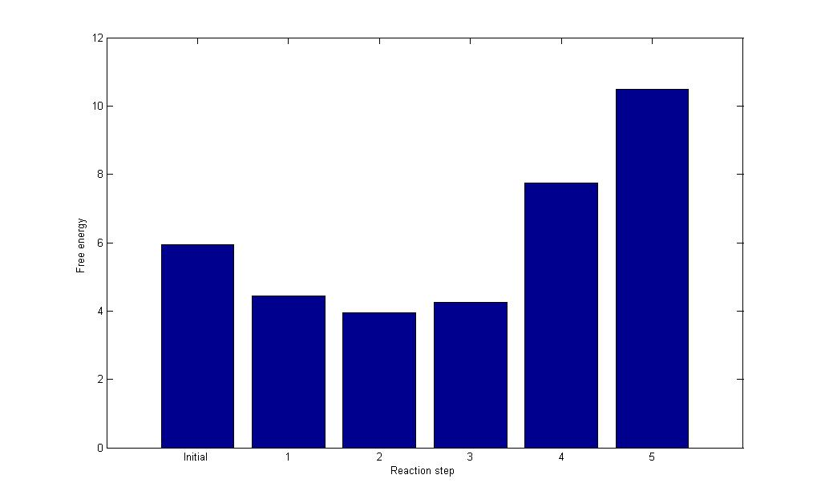
Example free energy path
Δ Free Energy from initial state (-kcal/mol)
Clicker question: At what reaction step is the reaction likely to stop?
0 1 2 3 4 5
Reaction Step
Clicker question 2: How would one make the reactions proceed through step 5?
The reactions will occur spontaneously
The reactions can be coupled with ATP hydrolysis
The reactions can be coupled with ATP synthesis
The reactions can be coupled with ΔG>0 reactions

Slide 10
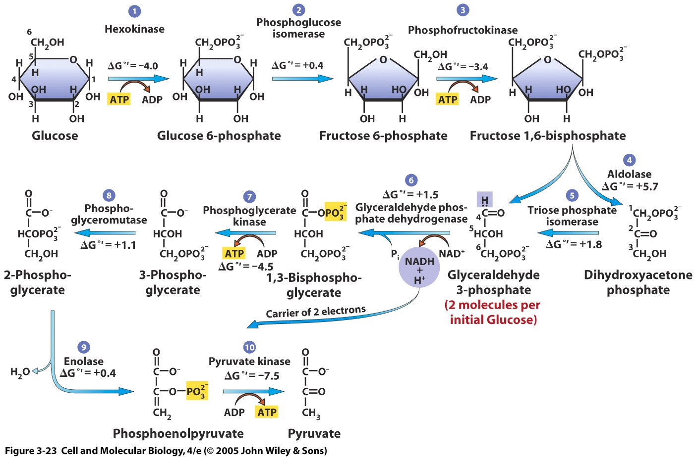
Glycolysis
Notes:
10
Glycolysis leads to the formation of pyruvate; Glycolysis is presumably the energy capture pathway used by our early anaerobic ancestors & is the major anabolic pathway used by anaerobic organisms today

Slide 11
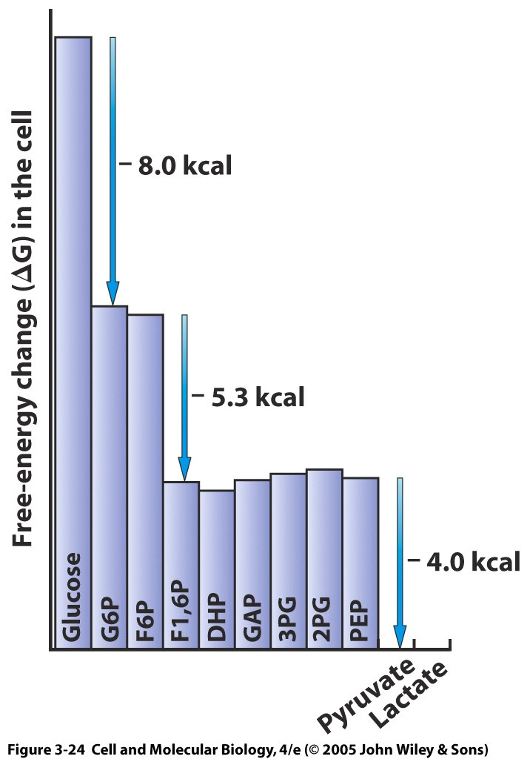
Free energy changes in glycolysis steps
Only three reactions highly favorable but drive reaction forward. Others near equilibrium
First two favorable because hydrolyze an ATP
3PG and PEP are high energy compounds that use a phosphate to form ATP
ATP made
Notes:
11
DG values measured for glycolysis reactions (using metabolite concentrations from cell)
2. All but 3 reactions have DG values of nearly 0; they are near equilibrium
3. 3 reactions are far from equilibrium (essentially irreversible in cell); they provide driving force that moves metabolites through glycolysis in directed manner

Slide 12
Concentrations of metabolites in a red blood cell
Compound | Concentration / mM
glucose | 5.0
glucose-6-phosphate | 0.083
fructose-6-phosphate | 0.014
fructose-1,6-bisphosphate | 0.031
dihydroxyacetone phosphate | 0.14
glyceraldehyde-3-phosphate | 0.019
1,3-bisphosphoglycerate | 0.001
2,3-bisphosphoglycerate | 4.0
3-phosphoglycerate | 0.12
2-phosphoglycerate | 0.03
phosphoenolpyruvate | 0.023
pyruvate | 0.051
ATP | 1.85
ADP | 0.14
P_{i} | 1.0
Relatively high
Relatively low
Low
Garrett, R.; Grisham, C. M. (2005). Biochemistry (3rd ed.).
Notes:
As you can see, these are far away from the 1 M concentrations used for reference Gibbs energies

Slide 13
ΔG values using actual [metabolite] in a red blood cell
Change in free energy for each step of glycolysis
Step | Reaction | ΔG°' / (kJ/mol) | ΔG / (kJ/mol)
1 | glucose + ATP⁴⁻ → glucose-6-phosphate²⁻ + ADP³⁻ + H⁺ | -16.7 | -34
2 | glucose-6-phosphate²⁻ → fructose-6-phosphate²⁻ | 1.67 | -2.9
3 | fructose-6-phosphate²⁻ + ATP⁴⁻ → fructose-1,6-bisphosphate⁴⁻ + ADP³⁻ + H⁺ | -14.2 | -19
4 | fructose-1,6-bisphosphate⁴⁻ → dihydroxyacetone phosphate²⁻ + glyceraldehyde-3-phosphate²⁻ | 23.9 | -0.23
5 | dihydroxyacetone phosphate²⁻ → glyceraldehyde-3-phosphate²⁻ | 7.56 | 2.4
6 | glyceraldehyde-3-phosphate²⁻ + P_{i}²⁻ + NAD⁺ → 1,3-bisphosphoglycerate⁴⁻ + NADH + H⁺ | 6.30 | -1.29
7 | 1,3-bisphosphoglycerate⁴⁻ + ADP³⁻ → 3-phosphoglycerate³⁻ + ATP⁴⁻ | -18.9 | 0.09
8 | 3-phosphoglycerate³⁻ → 2-phosphoglycerate³⁻ | 4.4 | 0.83
9 | 2-phosphoglycerate³⁻ → phosphoenolpyruvate³⁻ + H₂O | 1.8 | 1.1
10 | phosphoenolpyruvate³⁻ + ADP³⁻ + H⁺ → pyruvate⁻ + ATP⁴⁻ | -31.7 | -23.0
Garrett, R.; Grisham, C. M. (2005). Biochemistry (3rd ed.).
Notes:
1 kcal = 4.19 kJ

Slide 14
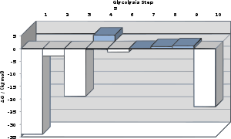
Free energy changes for each step of glycolysis using more realistic concentrations
Garrett, R.; Grisham, C. M. (2005). Biochemistry (3rd ed.).

Slide 15
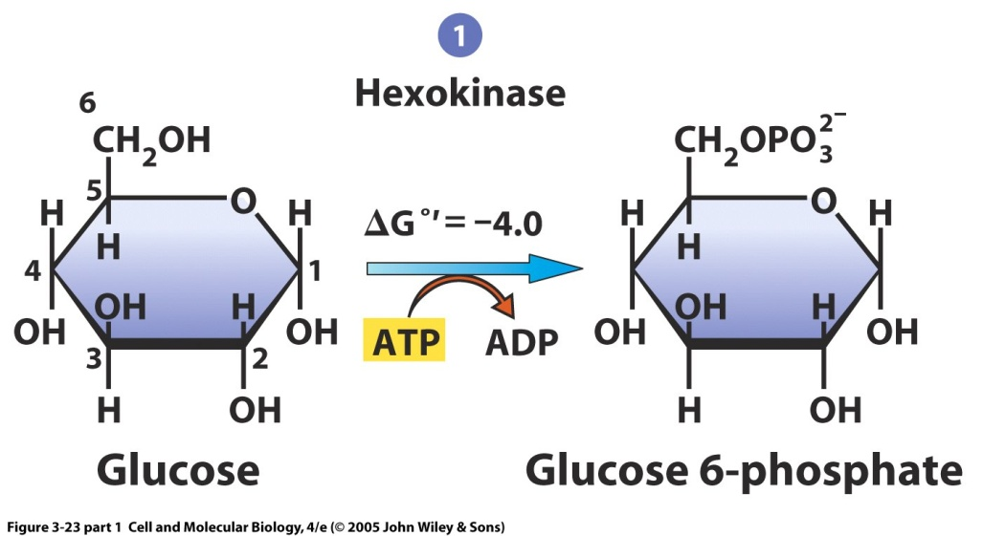
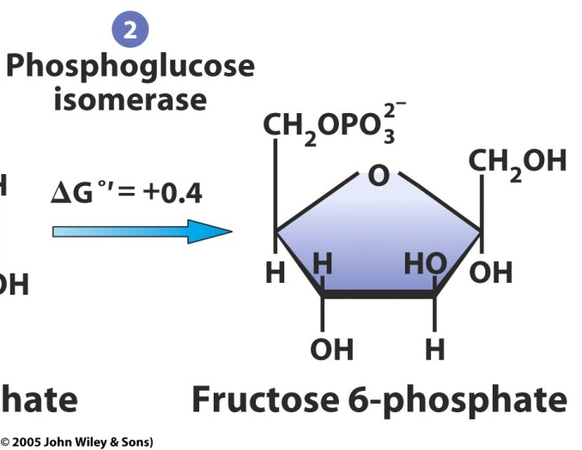
Intial phosphorylation of glucose uses ATP You have to spend money to make money!
ATP hydrolysis coupled with phosphorylation of glucose is energetically favorable
Glucose rearrange to fructose catalyzed by phosphoglucose isomerase
Kinases are a class of enzymes that participate in phosphorylation reactions.
Notes:
15
This is catalyzed with hexokinase enzymes, thus consuming one ATP. A major reason for immediate phosphorylation of the glucose is so that it cannot diffuse out of the cell. The phosphorylation adds a charged group so the G6P cannot easily cross cell membranes.

Slide 16
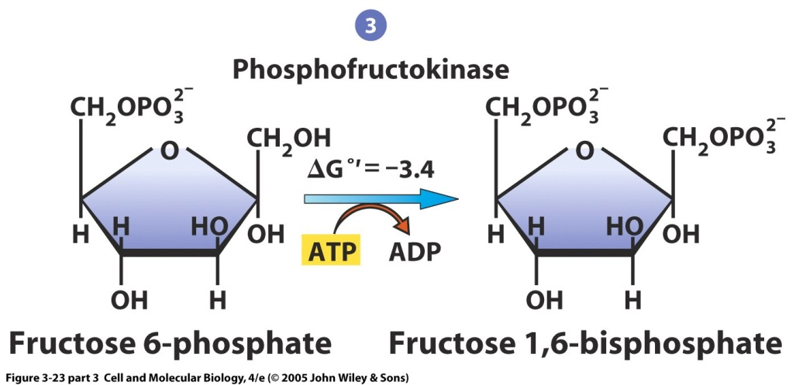
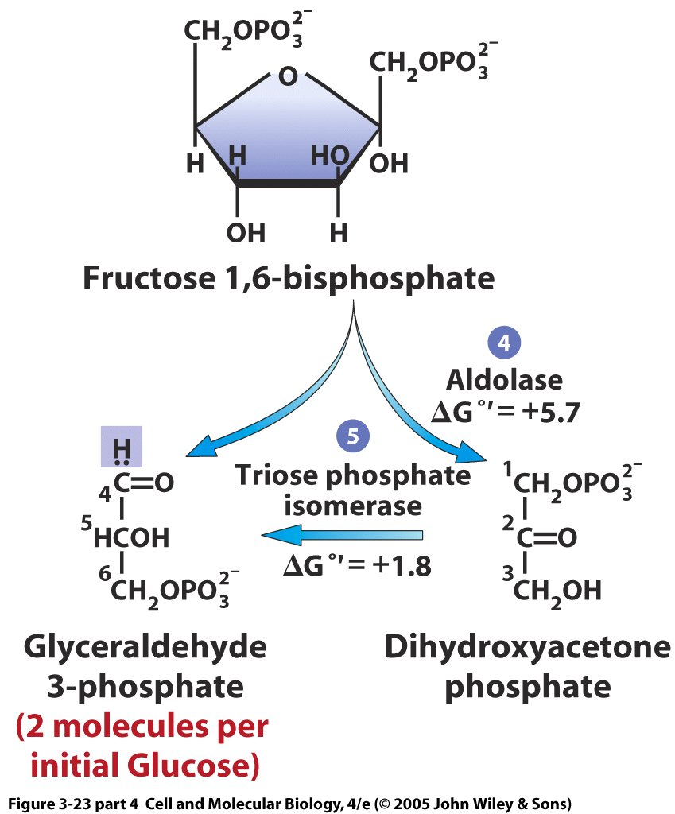
A second ATP adds a second phosphate to the sugar (now fructose)
Fructose bisphosphate (6 carbons) is broken down into two three carbon glyceraldehyde-3-phosphates (one via dihydroxyacetone phosphate)
Even though ΔG°’ > 0 for steps 4 and 5, the concentrations of the molecules make this ΔG near 0 (equilibrium)
Notes:
16
The generic fructose bisphosphate aldolase enzyme cleaves a 6-carbon fructose sugar into two 3-carbon products in a reverse aldol reaction. This reaction is typified by the formation of a Schiff base intermediate with a lysine residue (lysine 229) in the active site of the enzyme; the formation of a Schiff base is the key differentiator between Class I (produced by animals) and Class II (produced by fungi and bacteria) aldolases. After Schiff base formation, the fourth hydroxyl group on the fructose backbone is then deprotonated by an asparagine residue (asparagine 33), which results in an aldol cleavage. Schiff base hydrolysis yields two 3-carbon products. Depending on the reactant, F1P or FBP, the products are DHAP and glyceraldehyde or glyceraldehyde 3-phosphate, respectively. ^{[6]}
The ΔG°’ of this reaction is +23.9 kJ/mol. Though the reaction may seem too uphill to occur, it is of note that under physiological conditions, the ΔG of the reaction falls to close to or below zero. For example, the ΔG of this reaction under physiological conditions in erythrocytes is -0.23 kJ/mol. ^{[6]}
^ ª ^{b} Garrett RH and Grisham CM (2010). Biochemistry 4th Edition. Brooks/Cole.

Slide 17
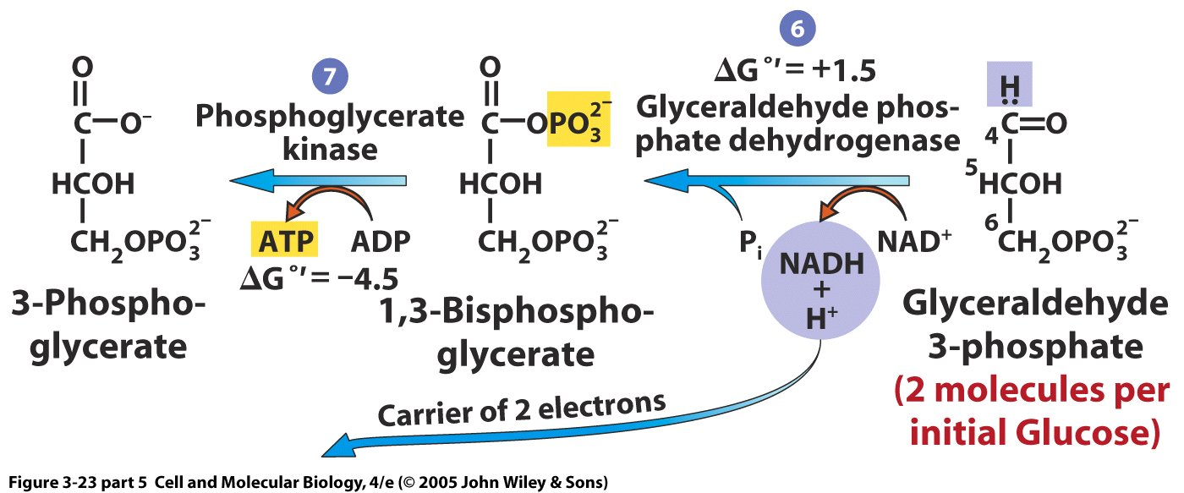
Acidification of glyceraldehyde3-phosphate (G3P) results in the formation of NADH and one ATP for each G3P
Nicotinamide Adenine Dinucleotide (NAD) plays a key metabolic role by accepting & donating electrons
First reaction is oxidation-reduction; 2 electrons & proton (equal to a hydride ion; :H-) are transferred from glyceraldehyde-3-phosphate (oxidized) to NAD+ (reduced) forming NADH
NADH and its role in the electron transport chain and ATP formation will be discussed later in the course
Notes:
17
Two 3-carbon monophosphates lose electrons that bind to NAD+ (NADox) to make NADH (NADre), while a new high-energy phosphate group is added
A. This is the conversion of glyceraldehyde-3-phosphate to 3-phosphoglycerate
B. The overall reaction is the oxidation of an aldehyde to a carboxylic acid; occurs in 2 steps catalyzed by 2 different enzymes
C. First enzyme requires nonprotein cofactor (coenzyme), nicotinamide adenine dinucleotide (NAD) to catalyze the reaction; NAD plays a key metabolic role by accepting & donating electrons
1. First reaction is oxidation-reduction; 2 electrons & proton (equal to a hydride ion; :H-) are transferred from glyceraldehyde-3-phosphate (oxidized) to NAD+ (reduced) forming NADH
2. Enzyme is glyceraldehyde-3-phosphate dehydrogenase; NAD+ (derived from vitamin niacin) acts as a loosely associated coenzyme to dehydrogenase which is able to accept hydride ion
3. NADH is released from enzyme in exchange for fresh NAD+; NADH is thought to be high-energy compound due to ease with which it transfers electrons to other molecules that attract electrons
4. NADH has high electron-transfer potential relative to other electron acceptors; usually transfers electrons to series of membrane-embedded electron carriers (electron-transport system or chain)
5. As electrons move along chain, they move to lower & lower free-energy state & are ultimately passed to molecular oxygen, reducing it to water
Energy released during electron transport is used to form ATP by oxidative phosphorylation
Glyceraldehyde-3-phosphate to 3-phosphoglycerate conversion includes direct ATP formation route
1. In 2nd step of overall reaction, phosphate group is moved from 1,3-bisphosphoglycerate to ADP to form ATP molecule; catalyzed by phosphoglycerate kinase by substrate-level phosphorylation
2. Formation of ATP is not that endergonic, not so energetic that it cannot be readily formed by metabolic reactions

Slide 18
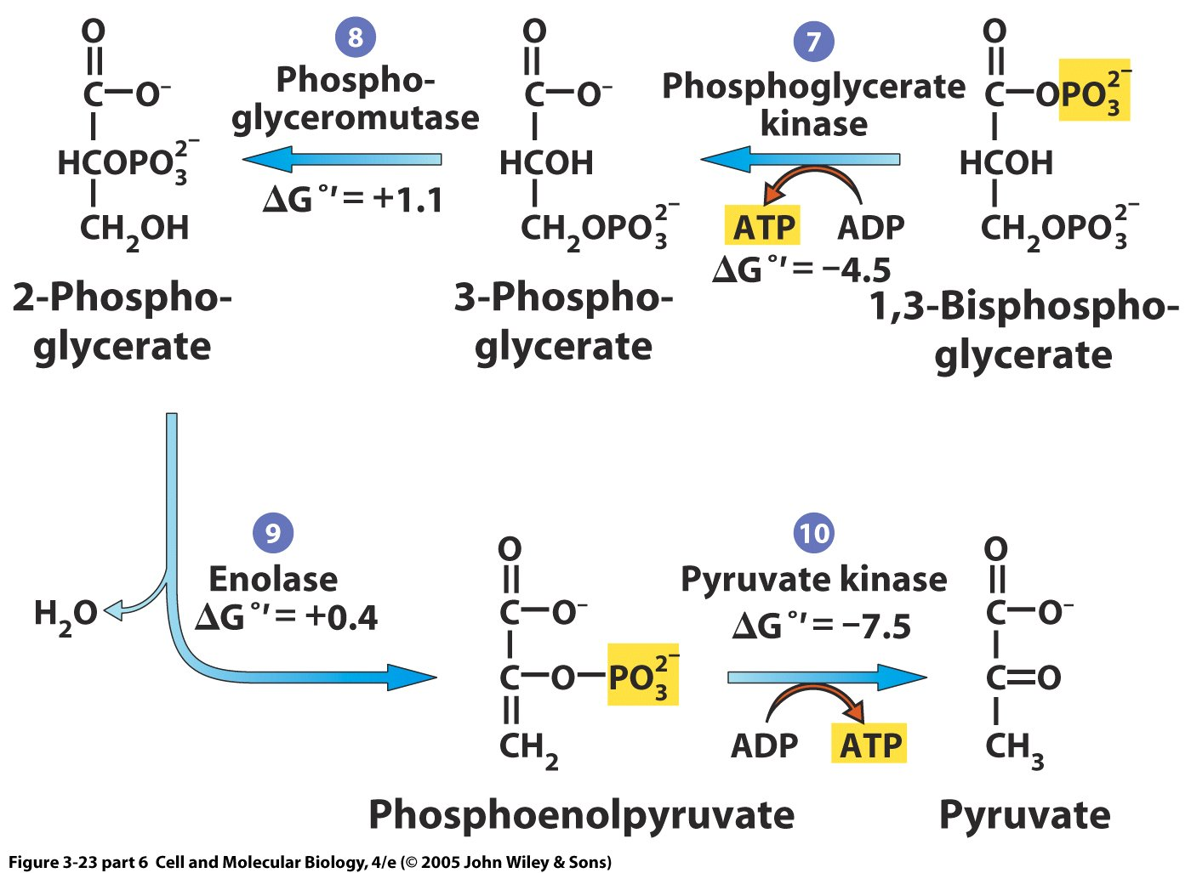
Removal of phosphate from PEP to form pyruvate makes another ATP for each PEP
Notes:
18
Glyceraldehyde-3-phosphate to 3-phosphoglycerate conversion includes direct ATP formation route
1. In 2nd step of overall reaction, phosphate group is moved from 1,3-bisphosphoglycerate to ADP to form ATP molecule; catalyzed by phosphoglycerate kinase by substrate-level phosphorylation
2. Formation of ATP is not that endergonic, not so energetic that it cannot be readily formed by metabolic reactions
Such donor molecules have lower affinity for the phosphate group than the molecule accepting it; the lower the affinity, the better the donor; the greater the affinity, the better the acceptor
E. Neither phosphate group donation to ADP by 1.3-bisphosphoglycerate or by phosphoenolpyruvate requires molecular oxygen; thus, glycolytic production of ATP is anaerobic

Slide 19
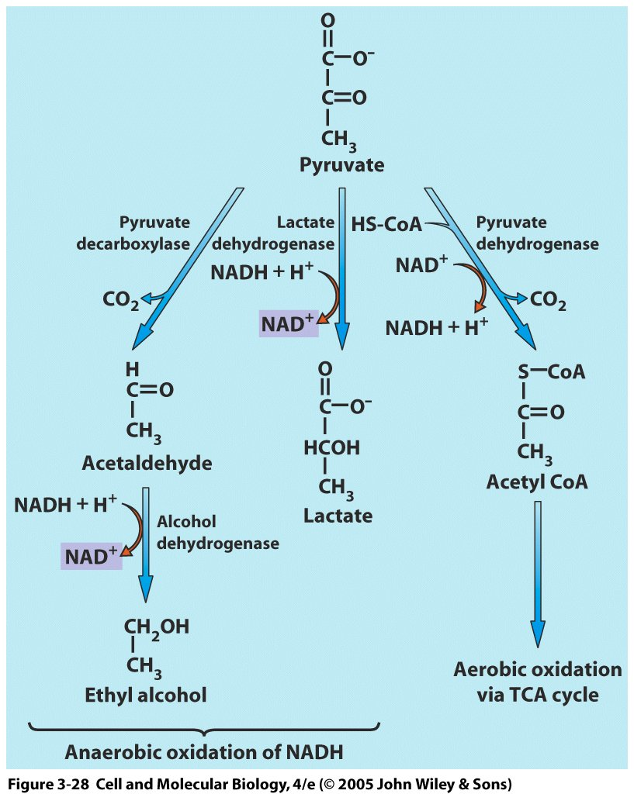
Pathways from pyruvate
Lose a CO2, regenerate NAD+, end with ethanol
Regenerate NAD+, reduce pyruvate to lactate
If NAD+ not regenerated, glycolysis will shut down
Both of these reactions are anaerobic, meaning no O2 required, and considered fermentation
Create another NADH, form acetyl CoA, enter TCA cycle for aerobic respiration using O2
Notes:
19
2 ATPs are produced by substrate-level phosphorylation from each molecule of glyceraldehyde-3-phosphate oxidized to pyruvate; since there are 2 of them, 4 ATPs are made
2. Since 2 ATPs are used up to start pathway, there is a net gain of 2 ATPs
3. Overall equation: Glucose + 2ADP + 2Pi + 2NAD+ —> 2Pyruvate + 2ATP + 2NADH + 2H+ + 2H2O
4. Pyruvate (glycolysis end product) is key compound; sits at junction between anaerobic & aerobic pathways: without O2, pyruvate undergoes fermentation; in its presence, aerobic respiration occurs
Fermentation - recycle NAD+ for use in glycolysis (stops without NAD+); occurs when O2 low because NAD+ cannot be recycled by ET system
A. Glycolytic reactions occur at rapid rates so cell can produce a significant amount of ATP
1. Some cells (yeast, tumor & muscle cells) rely heavily on glycolysis to make ATP
Pyruvate is converted to various substances (CO2 & ethanol in plants, yeast; lactate in animals)
1. When muscles contract repeatedly, O2 levels drop too low to keep pace with cell metabolic demands so the muscle cells regenerate NAD+ by converting pyruvate to lactate (fermentation)

Slide 20
Key points of glycolysis
Two ATPs are used to drive two initial phosphorylation reactions, which would be energetically unfavorable by themselves
Some steps with non-favorable ΔG°’ are near equilibrium mainly through maintenance of appropriate reactant and product concentrations
A 6 carbon molecule (fructose 1,6 bisphosphate) is broken down into two three carbon molecules (glyceraldehyde-3-phosphate)
Addition of a second phosphate to the three carbon molecule requires phosphate (Pi) and reduces NAD+ (NAD+ → NADH + H+)
Each 1,3 bisphosphoglycerate donates a phosphate to make 1 ATP
Reconfiguration makes phosphoenolpyruvate, which is converted to pyruvate in an energetically favorable reaction that also creates 1 ATP
Net equation: Glucose + 2ADP + 2Pi + 2 NAD+ → 2 pyruvate + 2 ATP + 2 NADH + 2 H+ + 2 H2O
NAD+ must be regenerated for glycolysis to continue for long periods

Slide 21
Clicker question: A bacterial colony with an important therapeutic gene vector is dying. Biochemical analysis reveals that there is excess glyceraldehyde 3 phosphate and NAD+. What can be done to rescue the colony?
Add glyceraldehyde phosphate dehydrogenase
Add ATP
Add ADP
Add lactate dehydrogenase
None of the above
Notes:
There is probably a mutation or disruption in glyceraldehyde phosphate dehydrogenase. Adding NADH would also work if there was a continuous supply. The answer is A

Slide 22
No amount of experimentation can ever prove me right; a single experiment can prove me wrong. Albert Einstein
It doesn't matter how beautiful your theory is, it doesn't matter how smart you are. If it doesn't agree with experiment, it's wrong. Richard P. Feynman

Slide 23
Turning observations into hypotheses
You are deep sea diving in Hawaii over winter break. 25 meters down, you notice a series of flashes of colored light. Swimming closer, it is coming from some nearby fish. You are able to catch a few (luckily, they are not endangered) and return them to your home laboratory.
Over the next few days, you notice that their flashing behavior does not occur for at least an hour after their water has been changed.
Write down a hypothesis regarding why this might be.
What additional observations or information would you want to refine this hypothesis?
Notes:
Because obviously you have a home laboratory, right?
What additional information would you need to make this hypothesis?

Slide 24
Hypotheses arise from a combination of observations, experiences, and logic
A hypothesis is a specific statement in which you propose a testable theory to explain your observations, including the important variables.
It can be narrow to explain a small group of observations (e.g. An altered shooting arm angle is causing Tim Duncan to miss free throws.) or broad to explain a large group of observations (e.g. Darwin’s theory of evolution).
The hypothesis should lead to predictions of an experimental outcome (a measured dependent variable) based on your manipulation of one or more independent variables that you have deemed important based on your observations, previous studies and logic.
It should be testable and should direct the way that you set up experiments to test the hypothesis.

