Slide 1
The key to SETI is to guess the type of communication that an alien society would use. The best guesses so far have been that they would use radio waves, and that they would choose a frequency based on 'universal' knowledge—for instance, the 1420 MHz hydrogen frequency. But these are assumptions formulated by the human brain. Who knows what sort of logic a superadvanced nonhuman life form might use? ... Just 150 years ago, an eyeblink in history, radio waves themselves were inconceivable, and we were thinking of lighting fires to signal the Martians. --David E. Fisher

Slide 2
Announcements
Review questions and assessment items are available on Blackboard
Alternate final exam 4-6 pm, Dec. 10, Lilly 1-105
Final exam (as scheduled), 3:30-5:30 pm Dec. 17, WTHR 200
80% material since exam 3, 20% previous material
Mostly short-answer, some multiple choice

Slide 3
Clicker question: In order for longer term (hours to days) changes to take place due to G-protein coupled receptor signaling, what must happen?
PKA must be activated to its catalytic form
cAMP must be generated
A PKA sensitive transcription factor must bind to a promoter
A PKA sensitive transcription factor must bind to mRNA
Notes:
Answer is C

Slide 4
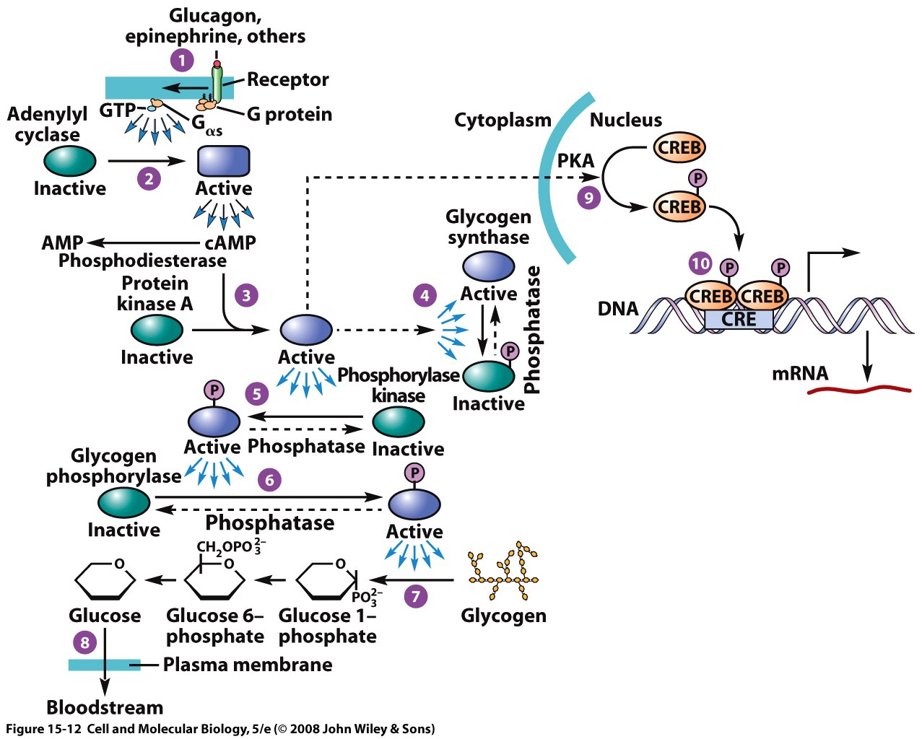
CREB/CRE are critical for coupling receptor activation to long-term changes in the cell
cAMP response element binding protein (CREB) is a common target for intracellular pathways (Aplysia sensitization, glucose regulation, etc)
PKA phosphorylates CREB and CREB dimerizes
CREB binds to the cAMP response element (CRE), which is a nuclear DNA sequence. CREB binding will upregulate transcription of multiple genes that are coupled to CRE, usually related to a unified function (e.g. synaptic plasticity, growth, apoptosis (cell death), etc.)

Slide 5
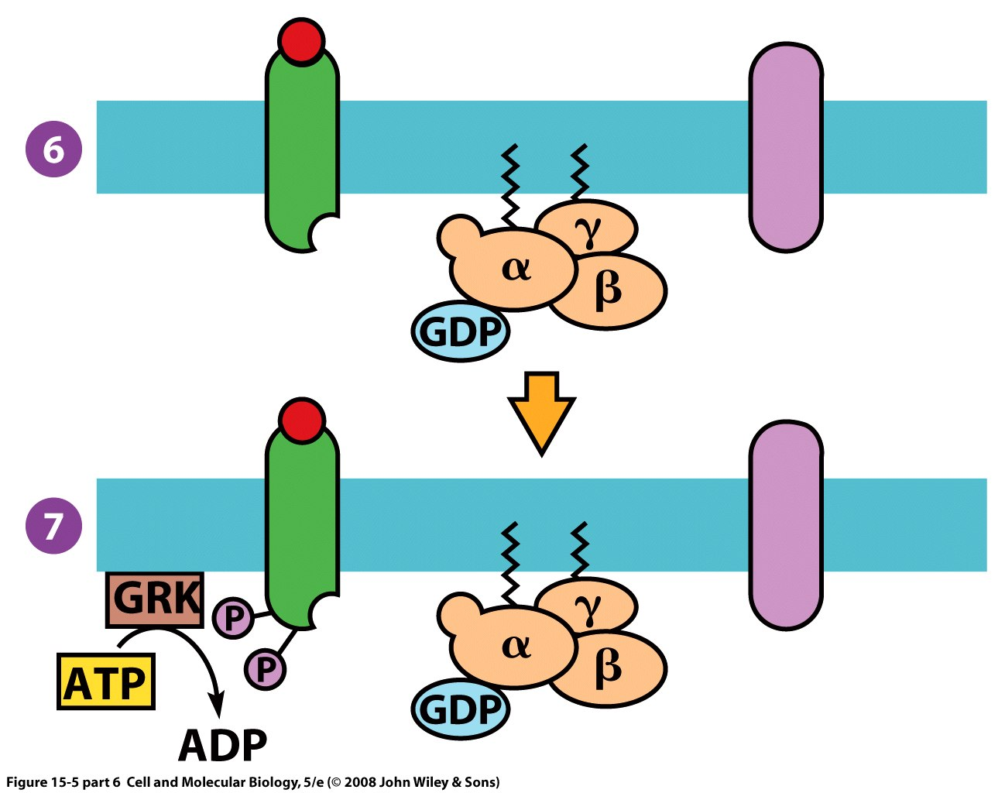
G-protein receptor kinases (GRK) are serine-threonine kinases that desensitize GPCRs
GRKs use two ATP to phosphorylate the activated receptor.
Desensitization is the cessation of the receptor response despite having bound ligand (red ball represents ligand)

Slide 6
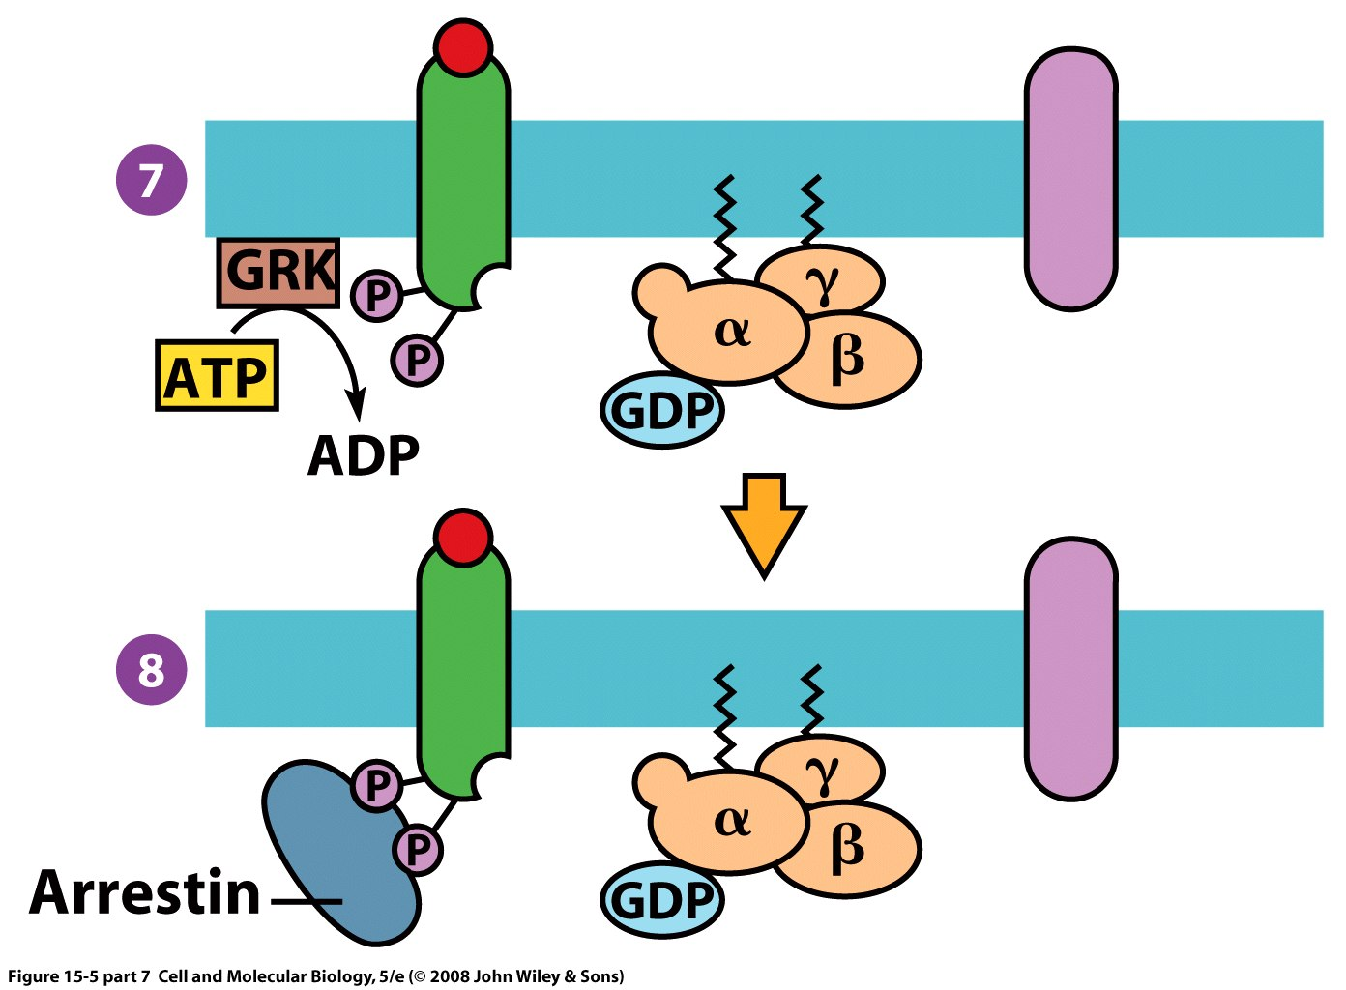
Arrestin binds to the two phosphates and prevents G-protein activation
Arrestin prevents association of G-proteins with the activated receptor, so the G-protein can’t be activated by GTP.
Arrestin bound receptors are often removed from the membrane by endocytosis.
This is not an obligatory part of the cycle.

Slide 7
Clicker question: Which of the following plots shows the rate G-protein production in the presence of arrestin?
Curve A
Curve B
Neither
Notes:
Answer was A, the curve with a shorter duration due to desensitization

Slide 8
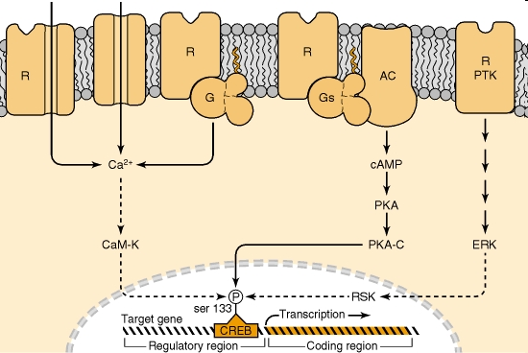
CREB is a key transcription factor regulated by multiple pathways
Notes:
Schematic illustration of the mechanism by which diverse types of first messengers converge on the phosphorylation of serine 133 of cAMP response element-binding protein (CREB). Some first messengers do this by increasing cAMP concentrations by activation of G protein-coupled receptors (R), Gs, adenylyl cyclase (AC) and cAMP-dependent protein kinase (PKA), which then phosphorylates CREB on ser 133. Others do so by increasing Ca2+ concentrations by activation of ionotropic receptors (R) that flux Ca2+, by activation of voltage-gated Ca2+ channels through membrane depolarization or by activation of G protein-coupled receptors that elevate intracellular Ca2+ concentrations, for example, via the phospholipase C pathway. Increased concentrations of Ca2+ then lead to activation of Ca2+/calmodulin-dependent protein kinases (type IV and, possibly, I) (CaM-K), which also phosphorylate CREB on ser 133. Still others do so by activating ERK: by activation of receptor-associated protein tyrosine kinases (R-PTK) and the mitogen-activated protein kinase cascade (see Fig. 24-3). Activation of extracellular signal-regulated kinase (ERK) then phosphorylates and activates ribosomal S6 kinase (RSK), which also phosphorylates CREB on ser 133. The step at which the cytoplasmic signal is transduced to the nucleus is well established for PKA: activation of the kinase leads to its dissociation and generation of the free catalytic subunit (PKA-C), which then translocates to the nucleus and phosphorylates CREB. The process is less well established for the CaMKs and ERK, as indicated by the dashed lines. Phosphorylation of CREB on ser 133 activates its transcriptional activity and leads to changes in the rate of transcription of target genes.

Slide 9
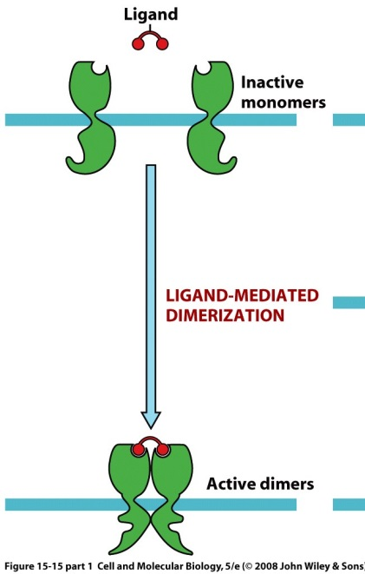
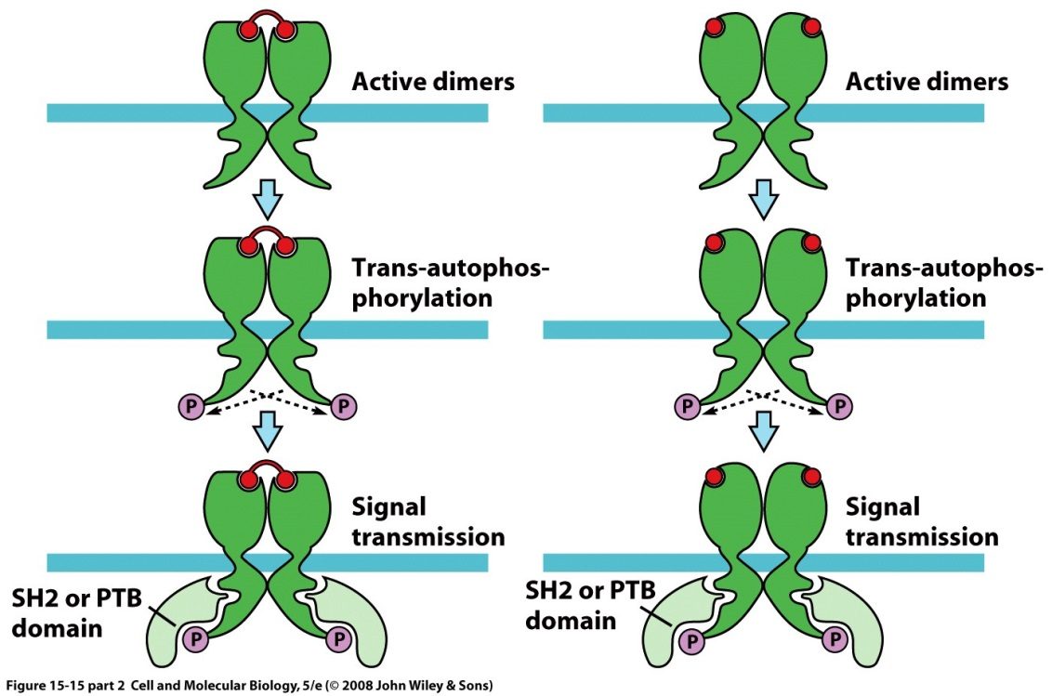
Receptor tyrosine kinases
Trans-autophosphorylation means that one subunit will phosphorylate the other subunit in the dimer
The phosphorylated receptors will now bind to target proteins with SH2 or PTB domains and activate them
Growth factors such as epidermal growth factor and nerve growth factor use protein tyrosine kinases
Notes:
9
SH2=src homology 2 proteins >110 of these in human genome, PTB phosphotyrosine binding domains

Slide 10
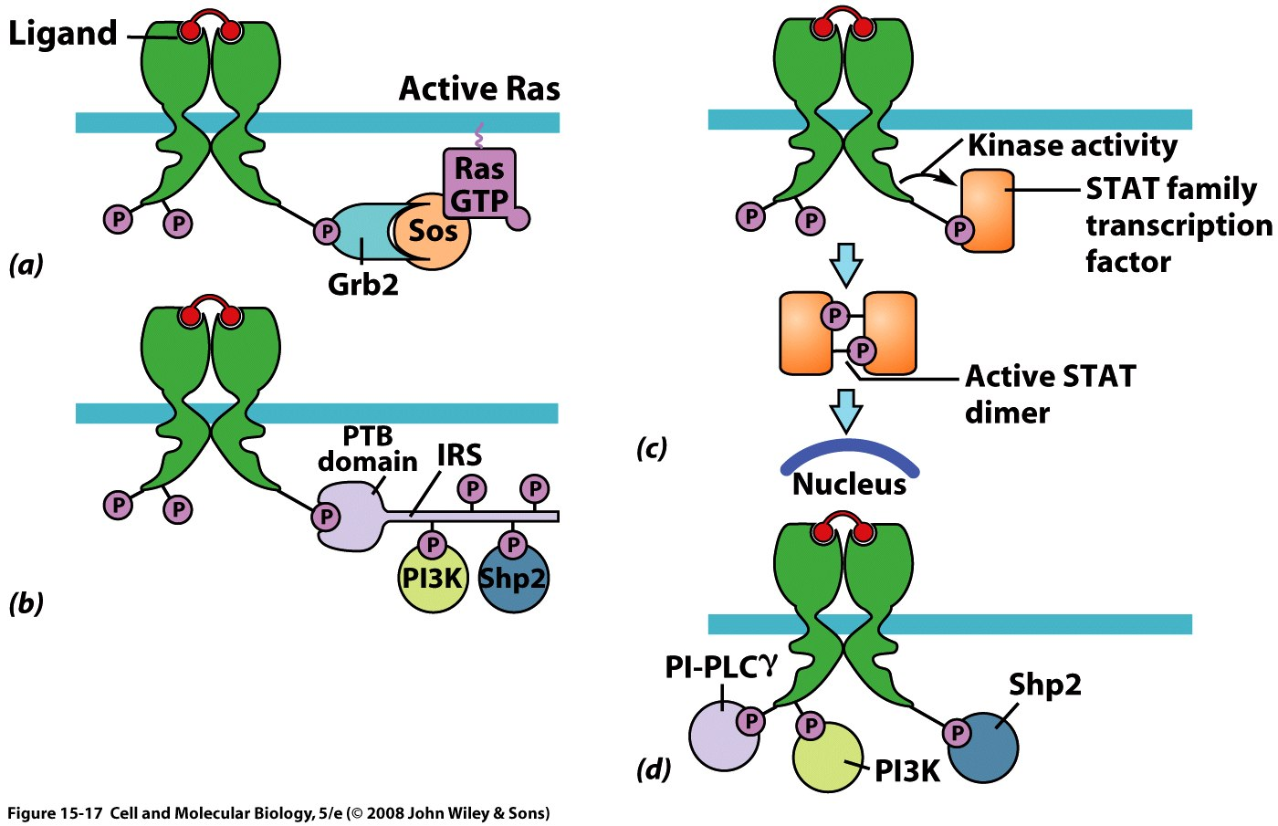
You’ve activated (phosphorylated) the receptor, now what? Different signaling proteins
Adaptor proteins: (Grb2) link signaling proteins with SH2 domain
Docking proteins: (IRS) can add tyrosine phosphorylation sites
Transcription factors: Activated factor goes directly to nucleus to regulate genes (STAT protein shown above, involved in immune function)
Notes:
10
Docking proteins are kind’ve like a USB hub or a plug power strip, PTB = phosphotyrosine binding domains

Slide 11
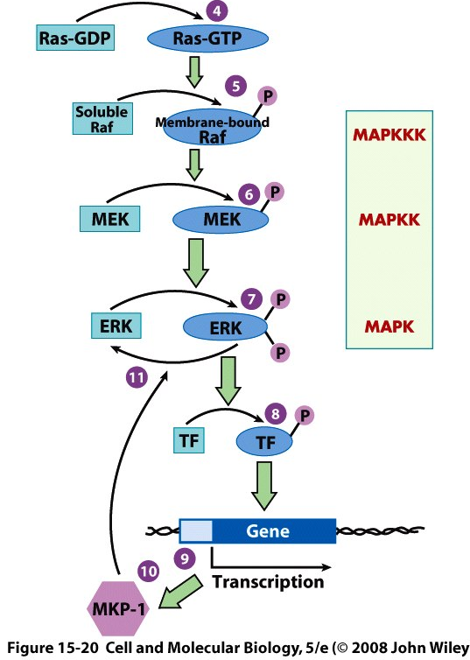
MAP kinase pathway
Sos activates Ras-GDP to Ras-GTP
Enter the kinase cascade, Raf, MEK, ERK
MAPKKK is a MAP kinase kinase kinase, because it phophorylates sequentially two steps away from MAPK
MEK (MAPKK) is a dual-specificity kinase and can work on tyrosine or serine-threonine
Activated MAPK into the nucleus to phosphorylate transcription factors
Transcription factors regulate genes
MAPK turned off by MAPK phosphatase (MKP-1) upregulated by transcription factor
Inhibitory
Notes:
11
14 different MAPKKK, 7 different Mapkk, and 13 different MAPK in mammals

Slide 12
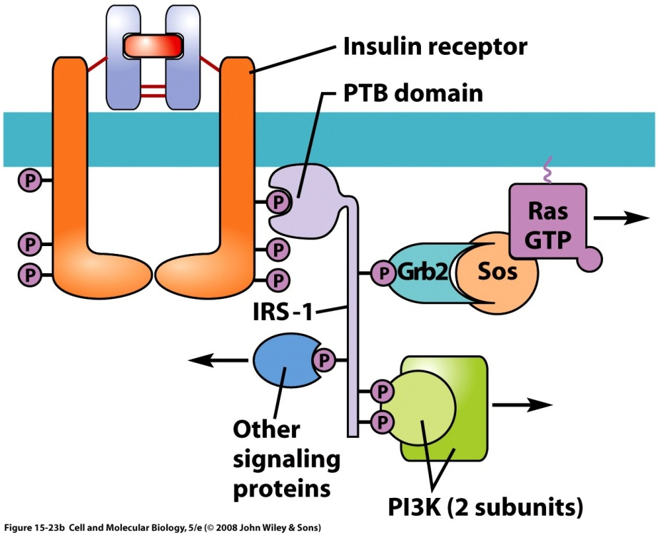
After activation of the insulin receptor
Modularity!
IRS-1 is a docking protein with multiple tyrosine phosphorylation sites that binds to the activated insulin receptor through a PTB domain
IRS-1 can bind to Grb2/Sos to activate Ras
PI3K can also bind to IRS-1. PI3K makes phosphoinositide triphosphate (PIP3) from PIP2
Notes:
12
PI3K is a lipid kinase PIP2 is phosphoinositol bisphosphate PI3K forms PIP3, another second messenger

Slide 13
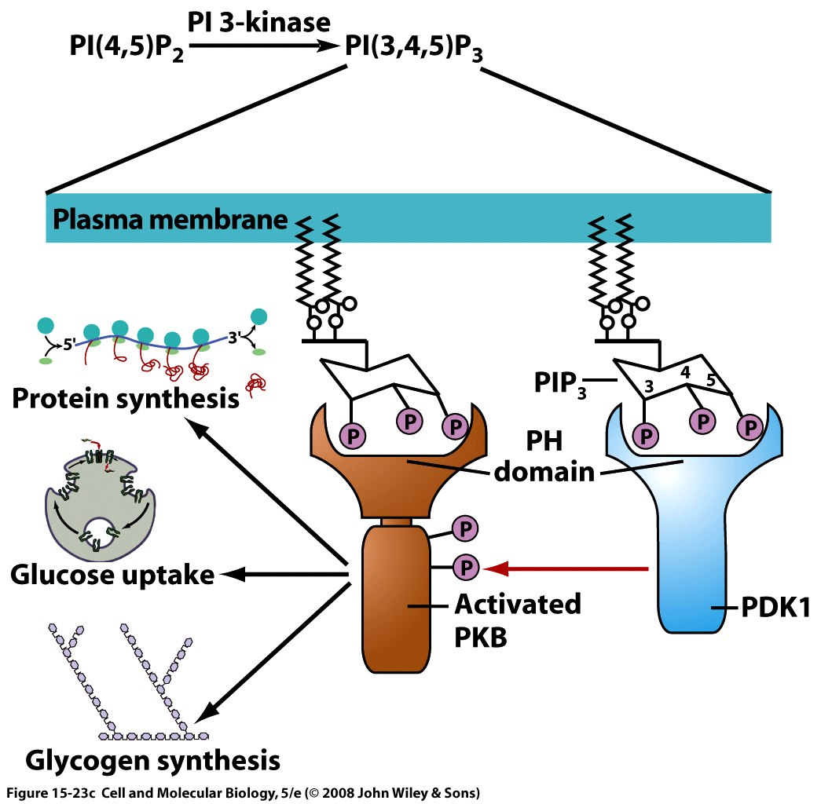
Further downstream of insulin binding
PI3K makes PIP3 which is in membrane
Two kinases phosphorylate PKB
Phosphorylated PKB dissociates from the membrane and signals glucose uptake, glycogen synthesis, and protein synthesis
Notes:
13
phosphoinositide triphosphate (PIP3)

Slide 14
Glycogen synthesis is enabled by maintaining glycogen synthase in an active, dephosphorylated state
PKB-P (phosphorylated state) is active
GSK3-P (glycogen synthase kinase 3) is inactive
glycogen synthase-P is inactive
GSK3 and glycogen synthase are unusual in that they are inactivated by phosphorylation.
PKB-P
GSK3
GSK3
active
GSK3-P
inactive
Glycogen synthase
active
Glycogen synthase-P
inactive
So, activation of PKB inhibits GSK3 activity by phosphorylation to GSK3-P. Therefore, it disinhibits glycogen synthase activity and permits glycogen synthase to remain in the active, non-phosphorylated state and allows glycogen to be synthesized.

Slide 15
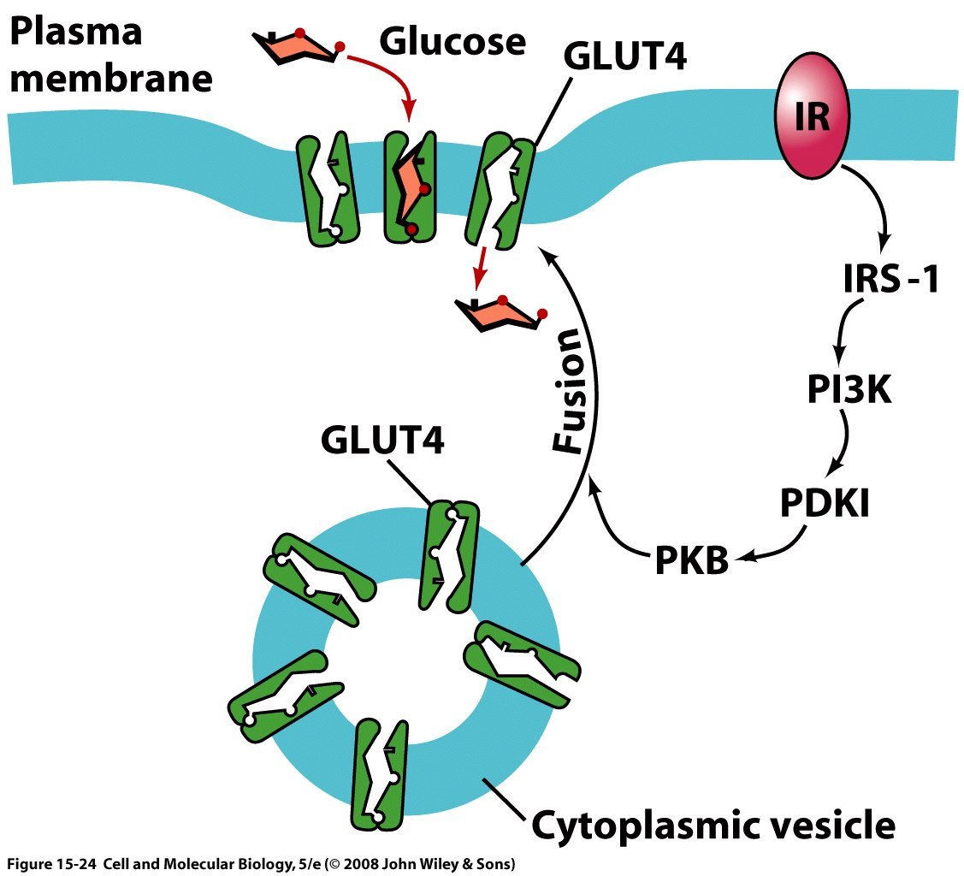
PKB is required to upregulate glucose transporter insertion into plasma membrane
Activated PKB enhances glucose transporter fusion, thereby increasing glucose uptake from blood into cells
Activated PKB also phosphorylates glycogen synthase kinase 3 (GSK-3) which is the negative regulator of glycogen synthase
GSK-3 is inactivated by phosphorylation by PKB, allowing glycogen synthase to operate at high rates
Notes:
15
B. Excess glucose taken up by muscle & liver cells is stored as glycogen, the synthesis of which is catalyzed by glycogen synthase, an enzyme turned off by phosphorylation on serine & threonine residues
1. Glycogen synthase kinase-3 (GSK-3) has been identified as glycogen synthase's negative regulator
2. GSK-3, in turn, is inactivated after phosphorylation by PKB
3. Thus, activation of the PI 3-kinase-PKB pathway in response to insulin leads to a decrease in GSK-3 kinase activity, resulting in an increase in glycogen synthase activity
4. Activation of protein phosphatase 1, an enzyme known to dephosphorylate glycogen synthase, contributes further to glycogen synthase activation

Slide 16
Second messengers
Activated by an effector that has been activated by first messenger (ligand) or the transduction of the ligand binding, such as activation of a G-protein by a ligand-activated receptor.
Examples include:
cAMP,
Ca++,
Phosphoinositides, such as PIP2 and PIP3
Inositol trisphosphate (IP3)
Diacylgycerol (DAG)
Cyclic GMP (cGMP, mostly in vision)
Nitric oxide

Slide 17
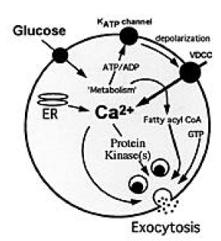
Calcium and PKB can regulate insertion of glucose transporters into membrane
Ca++ is required to secrete insulin from the beta pancreatic cells
Ca++ binds to calmodulin and activates it. Calmodulin can then bind to Ca/calmodulin-dependent kinases (CaM kinases)
In this example CaMKII promotes insulin release
Easom 1999

Slide 18
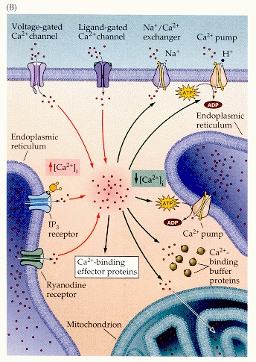
Calcium is another major type of second messenger Ways to regulate [Ca++] in cell
Red lines indicates ways to increase [Ca++], black lines ways to decrease it.
Many intracellular processes are [Ca++] sensitive (e.g. synaptic release)
Some kinases, such as calmodulin, are activated by Ca++

Slide 19
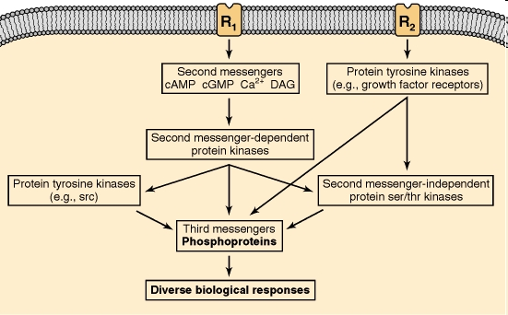
Convergence and crosstalk of pathways via kinases in neurons and glia
Basic Neurochemistry: Molecular, Cellular and Medical Aspects. 6th edition.
Siegel GJ, Agranoff BW, Albers RW, et al., editors.
Notes:
Signals in the brain. Extracellular signals, termed first messengers, produce specific biological responses in target neurons via a series of intracellular signals, termed second or third messengers. Second messengers in the brain include cAMP, cGMP, Ca2+ and diacylglycerol (DAG). cAMP and cGMP produce most of their second-messenger actions through the activation of cAMP-dependent and cGMP-dependent protein kinases, respectively. Ca2+ exerts many of its second-messenger actions through the activation of Ca2+-dependent protein kinases, as well as through a variety of physiological effectors other than protein kinases. Not illustrated in the figure is that some protein phosphatases can also be regulated directly by second messengers, for example, calcineurin, which is activated by Ca2+. The brain also contains a large number of other protein serine-threonine kinases (see Table 24-1) that are not activated directly by second-messenger pathways or by protein tyrosine kinases. The brain and other tissues contain two major classes of protein tyrosine kinases. Some of these enzymes are physically associated with plasma membrane receptors, such as most growth factor receptors, and become activated upon ligand binding to the receptors. Others, such as src, are not physically associated with receptors but are influenced indirectly by both second-messenger pathways and receptor protein tyrosine kinases.

Slide 20
Signaling pathways are not independent and can interact
Convergence: Signals from multiple receptors activate a common effector, such as Ras or Raf
Divergence: Signals produced by a single receptor activate more than one different effector, such as protein kinase C (PKC) and inositol triphosphate (IP3)
Crosstalk: Components of signaling pathways are shared between pathways, such as [cAMP], PKC, ATP

Slide 21
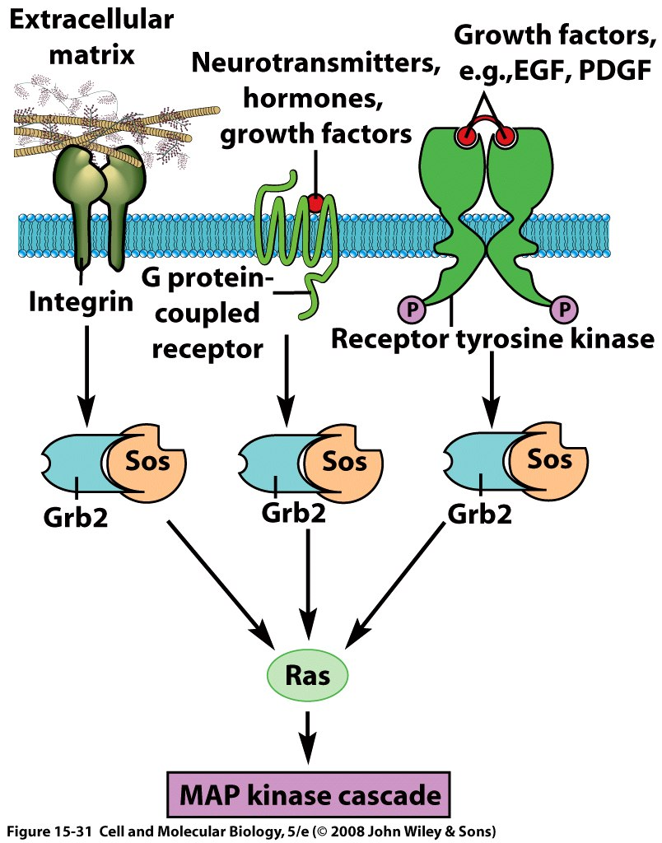
Convergence: Multiple pathways converge on a common signaling molecule
Convergence differs from crosstalk because the converging paths are the same after they converge.
Notes:
21

Slide 22
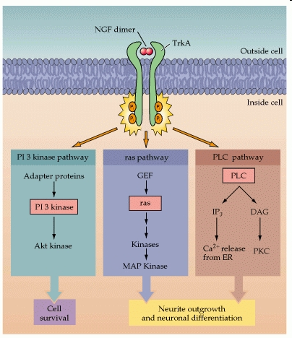
NGF is a receptor tyrosine kinase that activates multiple pathways to keep cells alive and grow new synapses
This is an example of divergence. (Erudite and Candor perhaps?)
Neuroscience. 2nd edition.
Purves D, Augustine GJ, Fitzpatrick D, et al., editors.
Notes:
Mechanism of action of NGF. NGF binds to a high-affinity tyrosine kinase receptor, TrkA, on the plasma membrane to induce phosphorylation of TrkA at two different tyrosine residues. These phosphorylated tyrosines serve to tether various adapter proteins or phospholipase C (PLC), which, in turn, activate three major signaling pathways: the PI 3 kinase pathway leading to activation of Akt kinase, the ras pathway leading to MAP kinases, and the PLC pathway leading to release of intracellular Ca2+ and activation of PKC. The ras and PLC pathways primarily stimulate processes responsible for neuronal differentiation, while the PI 3 kinase pathway is primarily involved in cell survival.

Slide 23
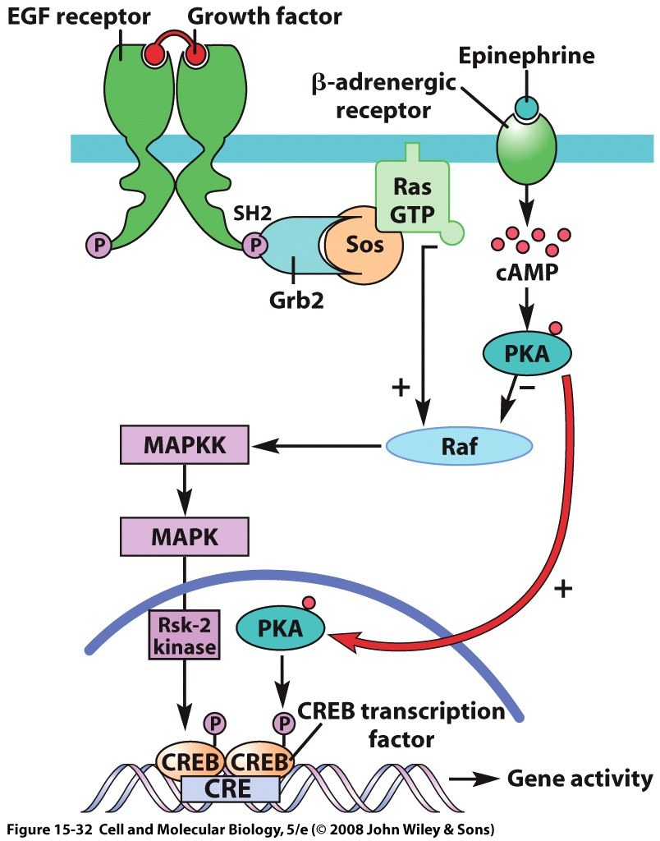
Positive and negative regulation of pathway intermediates (crosstalk example)
Binding of growth factor on receptor tyrosine kinase allows adaptor Grb2 to link to Sos and catalyze Ras-GTP formation.
The activated G-protein Ras-GTP binds to Raf to activate it
Epinephrine binding generates cAMP and activates PKA to inhibit Raf activity
In the nucleus, both PKA and a MAP kinase activate CREB transcription factor to upregulate specific CRE promoters

Slide 24
Positive and negative regulation of pathway intermediates (crosstalk example)
Binding of growth factor on receptor tyrosine kinase allows adaptor Grb2 to link to Sos and catalyze Ras-GTP formation.
The activated G-protein Ras-GTP binds to Raf to activate it
Epinephrine binding generates cAMP and activates PKA to inhibit Raf activity
In the nucleus, both PKA and a MAP kinase activate CREB transcription factor to upregulate specific CRE promoters

Slide 25
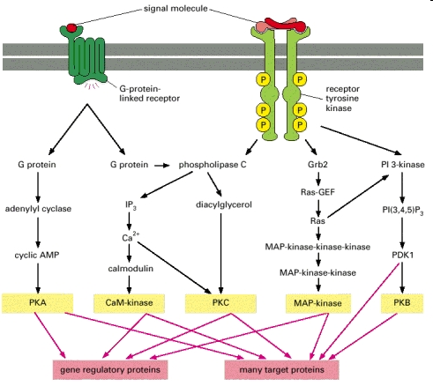
Parallel and interacting signaling pathways
Molecular Biology of the Cell. 4th edition., Alberts B, Johnson A, Lewis J, et al.
Notes:
n this schematic example, the five kinases (shaded yellow) at the end of each pathway phosphorylate target proteins (shaded red), some of which are phosphorylated by more than one of the kinases. The specific phospholipase C activated by the two types of receptors is different: G-protein-linked receptors activate PLC-β, whereas receptor tyrosine kinases activate PLC-γ (not shown).

Slide 26
Name that kinase!
Activated by cAMP - PKA
Triggered by growth factor binding – receptor tyrosine kinase (RTK)
Inactivates glycogen synthase – GSK3 or PKA
Forms PIP3 – PI3K
Activates CREB – PKA,PKC, or MAPK
Phosphorylates a MAPK – MAPKK or MEK
Can bind docking proteins with PTB or SH2 domains –RTK again
Promotes glycogen synthesis by phosphorylating GSK-3 to inactivate it - PKB
Notes:
26

Slide 27
Summary table of intracellular signals
 | G-protein/PKA | Tyrosine kinase/MAPK
First messenger | Ligand binds GPCR | Ligand→dimer receptor
Effector | Adenylyl cyclase on ATP | Phos. Receptor dimer
Second messenger | cAMP | Grb2/Sos/Ras-GTP
Activates | PKA | Raf-MEK-ERK cascade
Nuclear target | CREB | Jun,STAT, Elk-1, CREB, others
Shut down by | Galpha auto-GTPase, arrestin | Phosphatases, such as MKP-1

Slide 30
Dual PKA action activates glycogen breakdown and inhibits glycogen synthesis pathways
2
1
Phosphorylation by PKA activates phosphorylase kinase, leading to glycogen phosphorylase activation (glycogen breakdown) (1) and inhibits glycogen synthase by activating a kinase to phosphorylate glycogen synthase (2)
Notes:
30
Phosphorylated CREB binds as a dimer to sites on DNA containing a particular nucleotide sequence (TGACGTCA), known as the cAMP-response element (CRE)
1. Response elements are sites in the DNA where transcription factors bind & increase the rate of transcription initiation
2. CREs are found in the regulatory regions of genes that play a role in the response to cAMP
B. In liver cells, several gluconeogenesis enzymes are produced in response to cAMP (their genes contain nearby CREs); gluconeogenesis is a pathway by which glucose is formed from glycolysis intermediates
Phosphatase-1, the most important of these, removes PO43- from all of the phosphorylated enzymes: phosphorylase kinase, phosphorylase & glycogen synthase
B. cAMP phosphodiesterase helps to terminate the response to cAMP through the destruction of cAMP molecules present in the cell

Slide 31
Dual PKA action activates glycogen breakdown and inhibits glycogen synthesis pathways
2
1
Phosphorylation by PKA activates phosphorylase kinase, leading to glycogen phosphorylase activation (glycogen breakdown) (1) and inhibits glycogen synthase by activating a kinase to phosphorylate glycogen synthase (2)
Notes:
31
Phosphorylated CREB binds as a dimer to sites on DNA containing a particular nucleotide sequence (TGACGTCA), known as the cAMP-response element (CRE)
1. Response elements are sites in the DNA where transcription factors bind & increase the rate of transcription initiation
2. CREs are found in the regulatory regions of genes that play a role in the response to cAMP
B. In liver cells, several gluconeogenesis enzymes are produced in response to cAMP (their genes contain nearby CREs); gluconeogenesis is a pathway by which glucose is formed from glycolysis intermediates
Phosphatase-1, the most important of these, removes PO43- from all of the phosphorylated enzymes: phosphorylase kinase, phosphorylase & glycogen synthase
B. cAMP phosphodiesterase helps to terminate the response to cAMP through the destruction of cAMP molecules present in the cell

Slide 32
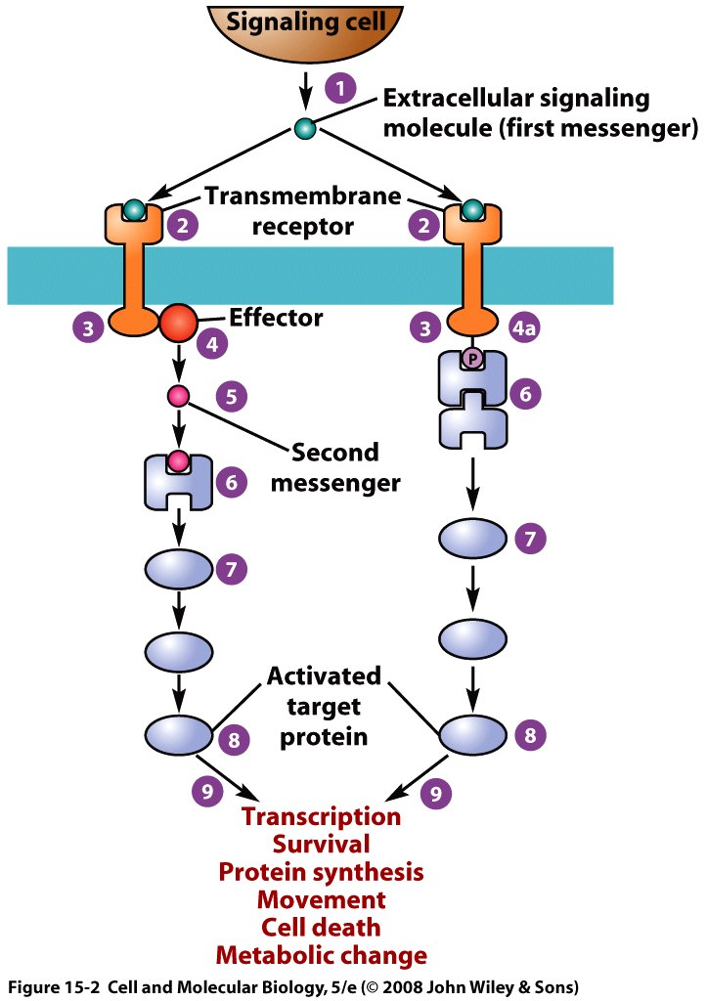
Intracellular Signaling Paths
Almost every intracellular process is regulated by extracellular signals
Left path, second messenger system
Second messengers are small substances that activate or inactivate specific proteins
Second messenger then binds to a “downstream” protein to continue signaling pathway
Right path, receptor activation of protein signaling complex
Proteins are either bound or recruited to activated intracellular portion of the receptor.
Translation of extracellular messenger binding into changes that occur inside of a cell is called signal transduction
Notes:
32
32
One type of receptor transmits signal from its cytoplasmic domain to a nearby enzyme that generates a second messenger
1. Since it brings about (effects) the cellular response by generating a second messenger, the enzyme responsible is called an effector
2. Second messengers are small substances that typically activate (or inactivate) specific proteins
3. Depending on its chemical structure, a second messenger may diffuse through the cytosol or remain embedded in the membrane lipid bilayer
A. Each signaling pathway consists of a series of distinct proteins that operate in sequence
B. Each protein in the pathway typically acts by altering the conformation of the subsequent (downstream) protein in the series, an event that activates or inhibits the protein
Virtually every activity in which a cell is engaged is regulated by signals originating at cell surface
1. The overall process in which information carried by extracellular messenger molecules is translated into changes that occur inside of a cell is called signal transduction

Slide 33
For the United States of America, “E pluribus unum” (Out of many, one)
For receptor tyrosine kinases (RTKs), “Ex uno plures” (Out of one, many)
Activation of a single RTK can activate many multiple diverse pathways

Slide 34
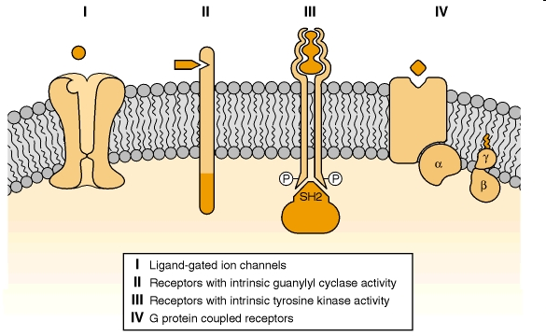
4 ways that extracellular signals are transduced across the membrane by ligand-receptor interactions
Notes:
Cell-surface receptors utilize four distinct molecular mechanisms for transmembrane signaling. I: Ligand-gated ion channels. II: Receptors which possess intrinsic guanylyl cyclase activity. III: Receptors with intrinsic tyrosine kinase activity. IV: G protein—coupled receptors, which are linked to the opening/closing of ion channels, modulation of adenylyl cyclase and phosphoinositide-specific phospholipase C activities. SH2, src homology 2 domain.

