Slide 1
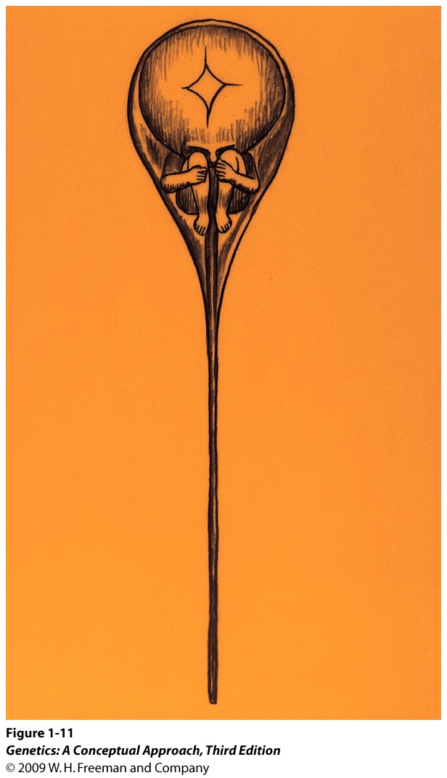
Theories of heredity before Mendel
Preformationism
There is a preformed mini-person (homunculus) inside an egg or a sperm.
Problems:
Only one parent contributes to the offspring.
A homunculus within a homunculus?

Slide 2
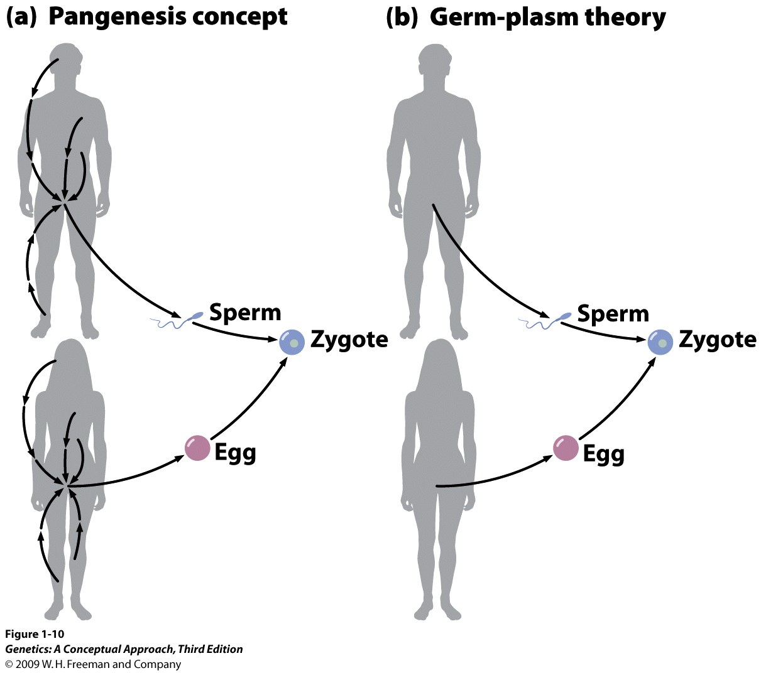
Pangenesis
Pangenesis: “particles” carrying information from various parts to the reproductive organ.
Inheritance of acquired characteristics.
Lamarckism: Use and Disuse.

Slide 3
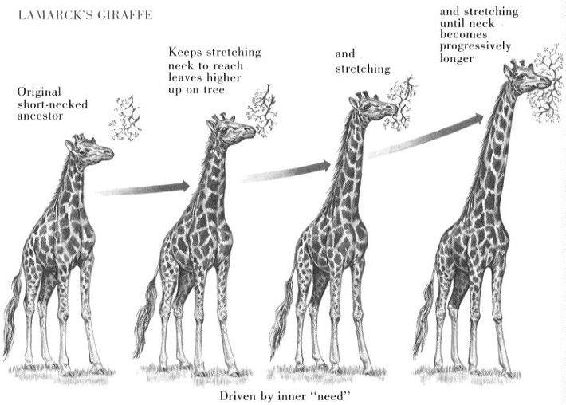

Slide 4
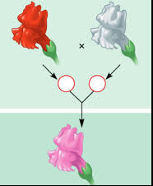
Blended Inheritance
  Parental traits are mixed and become forever changed in the offspring.
  This is problematic for the theory of evolution because desirable traits will be “diluted” in subsequent generations if inherited traits are blended.

Slide 5
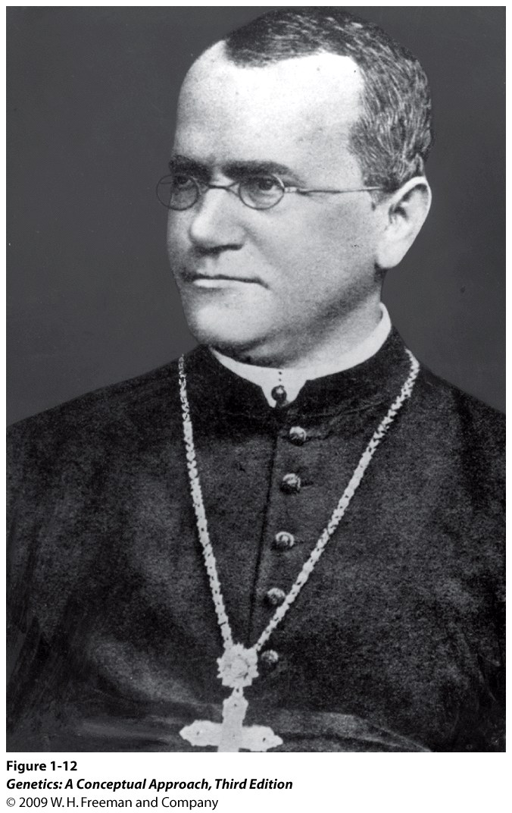
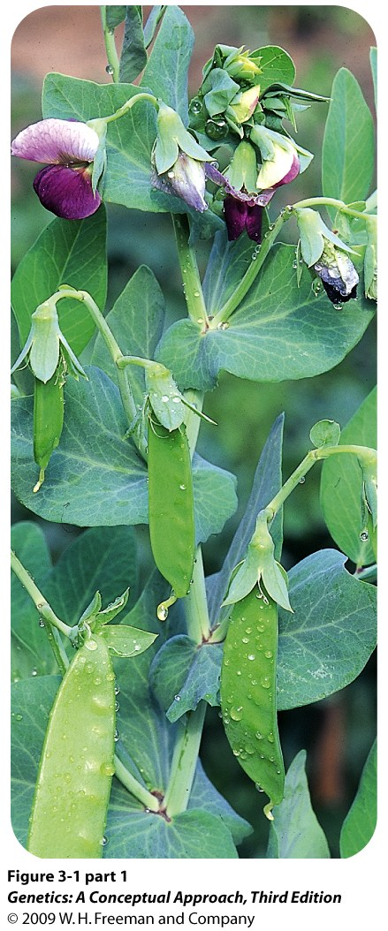
Gregor Mendel and Garden Pea
Pisum sativa
(Garden pea)
Gregor Mendel (1822-1884)
Augustinian monk

Slide 6
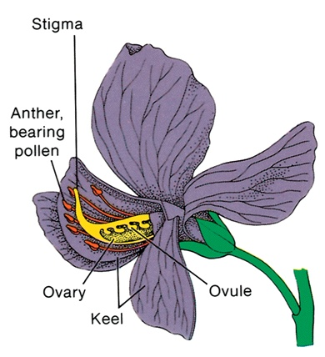
Model Organisms
Ease of cultivation,
Rapid Reproduction,
Small size,
Fecund (large brood size),
Mutants are available and easy to identify,
Broad literature and experimental background available.

Slide 7
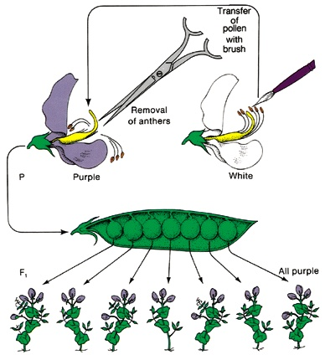

Slide 8
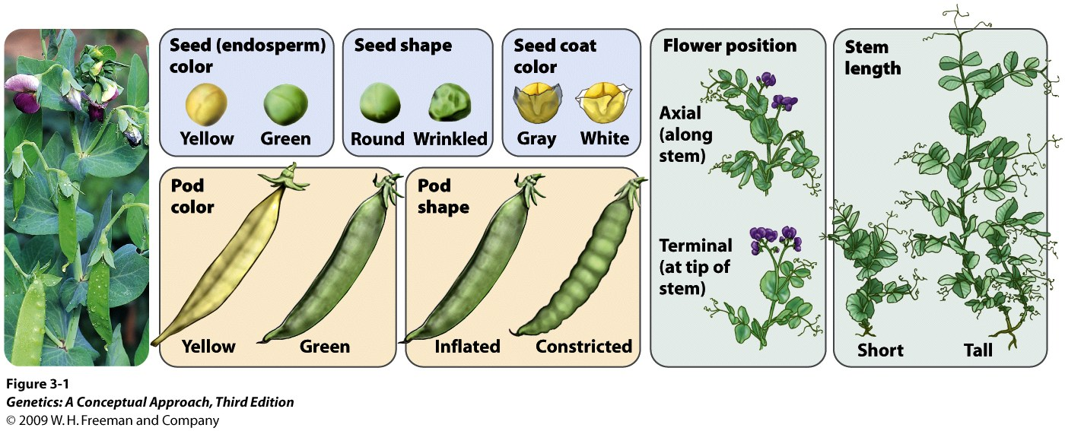
Monohybrid Cross
Mating between individuals that differ in only one trait.
Notes:
3.1 Mendel used the pea plant Pisum sativum in his studies of heredity. He examined seven characteristics that appeared in the seeds and in plants grown from the seeds. [Photograph by Wally Eberhart/Visuals Unlimited.]

Slide 9
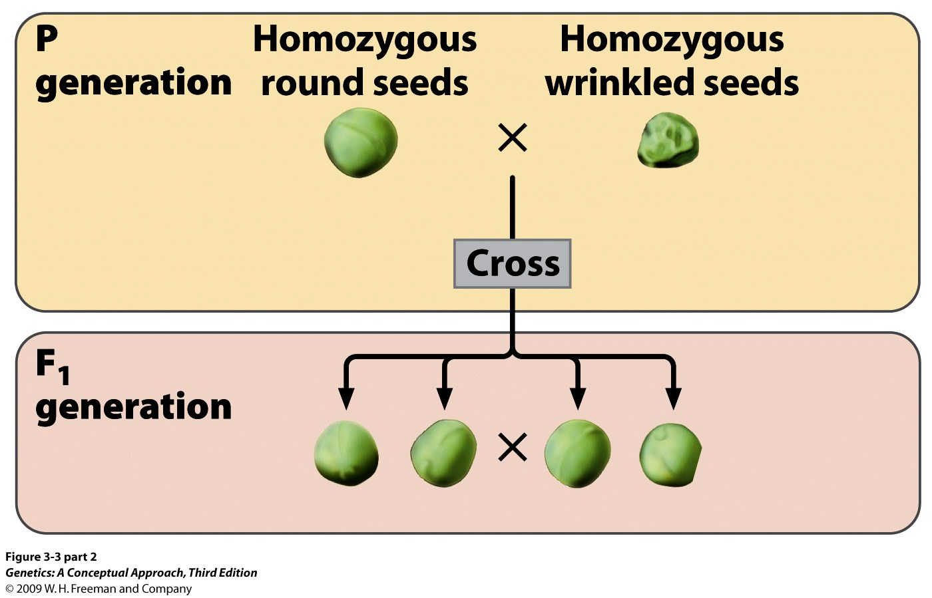
Monohybrid Cross
Seed plant
Pollen plant
Notes:
3.3 (part 2) Mendel conducted monohybrid crosses.

Slide 10
Autosomal Inheritance
Pollen plant
Seed plant
Notes:
3.3 (part 2) Mendel conducted monohybrid crosses.

Slide 11
Reciprocal cross
Mendel’s monohybrid crosses were not sex dependent. It did not matter whether, say, a round-seeded male plant pollinated a wrinkled-seeded female plant, or vice versa. The results were the same either way. This is called a reciprocal cross.
Mendel was dealing with autosomal inheritance.

Slide 12
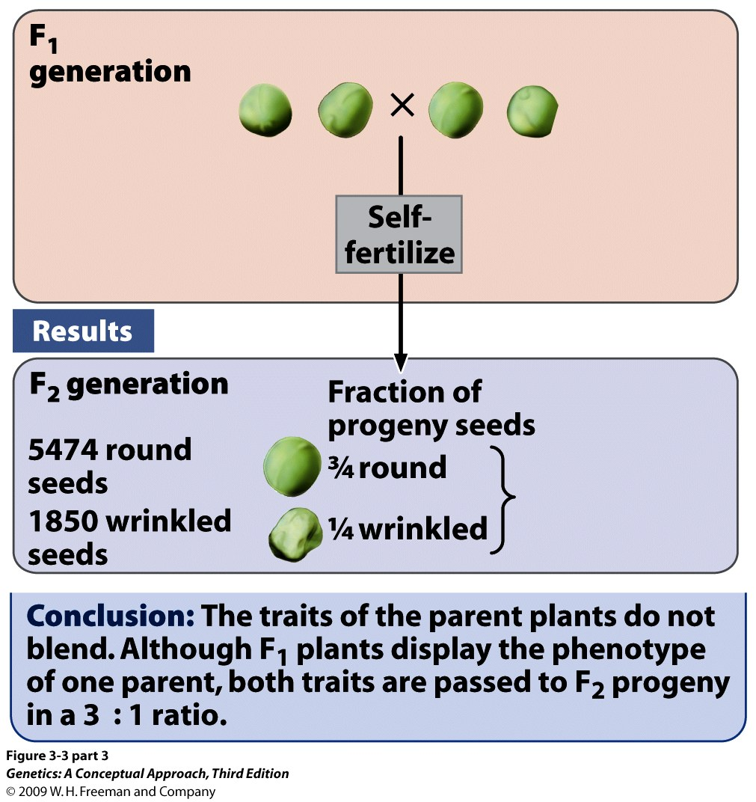
Notes:
3.3 (part 3) Mendel conducted monohybrid crosses.

Slide 13
Dominant vs Recessive
Traits blending did not occur.
The “wrinkled seed shape” must have been present but unexpressed in F₁.
Mendel coined the terms dominant and recessive. (round seed shape is dominant and wrinkled seed shape is recessive).

Slide 14
Nomenclature
Dominant unit factors are designated with a capital letter, often (but not always) with the first letter of the description,
  Y = yellow,
  V = violet,
  T = tall,
Recessive unit factors are represented by small letters,
  y = green,
  v = white,
  t = dwarf,

Slide 15
Notes:
3.3 (part 3) Mendel conducted monohybrid crosses.

Slide 16
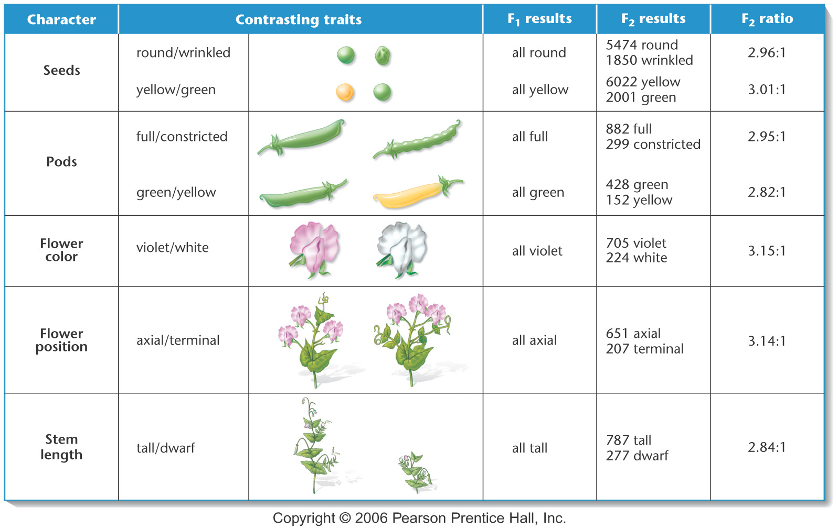
Notes:
Figure 3-1 A summary of the seven pairs of contrasting traits and the results of Mendel’s seven monohybrid crosses of the garden pea (Pisum sativum). In each case, pollen derived from plants exhibiting one trait was used to fertilize the ova of plants exhibiting the other trait. In the F1 generation, one of the two traits (dominant) was exhibited by all plants. The contrasting trait (recessive) then reappeared in approximately one-fourth of the F2 plants.

Slide 17
P
Yellow Pea
X
Green Pea
self
F₁
Yellow Pea
:
Green Pea
F₂
Yellow Pea
6022
2001

Slide 18
P
Yellow Pea
X
Green Pea
self
F₁
Yellow Pea
self
F₂
519
Yellow Pea
F₃
All Yellow, “pure”
Yellow and green, “impure”
166
353

Slide 19
P
Yellow Pea
X
Green Pea
self
F₁
Yellow Pea
F₂
Yellow Pea
Green Pea
6022
2001
3
:
1
1
:
2
:
1

Slide 20
Mendel’s explanation
Existence of genes: responsible for contrasting phenotypic differences.
Genes in pairs. Different forms of genes are called alleles.
Halving genes pairs in gametes.
Equal segregation (Mendel’s 1st law).
Random fertilization.

Slide 21
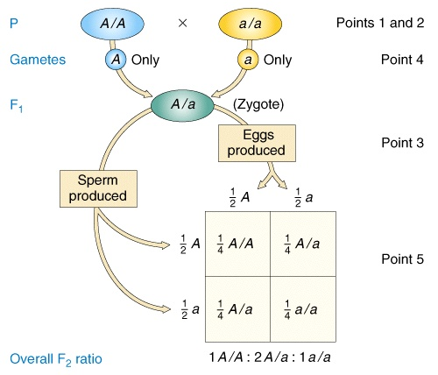
Mendel’s explanation for the 1:3 and 1:2:1 ratios

Slide 22
Genotype vs Phenotype
The genotype is the genetic makeup of an individual.
The phenotype is the physical expression of the genetic makeup.
3:1 is a phenotypic ratio and 1:2:1 is a genotypic ratio.

Slide 23
Homozygous vs Heterozygous
When the alleles for a trait in an individual are the same, the individual is homozygous.
If the alleles differ, the individual is heterozygous.
R
r
and
are both homozygous
R
r
R
is heterozygous
r

Slide 24
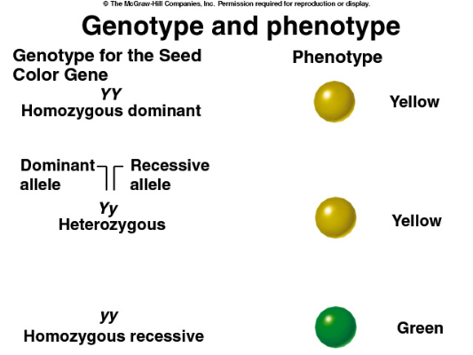

Slide 25
P
Yellow Pea
X
Green Pea
Y
Y
Y
Y
self
y
F₁
Yellow Pea
y
y
y
Y
Y
y
y
:
Green Pea
F₂
Yellow Pea
6022
2001
Y
y
Y
y
Y
Y
Y
y
Y
y
y
y

Slide 26
P
Yellow Pea
X
Green Pea
testcross
F₁
Yellow Pea
X
Green Pea
:
Green Pea
F₂
Yellow Pea
58
52
y
y
Y
Y
Y
y
y
y
y
y
y
y

Slide 27
Testcross
A testcross is a way to determine whether an individual displaying the dominant phenotype is homozygous or heterozygous for that trait.
In a testcross, the phenotype of the progeny = genotype.

Slide 28
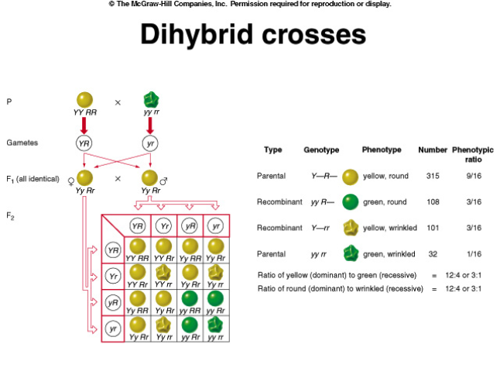

Slide 29
Mendel’s second law
Gene pairs on different chromosome pairs assort independently at meiosis

Slide 30
Meiosis without recombination. Independent assortment of homologs to different
Poles creates gamete diversity
2^{n} (n = # of diff chromosome pairs)
A
A
a
a
The two possible alignments
of nonhomologous
chromosomes at metaphase I
a
a
A
A
B
B
b
b
B
B
b
b
Anaphase I
A
A
a
a
a
a
A
A
Metaphase II
B
B
b
b
B
B
b
b
Anaphase II
A
A
a
a
a
a
A
A
B
B
b
b
B
B
b
b

Slide 31
We can use a Punnett Square to show that a self cross of dihybrids producing gametes in a 1: 1: 1: 1 will generate a 9: 3: 3: 1 phenotypic ratio.
female gamete
RY Ry rY ry
RR YY
round, yellow
RR yY
round, yellow
rR YY
round, yellow
rR yY
round, yellow
RY
Ry
rY
ry
RR Yy
round, yellow
RR yy
round, green
rR Yy
round, yellow
rR yy
round, green
male
gamete
Rr YY
round, yellow
Rr yY
round, yellow
rr YY
wrinkled, yellow
rr yY
wrinkled, yellow
Rr Yy
round, yellow
Rr yy
round, green
rr Yy
wrinkled, yellow
rr yy
wrinkled, green

Slide 32
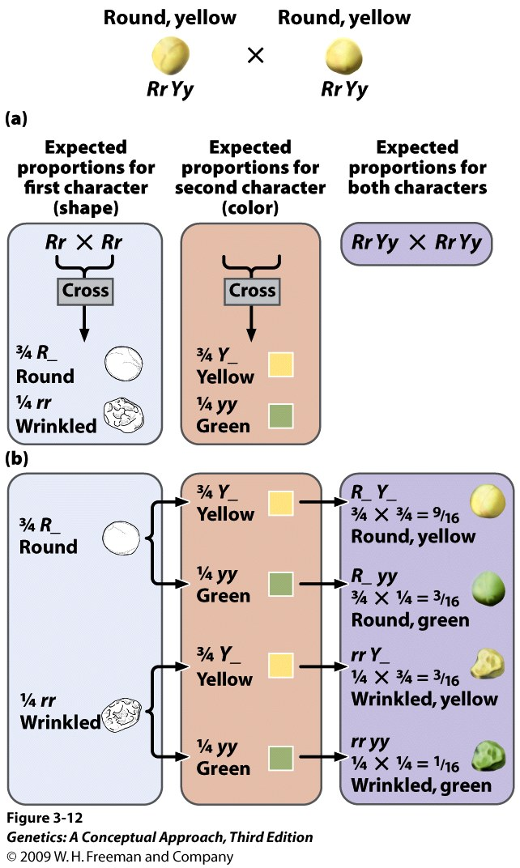
The Product Rule
-The probability of independent events occurring together is the product of the probabilities of the individual events.

Slide 33
More than two traits
The probability of obtaining a particular phenotype from
Heterozygous F₁ self-fertilization (monohybrid):
Purple
flower
Green
seed
Round
seed
Tall
Plant
Green
pod
3/4
1/4
3/4
3/4
3/4

Slide 34
The Sum Rule
-The probability of either of two mutually exclusive events occurring is the sum of their individual probabilities.
Example: What is the probability of obtaining homozygous
progeny from heterozygous “yellow seed” self-fertilization?
YY = 1/4 and yy = 1/4
1/4 + 1/4 = 1/2

Slide 35
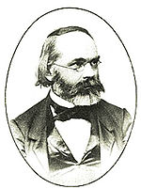
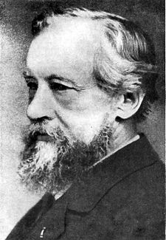
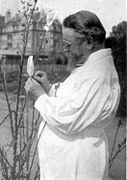
Epilogue
Mendel’s work was
published in 1865
Karl Wilhelm von Nägeli
Rediscovered in
1900
Hugo de Vries
Carl Correns

