Slide 1
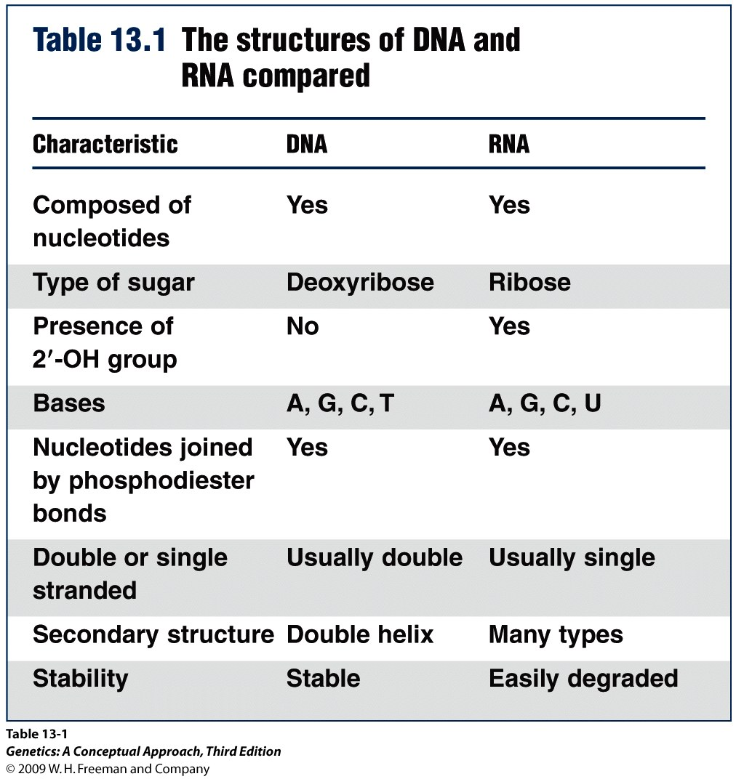

Slide 2
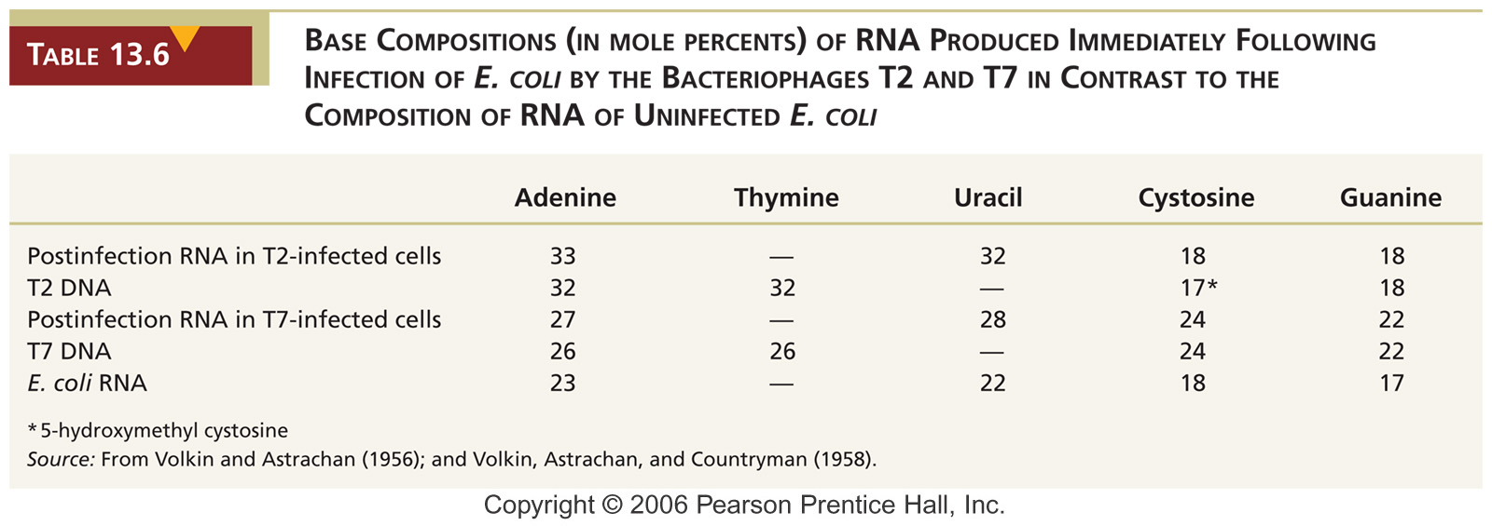
Evidences that mRNA is the intermediate
Volkin (1956) showed that, following phage infection, newly synthesized RNA has similar base composition as the phage DNA.

Slide 3
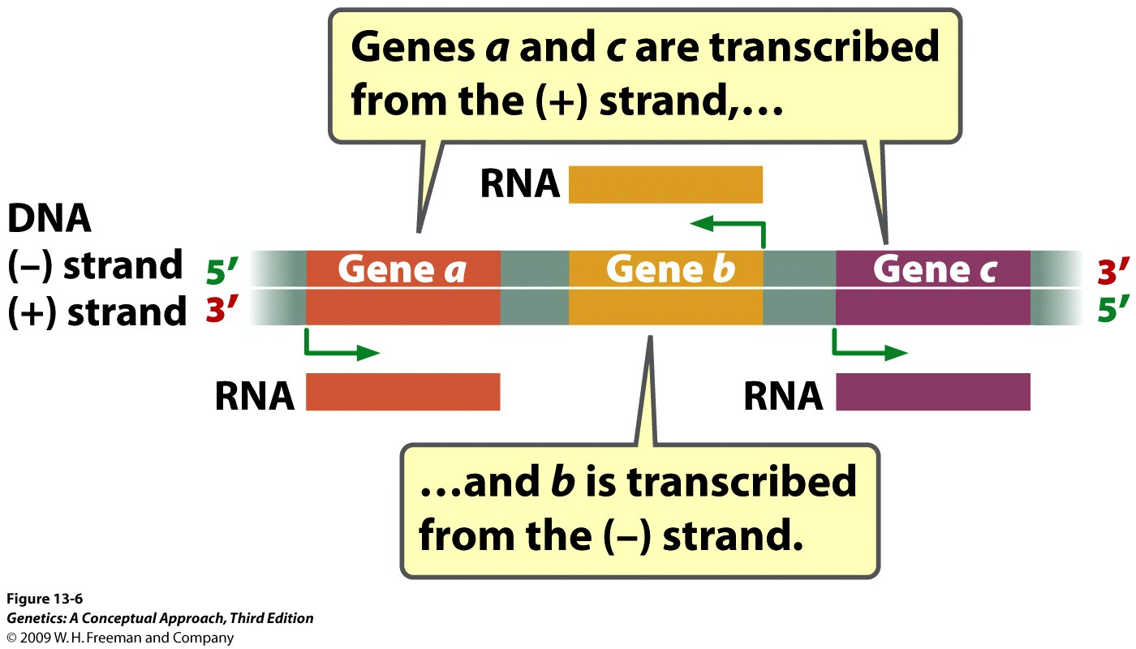
Transcription Synthesizes RNA on a DNA Template

Slide 4
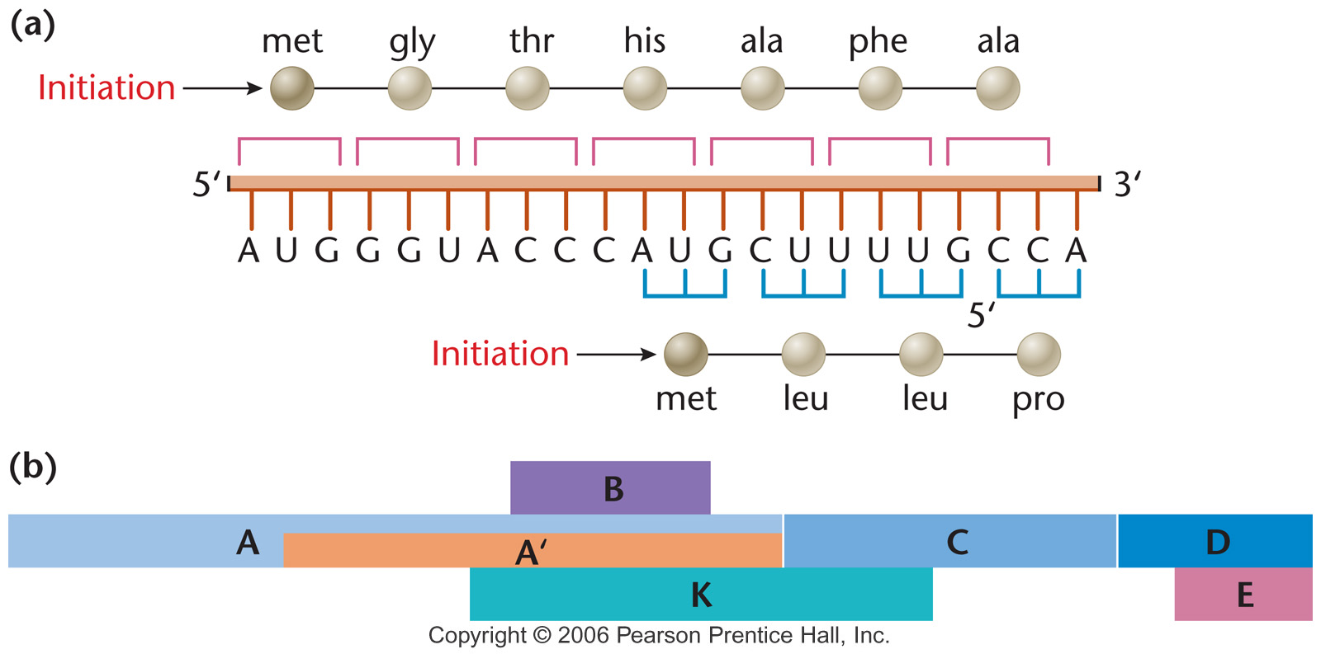
Overlapping Genes
In some viruses, overlapping genes have been identified.

Slide 5
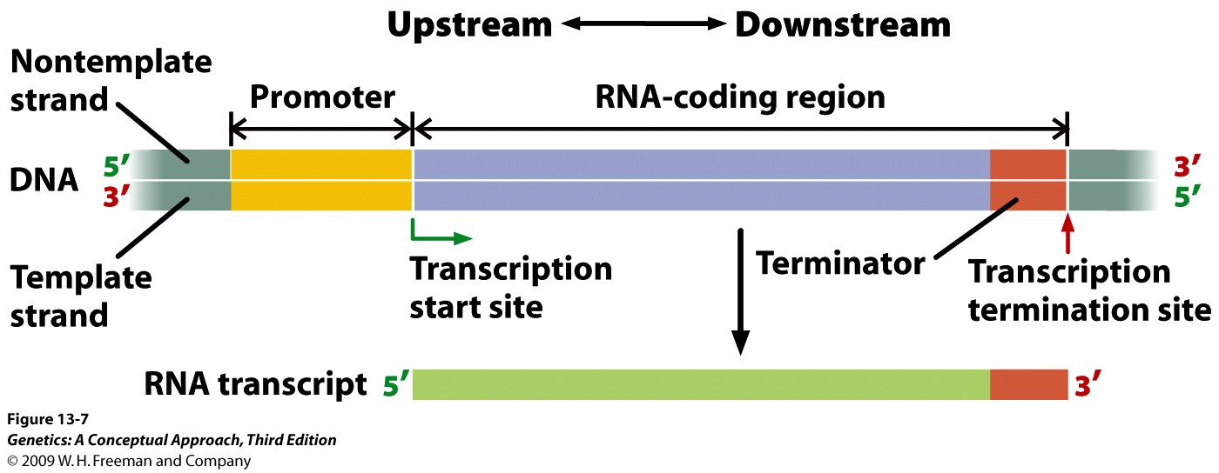
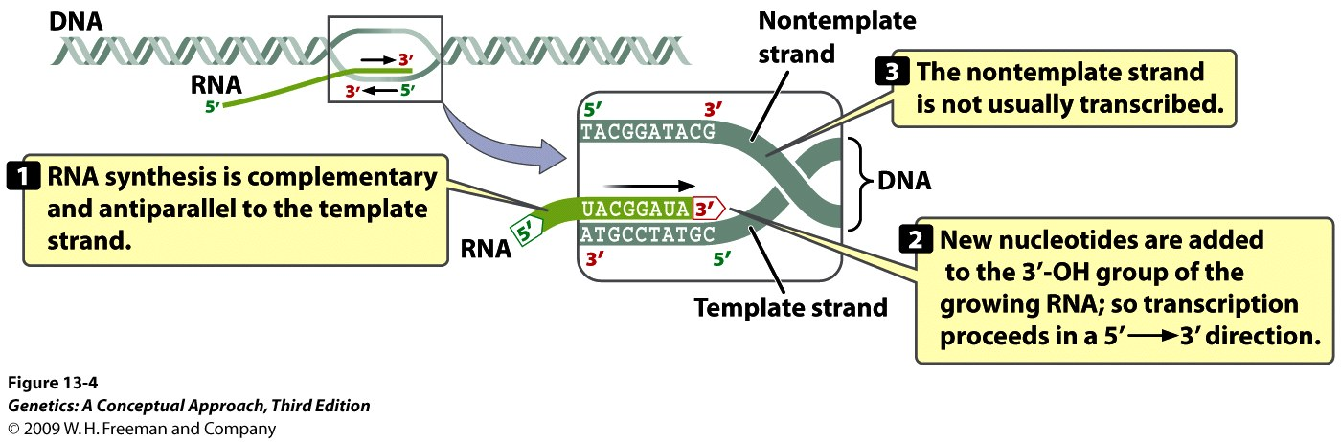
Notes:
Figure 13.7 A transcription unit includes a promoter, an RNA-coding region, and a terminator.

Slide 6
Prokaryotic RNA polymerase
RNA polymerase directs the synthesis of RNA using a DNA template.
No primer is required to initiation.
RNA polymerase from E. coli contains the subunits α₂, β, β', ω, and σ.
Transcription begins with template binding by RNA polymerase at a promoter. The σ subunit is responsible for promoter recognition.

Slide 7
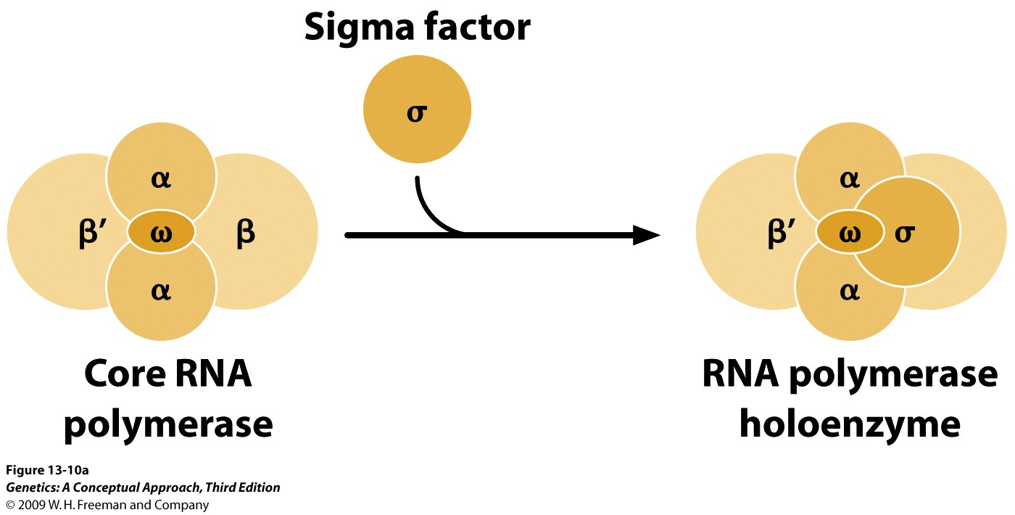
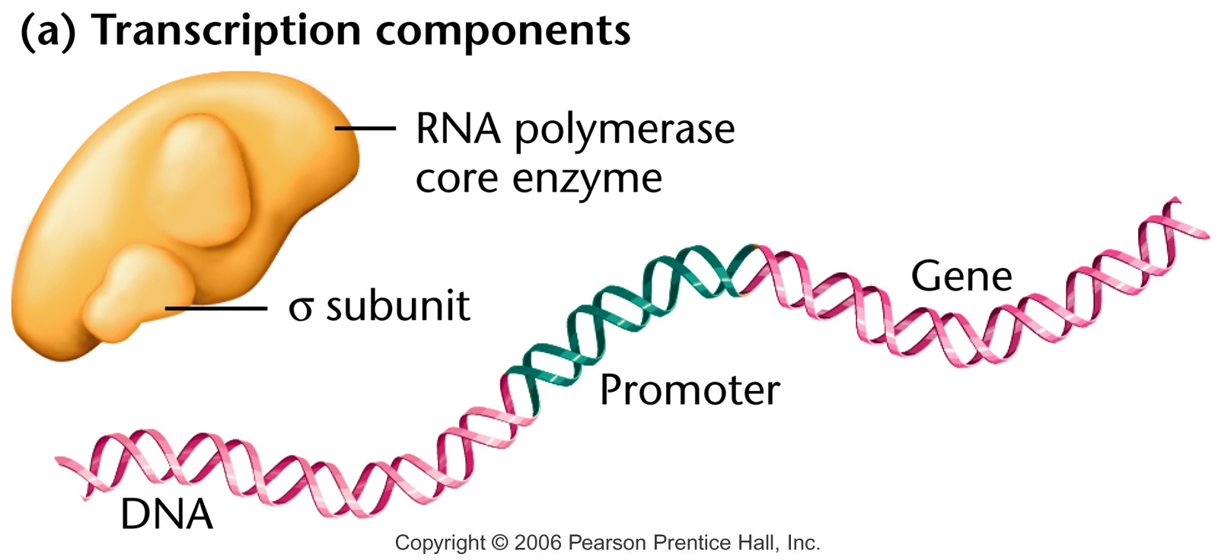
Notes:
Figure 13-9a The early stages of transcription in prokaryotes, showing (a) the components of the process; (b) template binding at the site involving the sigma subunit of RNA polymerase and subsequent initiation of RNA synthesis; and (c) chain elongation, after the sigma subunit has dissociated from the transcription complex and the enzyme moves along the DNA template.

Slide 8
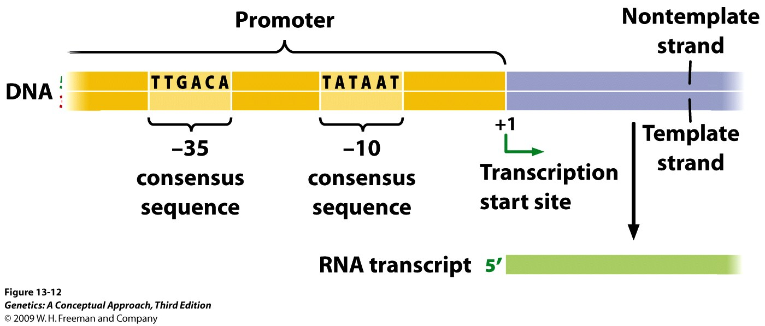
E. Coli promoters
E. coli promoters have two consensus sequences, TTGACA and TATAAT, positioned at –35 and –10 (Pribnow box) with respect to the transcription initiation site.

Slide 9
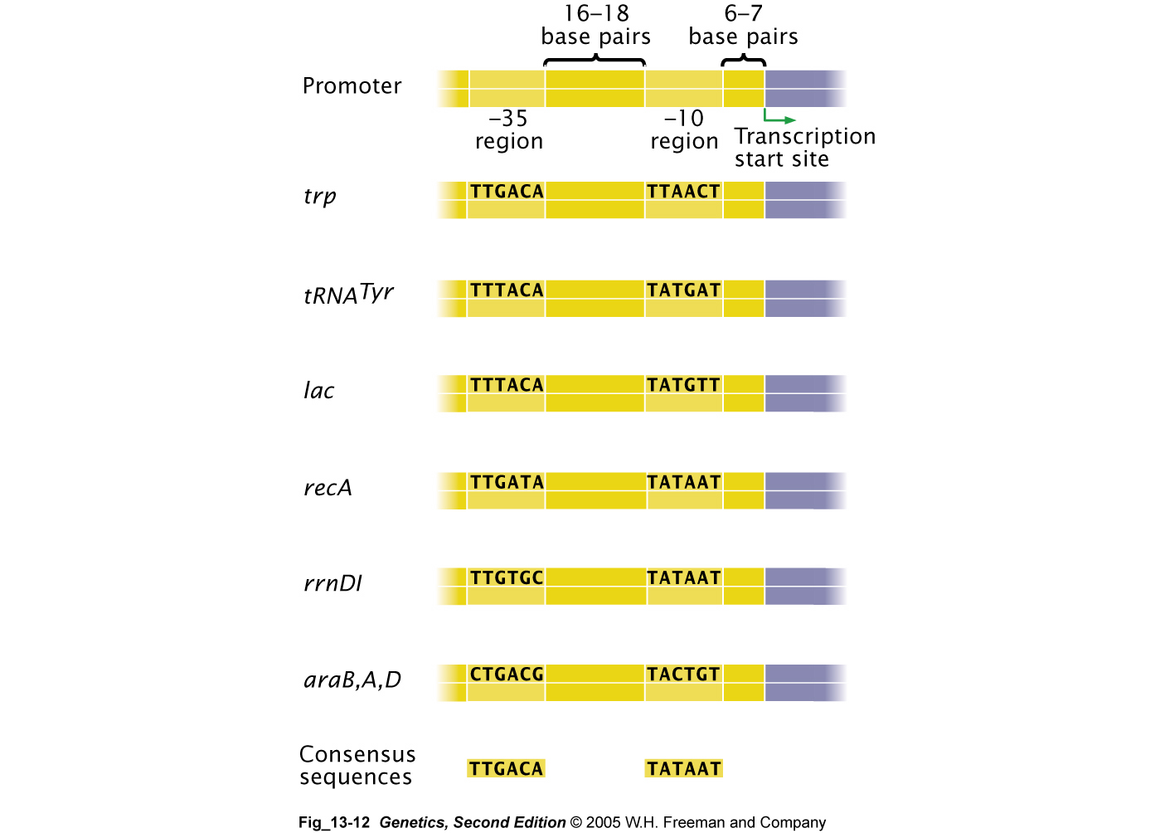
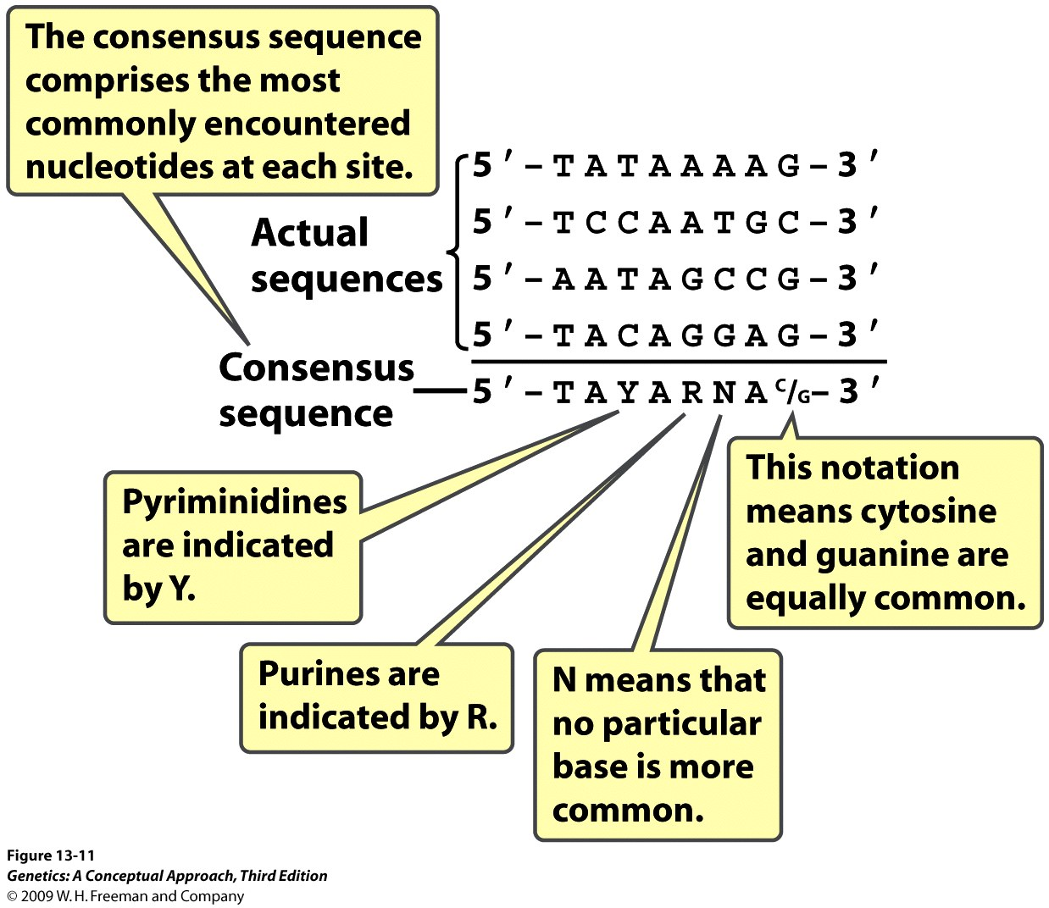

Slide 10
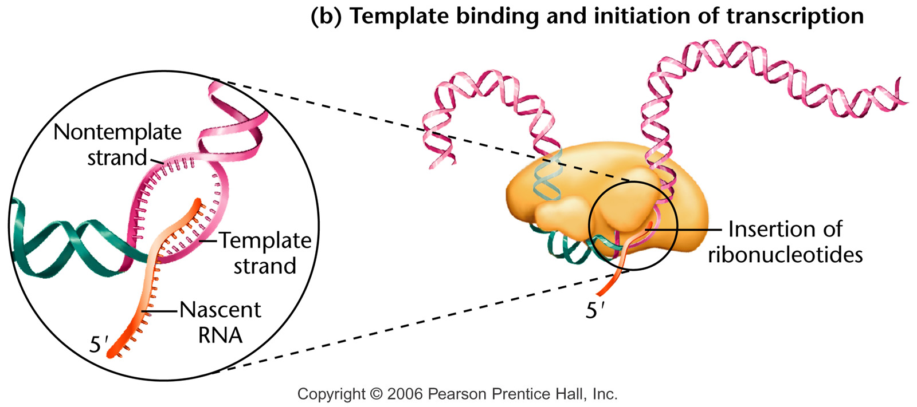
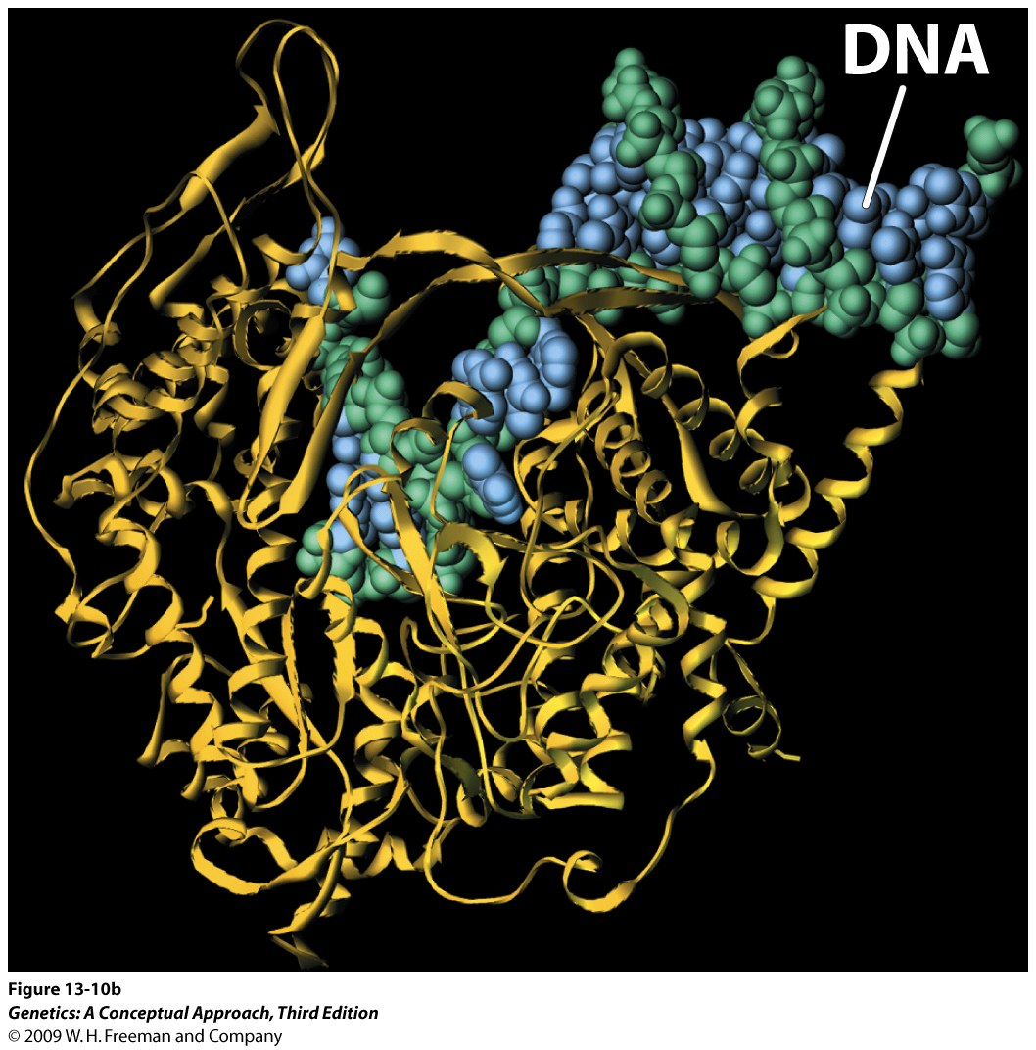
Transcription begins at the transcription start site, where the DNA double helix is unwound to make the template strand accessible.
Notes:
Figure 13-9b The early stages of transcription in prokaryotes, showing (a) the components of the process; (b) template binding at the site involving the sigma subunit of RNA polymerase and subsequent initiation of RNA synthesis; and (c) chain elongation, after the sigma subunit has dissociated from the transcription complex and the enzyme moves along the DNA template.

Slide 11
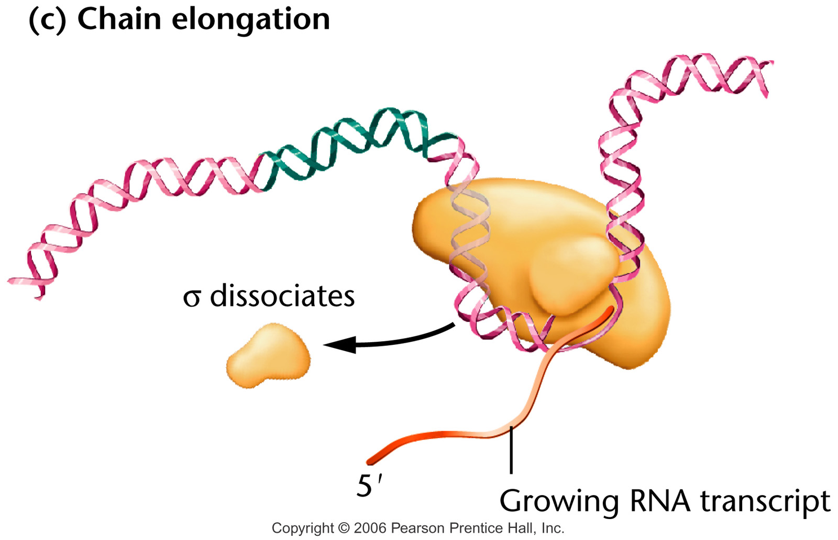
Once initiation has been completed with the synthesis of the first 8–9 nucleotides, sigma (σ) dissociates and elongation proceeds with the core enzyme
Notes:
Figure 13-9c The early stages of transcription in prokaryotes, showing (a) the components of the process; (b) template binding at the site involving the sigma subunit of RNA polymerase and subsequent initiation of RNA synthesis; and (c) chain elongation, after the sigma subunit has dissociated from the transcription complex and the enzyme moves along the DNA template.

Slide 12
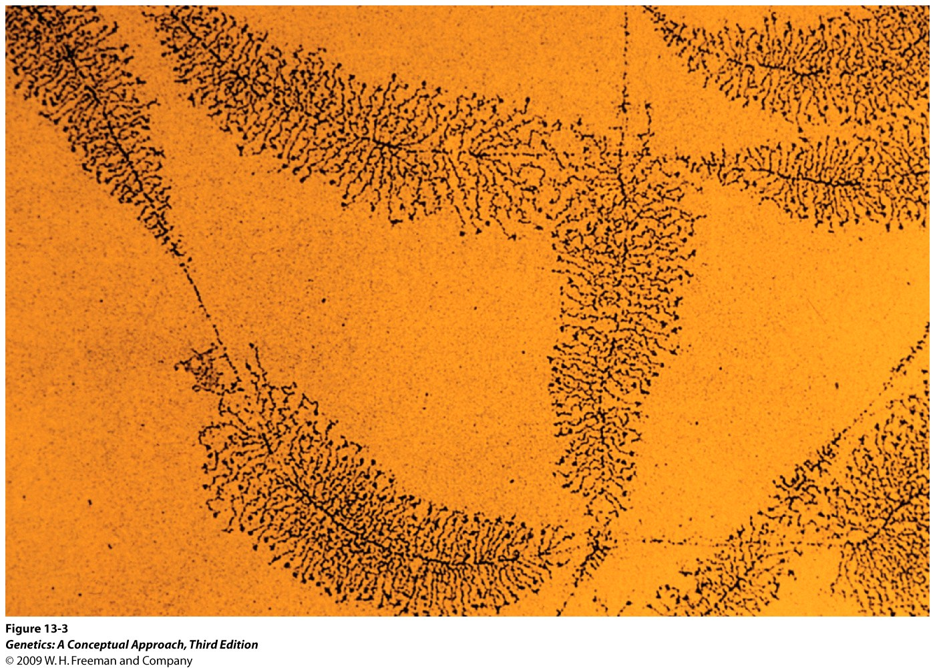
Notes:
Figure 13.3 Under the electron microscope, DNA molecules undergoing transcription exhibit Christmas-tree-like structures. The trunk of each “Christmas tree” (a transcription unit) represents a DNA molecule; the tree branches (granular strings attached to the DNA) are RNA molecules that have been transcribed from the DNA. As the transcription apparatus moves down the DNA, transcribing more of the template, the RNA molecules become longer and longer. [Dr. Thomas Broker/Phototake.]

Slide 13
Prokaryotic transcription termination
At the end of the gene, transcription terminates due to hairpin formation in the RNA (rho-independent termination).
In some cases, termination depends on the rho (ρ) termination factor.

Slide 14
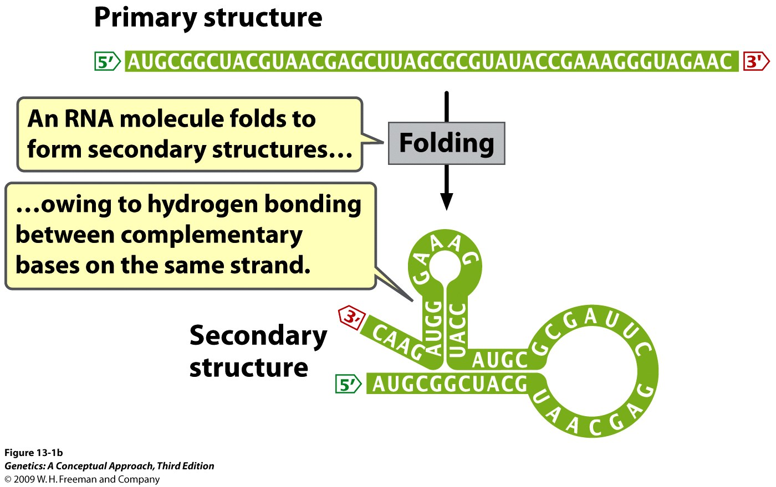
RNA can form secondary structure
Notes:
Figure 13.1b RNA has a primary and a secondary structure.

Slide 15
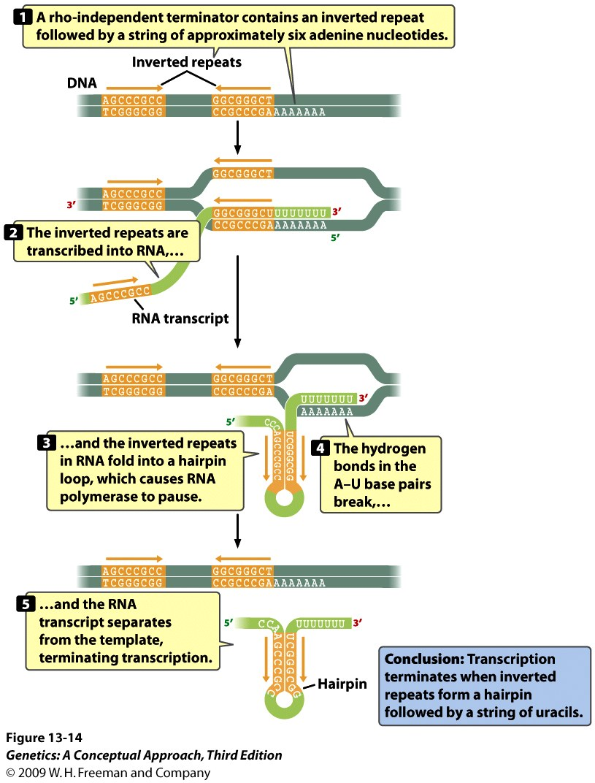
Rho-independent
termination
Notes:
Figure 13.14 Termination by bacterial rho-independent terminators is a multistep process.

Slide 16
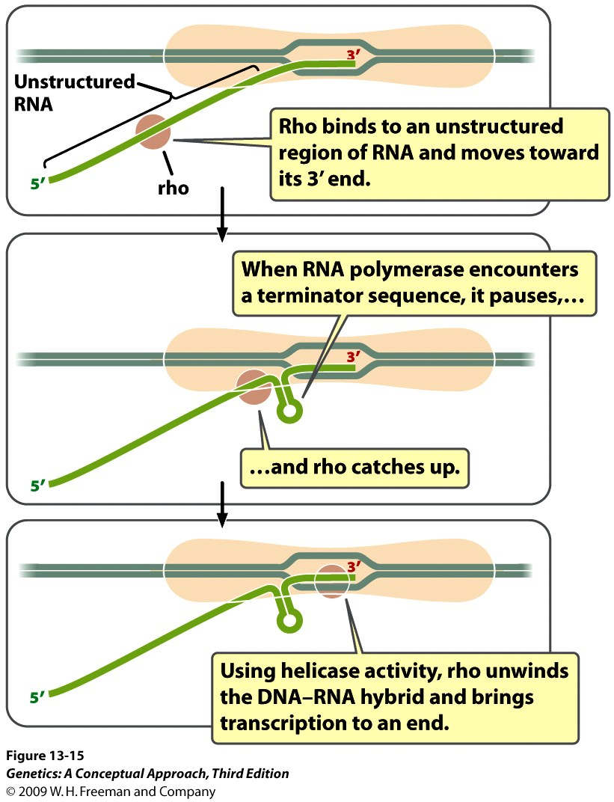
Rho-dependent
termination
Notes:
Figure 13.15 The termination of transcription in some bacterial genes requires the presence of the rho protein.

