Slide 1
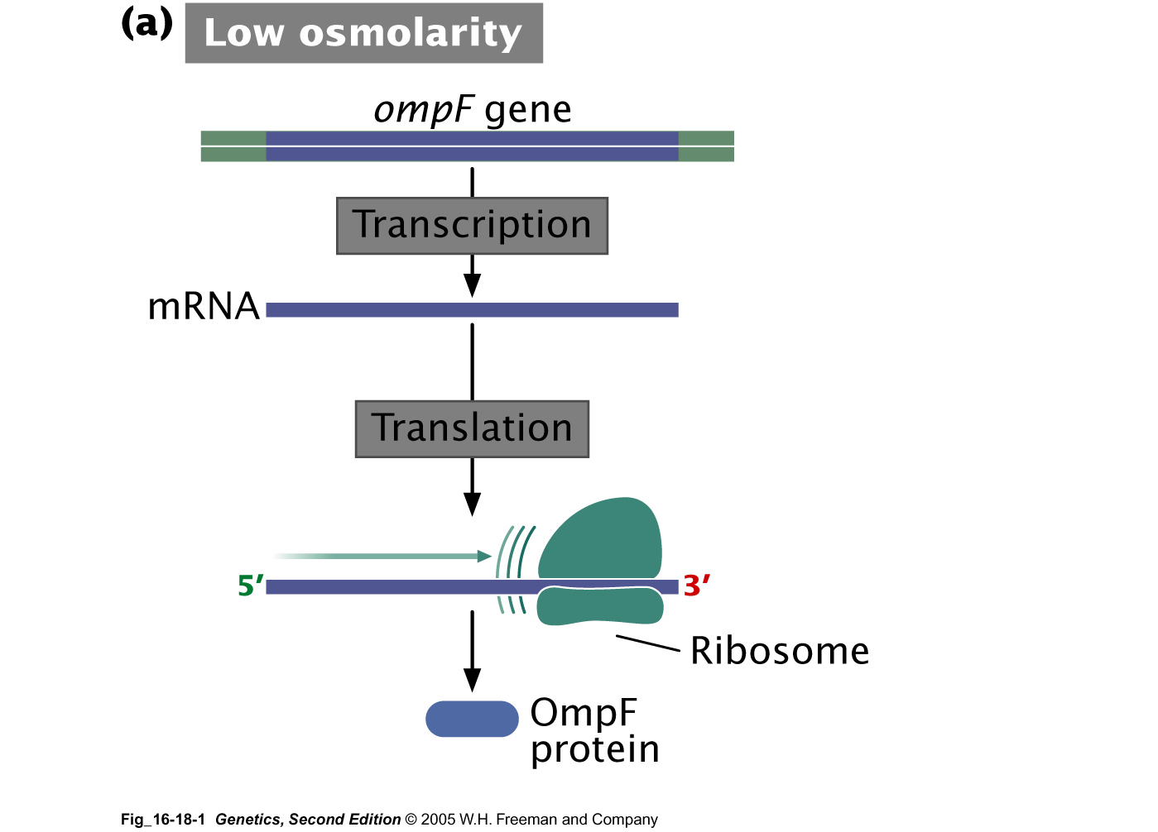
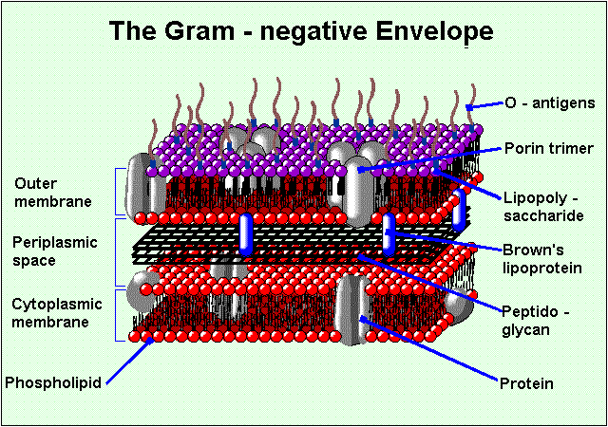
Regulation by antisense RNA

Slide 2
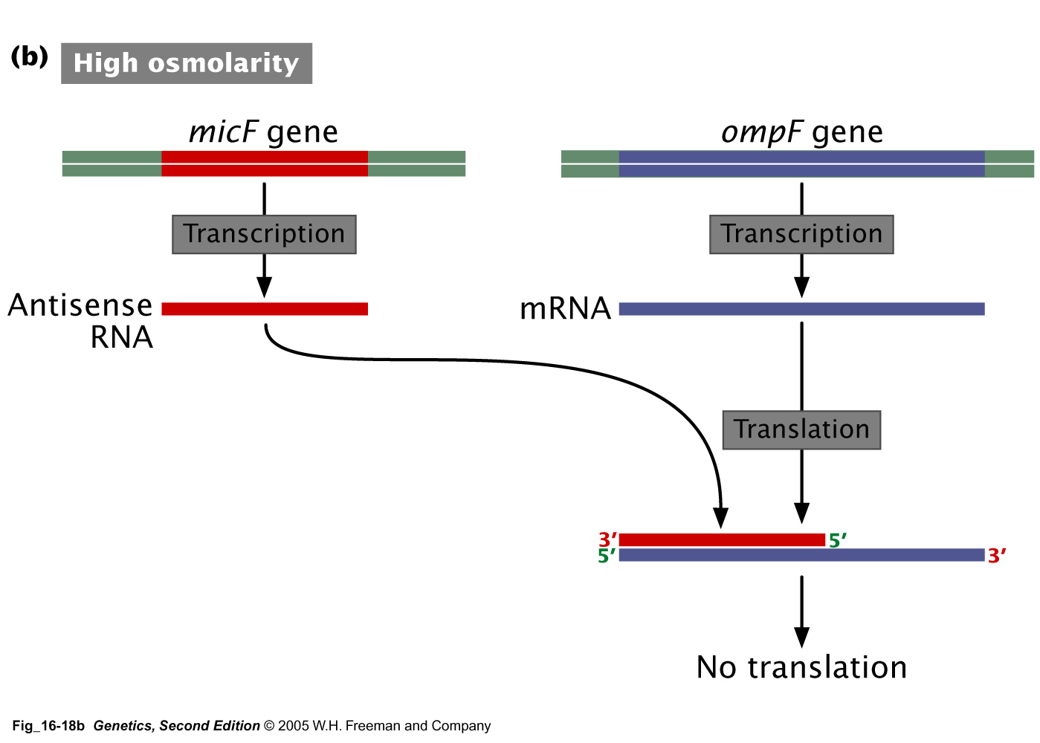

Slide 3
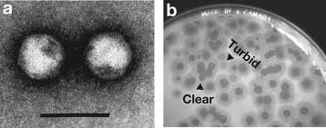
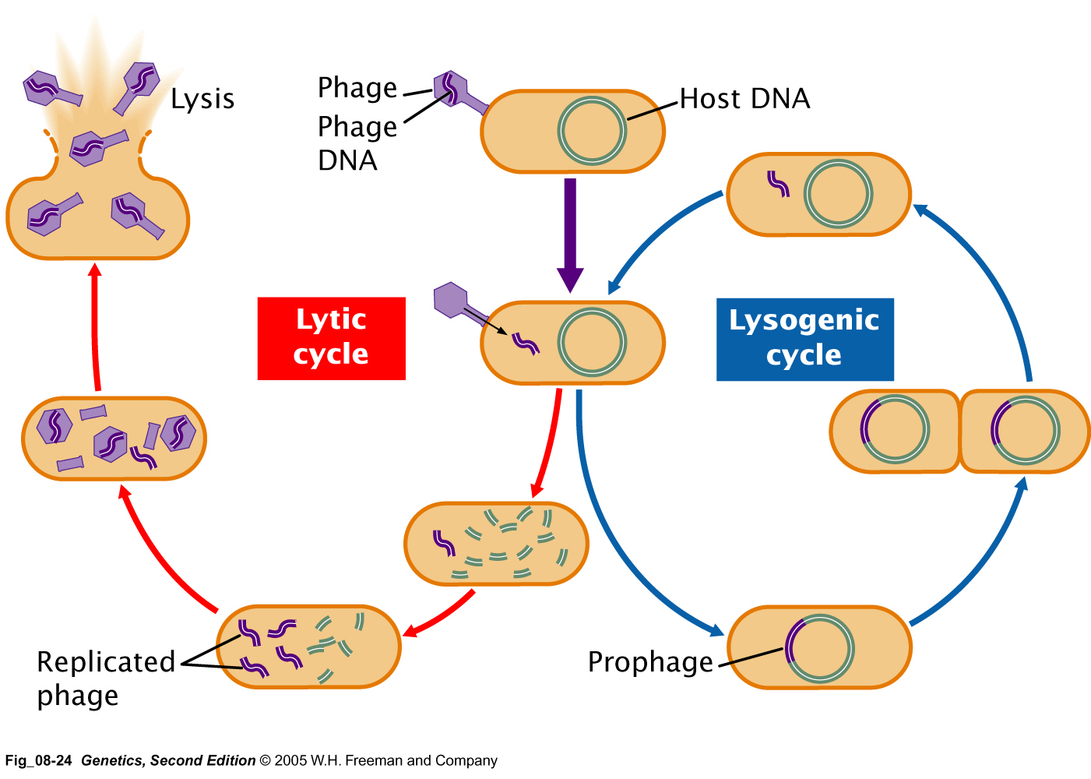
Phages can enter lytic or lysogenic cycles

Slide 4
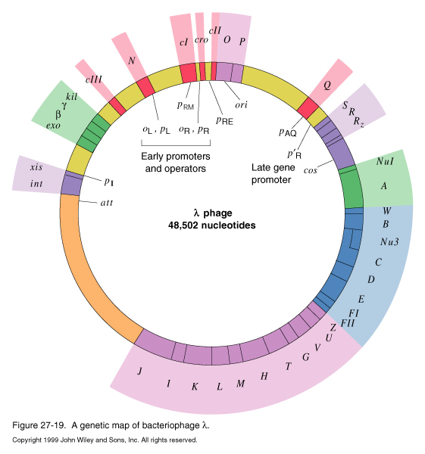
Genome of phage lambda

Slide 5
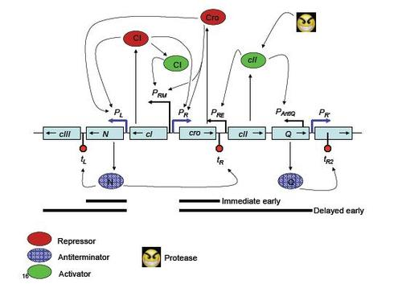

Slide 6
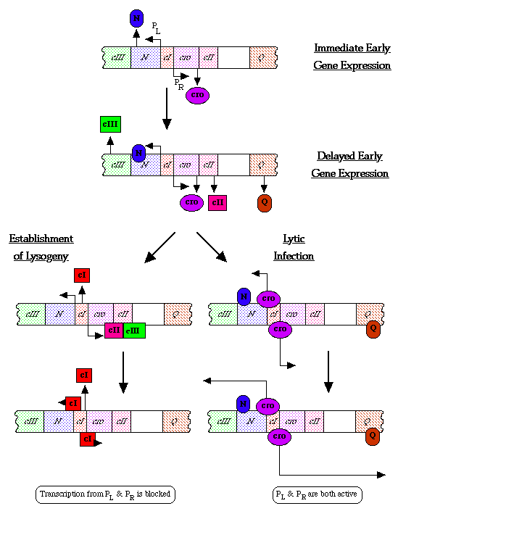

Slide 7
Lytic or lysogenic cycle?
    The decision between lysis and lysogeny depends on the race between two early genes, CII and cro.
    CII degrades easily and is sensitive to the presence of proteases when nutrient level is abundant. When CII is degraded, cro accumulates and inhibits the expression of genes required for lysogeny, and the phage enters the lytic cycle.
    On the other hand, when the nutrients are scarce, CII is stabilized and activates the expression of CI, the λ repressor. The λ repressor inhibits the expression of genes required for the lytic cycle and the phage enters lysogeny.

Slide 8
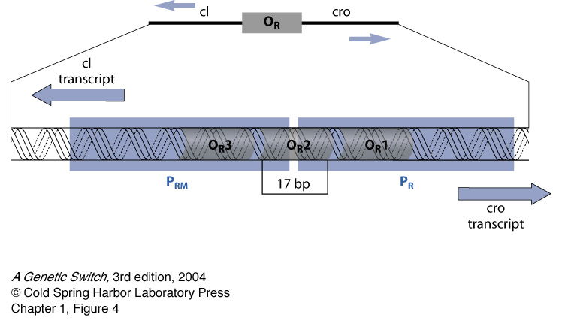
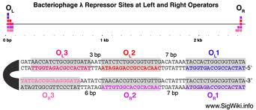
λ operators

Slide 9
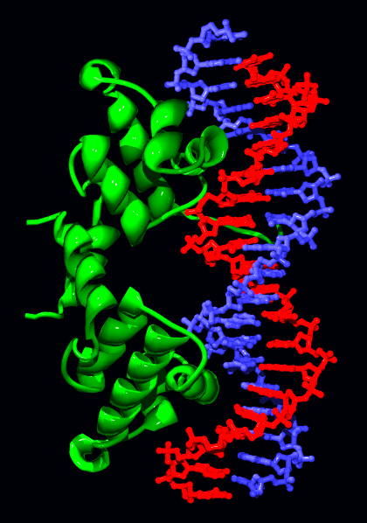

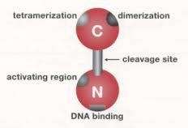
λ Repressor

Slide 10
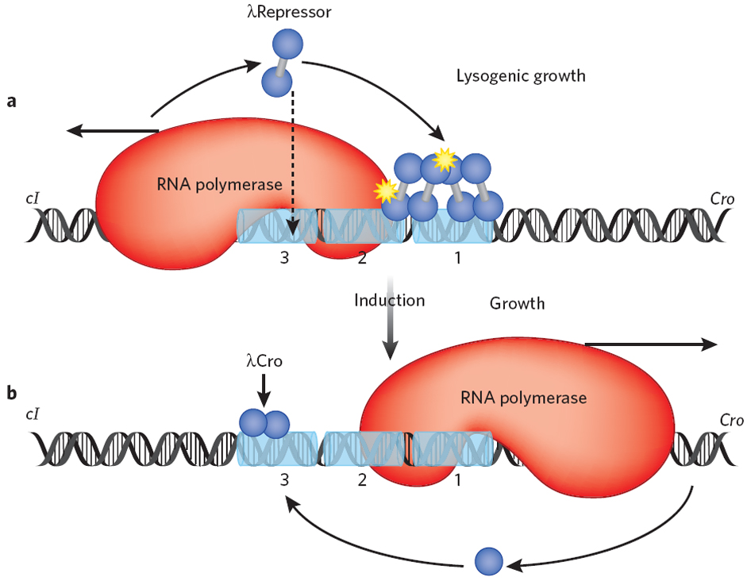
A genetic switch

Slide 11
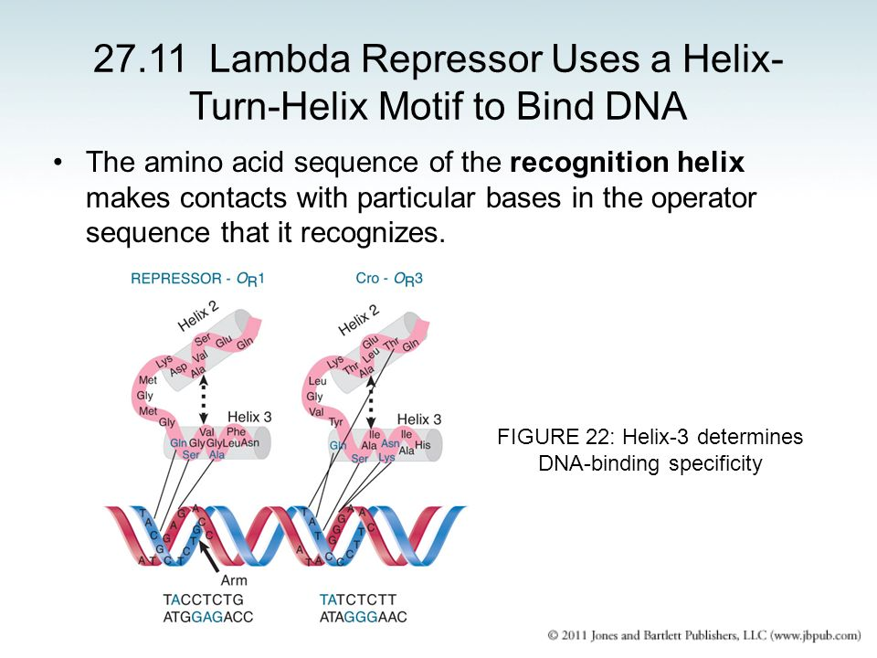

Slide 12
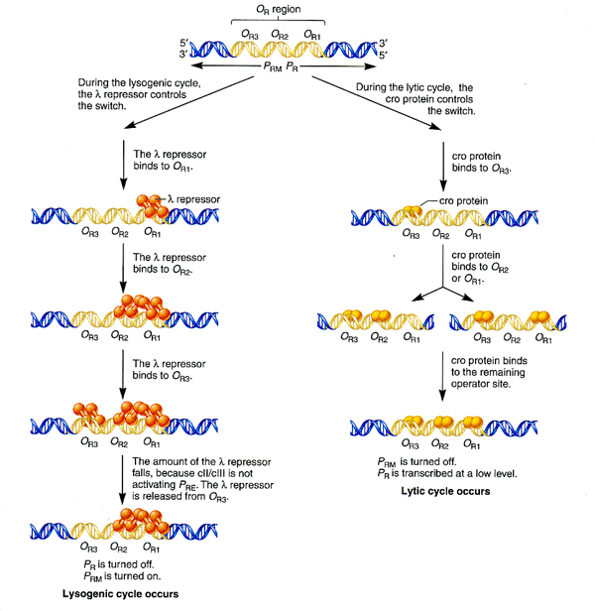

Slide 13
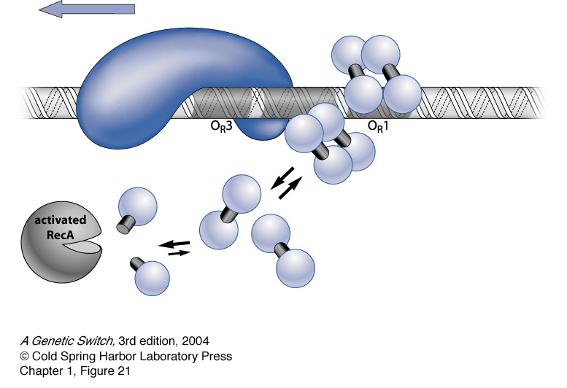
Prophage excises when the host cell is under stress

