Slide 1
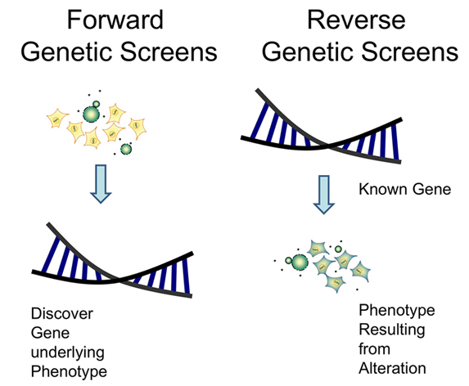

Slide 2
Rationale for Analyzing Model Organisms
Evolutionary conservation of gene functions: gene sequences are conserved from yeast to higher vertebrates and carry out similar functions.
Logistics: good model organism for genetic analysis must be easy to grow, have a short generation time, produce abundant progeny, and be readily mutagenized and crossed.

Slide 3
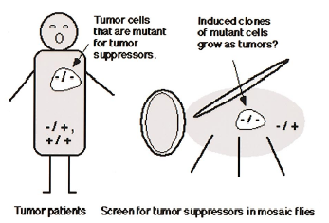
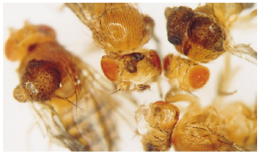

Slide 4
The Most Important Key to Success
Model Organisms
Ease of cultivation,
Rapid Reproduction,
Small size,
Fecund (large brood size),
Mutants are available and easy to identify,
Broad literature and experimental background available.
Use a model organism that is suitable for the question you are interested in.

Slide 5
Genome sequenced
Yeast (1996), E. coli (1997), Worm (1998), Fly (2000), Arabidopsis (2002), Mouse (2002)
Organism DNA Gene Common with Human X-some
E. coli 4.6mb 4,288 8% 1 (cir)
Yeast 12mb 6144 25% 16
C. elegans 103mb 20,500 25% 6
Drosophila 175mb 14,000 ~50% 4
Mouse 2,600mb 26,762 99% 20
A. thaliana 125mb 25,700 18% 5

Slide 6
Genetic analysis
Complementation tests define the number genes disrupted by mutations isolated.
Meiotic mapping (e.g. 3-factor cross) places mutations in specific locations in the genome.
Epistasis tests determine the order of gene functions.
Other genetic interactions (e.g. suppression).

Slide 7

Screens for cell death mutants
in C. elegans
Apoptosis plays an important role in development
Histogenic cell death: up to a half of the neurons normally die during development of parts of the brain.
Phylogenic cell death: the loss of the vertebrate tail during human fetal development.
Morphogenic cell death: the loss of mesenchyme between the digit.
Cancer: damaged precancerous cells are removed by programmed cell death.

Slide 8
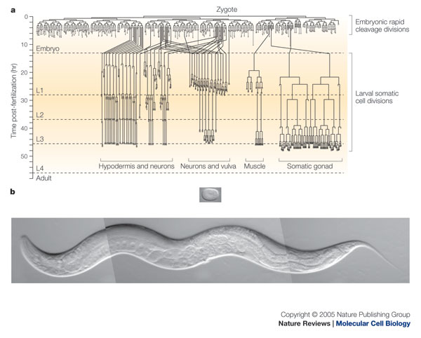
C. elegans develops from an invariant lineage

Slide 9
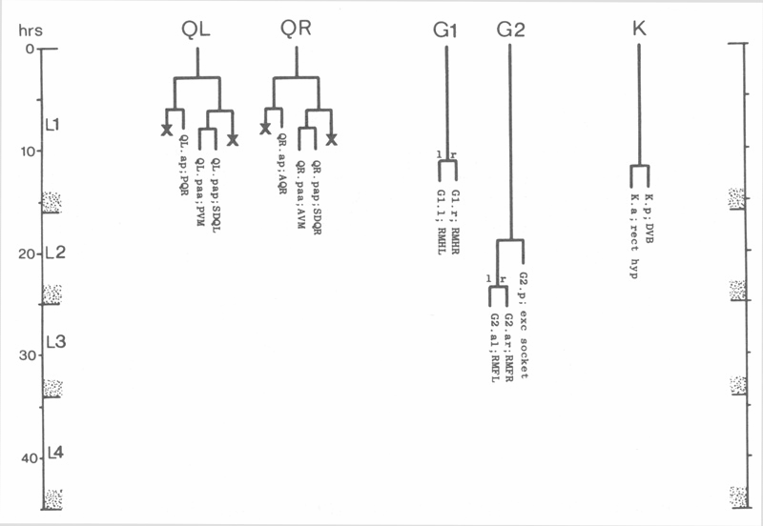
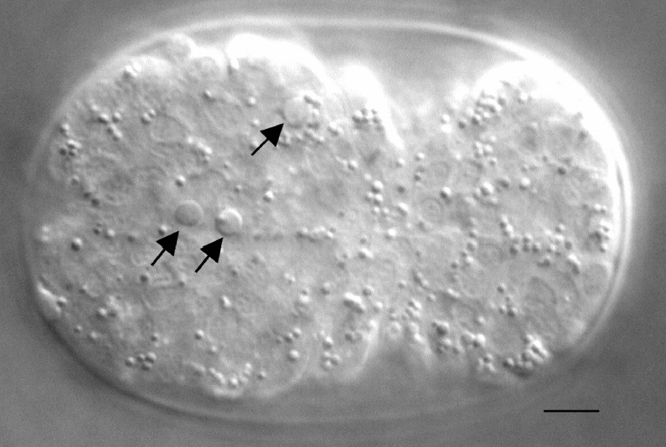
131 cells undergo apoptosis or programmed cell death
in the C. elegans hemaphrodite.
The cell deaths are indicated by Xs in the lineage.
Cell corpses can be observed by Nomarski optics

Slide 10
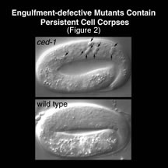
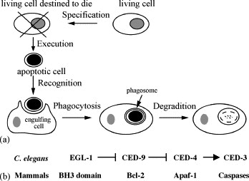
Disruption of engulfment genes results in persistent corpses.

Slide 11
Screens for apoptosis mutants took advantage of the persistent corpses in ced-1 mutants.
Engulfment mutant
apoptosis
engulfment
X
persistent corpse
Engulfment; apoptosis double mutant
apoptosis
engulfment
X
X
no persistent corpse

Slide 12
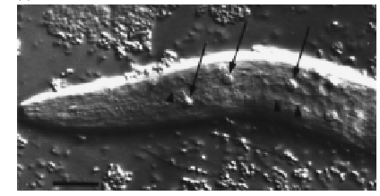
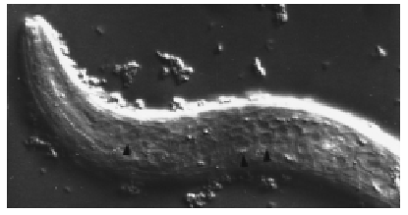
ced-3(lf) suppresses the engulfment defects of ced-1
ced-1/ced-1
ced-1/ced-1; ced-3/ced-3
Arrowheads indicate extra cells

Slide 13
In ced-3(lf), ced-4(lf), ced-9(gf) and egl-1(lf) mutants
all 131 cells that normally die survive.
+/+ ced-3/ced-3
Q neuroblast
Q neuroblast
X N
X
N N
N
N N
N N

Slide 14
Epistasis to order gene functions
ced-3 promotes apoptosis
ced-9 inhibits apoptosis
ced-9
ced-3
cell death
ced-3
ced-9
cell death
ced-3 ced-9
cell death
Prediction: ced-3(lf); ced-9(lf) intermediate phenotype
Prediction: ced-3(lf); ced-9(lf) animals survive and have no apoptosis
Prediction: ced-3(lf); ced-9(lf) animals die because of extensive apoptosis

Slide 15
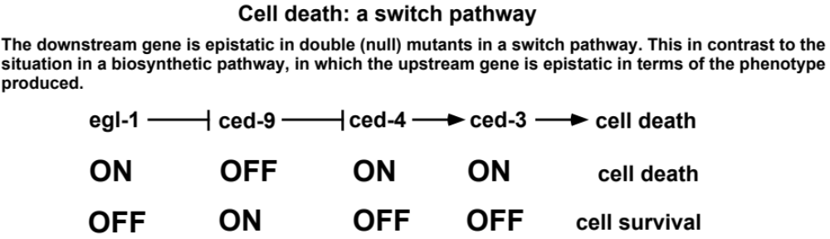
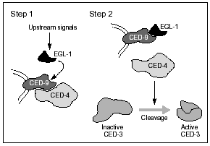
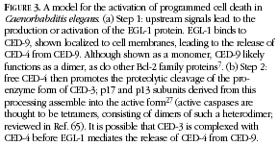

Slide 16
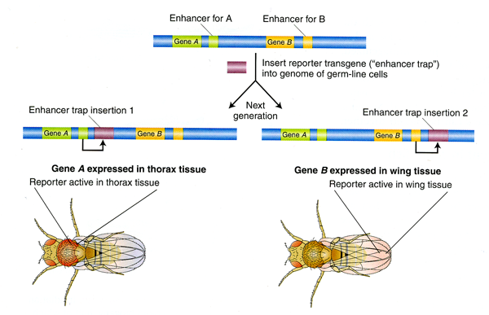
Enhancer trap
Enhancer trap:
An expression pattern-based screen

Slide 17
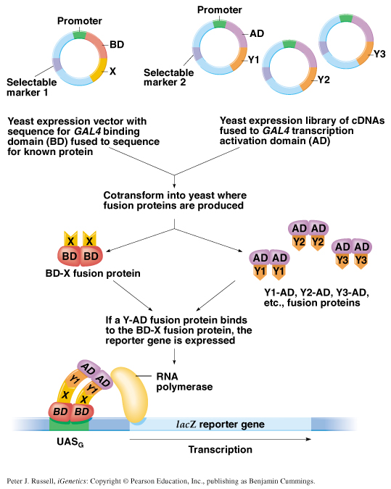
Fig. 8.3 The yeast two-hybrid system for detecting protein-protein interactions
Chapter 8 slide <number>
Peter J. Russell, iGenetics: Copyright © Pearson Education, Inc., publishing as Benjamin Cummings.

Slide 18
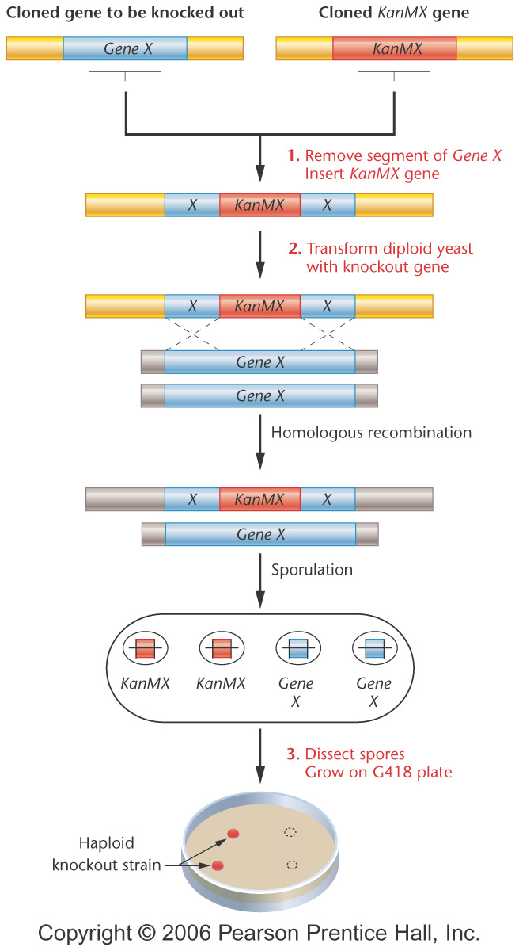
Generation of specific mutants by homologous recombination in yeast.
Reverse Genetics:
Notes:
Figure 21-17 Targeted gene knockout in yeast. The KanMX gene is inserted into a cloned copy of the gene to be disrupted (Gene X). The KanMX-disrupted Gene X is transformed into diploid yeast cells. Homologous recombination occurs between the cloned knockout gene and one chromosome of the diploid yeast cell, yielding a heterozygous knockout yeast strain. After sporulation, the four haploid spores are dissected from the ascus and grown on a plate containing medium and the antibiotic G418. Any spores that grow contain the KanMX-disrupted Gene X.

Slide 19
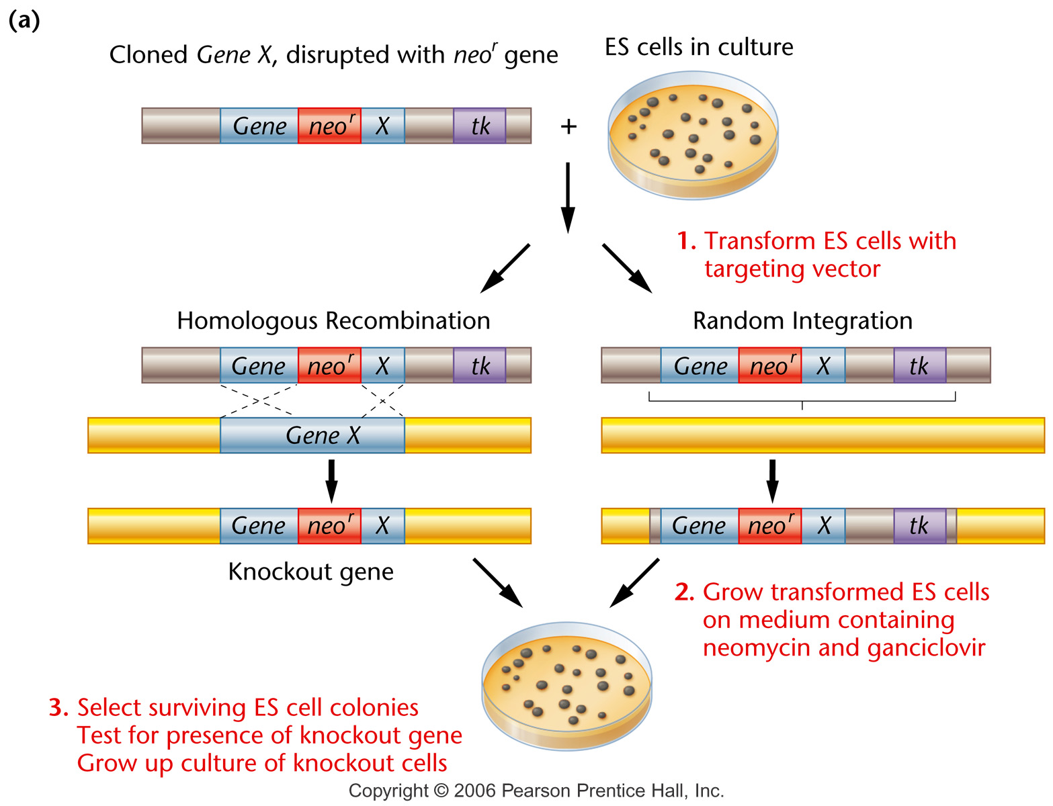
Homologous Recombination: Mouse
Notes:
Figure 21-18a Creating a knockout mouse. (a) Inserting the knockout gene into embryonic stem (ES) cells. ES cells are derived from an agouti (brown) mouse. (b) Creating the knockout mouse strain from knockout ES cells.

Slide 20
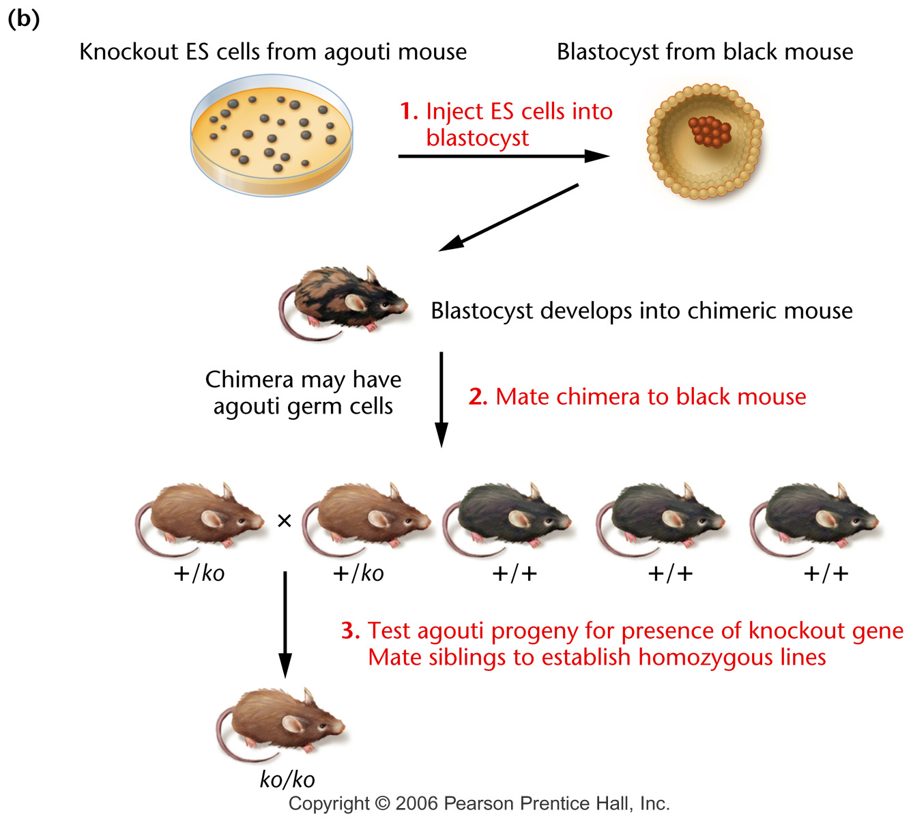
Homologous Recombination: Mouse
Notes:
Figure 21-18b Creating a knockout mouse. (a) Inserting the knockout gene into embryonic stem (ES) cells. ES cells are derived from an agouti (brown) mouse. (b) Creating the knockout mouse strain from knockout ES cells.

Slide 21
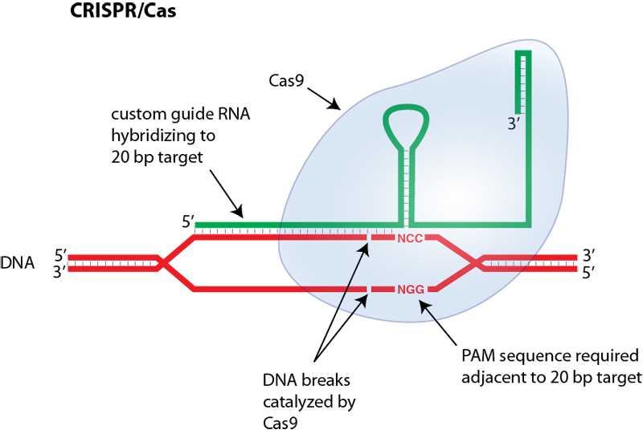
Genome editing (CRISPR/Cas)

Slide 22
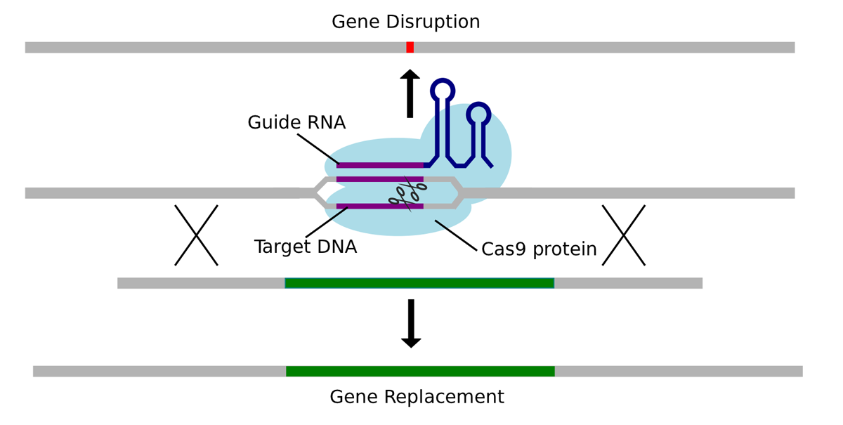
Genome editing (CRISPR/Cas)

Slide 23
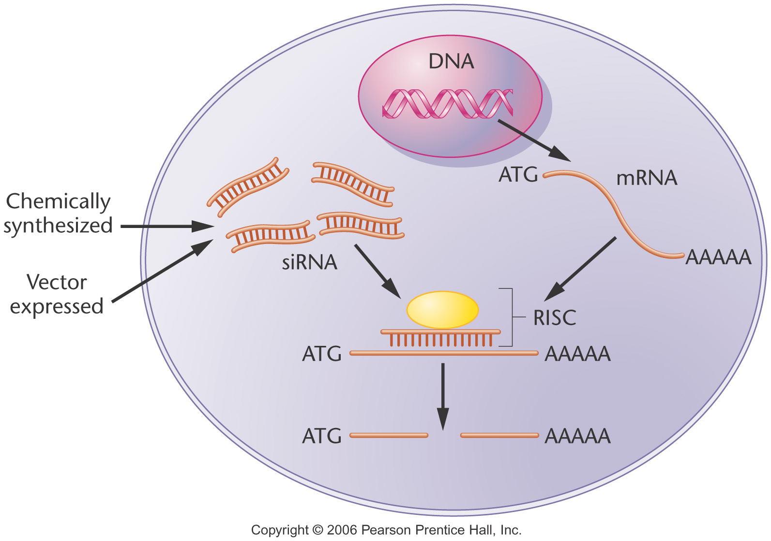
RNAi
RNA interference (RNAi) allows the silencing of single genes to allow rapid analysis of gene function.
Short synthetic double-stranded RNA molecules are introduced into cells, become part of the RNA-induced silencing complex (RISC), and trigger the RNA degradation pathway.

Slide 24
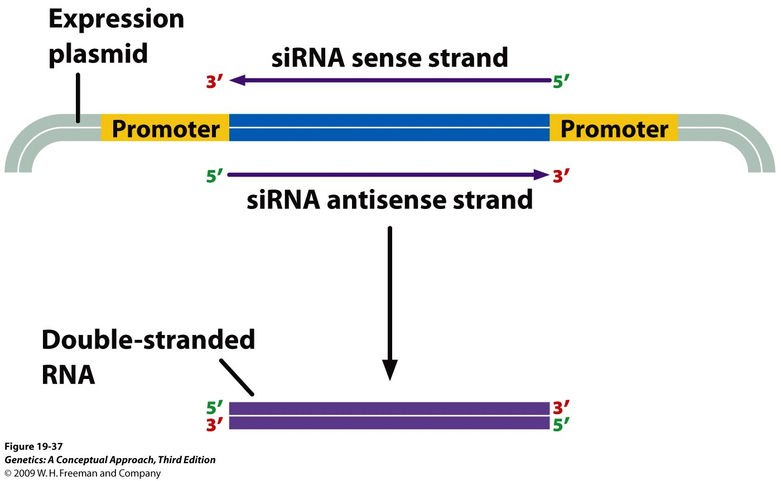
Notes:
19.37 SiRNAs can be produced by cloning DNA sequences corresponding to the siRNAs between two strong promoters. When cloned into an expression vector, both DNA strands will be transcribed and the complementary RNA molecules will anneal to form double-stranded RNA that will be processed into siRNA by Dicer.

Slide 25
Functional genomics
Genome-wide approach to understand biological processes and gene functions.
Example: Knock-down of gene functions by high throughput RNAi.
Advantages
Ploidy is not a concern.
The identification of genes is instantaneous.
Disadvantages
The level of knock-down needs to monitored.
Interferon and off-target effect. The specificity of knock-down needs to monitored.

