Slide 1
CHE320
Statistical Modeling
and
Quality Enhancement
Instructor: Jayanta (Joy) Chakraborty
Office: FRNY 1158
Office hours: Tuesdays 5:30-6:30

Slide 2
Course objectives
Develop and apply statistical methods, including designing experiments and building models from experimental data for use in the chemical process industries.
Get expertise in JMP (a statistical software) so that quick and accurate statistical analyses can be carried out.
Work in a team to execute a project successfully.

Slide 3
Accreditation Board for Engineering and Technology (ABET) syllabus
Statistical modeling methods, design of experiments, error analysis, curve fitting and regression, analysis of variance, confidence intervals, quality control and enhancement, emphasizes preparation for designing chemical engineering laboratory experiments and analyzing data

Slide 4
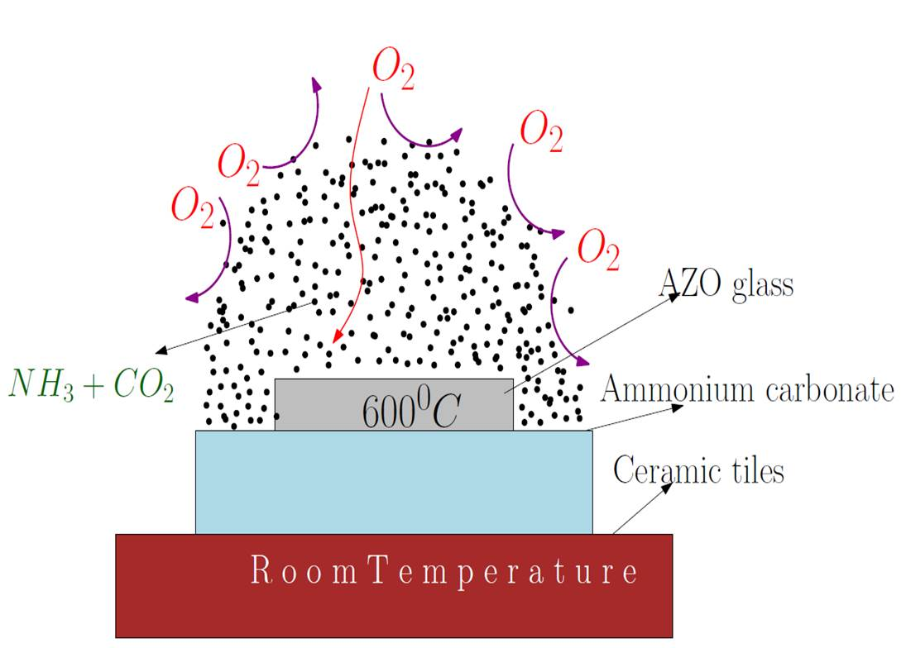
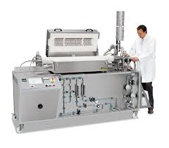
Case study:
conducting glass for amorphous silicon solar cells
Representative picture. Obtained from Google Images

Slide 5
Our glass vs. glasses available in the market
“We are interested in your method and would like to try it for ourselves. But before we make any
Commitments, we need definite proof from you that the quality of the glasses prepared by
JCLabs is better than (or at least as per) those available from AZOMAN.”
Because we conduct laboratory experiments, (everything is manual)
we could prepare only 70 glass samples.
With another weeks effort we can make another 30.
Commercial supplier (AZOMAN) sells box containing minimum
of 1000 glass pieces!
How can we obtain the definite proof?

Slide 6
The definite proof…
Compare our best sample of our lot (70) with the worst of the commercial lot (1000). It turns out that our best sample is better than the worst commercial sample tested.
Compare the average of our sample with average of commercial sample. It
turns out that average of our samples is slightly inferior to the commercial
samples. But we could test only 10 out of 70 glasses from our lot and 10
out of the 1000 commercial glasses. If we increase number of samples will
the situation change?
Increase the number of trials in lab until we get one glass which is better
than the average of the commercial samples. Note the operating condition
and reproduce it in to to so that all glasses made by us is better than the
average commercial glass (fails! The “best practice” sometime made worst
glass!!!)
Show me the way!

Slide 7
Statistical methods tells us how to obtain a suitable sample,
obtain the mean and get an quantitative idea on variability
of the observations.
And many more….

Slide 8
Variability
By variability, we mean successive observations of a system or phenomenon do not produce exactly the same result.
Statistics gives us a framework for describing this variability and for learning about potential sources of variability.

Slide 9
Probability and statistics
The Field of Probability
Used to quantify likelihood or chance
Used to represent risk or uncertainty in engineering
applications
Can be interpreted as relative frequency
The Field of Statistics
Deals with the collection, presentation, analysis, and
use of data to make decisions and solve problems.

