Slide 1
Lab 4

Slide 2
Lab 3 solutions

Slide 3
Poisson to exponential – New profiles being created in facebook
On an average, 5 new profiles are created every second!
Assume this to be a Poisson process

Slide 4

What is the probability that no new profiles were created in an interval of 3 seconds?
$P\left(X>3\right)= \int_{3}^{∞}{5e^{−5x}dx}= e^{−5(3)}=e^{−15}$

Slide 5

What is the probability that the time until the next new profile being created is between 1 and 1.5 seconds?
$P\left(1<X<1.5\right)=\int_{1}^{1.5}{5e^{−5x}dx=e^{−5}−e^{−7.5}}$

Slide 6

What is the interval of time such that probability that no profiles are created in the interval is 0.1?
$P\left(X>x\right)=e^{−5x}=0.1$

Slide 7
Joint distributions and independence
Example 3-40: The system here operates only is there is a path of functional components from left to right. The probability that each component functions is shown. Assume that the components function or fail independently. What is the probability that the system operates?
P(C1 or C2)
= 1-P(C1’,C2’)
= 1-P(C1’)P(C2’)
= 1-(0.1)(0.05)
= 0.995
C1
0.9
C2
0.95

Slide 8
The system operates only if there is a path of functional components from left to right. Assume independence. What is the probability that the system operates?
Block 2
Block 1:
1-(0.1)(0.2) = 0.98
Block 2:
Top part:
(0.2)(0.6) = 0.12
Bottom part:
(0.5)(1-(0.7)(0.8)) = 0.22
Net block 2:
1-(1-0.12)(1-0.22) = 0.31
Probability:
(0.98)(0.31)(0.9) = 0.27
0.12
Block 1
0.2
0.6
0.9
0.9
0.8
0.3
0.22
0.5
0.2

Slide 9
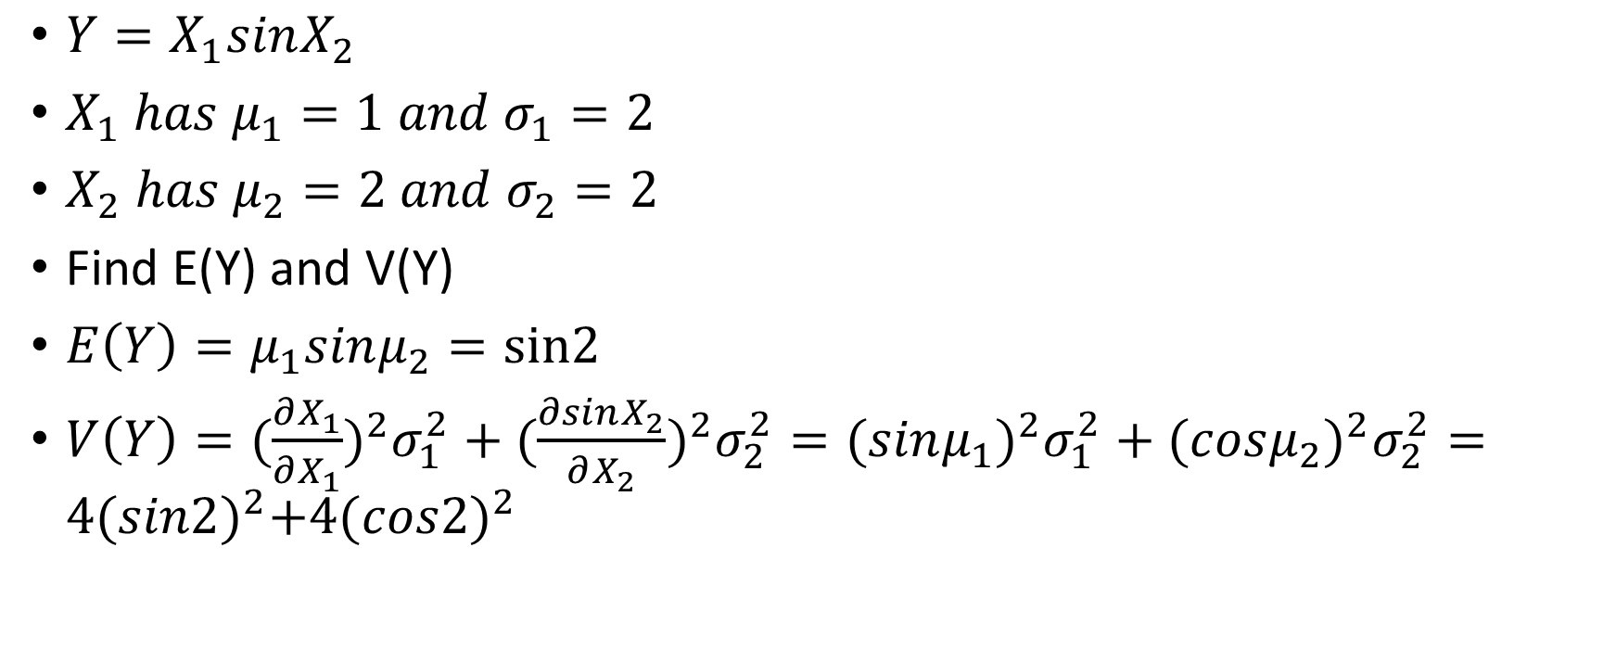
Functions of random variables
$Y=X_{1}sinX_{2}$
$X_{1} has μ_{1}=1 and σ_{1}=2$
$X_{2} has μ_{2}=2 and σ_{2}=2$
Find E(Y) and V(Y)
$E\left(Y\right)=μ_{1}sinμ_{2}=sin2$
$V\left(Y\right)=(\frac{∂X_{1}}{∂X_{1}})^{2}σ_{1}^{2}+(\frac{∂sinX_{2}}{∂X_{2}})^{2}σ_{2}^{2}={(sinμ_{1})}^{2}σ_{1}^{2}+{(cosμ_{2})}^{2}σ_{2}^{2}=4{(sin2)}^{2}+4(cos2)^{2}$

