Slide 1
Lecture 23:
Alcohols, ethers and thiols:
Nomenclature

Slide 2
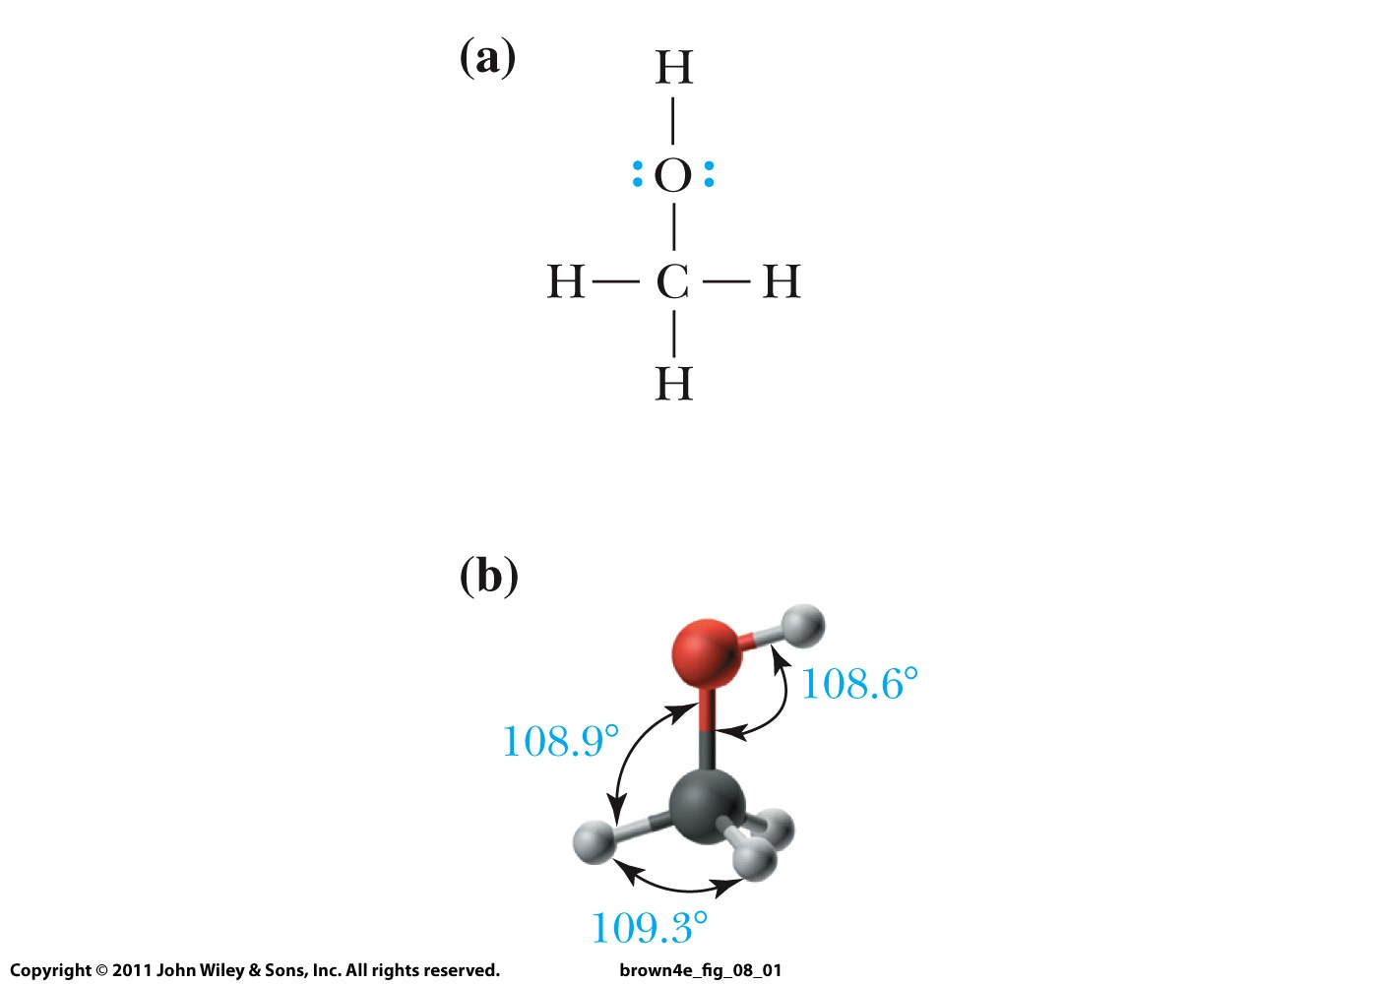
Alcohols

Slide 3
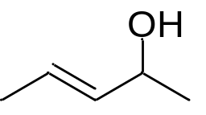
Nomenclature:
OH = hydroxyl functional group (to be used when an even
higher priority group is present)
Suffix = -ol
Ethane → ethanol
OH must get the lowest possible number
It takes precedence over alkyl groups, C=C bonds, halides
If necessary, indicate location of OH or SH just before “ol”:
3-buten-2-ol

Slide 4
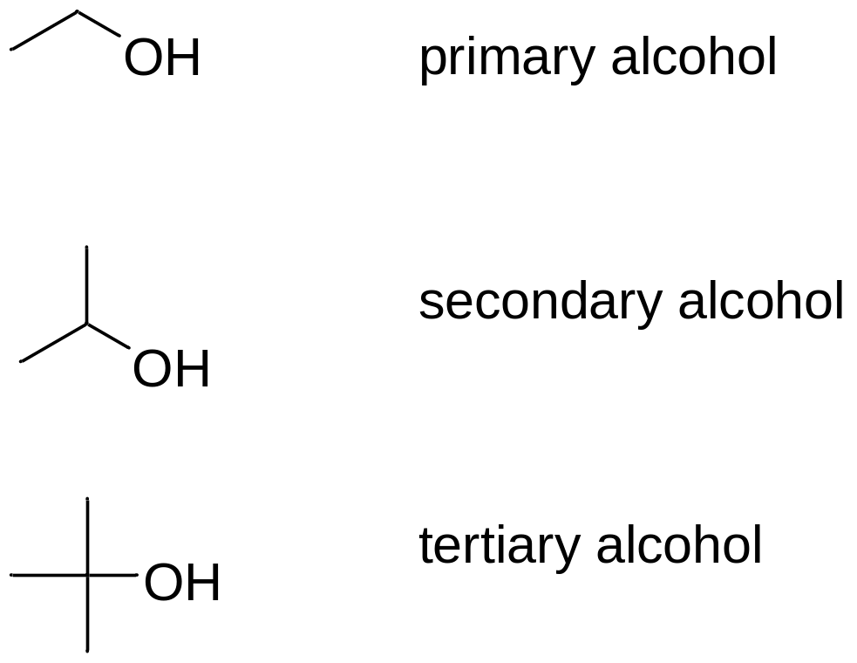
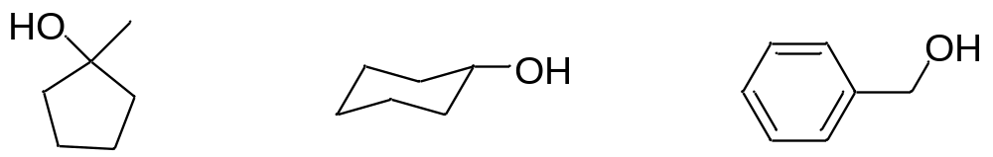
Ethanol
2-Propanol
2-Methyl-2-propanol
Are these primary, secondary or tertiary alcohols?

Slide 5
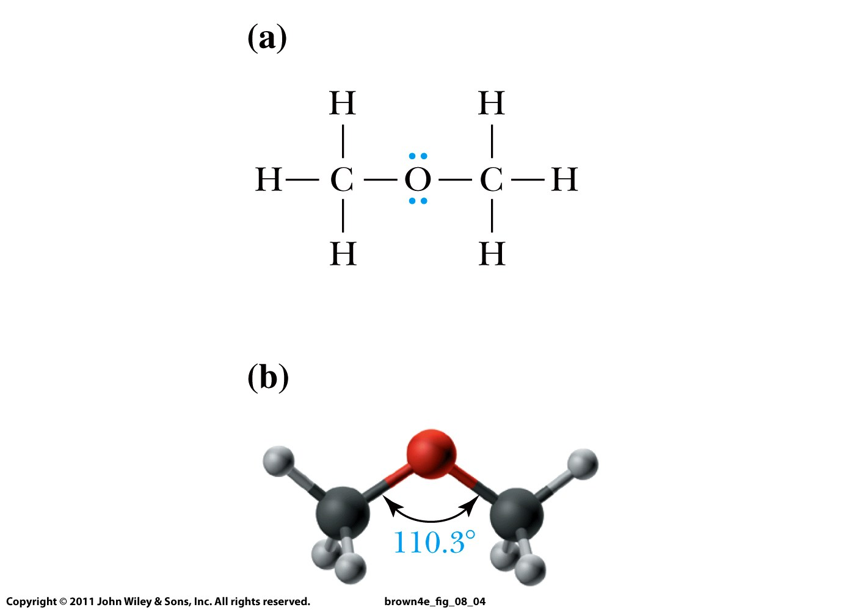
Ethers

Slide 6
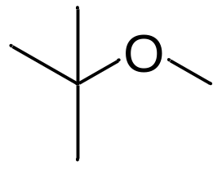
Nomenclature:
OR = alkoxy functional group (to be used when an even
higher priority group is present)
Suffix = ether
diethyl ether (2 words) or ethoxyethane
OH/C-O-C must get the lowest possible number
They take precedence over alkyl groups, C=C bonds, halides
tert-butyl methyl ether (three words)
or 2-methoxy-2-methylpropane

Slide 7
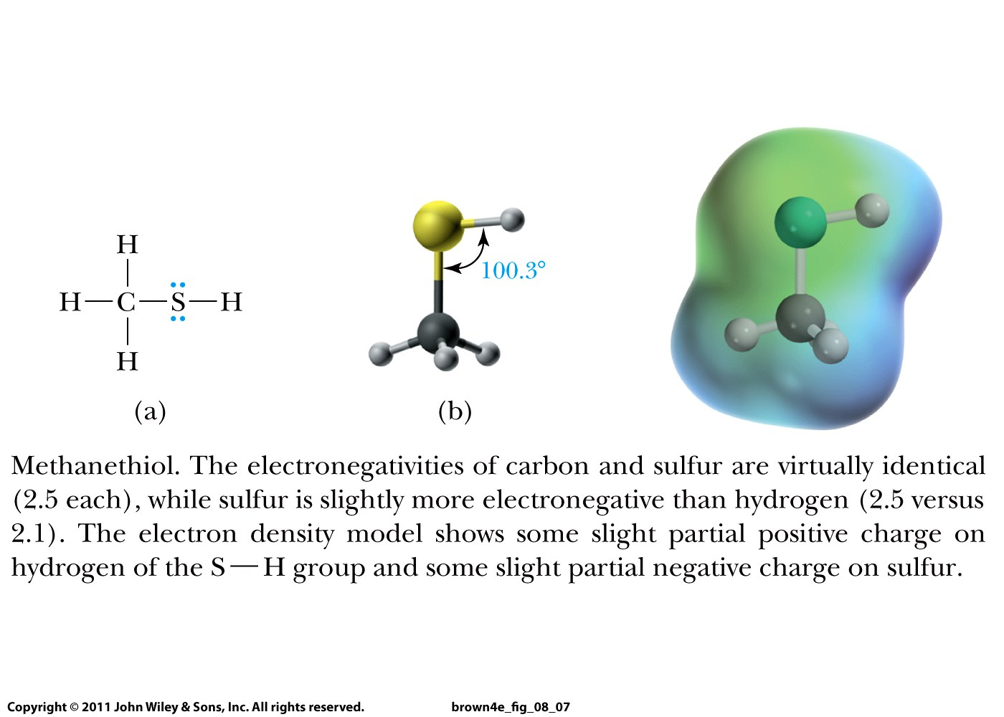
Thiols

Slide 8
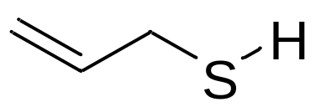
Nomenclature:
SH = sulfhydryl functional group
Suffix = thiol
Ethanethiol
(ethyl mercaptan)
OH/C-O-C/SH must get the lowest possible number
They take precedence over alkyl groups, C=C bonds, halides
If necessary, indicate location of OH or SH just before “ol”:
2-propene-1-thiol

