Slide 1
Lecture 26:
Aromaticity
Resonance Structures
Nomenclature

Slide 2
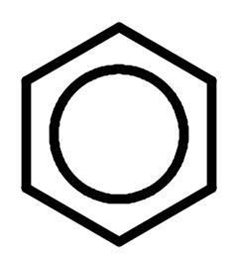
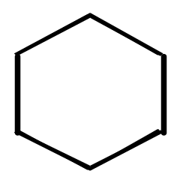


Lewis Structure of Benzene

Slide 3
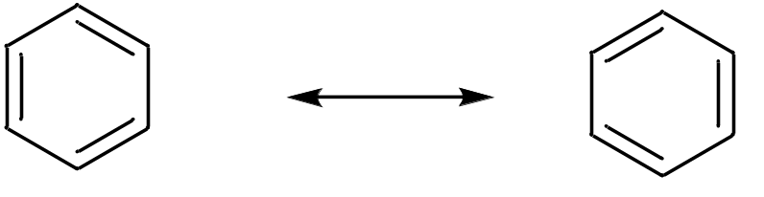
Benzene represented by two resonance structures:
Both structures are needed to fully describe benzene
as benzene is an average of them.
NOTE: only electrons change in above structures, not atoms!
The arrow above is called resonance arrow

Slide 4
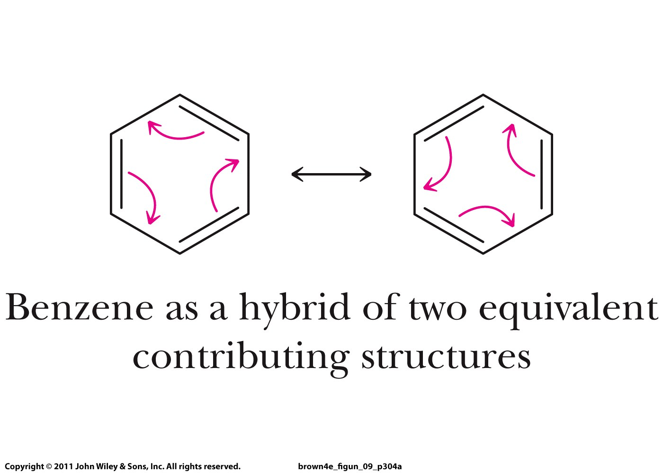
Resonance

Slide 5
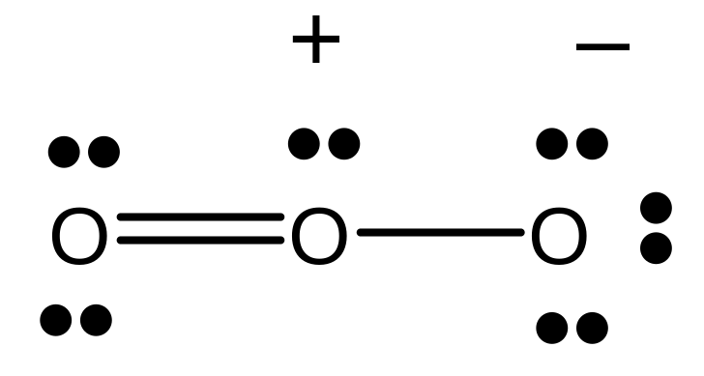
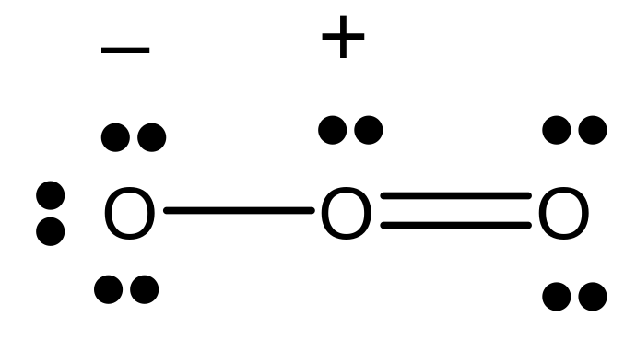



Resonance
Experimental evidence shows that both O—O bonds are equal in length (128 pm).
The real structure is somewhere between these two resonance structures.

Slide 6
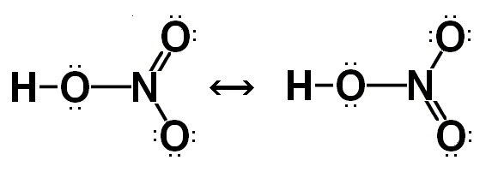


Resonance
If we can write two or more valid Lewis structures, the actual electron distribution is an average of the distributions shown by the Lewis structures.
-
+
+
-
NOTE!!!!! The double bond moves, NOT the atoms.

Slide 7
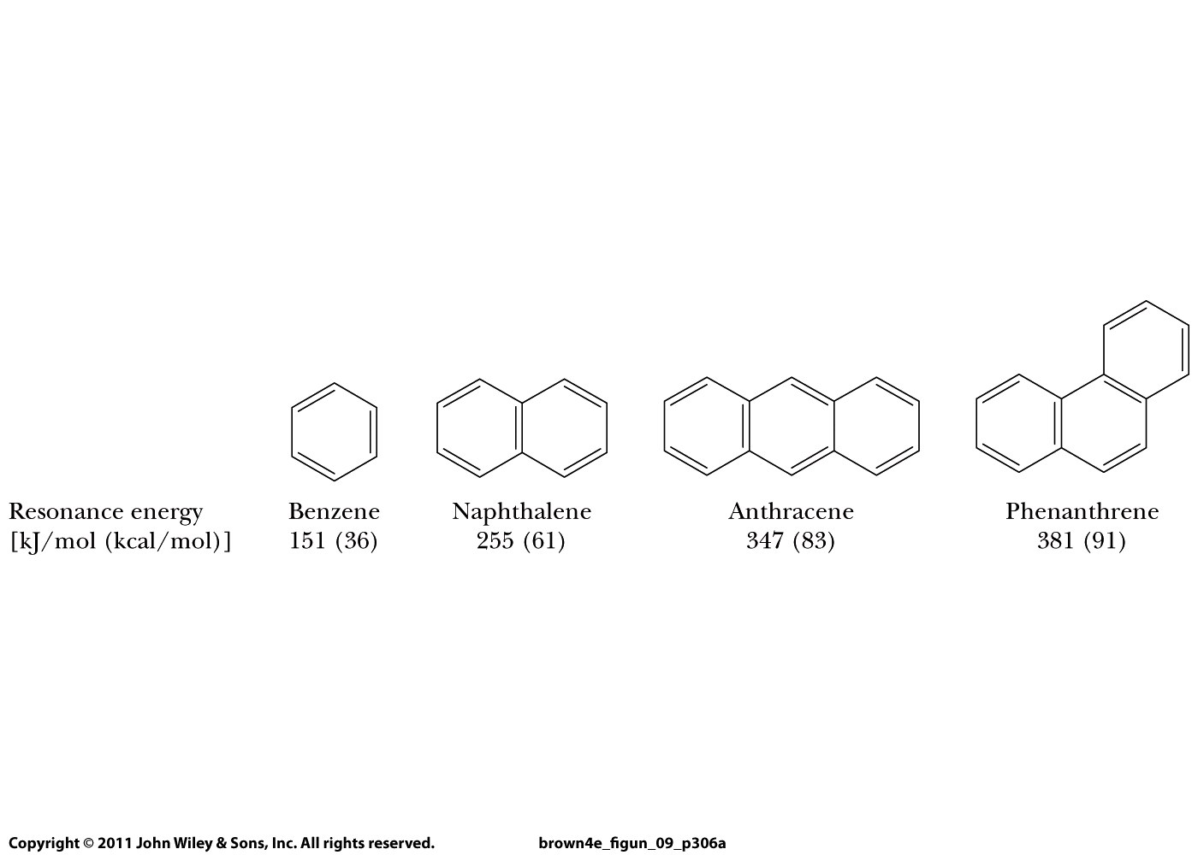
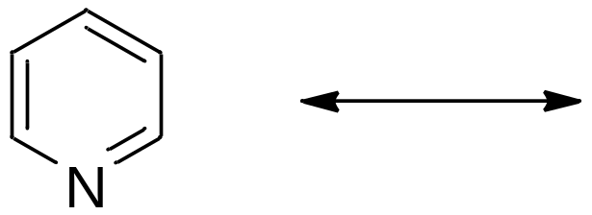
Buddy Question # 91
Draw all resonance structures for these molecules:
pyridine

Slide 8
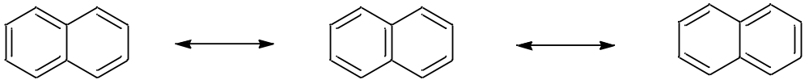
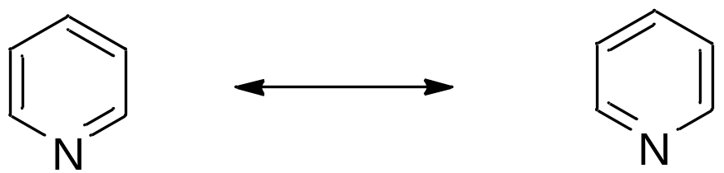
Buddy Question # 91
Draw all resonance structures for these molecules:

Slide 9
Buddy Question # 91
Draw all resonance structures for these molecules:
pyridine

Slide 10
Buddy Question # 91
Draw all resonance structures for these molecules:

Slide 11


Slide 12
The more resonance structures, the more stable the molecule
Aromatic molecules:

Slide 13
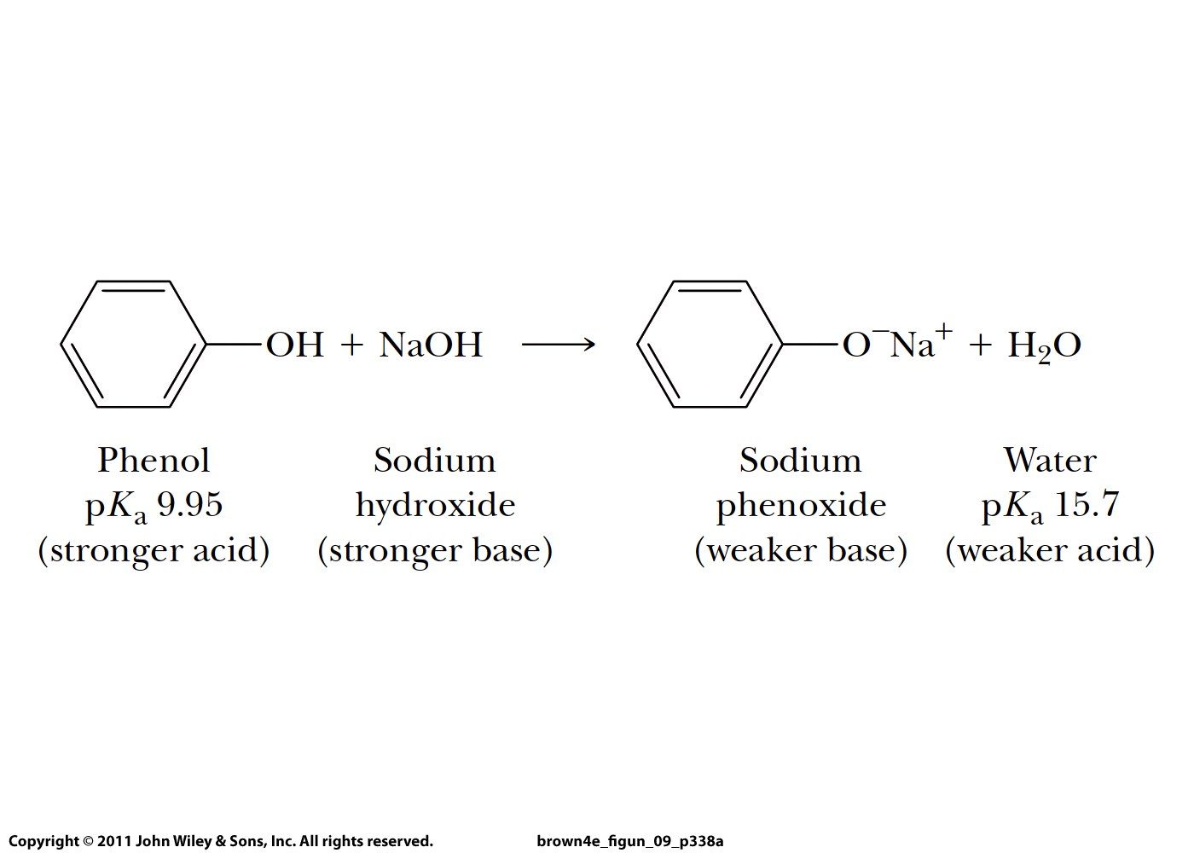
Why is phenol acidic?

Slide 14
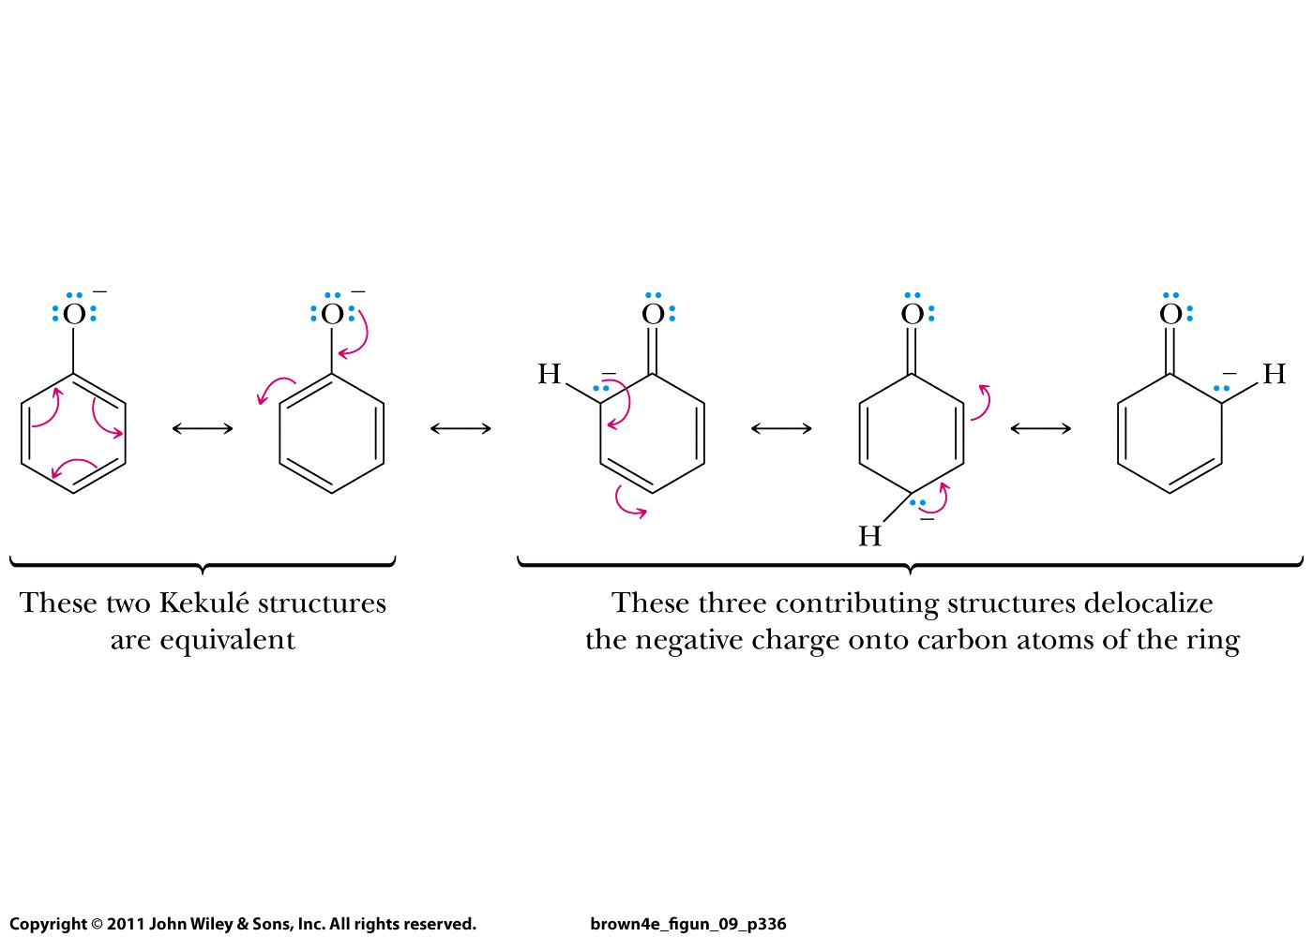

Slide 15
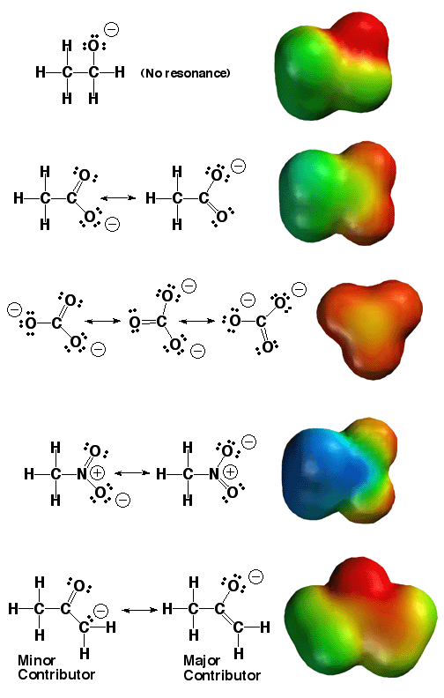

Slide 16
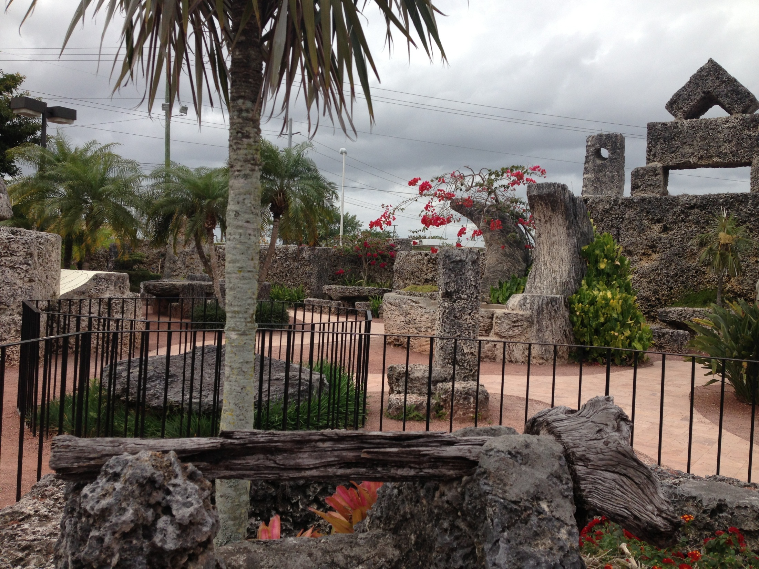
Coral Castle, Miami, built by
Latvian American eccentric Edward
Leedskalnin in 28 years
(starting 1923)
(limestone)

Slide 17
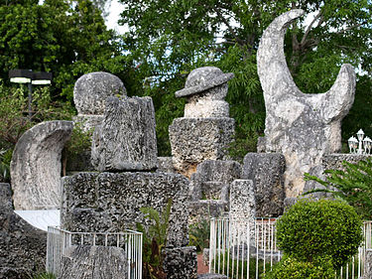
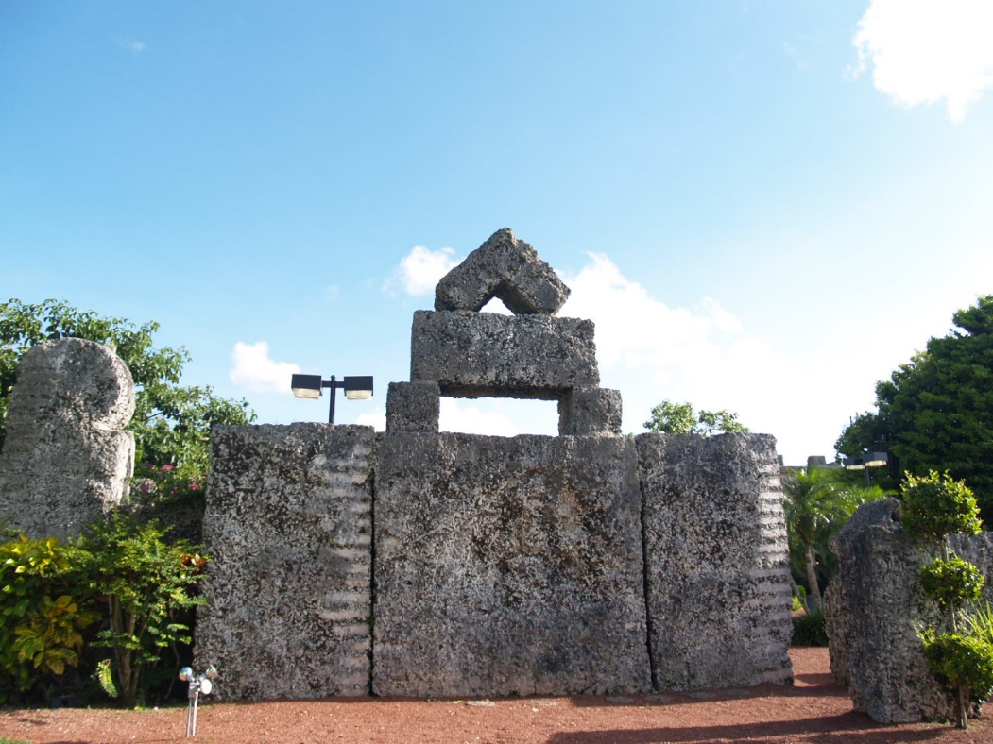
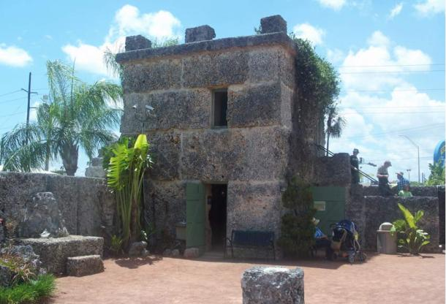
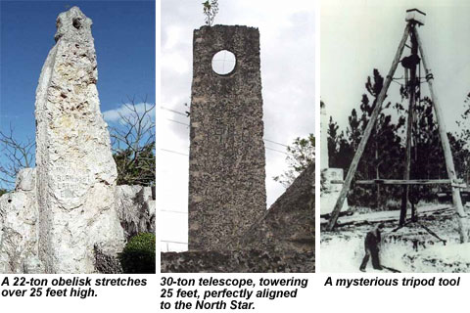

Slide 18
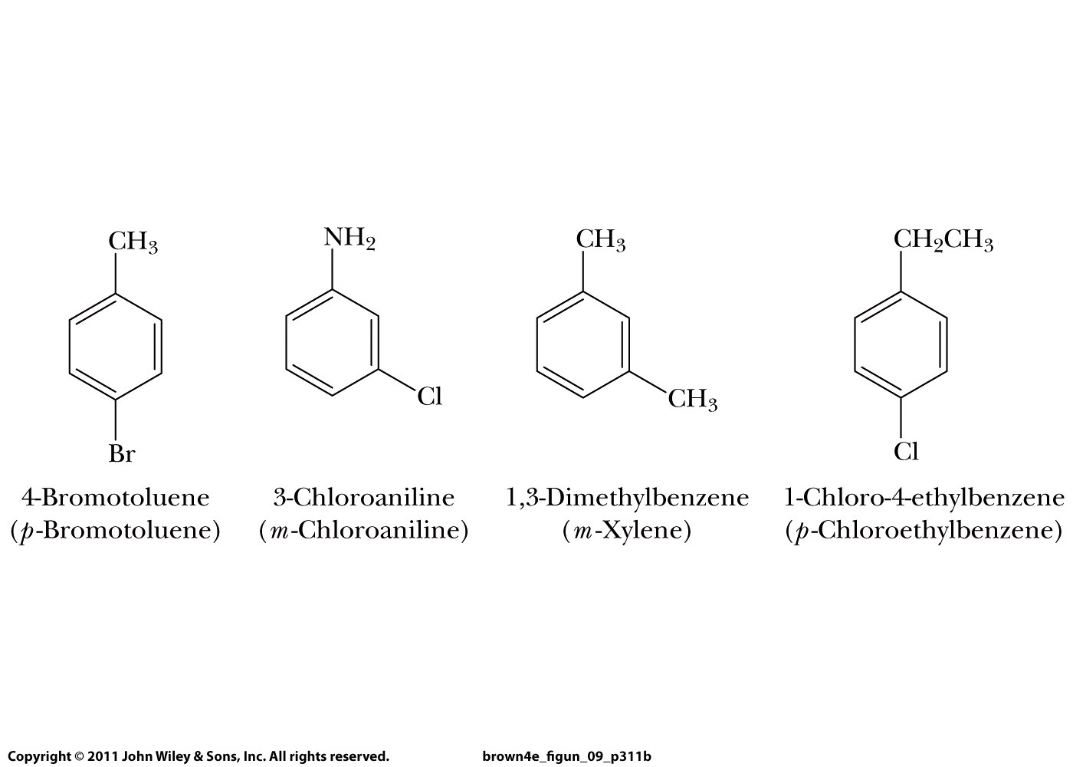

Slide 19
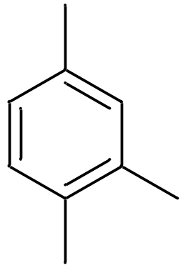
Buddy Question # 92
Name this compound

Slide 20
Buddy Question # 92
Name this compound
1,2,4-trimethylbenzene

Slide 21
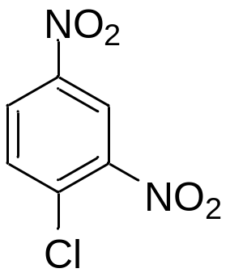
Buddy Question # 93
Name this compound
(-NO₂ = nitro)

Slide 22
Buddy Question # 93
Name this compound
(-NO₂ = nitro)
1-chloro-2,4-dinitrobenzene

Slide 24
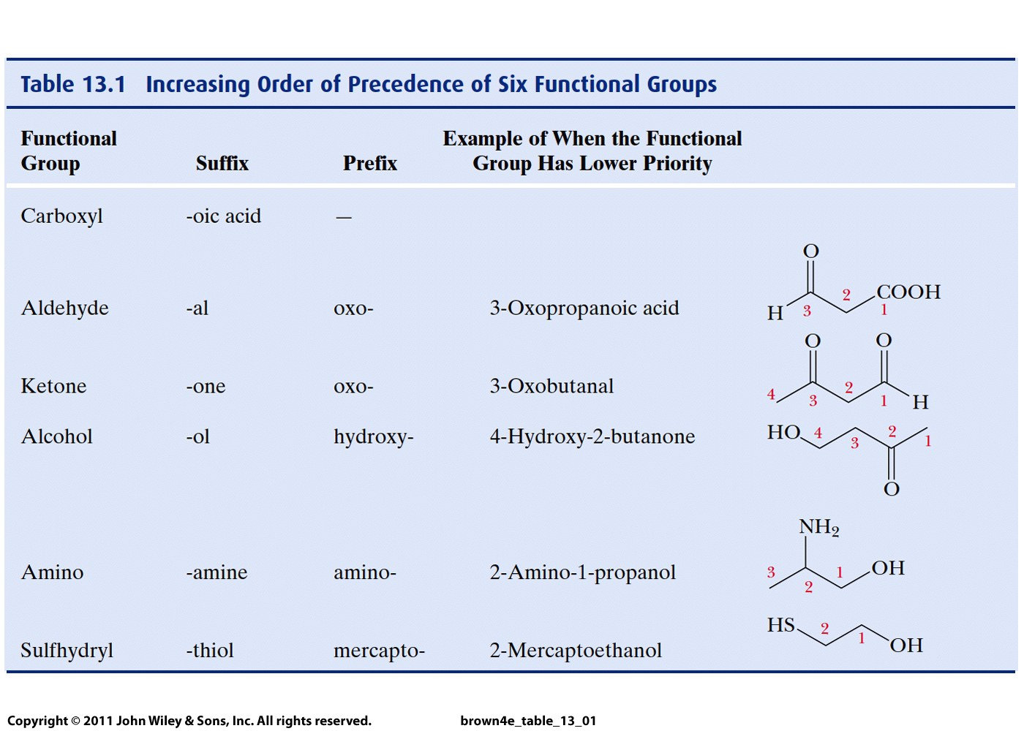

Slide 25
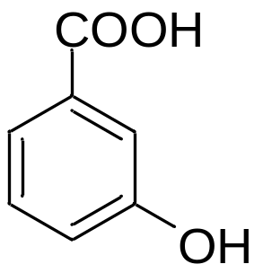
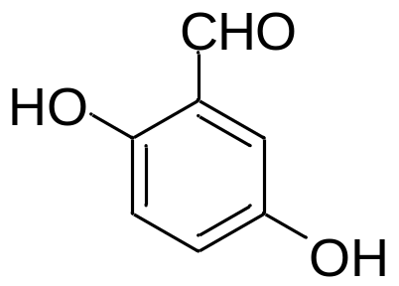
Buddy Question # 94
Name these compounds
3-Hydroxybenzoic acid
2,5-Dihydroxy-
benzaldehyde

Slide 26
Buddy Question # 94
Name these compounds
3-Hydroxybenzoic acid
3-Hydroxybenzoic acid
2,5-Dihydroxybenzaldehyde
2,5-Dihydroxy-
benzaldehyde

Slide 27
Buddy Question # 94
Name these compounds
3-Hydroxybenzoic acid
3-Hydroxybenzoic acid
2,5-Dihydroxybenzaldehyde
2,5-Dihydroxy-
benzaldehyde

Slide 28
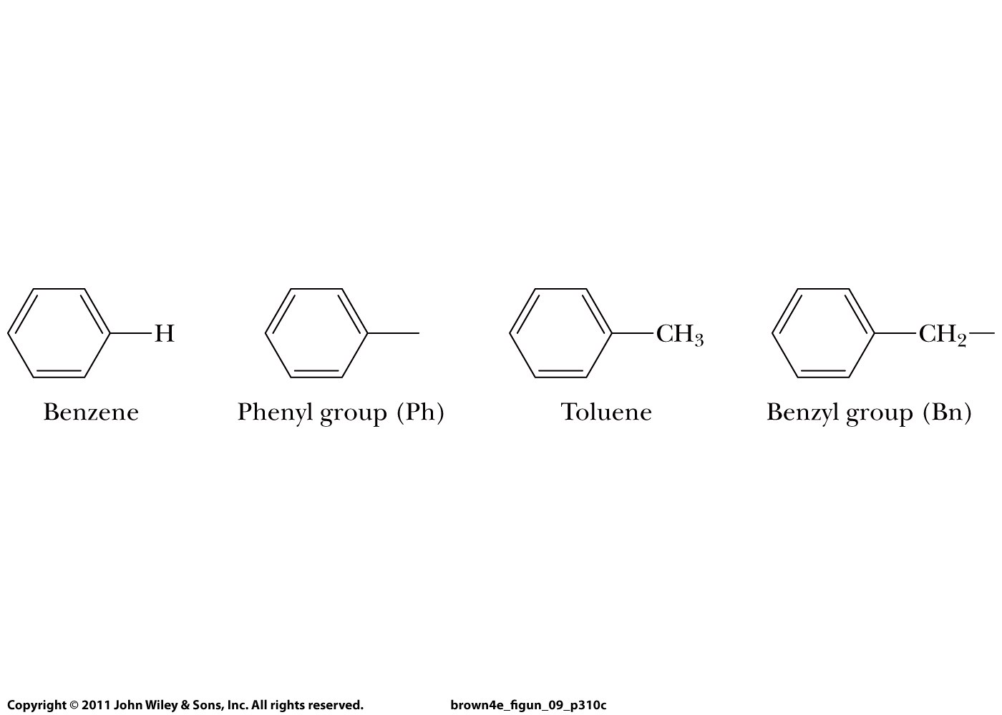

Slide 29
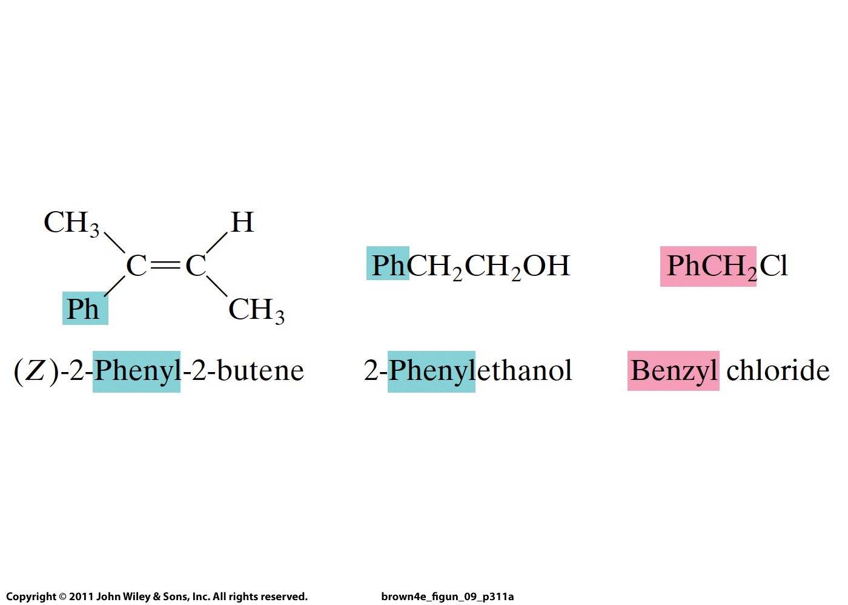
Buddy Question # 95
Name this molecule:

Slide 30
Buddy Question # 95
Name this molecule:
(Z)-2-phenyl-2-butene

Slide 31
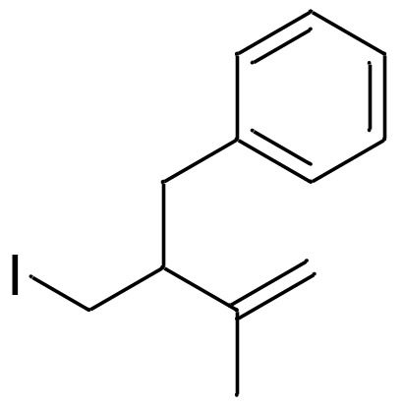
Buddy Question # 96
Name this compound

Slide 32
Buddy Question # 96
Name this compound
3-benzyl-4-iodo-2-methyl-1-butene

Slide 33
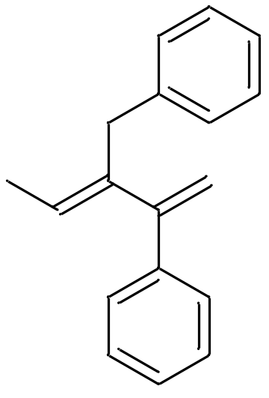
Buddy Question # 97
Name this compound

Slide 34
Buddy Question # 97
Name this compound
(E)-3-benzyl-2-phenyl-1,3-pentadiene

Slide 35


Slide 36
QUIZ

Slide 37
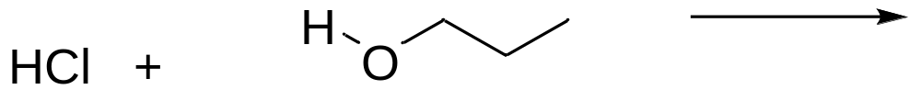
QUIZ
Give the mechanism and product of this reaction:

