Slide 1
Lecture 7
Nomenclature of organic compounds

Slide 2
Names of Simple Organic Molecules
Simple organic molecules are named on the basis of their size
The names have two parts:
parent + suffix
Indicates the number
of carbons
Indicates the type of molecule: alkanes have suffix “-ane”
Number of carbons parent name example
1 meth- methane CH₄
2 eth- ethane CH₃-CH₃
3 prop- propane CH₃-CH₂-CH₃
4 but- butane CH₃-CH₂-CH₂-CH₃
5 pent- pentane CH₃-CH₂CH₂-CH₂-CH₃
6 hex- hexane CH₃-(CH₂)₄-CH₃
etc

Slide 3
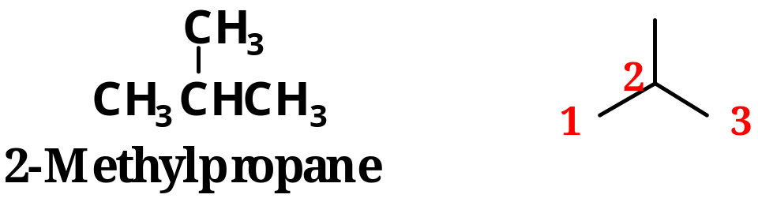
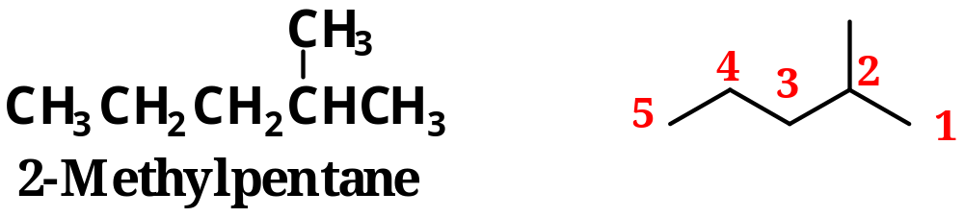
IUPAC Nomenclature (International Union of Pure and Applied Chemistry)
  1.The name of an alkane with an unbranched chain consists of a prefix and the suffix ane.
  2. For branched alkanes, the parent chain is the longest chain of carbon atoms.
  3. Each substituent is given a name and a number.
  4. If there is one substituent, number the chain from the end that gives it the lower number.

Slide 4
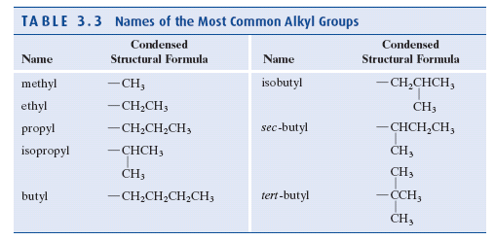

Slide 5
IUPAC Nomenclature
  1.The name of an alkane with an unbranched chain consists of a prefix and the suffix ane.
  2. For branched alkanes, the parent chain is the longest chain of carbon atoms.
  3. Each substituent is given a name and a number.
  4. If there is one substituent, number the chain from the end that gives it the smallest number.

Slide 6
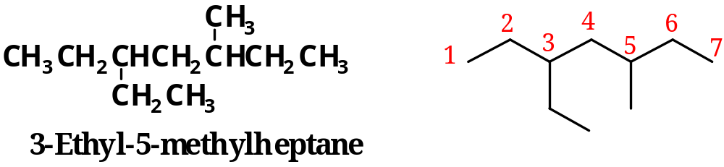
5.
6. If there are two or more different substituents,
  list them in alphabetical order.
  number from the end of the chain that gives the substituent encountered first the lower number.

Slide 7
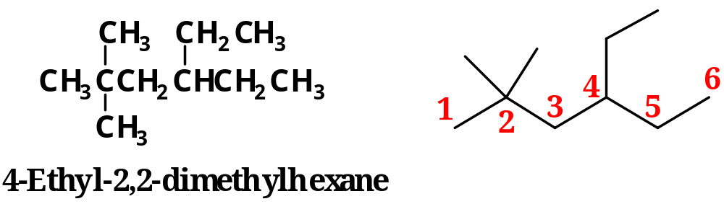
If there are more than one identical substituents,
use prefixes to indicate their number: di, tri, tetra
7. The prefixes di-, tri-, tetra-, etc. are not included in alphabetization. In the following example, the alphabetizing names are ethyl and methyl.

Slide 8
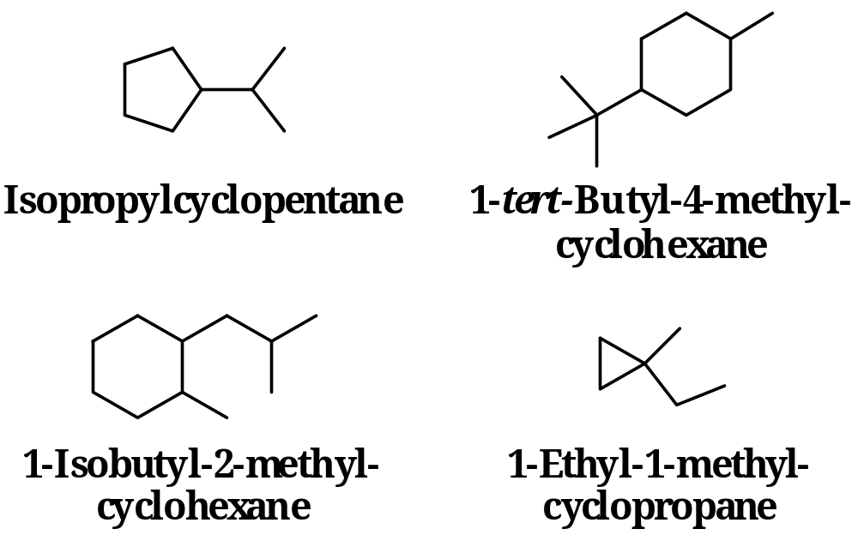
Cycloalkanes: numbering of ring starts at substituent that gives smallest numbers for all substituents
Commonly written as carbon skeleton (line-angle) formulas
isopropylcyclopentane

